Slide 1




LOS ANGELES COUNTY
Family Information Center
Planning Guide for Healthcare Entities
This project was funded by Hospital Preparedness Program grant number 6U3REP090253.

Slide 2
AGENDA
FIC Overview
  FIC Concept
  Case Studies
Project Overview
  History
  Objectives
  Methodology
Guide Review
  Scope
  Organization
  Content
  Implementation

Slide 3
  FIC OVERVIEW c
  History
  Goal and Objectives
  Methodology

Slide 4
FIC CONCEPT
What is a FIC?
Provides a place for families to go to, away from the treatment areas
Provides a mechanism to facilitate patient and family reunification
Facilitates access support services
Notes:
Who is familiar with the concept of a FIC or a FAC?
Who has participated in one?
Why benefits does a FIC/FAC provide?

Slide 5
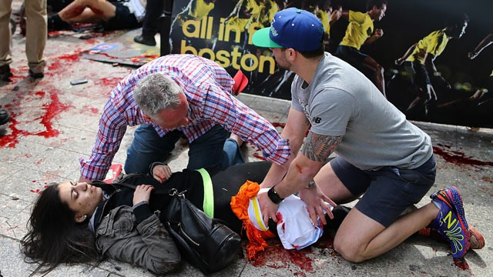
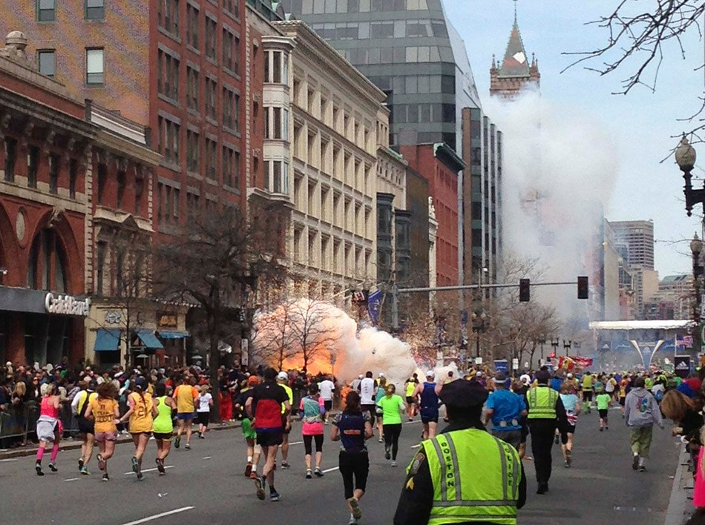
BOSTON MARATHON BOMINGS
April 15, 2013
3 deaths, 264 injured
City FAC activated
Multiple hospital FICs activated
Notes:
Boston Marathon Bombing resulted in 264 injured and 3 deaths. One death was a pediatric patient. At least 2 hospitals activated FICs.

Slide 6
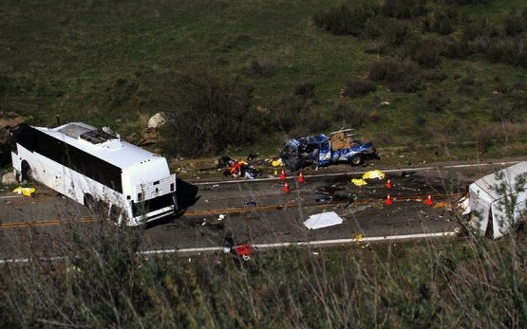
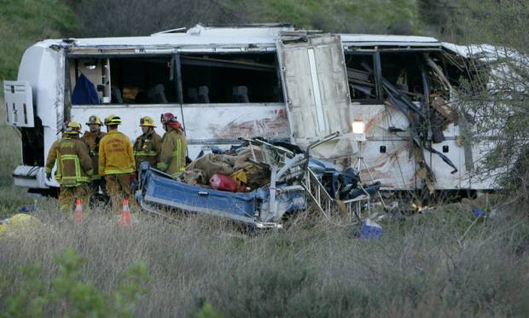
YUCAIPA BUS ACCIDENT
February 3, 2013
8 deaths
Over 3 dozen injured
Victims transported to at least 4 hospitals
Notes:
Yucaipa Bus Accident – Families were shown on the news crying, looking for loved ones. In interviews, they said they drove from hospital to hospital trying to get information.

Slide 7
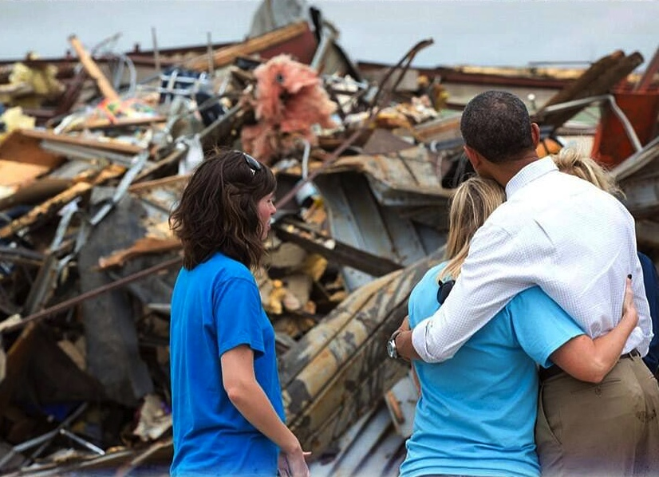
OKLAHOMA TORNADO
May 31, 2013
Military FAC activated
Multi-agency Resource Centers activated
Notes:
Oklahoma Tornado - The Tinker Air Force Base established an Emergency Family Assistance Center (EFAC) immediately following the May 20, 2013 Oklahoma City tornado. Specifically, the Tinker Air Force Base Airman & Family Readiness Center is being used for the EFAC. It operates 24/7, and the scheduled demobilization date is June 20, 2013. The EFAC has a slightly different function than the FAC designed in Los Angeles.

Slide 8
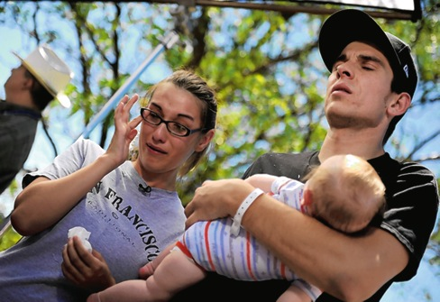

AURORA SHOOTING
July 20, 2012
12 deaths, 58 injured
FAC opened by and for military personnel
Hospital FIC activated
Notes:
Aurora Shootings - Mass shooting occurred at a Century movie theater in Aurora, Colorado, during a midnight screening of the film The Dark Knight Rises. A gunman, dressed in tactical clothing, set off tear gas grenades and shot into the audience with multiple firearms, killing 12 people and injuring 58 others.

Slide 9
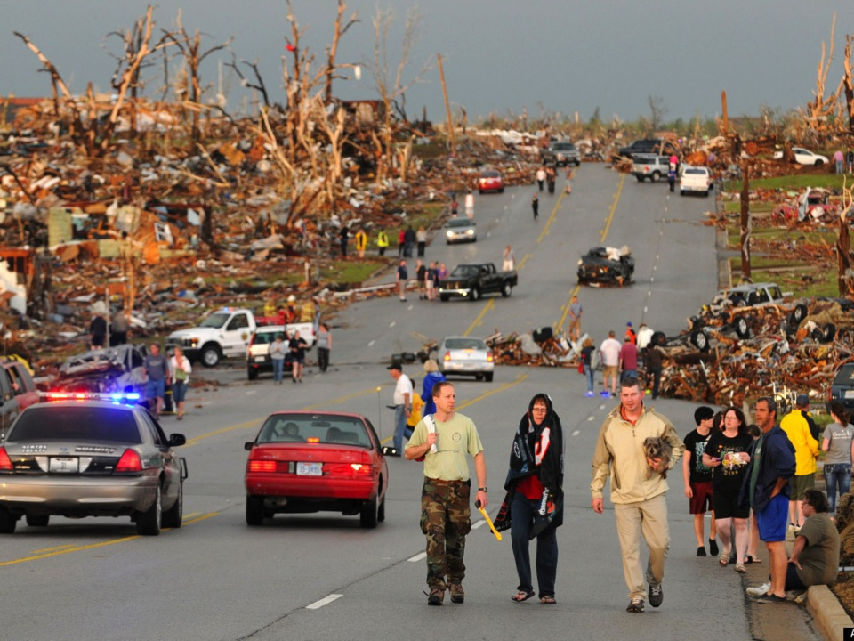
JOPLIN TORNADO
May 22, 2011
158 deaths and 1,000 injured
135 victims in morgue – all identified
Notes:
Joplin Tornado – Families went to clinics, in addition to hospitals, looking for loved ones.

Slide 10
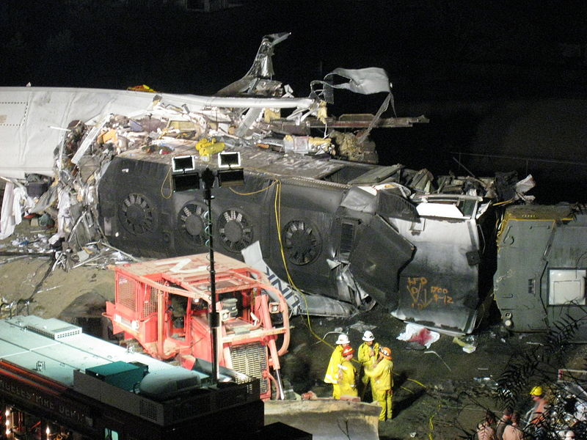
CHATSWORTH TRAIN COLLISION
September 12, 2008
25 deaths
FAC opened immediately as part of response
Notes:
Chatsworth train collision - Occurred when a Union Pacific freight train and a Metrolink commuter train collided. This incident overtook the Glendale Metrolink incident as the most deadly rail accident in Los Angeles County Operational Area history. A City FAC was immediately activated and operated for approximately five days.

Slide 11
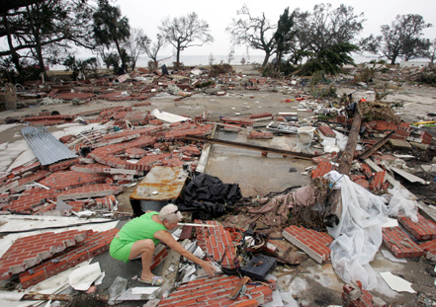
HURRICANE KATRINA
August 29, 2005
1,460 deaths
FAC opened September 7, 2005 and stayed open for 342 days
Notes:
Katrina - (approximately 1,460 deaths—910 deaths processed through DMORT morgues—and 13,197 missing persons reports) - A FAC opened September 7, 2005 and stayed open for 342 days.

Slide 12
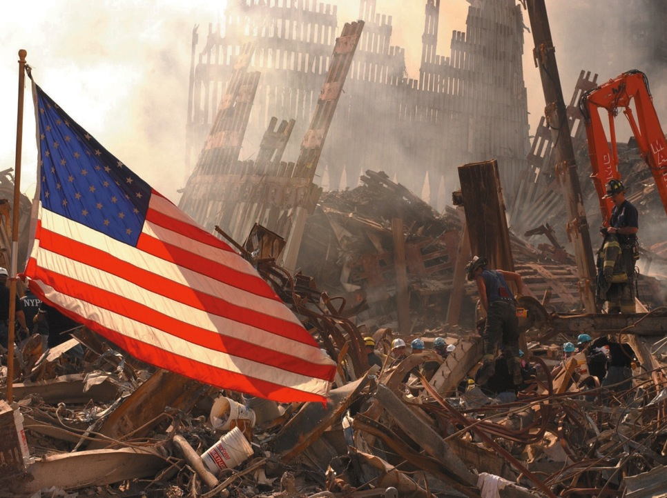
WORLD TRADE CENTER ATTACK
September 11, 2001
2,800 deaths
FAC opened through December, 2002
Notes:
World Trade Center attack (approximately 2,800 deaths) - A FAC was opened on 9/12, moved to a second location the afternoon of 9/12, and moved to its third location on 9/15. When lines of concerned family members stretched eight blocks in four directions, a new fourth site, Pier 94, was prepared. The FAC was open for approximately 460 days. Pier 94 closed in December of 2002.

Slide 13
  PROJECT OVERVIEW
  c
  History
  Goal and Objectives
  Methodology

Slide 14
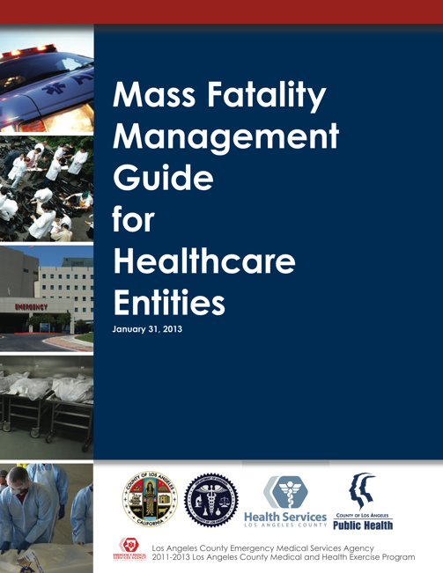
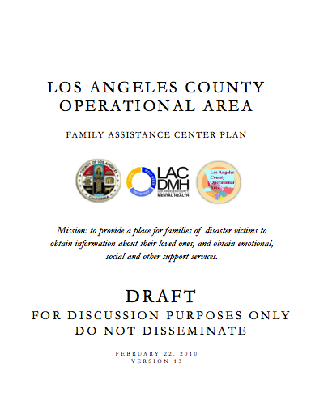
HISTORY
Initiated by the Los Angeles County EMS Agency in 2007
  Meant to ignite discussion regarding the need for FIC planning
  Based on best practices
    Israel PIC model
    World Trade Center Attack
Los Angeles County Operational Area FAC Plan, Mass Fatality Management Guide for Healthcare Entities developed in parallel
  Designed in compliment
Available at http://ems.dhs.lacounty.gov
Available at http://lacoa.org/annexes.html
Notes:
History
This is a legacy document that has been posted online since 2007.
The 2007 document was used during FIC activation at St. Joseph’s Medical Center in response to the Chatsworth incident.
The new guide is built from the 2007 document.

Slide 15
OBJECTIVES
Provide guidance for healthcare entities in Los Angeles County regarding the activation, operation and demobilization of a FIC
Build from, revise and enhance the 2007 FIC Planning Guide based on best practices and lessons learned
Ensure that the FIC Planning Guide for Healthcare Entities supports and is in alignment with County and Operational Area plans and best practices
Address special considerations for unaccompanied minors, AFN support, family member support services, and the reunification of unidentified patients with their loved ones

Slide 16
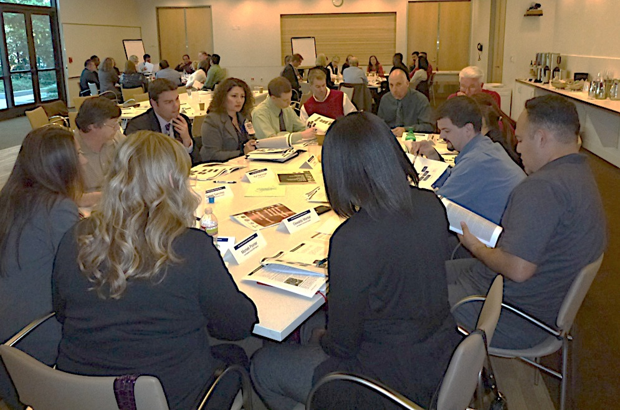
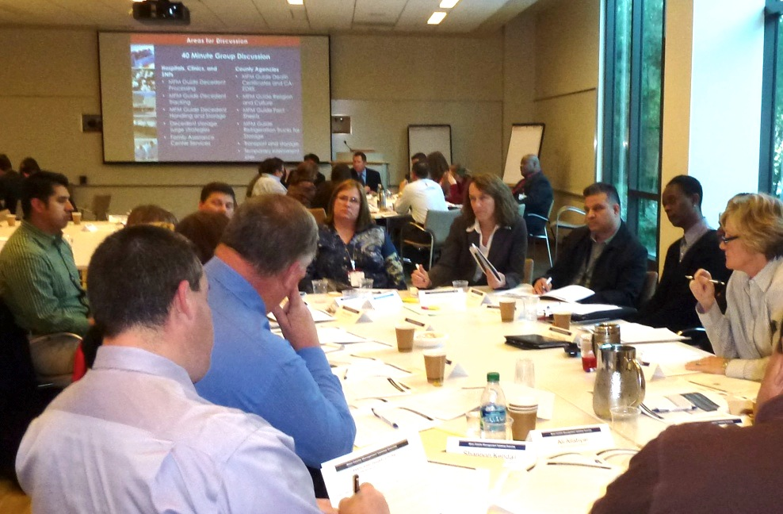
METHODOLOGY
Identify key stakeholders
  Project Oversight Group
  Interviewees/SME
  Expand on prior version
    Hospitals and clinics
    Comprehensive resource
    Incorporate findings from recent disasters
  Held workshop
    Target audience
    Present plan
    Static display
Timeline
  Jan 2013 – June 2013
Notes:
Project Oversight Group
Los Angeles County EMS Agency
Los Angeles County Department of Mental Health
Community Clinic Association of Los Angeles County
Los Angeles County Department of Mental Health
Providence Saint Joseph Medical Center
Children’s Hospital Los Angeles
PIH Health Hospital
Henry Mayo Newhall Memorial Hospital
Pomona Valley Medical Center
Contributor
Beth Israel Deaconess Medical Center Hospital Association of Southern California
Workshop Target Audience
Hospital and clinic disaster planners
Hospital and clinic social workers
Hospital and clinic mental health professionals

Slide 17
  GUIDE REVIEW c
  Scope
  Organization
  Content
  Implementation

Slide 18
SCOPE
Resource for hospitals, community clinics, and other healthcare entities to create facility- or organization-specific plans
  Large-scale disasters (e.g. earthquakes)
  Smaller, more localized incidents (e.g. shooting, transportation disaster);
  Long-term events (e.g. widespread disease outbreaks)
  High level, quick reference information
  Background and operational level detail
Notes:
The Guide can be expanded or scaled back to reflect the resources available to the facility.

Slide 19



ORGANIZATION
Introduction
Plan Development
Activation
Operation
Demobilization
Forms
Set-up Information
Location Assessment Criteria
Unaccompanied Minor Information
Materials and Supplies
JIT Training Materials
Job Action Sheets
Patient Identification Information
Mental Health Resources
ReddiNet Information
LOS ANGELES COUNTY
Family Information Center
Planning Guide for Healthcare Entities
Notes:
The information is provided in chronological order.
Key steps are listed up front in the main body (Plan Development, Activation, Operations and Demobilization).
Diagrams are provided.
There are tips provided in text boxes.
The document is in a user friendly, readable format.
The guide is scalable (for hospital, clinics).

Slide 20
CONTENT
ACTIVATION
Authorize Activation
  Who can do it?
Coordinate Staffing
  How much staff?
  What areas of expertise?
  What are the staffing sources?
  How do staff fit into the disaster organization chart?
Make Notifications
  How will they be alerted?
Coordinate Logistics
  What supplies are needed?
  Where will the FIC be located?
Prepare Staff for Activation and Operation
  What do they need to know?
  What’s the process for check-in/check-out?

Slide 21
CONTENT
Incident Commander
Operations
Section
Planning/Intel Section
Logistics
Section
Finance/Admin Section
Patient Family Assistance Branch
Registration and Tracking Specialist
Family Reunification Unit
Family Services Specialist
Sample HICS organization chart showing FIC staff

Slide 22
CONTENT
KEY TOPICS
Relationship to the City or County FAC
Role of mental health and mental health terminology
OPERATION
Perform Family Registration
  What does this look like?
  What about unaccompanied minors?
Facilitate Reunification
  How are patients located and reunified with family members?
  How is the process tracked?
Perform Family Notification
  How is this done?
Offer Support Services
  How will support services be provided?
Notes:
Information may be collected from:
ReddiNet
Patient Care Area
Other facilities
FAC
EMS Agency

Slide 23
CONTENT
PLAN DEVELOPMENT
Designate a Project Leader
Organize a Working Group
  Who should be involved in the process?
Review Existing Policies and Procedures
  What plans should be reviewed?
Review the FIC Planning Guide
Document and Approve the Plan
  What is the plan review and approval process?
Notes:
Examples of contributors may include: admissions, emergency or urgent care, administration, patient care, security, and others as deemed necessary.

Slide 24
IMPLEMENTATION
Download the Guide
Share conference materials with stakeholders at your facility
Initiate FIC Plan development efforts!

Slide 25

LOS ANGELES COUNTY
Family Information Center
Planning Guide for Healthcare Entities
Available at http://ems.dhs.lacounty.gov
This project was funded by Hospital Preparedness Program grant number 6U3REP090253.

