Slide 1
SCE Emergency Response and Resiliency
Jeanne Woo Senior Advisor
Business Resiliency and Compliance

Slide 2
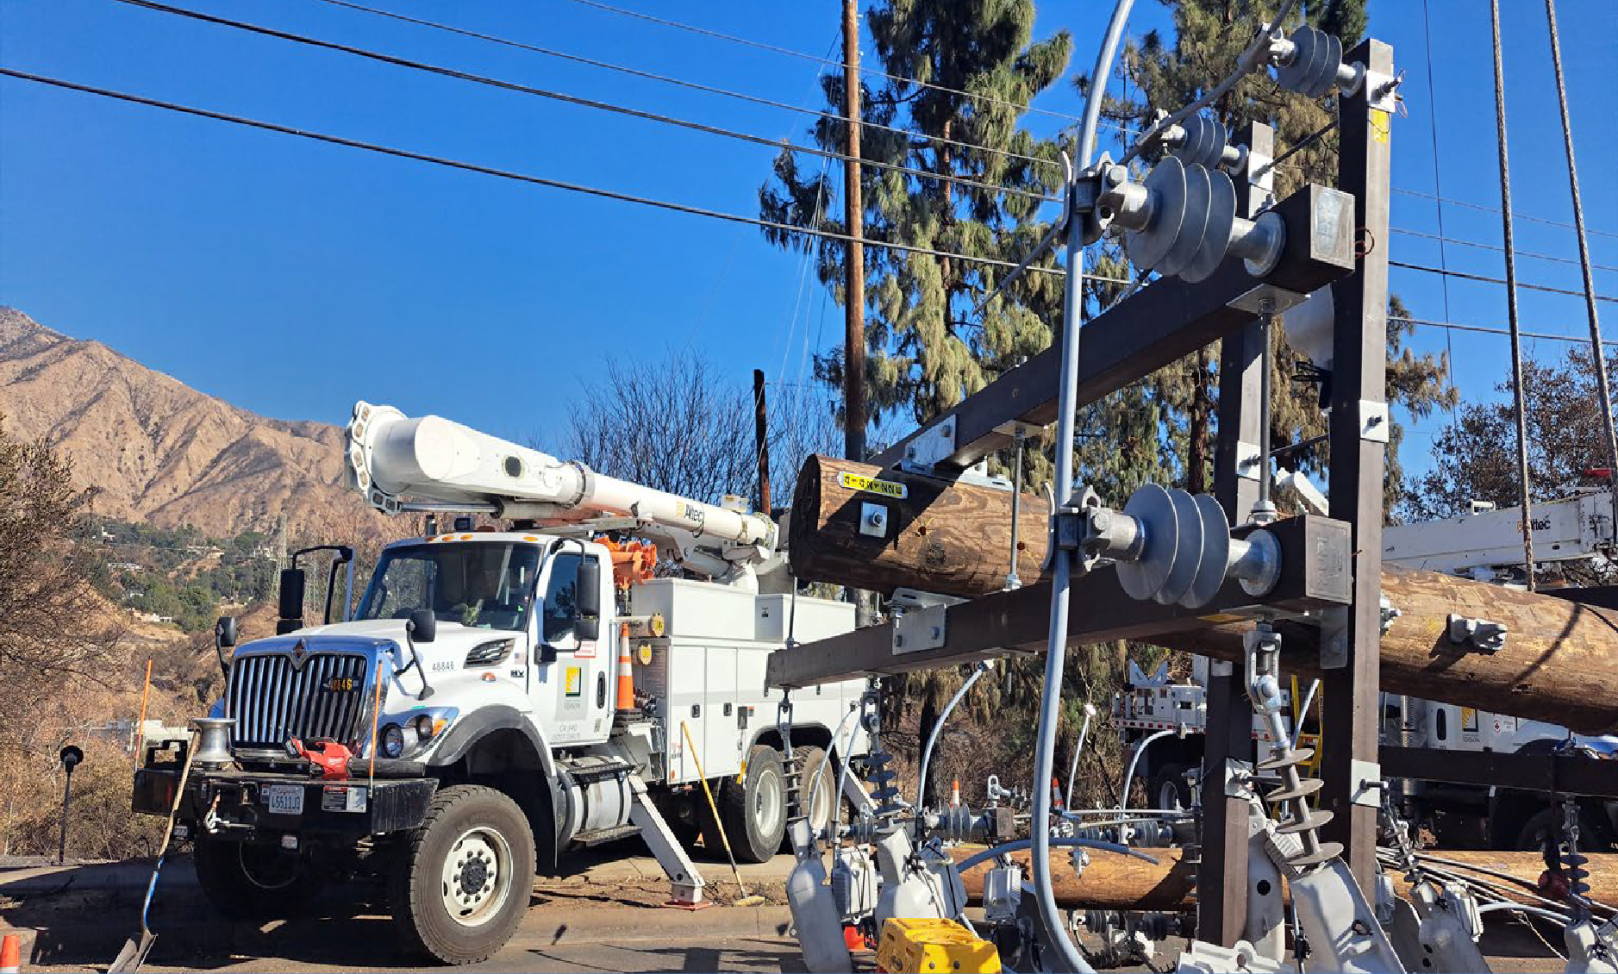
SCE ALL HAZARDS RESPONSE PLAN (AHP)
Response framework:
Compatible with ICS, SEMS, NIMS
Compatible with PSPS
Scalable
Continuous improvement:
Reviewed & updated annually
Informed by exercises, after action reviews & stakeholder feedback
SCE’s All Hazards Plan describes:
How SCE monitors, escalates and responds to incidents that impact electric service to our customers
How SCE organizes and manages incident response using Incident Management Teams (IMT’s)
The interface between SCE and public safety agencies, emergency managers, & elected officials
How restoration priorities are established and communicated
SCE’s communication and engagement strategy with stakeholders before, during, & after incidents
This AHP is developed and maintained in accordance with CPUC General Order 166

Slide 3
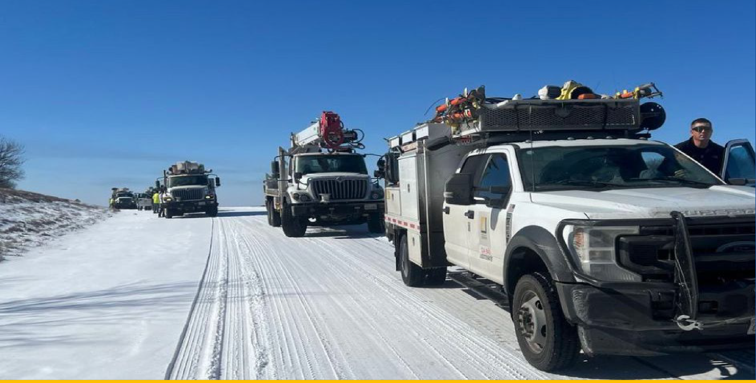
CONCEPT OF OPERATIONS
The All-Hazards Plan Concept of Operations (CONOPS) describes SCE’s phased approach to emergency response, including what SCE will do before, during, and after an incident.
*Alignment with State and Federal Emergency Management Systems & FEMA CPG 101
EMERGENCY OPERATIONS CENTER
Details functions of the EOC and demonstrates how information flows internally & externally
DAMAGE ASSESSMENT
Identifies & assess impacts to electrical infrastructure & public safety
RESOURCE COORDINATION
Describes the mobilization of personnel, equipment, and mutual assistance
RESTORATION PLANNING & PRIORITIZATION
Outlines strategy based on public safety, grid stability, and community needs
DE-ESCALATION & DEMOBILIZATION
Details safe scale down of response activities and transition to recovery

Slide 4

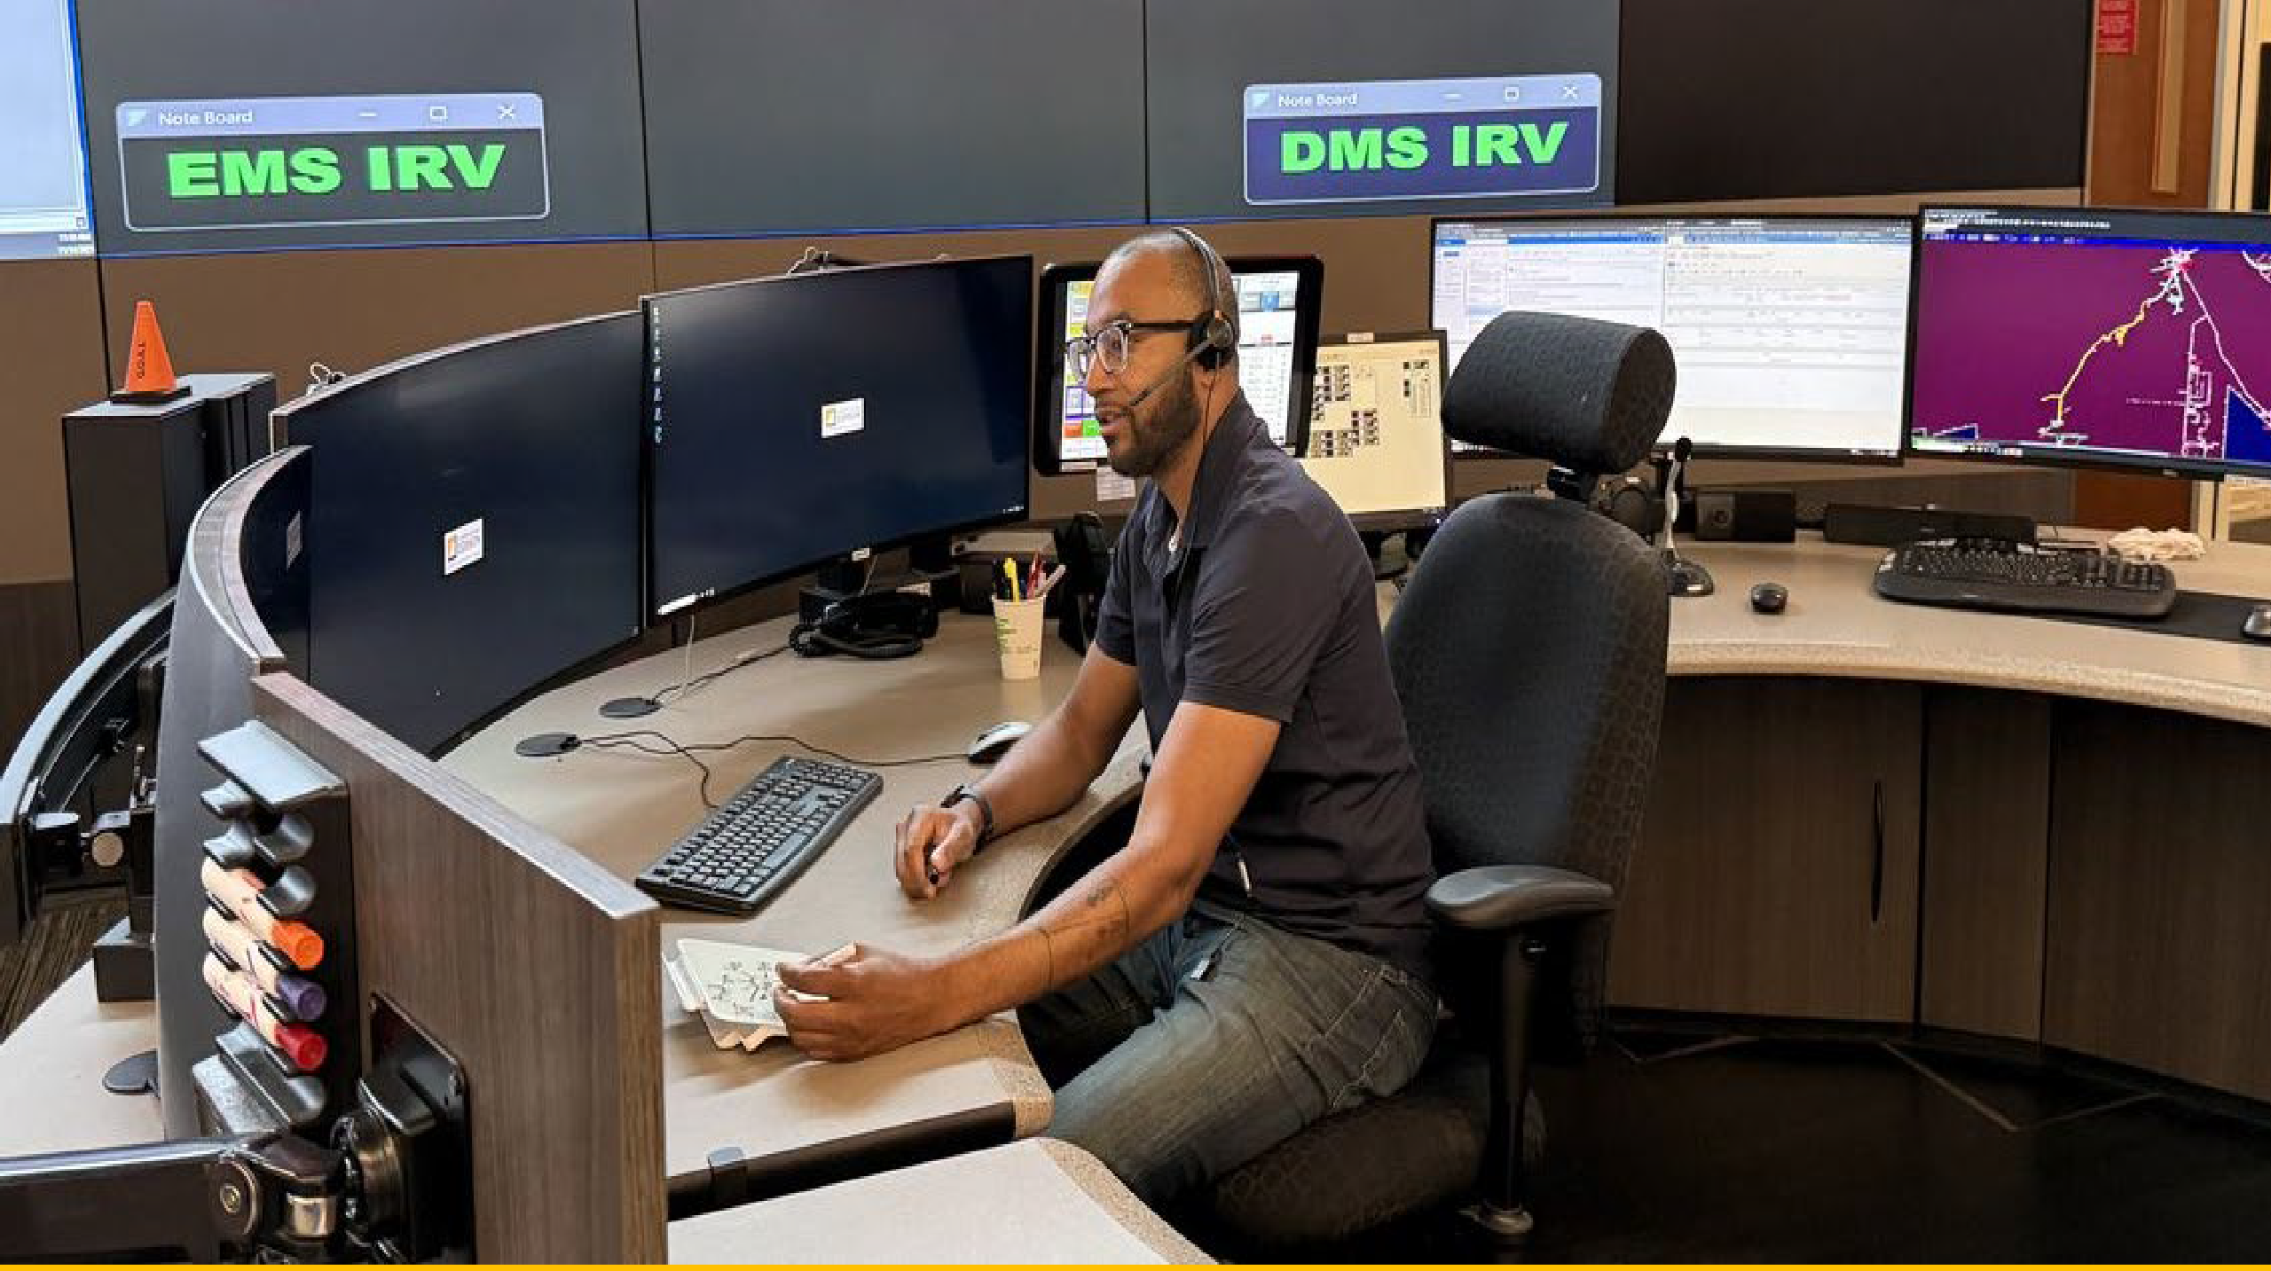
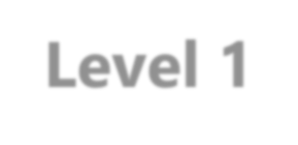

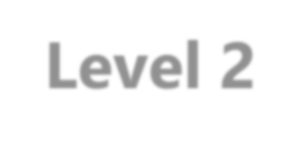

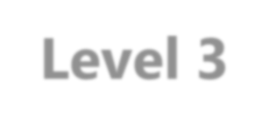
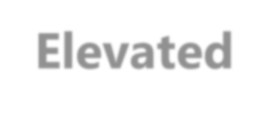
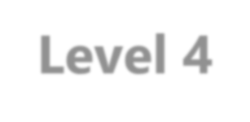

INCIDENT ESCALATION & EOC ACTIVATION
Complexity Analysis Criteria
Operational Impacts
  Electrical
  IT
  Generation
  Facilities
Customer Impacts
  # of Customers
  Category (Public Safety, AFN, etc.)
Community Impact
  Counties/Cities
  Community sensitivities
Parallel incidents (multiple IMTs)
  Resource conflicts
Event Duration
*The above criteria is intended to guide judgement and is not absolute nor numerically driven.*
Supports: timely activation, right sizing resources, and clear coordination
Activation Level
Resources
All Functional IMTs
IST
Pooled positions (all)
January 2025 Wind Event
Level 1
Severe
_{Level 2} ▪Multiple or Single Functional IMT
Substantial ^{▪IST}
Pooled positions (select)
PSPS Event during a concurrent IMT Activation
Level 3
Elevated
Single IMT
Select Pooled Positions
PSPS Activation
Level 4
Guarded
Management Coordination
Project Management Team
Special Events (Olympics, NBA,FIFA), Special Elections, Mutual Assistance Deployments

Slide 5
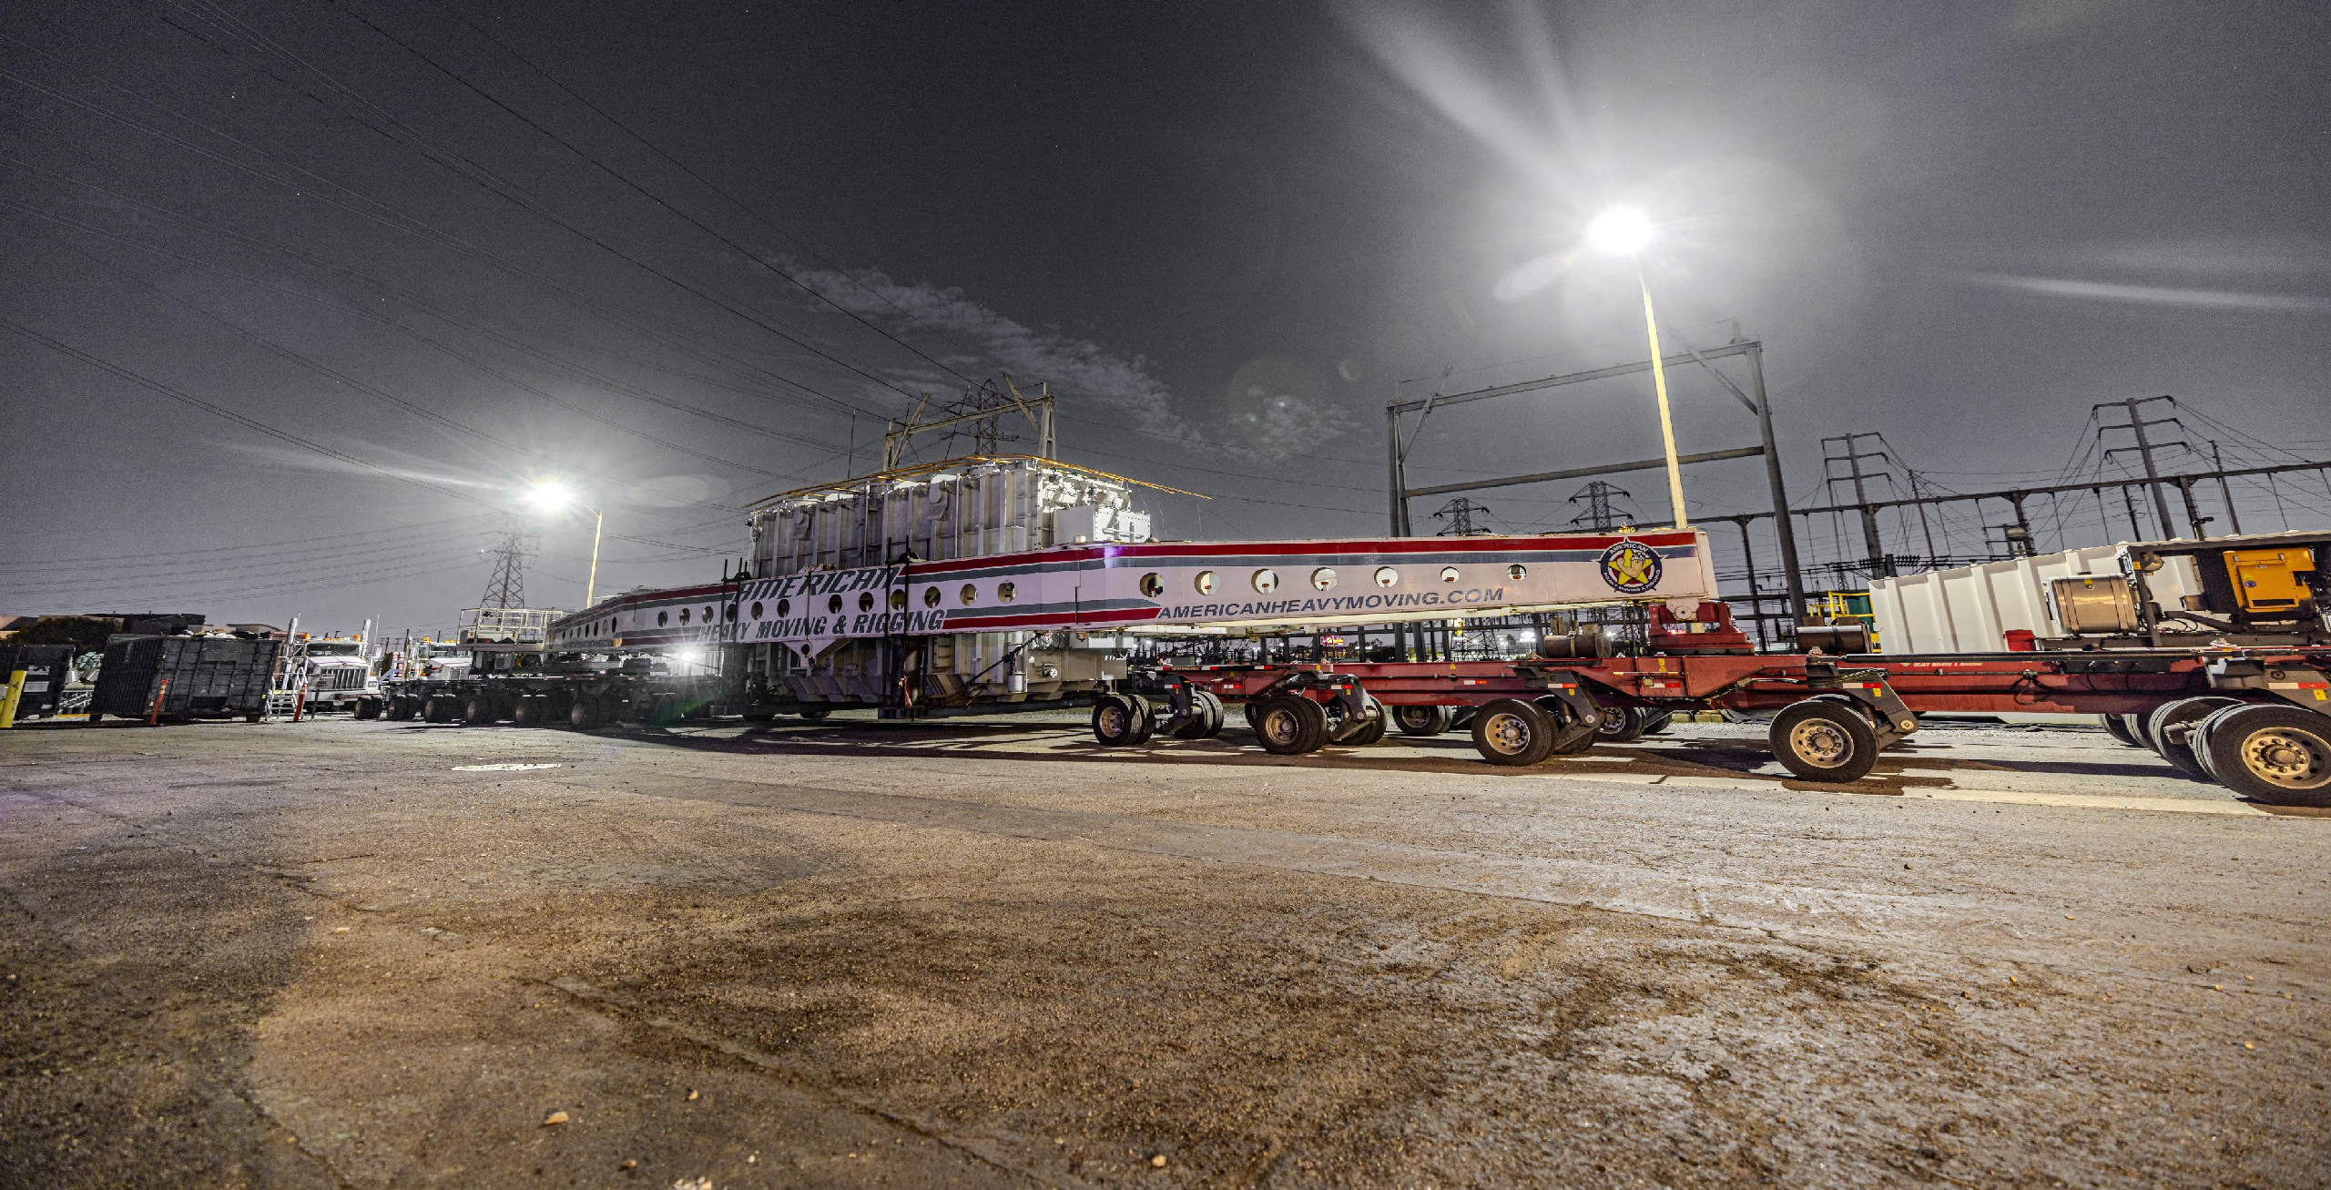

RESTORATION PLANNING
Grid stability = top priority
SCE IMT/IST determines restoration priorities based on:
Electrical hazards/public safety
Grid Stability
Restoration to customers that provide essential public service and essential use customers imperative for public safety:
Hospitals, police, fire, utilities, etc.
Length of time without service
Circuits with large numbers of customers affected and where community special circumstances exist
Area-wide outages
60 Hertz
Transmission System
Distribution System
Distribution Feeders
Distribution Laterals
Individual Service Lines
Challenges to Restoration
System interdependencies – availability of generation
Areas might need to go offline for repairs
Limited availability of generators, tie-ins
Roadway damage/debris
Impacts to equipment supply chain
Lack of available personnel
5

Slide 6
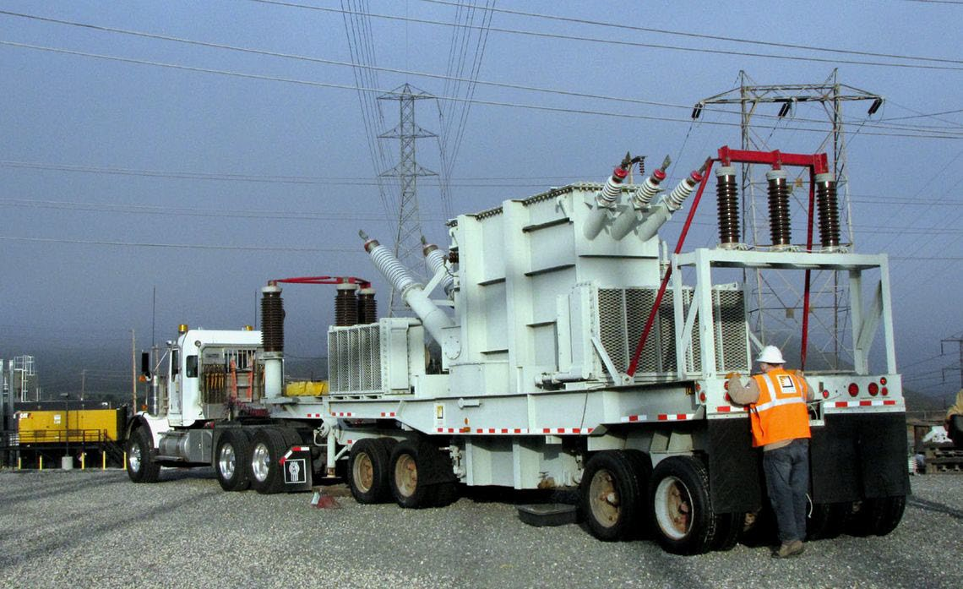
LA 2028: LOOKING AHEAD
SCE collaborating with external infrastructure stakeholders (venues, LA Metro, Counties/Cities impacted, etc.) regarding reliability and infrastructure improvements
SCE also working with LA28 organization in emergency response planning and coordination for emergency management posture
SCE holding internal planning and coordination meetings (internal OU stakeholders) regarding staffing, resource positioning, IMT posture, and PSPS considerations)
Encourage external commercial customers to engage with their SCE Account Manager regarding needs

