Slide 1
Powering Patient Care: Hospital Backup Power Preparedness
AMHE 2026

Slide 2
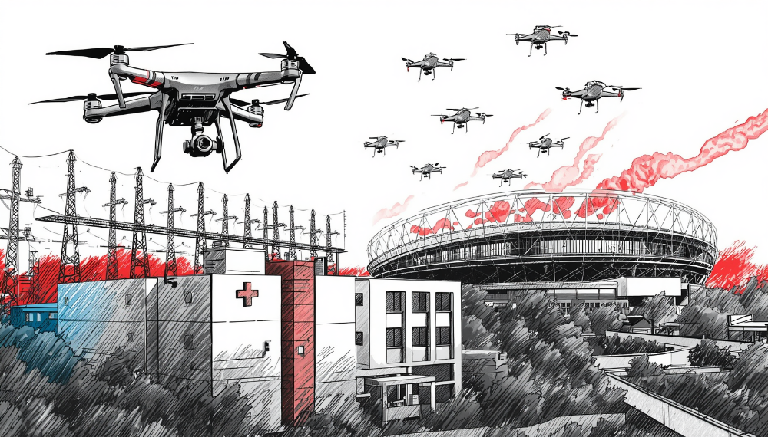
2026 AMHE Scenario
Drone attack on local Olympic Event resulting in large Mass casualty incident. Patients are being distributed across the LA County. Local Power substations are also targeted causing hospital power disruption.
Trauma patient influx
Code triage activation
MCI Policy initiated
Backup power required
Downtime procedures in place

Slide 3
Huntington Hospital
Licensed hospital beds: 534
Emergency department: 52 treatment beds. Can flex to over 70 treatment areas.
  Emergency patients: 80,000 in 2025. >85,000 expected for 2026
Trauma designation: Level II Trauma Center—the only trauma center in the San Gabriel Valley
  Trauma patients: More than 2,700 annually. Highest volume level 2
OLYMPICS 2028
Pasadena
Rose Bowl: Soccer (5 Games)
Rose Bowl Aquatic Center: Diving
Within .5 miles of distance between site locations.
Two overlapping event dates.
Notes:
Rose Bowl location

Slide 4
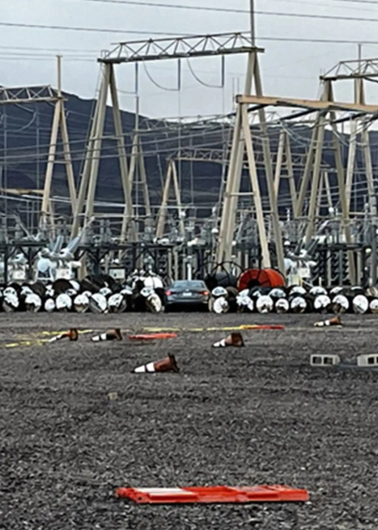
Huntington Hospital Electrical Power Sources
The City of Pasadena provides two sources of power to Huntington hospital. If there is an issue with one substation, the hospital would normally have the second source available.
A simultaneous loss or failure of both sources would be considered unlikely except in a major event such as an earthquake or terrorist attack. The November exercise can therefore simulate damage to both substations.
If both utility sources are lost, the hospital’s generators automatically start and provide emergency power.

Slide 5
Huntington Hospital Generators
The hospital has four generators and has redundancy built into the system. Two generators are capable of supporting the hospital’s required emergency load.
The hospital can operate on generator power for approximately five days, depending on the number of generators operating and the electrical/fuel load.
Emergency power is distributed through designated emergency-power circuits/outlets. Some equipment is connected to emergency power and some is not.
The hospital has two 40,000-gallon fuel tanks, for a total capacity of approximately 80,000 gallons.
The tanks are not filled to 100% capacity. They are maintained at approximately 60% to 90% because fuel expands with temperature.
At full generator load, the generators could consume approximately 12,000 gallons of fuel in 24 hours.
Operating fewer generators would reduce fuel consumption and potentially extend the duration of available backup power.
Notes:
Rose Bowl location is

Slide 6
Generator Testing and Maintenance
Generators are tested monthly, following Joint Commission recommendations and NFPA 110 requirements.
Facilities also performs quarterly generator maintenance. Maintenance includes items such as:
  Oil
  Coolant
  Belts
  Batteries
  Fuel system
  General mechanical condition
Generator batteries are checked weekly to ensure proper voltage and readiness.
The fuel system is tested annually for purity, including checking for water and bacterial contamination.
Notes:
Weekly visual inspections are performed using a checklist, similar to an aircraft pre-flight checklist. Technicians document the inspections.
Bacterial growth in diesel fuel can create sludge and cause problems with the fuel system. If contamination occurs, the fuel may need to be polished/filtered, which is a significant process.
Generator Reliability
There have been instances of mechanical issues with generators during testing. When problems have occurred, they have been repaired within approximately 48 hours.
The overall system is designed with redundancy so that the hospital can continue to support its emergency electrical load if a generator is unavailable.

Slide 7
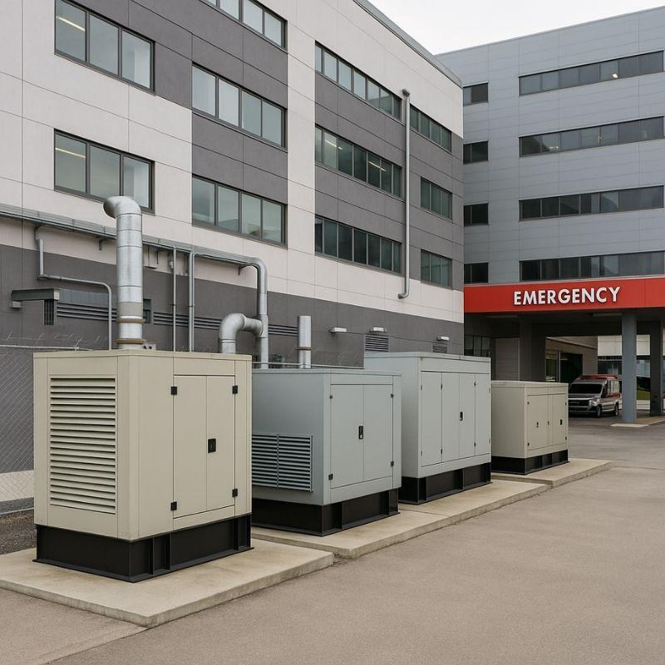
Emergency Power Procedures
Utility power is lost.
Generators automatically start.
Automatic Transfer Switches transfer appropriate electrical loads to emergency power.
Facilities responds and verifies the electrical system.
Departments verify that equipment requiring emergency power is functioning.
Facilities continues monitoring generators, fuel systems, ATSs, and related infrastructure.
Hospital leadership and operational teams continue managing the event based on the emergency/power-outage plan.

Slide 8
Backup Power
Backup power is a system, not just generators; maintenance matters; know what equipment is on emergency power; understand communications/command process

Slide 9
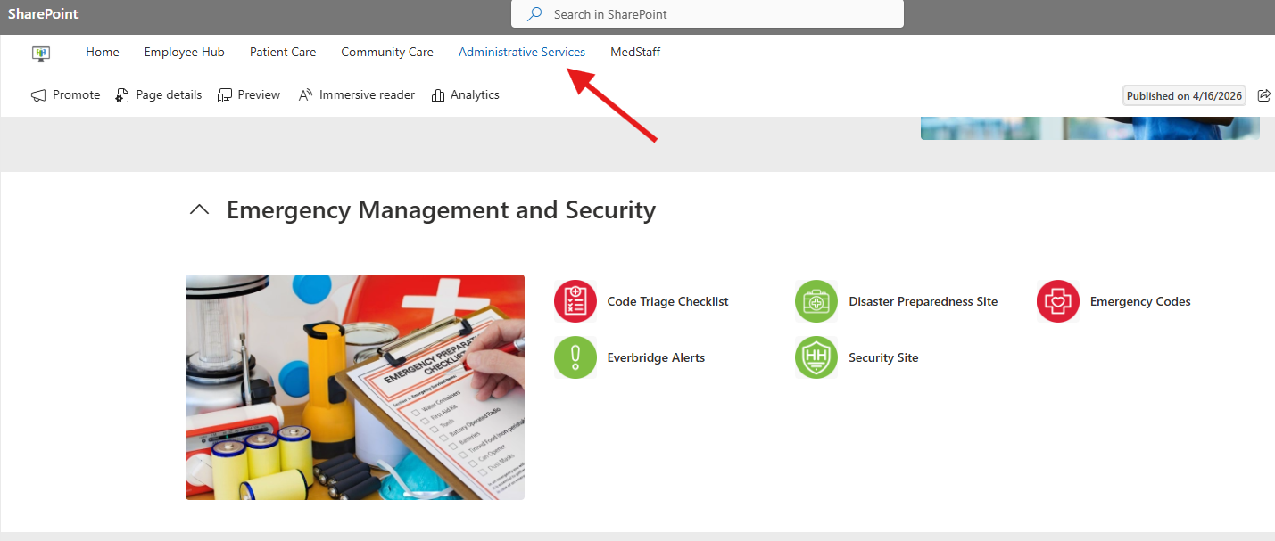
Virtual Command Center / Emergency Communications
A Teams meeting can be established within the Virtual Command Center channel. Link sent out via Everbridge message.
Initial Briefing — Leadership joins Teams meeting for emergency briefing

Slide 10
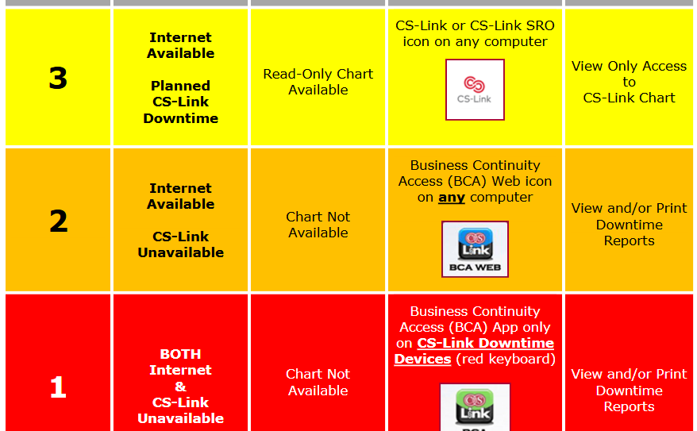
Downtime
Communication Redundancy
Radio’s
Everbridge
Microsoft Teams
Overhead Paging systems
ReddiNET
Satellite Phones
HAM radio (ARES)
VoIP phones
Personal cellphones
Runners/Paper charting
Notes:
Hardwired Landline system (phone and fax) were removed.

Slide 11
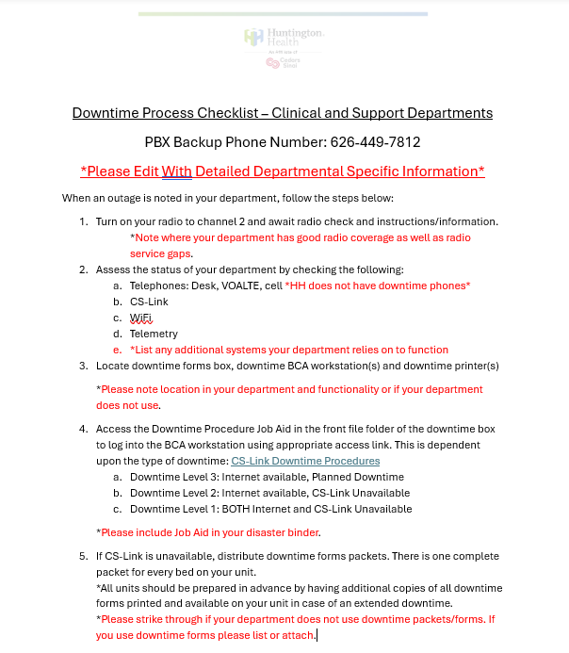
Downtime Education
Annual Downtime Exercise
Quarterly Leadership Lead Downtime Drills
Department Specific Downtime Forms
Department Downtime Boxes

Slide 12

System Gaps
Radios- location, usage and frequency.
Everbridge- education, network, empowerment.
Downtime Forms- repository, accessibility.
Command Center- runners, initiation, leadership.
Registration and patient tracking.

Slide 13
Thank You!

