Slide 1
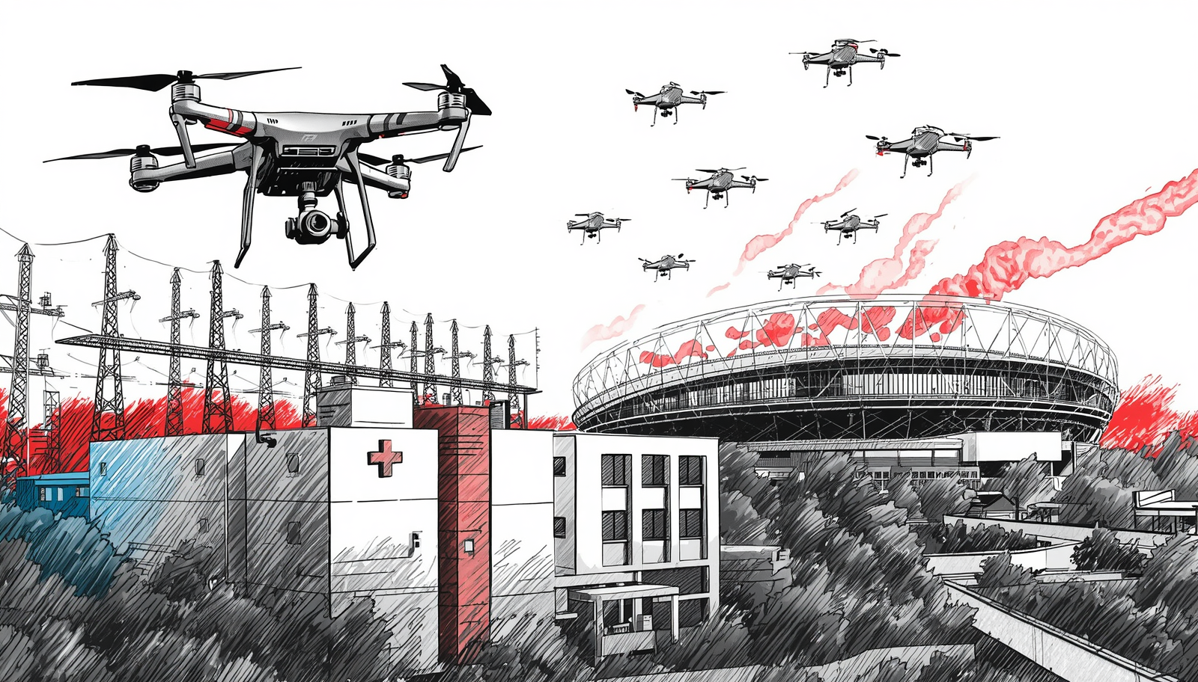
Exercise Overview
Darren Verrette
Disaster Program Manager
Los Angeles County EMS Agency
Notes:
The AMHE Participant Webinar is intended to prepare facilities in the HCC to participate in the 2026 AMHE Exercise scheduled for Thursday, November 19, 2026

Slide 2
2026 AMHE
Critical Infrastructure: Targeted Violence and Power Outage Exercise.

Slide 3
Program Priorities
2026 AMHE:
MRSE Requirement: Patient Surge (MCI)
LA28 Summer Olympics: MCI at Summer Olympic Venue
Hazard Vulnerability Analysis (HVA): #3 Power Outage
Notes:
To meet ASPR grant requirements, to foster preparedness for the 2028 Olympics, and to address our regional HVA
Power Outage was identified as the number three threat on the overall Los Angeles County Medical and Health Hazard Vulnerability Analysis (HVA).

Slide 4




Critical Infrastructure Sectors
Scenario
Pre-exercise (2-3 days before exercise): Heighten security posture following threats to the following critical infrastructure sectors in the Los Angeles area:
Commercial Facilities Sector (Sports Arena / Stadiums)
Energy Sector (Power Plants / Electric Sub-stations)
Healthcare and Public Health Sector
Notes:
There are 16 critical infrastructure sectors whose assets, systems, and networks, whether physical or virtual, are considered so vital to the United States that their incapacitation or destruction would have a debilitating effect on security, national economic security, national public health or safety, or any combination thereof. Presidential Policy Directive 21 (PPD-21): Critical Infrastructure Security and Resilience advances a national policy to strengthen and maintain secure, functioning, and resilient critical infrastructure.

Slide 5

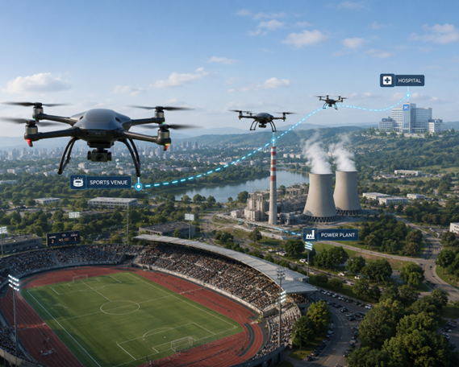
The Critical Infrastructure Sectors
Scenario
Pre-Exercise: 2028 Olympic Games are underway.
Local law enforcement has issued a “Be on the Lookout” (BOLO) alert to the community requesting anyone observing suspicious Unmanned Aircraft System (UAS) - drone activity to report it to authorities.

Slide 6
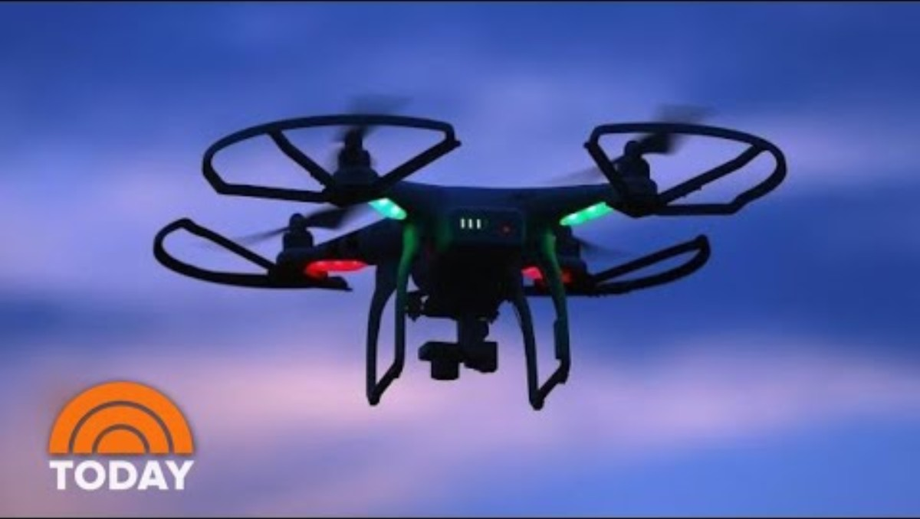
Mystery Drones
Notes:
2020 - Mystery Drones Fly Over Colorado And Nebraska

Slide 7
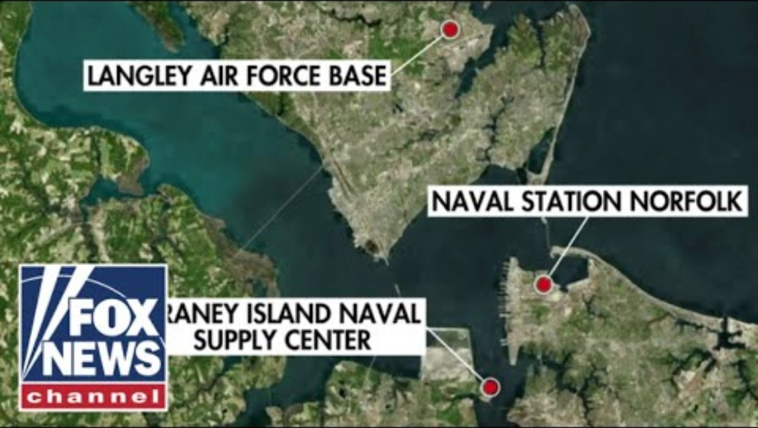
Mystery Drones Over Military Bases
Notes:
December 2023 - Mystery Drones Fly Over Military Bases

Slide 8
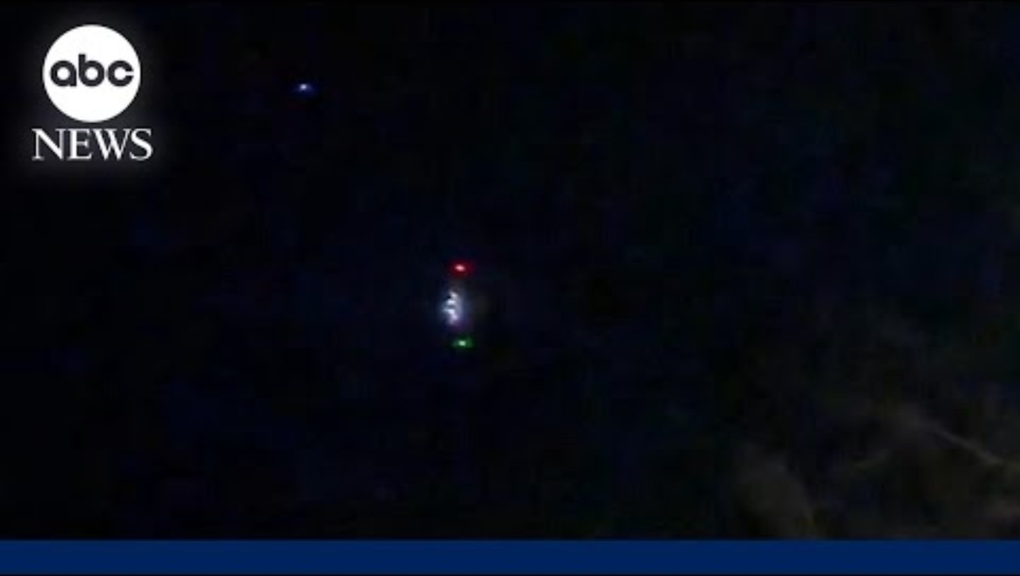
Mystery Drones Over New Jersey
Notes:
December 2024 - FBI investigates large drones spotted flying over New Jersey

Slide 9
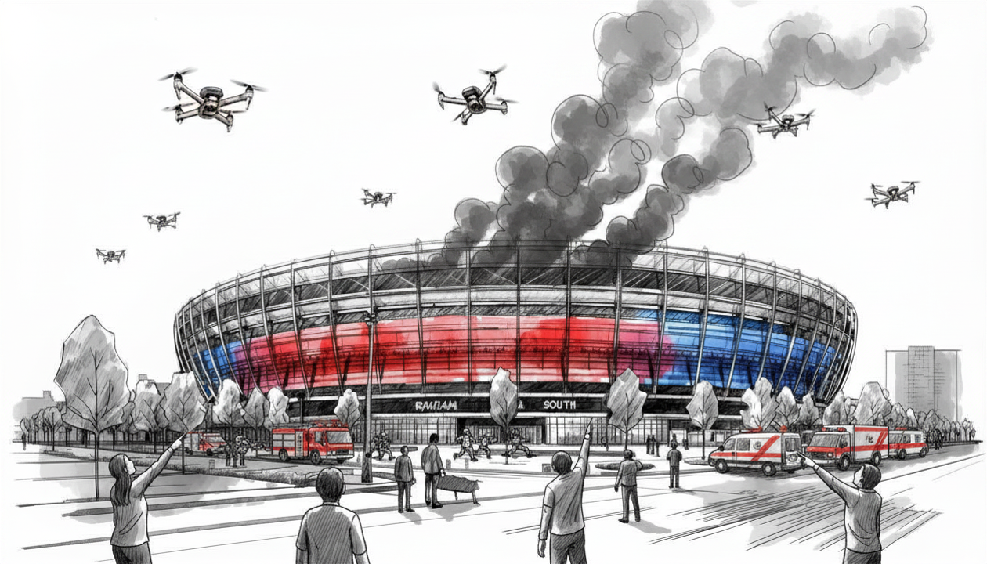
Scenario
Day of Exercise: Unmanned Aircraft System (UAS) drone strike at Olympic event near you or multiple sites
No central location for MCI. This allows everyone in County to play
Central MCI location only for Fire and Provider Agencies to test FOAC
Many victims self dispatch to nearby clinics and hospitals
Fire arrives on scene and initiates MCI with MAC on V-MED28
Victims are transported to ED resulting in patient surge (MRSE Requirement)

Slide 10
MRSE Requirement
ASPR grant requirements; specifically, the Medical Response and Surge Exercise (MRSE) requirements.
Surge Capacity Requirements
Performance Measures
Data Collection Requirements

Slide 11
MRSE Requirement: Patient Surge
The Healthcare Coalition (HCC) must surge to 10% of its licensed bed capacity
L.A. County has approx. 21,159 licensed beds. 10% = 2,160 surge patients
At a minimum we will surge to 3,350 patients
Notes:
Staffed beds mean those beds which are equipped and available for patient use. Staffed beds include those that are occupied and those that are vacant.

Slide 12
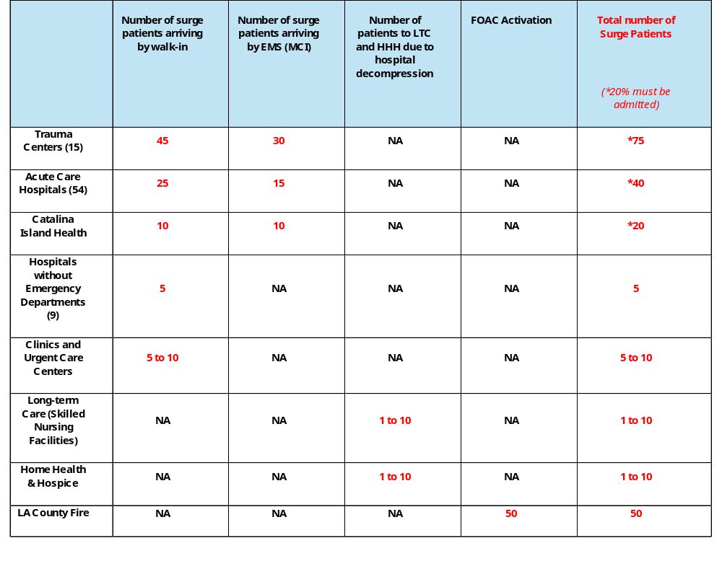
Patient
Allocation
Table
Notes:
Patient Allocation Table

Slide 13
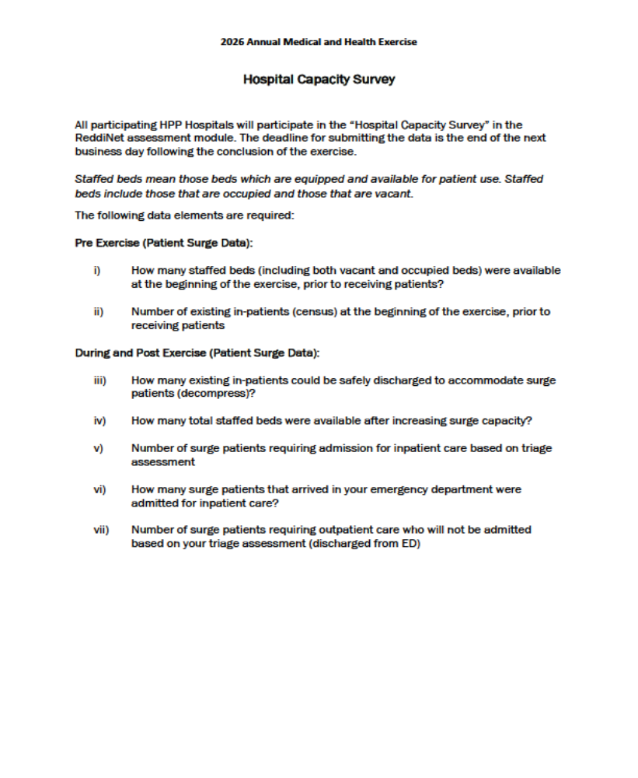
ReddiNet Assessment Poll:
Hospital Capacity Survey
MRSE Requirement: Performance Measures
Notes:
Information needed to fulfill ASPR performance measure. Have until close of next business day to complete survey

Slide 14
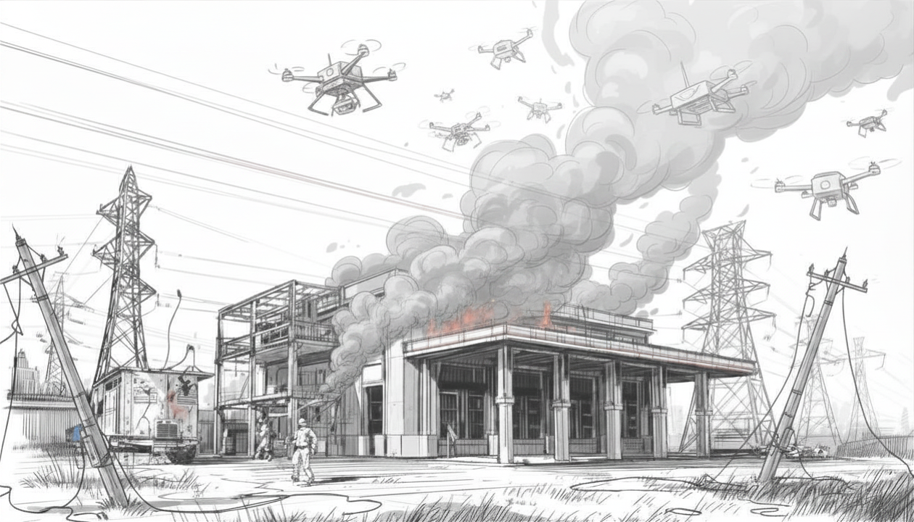
Scenario: Day of Exercise
Day of Exercise: At 9:00am a targeted UAS strike at a local electric sub-station…
Grid power failure impacting area around your facility
Power to the area around your facility is down (ATM’s, homes, schools, stores, streetlights, etc.).

Slide 15
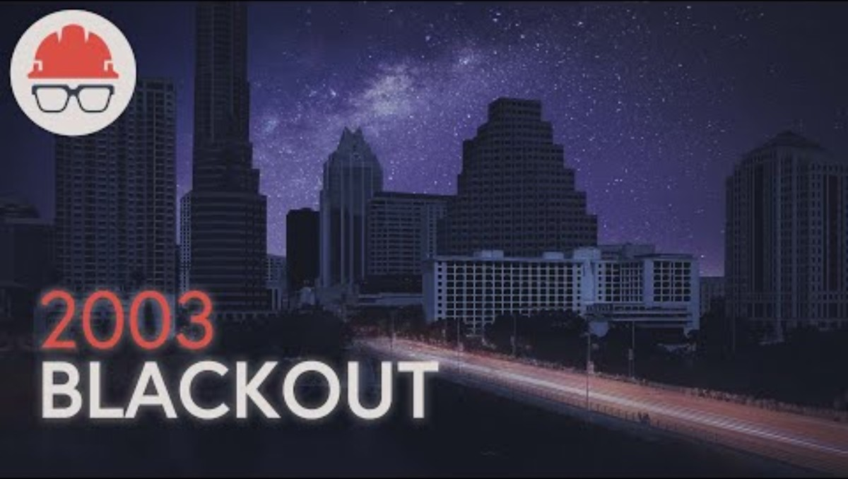
2003 Northeastern US – Blackout
Notes:
In 2003, one of the most severe power outages in history affected the northeastern US and parts of eastern Canada. This video summarizes the events leading up to and during the blackout

Slide 16
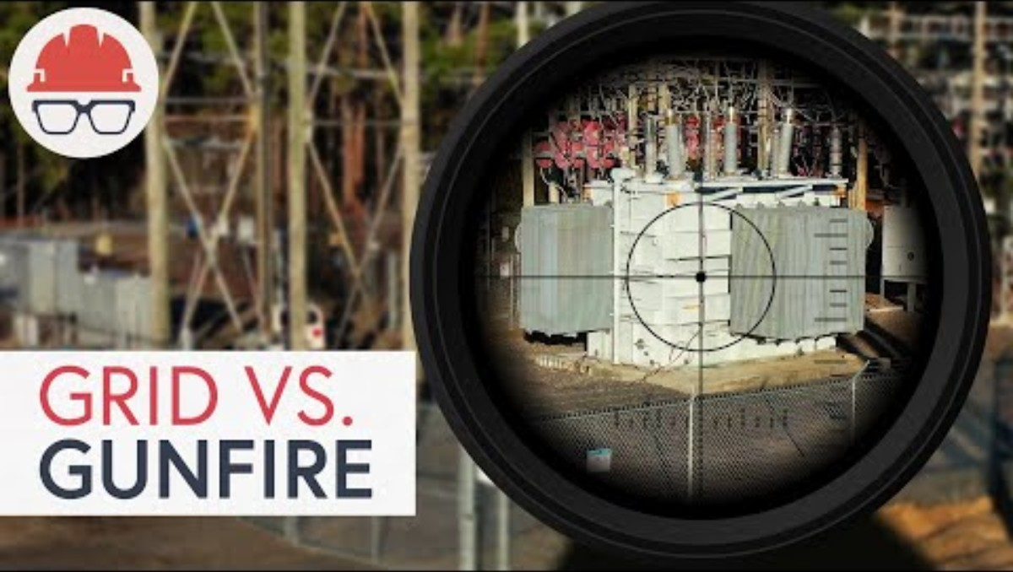
2022 Substation Attack in North Carolina - Power Outage
Notes:
May 2026 - What Really Happened with the Substation Attack in North Carolina?
An overview of the substation attack in Moore County, North Carolina in December 2022.

Slide 17
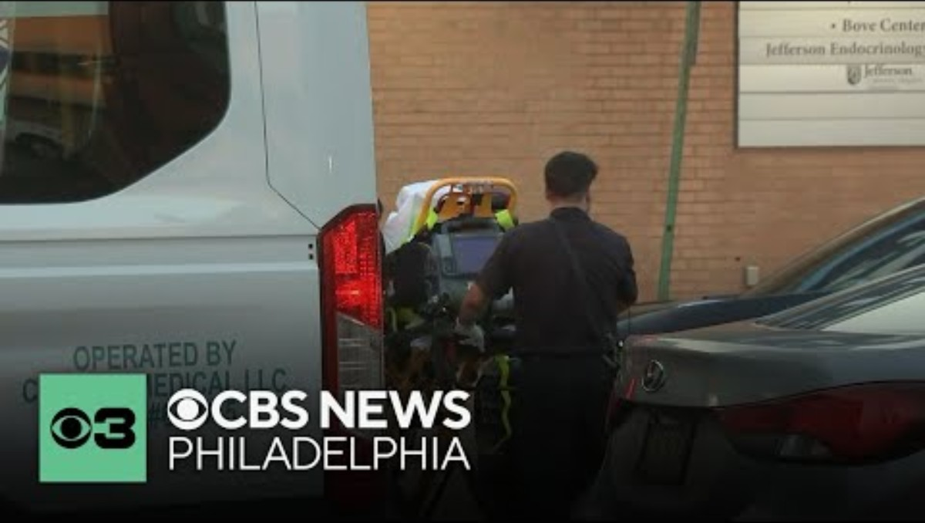
May 2026 - Philadelphia Hospital Evacuated after Power Outage
Notes:
May 2026 - Philadelphia Hospital Evacuated after Power Outage
A power outage caused by a burst pipe led to evacuations at Jefferson Methodist Hospital in South Philadelphia on May 19 (night) to May 20 (morning). Sources told CBS News Philadelphia at one point, the temperature in the intensive care unit reached 88 degrees.

Slide 18
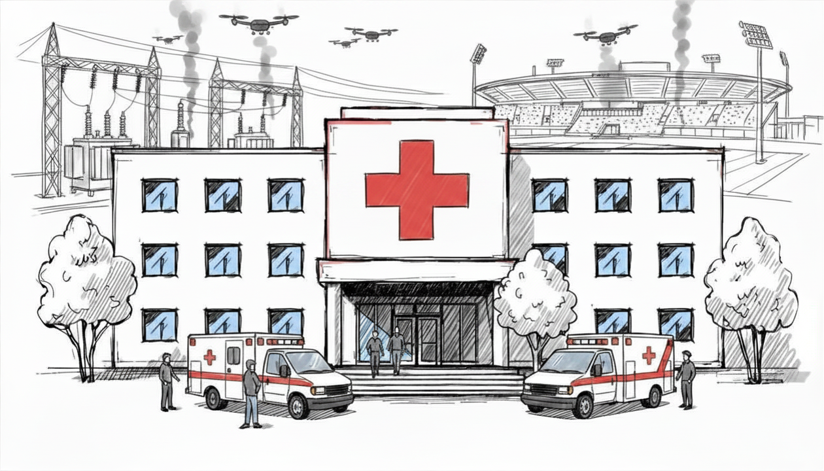
Scenario: Region-8
Day of Exercise: …forcing your facility on back-up generator or resulting in total power loss.
Each facility self-determine if on back-up power or no power
DRC Region-8 hospitals and SNFs to test emergency power playbook with MCC
All others outside Region-8 also use ReddiNet “pill” and answer questions. Answers to reflect green or yellow risk level. Not red or orange risk level.
LTC MAP coordination
Emergency fuel for designated provider agency
Notes:
At 9:00am the lead controller must announce to players that the power is out, and the facility is on back-up power source, or the facility has no power. If able, you can simulate power outage by turning off the lights or use some other creative method to simulate power failure.
Not all facilities use back-up generators that require fuel, some facilities use other back-up power sources such as power banks that store energy in batteries.

Slide 19


Power Outage
Power failure provides the opportunity to evaluate many areas. Here are some suggested areas to consider:
Assessment of power needs
Back-up communications / ARES
Back-up power system failure
Business continuity plan
Cancel procedures / surgeries
Cash needs for purchases
Charging stations for phones and laptops
Connecting portable power banks / extension cords
Downtime procedures
Electric fuel fleet charging needs
Elevators down / Med-Sled use
Emergency fuel for response vehicles
Emergency supplies (flashlights / batteries)
Evacuation / relocation
Fuel for back-up generators (How to acquire / MOU)
HVAC system failure (Emergency cooling or warming)
Identify vendors that provide back-up power (How to acquire / MOU)
Identify which essential systems that are not on back-up power
IT network down
Medical gas failure
Quick connect capability
Robotic systems that require charging
Secure parking ingress / egress
Supporting the Community
Utility failure (water, etc.)
Notes:
ASPR TRACIE
Planning for Power Outages A Guide for Hospitals and Healthcare Facilities
https://www.michigan.gov/-/media/Project/Websites/michiganprepares/docs/pdf/01/HC_PH_Energy.pdf?rev=730c903396c34c13b82b6e336f0b3fcb&cb=4033
FEMA and ASPR
https://www.fema.gov/sites/default/files/2020-07/healthcare-facilities-and-power-outages.pdf

Slide 20
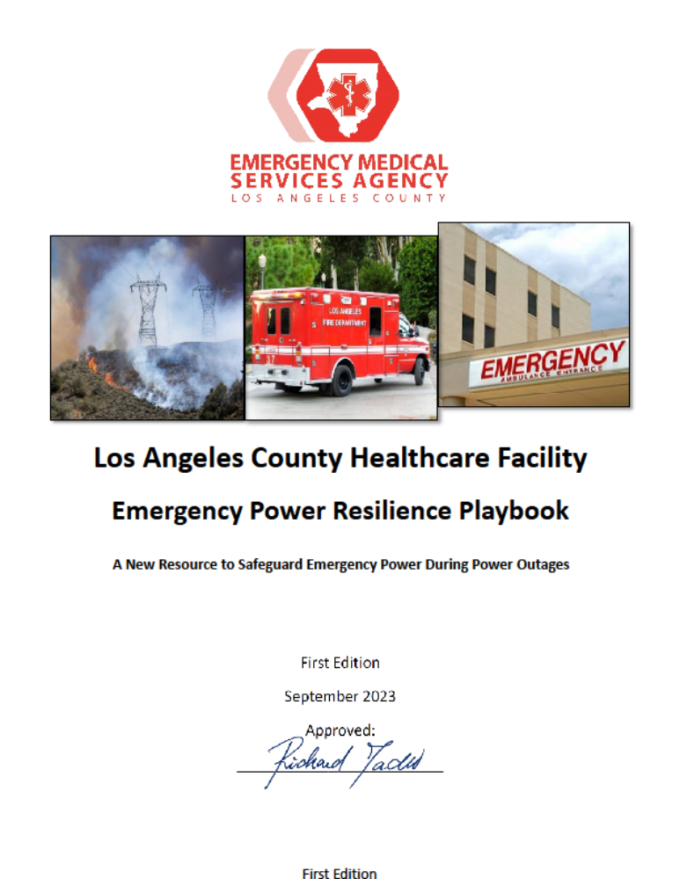
Emergency Power Resilience Playbook
Notes:
Playbook Appendix B (Hospitals) and Appendix C (SNFs)
It is important for everyone to complete the assessment in the playbook.
Facilities will gain critical information about their facilities emergency power needs that will save time if requesting resources.

Slide 21
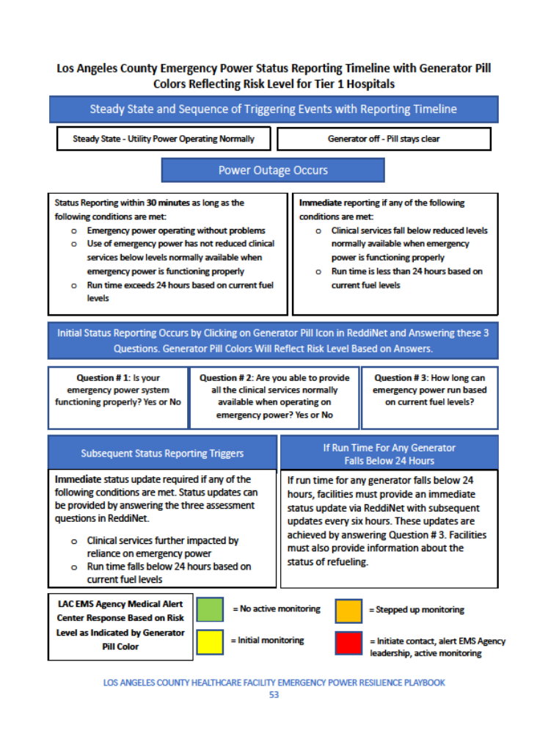
Emergency Power Resilience Playbook
(Protocol Sheet)
Notes:
Appendix G in the Playbook is the protocol sheet for the ReddiNet generator pill
For the exercise, we are requesting all hospitals and SNF’s to test the power status reporting protocol.

Slide 22

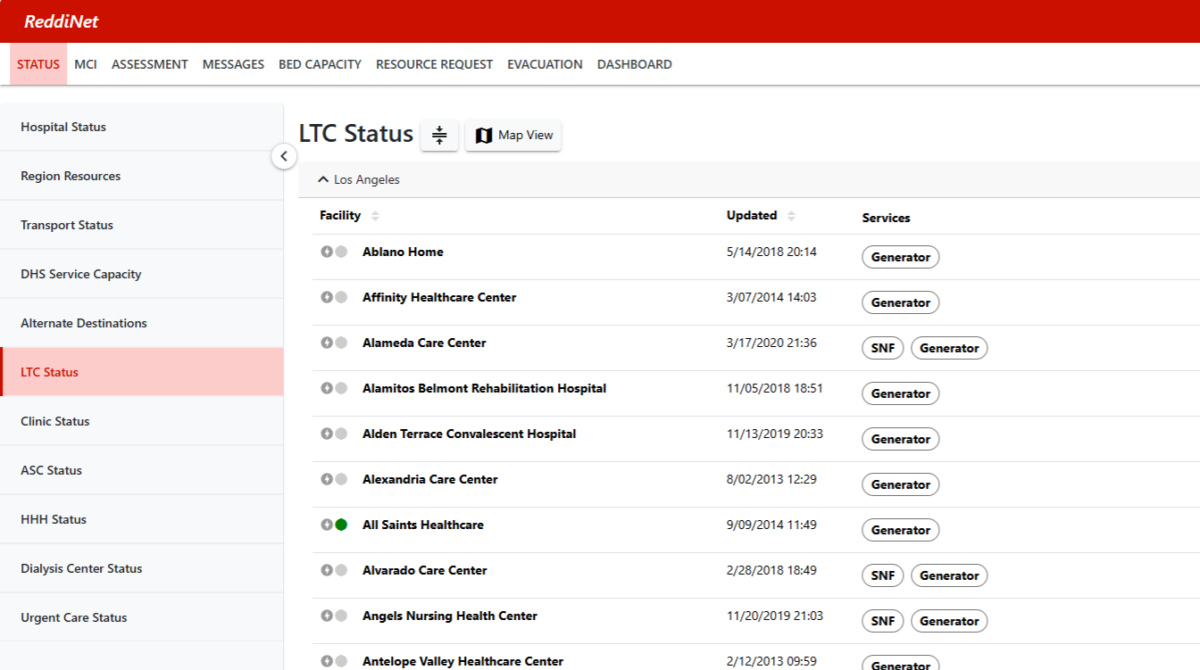
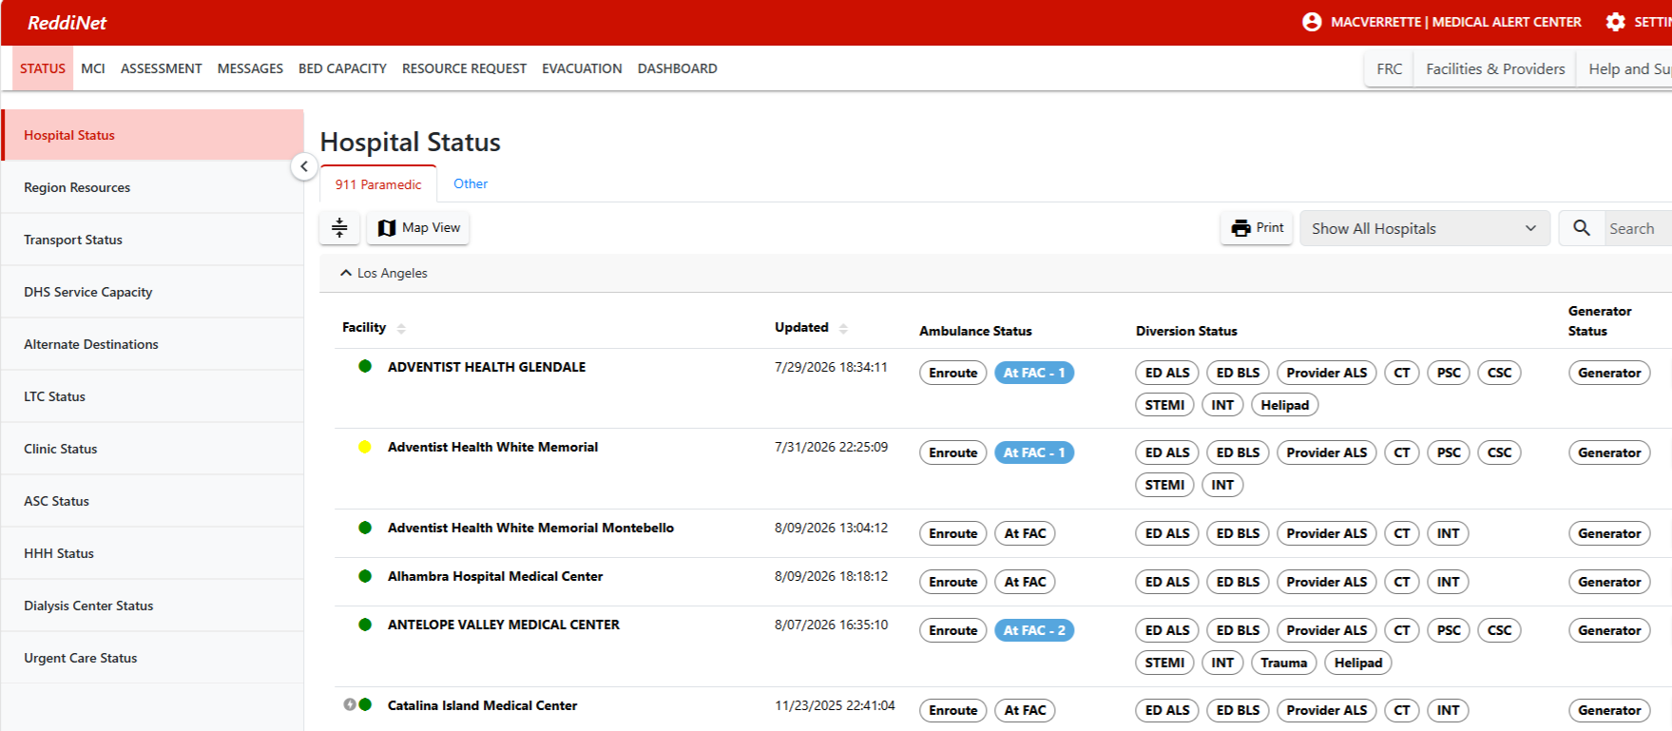

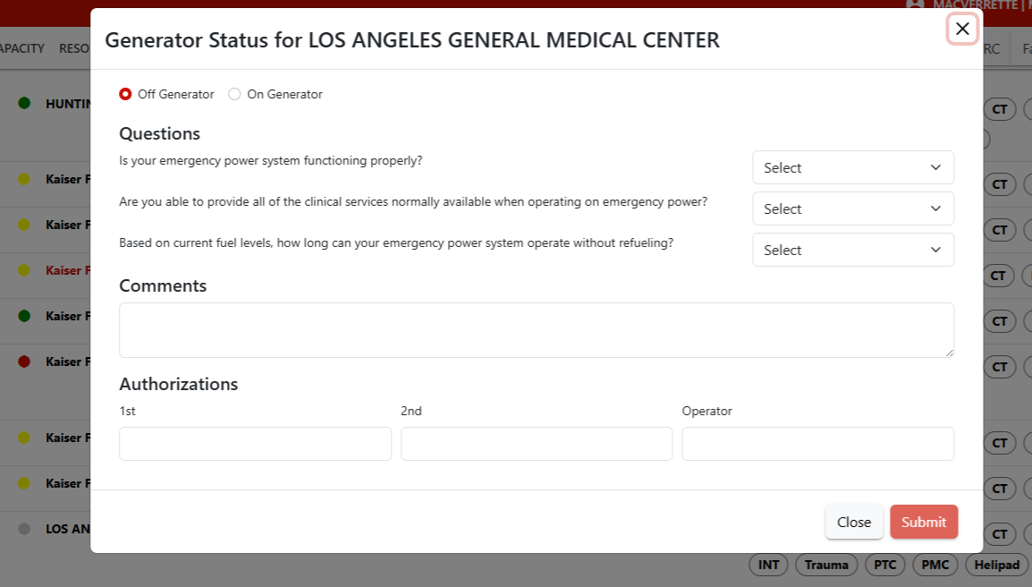

ReddiNet Generator Pill
Notes:
PLEASE NOTE: During the exercise when you update the “pill”, be sure to enter “Drill, Drill, Drill” or “This is an Exercise” or “2026 AMHE” in the comments section to distinguish between an actual incident versus exercise activity. Following the conclusion of the exercise be sure to return your facility’s generator status to “Off Generator”.

Slide 23
Region-8 Facilities (*Generator Pill) and other sectors
911 Receiving Hospitals in DRC Region-8 will simulate Internal Disaster.
*Adventist Health White Memorial - Montebello
*Coast Plaza Doctors Hospital
*Greater El Monte Community Hospital
*Norwalk Community Hospital
*PIH Health Hospital – Downey
*PIH Health Hospital - Whittier
*Rancho Los Amigos Rehabilitation Hospital
*Saint Francis Medical Center
*Whittier Hospital Medical Center
*Skilled Nursing Facilities
Ambulatory Surgery Centers
Clinics
Dialysis
HHH
Urgent Care

Slide 24
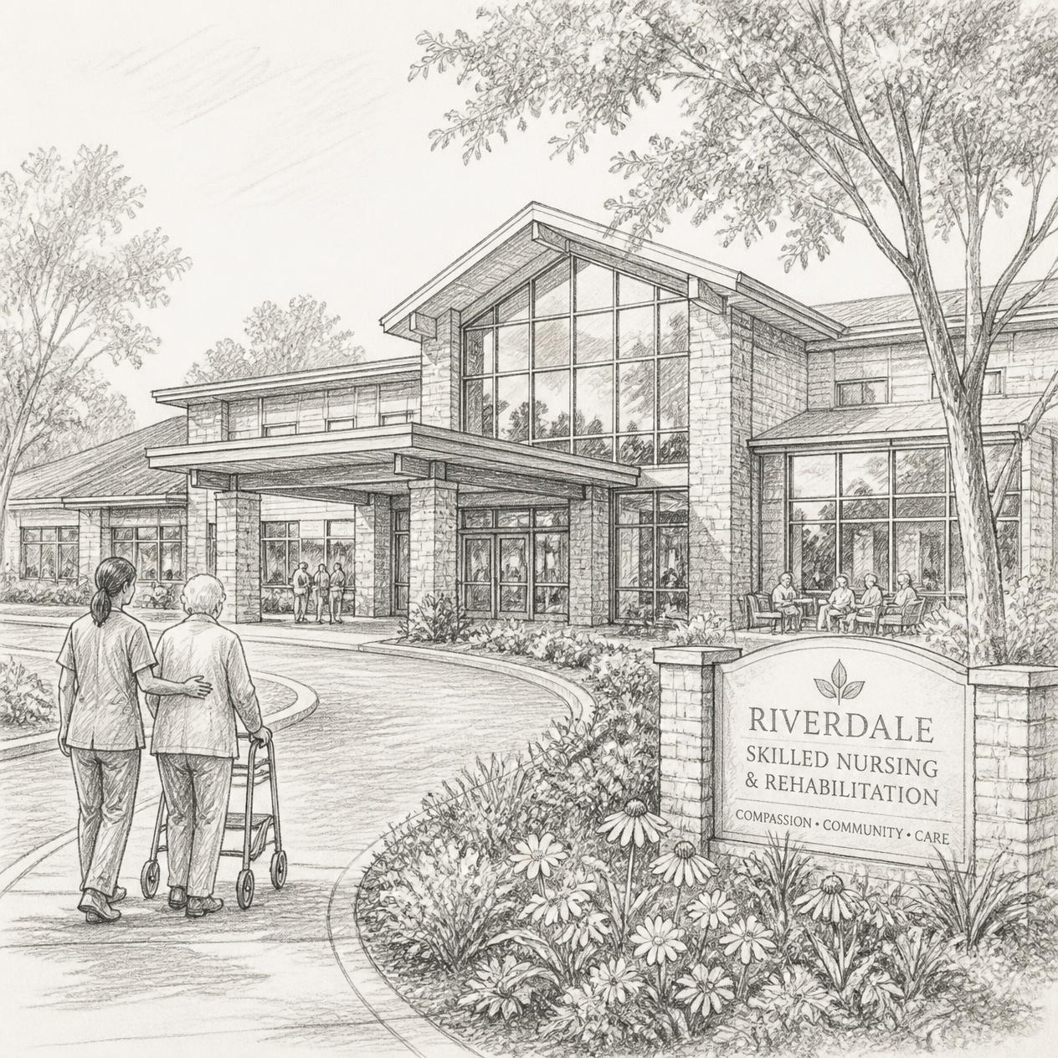
Region-8 Long Term Care - Skilled Nursing Facilities
SNFs to Test Patient Surge and Power Outage
Long-term Care Mutual Aid Program (LTC-MAP) Coordination
The LTC-MAP group will test team communication, notification, activation, and coordination.
The group pre-identified a skilled nursing facility (SNF) in Region-8 to evacuate
In addition to testing power outage other SNFs in LA County will be asked to set-up their surge capacity areas if they were to receive an influx of residents
Notes:
2025 LA Wildfires catalysts to develop mutual aid group

Slide 25
Ambulance Emergency Fuel
EMS Agency will work with a designated ambulance provider to test emergency fueling process
Ambulance provider will contact the EMS Agency and submit a RR for fuel
The ambulance provider will be given a location (ISD yard, Fire Department, Sheriff, etc.) and temporary credentials to access fuel
Notes:
ISD = Internal Services Department

Slide 26
Exercise Essentials
Scenario
Scope
Assumptions
MSEL
Resource Requesting
ARES
Conclusion of Exercise
Documentation
Registration

Slide 27
Scenario
Pre-Exercise: 2028 Summer Olympics are underway. Local law enforcement has issued a “Be on the Lookout” (BOLO) alert to the community requesting anyone observing suspicious Unmanned Aircraft System (UAS) - drone activity to report it to authorities. There has been an increase in threats to critical infrastructure sectors in the Los Angeles area. Specifically, to power plants, sports stadiums, and the medical and health sector. The BOLO is to remain in place for the duration of the Olympic Games.
Day of Exercise: An Unmanned Aircraft System (UAS) drone attack at Olympic event near your facility. Many victims with mild to moderate injuries self-dispatch to nearby clinics and hospitals. The Fire Department arrives on scene and initiates an MCI with the Medical Alert Center (MAC) and activates a FOAC. Victims are transported by ground ambulance resulting in a patient surge to emergency departments.
This is immediately followed by a targeted UAS strike at a local electric sub-station resulting in grid power failure and forcing your facility on back-up power or resulting in total power loss.

Slide 28
Exercise Scope
Command center activation is encouraged.
There will be no actual movement of patients.
Play will take place in the live ReddiNet system and V-MED28.
The exercise will begin at 8:00 a.m. and end at 12:00 p.m.

Slide 29
Exercise Assumptions
The scenario is plausible and meets criteria to activate applicable plans.
The time during the exercise is not reflective of actual time.

Slide 30
Master Scenario Event List (MSEL)
MSEL is a chronological list of simulated events (injects) that participants (players) will be asked to respond to during an exercise
Some injects are for all players such as the Service Level Poll
Some injects are for specific sectors and players such as Long-Term Care Bed availability Poll
It is okay to remove non-pertinent injects or add additional if needed to meet your objectives

Slide 31
Resource Requesting
MCC will open a resource request incident to support the exercise titled:
“2026 AMHE Exercise”
Use this incident in ReddiNet for exercise related resource requests
Notes:
Everyone please submit at least one resource request between 8:30am and 11:00am

Slide 32
Resource Requesting – EMS Agency
We (EMS Agency) process RR via ReddiNet
We only process medical and health resource requests except for shelters, HVACs, and generators.
We do not process RR for fuel except for emergency fuel requests from ambulance provider agencies.
Contact vendors then your local city EOC or DMAC coordinator for non-medical and health resource requests.
Notes:
Important: If you are not able to obtain a needed item (like back-up generator) through your normal procurement process, or vendors (sunbelt, united rental, etc.) within reasonable timeframe, and you're not able to obtain it from other non-traditional source (Home Depot, Lowes, etc.) within reasonable timeframe then submit RR to EMS Agency and your local EOC or DMAC. Shelters, HVACs, and generators can submit to both local city EOC/DMAC and EMS Agency.

Slide 33
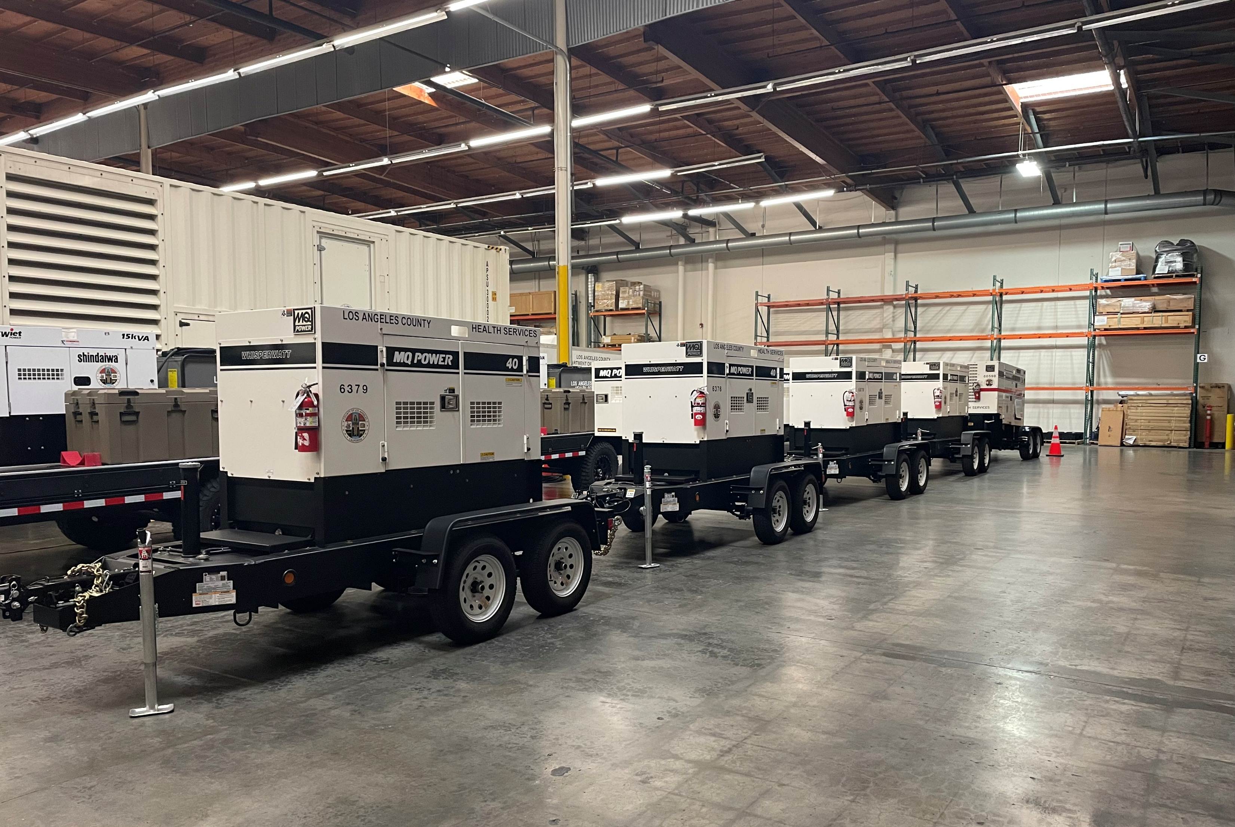
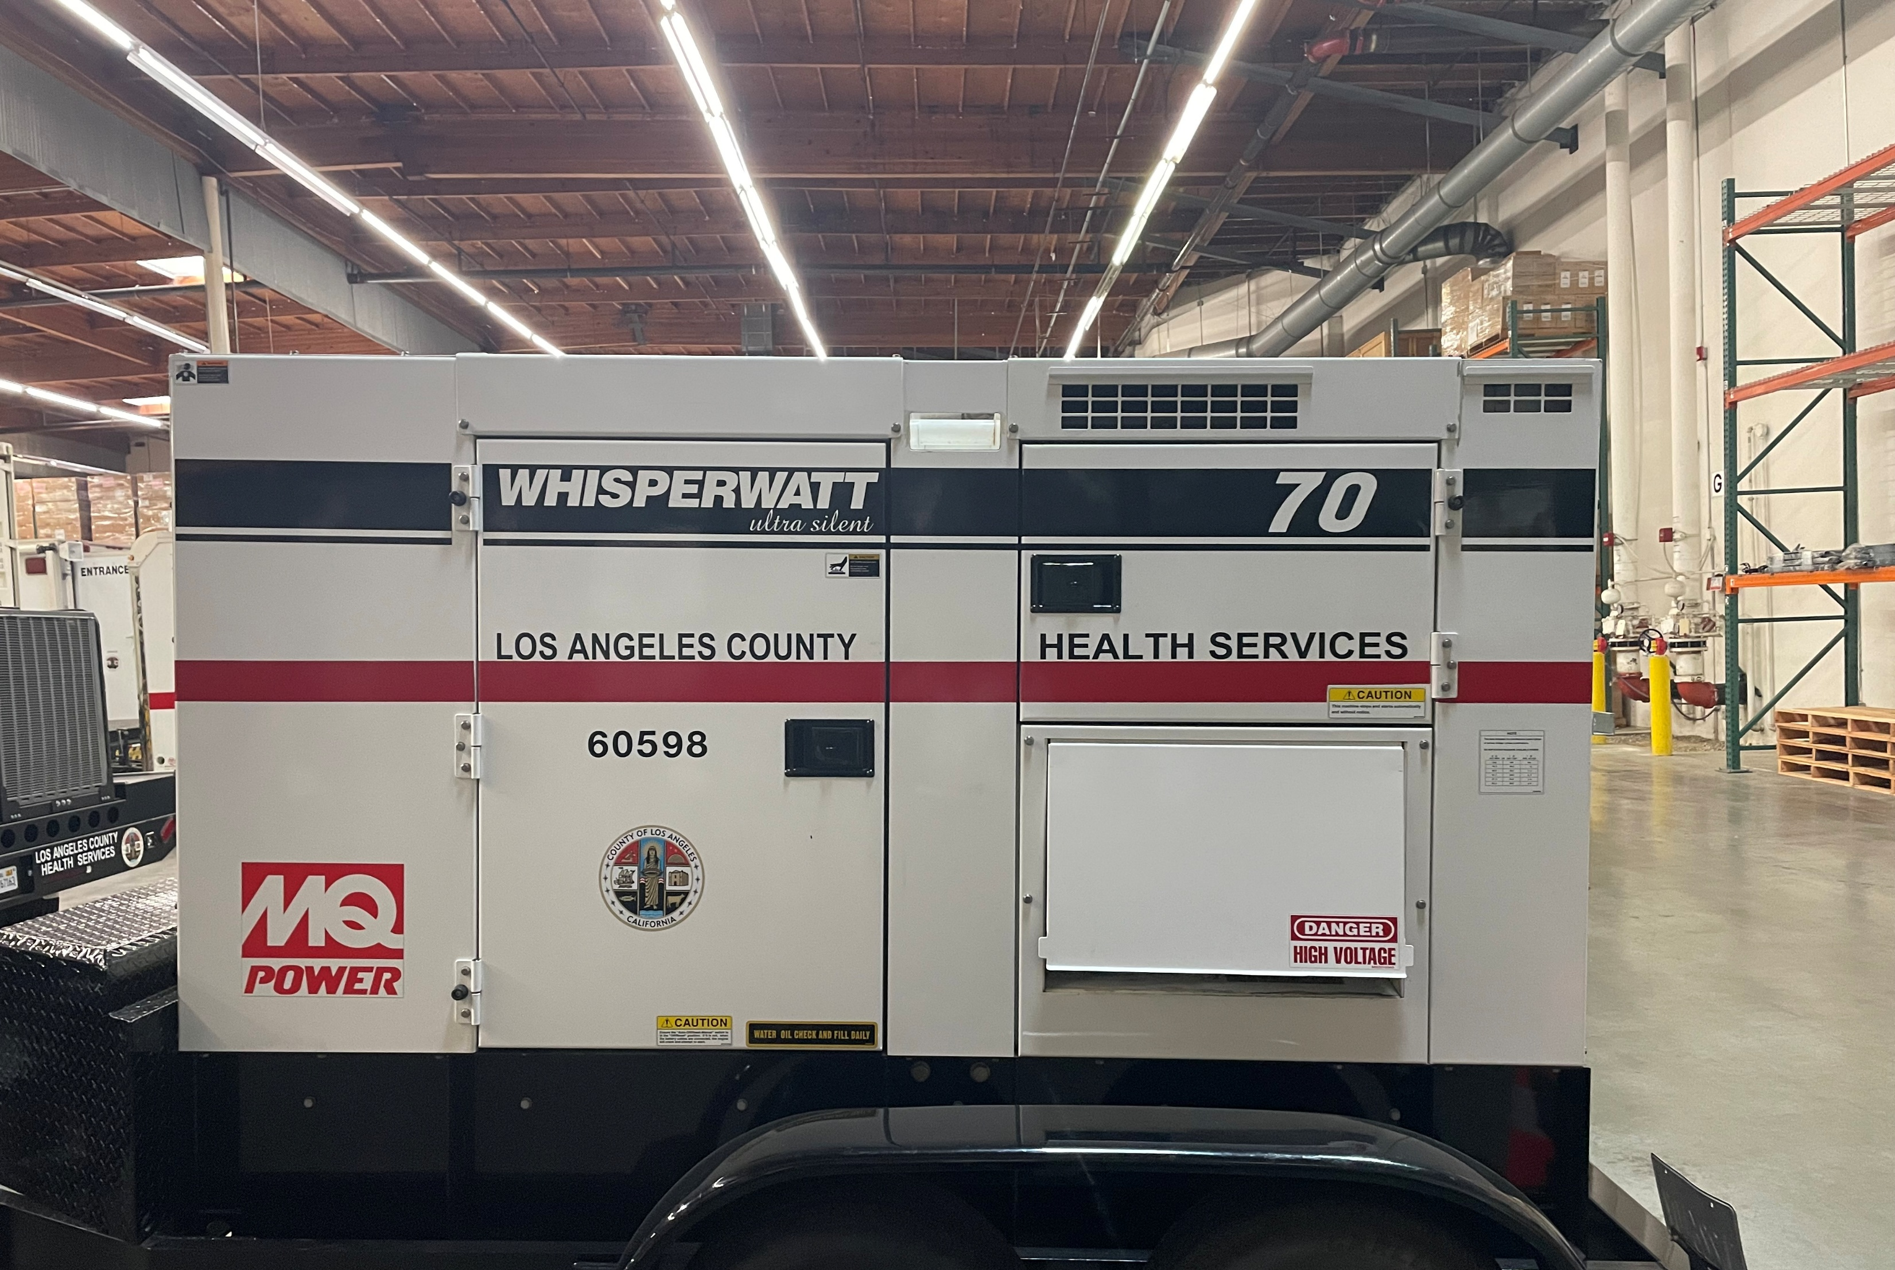
EMS Agency Generator Fleet
Notes:
Limited number of generators in various sizes from small 15kVA (kilovolt-ampere) to two large 800kW generators
Do not have cabling, SME, electrician

Slide 34
Amateur Radio Emergency Service (ARES)
Great opportunity to invite ARES to your hospital to test back-up communications
ARES will setup Net Control at the MAC
ARES can transmit and receive messages, resource requests, bed availability reports, and more via HAM radio

Slide 35
Conclusion of Exercise
Recommend hot-wash (debrief) with players
Participant Feedback Forms
60 days to complete and submit AAR/IP
Exercise Evaluation Conference 12/8/26

Slide 36
Documentation
Exercise Plan (ExPlan)
Exercise Objectives (Sector Specific)
Situation Manual (SitMan)
Controller Evaluator Handbook
Exercise Evaluation Guide (Sector Specific)
Victim Cards
Master Scenario Event List (MSEL)
Participant Feedback Form
After-Action Report / Improvement Plan - Template
Notes:
The ExPlan has a section with the sector specific objectives that are abbreviated.
The Exercise Objective sheets are sector specific and contain the full non-abbreviated objective. SMART (Specific, Measurable, Achievable, Realistic, Timebound)
The Situation Manual has three modules (Heightened Security, MCI Initiation, Power Outage) to conduct a TTX exercise prior to the FSE in November. You can add / remove modules add / remove questions.
The EEG *Important tool for Controllers and Evaluators. EEG: Identifying critical tasks, tied back to objectives. Prepare and review with your evaluators before the exercise.
Victim Cards (Sample MCI Victim Cards / Profiles, Clinic Victim List, Inpatient List) Pick and choose, mix and match, can use or create own, can edit and revise change names, etc. as needed.)

Slide 37
Websites:
L.A. County Healthcare Coalition Website:Link to the L.A. County Healthcare Coalition Websitehttps://www.lacountyhcc.org/trainings-exercises-drills/amhe-annual-medical-health-exercise/2026-amhe -
EMS Agency Website:
https://dhs.lacounty.gov/emergency-medical-services-agency/home/disaster-programs/exercise-drills/
Notes:
HCC Website google sheets
EMS Agency Website Microsoft forms

Slide 38

Exercise Registration https://forms.cloud.microsoft/Pages/ResponsePage.aspx?id=SHJZBzjqG0WKvqY47dusgeAx3rhTCttAiemAxAwTrD9UMTFDREpKMVpDVFMzMU1ZVjRXU05KS1UyNC4u
Please register your facility for the exercise
Registration will confirm your facility is planning to participate
Registration will provide point-of-contact information to EMS
Notes:
This is facility level registration, not for individual players / participants
Registration is open

Slide 39
Questions
Type questions in chat or unmute

Slide 40

Thank you!
Darren Verrette
dverrette@dhs.lacounty.gov

