Slide 1
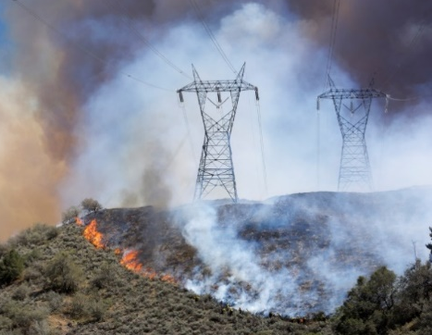
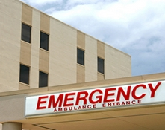
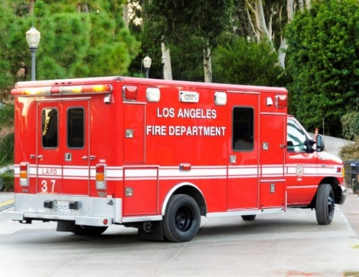
Overview
Overview of the LA County EMS Agency’s Emergency Power Resilience Initiative & Emergency Power Resilience Playbook

Slide 2
Initiative Overview
Four-phase initiative launched in May 2019 as Public Safety Power Shutoff (PSPS) threats increased
Powered for Patients, 501c3 non-profit, hired as contractor
Initiative sought to:
  Evaluate existing protocols around generator threat reporting and response by government agencies

Slide 3
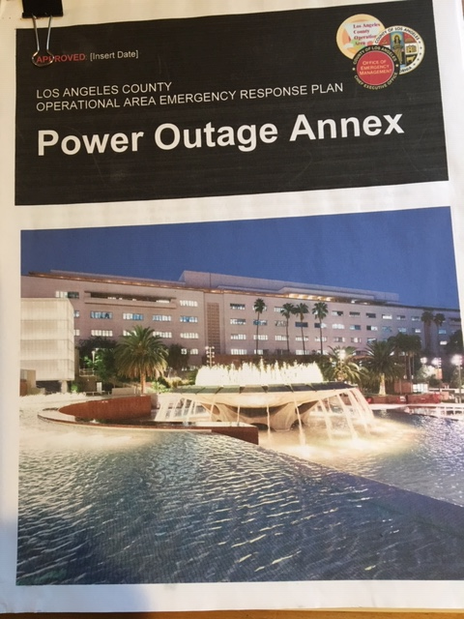
Annex
Review existing state and county protocols and identify gaps
LA County Office of Emergency Management developed an initial framework for addressing emergency power threats

Slide 4
Process
Conduct a detailed census of Emergency Power Systems in the 80 hospitals participating in the ASPR Hospital Preparedness Program
Completed an emergency power fleet census in LA County

Slide 5
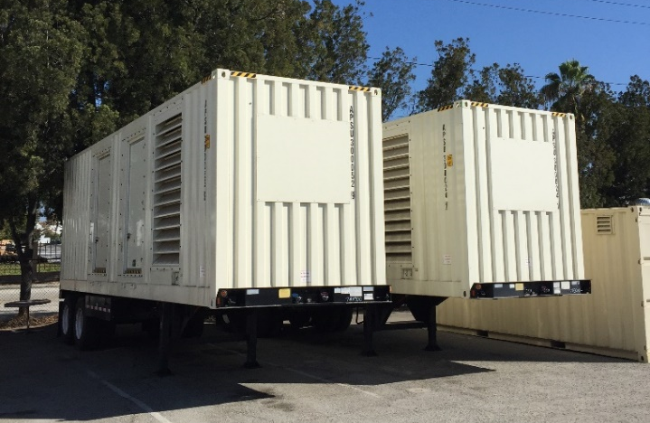
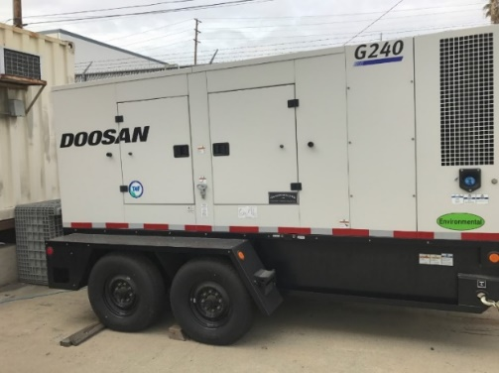
Fleet
LA County Generator Fleet: Twelve 800 kW generators and twenty-three 200 kW generators

Slide 6
Tiers
Develop new protocols to better safeguard emergency power
Create a confidential Risk Rating for Hospitals
  Tier 1 – No concerns with emergency power system (42 hospitals)
  Tier 2 – Concerns based on outdated generators, lack of redundant emergency power or limited run time due to low onsite fuel capacity (37 hospitals)

Slide 7
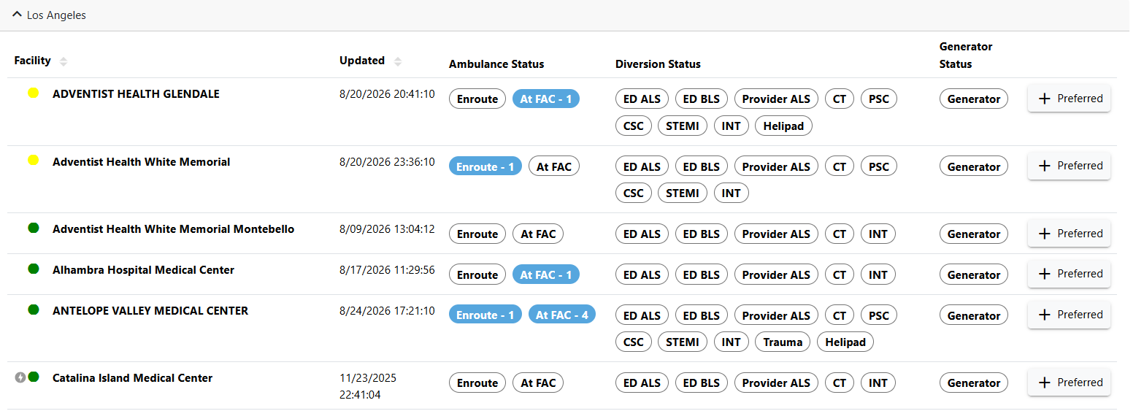
ReddiNet

Slide 8
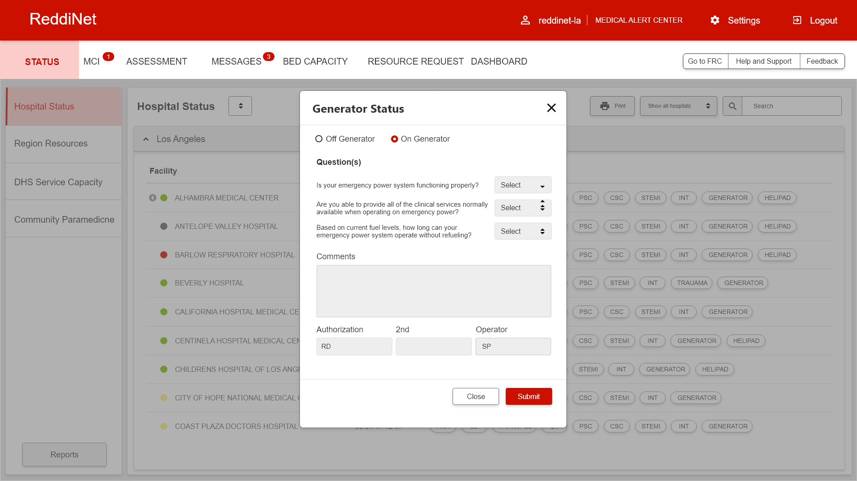
ReddiNet Generator Pill
Notes:
Question #1 Yes or No
Question #2 Yes or No
Question #3 Dropdown
Over 48 hours
25- 48 hours
Under 24 hours

Slide 9
Playbook Overview
Key Stakeholders for whom Playbook was developed:
  Hospital and Sub-acute SNF (Facility directors, Emergency Management Officers and Administrators)
  Government officials
  Generator service, fuel and rental providers
  Electric Utilities Providers

Slide 10
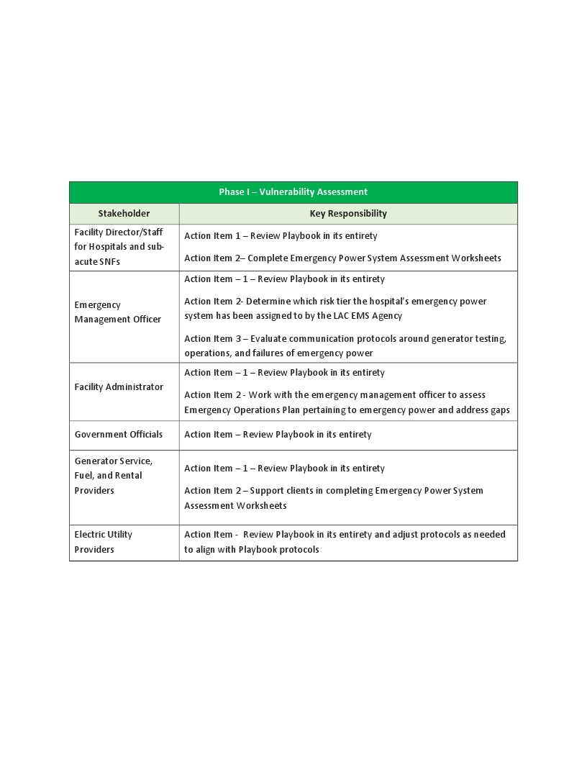
Stakeholder Responsibilities
All 4 Phases has a list of action items

Slide 11
20 Appendices
Emergency Power System Assessment Worksheets For Hospitals & Sub-Acute SNFs
FEMA Checklists for Safeguarding Emergency Power Before, During and After Power Outages
The 10 Most Common Causes Of Generator Failure

Slide 12
Hospitals- Appendix B
Number of generators
What is the ratio of total kW of generator power to the number of licensed acute care beds in your facility?
How old are your generators?
What is the emergency power system runtime based on your facility’s onsite fuel storage capacity?
Do you have a generator services contact in place?
https://docs.google.com/document/d/1n0oIxCyL09iFPhN9W3TQ1IdAkAPddiXl/edit

Slide 13
Sub-acute SNF- Appendix C
Number of generators
Does your facility rely on any generators that exceed 30 years of age?
Based on current on-site fuel capacity, what is the emergency power system runtime?
Do you have a generator service contract in place?
https://docs.google.com/document/d/1fHemqIXzNMfQKgjzgcrZVR4o9ReANaxv/edit

Slide 14
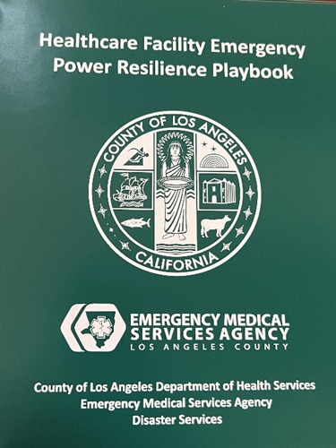
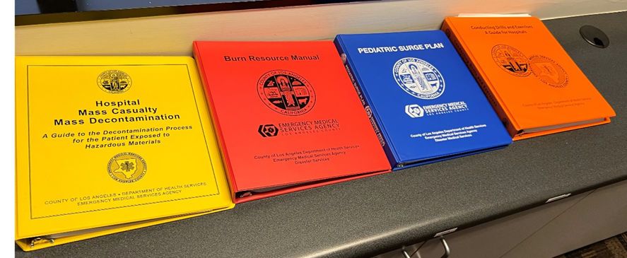
Various Disaster Plans

Slide 15



Questions
Chris Sandoval, BSN, RN
Chief, Disaster Services, Coordination and Response
Los Angeles County EMS Agency
csandoval@dhs.lacounty.gov
562.378.2443

