Slide 1
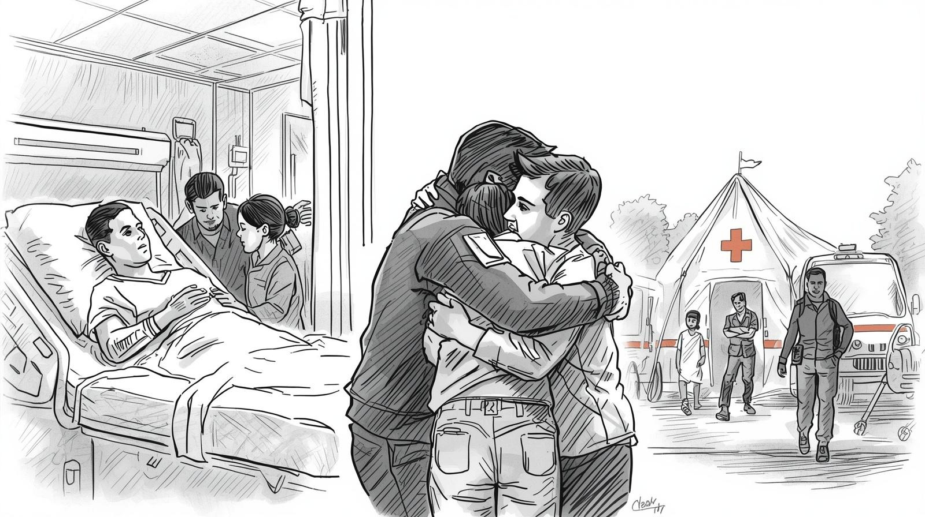
2026 Family Reunification Center Exercise Briefing
2026 FRC Exercise Briefing
Welcome

Slide 2
Darren Verrette
EMS Agency
2026 FRC Exercise Briefing
Target Audience
Exercise Controller: Controllers plan, manage exercise play, set up, and operate the exercise at their respective facility. Controllers direct the pace of the exercise in accordance with the Master Scenario Event List (MSEL) developed by the EMS Agency.
Exercise Evaluator: Evaluators observe and document performance against established capability targets and critical tasks, in accordance with the Exercise Evaluation Guides (EEGs) developed by the EMS Agency.

Slide 3
FRC Exercise: Components
  FRC Briefing
  FRC Application Training
  FRC Exercise
  FRC AAR

Slide 4
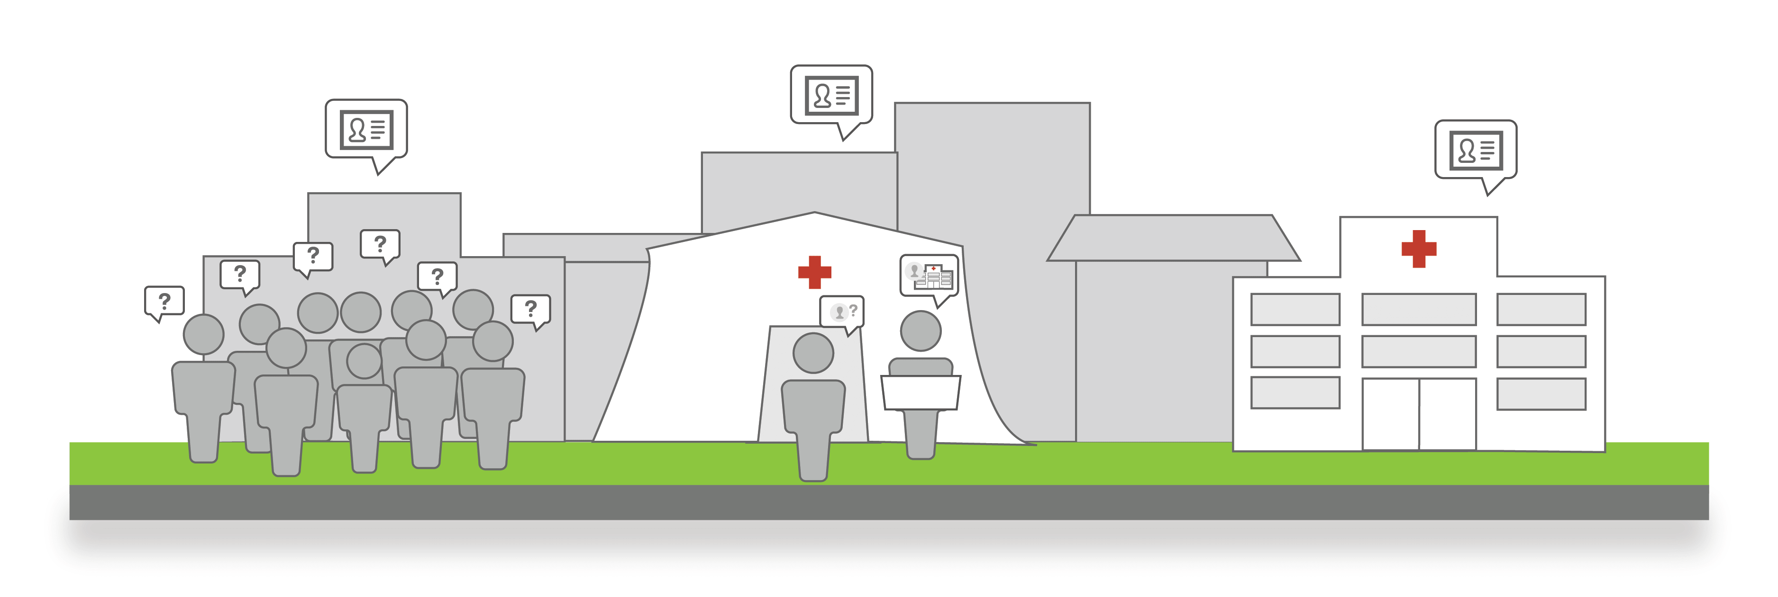
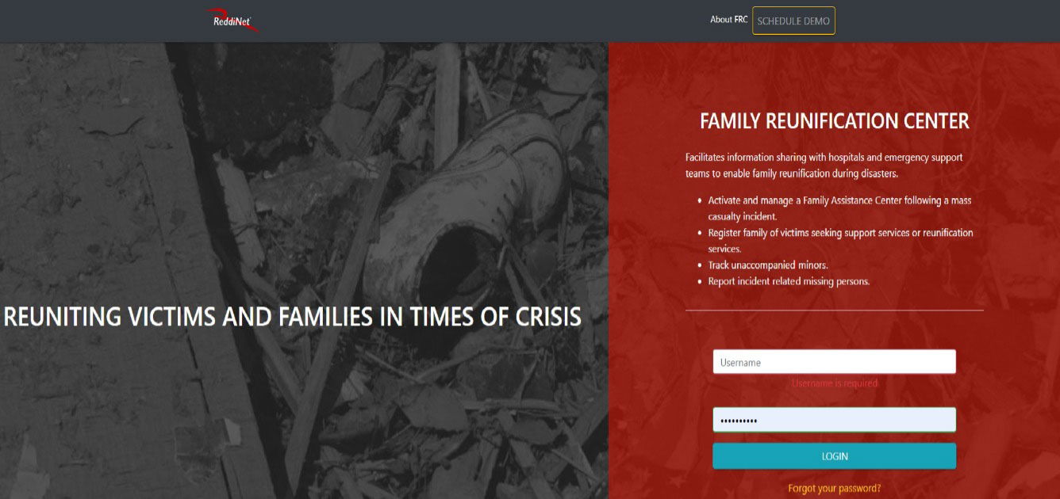
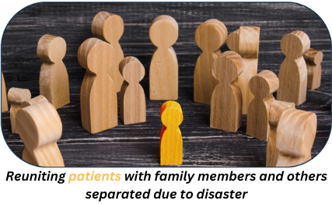
2022
Family Reunification Center (FRC) Exercise Background
2025
2023
2024
Notes:
In 2021 leadership directed the development of an annual FRC exercise. The goal of the exercise is to test the effectiveness of the FRC application, FRC plans, and identify areas for improvement.
Progressive exercise planning with an increasing level of complexity over time.
Identified FRC end-users (case management, social workers, admission, clerical, and others)
System access (usernames and passwords)
Familiarization with application (through training and hands-on testing)
Developing resources (JIT sheets, quick reference guides, checklist, etc.) and refining processes
Improvements in the FRC application (Bandwith, etc.… completed by ReddiNet)
Identified best practices for successful reunification (2025 FRC AAR)

Slide 5
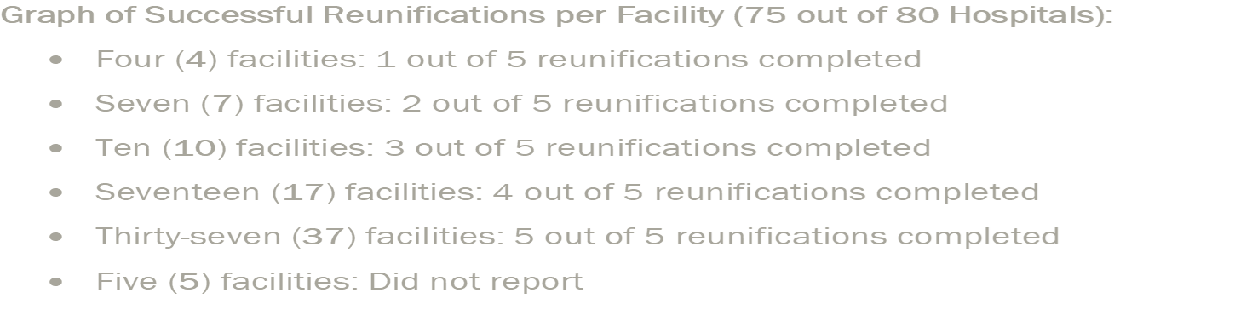
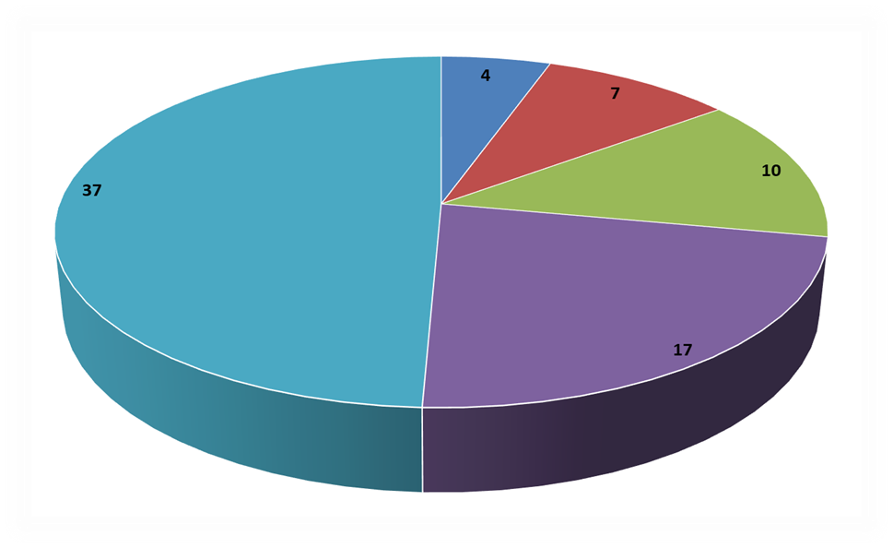
2025 FRC After-Action Report (AAR)
2025 FRC Exercise
Reunification Efforts:
Analyzed the outcomes of reunification efforts, and the barriers encountered during the FRC exercise. Barriers are noted by Facility Performance perspective and by FRC Processes perspective.
Facility Performance:
  Those that successfully reunited 5 out of 5
  Made persistent efforts
  Success often depended on individual staff’s attention to detail and corrections made during the exercise
FRC Processes:
  Data Entry and Application Barriers
  Inter-Dependency and System Barriers
  Verification Barriers
Notes:
Why did or did not facilities complete reunification? Was it the facility or the process?
Facility Performance
While a significant portion of facilities were able to achieve full reunification, persistent barriers in external communication, data accuracy, and staff awareness hindered overall performance.
FRC Processes:
Success rates increased as process-related barriers were reduced: facilities utilizing accurate data entry (both ends), up-to-date contact details, persistent efforts, and well-informed staff achieved higher reunification rates.
AAR available on website

Slide 6

2026 Family Reunification Center (FRC) Exercise
  FRC exercise meets the Hospital Preparedness Program (HPP) grant requirement:
  10.9.2 All participants will receive Seven Hundred and Fifty Dollars ($750) to maintain ReddiNet FRC application capability.
  10.7.1 All participants will receive Six Thousand Dollars ($6,000) to participate in exercises and drills in conjunction with County and community partners to ensure hospital preparedness, including but not limited to:
  10.7.1.2 “Participate in the County’s Family Reunification Center (FRC) Exercise, if conducted during the term of this Master Agreement, by performing the following activities:
    10.7.1.2.1 Attend the FRC Briefing.
    10.7.1.2.2 Attend one designated ReddiNet® FRC Training.
    10.7.1.2.3 Complete the specified After-Action Report/Improvement Plan to the County’s EMS Agency within sixty (60) days of the exercise’s completion.
Notes:
Deliverables:
10.9 Situational Awareness
10.7 Exercises and Drills

Slide 7
Capability-Based; Objective Driven
Capability 2: Health Care and Medical Response Coordination
Objectives:
Activate the FIC/FRC plan within 15-minutes of notification.
Identify an area in-or-near the facility to use for family reunification within 15-minutes of plan activation.
Clearly define roles and responsibilities of staff assigned to the FIC/FRC area during the incident.
Develop and/or implement processes to ensure the FRC application is utilized during the activation of the FIC/FRC plan for conducting reunification efforts.
Notes:
The Core Capabilities are from the Office of the Assistant Secretary of Preparedness and Response, 2017-2022 Health Care Preparedness and Response Capabilities guide.
Objectives:
#1 – Page 16 LA County FIC Planning Guide for Healthcare Entities (Section III: Activation)
#2 – Page 10 LA County FIC Planning Guide for Healthcare Entities (line #2)
#3 – Page 10 LA County FIC Planning Guide for Healthcare Entities (line #3)
#4 – Senior Leadership Guidance
SMART Objectives:
Specific
Measurable
Achievable
Realistic
Timebound – Obj #3 “during the incident” and Obj. #4 “during the activation” to ensure time bound.

Slide 8

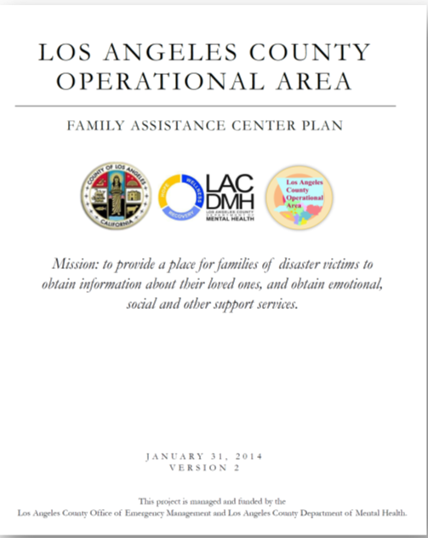
Plans and Guides
LA County FIC Planning Guide for Healthcare Entities
Hospital Reunification and Family Information Center Plans
LA County OEM and DMH Family Assistance Plan
LA County OEM: SOP – Family Assistance Center Activation
Notes:
County of Los Angeles Office of Emergency Management and Department of Mental Health coordinate and operate Family Assistance Center (FAC)
Hospitals coordinate and operate Family Information Centers (FIC)

Slide 9
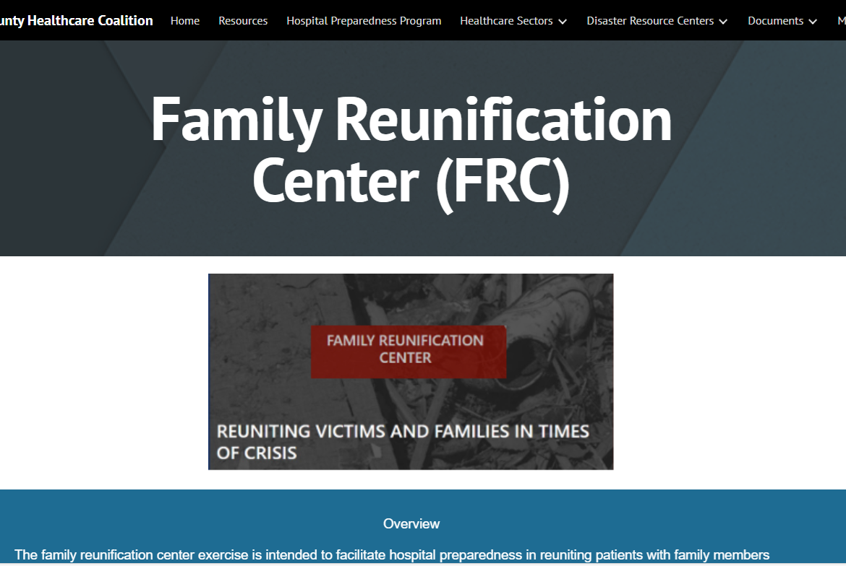
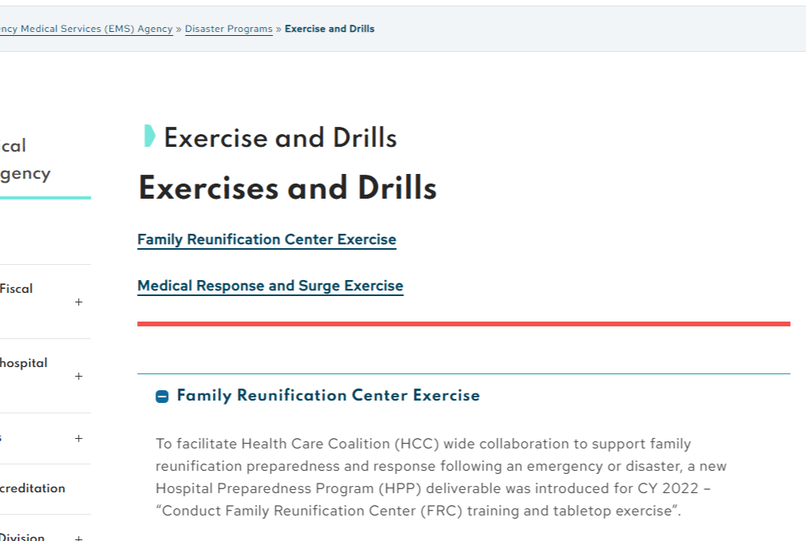
Healthcare Coalition and EMS Agency Websites
Notes:
Download exercise documents: HCC Website (Google docs) and EMS Agency Website (Microsoft docs)

Slide 10
FRC Application Training
ReddiNet will provide FRC training:
  Thursday, April 23, 2026 / 10am
  Wednesday, May 20, 2026 / 10am, 2pm, & 8pm
  Thursday, June 25, 2026 / 10am & 2pm
  Tuesday, July 21, 2026 / 10am & 2pm
  Registration open: https://register.gotowebinar.com/rt/1954750706380352856
Notes:
Training will focus on the exercise and attendance is required
Required to have at least one FRC end-user from each hospital to participate in training session
Will demonstrate use of the application, how to enter address/location of FAC, telephone number of FAC location, and the use other search parameters.

Slide 11
Exercise Scope
    Exercise activities will be conducted at HPP hospitals and will involve each facility identifying a safe and secure location to use as their reunification area.
    There will be no actual movement of patients.
    The exercise will last three hours to ensure all tasks are achieved.
Notes:
In addition to identifying a safe and secure location for your reunification area, end-users are to enter the location and telephone number into the FAC.
Command center activation is not necessary.
It will be very similar as last year’s exercise except different missing person and seeker assignments, adding more complexity to this year’s exercise:
Of the 79 missing persons, 26 will be a John Doe patient. Each hospital will receive either 1 or 2 Seekers searching for a family/patient that was entered as a John Doe. FRC end-users will have to locate the missing person using other search parameters.
Adding tattoo descriptor for John Doe’s only.
Upload photo (your choice) to missing person profile (all 79) e.g., dog, cat, pet, self, etc.
NOTE: Patient will remain a John Doe in the FRC application and ReddiNet for the duration of the exercise. DO NOT UPDATE ReddiNet/FRC PROFILE WITH ACTUAL NAME.

Slide 12
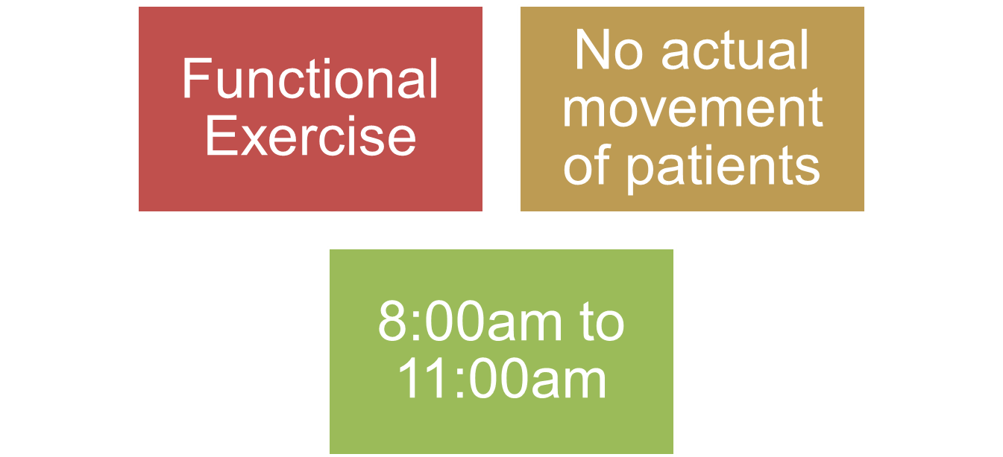
Exercise Scope
Notes:
Duration is 3 hours to allow complete reunification:
to contact the facility where the missing person is located
to find out if its okay to disclosure information,
to confirm if still at facility,
and to close the loop.
BUT DO NOT close FAC until 12:00PM.

Slide 13
Exercise Control
Exercise Control:
Pre-exercise briefing (FRC Briefing Webinar) to ensure Participants (Controllers/Evaluators) understand roles and responsibilities
Centralized location (MAC) coordinating activities across all locations in Los Angeles County
Use of technology: ReddiNet and FRC Application
With the online communication tools, participating hospitals will receive pertinent injects listed in MSEL
Notes:
In previous exercises, some hospitals activated FAC ahead of time and got ahead of the MSEL.

Slide 14
Exercise Participants
Medical Alert Center
79 HPP Hospitals
  69 9-1-1 Receiving Hospitals with ReddiNet MCI Module
  10 Hospitals without an Emergency Department and no access to the MCI Module
*No-ED facilities will not have ReddiNet End-Users

Slide 15
Exercise
Participants
Participants | Role | Extent of Play
Hospitals: Emergency Managers and/or Designee | Controller / Evaluator | Facilitate and evaluate play, Provide injects with needed patient and seeker data to players
Hospitals: *ReddiNet End Users (ED Charge Nurse, MICN, ED staff, etc.) | Player | Hospital ReddiNet MCI Module Management
Hospitals: FRC Application End Users (Social workers, registration staff, admission team, case management, PBX operators, administrators, etc.) | Player | Hospital FRC Application Management
MAC (EMS Agency) | Player | Countywide ReddiNet Messaging and MCI Module Management
*No-ED facilities will not have ReddiNet End-Users

Slide 16
Exercise Play
Exercise play will take place at each hospital in live ReddiNet and FRC applications

Slide 17
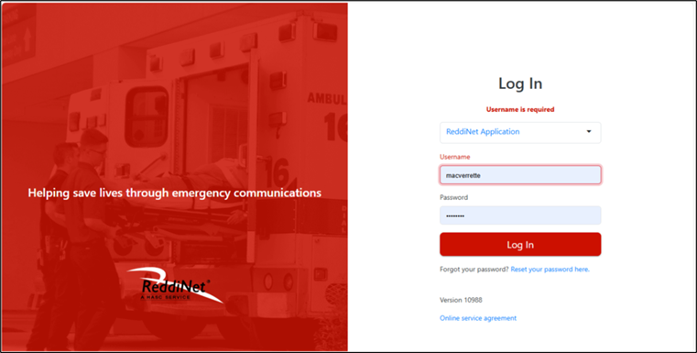
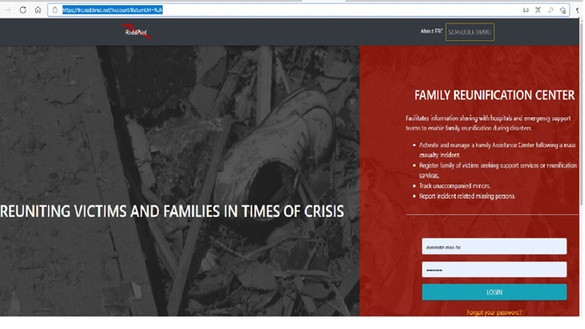
Live ReddiNet and Family Reunification Center Applications
Notes:
Live is RED.

Slide 18
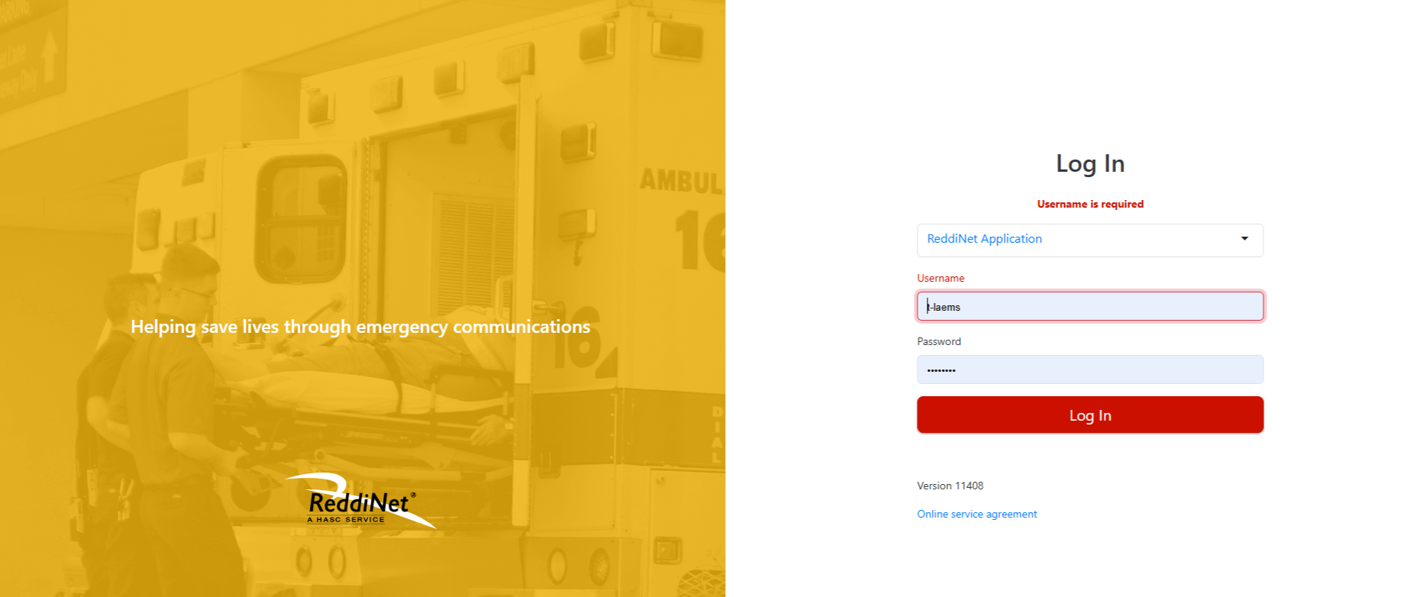
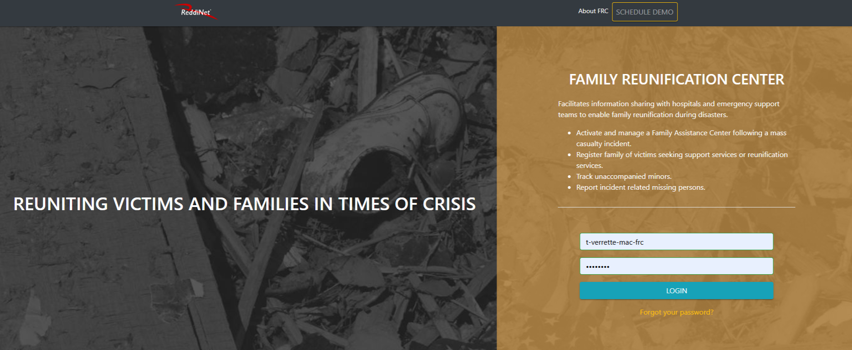
Training Environments for
ReddiNet and Family Reunification Center Application
Notes:
Training is GOLD.

Slide 19
Exercise
Documents and Tools
Available on HCC and EMS Website
Exercise Plan
Controller/Evaluator Handbook
Exercise Evaluation Guide
Participant Feedback Form
After-Action Report/Improvement Plan
Master Scenario Event List (MSEL)
2026 FRC Patient and Seeker Data
Notes:
The Exercise Plan (ExPlan) gives elected and appointed officials, observers, media personnel, and players from participating organizations information they need to observe or participate in the exercise. Some exercise material is intended for the exclusive use of exercise planners, controllers, and evaluators, but players may view other materials that are necessary to their performance. All exercise participants may view the ExPlan.
The Controller/Evaluator (C/E) Handbook describes the roles and responsibilities of exercise controllers and evaluators, and the procedures they should follow. Because the C/E Handbook contains information about the scenario and about exercise administration, it is distributed to only those individuals specifically designated as controllers or evaluators; it should not be provided to exercise players. The C/E Handbook may supplement the Exercise Plan (ExPlan) or be a standalone document.
The Exercise Evaluation Guides (EEGs) are structured to capture information specifically related to the evaluation requirements developed by the Exercise Planning Team. The following evaluation requirements are documented in each EEG the capability target will be met. Critical tasks generally

Slide 20
Evaluation
Exercise Evaluation Guide (EEG):
The Exercise Evaluation Guide (EEG) contains “critical tasks”.
Some of the objectives and associated “critical tasks” are time-bound and ought to occur within the specified time limits during the exercise.
Review the EEG before the exercise.
Notes:
*Important tool for Controllers and Evaluators
EEG: Identifying critical tasks, tied back to objectives, tied back to plan

Slide 21
Exercise Assumptions
Incident meets criteria to activate your Family Information Center plan at your site.
Notes:
Lots of artificiality in exercise. It’s needed to test the FRC application.
FIC or FAC.

Slide 22
Exercise Scenario
A large-scale multi-casualty incident (MCI) has occurred at a Summer Olympic event near your hospital, and multiple athletes have been transported to hospital emergency departments throughout the county.
Your emergency department has received six (6) patients by ambulances including one (1) athlete. The other five (5) patients were spectators. You have a total of six (6) patients from the incident in your emergency department.
The athlete that arrived at your emergency department by ambulance is either unresponsive or can only recall his first name, last name, and age. The patient has no identification or cell phone and cannot recall family contact information. The patient is otherwise stable in the delayed category.
The other five (5) patients are stable and require observation only.
Notes:
Inject #7:
- ReddiNet End-User (i.e., hospital with ED) enters five (5) additional ambulance patients into the MCI victim list.
- Use fictional first names, last names, gender, and age.
- Enter a triage tag number using your hospital's 3-letter hospital code. (XXX-01, XXX-02, XXX-03, etc.)

Slide 23
Exercise Scenario (No ED)
A large-scale multi-casualty incident (MCI) has occurred at a Summer Olympics event near your hospital, and multiple patients have been transported to hospital emergency departments throughout the county.
Your hospital has received one (1) patient by private auto from the incident.
The patient is either unresponsive or can only recall his first name, last name, and age. The patient is otherwise stable and in the delayed category. The patient has no identification, no cell phone, and cannot recall family contact information.
Notes:
10 non-ED Hospitals:
Barlow
City of Hope
Kindred Paramount
Kindred South Bay
LA Downtown Medical Center
Los Angeles Community Hospital
Miller Children's Hospital
Rancho Los Amigos
Southern California Hospital at Hollywood
Vista Specialty Hospital (formerly Kindred La Mirada)

Slide 24
Exercise Play:
Exercise will start at 8:00 a.m. and end at 11:00 a.m. to ensure all tasks are achieved.
Notes:
The exercise will last three hours to ensure all tasks are achieved followed by an internal debrief.
DO NOT close FAC until 12:00PM.

Slide 25
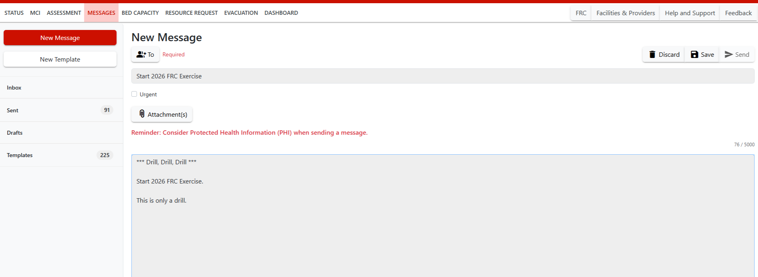
ReddiNet Message Screen:
Notes:
Inject #3: STARTEX
Screenshot of the ReddiNet Message.

Slide 26
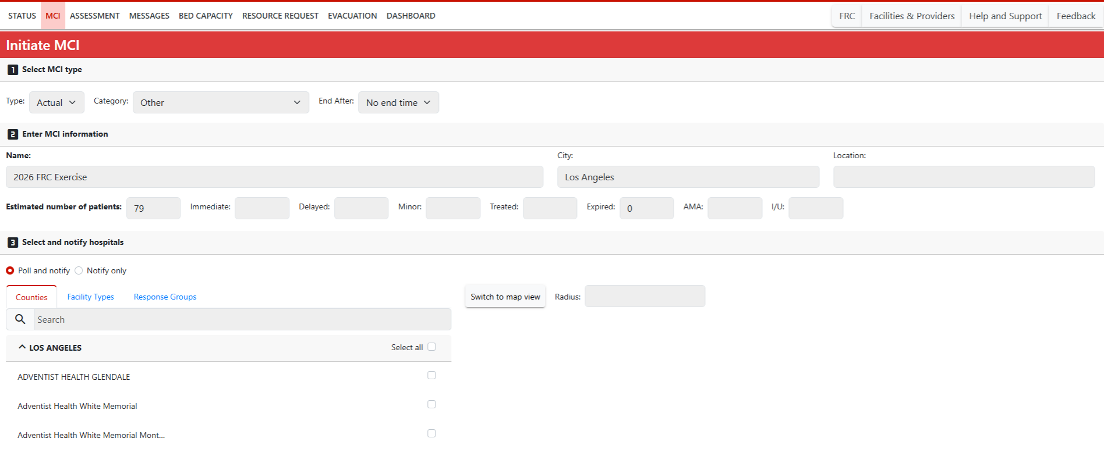
ReddiNet MCI Screen:
Notes:
Inject #4: MAC initiates MCI poll titled "2026 FRC Exercise“.
Screenshot of the ReddiNet MCI Message.
Reminder: Non-ED’s will not be assigned MCI patients in ReddiNet.

Slide 27
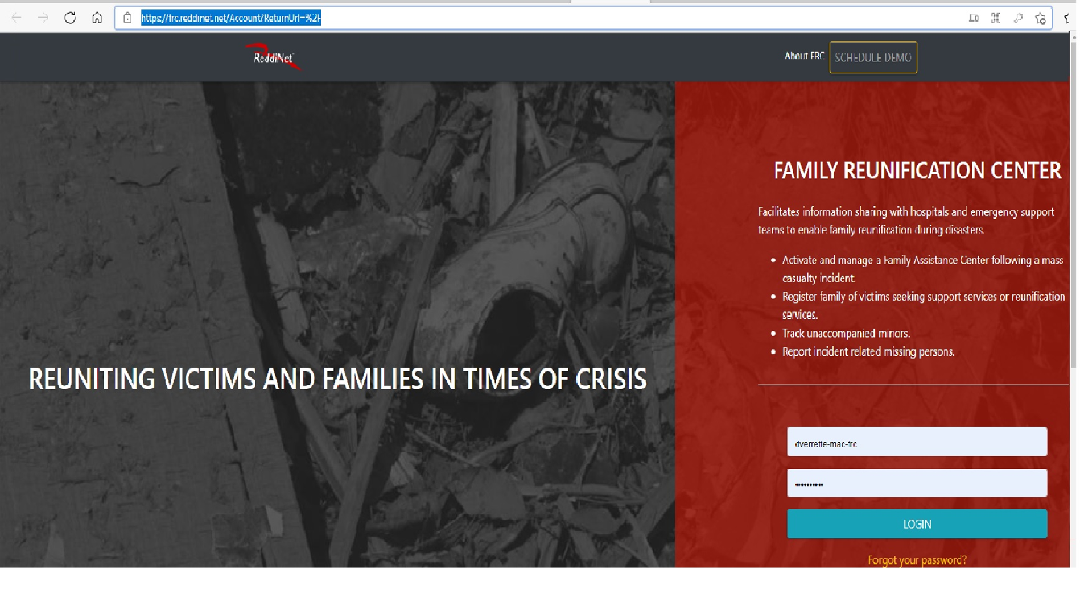
Notes:
Inject #9: Activate your FAC.
FRC Login Screen

Slide 28
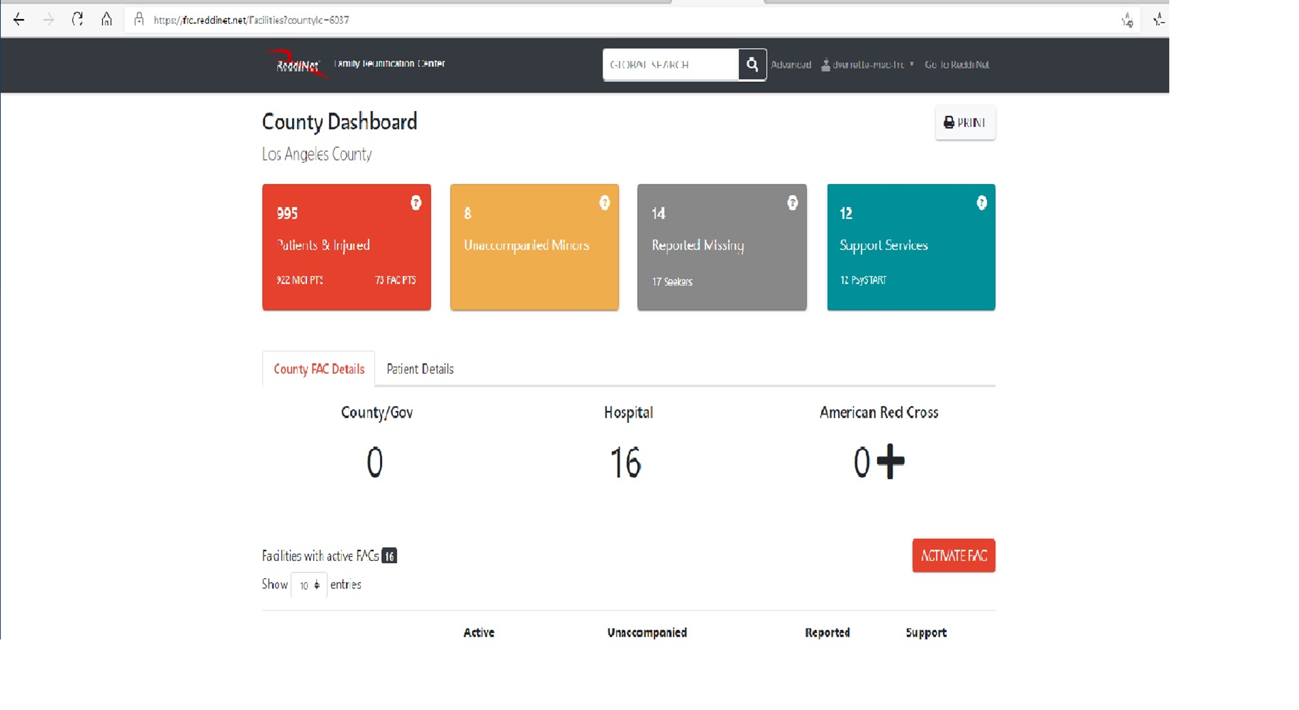
FRC Application Dashboard:
Notes:
FRC Application

Slide 29
Master Scenario Events List (MSEL):
Notes:
2026 New Tasks in RED text: John Doe, Tattoo, Upload Photo
Injects #4, 5, 6, & 7 do not apply to non-ED hospitals.

Slide 30
No-ED Master Scenario Events List (MSEL):
Notes:
New tasks in red text (John Doe, Tattoo, Upload Photo)
Injects #4, 5, 6, & 7 do not apply to No-ED hospitals.
10 non-ED Hospitals:
Barlow
City of Hope
Kindred Hospital Paramount
Kindred Hospital South Bay
Vista Hospital (formerly Kindred Hospital La Mirada)
LA Downtown Medical Center
Los Angeles Community Hospital
Miller Children's Hospital
Rancho
Southern California Hospital at Hollywood

Slide 31

Patient and Seeker Data:
Patient Data
Seeker Data
Notes:
NOTE: Patient will remain a John Doe in the FRC application and ReddiNet for the duration of the exercise. DO NOT UPDATE ReddiNet/FRC PROFILE WITH ACTUAL NAME.

Slide 32
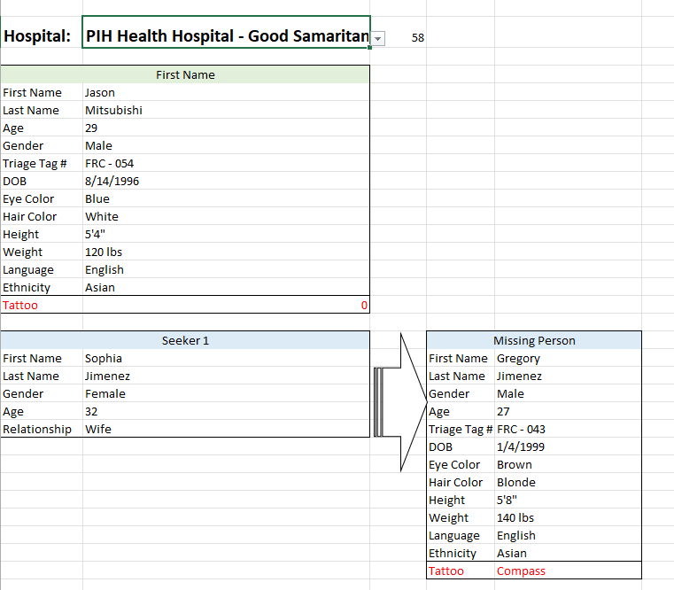
Injects
Notes:
You will need to create your own inject cards or prompts from the Patient and Seeker data.
NOTE: Patient will remain a John Doe in the FRC application and ReddiNet for the duration of the exercise. DO NOT UPDATE ReddiNet/FRC PROFILE WITH ACTUAL NAME.

Slide 33
Player Roles After ENDEX
Participate in the debrief/hotwash conducted by the Controller at your facility.
Complete and submit a Participant Feedback form.
Notes:
1100 Inject 14: ENDEX.
1100-1130 Inject 15: Controller conducts the hotwash/debrief. Players fill out Participation Feedback Forms.
1200 Inject 16: Deactivate FAC.

Slide 34
Exercise Participation Confirmation
AAR / IP Submission
Within 60 days following exercise
Notes:
The AAR/IP Survey Link (Survey Monkey) will be active at the end of the Ex.
Submit AAR/IP w/i 60 days following exercise: Sep 21, 2026.

Slide 35
Summary of Exercise Components
Attend FRC Exercise Briefing
Attend FRC Application Training by ReddiNet
  Minimum 1 attendee per facility. Registration is open.
Participate in FRC Exercise
  Registration [Facility only] opens today.
Complete on-line AAR/IP via SurveyMonkey by 09/21/26
  Survey opens after ENDEX.

Slide 36
Healthcare Coalition and EMS Agency Websites
Notes:
Download exercise documents: HCC Website (Google docs) and EMS Agency Website (Microsoft docs)

Slide 37
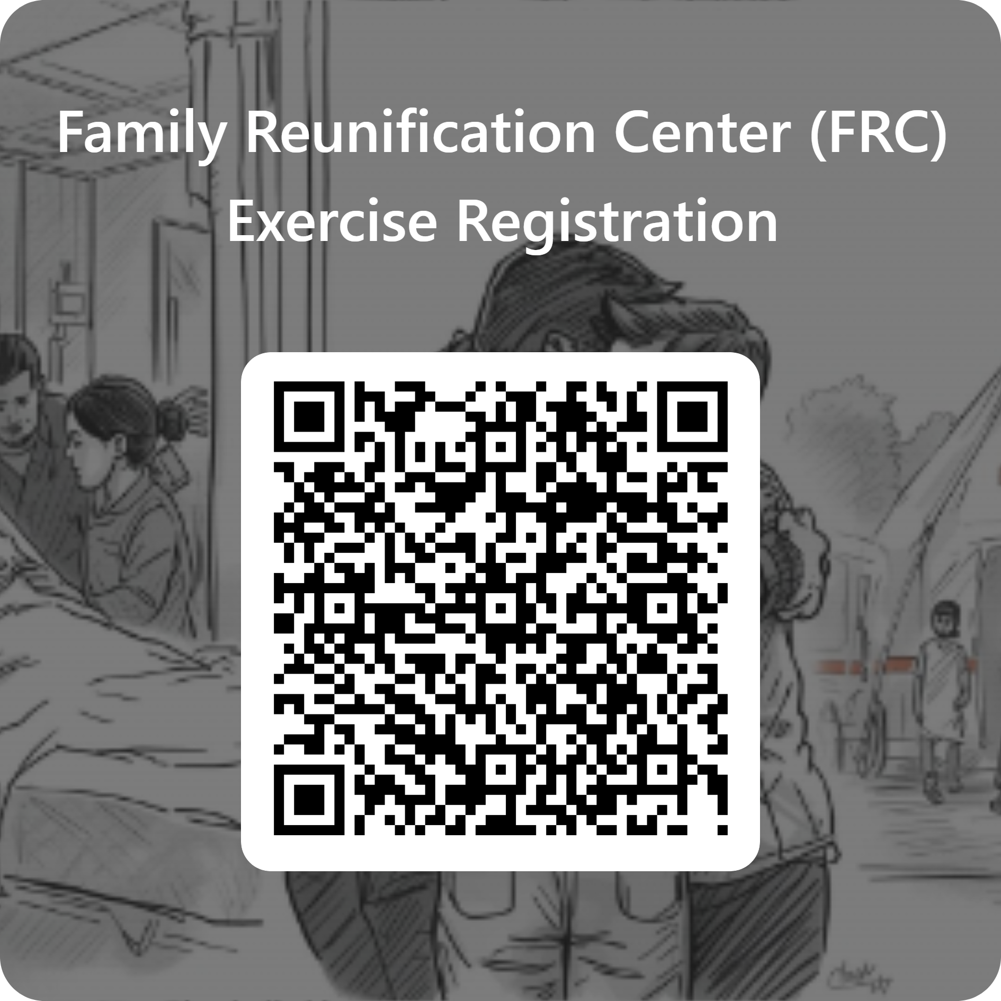
FRC Exercise Registration
https://forms.office.com/Pages/ResponsePage.aspx?id=SHJZBzjqG0WKvqY47dusgeAx3rhTCttAiemAxAwTrD9URDBNMUtOR1JITkpCQzY3NEpMRzROWVhWQy4u
Notes:
Register your facility for the Exercise. This is facility level registration only and not intended for individual exercise players.

Slide 38
Summary: EX Deliverables - ED Participants
ReddiNet MCI module
  Register your (1) “athlete” patient. This is the Standardized Patient.
    If ID known: name, gender, age, triage tag #.
    If John Doe: “John Doe”, gender.
  Register (5) additional “spectator” patients.
    Make them up. Use XXX-01, etc. for triage tag.
FRC Application
  Activate FAC.
  Update your (1) “athlete” patient with the additional data and upload photo. If “John Doe” include tattoo type
  Register your (5) Seekers.
    Each Seeker is seeking a different victim at different hospitals.
  Search for the (5) respective Patients being sought by the Seekers.
Contact, confirm, and inform.
Notes:
Photo of your choice.
Call the facility.
Confirm the person is there and OK to disclose.
Inform Seeker of missing person’s location only.

Slide 39
Summary: EX Deliverables - No ED Participants
FRC Application.
  Activate FAC.
  Register your (1) “athlete” patient. This is the Standardized Patient.
    Either ID know or John Doe
    Include all identifiers and upload a photo. If John Doe include tattoo type
  Register your (5) Seekers.
    Each Seeker is seeking a different victim at different hospitals.
  Search for the (5) respective Patients being sought by the Seekers.
Contact, confirm, and inform.
Notes:
Photo of your choice.
Call the facility.
Confirm the person is there and OK to disclose.
Inform Seeker of missing person’s location only.

Slide 40
Questions?

Slide 41
Thank you!

