Slide 1
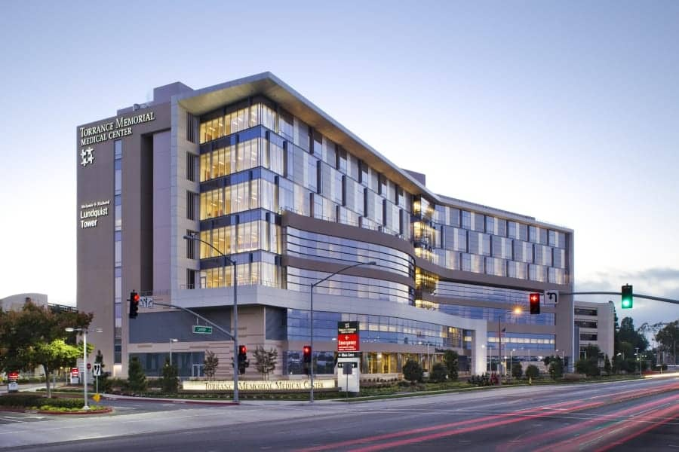

Christine Serra, Manager
Emergency Management
Andrew Shen, MD
Physician Adviser, Emergency Management
December 9, 2025

Slide 2
Total Number of Licensed Beds
Licensed Beds in 2024: 610
Acute Care: 570
Transitional Care: 40
Currently:
77 Beds Suspended
Units not Staffed (construction)
Total beds listed: 435
Exercise objective: evacuate 10% licensed beds
Exercise Goal: Evacuate 45 patients
Mini Bungee Cord
04.
Flip Flops
1

Slide 3
Exercise Preparation
Exercise Planning meetings with Stakeholders & units directly involved with exercise objectives
Discussed exercise with System Affiliates and created a Transfer Center Directory
HICS training course for Leadership team
Review of Policies and Procedures
Recruitment of additional Leadership for the Command Center and the ED Disaster Team
Mini Bungee Cord
04.
Flip Flops
2

Slide 4
Evacuation Participation
Evacuation of patients from the following units:
Mini Bungee Cord
CRITICAL CARE SERVICES
3E ICU – 3 patients
4E CVICU – 3 patients
4E Burn – 3 patients
PCU SERVICES
3 West – 3 patients
4 West – 3 patients
5 West – 3 patients
5 East- 3 patients
7 East – 3 patients
Medical Surgical/Oncology
6 East -3 patients
6 West – 3 patients
7 West- 3 patients
7 Tower – 3 patients
5 North – 3 patients
TCU
5 – patients
Women Services
Peds – 1 patient
04.
Flip Flops
3

Slide 5
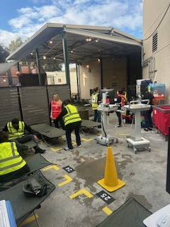
Exercise Initiation
Everbridge utilized to notify all staff the exercise had
begun with scenario details, followed up with series of
overhead pages.
ED Disaster Team set up outdoor triage area
Exercise participants began working on initial injects
Mini Bungee Cord
04.
Flip Flops
4

Slide 6
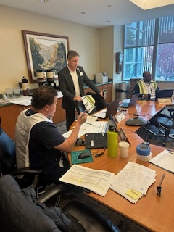
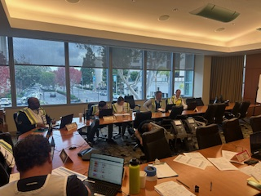
Code Triage External
25 Community member volunteer patient/victims
Due to the patient surge, Code Triage was activated
An additional Everbridge message was sent out to Leadership, asking them to report to the Command Center
Mini Bungee Cord
04.
Flip Flops
5

Slide 7
Code Triage Evacuation
Inpatient units provided patient information to our Case Management Team
Case Management Team utilized the Transfer Center Directory to obtain beds within the Cedars Sinai Healthcare System
Utilized the ambulance companies currently contracted with Torrance Memorial because local agencies were not available due to scenario
Eventually reached out to the MAC for assistance with finding beds for patient evacuation
Mini Bungee Cord
04.
Flip Flops
6

Slide 8
Completion of Injects/Patient Evacuation
26 patients were successfully evacuated
Approximately 15 patients were transferred to System Affiliates Huntington Memorial and Cedars Sinai Marina Del Rey
5 patients were transferred to local SNFs
5 patients were discharged to Home Health services
1 patient was laterally transferred after hospital decompression
Attempted to utilize the MAC for assistance to evacuate the remaining 19 patients
Mini Bungee Cord
04.
Flip Flops
7

Slide 9

Debrief
ED Disaster team triaged 64 patient volunteers
27 patient volunteers had injuries requiring hospital admission
Google translate works! Google translate utilized to treat Korean speaking patient, expediting treatment
Improvement to ED triage areas recommended after last MRSE was helpful in the success of set up and treatment of patients
Newly trained Incident Command Team members and ED Disaster Team
Communication with Affiliates during exercise: Transfer Center, Logistics team
Contracted with additional ambulance company
Gap areas revealed
Mini Bungee Cord
04.
Flip Flops
8

Slide 10

Lessons Learned/Action Items
We can not solely rely on our system affiliates
Additional team members need to be trained for the transfer center
Update communication tools: Command Center and Labor Pool
Missed discharge opportunities during hospital decompression and evacuation
More work to be done involving hospital evacuation procedures
Mini Bungee Cord
04.
Flip Flops
9

Slide 11
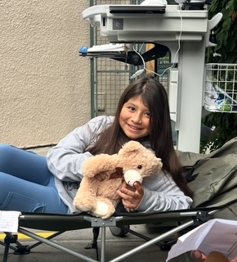
Thank You
Mini Bungee Cord
04.
Flip Flops

