Slide 1
PICO RIVERA HEALTHCARE CENTER

Slide 2
Earthquake Scenario Exercise: Overview
-Simulated a 7.5-magnitude earthquake striking the facility
-Tested emergency response protocols and communication systems
-Evaluated staff preparedness and response to the disaster scenario
-Identified areas for improvement and opportunities for growth

Slide 3
Facility’s goals and objectives for the exercise
Goals:
-Ensure resident safety and well-being
-Test emergency response protocols and procedures
-Evaluate communication systems and external coordination
Objectives:
Achieve timely and effective evacuation of residents
Demonstrate effective communication with staff, families, and external agencies
Identify areas for improvement in emergency preparedness and response

Slide 4
Preparation
In-Service and Re-education
DROP, COVER, AND HOLD ON to protect themselves and residents
Designate Staff who would conduct rapid assessments of the facility to ensure staff / resident participation
Establish Incident Command Center (indoor patio)
Form /Assign Emergency Response Teams
Evacuation
Use live polls or surveys to gather audience opinions, promoting engagement and making sure the audience feel involved

Slide 5
Great California shakeout 2025
- On 10/16/25 , a 7.5-magnitude earthquake strikes the facility, causing widespread damage and disruption. The earthquake occurs at 10:00 AM, during peak activity hours in the facility.

Slide 6
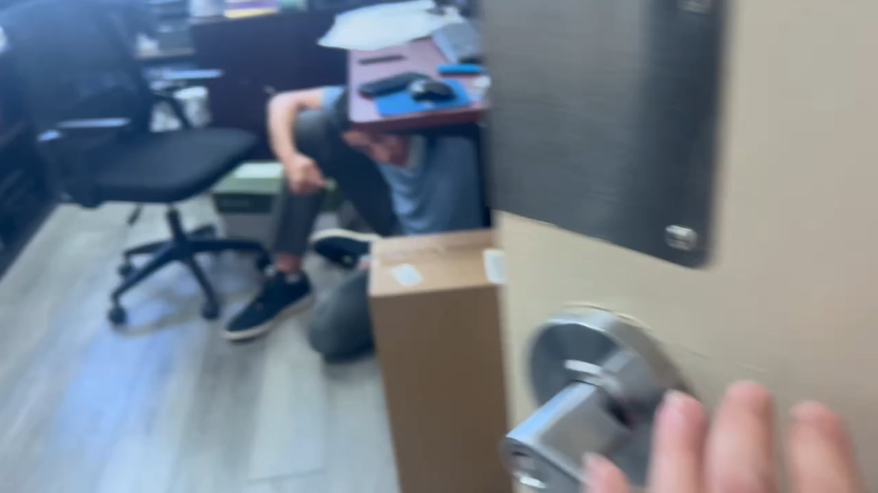

The power of communication

Slide 7
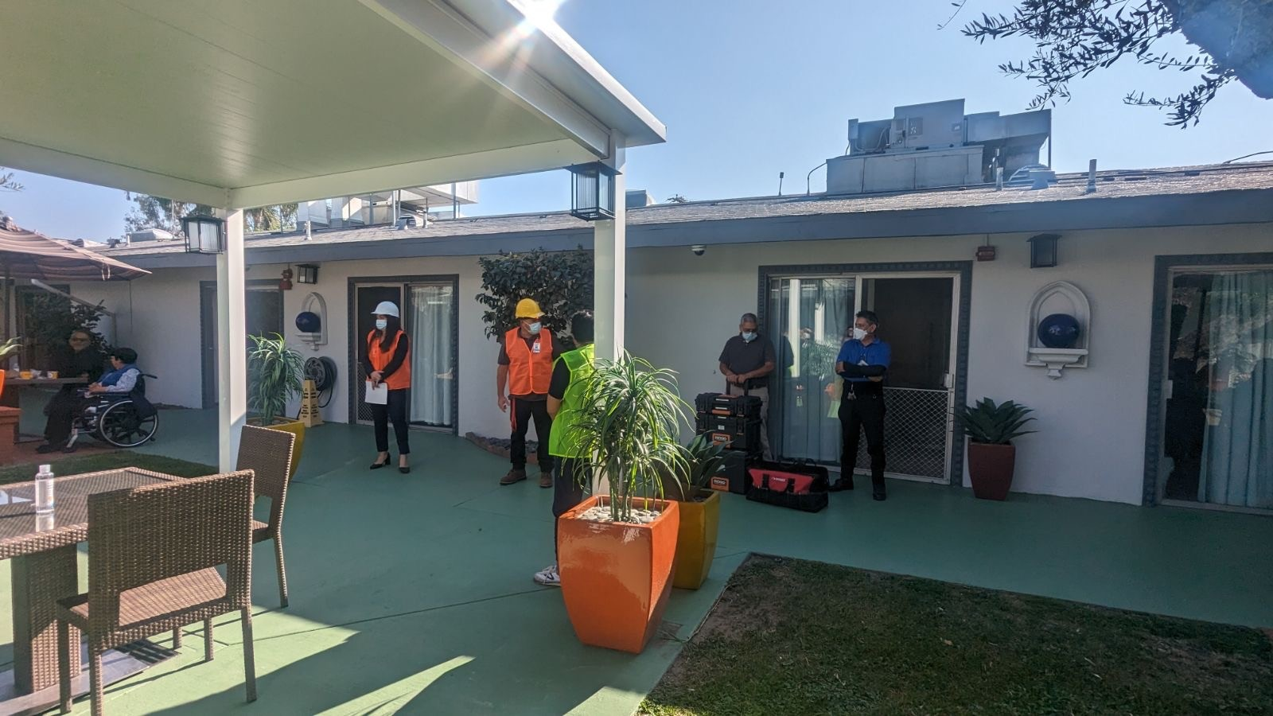

Slide 8
Exercise activities conducted
Evacuation Drill – residents are evacuated to designated safe areas.
Emergency Response – Staff respond to simulated injuries and medical emergencies
Communication Exercise – Staff practiced communication protocols with:
- Residents and families
- External emergency services
- Coordination with External Partners
Other healthcare facilities and support services

Slide 9
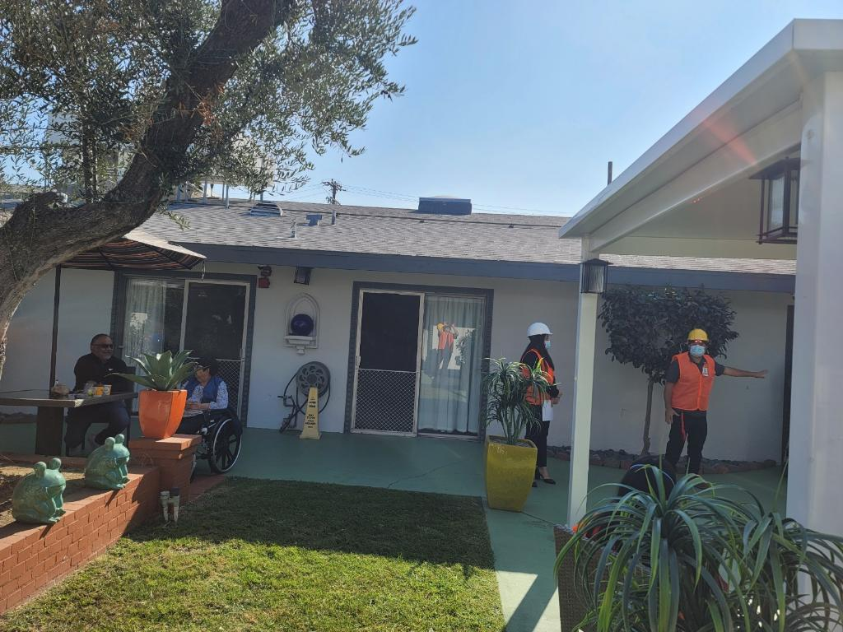

Slide 10
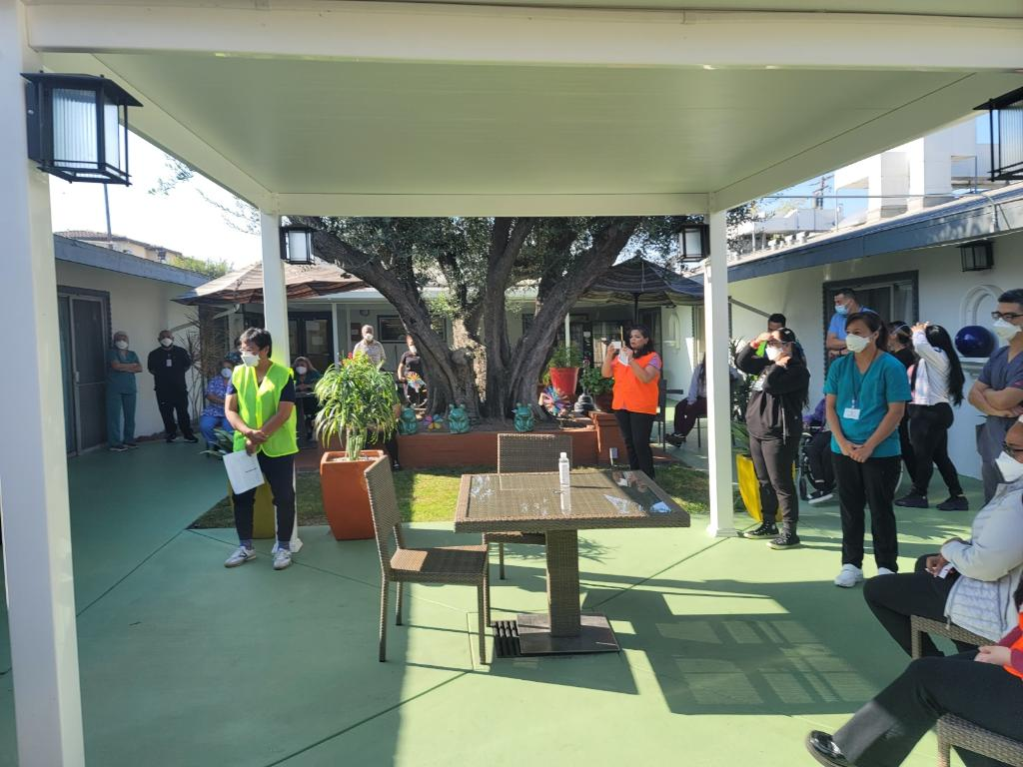

Slide 11
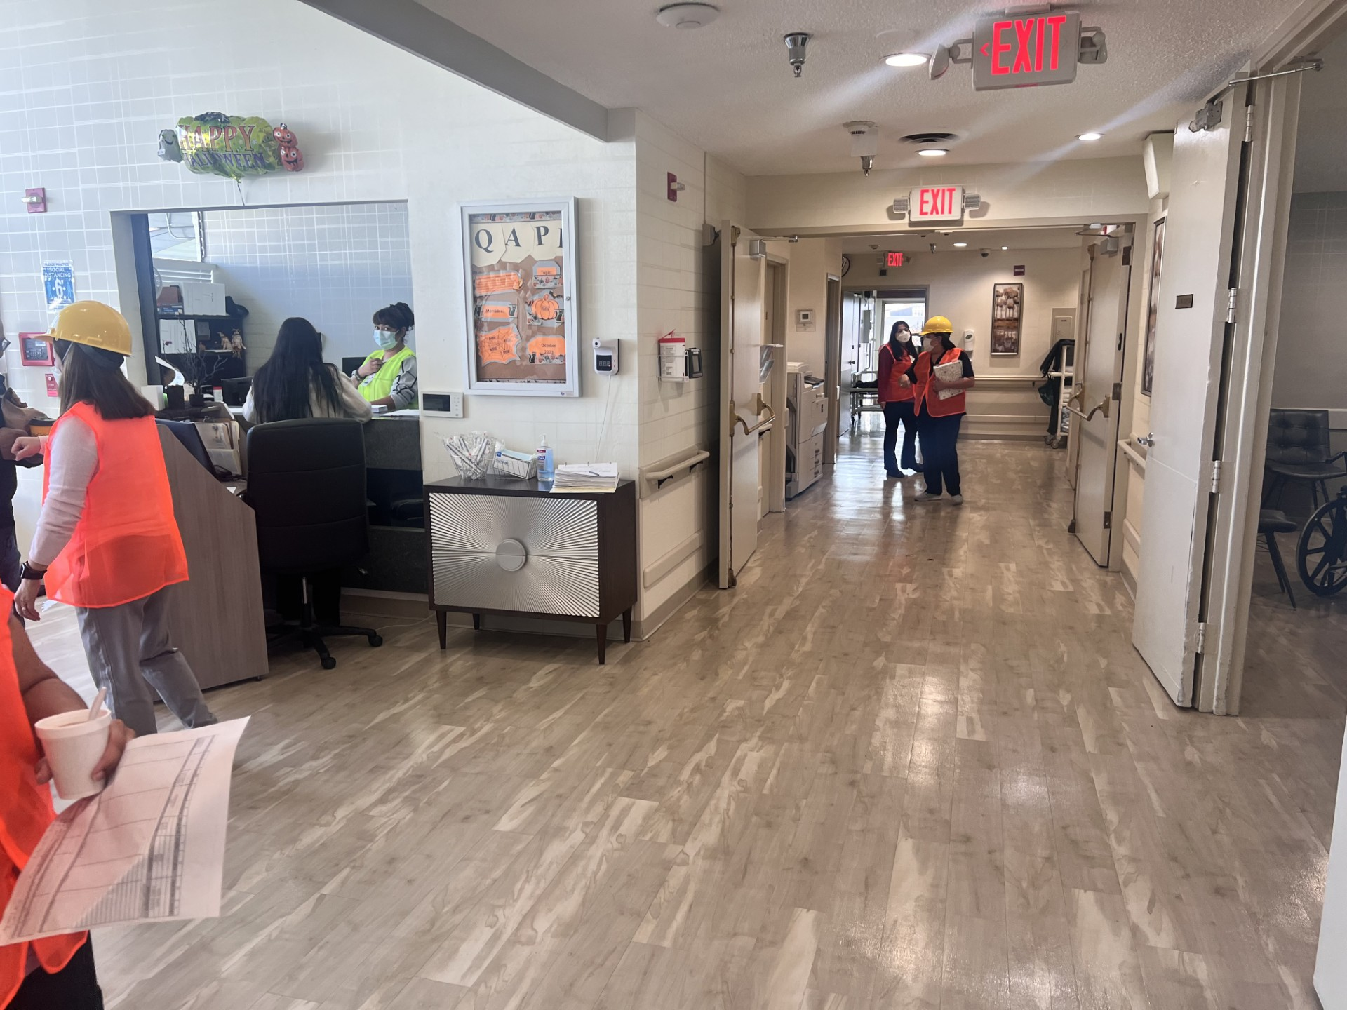
Communication exercise and damage assessment
Notification of Authorities
-Local emergency services (Pico Police Dept)
-Resident and Family Updates
-Coordination with External Partners

Slide 12
* Response and Outcomes *
Effectiveness of facility’s response
Lessons learned and areas for improvement
Successes and challenges

