Slide 1
Cedars-Sinai Medical Center
2025 AMHE Planning and Response Efforts
December 9, 2025

Slide 2

AMHE Planning

Slide 3
AMHE Internal Participants
Emergency Department
Perioperative Services
Trauma Services
Intensive Care Units
Medical and Surgical Inpatient Units
Pediatrics
Transplant
Imaging
Pharmacy
Laboratory
Clinical Operations Administrator (House Supervisor)
Case Management & Social Work
Capacity Management (Transfer Center & Patient Placement)
Supply Chain Operations
Patient Transport
Facilities
Environmental Services
Linen Services
Admissions & Registration
EIS (CS-LINK/EPIC)
Simulation Center

Slide 4
AMHE Internal & External Participants
Environmental Health & Safety
Emergency Management
Volunteer Services (Victims & Moulage Artist)
Office of Licensing, Accreditation, and Regulation
Security
Leadership
Communication / Media
Legal
Risk Management
Nursing Institute
Cedars-Sinai Medical Center
Cedars-Sinai Marina Hospital
Huntington Health
Torrance Memorial
Tarzana Medical Center

Slide 5
AMHE Planning Meeting
Cedars-Sinai Medical Center followed the Homeland Security Exercise and Evaluation Program (HSEEP) planning structure to ensure a coordinated, well-designed exercise.
Our standing bi-monthly meeting with CS-Affiliates was held separately, where we discussed opportunities to enhance mutual support and collaboration.
Concept & Objective / Introduction Meeting
Thursday, June 26
Initial Planning Meeting
Thursday, July 17
Wednesday, July 30
Wednesday, August 13
Master Scenario Events List Meeting
Midterm Planning Meeting
Final Planning Meeting
Thursday, September 18
Tabletop Exercise – The Great ShakeOut
Thursday, October 16
Full Scale Exercise
Thursday, November 20
After Action Meeting
Thursday, December 16
Resource: Homeland Security Exercise and Evaluation Program (HSEEP)

Slide 6
CS-LINK and MCI/Surge Integration
Collaborated with EIS Application Team to outline system vision and functional expectations.
Surge bed capacity created within CS-Link, and only visible during activations.
Once activated, patients can be assigned to designated surge units/areas.
Naming convention: patients/victims will receive a disaster name (already built-in within CS-Link) which enables rapid registration during MCI/Surge; patient details updated afterward.
System includes adult and pediatric disaster patient profiles.
Surge beds mirror existing workflows, ensuring accurate patient tracking, order placement, and test processing.
Next Steps:
ED Surge Capacity module (developed during COVID-19) exists but was not used during this exercise; the team will evaluate how to adapt and integrate it for future disaster use.
Develop surge workflows for non-traditional care spaces (conference rooms, auditoriums, cafeteria, etc.).

Slide 7
Contingency Planning Highlights
Inclement Weather
Team continuously monitored evolving weather conditions.
Heavy rain occurred the week prior; 60% chance of rain forecast for 11/20.
Identified two alternate Volunteer Staging locations and maintained clear communication with volunteers.
Day-before: sunny; Day-of: cold but manageable, heavy rain began at 1:00 p.m.
Construction Impacts
Significant construction in the ED Ambulance Bay and waiting area.
Plans in place to partially close the Ambulance Bay before or on 11/20.
Team secured alternative locations for exercise play and adjusted travel paths.
Real-World Emergencies & Events
AGVS lithium battery fire: 11/10
Resulting in cart and system downtime.
Equipment and supply movement transitioned to manual processes.
Increased elevator usage across the facility.
CMS onsite survey: 11/17–11/21
Extremely high inpatient census.
High number of boarding patients in the ED.

Slide 8
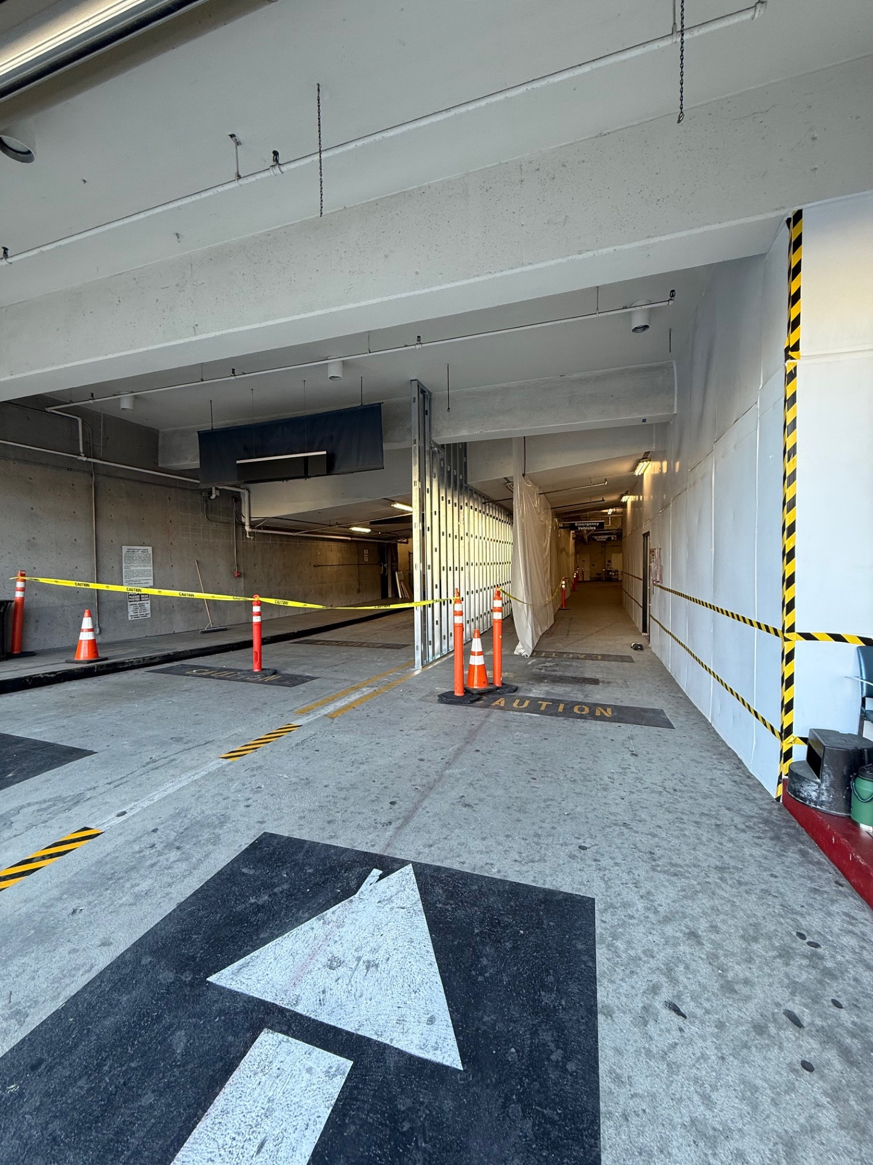
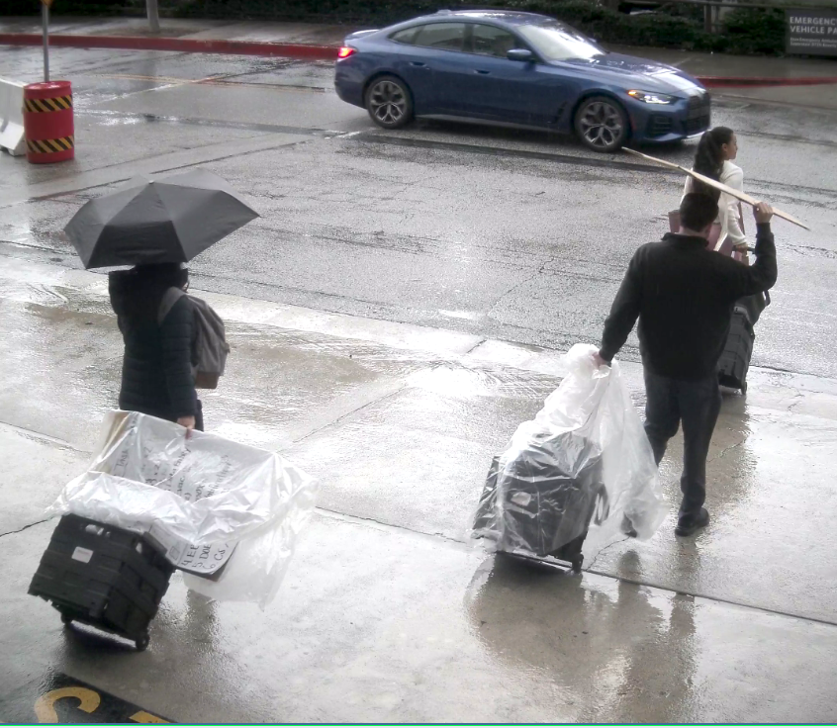
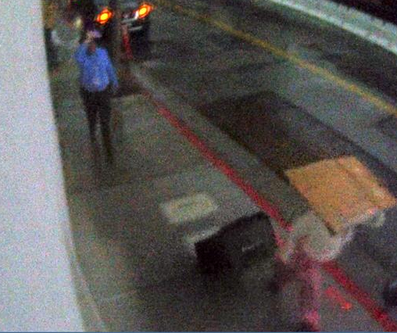

Slide 9
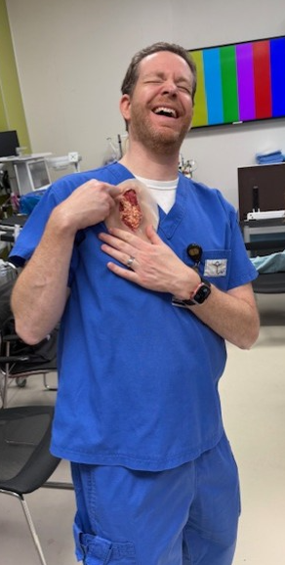
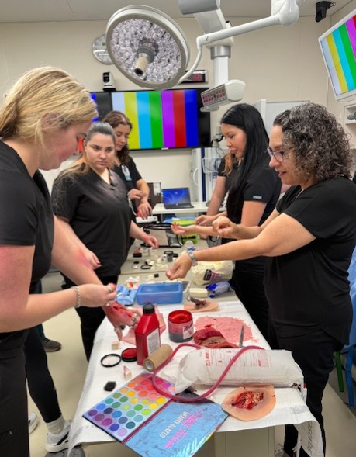
Volunteer Management & Support
Volunteer recruitment initiated in October.
Orientation & Safety Briefing: 11/13 (morning).
Moulage Training: 11/13 (afternoon).
Emailed maps and visual diagrams for clear directions.
The team assigned four volunteer leads to support coordination and ensure safety.
Distributed DOE contact number to all volunteers.
Maintained consistent and proactive communication before and throughout the event.

Slide 10
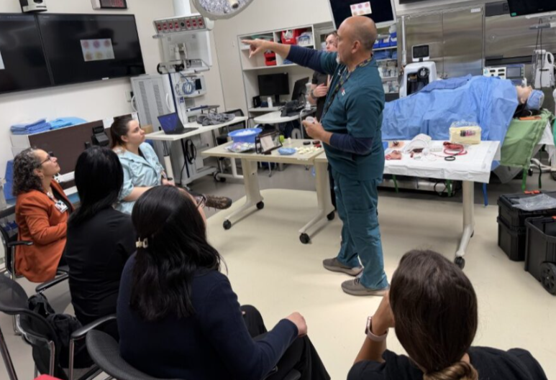
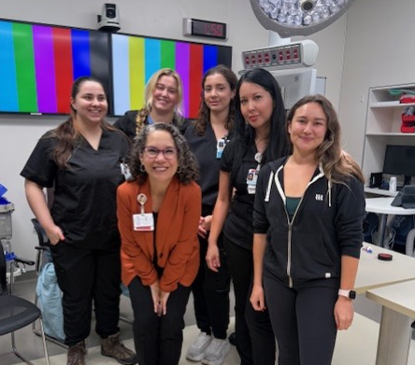
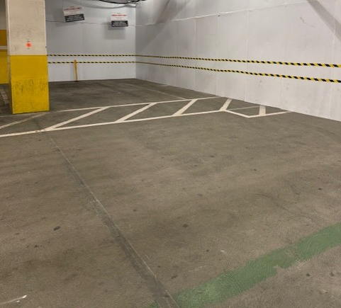





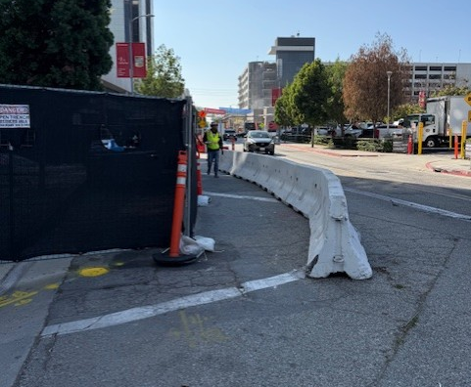
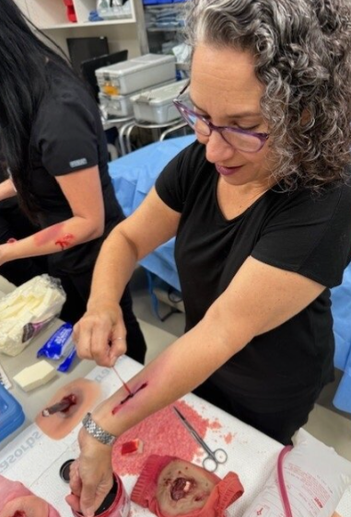
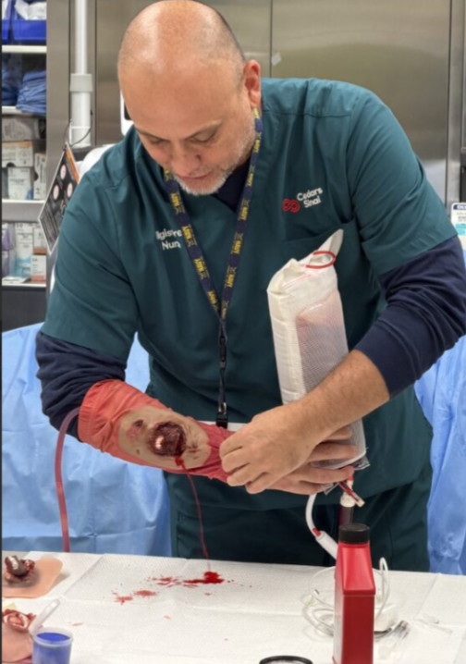




Slide 11
Logistics and Participant Support
Participant Comfort: Snacks, food, water, and coffee provided to maintain energy and engagement.
Accessible Materials: Electronic and paper formats offered to support all users and ensure accurate form completion.
Clear Signage: Check-in points to guide participants.
Equipment & Supplies: Clipboards, pens, colored vests, radios, and spare chargers available as needed.
Staff Presence: Dedicated team on-site for troubleshooting and participant assistance.
Professionalism & Culture: Encouraged kindness, respect, and positive engagement.
Morale & Engagement: Emphasized having fun while learning.

Slide 12
Tabletop Exercise Objectives – Discussion Based (Part 1) October 16, 2025, 10:16 a.m. – 12:16 p.m. (2-hours)
OBJECTIVE 3*
Notify the Hospital Incident Management Team (HIMT) or Hospital Command Center (HCC) personnel of the incident within [15] minutes.
Identify the triggers that activate alerts to the appropriate departments and personnel within the hospital.
Identify communication processes (redundancies) & utilize Emergency Communication Systems for staff notification/recall (e.g. Everbridge, Dept. Emergency Call Trees, Cell phones, Voalte, handheld radios, runners, etc.)
OBJECTIVE 4*
Activate the Hospital Command Center within [30] minutes of notification.
Incident commanders establish command structure
Activate incident management team with subject matter expertise based on scenario (e.g., medical technical specialist)
Evaluate strategies for operating without electronic health records (EHRs) and identify any issues related to information sharing between systems.
Coordinate health care information that could be shared with the public (information should be accurate, consistent, and appropriate).
OBJECTIVE 5
Develop an Incident Action Plan (IAP).
Identify and review applicable plans, policies, and/or procedures (e.g., Surge, Earthquake, Evacuation, Communication, Shelter-in-Place, Fatality Management Plans, etc.)
Assess facility status and provide a status report.
Establish incident objectives and determine the tactics and resources needed to achieve them.
OBJECTIVE 6
Continuity of Essential Functions
Identify and communicate essential departments and critical services/functions that must remain operational to ensure safe and continuous patient care.
Identify and communicate non-essential departments and services/functions that can be temporarily suspended or delayed. Discuss options such as reassigning staff to support priority operations (e.g., supplementing the labor pool or taking on alternate duties).
Evaluate supply chain integrity and availability to ensure the ongoing delivery of patient care services.

Slide 13
Full Scale Exercise Objectives – Boots on the Ground (Part 2) November 20th, 2025, 7:30 a.m. – 12 p.m. (4.5-hours)
OBJECTIVE 1
MHOAC Communications and Resource Requesting.
Establish access to communication systems (e.g., ReddiNet, VMed-28, etc.)
Respond to pertinent polls, surveys, and/or emails received from MHOAC.
Identify needs and submit appropriate Resource Request(s).
OBJECTIVE 2
Maintain situational awareness by gathering and sharing real-time emergency information through coordination with the Medical and Health Operational Area Coordinator (MHOAC).
Define procedures for how information will be shared during the response to the incident (i.e. frequency of information sharing).
OBJECTIVE 3*
Notify the Hospital Incident Management Team (HIMT) or Hospital Command Center (HCC) personnel of the incident within [15] minutes.
OBJECTIVE 4*
Activate the Hospital Command Center within [30] minutes of notification.
Incident commanders establish command structure
Coordinate health care information that could be shared with the public (information should be accurate, consistent, and appropriate).
OBJECTIVE 7
Assess the hospital’s ability to activate patient surge response plan(s) during a large-scale or multicausality incident.
Implement plans to receive an influx of patients (e.g. Patient Surge Plan, Code Triage, etc.)
Implement strategies to expand operational capacity and accommodate increased demand.
Initiate the use of alternate care spaces to meet patient care needs (non-traditional settings and modalities for healthcare delivery).
Assess resource requirements (e.g. people, equipment, supplies, space, systems).

Slide 14
Day of Exercise

Slide 15
Capacity Dashboard 11/20/2025, 5:00 a.m.
Total Census: 1,031
Emergency Department Census: 88
Boarders: 42
Open Beds:
Staffing:
Well-staffed with many floating ICU nurses.
Discharge opportunities:
Pending D/C: 174 D/C Order: 22 D/C Lounge Eligible: 81
ICU: 9 | Medical: 0 | Surgical: 0
Women’s: 7 | Children’s: 10
ACU: 3
Observation: 8

Slide 16
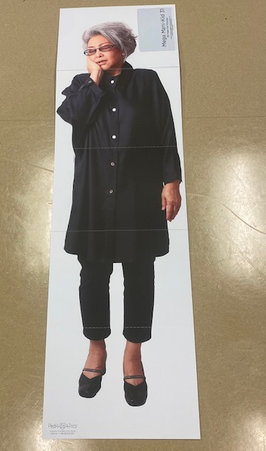
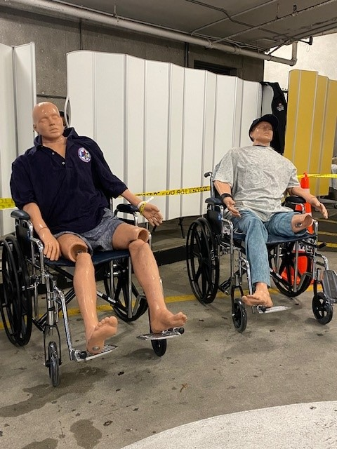
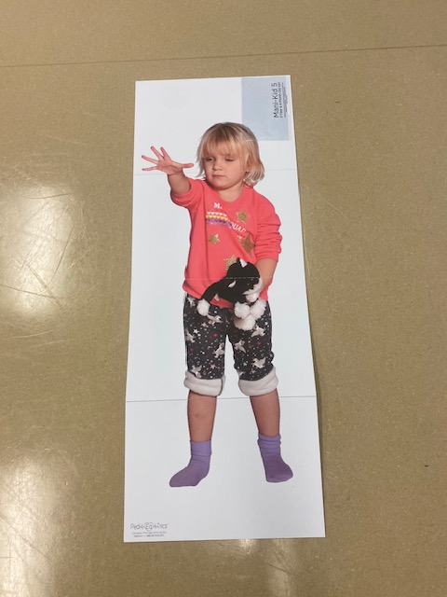
Volunteers (Boarders + Earthquake Victims) 11/20/2025
ED Boarders: placed and transported 30 patients from the Emergency department to their assigned units/area.
EQ Victims: 36 live-victim actors
Cardboard EQ Victims: 15
Mannequin EQ Victims: 3

Slide 17
Surge Management
Activation & Initial Priorities
Activated Mass Casualty Incident (MCI) protocols.
Primary objective: rapid ED decanting to increase treatment capacity.
Identified and moved 30 ED boarders, prioritizing patients in the Acute area to free up critical treatment spaces.
Patient Movement & Capacity Expansion
Capacity Management Team and COA collaborated to expedite patient transfers out of the ED.
CTS transported patients to pre-assigned inpatient units.
Surge workflow expanded beyond normal operations to support emergency patient volume.
ED Triage & Patient Flow
ED designated specific areas for Minor, Delayed, Immediate, and Expectant categories.
ED staff performed rapid triage; registration team manually registered patients using disaster aliases.
Triage nurses later entered victims into the electronic system.

Slide 18
Surge Management
Clinical Support
Trauma physicians reported to the ED to support Emergency Medicine physicians.
Patients requiring urgent transfer to inpatient units were moved by CTS; if CTS was stretched, volunteers or receiving-unit clinicians assisted with transport.
Logistics & Equipment
CTS supplied additional gurneys, wheelchairs, and transport equipment, maintaining an ongoing supply in the ED.
Case Management & External Coordination
Case Management contacted private ambulance providers and regional healthcare partners for patient placement, receiving strong support.
Transplant Team notified UNOS and One Legacy with a simulated operational update: “Due to the earthquake, transplant operations are suspended for 72 hours.”
Pharmacy & Communication Systems
Submitted 6 pharmaceutical resource requests for pain management—responses received for all.
MICN entered 56 disaster patients into ReddiNet for regional tracking and situational awareness.

Slide 19
2025 AMHE Participation Stats
Representation from approximately 77 departments
Nearly 100 individual staff participants
36 volunteers (moulage artists and live role-play victims)
15 cardboard and 3 mannequins incorporated as additional simulated victims
19 controllers and evaluators supporting exercise operations

Slide 20
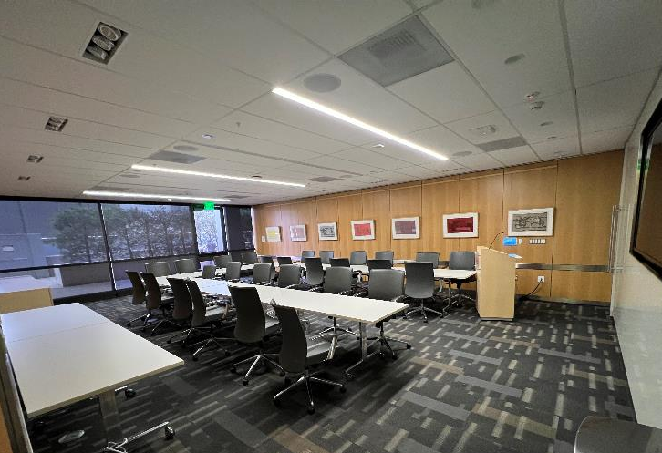
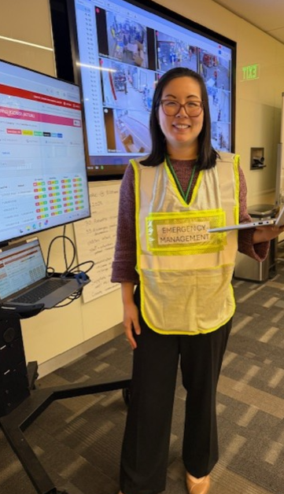
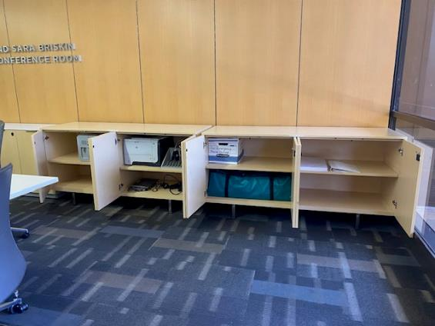
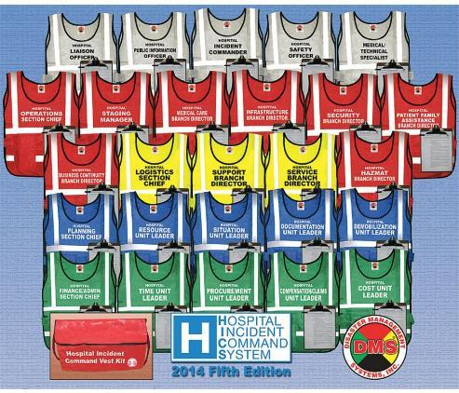
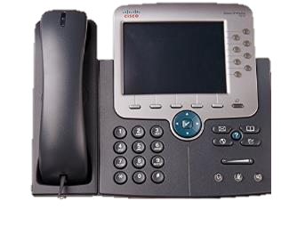

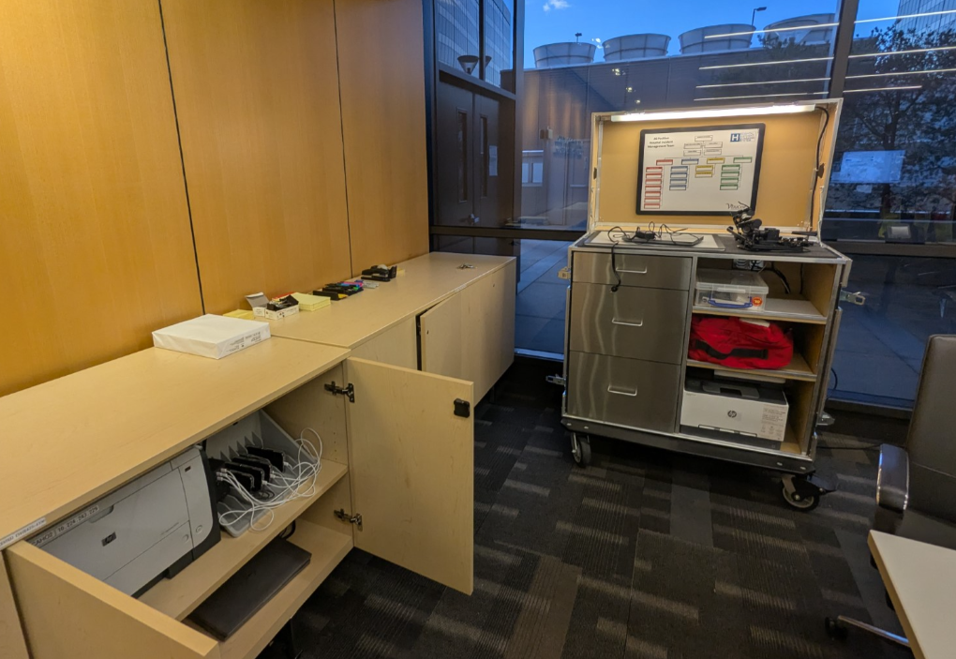
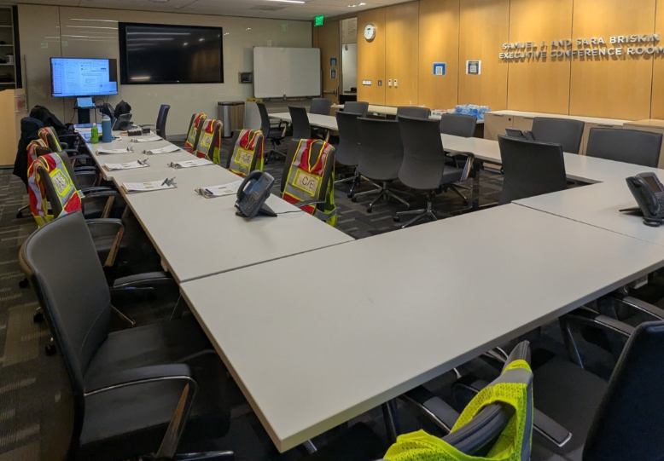
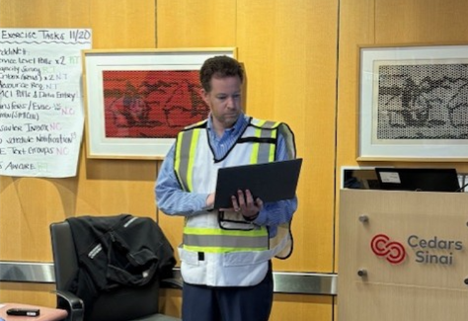

Slide 21
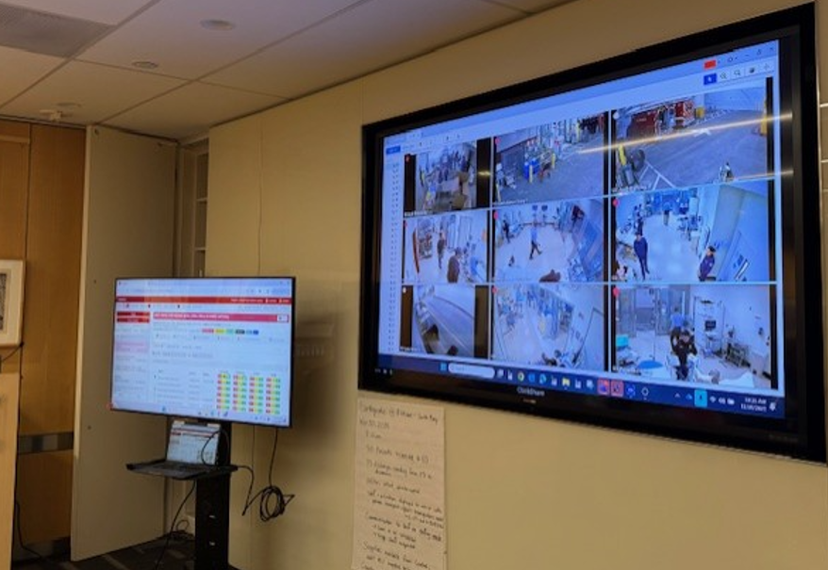
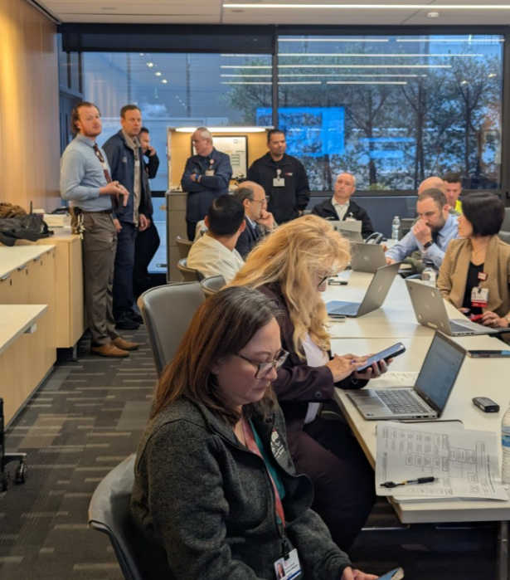
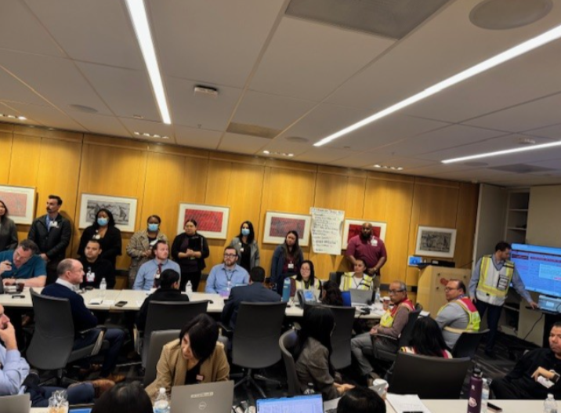
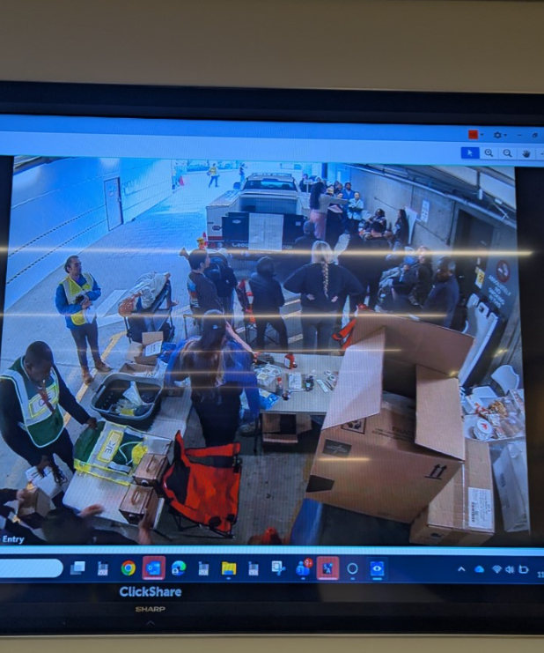
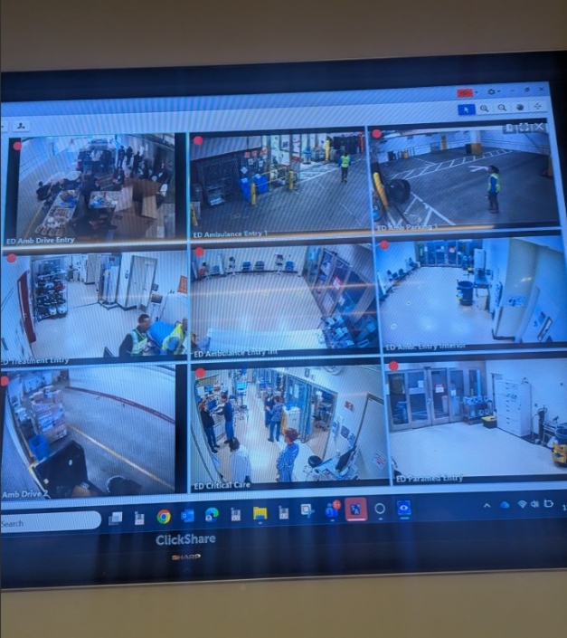
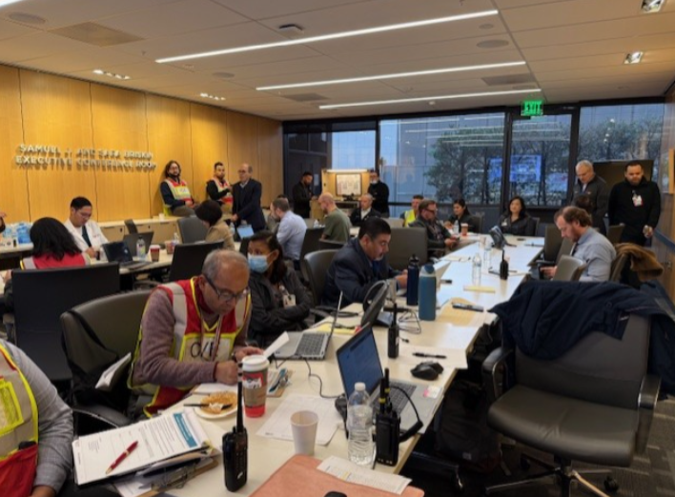
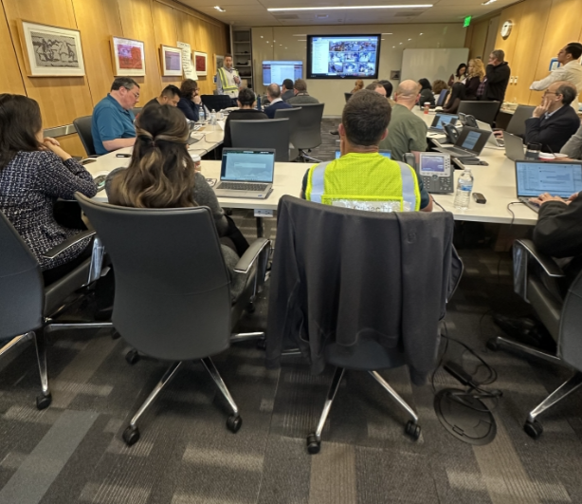

Slide 22
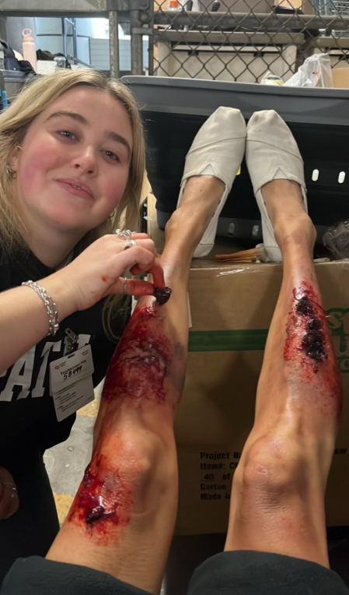
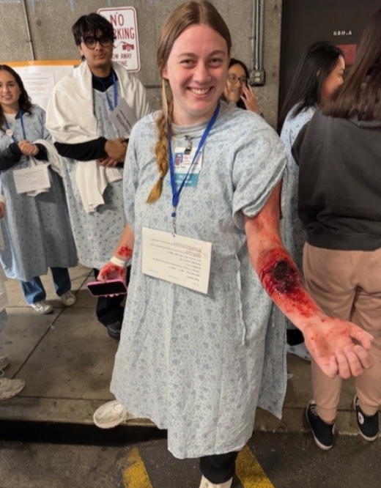
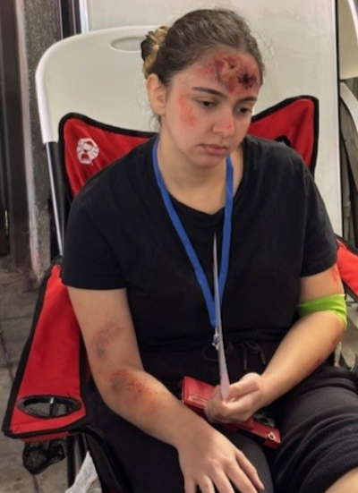
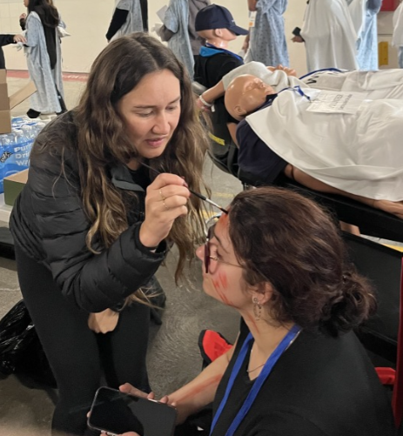
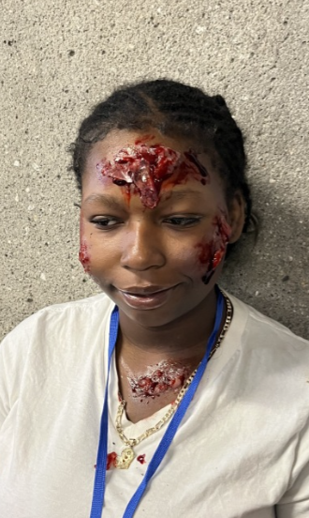

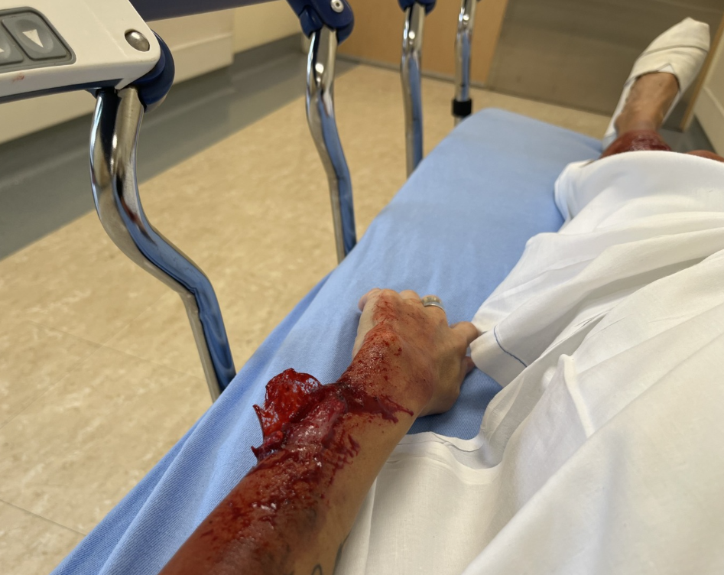
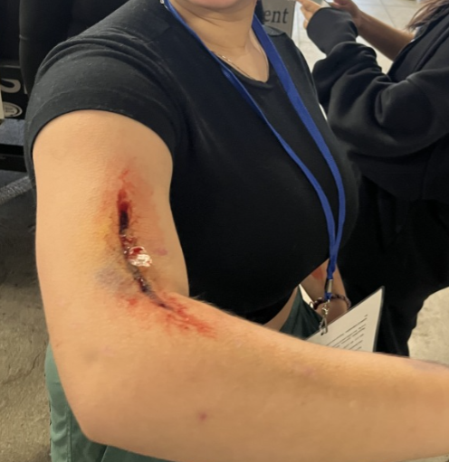

Slide 23
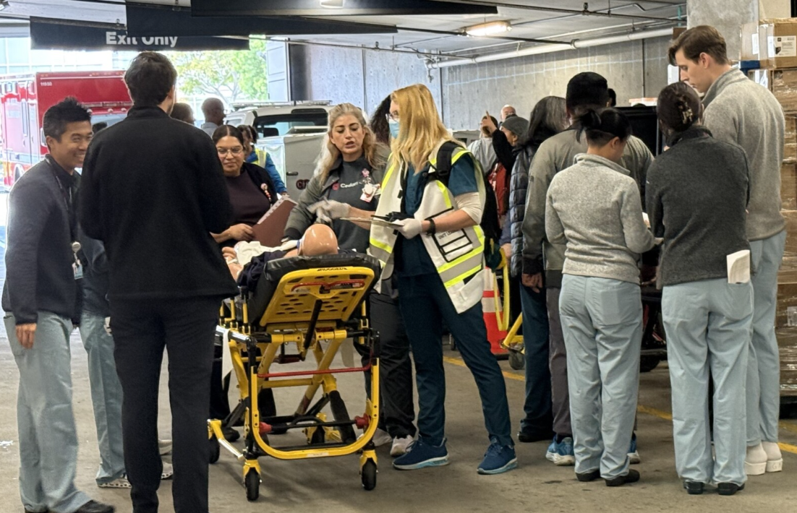
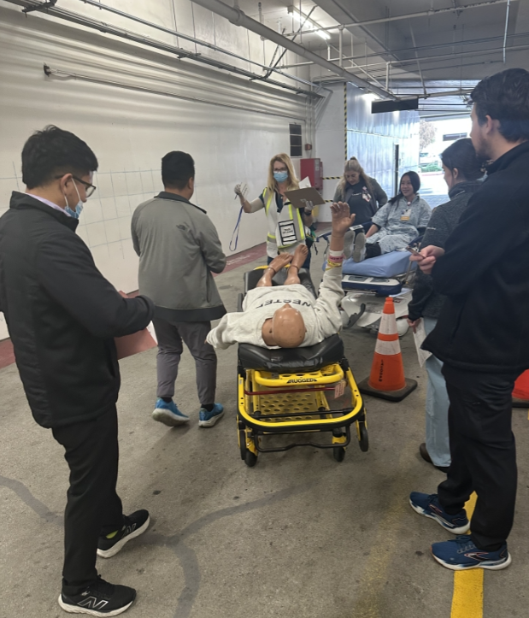
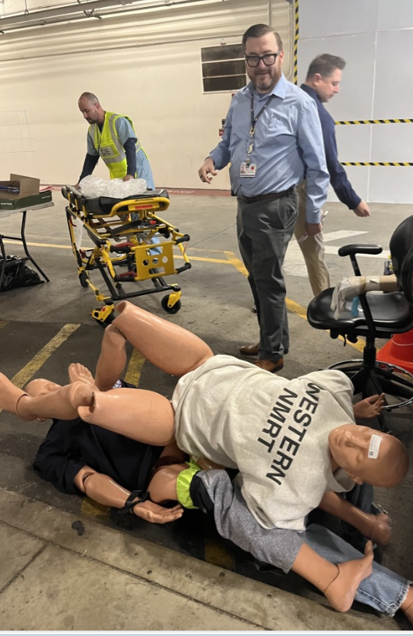
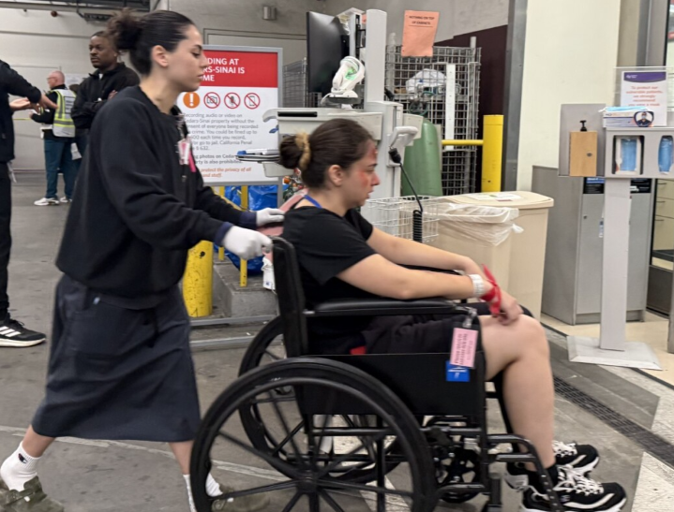
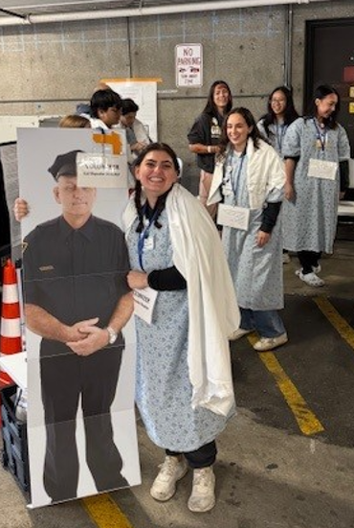
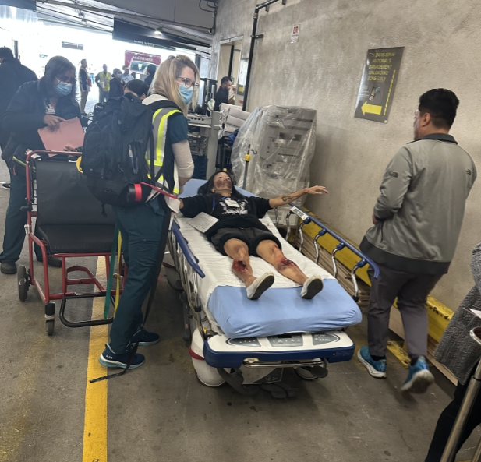
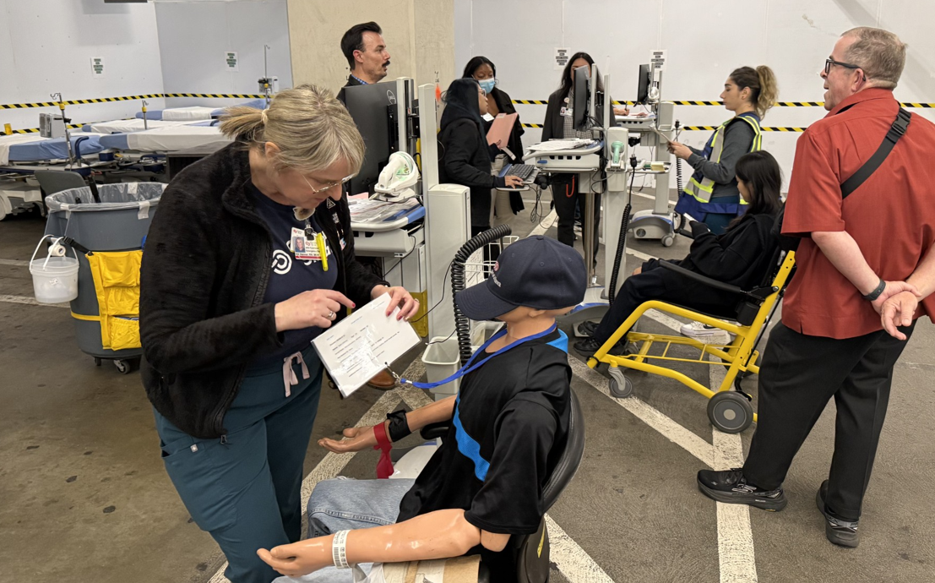

Slide 24
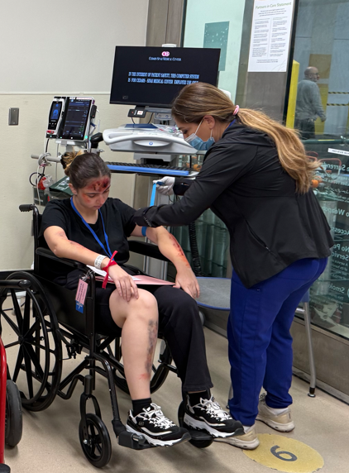
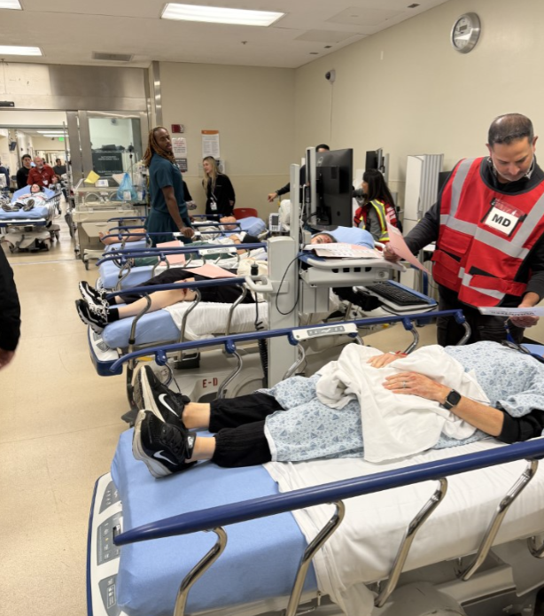
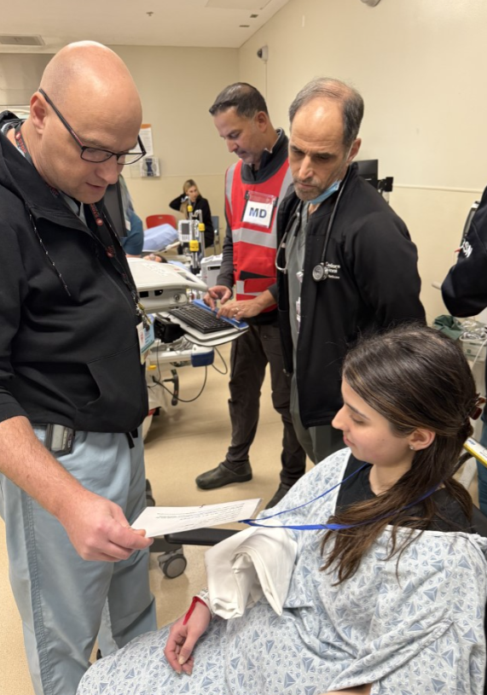
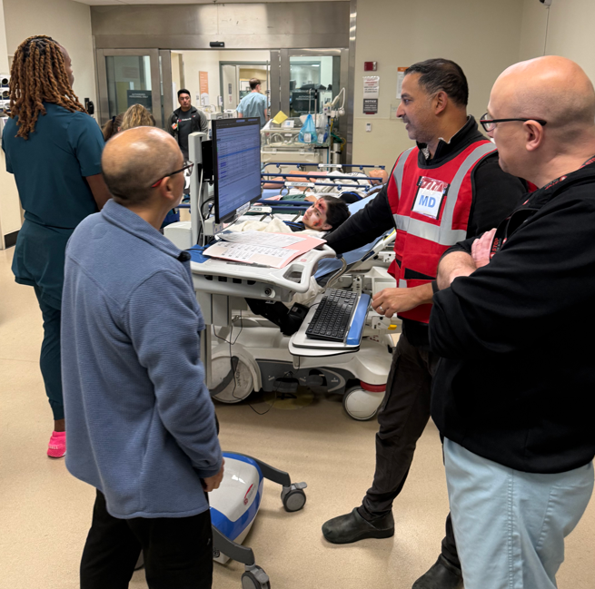
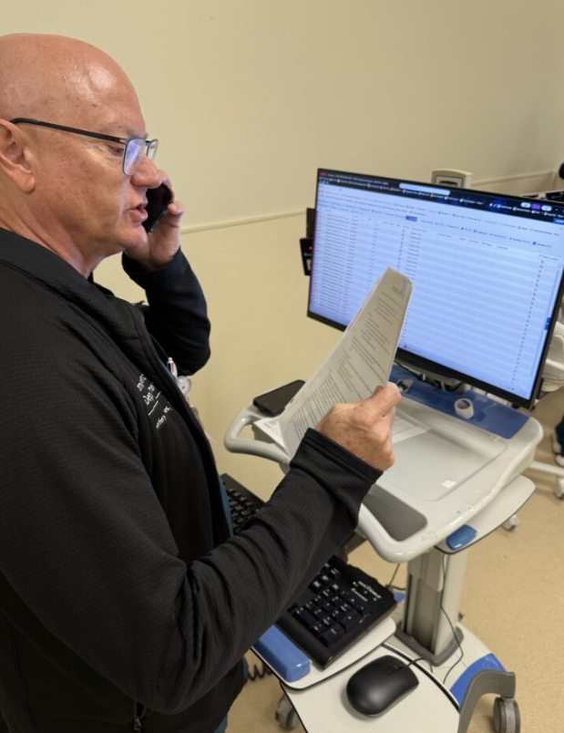
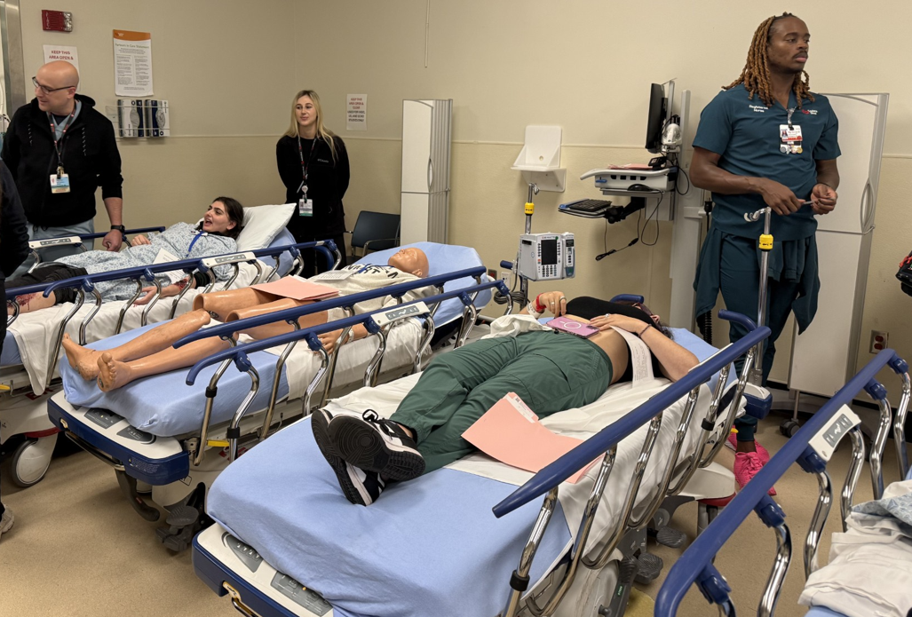
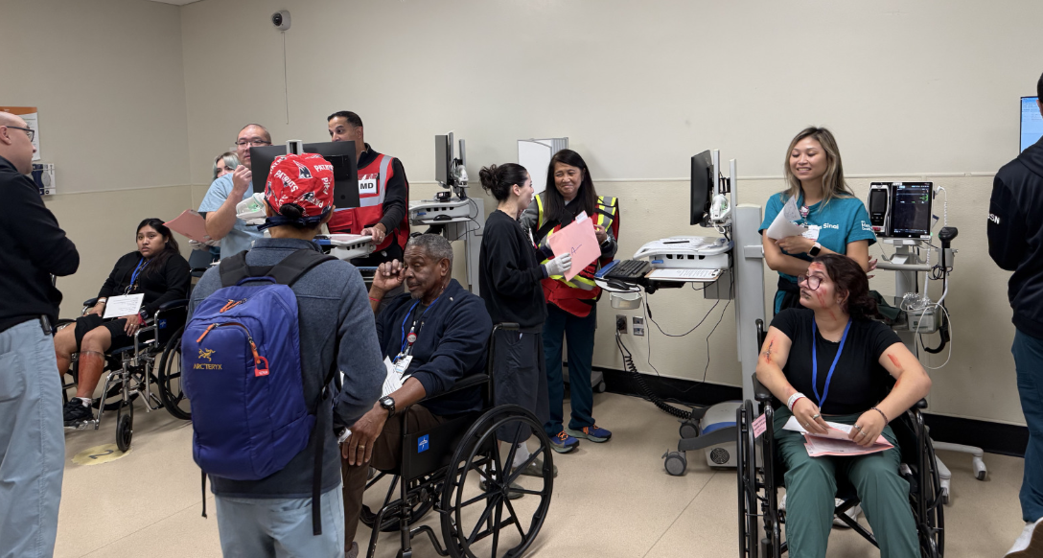


Slide 25







Slide 26
Strengths
Stakeholders present in the HCC were well-informed, actively engaged, and represented a strong cross-section of activated roles.
Situation updates, resource needs, and operational decisions were communicated consistently, supporting coordinated actions.
Staff in both the HCC and the ED demonstrated proactive problem-solving that improved response efficiency and situational awareness.
Teams demonstrated flexibility when exercise conditions evolved, adjusting workflows to meet emerging needs, e.g., evacuation.
Manual and electronic patient tracking processes were carried out promptly, demonstrating operational capability under surge conditions.
Effective communication and coordination were observed across all participating units, contributing to smooth operational flow during the exercise.
The use of real victims added authenticity and helped teams practice realistic triage and clinical decision-making.
The refinements to our activation protocols and updates to the MCI Plan enhanced clarity, improved accuracy, and strengthened overall operational readiness.

Slide 27
Lessons Learned
Deploy EIS personnel to the ED during drills and real events to resolve application issues, troubleshoot WOWs, and maintain technology readiness.
Assign an Operating Room representative to the ED to assist with patient flow, coordination, and surgical-related decision-making.
Improve processes for radiologists to verbally communicate critical results directly to physicians, as secure chat may not be monitored during an MCI.
Develop an elevator priority strategy to ensure rapid transport of critical patients to appropriate units.
Increase security presence and add clear signage to direct the public away from restricted areas.
Create protocols for family reunification, particularly for unaccompanied minors.
Identify sleeping and rest accommodations for staff who remain onsite during extended emergencies or cannot return home.

Slide 28

Thank you!
Nancy Cabrera, MPH, BS-HSEM
Manager, Business Continuity
Nancy.Cabrera@cshs.org
GroupCSMCSafetyEmergencyManagement@cshs.org

