Slide 1
  EMS Agency
  Medical Coordination Center (MCC) Communications
  John Quiroz, RN, Nurse Manager
  Ambulance Services, Central Dispatch Office & Medical Alert Center
  Essence Wilson, RN, Sr. Nursing Instructor, Disaster Services
Communication between facilities during Amhe 2025

Slide 2
Presentation Objectives:
Provide Summary of MCC Exercise Activation
Review Methods of Communications
Explore Types of Information Gathered and Exchanged
Real World Applications

Slide 3
Summary of MCC Activation
The Medical Alert Center (MAC) was alerted to incident
  Earthquake and subsequent Multi Casualty Incidents
MAC communicated with EMS Agency Administrator on Duty (AOD)
AOD decided to lean forward and activate our MCC to support incident (Everbridge Notification System)
MAC sent incident notifications to EMS alert our Agency, relied heavily on ReddiNet messaging and polls to communicate with our acute care hospitals, prehospital care and healthcare coalition partners
MCC communicated with hospital partners to assess, coordinate and prioritize resources requested in support of incident
End all activations with End Exercise messages and complete After Action Debrief

Slide 4



Methods of Communication
ReddiNet
  HAvBED Poll
  Service Level Poll (Hospital Triage Tag Concept)
  MCI Module
  Messaging Module (one-way, two-way or group comms)
  Resource Request Module
  Assessment Poll Module
Telephone (landline, fax and satellite back-up)
VMED-28 Radio
Amateur Radio Emergency Service (ARES)
Email
Conference Call Software (Microsoft Teams, Zoom)
Everbridge Notification System

Slide 5

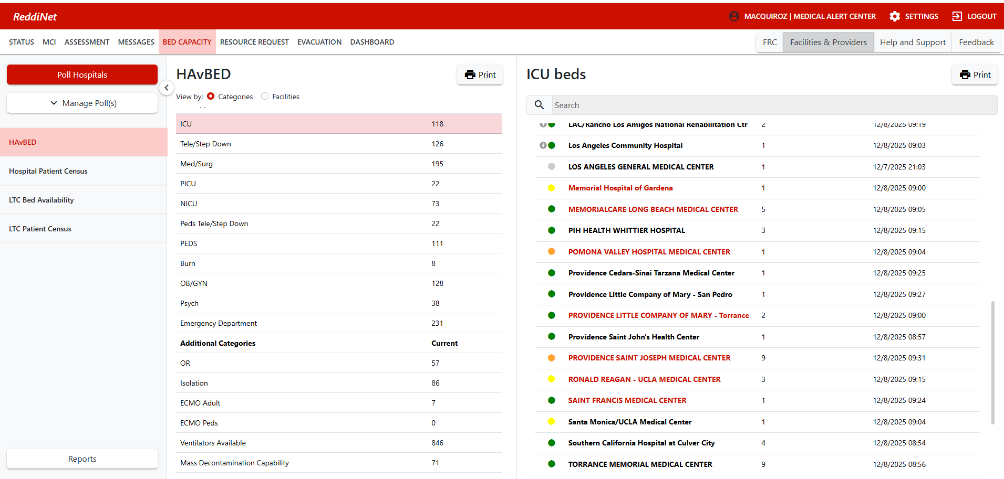




HAvBED

Slide 6

Information Gathered/Exchanged
HAvBED-Bed availability
Service Level Poll (Damage Assessment)
MCI Module to manage patient destinations with paramedic Providers and receiving hospitals.
ReddiNet Message Module notice of MCC activation, reminders to complete polls, notifications, complete victim list information.
Resource Request Module to process hospital request for resources (Supplies, Services, Equipment, and Personnel)
Assessment Polls are ad hoc request for more detailed information (ie)
  How many staffed beds available post surge plan activation

Slide 7
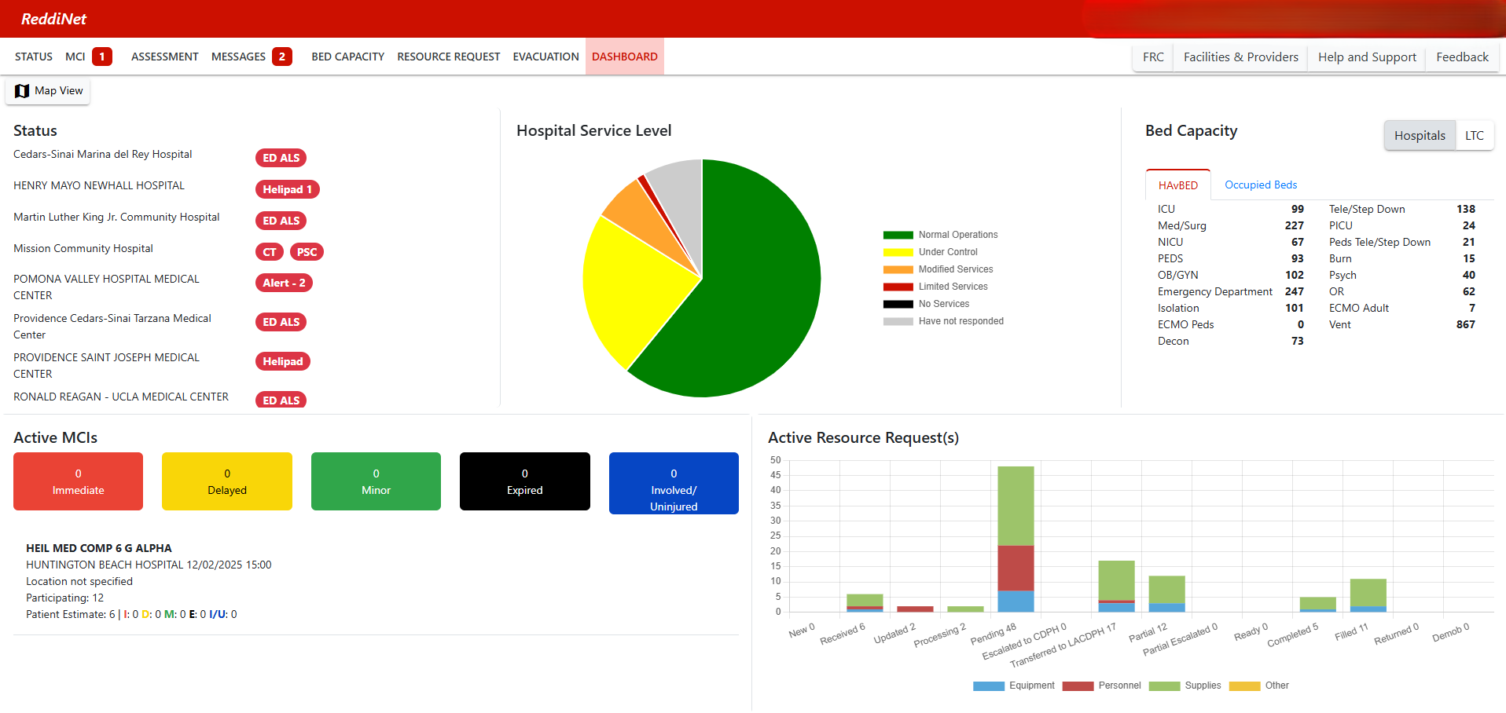
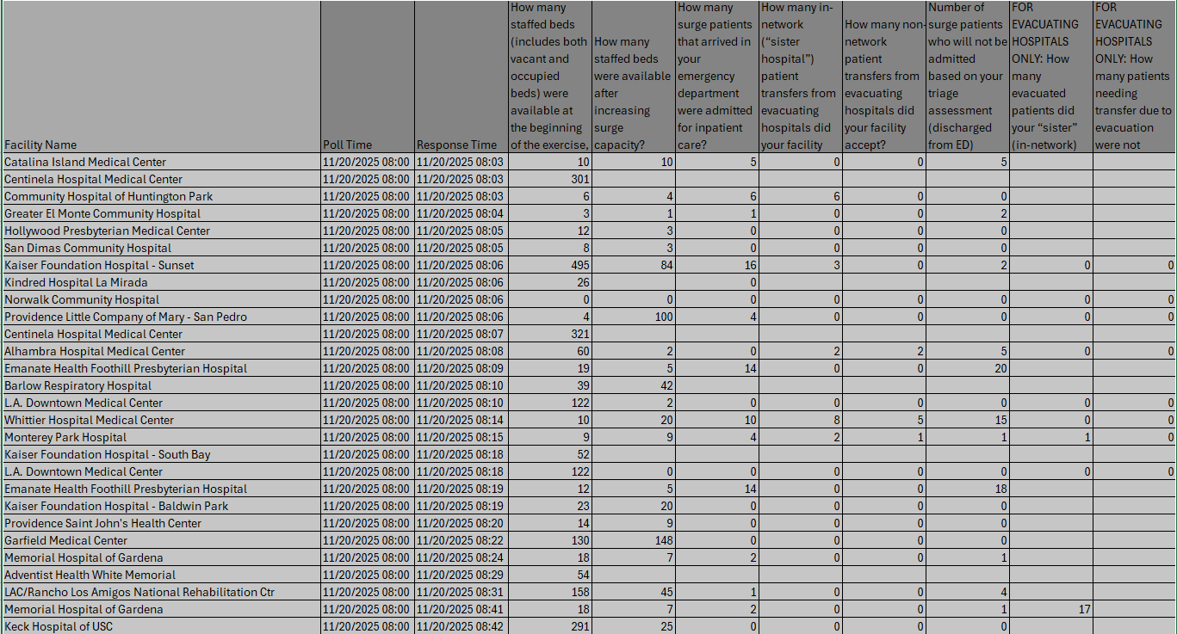
ReddiNet Information

Slide 8
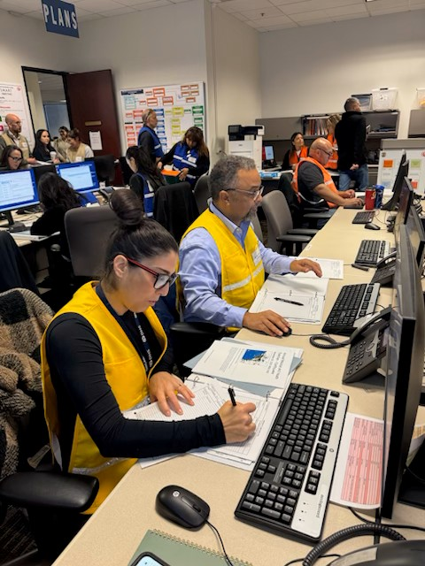
Application of Information
Obtain Situation Awareness
  Scope of the incident (Isolated, South bay, or County-wide)
  Impacted facilities-Service Level (ID hospitals requiring assistance)
  Identify hospitals with resources to assist others
  Intake Resource Request from healthcare partners
  Prioritize and fulfill Resource Requests
Maps of facilities, evacuations, fires, floods, smoke plumes.
Communicate status updates and guidance with hospital partners
Consider waivers to 9-1-1 Prehospital Care System (ie) patient destinations, transportation guidelines, or activation of Surge Plans (ie) Burn Surg Plan
Assist with hospital evacuations and patient transfers by providing bed availably (HAvBED) for transfers and provide ambulance transportation resources
Use information to conduct an After Action Debrief (identify sustainment and improvements)
Share information with local, state and Federal partners

Slide 9
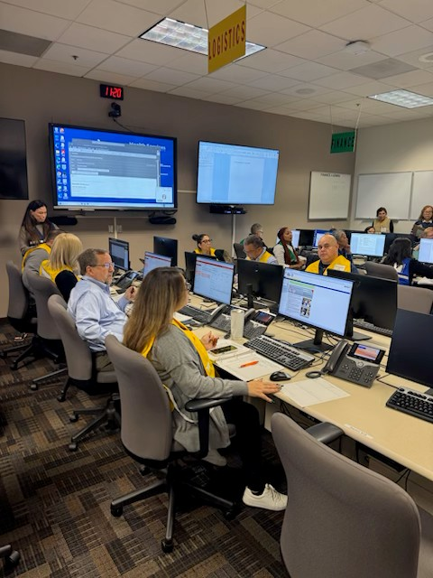
Sustain and Improvement
Sustain
  ReddiNet Effective Communication Method
  Service Level and Assessment Polls
  Resource Request Module intake process and track
Improvement
  Participant ReddiNet Contact Directory
  Hospital Staff Unaware of HICS Activation and Contact Info

Slide 10
Closing Comments on Communications:
Serves as the foundation in responding to exercises and real incidents
Rely on redundant technology to communicate, coordinate and fulfil mission objectives
Historically communications involved short bursts of one ,two-way voice or text messaging
In today’s environment, we rely heavily on communications to exchange data to assess, coordinate disaster response, including resource allocation with hospital, prehospital, state and Federal partners

Slide 11
Thank you!

