Slide 1
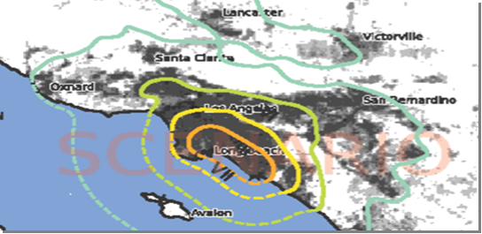
The Annual Medical and Health Exercise (AMHE)
2025 Exercise Evaluation Conference

Slide 2
Darren Verrette Disaster Program Manager EMS Agency
2025 Exercise Evaluation Conference
Welcome

Slide 3
2025 Exercise Evaluation Conference
Conference Etiquette:
Building Safety
Refreshments
Restrooms
Please silence cell phones

Slide 4
Agenda
8:00 – 8:05 WELCOME & INTRODUCTIONS
8:05 – 8:45 EXERCISE EVALUATION OVERVIEW
8:45 – 10:00 FACILITY PRESENTATIONS
10:00 – 10:10 BREAK
10:10 – 10:55 GROUP BREAKOUT SESSIONS:
AMBULATORY SURGERY CENTER, CLINIC, URGENT CARE SECTORS
DIALYSIS SECTOR
HOME HEALTH HOSPICE and LONG TERM-CARE SECTORS
HOSPITAL GROUPS
OTHERS
10:55 – 11:05 BREAK
11:05 – 11:45 GROUP BRIEF OUTS
11:45 – 11:55 AFTER-ACTION REPORT / IMPROVEMENT PLAN
11:55 – 12:00 CLOSING REMARKS

Slide 5
Healthcare Coalition (HCC) Sectors
Amateur Radio Emergency Services (ARES)
Ambulatory Surgery Center Sector (ASC)
Clinic Sector (Clinic)
Dialysis Sector (Dialysis)
EMS Agency (MAC/MCC/MHOAC)
Fire Department (Fire)
Home Health & Hospice Sector (HHH)
Hospital Sector (Hospital)
Long Term Care Sector (LTC)
Mental Health (DMH)
Office of Emergency Management (OEM)
Provider Agency Sector (Ambulance)
Public Health (DPH, LBHHS, Pasadena PH)
Urgent Care Sector (UC)

Slide 6
Importance of Exercise Evaluation Conference
To share the HCC sectors level of participation
To share the Facility strengths and gaps
To share the Exercise strengths and gaps

Slide 7
The Annual Medical and Health Exercise
Exercise Overview

Slide 8
Annual Medical and Health Exercise
Date of Exercise: Thursday, November 20, 2025
Threat: Earthquake
Plans/Processes: Evacuation, Relocation, Communication, Coordination,
Patient Surge, Shelter-in-Place, and other critical capabilities
Core Capabilities: Office of the Assistant Secretary for Preparedness and Response
for 2017-2022 Healthcare Preparedness and Response:
Capability 1: Foundation for Healthcare and Medical Readiness
Capability 2: Healthcare and Medical Response Coordination
Capability 3: Continuity of Health Care Service Delivery
Capability 4: Medical Surge

Slide 9
HCC Members Registered to Participate
Ambulatory Surgery Centers (ASC) = 24
Clinics = 62
Dialysis Centers = 35
Home Health Hospice (HHH) = 31
Hospitals = 70
Long Term Care (LTC) Facilities = 32
Provider Agencies = 1
Urgent Care (UC) Facilities = 0
Other = 1
Total HCC Members Registered = 256

Slide 10
Scenario: Doublet Earthquake
Initial Earthquake:
The initial M6.3 earthquake occurred at 7:30 a.m. intense shaking in the Long Beach and South Bay areas of Los Angeles County. This was intended to cause a patient surge.
Subsequent Larger Earthquake:
The subsequent M6.8 earthquake occurred at 9:30 a.m. intense shaking in the Long Beach and South Bay areas of Los Angeles County. This was intended to cause another patient surge and facility evacuations to test various evacuation plans and procedures, including the Hospital Evacuation Policy, Reference 1112.

Slide 11
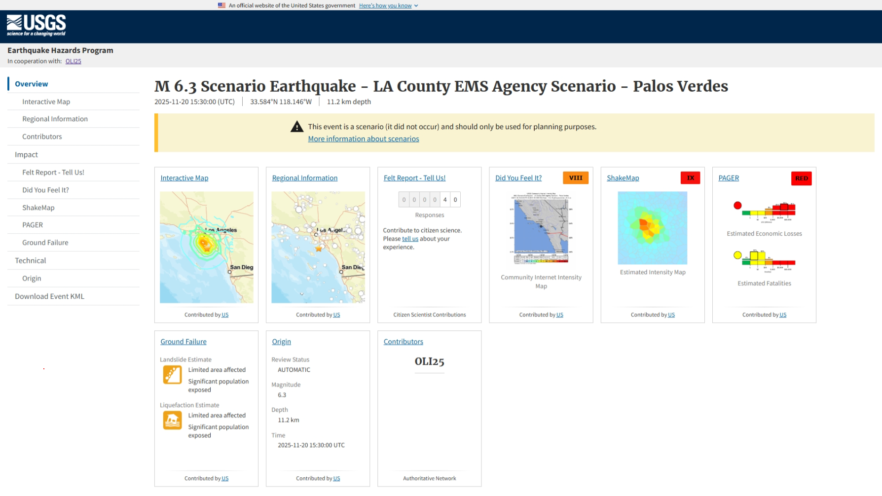

Slide 12
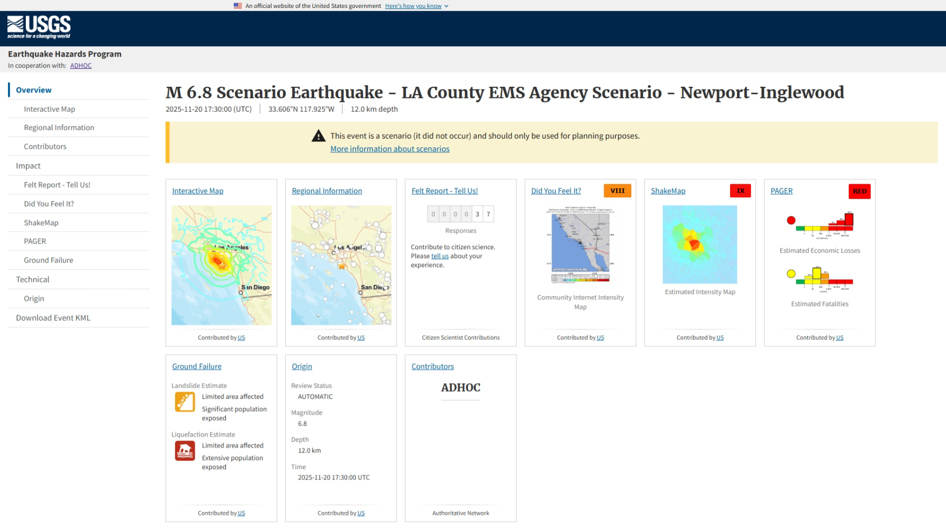

Slide 13
MRSE Components Annual Medical and Health Exercise
Our HCC still must meet ASPR grant requirements; specifically the Medical Response and Surge Exercise (MRSE) requirements:
Surge Capacity Requirements
Performance Measures
Data Collection Requirements

Slide 14
MRSE Surge Capacity Requirement
The Healthcare Coalition (HCC) must surge to 10% of its licensed bed capacity
L.A. County has approximately 21,159 staffed beds. 10% = 2,160 surge patients

Slide 15
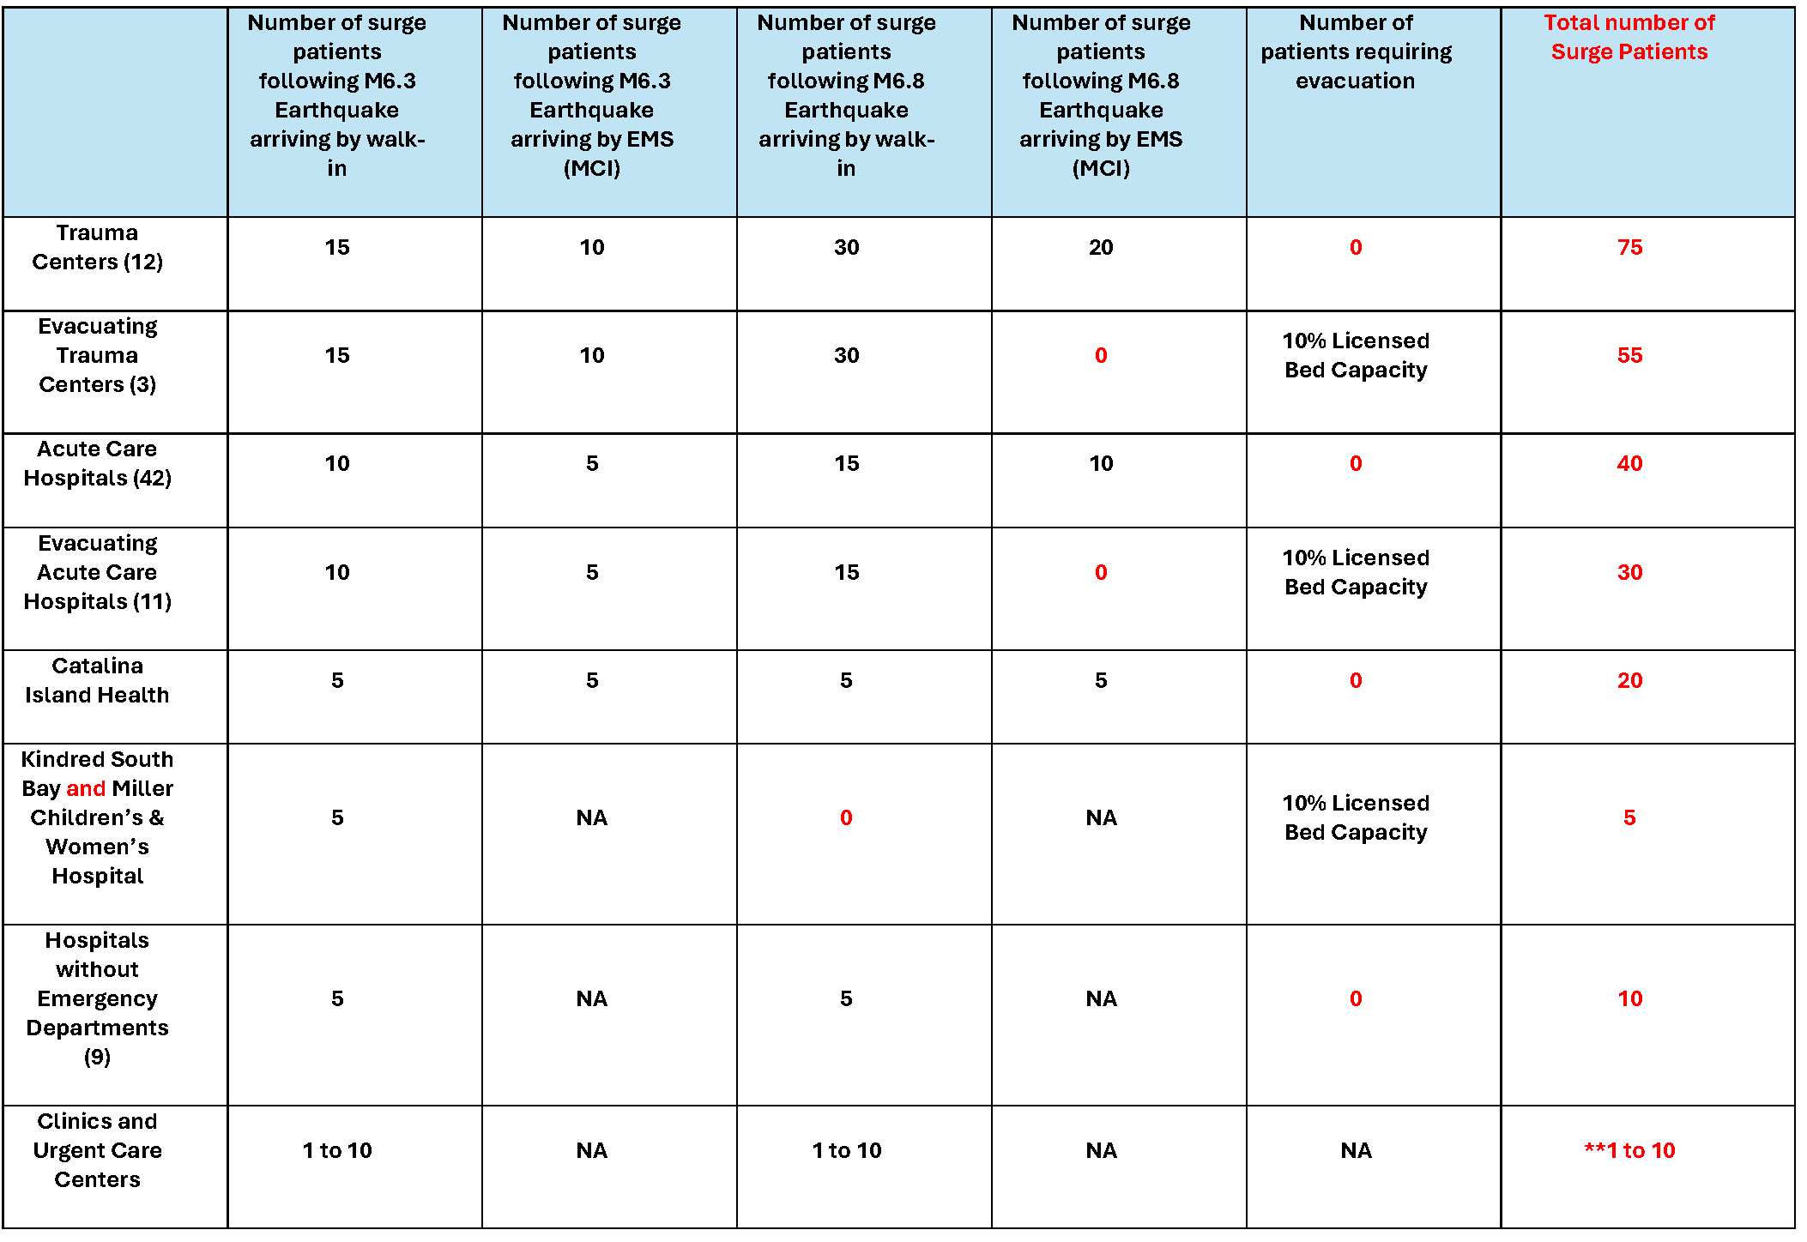
Patient Allocation Table
Notes:
Patient Allocation Table

Slide 16
ReddiNet MCI #1:
MCI initiated via ReddiNet at 08:00 hours:
911-Receiving Hospitals MCI Poll: 69
Facilities that Responded: 67
Facilities that did not Respond: 2
Available Capacity by Category:
Immediate Patients: 390
Delayed Patients: 390
Minor Patients: 595
Total Available Capacity: 1,375
MAC Assigned Patients by Category:
Immediate Patients: 239
Delayed Patients: 66
Minor Patients: 160
Total Number of Patients Assigned by MAC: 465
Number of Ambulances sent by MAC: 74
Number of Hospitals that “Arrived” Ambulances: 47
Number of Patients in “Arrived” Ambulances: 320
Number of Hospitals entered MCI victim data: 64
Number of Walk-in Patients entered in MCI Victim List: 1,093
Total Number of Patients (Walk-in and MCI) in Victim List: 1,671

Slide 17
ReddiNet MCI #2 (“Main Shock”):
MCI initiated via ReddiNet at 09:45 hours:
911-Receiving Hospitals MCI Poll: 69
Facilities that Responded: 58
Facilities that did not Respond: 11
Available Capacity by Category:
Immediate Patients: 323
Delayed Patients: 311
Minor Patients: 478
Total Available Capacity: 1,112
MAC Assigned Patients by Category:
Immediate Patients: 275
Delayed Patients: 56
Minor Patients: 355
Total Number of Patients Assigned by MAC: 686
Number of Ambulances sent by MAC: 61
Number of Hospitals that “Arrived” Ambulances: 33
Number of Patients in “Arrived” Ambulances: 415
Number of Hospitals entered MCI victim data: 48
Number of Walk-in Patients entered in MCI Victim List: 489
Total Number of Patients (Walk-in and MCI) in Victim List: 972

Slide 18
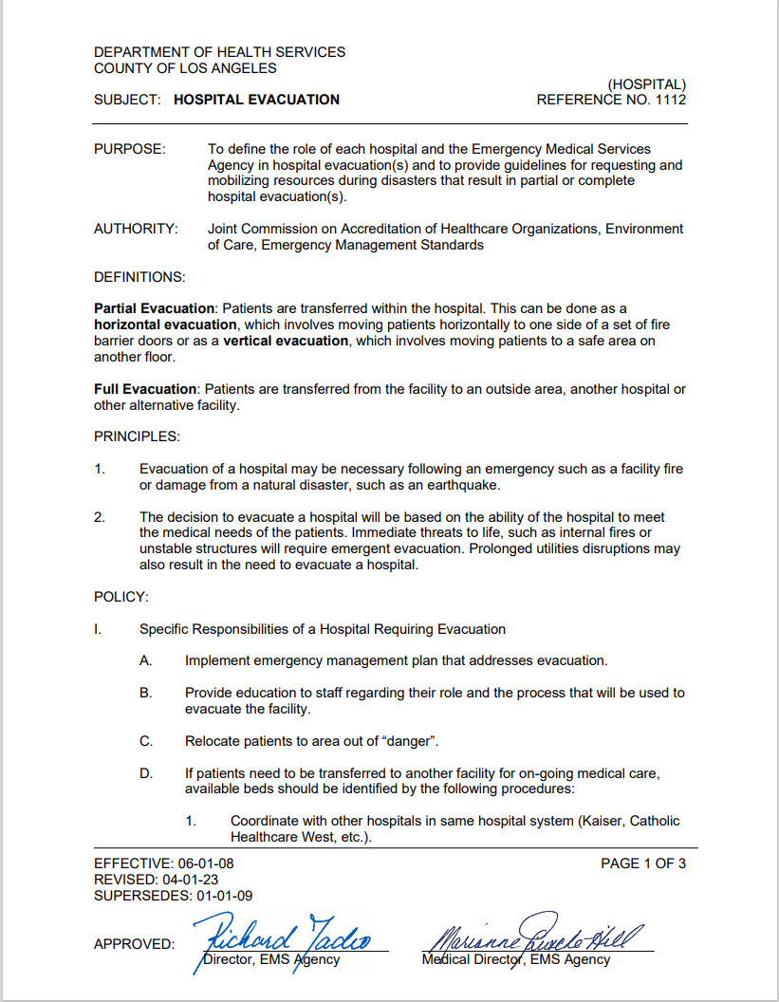
Hospital Evacuation Plan

Slide 19
Evacuating Hospitals 12 Hospitals in the severely impacted areas partial evacuations:
Cedars Sinai Marina Del Rey (Cedars)
College Medical Center (College)
Saint Mary Medical Center (Dignity)
Harbor UCLA (DHS)
Kaiser South Bay (Kaiser)
Long Beach Memorial / Miller’s Children’s (Memorial Care)
LCM San Pedro (Providence)
LCM Torrance (Providence)
Torrance Memorial (Cedars)
Gardena Memorial (Pipeline)
Centinela Medical Center (Prime Health)
Kindred South Bay (Kindred)

Slide 20
MAC/MCC Activities
MCC Activated
MHOAC Coordination
RDMHS Situational Awareness
Assessment Polls
Service Level Polls
Transportation Coordination
Resource Request Management

Slide 21
Statistics by HCC Sector
Ambulatory Surgery Centers (ASC) – 107 on ReddiNet / 24 Registered:
Facilities responded to 1st Service Level Poll: 15
Facilities responded to 2nd Service Level Poll: 15 (2 Black, 0 Red)
Resource Requests Received: 7
Clinics – 314 on ReddiNet / 62 Registered:
Facilities responded to 1st Service Level Poll: 42
Facilities responded to 2nd Service Level Poll: 37 (0 Black, 0 Red)
Resource Requests Received: 24
Dialysis Centers – 126 on ReddiNet / 35 Registered:
Facilities responded to 1st Service Level Poll: 43
Facilities responded to 2nd Service Level Poll: 27 (0 Black, 0 Red)
Resource Requests Received: 3

Slide 22
Statistics by HCC Sector
Home Health/Hospice (HHH) – 204 on ReddiNet / 31 Registered:
Facilities responded to 1st Service Level Poll: 16
Facilities responded to 2nd Service Level Poll: 24 (0 Black, 0 Red)
Resource Requests Received: 10
Hospitals – 87 on ReddiNet / 70 Registered:
Facilities responded to 1st Service Level Poll: 77 (1 Black, 1 Red, 1 Orange)
Facilities responded to 2nd Service Level Poll: 73 (4 Black, 8 Red)
Resource Requests Received: 75
Long Term Care (LTC) Facilities – 329 on ReddiNet / 32 Registered:
Facilities responded to 1st Service Level Poll: 14
Facilities responded to 2nd Service Level Poll: 17 (0 Black, 0 Red)
Resource Requests Received: 2
Urgent Care (UC) Facilities – 40 on ReddiNet / 0 Registered:
Facilities responded to 1st Service Level Poll: 0
Facilities responded to 2nd Service Level Poll: 0
Resource Requests Received: 0

Slide 23
Statistics by HCC Sector
Provider Agencies (Public and Private) – 1 Registered:
Resource Requests Received: 0
Fire Operational Area Coordinator (FOAC) Activation:
LA County Fire
Central Dispatch Office
Conference call with Providers

Slide 24
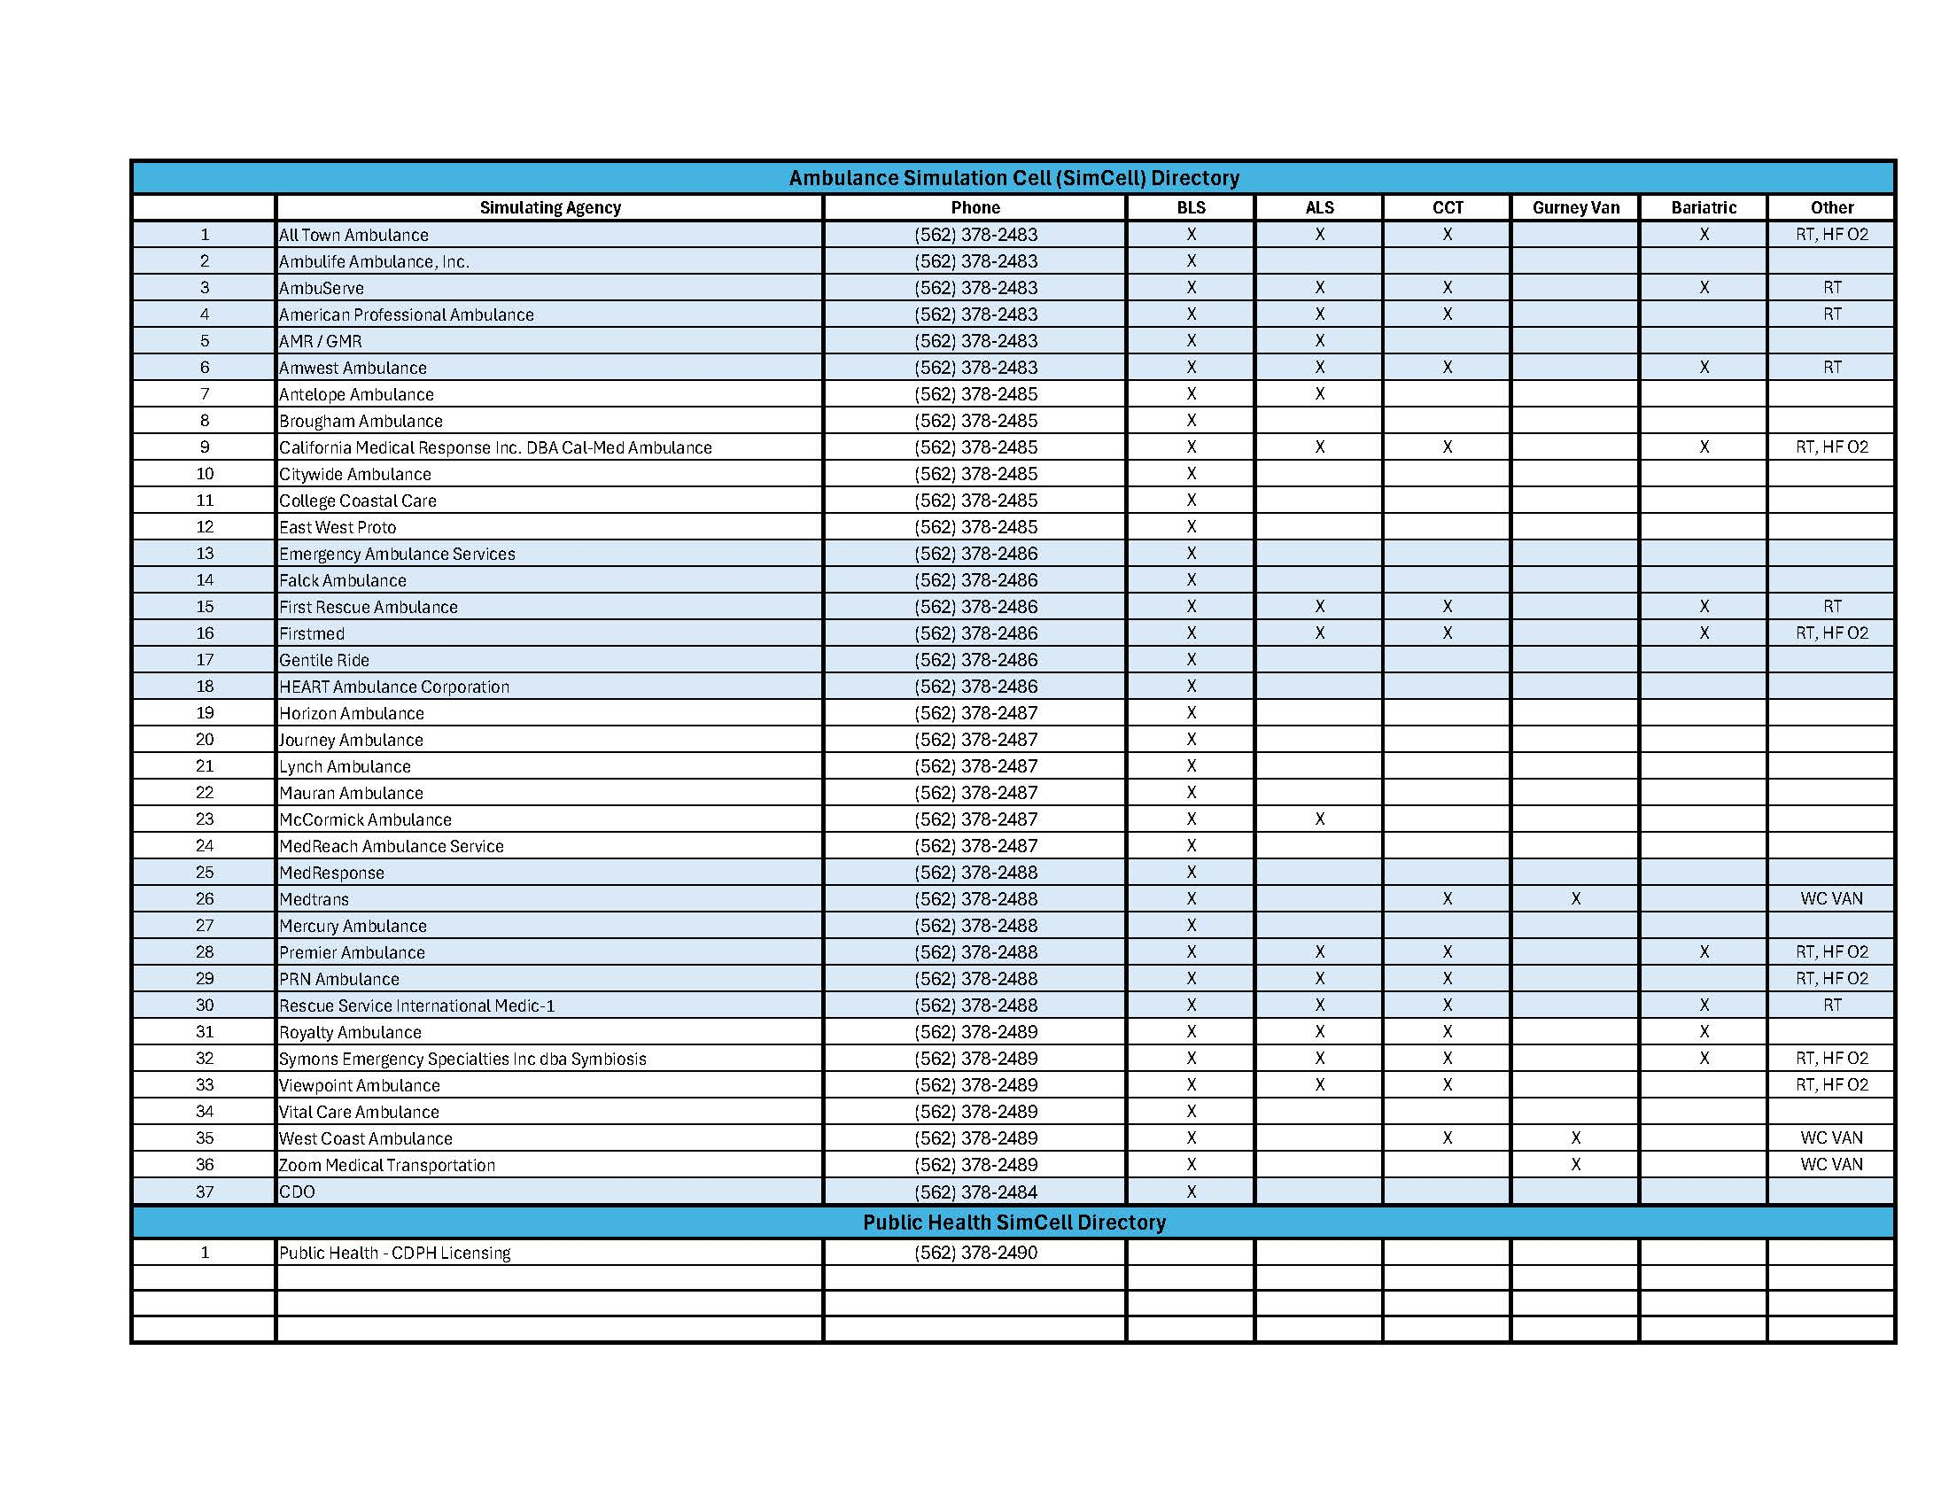
SimCell Directory
Simulation Cell (SimCell) for Ambulance Providers and CDPH

Slide 25
Assessment Poll
Assessment Poll: Hospital Sector: “Ability to provide additional equipment and supplies”
Questions:
Does your facility have additional hospital beds?
Does your facility have additional IV solutions?
Does your facility have additional gurneys?
Does your facility have additional latex or non latex gloves?
Does your facility have additional IV pumps?
Hospital Sector:
Facilities Polled: 89
Facilities Responded: 71
Facilities Did Not Respond: 18

Slide 26
Assessment Poll
Assessment Poll: Non-Hospital Sectors: “Resource sharing ability”
Questions:
Available beds
Available transport vans for ambulatory patients
Available medical supplies
available DME
Non-Hospital Sectors:
Facilities Polled: 1124
Facilities Responded: 116
Facilities Did Not Respond: 1008

Slide 27
Assessment Poll Results: 2025 Medical Response and Surge Exercise – Hospital Capacity Survey
An Assessment Poll titled, “2025 AMHE - Hospital Capacity Survey” went out to all participating hospitals at the beginning of the exercise.
ReddiNet Assessment Poll:
Number of HPP Hospitals Polled: 80
Number of HPP Facilities Responded to Poll: 56
Number of HPP Facilities Did Not Respond to Poll: 24

Slide 28
Observations:
Health Care Coalition (HCC):
Worked Well:
ReddiNet worked well as primary communication tool for HCC:
Messaging
MCI Management
Assessment Polls
Service Level Polls (color coded)
Resource Requesting

Slide 29
Observations (continued):
Gaps:
More engagement with Non-Hospital Sectors
ReddiNet MCI Training:
Arriving Ambulances
Updating Victim List
ReddiNet Assessment Poll Training:
Developing and Setting up Polls
Some of the callers contacting SimCell not familiar with process or which ambulance company contracted with

Slide 30
Amateur Radio Emergency Services (ARES)
ARES – HAM Radio:
ARES setup Net-Control outside the MAC / MCC
Received Situation Status reports
Resource Request
Great resource

Slide 31
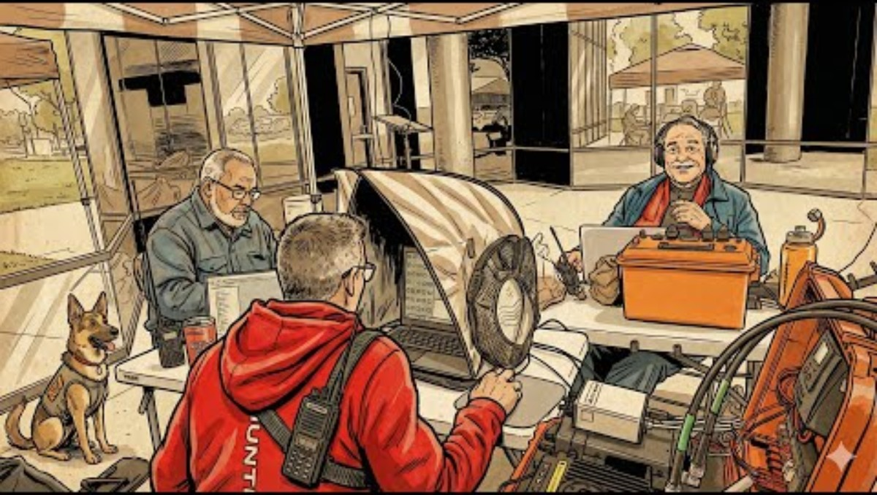
Amateur Radio Emergency Services (ARES)

Slide 32
2025 Annual Medical and Health Exercise Overview
Questions?

Slide 33

Breakout Sessions

Slide 34
Breakout Sessions
Breakout Session Groups:
Group 1: Hospital
Group 2: Hospital
Group 3: Hospital
Group 4: Hospital
Group 5: Ambulatory Surgery Center, Clinic, & Urgent Care Sectors
Group 6: Dialysis Sector
Group 7: Home Health Hospice & Long Term-Care Sectors
Group 8: Others

Slide 35
Breakout Sessions
Hospital Group 1:
Evacuating: Cedars Marina, Torrance Memorial, & Centinela.
Network: Cedars & Prime
DRC Regions: Region 2, Region 4, & Region 9
Hospital Group 2:
Evacuating: Kaiser South Bay & Harbor UCLA.
Network: Kaiser & DHS
DRC Region: Region 6
Hospital Group 3:
Evacuating: St. Mary, LBM/Miller Children’s, & Gardena Memorial
Network: Dignity, Memorial Care, & Pipeline
DRC Regions: Region 1, Region 7, & Region 8
Hospital Group 4:
Evacuating: LCM San Pedro, LCM Torrance, College MC, & Kindred South Bay
Network: Providence, College, & Kindred
DRC Regions: Region 5 & Region 10

Slide 36
10:10 to 10:55 Break Out Sessions 10:55 to 11:05 10-Minute Break
GROUP BREAKOUT SESSIONS
Event will resume at 11:05 a.m. in the Cooper Room

Slide 37
Thank you!
BREAK
10:55am – 11:05am
Event will resume at 11:05 a.m. in the Cooper room

Slide 38
Welcome Back
Group Brief Outs:
Representative for Hospital Groups
Group 5: Ambulatory Surgery Center, Clinic, & Urgent Care Sectors
Group 6: Dialysis Sector
Group 7: Home Health Hospice & Long Term-Care Sectors
Group 8: Others (Optional)

Slide 39
After-Action Report / Improvement Plan
Darren Verrette
EMS Agency

Slide 40
What Next?
Gather documents and compile data
Prepare a facility level After-Action Report / Improvement Plan

Slide 41
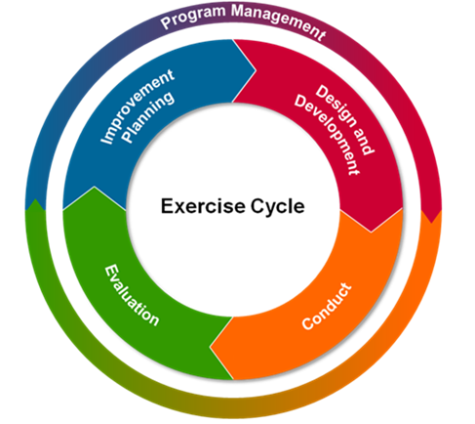
HSEEP Exercise Documents
Participant Feedback Forms
Exercise Evaluation Guide (Sector Specific)
After-Action Report / Improvement Plan

Slide 42
Participant Feedback Form Part I: General Info Part II: Exercise Design Feedback Part III: Capabilities Feedback - Strengths - Areas of Improvement - Training that will help you - Materials most helpful - Recommendations

Slide 43
Exercise Evaluation Guide (Sector Specific) Contains: - Exercise Objectives - Critical Tasks - Evaluator’s Observation Notes

Slide 44
Traditional After-Action Report / Improvement Plan (AAR/IP) Contains: - Cover Page - Exercise Overview - Analysis of Capabilities - Overview of Performance - Improvement Plan

Slide 45

After-Action Reporting Tool
We developed a survey in Survey Monkey that we are calling the, “2025 Annual Medical and Health Exercise After-Action Report Survey”.
This tool is intended to replace the traditional Word or PDF AARs usually submitted to the EMS Agency.
The tool makes it easier to collect and analyze the large volume of data normally submitted.
The tool will capture participants:
Contact Information
Facility / DRC Region / Sector
Overall Assessment
Strengths
Areas for Improvement
Corrective Action Plan
And other information
https://www.surveymonkey.com/r/TLPBVJM

Slide 46
After-Action Reporting Tool
We are asking that you use the AAR survey tool in SurveyMonkey
Do not have to send us a Word or PDF AAR
Completing the survey will meet your AAR submission requirement for EMS Agency – not other regulatory agencies
AARs are due by January 20, 2026

Slide 47
Thank you!
Questions?

Slide 48
Darren Verrette Disaster Program Manager LA County EMS Agency
Closing Remarks

Slide 49
End Slide

