Slide 1
Annual Medical and Health Exercise
Thursday, November 20, 2025
Exercise Overview
Darren Verrette
Disaster Program Manager
Los Angeles County EMS Agency

Slide 2
Healthcare Coalition (HCC) Members Participating in the Exercise:
Amateur Radio Emergency Services (ARES)
Ambulatory Surgery Center Sector (ASC)
Clinic Sector (Clinic)
Dialysis Sector (Dialysis)
EMS Agency (MAC/MCC/MHOAC)
Fire Department (Fire)
Home Health & Hospice Sector (HHH)
Hospital Sector (Hospital)
Long Term Care Sector (LTC)
Mental Health (DMH)
Office of Emergency Management (OEM)
Provider Agency Sector (Ambulance)
Public Health (DPH, LBHHS, Pasadena PH)
Urgent Care Sector (UC)

Slide 3
Threat / Hazard
EARTHQUAKE
Notes:
Earthquake was identified as the number one threat on the overall Los Angeles County Medical and Health Hazard Vulnerability Analysis (HVA) and the number three threat on the Los Angeles County Jurisdictional Risk Assessment (JRA) conducted by Public Health.

Slide 4

2019 Ridgecrest Earthquake
Notes:
July 4, 2019, initial M6.4
July 5, 2019, subsequent M7.1

Slide 5
2019 Ridgecrest Earthquake
Notes:
May of 2023 Stephanie Meeks of Ridgecrest Regional Hospital speaker at BCP event.

Slide 6
United States Geological Survey (USGS)
M6.3 Scenario

Slide 7
United States Geological Survey (USGS)
M6.8 Scenario

Slide 8
Scenario
At 7:30 a.m., a M6.3 earthquake occurred on a section of the Palos Verdes fault. The entire Los Angeles region experienced shaking, with stronger tremors felt in Long Beach, Terminal Island, San Pedro, Carson, Lomita, Torrance, and Redondo Beach.
No reports of any significant damage occurring to any facility in the County. All facilities remain operational.
Emergency Departments, Clinics, and Urgent Care facilities in the County are receiving an influx of patients by walk-in. Emergency Departments are also receiving patients due to an MCI. Victims sustained mild to moderate injuries. Very few require admission.
Two hours later at 9:30 a.m., a M6.8 earthquake occurred along the Newport-Inglewood fault. Once again, the entire Los Angeles region experienced shaking, with particularly intense shaking in the Long Beach and South Bay areas of Los Angeles County.
Consequently, facilities are receiving and influx of patients by walk-in. Emergency Departments are receiving patients due to an MCI resulting in a second and larger patient surge.
Also, received reports that facilities in the Long Beach and South Bay areas require evacuation (partial or complete) due to structural and/or other infrastructure damage.

Slide 9
Earthquake
Exercise
The exercise will test patient surge, evacuation plans, transportation coordination, and other pertinent plans and processes related to earthquakes.

Slide 10
Patient Surge and Evacuation
Patient Surge:
The initial M6.3 earthquake is intended to cause a mild surge to drive play to meet surge requirements.
Patient Surge:
The subsequent M6.8 earthquake is intended to cause another patient surge to drive play to meet surge requirements.
Evacuation:
The M6.8 earthquake is also intended to cause facility evacuations to test various evacuation plans and procedures, including the Hospital Evacuation Policy, Reference 1112.

Slide 11
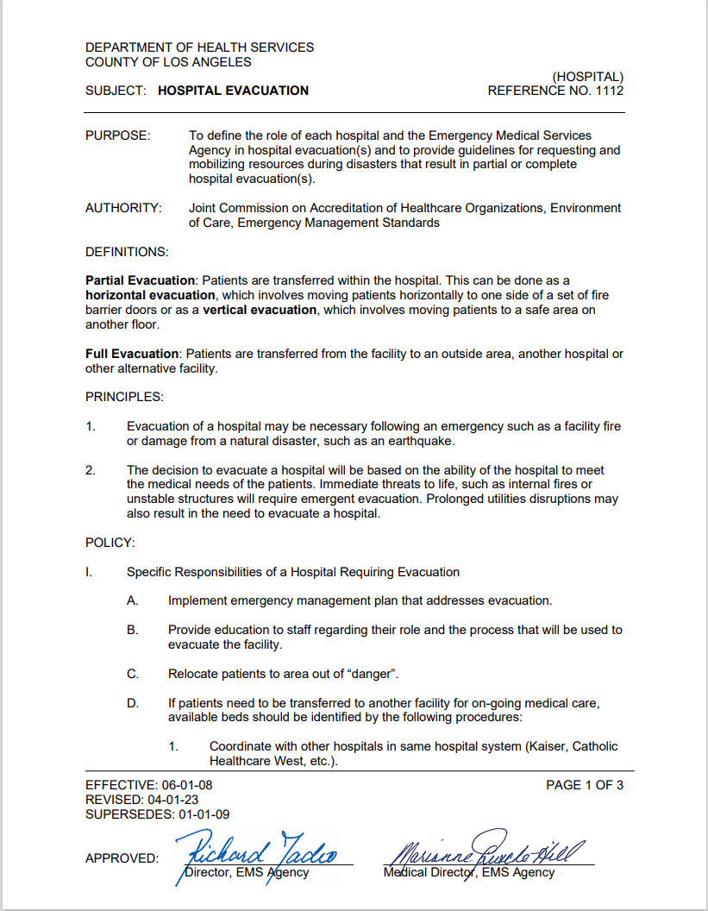
Hospital Evacuation
Plan

Slide 12
Evacuating Hospitals
12 Hospitals in the severely impacted areas will be required to evacuate but can self-determine scale (full vs. partial):
Cedars Sinai Marina Del Rey (Cedars)
College Medical Center (College)
Saint Mary Medical Center (Dignity)
Harbor UCLA (DHS)
Kaiser South Bay (Kaiser)
Long Beach Memorial / Miller’s Children’s (Memorial Care)
LCM San Pedro (Providence)
LCM Torrance (Providence)
Torrance Memorial (Cedars)
Gardena Memorial (Pipeline)
Centinela Medical Center (Prime Health)
Kindred South Bay (Kindred)

Slide 13
Evacuating Long Term Care (LTC) Facilities
3 Long Term Care facilities in the severely impacted areas will also evacuate:
Long Term Care Facility 1
Long Term Care Facility 2
Long Term Care Facility 3

Slide 14
Hospital Patient Evacuation Plan (10% Minimum)
Evac. Hospital: 2024 License:
Cedars Marina Del Rey 133 13
College 221 22
St. Mary 360 36
Harbor UCLA 453 45
Kaiser South Bay 257 26
LBM / Millers Child. 453 / 357 45 / 36
LCM SP 356 36
LCM Torrance 442 44
Gardena Mem. 172 17
Centinela 362 36
Torrance Mem. 533 53
Kindred South Bay 54 5
Total 414

Slide 15
Hospital Actions
Evacuating Hospital (Actions):
External Notifications (MAC / CDPH)
Identify how many patients need evacuation
Identify type of bed (ICU, Tele, etc.) and service (Surgery, Cardiology, etc.) needed
Identify what ambulances are needed by type (BLS, ALS, CCT, etc.)
Contact Network “Sister” Hospitals
Contact contracted ambulance providers (SimCell)

Slide 16
Hospital Actions
Network “Sister” Hospital (Actions):
Direct call to appropriate person / location (Command Ctr., Transfer Ctr., etc.) for processing
Determine how many, if any, patients can accept using internal transfer policy and surge criteria
Inform evacuating hospital of how many patients can accept

Slide 17
Hospital Actions
Evacuating Hospital (Actions):
If additional beds needed, contact EMS MCC
Provide how many patients need evacuation
Provide type of bed and service needed
If additional transport resources needed, contact EMS MCC

Slide 18
EEG:
Evacuating Hospitals and Network Hospitals

Slide 19

Evacuating Hospital / LTC
Transportation Coordination
SimCell (private ambulance providers)
Representatives from private ambulance companies serving as SimCell
Will have SimCell Directory
Limited resources, will not have sufficient resources to manage incident
Evacuating Facilities (Actions):
Contact contracted ambulance providers
Request quantity and type of ambulances needed
If need additional transport resources, contact MAC
EMS MCC (Actions):
Will process requests for transportation
FOAC, RDMHS/State AST, etc.
EMS MCC will assign transport resources to facility (facility will manage resources)

Slide 20
SimCell Directory
Will utilize Simulation Cell (SimCell) for Ambulance Providers and CDPH
Ambulance Simulation Cell (SimCell) Directory
 | Simulating Agency | Phone | BLS | ALS | CCT | Gurney Van | Bariatric | Other
1 | All Town Ambulance | TBD | X | X | X |  | X | RT, HF O2
2 | Ambulife Ambulance, Inc. | TBD | X
3 | AmbuServe | TBD | X | X | X |  | X | RT
4 | American Professional Ambulance | TBD | X | X | X |  |  | RT
5 | AMR / GMR | TBD | X | X
6 | Amwest Ambulance | TBD | X | X | X |  | X | RT
7 | Antelope Ambulance | TBD | X | X
8 | Brougham Ambulance | TBD | X
9 | California Medical Response Inc. DBA Cal-Med Ambulance | TBD | X | X | X |  | X | RT, HF O2
10 | Citywide Ambulance | TBD | X
11 | College Coastal Care | TBD | X
12 | East West Proto | TBD | X
13 | Emergency Ambulance Services | TBD | X
14 | Falck Ambulance | TBD | X
15 | First Rescue Ambulance | TBD | X | X | X |  | X | RT
16 | Firstmed | TBD | X | X | X |  | X | RT, HF O2
17 | Gentile Ride | TBD | X
18 | HEART Ambulance Corporation | TBD | X
19 | Horizon Ambulance | TBD | X
20 | Journey Ambulance | TBD | X
21 | Lynch Ambulance | TBD | X
22 | Mauran Ambulance | TBD | X
23 | McCormick Ambulance | TBD | X | X
24 | MedReach Ambulance Service | TBD | X
25 | MedResponse | TBD | X
26 | Medtrans | TBD | X |  | X | X |  | WC VAN
27 | Mercury Ambulance | TBD | X
28 | Premier Ambulance | TBD | X | X | X |  | X | RT, HF O2
29 | PRN Ambulance | TBD | X | X | X |  |  | RT, HF O2
30 | Rescue Service International Medic-1 | TBD | X | X | X |  | X | RT
31 | Royalty Ambulance | TBD | X | X | X |  | X
32 | Symons Emergency Specialties Inc dba Symbiosis | TBD | X | X | X |  | X | RT, HF O2
33 | Viewpoint Ambulance | TBD | X | X | X |  |  | RT, HF O2
34 | Vital Care Ambulance | TBD | X
35 | West Coast Ambulance | TBD | X |  | X | X |  | WC VAN
36 | Zoom Medical Transportation | TBD | X |  |  | X |  | WC VAN
Public Health SimCell Directory
1 | Public Health - CDPH Licensing | TBD
Notes:
A Resources: Dual Use Vehicle (large and small) Long Beach, wheelchair or litter, gurney (18 and 30), emulates military aircraft

Slide 21
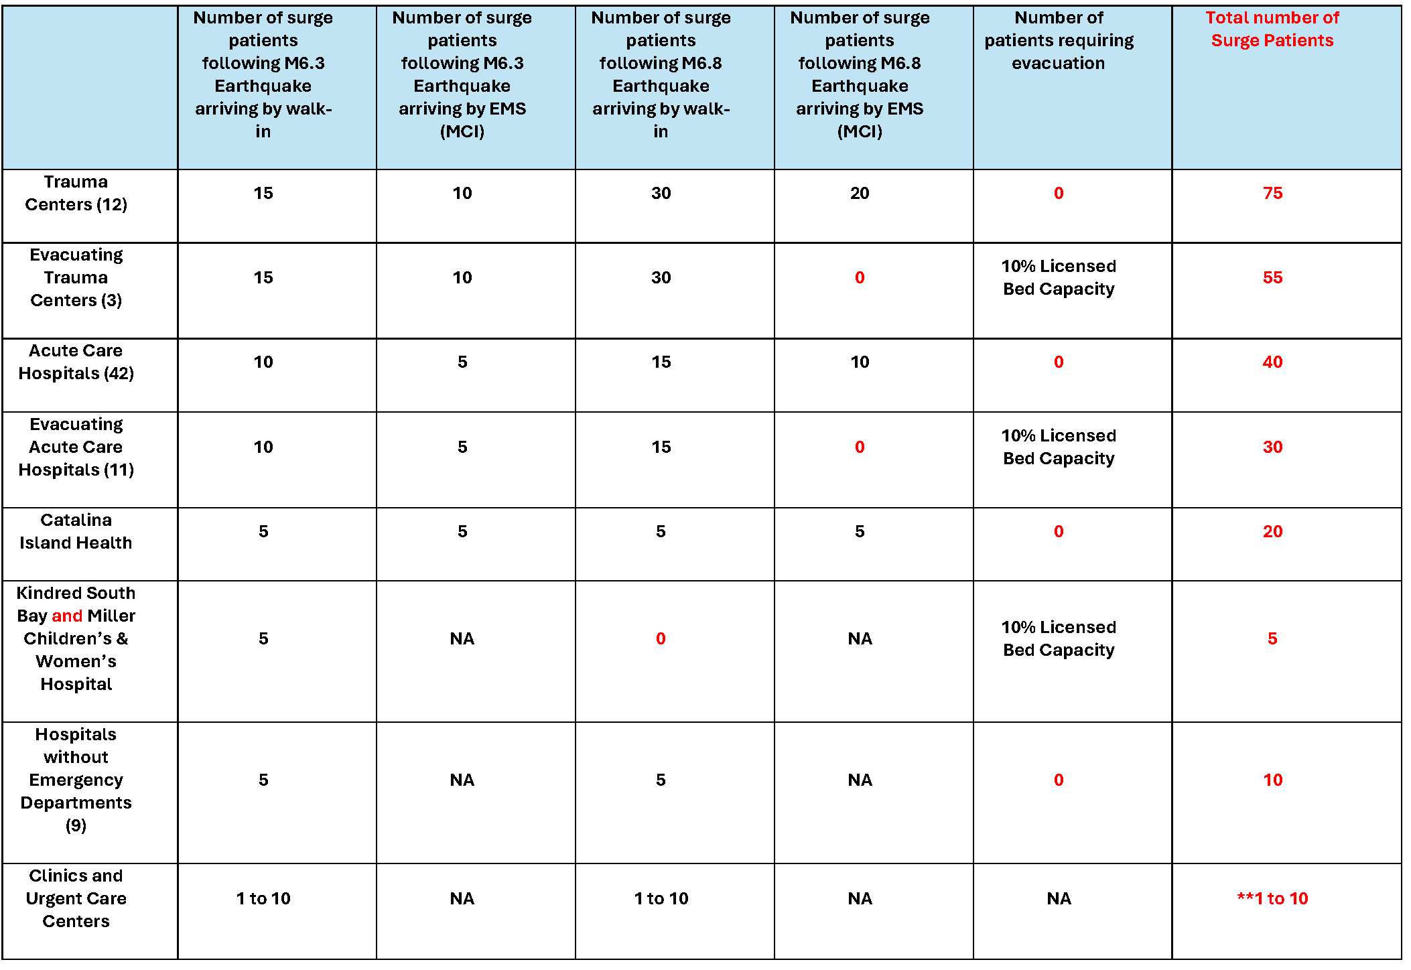
Patient Allocation Table
Notes:
Patient Allocation Table

Slide 22
MRSE Components
Our HCC still must meet ASPR grant requirements; specifically, the Medical Response and Surge Exercise (MRSE) requirements.
Surge Capacity Requirements
Performance Measures
Data Collection Requirements

Slide 23
Surge Capacity
The Healthcare Coalition (HCC) must surge to 10% of its licensed bed capacity
L.A. County has approx. 21,159 licensed beds. 10% = 2,160 surge patients
At a minimum we will surge to 3,195 patients

Slide 24
ReddiNet Assessment Poll:
Hospital Capacity Survey

Slide 25
Exercise Essentials
Scope
Assumptions
MSEL
Resource Requesting
Great ShakeOut
ARES
Conclusion of Exercise
Documentation
Registration

Slide 26
Exercise Scope
Command center activation is encouraged.
There will be no actual movement of patients.
Play will take place in the live ReddiNet system.
The exercise will begin at 8:00 a.m. and end at 12:00 p.m.

Slide 27
Exercise Assumptions
The scenario is plausible and meets criteria to activate applicable plans.
The time during the exercise is not reflective of actual time.

Slide 28
Master Scenario Event List (MSEL)
MSEL is a chronological list of simulated events (injects) that participants (players) will be asked to respond to during an exercise
Some injects are for all players such as the Service Level Poll
Some injects are for specific sectors and players such as Long-Term Care Bed availability Poll
It is okay to remove non-pertinent injects or add additional if needed to meet your objectives
Notes:
M6.3
All facilities will respond to the Service Level Poll as either “Green” (Normal Operations), “Yellow” (Under Control).
M6.8
Evacuating facilities will respond to the Service Level Poll as either “Red” (Limited Services) or “Black” (No Services) for the exercise.
Non-Evacuating facilities will respond to the Service Level Poll as either “Green” (Normal Operations), “Yellow” (Under Control), or “Orange” (Modified Services).

Slide 29
Resource Requesting
MCC will open a resource request incident to support the exercise titled:
“2025 AMHE Exercise”
Use this incident in ReddiNet for exercise related resource requests

Slide 30
Great ShakeOut
Great ShakeOut is Thursday, October 16, 2025
Good opportunity to expand/extend earthquake preparedness
Can use resources from the Great ShakeOut for November exercise (audio, video, etc.)

Slide 31
Amateur Radio Emergency Service (ARES)
Great opportunity to invite ARES to your hospital to test back-up communications
ARES will setup Net Control at the MAC
ARES can transmit and receive messages, resource requests, bed availability reports, and more via HAM radio

Slide 32
Conclusion of Exercise
Recommend hot-wash (debrief) with players
Participant Feedback Forms
60 days to complete and submit AAR/IP

Slide 33
Documentation
Exercise Objectives (Sector Specific)
Exercise Plan (ExPlan)
Situation Manual (SitMan)
Controller Evaluator Handbook
Exercise Evaluation Guide (Sector Specific)
Victim Cards
Master Scenario Event List (MSEL)
Participant Feedback Form
After-Action Report / Improvement Plan Template
USGS Earthquake Resources

Slide 34
Websites:
L.A. County Healthcare Coalition Website:
https://www.lacountyhcc.org/trainings-exercises-drills/mrse-medical-response-surge-exercise/2025-mrse
EMS Agency Website:
https://dhs.lacounty.gov/emergency-medical-services-agency/home/disaster-programs/exercise-drills/

Slide 35
Exercise Registration
Please register your facility for the exercise
Registration will confirm your facility is planning to participate
Registration will provide point-of-contact information to EMS
Registration will provide needed information from Evacuating facilities
Facility registration not individual players / participants

Slide 36
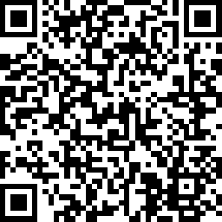
Exercise Registration https://www.surveymonkey.com/r/YS5KGSL

Slide 37
Questions
Type questions in chat or unmute

Slide 38

Thank you!
Darren Verrette
dverrette@dhs.lacounty.gov

