Slide 1
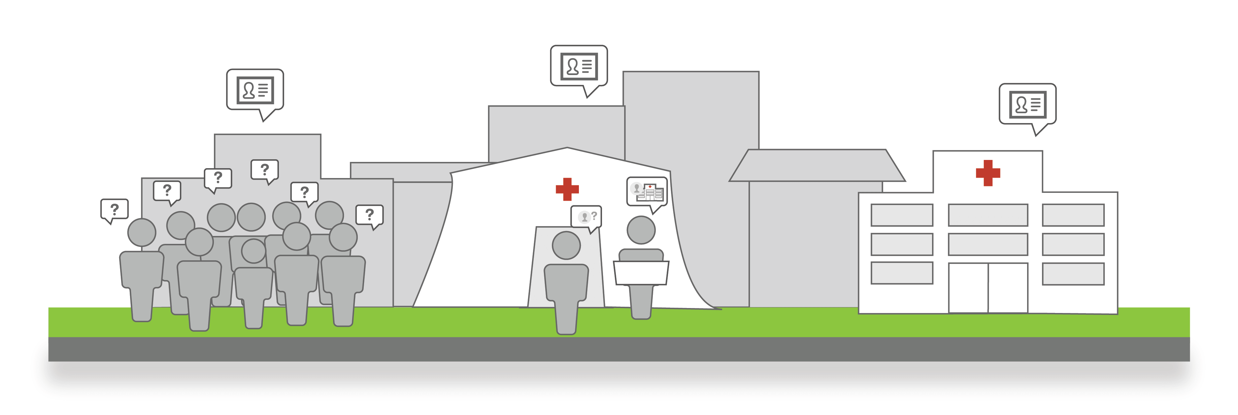
2025 Family Reunification Center Exercise Briefing
2025 FRC Exercise Briefing
Welcome

Slide 2
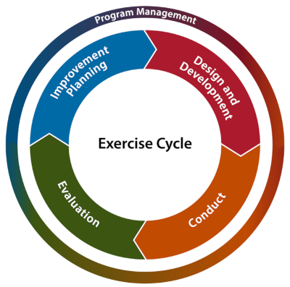
2025 Family Reunification Center (FRC) Exercise
  FRC exercise meets the Hospital Preparedness Program (HPP) grant requirement:
  10.9.2 “All participants will receive Seven Hundred and Fifty Dollars ($750) to maintain ReddiNet FRC application capability.”
  10.7.1 All No ED participants will receive Five Thousand Dollars ($5,000) and all other participants will receive Six Thousand Dollars ($6,000) to participate in exercises and drills in conjunction with County and community partners to ensure hospital preparedness, including but not limited to:
  10.7.1.2 “Participate in the annual Family Reunification Center (FRC) exercise by performing the following activities:”
    Attend FRC Briefing
    Attend one ReddiNet FRC Training
    Participate in the FRC Exercise
    Complete AAR Survey

Slide 3
2025 Family Reunification Center (FRC) Exercise
Family Information Center (FIC) Guide
Hospital Specific FIC Plans
Notes:
County of Los Angeles Office of Emergency Management and Department of Mental Health coordinate and operate Family Assistance Center (FAC)
Hospitals coordinate and operate Family Information Centers (FIC)

Slide 4
2024 FRC After-Action Report (AAR) Survey

Slide 5
2024 FRC After-Action Report (AAR) Survey

Slide 6

2024 FRC After-Action Report (AAR)
Strengths:
  Improved Connectivity
  Familiarity with Processes
  Effective Training and Preparedness
Areas for Improvement:
  Not all facilities participated
  More training
  Need for Standard Operating Procedures (SOP)
2024 FRC Exercise
Notes:
AAR available on website

Slide 7
Components of FRC Exercise
  FRC Briefing
  FRC Application Training
  FRC Exercise
  FRC AAR

Slide 8
FRC Application Training
  ReddiNet will provide FRC training:
    June 18th
    June 26th
    July 10th
    July 15th
  Registration open: https://attendee.gotowebinar.com/rt/7287100619328144216
Notes:
Required to have at least one end-user take basic FRC training session
In addition, recommended to have advanced users take hands-on session with Lewis West at ReddiNet (optional – not mandatory)
Basic training sessions will occur on June 18, June 26, July 10, July 15, 2025
The basic training sessions will focus on the exercise and attendance is required

Slide 9
Scope of Exercise:
    The FRC exercise is a functional exercise for Hospital Preparedness Program (HPP) fund recipients.
    Exercise activities will be conducted at HPP hospitals and will involve each facility identifying a safe and secure location to use as their reunification area.
    There will be no actual movement of patients. The exercise will last three hours to ensure all tasks are achieved.
    Play will take place in the live ReddiNet and FRC systems.
Notes:
Command center activation is not necessary
Three hours to allow time to complete reunification and to contact the facility where the missing person is located to find out if its okay to disclosure information, to confirm if still at facility, and to close the loop. In addition to identifying a safe and secure location for your reunification area we are asking that your end-users enter the location and telephone number into the FAC. We will request this data in the After-Action survey. No other complexities added to this year’s exercise. It will be very similar as last year’s exercise except different missing person and seeker assignments.

Slide 10
Exercise Participants:
Participants | Role | Extent of Play
Emergency Managers and/or Designee | Controller / Evaluator | Facilitate and evaluate play, Provide injects with needed patient and seeker data to players
*ReddiNet End Users (ED Charge Nurse, MICN, ED staff, etc.) | Player | Hospital ReddiNet MCI Module Management
FRC Application End Users (Social workers, registration staff, admission team, case management, PBX operators, administrators, etc.) | Player | Hospital FRC Application Management
EMS Agency / MAC | Player | Countywide ReddiNet Messaging and MCI Module Management
*No-ED facilities will not have ReddiNet End-Users
Notes:
No-ED facilities will not have ReddiNet End-Users

Slide 11
Exercise Assumption:
Incident meets criteria to activate your Family Reunification Center plan at your site.

Slide 12
Scenario:
A large-scale multi-casualty incident (MCI) has occurred, and multiple patients have been transported to hospital emergency departments throughout the county. Your facility has received one (1) patient via ambulance. Five (5) additional patients have self-dispatched to your facility by private auto and walked-into the emergency department. You have a total of six (6) patients from the incident in your emergency department. The patient that arrived by ambulance is initially amnestic to the incident and is only able to provide first name, last name, and age. The patient is otherwise stable in the delayed category. The patient has no identification or cell phone and cannot recall family contact information. The other patients who self-dispatched are stable and require observation only.

Slide 13
Scenario:
(No-ED)
A large-scale multi-casualty incident (MCI) has occurred, and multiple patients have been transported to hospital emergency departments throughout the county. Your facility has received one (1) patient by private auto. You have one (1) patient from the incident in your facility. The patient was initially amnestic to the incident and is only able to provide his first name, last name, and DOB. The patient is otherwise stable and in the delayed category. The patient has identification but no cell phone and cannot recall family contact information.
Notes:
11 non-ED Hospitals:
Barlow
City of Hope
Kindred Hospitals (La Mirada, Paramount, San Gabriel, South Bay)
LA Downtown Medical Center
Los Angeles Community Hospital
Miller Children's Hospital
Rancho
Southern California Hospital at Hollywood

Slide 14
Exercise Play:
Exercise will start at 8:00 a.m. and end at 11:00 a.m. to ensure all tasks are achieved.
Notes:
The exercise will last three hours to ensure all tasks are achieved followed by an internal debrief.

Slide 15
Master Scenario Events List (MSEL):
Inject # | Time | Inject Mode | Synopsis | From | To | Message | Expected Action | Responsible Organization | POC/Author | Comment
1 | 7:00am | In Person | Player Check-in | Controller / Evaluator (C/E) | Players | Player, Controller, Evaluator - Check In | All players check-in and receive appropriate materials. | All Players
2 | 7:45am | In Person | Player Briefing | C/E | Players | Player Briefing (Plan a 15 Min Brief) | Exercise director / facilitator conducts exercise and safety briefing. | All Players
3 | 8:00am | ReddiNet | Start Exercise (StartEx) | Medical Alert Center (MAC) | Hospitals | Start Exercise | Exercise participants initiate play. | All Players
4 | 8:00am | ReddiNet | MCI Initiated | MAC | Hospitals | MAC initiates MCI poll titled "2025 FRC Exercise" | Respond to MCI poll. Input bed availability data into ReddiNet MCI module (minimum quantities 2 Immediate, 2 Delayed, 2 Minor) | Hospital ReddiNet End-Users
5 | 8:00am to 8:10am | ReddiNet | MAC inputs patient destination | MAC | Hospitals | Each hospital will receive one (1) ambulance with one (1) "ambulance patient" | ReddiNet End-User arrives the ambulance in the ReddiNet MCI Module | Hospital ReddiNet End-Users
6 | 8:00am to 8:15am | In Person | Provide pre-designated patient demographic data | C/E | ReddiNet End User | C/E provides the pre-designated "ambulance patient" information to the ReddiNet End-User. The information is needed to update the MCI victim list. The information is regarding the "ambulance patient" who arrived at the Emergency Department by ambulance and contains the patient's first and last name, gender, age, and triage tag# | ReddiNet End-User updates MCI victim list and enters "ambulance patient": 1. First name, 2. Last Name 3. Sex, 4. Age, 5. Triage Tag # | Hospital ReddiNet End-Users
7 | 8:15am to 8:30am | In Person | Add five (5) additional walk-in patients to the MCI victim list | C/E | ReddiNet End User | C/E informs ReddiNet End-User to enter five (5) additional walk-in patients to the MCI victim list. Use fictional first names and your hospital's three 3- letter hospital code as the last names. | ReddiNet End-User enters five (5) walk-in patients into the MCI victim list. End user must check the box labeled "Walk-In" when adding walk-in patients. Use fictional first names, and gender. Do not enter a triage tag number. Use your hospital's 3-letter hospital code for the last names. | Hospital ReddiNet End-Users
8 | 8:30am | ReddiNet | MAC sends message to all hospitals that the County has activated a FAC to support the incident. All hospitals activate FIC/FRC Plan | MAC | Emergency Manager | The County has activated a Family Assistance Center (FAC) to support the incident. Activate your FIC/FRC plan. | Emergency Manager activates the FIC/FRC team and discuss next steps to activate the FIC/FRC plan. | Hospital EM and FIC team
9 | 8:40am | In Person | FRC End-User logs into Family Reunification Center (FRC) application and activates a "FAC" | C/E | FRC End-User | Designated FRC End-User of the FIC team logs into the FRC application and activates a "FAC" | 1. FRC End-User logs into the FRC application. 2. FRC End-User activates a "FAC" in the FRC application and names the "FAC" your hospital name followed by "- FRC Exercise" (e.g. "ACME Hospital - FRC Exercise"). 3. FRC End-User associates the "FAC" with the MCI titled "2025 FRC Exercise". 4. FRC End-User enters actual location information and direct telephone number of FAC | FRC End-User
10 | 8:40am | In Person | FRC End-User updates MCI patient profile in FRC application | C/E | FRC End-User | C/E provides the pre-designated "ambulance patient" information to the FRC End-User. The data is needed to update the "ambulance patient" profile in the FRC application. The information is regarding the "ambulance patient" who arrived in the Emergency Department by ambulance. | FRC End-User searches for the "ambulance patient" profile in the FRC application and updates the profile with the following seven (7) data elements: 1. DOB. 2. Eye Color. 3. Hair Color. 4. Height. 5. Weight. 6. Language. 7. Ethnicity | FRC End-User
11 | 8:50am | In Person | Register the five (5) pre-designated seekers into the FRC "FAC" | C/E | FRC End-User | Five (5) unrelated persons (designated seekers) each seeking a family member (missing person/patient) involved in the incident arrived at your hospital. The missing persons (patients) are located at other facilities. C/E provides the Seeker data to the FRC End-User to Register into the "FAC" | Register each Seeker into the FRC "FAC" from data provided by C/E. (Seekers will have all demographic data of the missing person) | FRC End-User
12 | 9:00am | In Person | Facilitate family reunification | C/E | FRC End-User | Inform the FRC End-User to locate and reunite each Seeker with the correct missing person (patient) in the FRC application and inform the family (C/E) of their location. | Locate and reunite each designated Seeker with the correct missing person (patient) in the FRC application. | FRC End-User
13 | 9:00am to 11:00am | In Person | Contact other facilities | C/E | FRC End-User | Inform the FRC End-User to contact the facility with the missing person (patient) to confirm the person is at that location and that it is okay to disclose information. Close the loop. | After locating the missing person, call the facility with the missing person. Use the telephone number listed in the MCI victim profile. Confirm the person is at that location and it is okay to disclose information. Inform the seeking-person (family member) of the missing-person's location only. | FRC End-User
14 | 11:00am | ReddiNet | End Exercise (End Ex) | MAC | Hospitals | End Exercise | End all exercise play and activity. (Do Not Deactivate FAC) | All Players
15 | 11:00am to 11:30am | In Person | Debrief with players within your facility | C/E | All Players | Huddle all players for a debrief | Conduct debrief and have all players complete a participant feedback form | All Players
16 | 12:00pm | In Person | De-activate FAC (1-hour after conclusion of exercise) | C/E | FRC End-User | Do not deactive FAC before 12:00 p.m. Inform the FRC End-User to deactivate "FAC" in FRC at 12:00 p.m. | FRC End-User deactivates "FAC" in FRC at 12:00 p.m. (1 hour after conclusion of exercise.) | FRC End-User
Notes:
Injects #4, 5, 6, & 7 do not apply to non-ED hospitals.

Slide 16
No-ED Master Scenario Events List (MSEL):
Inject # | Time | Inject Mode | Synopsis | From | To | Message | Expected Action | Responsible Organization | POC/Author | Comment
1 | 7:00am | In Person | Player Check-in | Controller / Evaluator (C/E) | Players | Player, Controller, Evaluator - Check In | All players check-in and receive appropriate materials. | All Players
2 | 7:45am | In Person | Player Briefing | C/E | Players | Player Briefing (Plan a 15 Min Brief) | Exercise director / facilitator conducts exercise and safety briefing. | All Players
3 | 8:00am | ReddiNet | Start Exercise (StartEx) | Medical Alert Center (MAC) | Hospitals | Start Exercise | Exercise participants initiate play. | All Players
4 | 8:00am | ReddiNet | MCI Initiated | MAC | Hospitals | MAC initiates MCI poll titled "2025 FRC Exercise" | Respond to MCI poll. Input bed availability data into ReddiNet MCI module (minimum quantities 2 Immediate, 2 Delayed, 2 Minor) | Hospital ReddiNet End-Users
5 | 8:00am to 8:10am | ReddiNet | MAC inputs patient destination | MAC | Hospitals | Each hospital will receive one (1) ambulance with one (1) "ambulance patient" | ReddiNet End-User arrives the ambulance in the ReddiNet MCI Module | Hospital ReddiNet End-Users
6 | 8:00am to 8:15am | In Person | Provide pre-designated patient demographic data | C/E | ReddiNet End User | C/E provides the pre-designated "ambulance patient" information to the ReddiNet End-User. The information is needed to update the MCI victim list. The information is regarding the "ambulance patient" who arrived at the Emergency Department by ambulance and contains the patient's first and last name, gender, age, and triage tag# | ReddiNet End-User updates MCI victim list and enters "ambulance patient": 1. First name, 2. Last Name 3. Sex, 4. Age, 5. Triage Tag # | Hospital ReddiNet End-Users
7 | 8:15am to 8:30am | In Person | Add five (5) additional walk-in patients to the MCI victim list | C/E | ReddiNet End User | C/E informs ReddiNet End-User to enter five (5) additional walk-in patients to the MCI victim list. Use fictional first names and your hospital's three 3- letter hospital code as the last names. | ReddiNet End-User enters five (5) walk-in patients into the MCI victim list. End user must check the box labeled "Walk-In" when adding walk-in patients. Use fictional first names, and gender. Do not enter a triage tag number. Use your hospital's 3-letter hospital code for the last names. | Hospital ReddiNet End-Users
8 | 8:30am | ReddiNet | MAC sends message to all hospitals that the County has activated a FAC to support the incident. All hospitals activate FIC/FRC Plan | MAC | Emergency Manager | The County has activated a Family Assistance Center (FAC) to support the incident. Activate your FIC/FRC plan. | Emergency Manager activates the FIC/FRC team and discuss next steps to activate the FIC/FRC plan. | Hospital EM and FIC team
9 | 8:40am | In Person | FRC End-User logs into Family Reunification Center (FRC) application and activates a "FAC" | C/E | FRC End-User | Designated FRC End-User of the FIC team logs into the FRC application and activates a "FAC" | 1. FRC End-User logs into the FRC application. 2. FRC End-User activates a "FAC" in the FRC application and names the "FAC" your hospital name followed by "- FRC Exercise" (e.g. "ACME Hospital - FRC Exercise"). 3. FRC End-User associates the "FAC" with the MCI titled "2025 FRC Exercise". 4. FRC End-User enters actual location information and direct telephone number of FAC | FRC End-User
10 | 8:40am | In Person | FRC End-User registers designated patient into FRC application | C/E | FRC End-User | C/E provides pre-designated patient data to the FRC End User. The data is needed to register the desginated patient into the FRC system. | FRC End User enters the patient data into the FRC application with the following eleven (11) data elements: 1. Triage tag #. 2. First Name. 3. Last name. 4. DOB. 5. Gender. 6. Eye Color. 7. Hair Color. 8. Height. 9. Weight. 10. Language. 11. Ethnicity | FRC End-User
11 | 8:50am | In Person | Register the five (5) pre-designated seekers into the FRC "FAC" | C/E | FRC End-User | Five (5) unrelated persons (designated seekers) each seeking a family member (missing person/patient) involved in the incident arrived at your hospital. The missing persons (patients) are located at other facilities. C/E provides the Seeker data to the FRC End-User to Register into the "FAC" | Register each Seeker into the FRC "FAC" from data provided by C/E. (Seekers will have all demographic data of the missing person) | FRC End-User
12 | 9:00am | In Person | Facilitate family reunification | C/E | FRC End-User | Inform the FRC End-User to locate and reunite each Seeker with the correct missing person (patient) in the FRC application and inform the family (C/E) of their location. | Locate and reunite each designated Seeker with the correct missing person (patient) in the FRC application. | FRC End-User
13 | 9:00am to 11:00am | In Person | Contact other facilities | C/E | FRC End-User | Inform the FRC End-User to contact the facility with the missing person (patient) to confirm the person is at that location and that it is okay to disclose information. Close the loop. | After locating the missing person, call the facility with the missing person. Use the telephone number listed in the MCI victim profile. Confirm the person is at that location and it is okay to disclose information. Inform the seeking-person (family member) of the missing-person's location only. | FRC End-User
14 | 11:00am | ReddiNet | End Exercise (End Ex) | MAC | Hospitals | End Exercise | End all exercise play and activity. (Do Not Deactivate FAC) | All Players
15 | 11:00am to 11:30am | In Person | Debrief with players within your facility | C/E | All Players | Huddle all players for a debrief | Conduct debrief and have all players complete a participant feedback form | All Players
16 | 12:00pm | In Person | De-activate FAC (1-hour after conclusion of exercise) | C/E | FRC End-User | Do not deactive FAC before 12:00 p.m. Inform the FRC End-User to deactivate "FAC" in FRC at 12:00 p.m. | FRC End-User deactivates "FAC" in FRC at 12:00 p.m. (1 hour after conclusion of exercise.) | FRC End-User
Notes:
Injects #4, 5, 6, & 7 do not apply to No-ED hospitals.
11 non-ED Hospitals:
Barlow
City of Hope
Kindred Hospitals (La Mirada, Paramount, San Gabriel, South Bay)
LA Downtown Medical Center
Los Angeles Community Hospital
Miller Children's Hospital
Rancho
Southern California Hospital at Hollywood

Slide 17
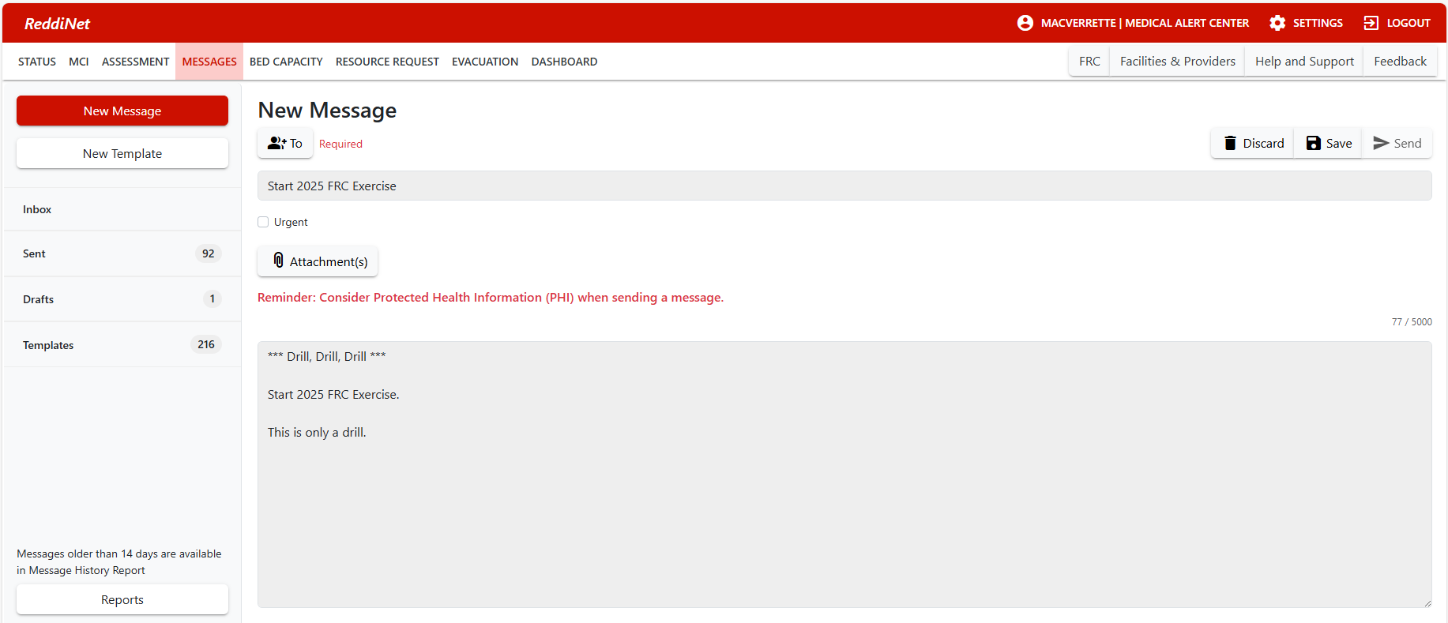
ReddiNet Message Screen:
Notes:
ReddiNet Message Screen:
Inject #3

Slide 18
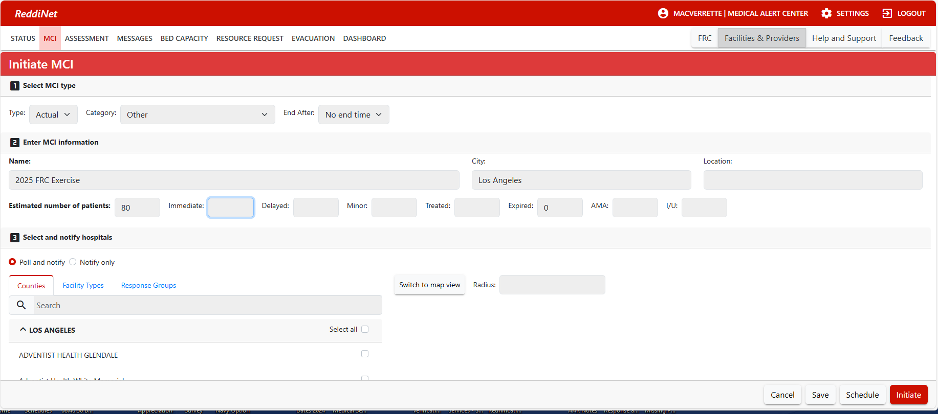
ReddiNet MCI Screen:
Notes:
ReddiNet MCI Screen:
Inject #4
Non-ED’s will not be assigned MCI patients in ReddiNet

Slide 19
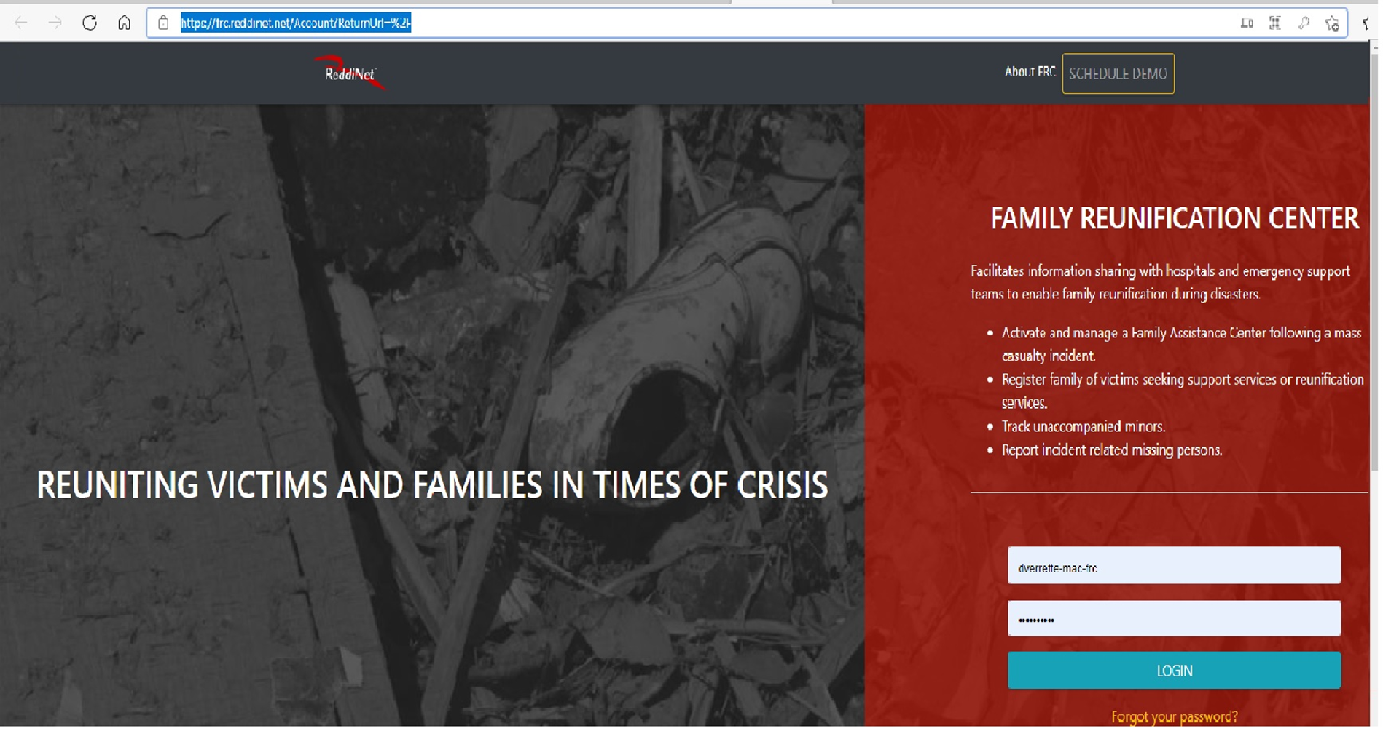
Notes:
FRC Login Screen
Inject #9

Slide 20
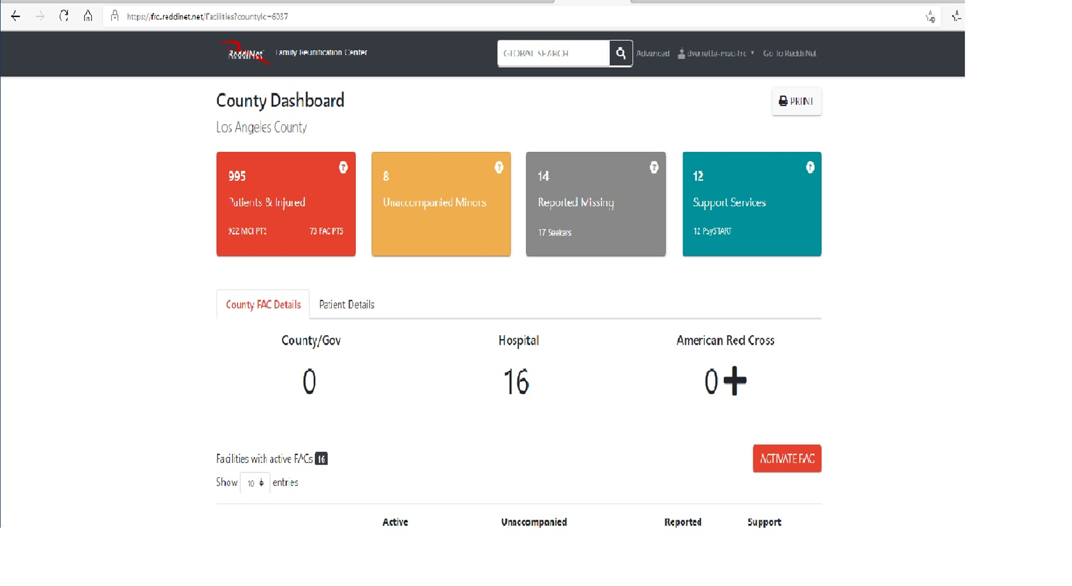
FRC Application Dashboard:
Notes:
FRC Application

Slide 21

Patient and Seeker Data:
Patient Data
Seeker Data

Slide 22
Healthcare Coalition Website
Notes:
Download exercise documents. Google documents
Register your facility for the Exercise. This is facility level registration only and not intended for individual exercise players.

Slide 23
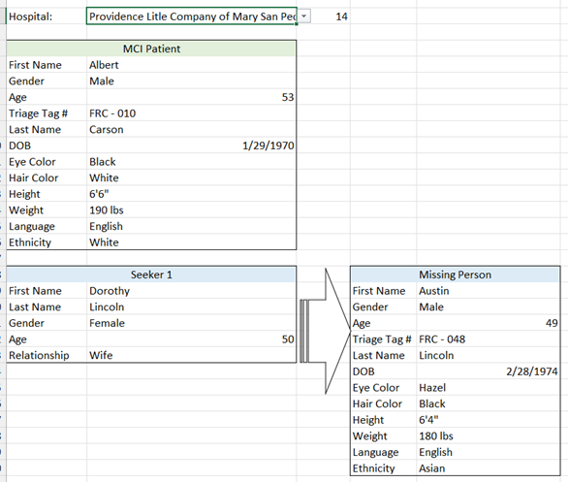
Injects:
Notes:
You will need to create your own inject cards or prompts from the Patient and Seeker data

Slide 24
Player Role After Exercise
Conduct debrief with players at your facility
Complete and submit a Participant Feedback form
Notes:
EM conducts hotwash / debrief
C/E sends in AAR/IP to EMS Agency

Slide 25
Confirmation of Exercise Participation:
AAR / IP Submission
Within 60 days following exercise
Notes:
Submit within 60 days following exercise. Will utilize survey monkey to capture AAR data.

Slide 26
Documentation:
Available on HCC and EMS Website
Exercise Plan
Controller / Evaluator Handbook
Exercise Evaluation Guide
Participant Feedback Form
After-Action Report/Improvement Plan
Master Scenario Event List (MSEL)
2025 FRC Patient and Seeker Data
Notes:
The Exercise Plan (ExPlan) gives elected and appointed officials, observers, media personnel, and players from participating organizations information they need to observe or participate in the exercise. Some exercise material is intended for the exclusive use of exercise planners, controllers, and evaluators, but players may view other materials that are necessary to their performance. All exercise participants may view the ExPlan.
The Controller/Evaluator (C/E) Handbook describes the roles and responsibilities of exercise controllers and evaluators, and the procedures they should follow. Because the C/E Handbook contains information about the scenario and about exercise administration, it is distributed to only those individuals specifically designated as controllers or evaluators; it should not be provided to exercise players. The C/E Handbook may supplement the Exercise Plan (ExPlan) or be a standalone document.
The Exercise Evaluation Guides (EEGs) are structured to capture information specifically related to the evaluation requirements developed by the Exercise Planning Team. The following evaluation requirements are documented in each EEGthe capability target will be met. Critical tasks generally

Slide 27
Questions?

Slide 28
Thank You!

