Slide 1
LOS ANGELES COUNTY
2024 MEDICAL RESPONSE AND SURGE EXERCISE (MRSE) PARTICIPANT WEBINAR
EXERCISE PLANNING 101
Essence Wilson, Senior Nursing Instructor
Disaster Program Manager
eswilson@dhs.lacounty.gov
562-378-2442

Slide 2
PRESENTATION OBJECTIVES
At the end of this presentation, each participant will be able to:
Define 3 types of exercise – tabletop, functional and full-scale
Verbalize at least 3 components needed to plan/conduct an exercise
Understand the purpose of each component and how they relate to each other
Discuss how to adapt the LA County Master Scenario Events List (MSEL) to suit the needs of their facility or agency

Slide 3
EMS AGENCY
Support agency – responsible for coordinating care during a large-scale disaster or incident either within the Medical Alert Center (MAC) or Medical Coordination Center (MCC)
Not affiliated with CMS nor any other regulatory body, however, exercising with us may assist sectors in meeting some regulatory requirements
Mission is to support and train medical sectors to be prepared for a disaster
Overarching goal during a disaster: Each patient receive the correct care at the correct facility that can meet their needs

Slide 4
DEFINITIONS OF 3 TYPES OF EXERCISES
Tabletop exercise (TTX)
Facilitator guided discussion on one or more scenarios. Focus on policies and procedures
Simulated operational environment. Designed to exercise specific team members, processes and/or resources
Typically, a lengthier exercise that takes place on location using equipment and personnel that would be called upon in an actual event (most realistic)
Functional exercise
Full-scale exercise
Community Wide - An exercise that involves more that just your facility or agency

Slide 5
EXERCISE COMPONENTS
Objectives
Scenario
Master Scenario Events List (MSEL)
Exercise Injects (i.e. victims, messages)
Exercise Evaluation/Participant Feedback
After Action Report (AAR)
Improvement Plan (IP)
2024 MRSE

Slide 6
OBJECTIVES
Objectives are what you would like to test e.g., communication, triage, contacting specialists, etc.
Review previous AARs and IPs
For each objective, list steps on how the objective could be tested – example to follow
Need to be measurable

Slide 7
OBJECTIVE EXAMPLE
OBJECTIVE: Communication
Maintain situational awareness by gathering and sharing real-time information related to the emergency and the current state of the (facility/agency) through coordination with ….(staff, EMS Agency, etc.)
Sample Task(s):
Activate communication plan/policy or develop a process for sharing of information related to the incident with on-duty staff and those who are scheduled to work within 30 minutes of incident notification
Respond to communication received from local healthcare partners and/or EMS Agency MCC, e.g., service level request, resource availability and/or capabilities.
Utilize and test redundant communication systems [insert specific systems to test, such as text messaging, email, mass notification software, etc. – refer to your communication plan/policy] to notify staff, response partners and EMS Agency MCC as applicable.

Slide 8
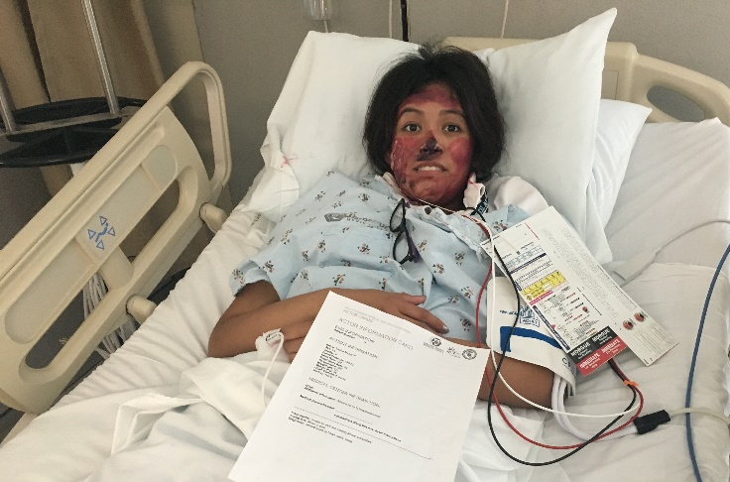
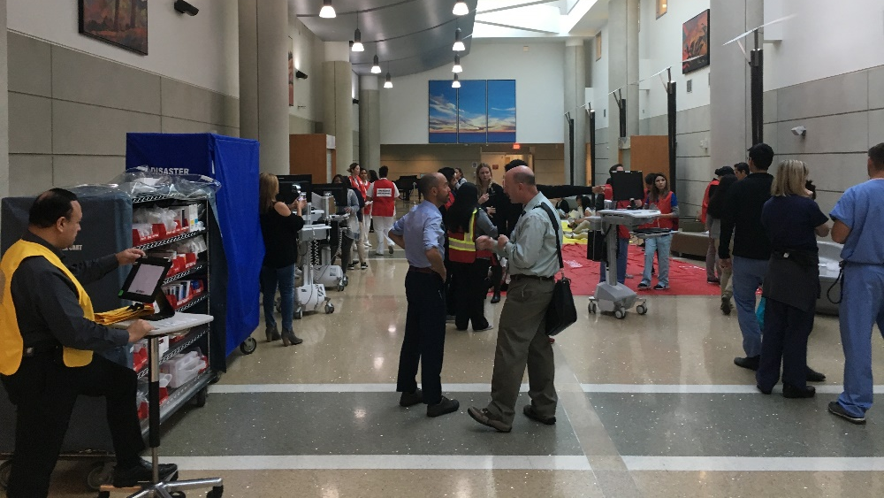
SCENARIO
The scenario should be developed after the objectives have been determined so that it can test the objectives
However, with the Medical Response & Surge Exercise (MRSE), the scenario has already been set – Burn surge
Scenario should be relevant, and include situations that will test the objectives i.e., based on your Hazard Vulnerability Analysis/Assessment (HVA)

Slide 9
MASTER SCENARIO EVENTS LIST (MSEL)
Chronological listing of events
Used in an exercise
Based on the scenario and sample tasks for each objective
Each row is called an inject with a time assigned to it
Column headings may include, but not limited to inject number, time, from and to actual message/information, expected action
MSEL for the MRSE has more columns
Only exercise controllers should have access to the MSEL

Slide 10
EXCERPT FROM MRSE MSEL

Slide 11
EXERCISE INJECTS
Hand delivered message
Email blast
Phone call
Overhead announcement
Pre-filled forms (i.e., FAC seeker forms)
Live mock victims

Slide 12
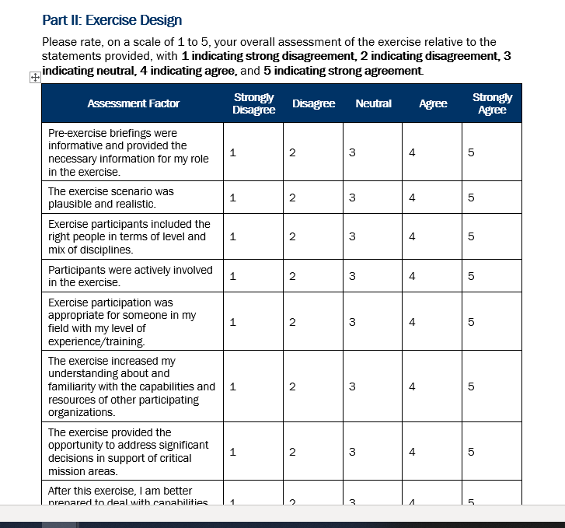
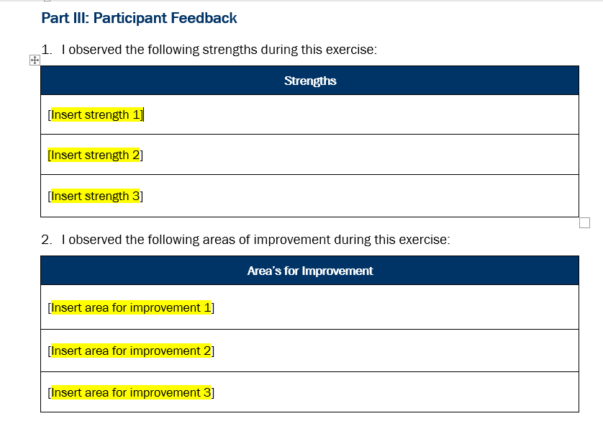
EXERCISE EVALUATION – PARTICIPANT FEEDBACK FORM
Exercise evaluation guides are available on the LACountyHCC.org website along with a Participant Feedback Form
Anyone who participates in any way (player, controller, evaluator, etc.) should complete a feedback form
Information from evals and feedback should be collated, organized and put into an After-Action Report (AAR)

Slide 13
AFTER ACTION REPORT (AAR)
/IMPROVEMENT PLAN (IP)
Can be two documents or combined into one
AAR contains information on how the exercise went – did you meet your objectives by completing the sample tasks?
Which areas did you do well in (strengths)
Which areas need some improvement
Improvement plan should be based on the areas for improvement
AARs for the MRSE are due 60 days after the exercise (mid January 2025)

Slide 14
AFTER ACTION REPORT (CONTD.)
List top 3 strengths
We were able to contact all staff both in the facility and those scheduled to work later in the day
List top 3 areas for improvement
We were unable to contact all appropriate staff as the call list did not contain everyone’s current numbers

Slide 15
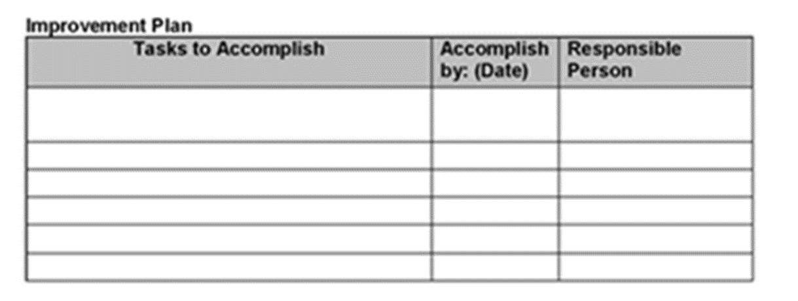
IMPROVEMENT PLAN
Improvement plan is based on your areas for improvement
Based on the previous example - We were unable to contact all appropriate staff as the call list did not contain everyone’s current numbers
Enter the date to be accomplished and the person responsible for completing the task

Slide 16
EMS AGENCY DISASTER PROGRAM MANAGERS
Hospitals, Pediatric Surge, Trauma Surge, HDMT:
Essence Wilson
Email: eswilson@dhs.lacounty.gov
Phone: 562-378-2442
Ambulatory Surgery Centers, Dialysis Centers, Home Health/Hospice Agencies, Urgent Cares:
Laurie Lee-Brown
Email: llee-brown6@dhs.lacounty.gov
Phone: 562-378-2459
Back up for Hospitals, Pediatric Surge, Trauma Surge, HDMT:
Lorna Mendoza
Email: lmendoza3@dhs.lacounty.gov
Phone: 562-378-2457
Clinics, Long Term Care Facilities, EMS Providers, Emerging Infectious Diseases:
Nnabuike “BK” Nwanonenyi
Email: nwanon@dhs.lacounty.gov
Phone: 562-378-2460

Slide 17
REFERENCES
Homeland Security Exercise and Evaluation Program (HSEEP) https://www.fema.gov/sites/default/files/2020-04/Homeland-Security-Exercise-and-Evaluation-Program-Doctrine-2020-Revision-2-2-25.pdf
Exercises. (2023). Ready. https://www.ready.gov/business/training/testing-exercise/exercises

Slide 18
Resource Links
Lacountyhcc.org
https://dhs.lacounty.gov/emergency-medical-services-agency/home/disaster-programs/

Slide 19
THANK YOU

