Slide 1
Burn Surge Plan
Essence Wilson, BSN, PHN
Disaster Program Manager
Los Angeles County EMS Agency

Slide 2
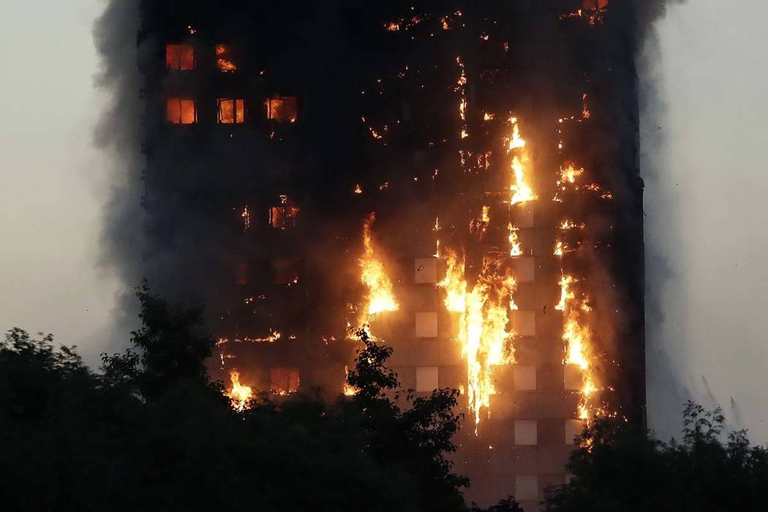
Learning Objectives
Discuss why we need a burn surge plan
Define Burn disaster
Describe the role of Los Angeles County trauma centers during a surge of patients
Describe the role of Los Angeles County 911 Receiving EDs during a surge of burn patients
London 2017

Slide 3
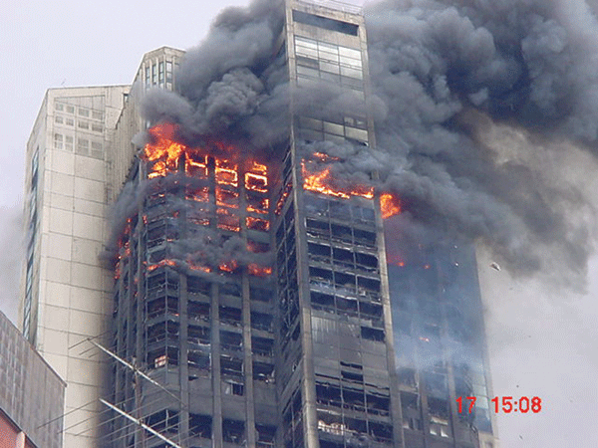
What is a Burn Disaster?
Any event in which the number
of patients with burns exceeds
the capability of local resources
Leads to a “surge” of patients
  2001 - World Trade Center 22 injuries sent to one burn center

Slide 4
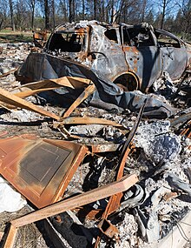
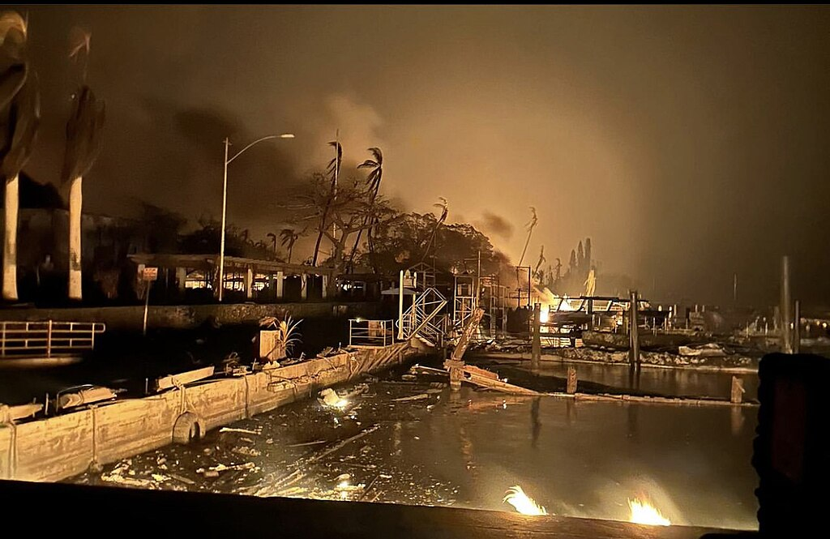
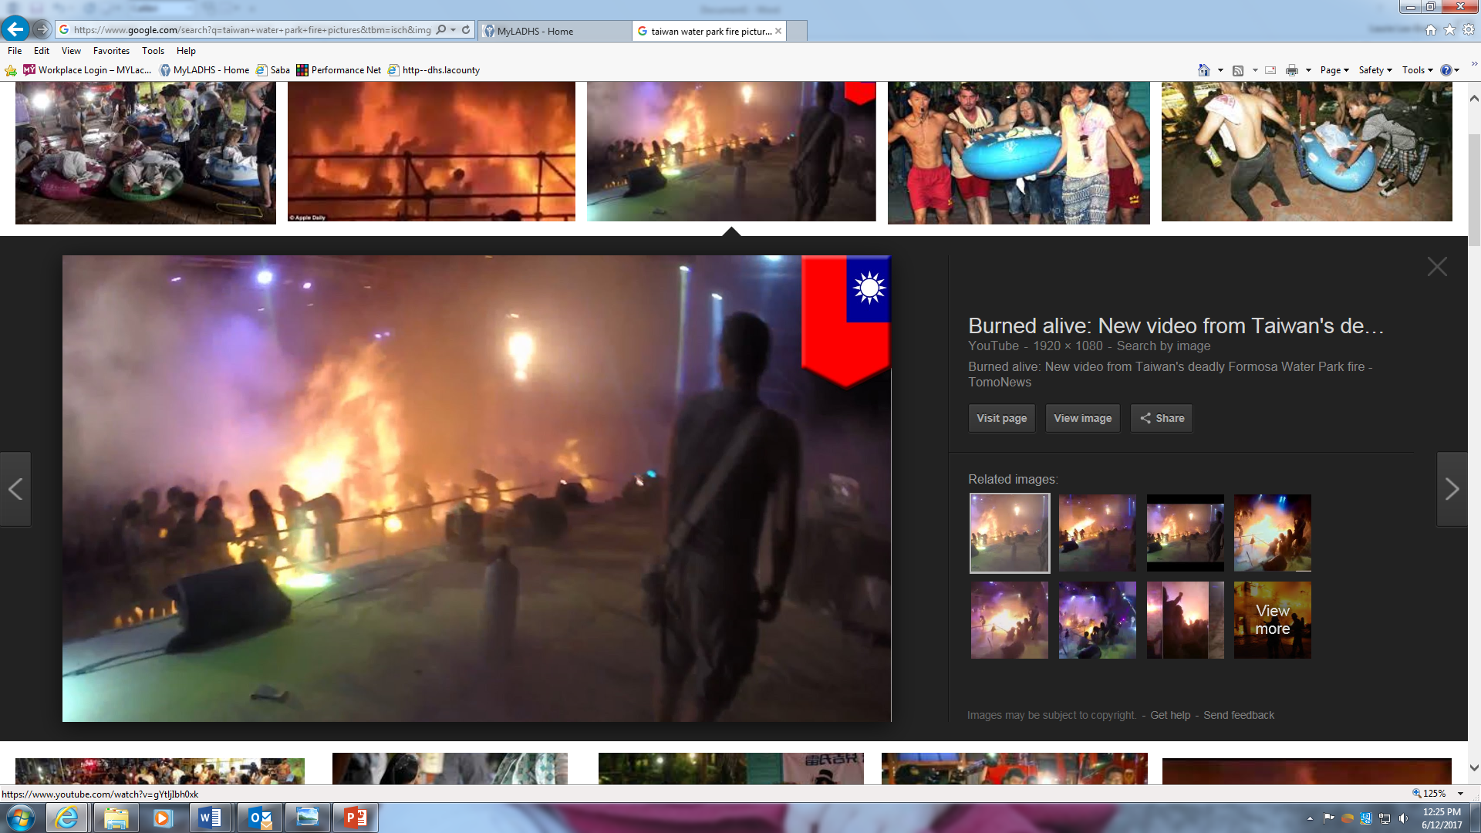
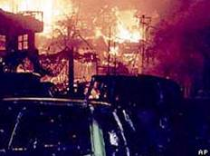
Historical Burn Disasters
2018 – Camp Fire in Northern California’s Butte County
17 Injured / 85 deaths
2023 - Hawaii Wildfires
67 injured, 102 deaths
Terrorist attacks Bali car
bombing 2003: 209 injured
Taiwan 2015-498 injuries

Slide 5



Why do we need a “Burn Surge Plan”?
Homeland Security initiative
Federal Grant Requirements
Hospital Preparedness Program (HPP)

Slide 6
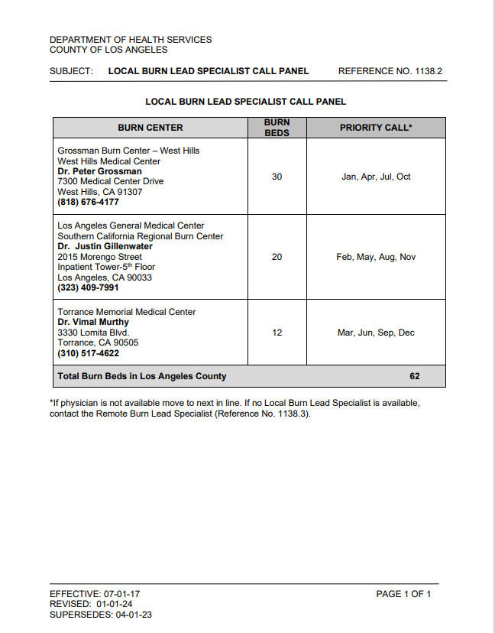
Los Angeles County’s
Burn Capacity and Burn Surge Capacity
Current patient capability in Los Angeles County is ~62 designated burn beds between three area hospitals (Ref. No. 1138.2)
The Burn Surge plan will create an additional 300 disaster burn beds
Grossman Burn Center - 30
LA Gen Med Center - 20
Torrance Memorial Medical Center- 12
15 Trauma Hospitals x 20 critical burn patients = 300

Slide 7
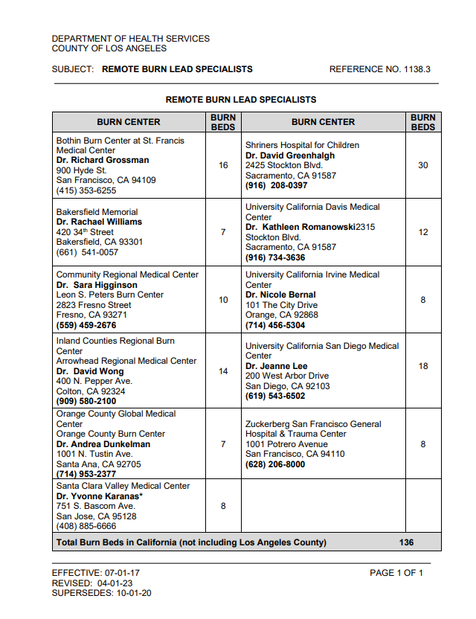
Regional Burn Care Capacities
Current designated burn bed capability in California excluding Los Angeles County is ~ 136 (Ref. No. 1138.3)
California - total ~198 burn beds
U.S. Burn Care Capacities
  ~125 designated burn centers
  ~1,825 designated burn beds

Slide 8
What is the Plan for
Los Angeles County in the event of a burn disaster?

Slide 9
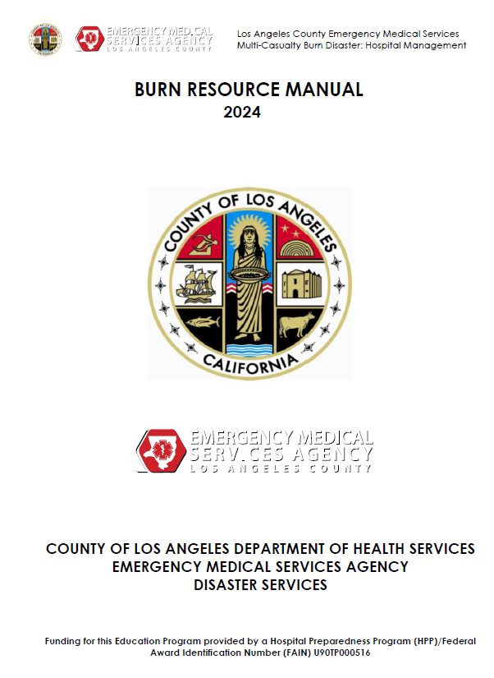
The Burn Surge Plan
Utilize the established trauma system that can accommodate large number of beds and have highly trained personnel
Designate the Trauma hospitals as “Burn Resource Centers” (Reference No. 1138)
Establish hospital guidelines for TC to provide burn care for up to 20 patients for up to 72 hours

Slide 10
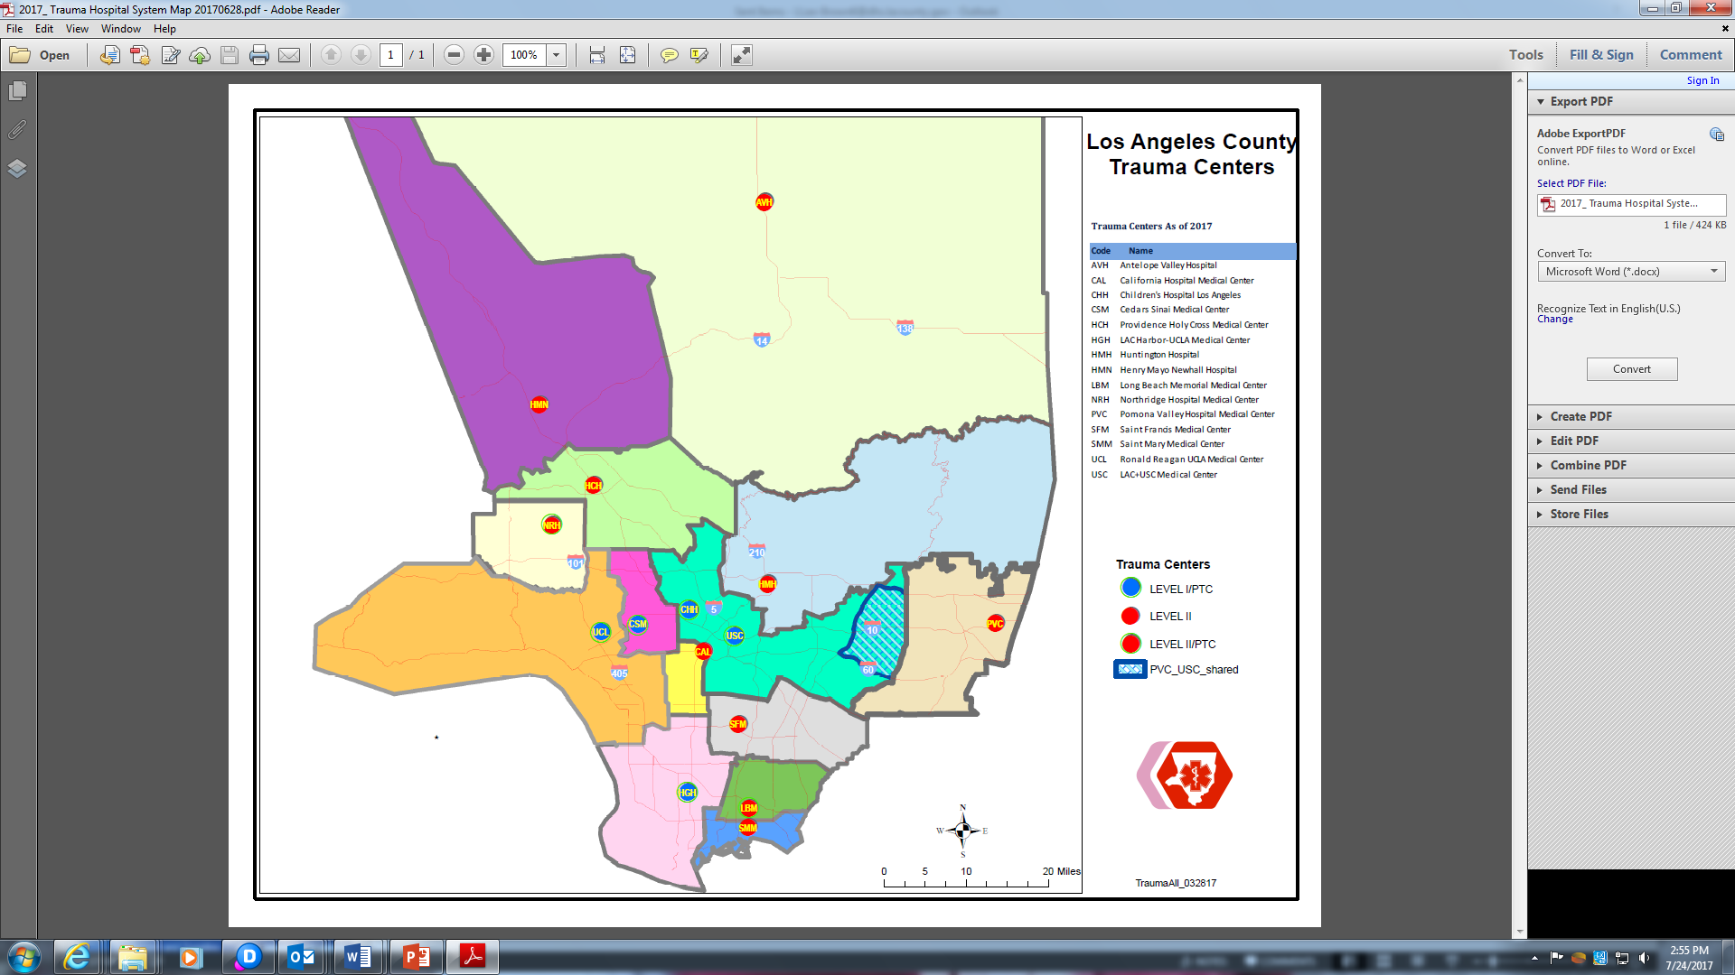

Trauma Centers-LA County
Trauma Centers
Antelope Valley Hospital
California Hospital Medical Center
Cedars Sinai Medical Center
Children’s Hospital Los Angeles
Henry Mayo Newhall Hospital
Huntington Memorial Hospital
LAC Harbor/UCLA Medical Center
Los Angeles General Medical Center
Long Beach Memorial Medical Center
Northridge Hospital Medical Center
Pomona Valley Hospital Medical Center
Providence Holy Cross Medical Center
Saint Francis Medical Center
Saint Mary Medical Center
Ronald Reagan UCLA Medical Center
PTC
PTC
PTC
PTC
PTC
PTC
PTC
7 Peds Trauma Centers

Slide 11
Policy 1138 Burn Resource Center (BRC) Designation & Activation
Burn Surge Plan Activation- An incident resulting in 20 or more burn patients or any event that exceeds burn care resources available in LAC
Burn Resource Center
A BRC is a designated trauma center in LAC that has agreed to provide medical care for up to 20 critically burned patients for a minimum of 72 hours.
BRC shall ensure a constant state of readiness:
  Provision of pharmaceuticals
  Medical supplies
  Equipment
  Training and resource materials to BRC staff for management of burn patients

Slide 12
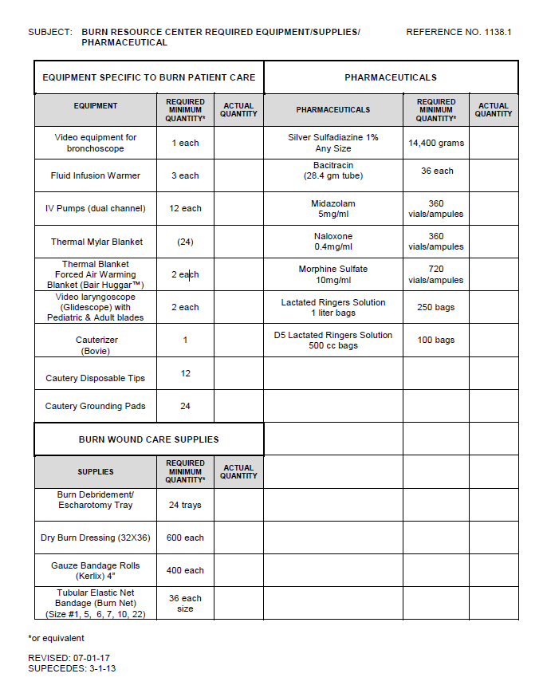


Policy 1138.1, 1138.2 & 1138.3
Policy Ref. No 1138.1:
Policy Ref. No 1138.1:
  Pharmaceuticals
  Equipment
  Supplies
Policy Ref. No 1138.2:
  Local Burn Lead Specialist Call Panel
Policy Ref. No 1138.3:
  Remote Burn Lead Specialist Call Panel

Slide 13
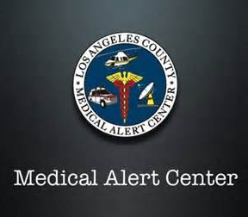

Burn Surge Plan Activation
EMS Administrator on Duty (AOD) decides if the BRCs are activated
Med Alert Center (MAC) will :
  Coordinate patient distribution to avoid overloading a single facility
Notification via ReddiNet

Slide 14
Burn Injury Classification
Major/Critical Burns:
  Adults (15+): Burns ≥ 20% Total Body Surface Area (TBSA)
  Pediatrics (14 and under): Burns ≥ 10% TBSA
Minor Burns:
  Adults: Burns < 20% TBSA
  Pediatrics: Burns < 10% TBSA
BRC (Trauma Center)
Most Assesible 911 Receiving ED

Slide 15
How Will MAC Decide Who Goes Where?
Consultation with an on call “Local Burn Lead Specialist” An MD from an LA County burn center
  Assist MAC and the EMS system in managing available burn resources
  Consultant for: triage, treatments, transfers
  Transfer and treatment priority will be based on ethical standards

Slide 16
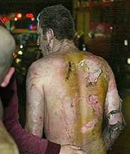
Transfer Priorities for LA County Burn Disaster
Patient transfer plan:
  All burn patients will be moved to higher levels of care
  as soon as space becomes available
9-1-1 receiving hospitals:
  Care focused on minor burn injuries
  Major/Critical burn injuries sent to Trauma Centers
Burn Resource Center to Burn Center
  Transfers should occur within 72
  hours but may not always happen
  Burn Lead Specialist available for
  consultation and assistance
Burn Center to Out of Area Burn Center
  Agreements should be formed to more
  easily transfer patients (Regional Plan)

Slide 17
Applicable LA County Policies
  Ref. No. 1130 Trauma Center Emergency
  Preparedness
  Ref. No. 1138 Burn Resource Center
  Designation and Activation
  Ref. No. 512 Burn patient destination
  Ref. No. 519 Multi Casualty triage guidelines

Slide 18
Summary
Disasters will require some adjustments to the way things are “normally done” so be flexible
Surge events create strain on resources
Surge plan activations and patient destination assignments will be handled by the MAC
Destination policies may be waived

