Slide 1
Resource Request
Critically Low
Dr
Back Order
Cir
Scarce
Ave
Emergent
Rd
Isabel Sanchez
Emergency Coordination Program
MHOAC, DEC, RDMHC
L.A. County EMS Agency
E: ISanchez2@dhs.lacounty.gov

Slide 2
Resource Request
The formal process where a facility/agency identifies and requests a specific resources needed to effectively manage and respond to an emergency or critical situation. This can include equipment, supplies, and personnel.
The goal of a resource request is to effectively and efficiently utilize resources to support the response and recovery efforts of the operational area during an emergency.
Notes:
What is a resource request?

Slide 3
Resource Request
MCC (EMS Agency vs City/County EOC
EMS Agency
Medical Supplies
Medical Staff
Movement of Patients
Pharmaceuticals
PPE
Medical (masks, gloves, etc)
Surge Capacity Supplies
Decontamination Trailer/supplies
CHEMPACK
Medical Equipment
(Ventilators, Cardiac Monitors)
Tents, Generators, HVACs
Mental Health
City/County
Non-Medical Supplies
Security/Law Enforcement
Street Closures/Barricades
Utilities
Water/Power/Gas/Phone
Food and Potable Water
Family Assistance Centers
Notes:
Resources Requests can be made via the Medical Coordination Center, the City Emergency Operations Center or the County Emergency Operations Center. This slide represents where things are requested from.
Please note that we do not want you to make requests directly thru the County EOC, they will send it to the DHS representative at the EOC who will then send it back to us at the MCC.
If your facility is in a city with a local EOC and you have an established relationship with them, direct your requests to the City EOC. Hospitals and healthcare agencies are encouraged to build these local relationships for smoother coordination.
However, if you have not established a relation with your city EOC, you can submit your requests to the MCC, just keep in mind that if the request is not a Medical & Health request then there may be an increased delay in getting that asset to you!

Slide 4
Resource Request
Before submitting a resource request…
Is this truly an emergency?
Notes:
Ask yourself, is this truly an emergency? If it is, then you must meet the following criteria… NEXT SLIDE

Slide 5
Resource Request
Has your facility…
Exhausted or nearly exhausted the resource(s) being requested
Been unable to obtain the resource within a reasonable time frame (based upon the priority level) from pre-established vendors/contractors, corporate office, sister facilities?
Reached out to non-traditional sources, non-contracted vendors/contractors, hospitals within your region?
**Has command/management (admin) reviewed and approved this request for submission?

Slide 6
Resource Request
Resource Request should be submitted via ReddiNet
Notes:
All who have ReddiNet access, should submit resource requests via the ReddiNet. Should ReddiNet not be available, then the RR form can be emailed to LAEMSA duty officer.

Slide 7
Resource Request
Notes:
Ensure you are selecting the appropriate incident according to the resource you are requesting.
If there is no incident open, then your request will fall under “General Incident”
Once you’ve selected the appropriate incident, click New Resource Request

Slide 8
Resource Request
Notes:
Requestor Details:
Some fields in the request will automatically populate based on how you logged in.
You will need to add your position and phone number to the blank fields. Phone number should be entered without dashes.
NOTE: When entering a phone number add the best number to be reached at in case there are any questions from the staff processing the request. If you’re not going to be in your office, then don’t put that number down.
If you log in using a generic users name such as USCER-2, you will need to enter your first/last name, your email, and other required fields.
If these required fields are not completed, the system will not allow you to move forward.
All fields must be completed.

Slide 9
Resource Request
Notes:
Requestor Details – section complete by adding POSITION and PHONE NUMBER

Slide 10
Resource Request
Notes:
Mission/Tasks complete –
In this area we need you to enter the purpose/reason for your request.
Why are you requesting this resource.
What are your par levels? If your orders with your vendors are delayed/back-ordered, what is the ETA?
Examples include:
Supplies: To provide necessary critical patient care during the current pediatric surge. We have xxx on-hand, and our daily or weekly burn rate is xxx. We currently have 3 orders that are on back-order from our vendors with no delivery date provided. We have reached out to sister facilities, but their orders are also back-ordered.
Equipment (Ventilators): To ensure adequate respiratory support for patients. We currently, have 12 ventilators, 10 are being used on in-patients and 1 will be used on a patient being admitted from the ER. We have reached out to sister facilities, but they are at capacity. Vendors are exhausted, no rentals available and purchases are on back-order.
Pharmaceuticals: To ensure that we maintain adequate medications for patient care; currently our PAR levels are insufficient to meet the demand of ongoing treatments. We have xxx on-hand, and our daily or weekly burn rate is xxx. Vendor supplies are on back-order and sister facilities are unable to assist.

Slide 11
Resource Request
Notes:
Order Request Details complete:
Order Type: Supplies
Order Details – Includes Priority and description
Suitable Substitutes
You can also see at the bottom that it has an area to add Delivery Address…
Note: The EMS Agency will not delivery, you will need to make arrangements for pick. Instructions for pick up are provided when the order is filled and ready for pick up.

Slide 12
Resource Request
Notes:
Click 3 times - 3 requirements that need to be met before you submit the request for review and processing.
Is the resource(s) being requested exhausted or nearly exhausted? – If the answer is yes, click the box and proceed to the next requirement. If the answer is no, there is no need for the resource, do not proceed with request submission.
Facility is unable to obtain resources within a reasonable time (based upon priority level below) from vendors, contractors, MOU/MOAs or corporate office. - If the answer is yes, click the box and proceed to the next requirement. If the answer is no, there is no need for the resource, do not proceed with request submission.
Facility is unable to obtain resource from other non-traditional sources - If the answer is yes, click the box and proceed to the next requirement. If the answer is no, there is no need for the resource, do not proceed with request submission.
You are now ready for command review.

Slide 13
Resource Request
Notes:
Completed Resource Request after Command/Management Review. Click Submit

Slide 14
Resource Request
If ReddiNet is not available, Resource Requests may be submitted via email to the LA EMSA Duty Officer.
- Incomplete forms will be returned
Notes:
All who have ReddiNet access, should submit resource requests via the ReddiNet. Should ReddiNet not be available, then the RR form can be emailed to LAEMSA duty officer. The email is on the top right corner: laemsadutyofficer@dhs.lacounty.gov

Slide 15
Resource Request
Cal/OES
EMSA
(State)
MCC/MHOAC
(County)
LOCAL
( Facility)
Notes:
Any resource requests that cannot be filled locally and requires escalation to the State, will also require a Situation Report. Your facility will need to provide this sit rep prior to the request being escalated.
A Situation Report provides an overview of the situation and your ongoing operations. It summarizes:
current status
key issues
current objectives
future objectives
relevant actions taken
next steps
resources needed

Slide 16
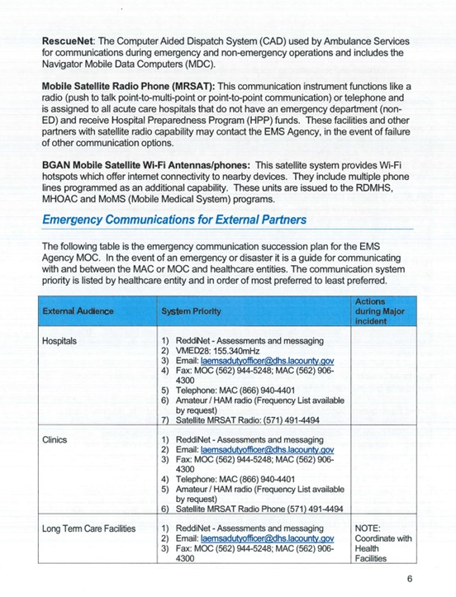
Resource Request
Follow the Los Angeles County Emergency Medical Services Agency Communication Plan.
- Disaster Programs tab of the LA County EMS Agency website
- LA County Healthcare Coalition website
https://file.lacounty.gov/SDSInter/dhs/206683_Communication.pdf

Slide 17
Questions

