Slide 1
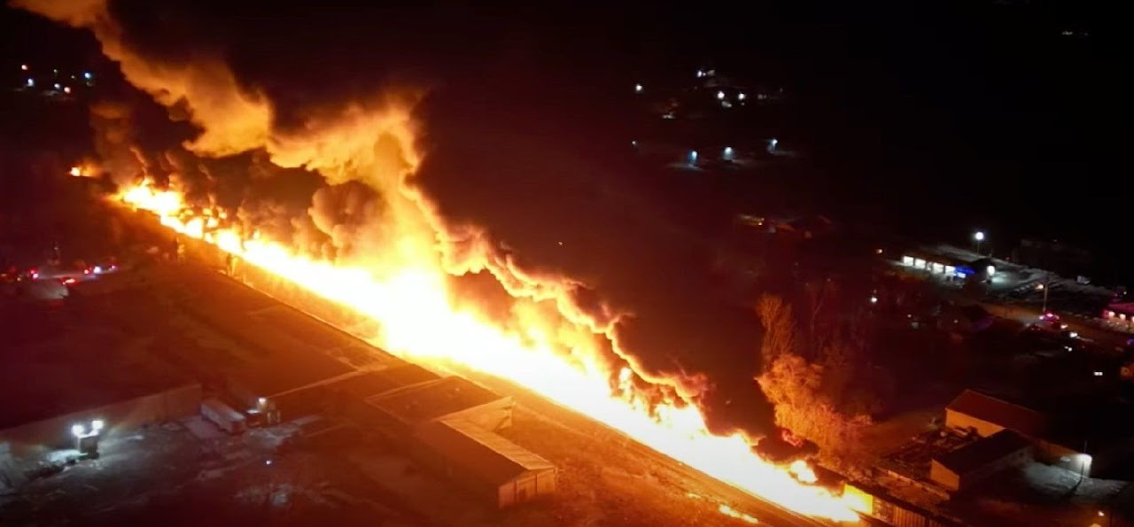
Los Angeles County 2024 MRSE Participant Webinar for Non-acute Sectors
Notes:
As Darren said, this is an exercise that is focusing on Burn Surge. For non-hospital sectors, we will focus on SIP/Evacuation in response to the toxic smoke plume providing an opportunity to evaluate the ability to continue or modify operations while determining the need to SIP or evacuate.
The goal is to exercise your plans, capabilities, and meet the objectives from the following slides.
Remember to look at your previous AAR /Improvement Plan as a guide from your previous drill, exercise or incident to build upon strengths and areas of improvement (SWOT).
Incorporate your areas of improvement identified from your last incident, exercise or drill.
Last year some areas of improvement included identified gaps:
Issues with internal notification procedures and out of date employee contact lists
Partner Contact List
Issues with implementing SIP/evacuation plans with staff and visitors, primary communication system failure (need to develop alternate communication methods to support continuity of operations)
*Remember cell towers could be impacted, hindering traditional methods of communicating!
If you’re a Hub and Spoke or Autonomous
Another identified area for improvement included challenges with a process to provide supplies to field personnel within the Home Health/Hospice sector
Trunk supplies (NRS vs Other)
And ALL sectors identified the need for ReddiNet training…please sign up for the Oct 19th class.
Status, Requisition Request, After Action Report… Communication
Link later-on in deck
No matter what sector you represent, the idea of safety & continuing to care for YOUR patients is paramount, never to just “send them to the hospital”
This probably goes without saying, but any real incident takes priority over the exercise. Make sure during the exercise your staff know the designated word if an emergency arises. During our HealthCare Disaster Management Training, we use the word “Tinkerbell” in the event someone is really experiencing an emergency to differentiate from exercise play.

Slide 2
Exercise Overview
Exercise Name: Medical Response and Surge Exercise Burn focus
Exercise Date: November 21, 2024
Exercise Time: 0800-1200
Exercise Type: Functional
COP: 484.102 HHA & 418.113 HOS
Exercise Goals:
Capability 1: Foundation for Healthcare & Medical Readiness
Capability 2: Health Care & Medical Response Coordination
Capability 3: Continuity of Health Care Service Delivery
Capability 4: Medical Surge
Notes:
Functional exercise: Simulates an emergency in the most realistic manner possible, short of moving resources to an actual site.
Conducted in a “real—time” environment in an EOC or Command Post.
Used to test and evaluate the capability of an organization to respond to an emergency using a simulated event
Some of you may choose to do a:
Tabletop exercise: which is a facilitated discussion of a plan in an informal, stress-free environment. Participants share capabilities and solve problems as a group based on their organizations existing plans and determine the objectives of the exercise
Full-scale exercise is usually lengthy and utilizes equipment, personnel with total coordination among many
We are going to discuss each capability and what objectives you can consider to meet these goals.
Some activities will overlap and can fulfill more than one capability.
Administration for Strategic Preparedness and Response (ASPR) Health Care Preparedness and Response Capabilities include:
Capability 1: Foundation for Health Care and Medical Readiness
Goal of Capability 1: The community has a sustainable Health Care Coalition – comprised of members with strong relationships – that can identify hazards and risks and prioritize and address gaps through planning, training, exercising, and acquiring resources.
Capability 2. Health Care and Medical Response Coordination
Goal for Capability 2: Health Care and Medical Response Coordination Health care organizations, the HCC, their jurisdiction(s), and the ESF-8 lead agency plan and collaborate to share and analyze information, manage, and share resources, and coordinate strategies to deliver medical care to all populations during emergencies and planned events.
Activate EOP and Polices related to incident
Maintain appropriate communication
Capability 3: Continuity of Health Care Service Delivery
Goal of Capability 3: Health care organizations, with support from the HCC and the ESF-8 lead agency, provide uninterrupted, optimal medical care to all populations in the face of damaged or disabled health care infrastructure. Health care workers are well-trained, well-educated, and well-equipped to care for patients during emergencies. Simultaneous response and recovery operations result in a return to normal or, ideally, improved operations.
Maintain Continuity of Health Care Services patients
Shelter in Place/Evacuate
Capability 4. Medical Surge
Goal for Capability 4: Health care organizations — including hospitals, emergency medical services (EMS), and out-of-hospital providers — deliver timely and efficient care to their patients even when the demand for health care services exceeds available supply. The HCC, in collaboration with the Emergency Support Function-8 (ESF-8) lead agency, coordinates information and available resources for its members to maintain conventional surge response. When an emergency overwhelms the HCC’s collective resources, the HCC supports the health care delivery system’s transition to contingency and crisis surge response and promotes a timely return to conventional standards of care as soon as possible.
Critical Decisions and Considerations need to be made. We will address some of these as we go through each capability and objectives with tasks
Number of people in your facility (staff, patients, visitors)
Are you able to maintain current operations?
Are there services you should discontinue?
What if staff/patients want to leave?
What resources do you have on hand?
What protective measures need to be implemented?
Activate Incident Command?
Decontamination?
Establish & maintain public reception area?
Remain calm
Consider shutting down air intake into the ventilation system (could be airborne particles)
Ensure patients/visitors are aware of the threat
Update your IC on the operational status of your facility and impact on patient care
Personnel to remain with patients
AOD notified
Overhead page “Code XX” We have been advised of an emergency nearby. For your safety, everyone is to remain inside and SIP until we are notified the emergency is over.
Assessment:
Who do you contact for direction?
How do you find out if your geographic area is impacted?
Is there a possibility of a need to evacuate?
What is the availability of other resources (law, fire)
Census of personnel, patients, and visitors. All ambulatory?
Activate the Command Center?
Develop and Implement Incident Action Plan (goals, objectives, and strategies for an operational period)
Who determines when the facility is safe to resume normal operations?
PLAN ACTIVATION
Who activates this plan? (should be the incident commander)
Do you have a decision tree or matrix? Incident assessment worksheet?
INCIDENT MANAGEMENT
Does your EOP identify the designated Incident Commander? (IC=gathers all information related to the incident and coordinated and released via the command center. IC has full authority and responsibility for the decision-making process for this response
IC activate “Code______”
ICS Job Action Sheets #254 victim/patient tracking
ROLES & RESPONSIBILITIES
PIO, Liaison Officer, Safety Officer, Operations Section Chief, Planning Chief, Logistics Section, Personnel
What are YOUR plans?
Does your facility/agency have any plans for this type of incident?
Have you coordinated with public safety to identify how to respond to such an incident?
What are your top 3 concerns of your facility/agency?
What types of information would be released?
How would employees/patients be notified
Who makes the notifications?
Where do you get the information?
484.102 HHA 418.113 HOS Conditions of Participation: Emergency Preparedness
E-0039 Must conduct exercises to test the emergency plan at least annually (Full Scale exercise that is community based Every 2 Years) E-0039 When a community-based exercise is not accessible, conduct an annual individual, facility-based functional exercise every 2 years.

Slide 3
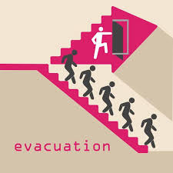
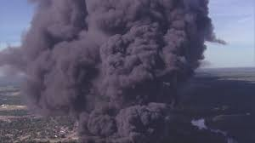
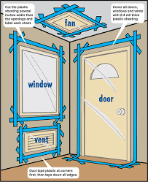
Critical Decisions & Actions for a Toxic Chemical Plume?
What criteria are used to determine whether your facility will evacuate or shelter in place?
Notes:
One critical decision and action you will need to take when faced with a toxic chemical plume near your community is to figure out if you SIP or evacuate (Business, building or home).
What information will help guide this decision?
Who makes the decision?
Activate the Command Center?
PLAN ACTIVATION
Who activates this plan? (should be the incident commander)
Do you have a decision tree or matrix? Incident assessment worksheet?
INCIDENT MANAGEMENT
Does your EOP identify the designated Incident Commander? (IC=gathers all information related to the incident and coordinated and released via the command center. IC has full authority and responsibility for the decision-making process for this response
IC activate “Code______”
ICS Job Action Sheets #254 victim/patient tracking
Are your employees familiar with your policy regarding shelter in place?
If you are told there is danger of exposure, how versed are you and your staff on evacuation procedures?
When was the last time you exercised to SIP/evacuation?
DO YOU KNOW WHEN TO:
Activate Incident Command?
Close the business?
Are you responsible for the customers, clients, or visitors in the building?
Should you turn on call-forwarding or alternative telephone answering systems or services? Do you change the recording to indicate that the business is closed and what patients should do if scheduled for say dialysis?
Where are disaster supplies, if needed?
At what point would you call emergency contacts?
***Cellular telephone equipment may be overwhelmed or damaged during an emergency.
Considerations:
Number of people in your facility (staff, patients, visitors)
Can you maintain current operations?
Are there services you should discontinue?
What if staff/patients want to leave?
What resources do you have on hand?
What protective measures need to be implemented?
Who determines when the facility is safe to resume normal operations?
Remain calm
Ensure patients/visitors are aware of the situation
Who does the Assessment:
Contact utility company?
How large of a geographic area is impacted?
Is the backup power fired up??
Do you have back up power? Fuel?
Is there a possibility of a need to evacuate?
What is the availability of other resources (law, fire)
ROLES & RESPONSIBILITIES
PIO, Liaison Officer, Safety Officer, Operations Section Chief, Planning Chief, Logistics Section, Personnel

Slide 4
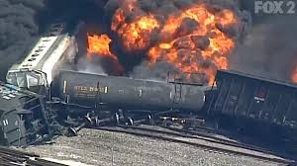
7:45 am
Notes:
11/21/2024 train derailment announced
FROM: Exercise Director for all Sectors
TO: All Participants
A freight train carrying hazardous material derailed at a location near your facility
•Several railcars were damaged and released a gaseous substance into the air. •A subsequent explosion occurred with a brief fireball that had a horizontal expansion approximately two blocks in one direction that resulted in multiple persons attending a mass gathering event with burn injuries. • Fire and HAZMAT are on scene of the incident. •First responders reported an estimated 1,700 persons injured with approximately 800 with burn injuries. •Others sustained minor injuries. •Several railcars are fully engulfed and a smoke plume, presumed toxic, is traveling in a North-East direction. •News crews respond to the scene and begin broadcasting. •First responders began triaging the victims in the Immediate, Delayed, and Minor categories and are preparing patients for transport to local hospitals. •HAZMAT considering Evacuation and Shelter-in-Place advisories.

Slide 5
ReddiNet®
Communication Tool
MCI
General Notifications
Polls
Assessment Polls
Service Level Polls
Resource Requests
Notes:
At this point, if you don’t have a ReddiNet account, NOW is the time to sign up for the actual exercise in November!
ReddiNet is our main communication platform, it is paid for by federal dollars and is FREE to you.
During COVID we were able to distribute an enormous amount of PPE, ventilators, monoclonal antibiotics, COVID test kits, and fulfill requests for staff through resource requests submitted via ReddiNet
Again, ReddiNet is our main communication platform. It is both Web and Satellite Based
ReddiNet is used by MAC, PH, Hospitals, Fire Departments, Police Depts, LTC, ASC, HHH, UCC, ESRD, CCALAC
Think about what triggers activation of your Communication Plan
What is the expected time frame to notify Internal and external customers? What priorities do you have for leadership, staff, patients, sister facilities, geographically close facilities, Local EMS Agency etc.
When did you last test your communication plan?
What systems are included in your plan? Phone, text, email, mass messaging,
ASC-contact your next surgical case, the physicians performing the surgery,
ESRD-clamp and disconnect procedures, arrangements for next wave of patients, contact the next shift, is there another Dialysis facility you could refer to? How do you prioritize patients
HHH-What provisions are made for power dependent patients?
Clinics & Urgent Care facilities-how to you anticipate/handle walk-ins?
Maintain Communications: Initially you may want to review your EOP, specifically your communications plan
Determine if you need to activate your incident command system (ICS), consider using a 214 Activity Log
Review strategies
Key communications with:
Personnel on duty AND Personnel off duty (instruct to report or not)
Patient families
Medical Providers
Personnel families
Public Safety (EMS, transport providers, buses, etc.)
Media

Slide 6
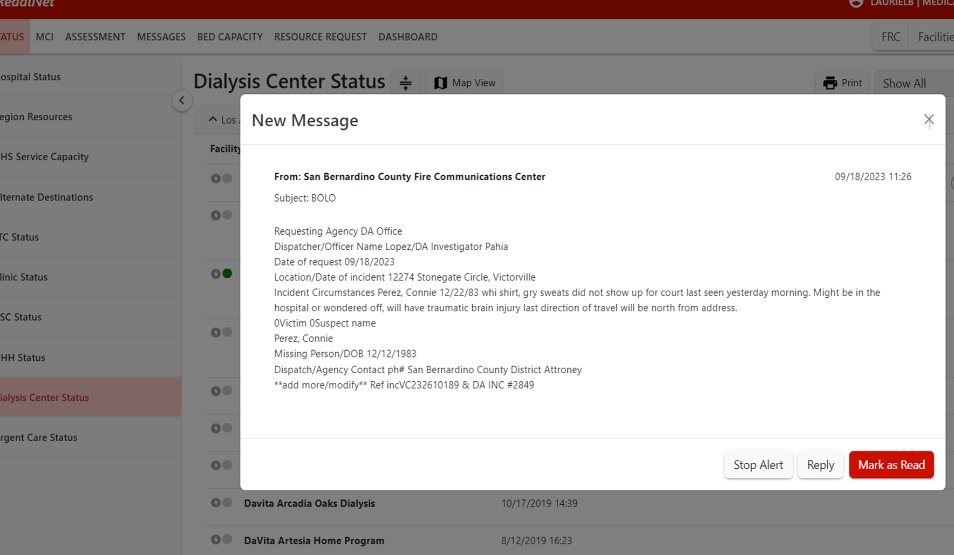
MSEL 8:00-8:05 am
8:00 am
ASC Dialysis and HHH Objective 1
Notes:
11/21/2024 8:00am Inject
FROM: Medical Alert Center (MAC)
TO: Healthcare Partners who have ReddiNet
*** Exercise, Exercise, Exercise *** The 2024 Medical Response and Surge Exercise begins. *** Exercise, Exercise, Exercise participants initial play.
EXERCISE Participants acknowledge message in ReddiNet. Read the message and click on the red box, “Mark as Read”
THIS IS YOUR SITUATIONAL AWARENESS meeting objective 1: Maintain awareness of the common operating picture by gathering and sharing real time information in coordination with the MHOAC (Medical & Health Operational Area Coordinator)

Slide 7
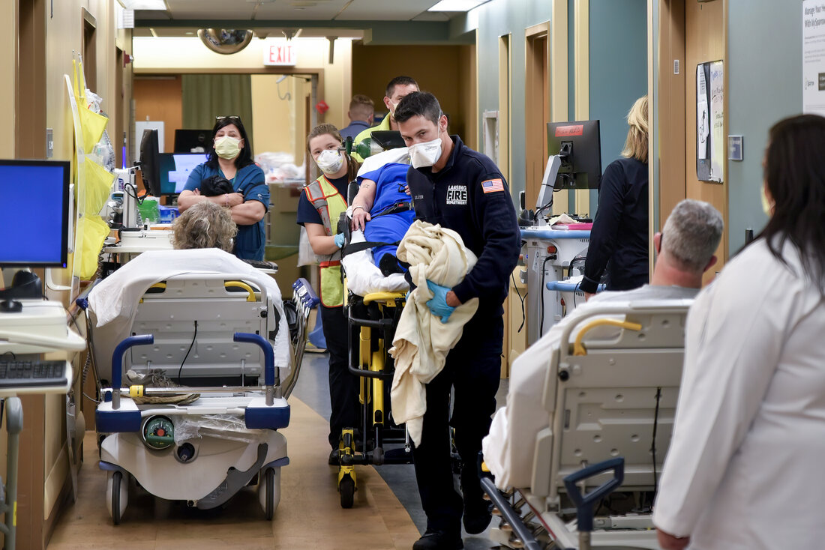
9:00 am SIP & Evacuation Advisory
ASC, Dialysis Objective 3:
Determine facility priorities for ensuring key functions are maintained, including provision of care
HHH Objective 3-4: Activate and Implement Surge Plan
Notes:
At 9:00 am MCC sends following message via ReddiNet:
"Fire / HAZMAT recommend Shelter-in-Place and Evacuation due to presumed toxic smoke plume traveling Northeast of incident."
"All HCC members continue to monitor ReddiNet and respond to polls"
"This is an exercise there will be no actual movement of patients.“
Each non-acute care sector site will independently determine if they want to exercise this inject as either Shelter-in Place, or Evacuate, or no action
Once again, consider:
What criteria are used to determine whether the building/facility/home will SIP or evacuate?
Who will make that decision ?
What policy or procedure will you use to determine the next steps?

Slide 8
What does SIP look like?
What is the ideal location to shelter within a home/building?
What supplies are needed?
Is there a protocol to follow for securing the home/building?
What about the ventilation system?
Notes:
Shelter-in-Place Hazardous Materials
Shelter-In-Place simply means seeking immediate shelter inside a building. This action may be taken during a release of toxic chemicals, biological or radioactive materials to the outside air or other emergency.
If the outside air quality is threatened or compromised, sheltering in place keeps you inside an area offering more protection.
Although rarely called for, Shelter-In-Place events usually last only a few hours. Emergency supply kits of food, water, and other items can be used during Shelter-In-Place events.
What type of room is ideal in case a Shelter In-Place is activated?
DO NOT GO TO THE BASEMENT!
Move to floors above ground level. Chemical agents tend to be heavier than air and settle at ground level
Shelter-In-Place in an interior room above ground without windows or with the least number of windows.
Once you have identified the most appropriate room, what should you next?
Shut and lock all windows and interior & exterior doors, this will create a tighter seal reducing the amount of seepage into the room.
Turn off all air conditioners and fans; be sure to shut off all heaters as well. Many buildings’ ventilation systems are remotely controlled by Facilities Management. If necessary, locally turn off heat, fans, air conditioning, or ventilation systems. Close vents as you are able
If you are able, close or cover all vents in the room for added protection.
Make a list of all the people in the room with you; make sure to get all emergency cell numbers as well. Please keep in mind that during an emergency event local phone lines may not work due to damage or a high volume of calls, texting may be a better option at that point
Do not use the elevator while making your way to the appropriate room, operating elevators can cause outside contaminated air to infiltrate the interior of the building.
What supplies should you grab?
If it is safe to do so and time permits, the following items would be very helpful and recommended:
Bottled water, juice or any other liquid that will keep your body hydrated.
Comfort foods such as candy, chips, gum or anything else you can find along the way.
Plastic garbage bags to use as portable bathrooms.
Plastic material to cover the doors and windows.
Tape of any sort, preferably Duct Tape (silver tape).
Medical kit or supplies.
Call 911 and let them know exactly where you are in the building, when it is safe to do so,. Include floor level and room number when relaying information to emergency personnel.
If needed, cover mouth and nose with a wet cloth for added protection. •
If the room has a radio or TV, please tune into local stations for more details and information.
DO NOT DRINK FAUCET OR TOILET WATER! EITHER OR BOTH MAY BE CONTAMINATED.
Is there anything you should not bring into your room during a Shelter In Place? Absolutely.
Do not bring in candles, weapons, or any kind of controlled substance unless prescribed by a physician. Do not bring in any items that could create carbon monoxide or release poisonous chemicals or gases. In case of a Shelter In-Place emergency: stay calm and alert to what is going on around you; often times the most useful way for you to help is by calling emergency services during an event.
Immediate Shelter-In-Place:
When the release is nearby and the need to seek shelter is immediate.
Stay inside a building.
If outside, enter nearest building.
Remain in place until advised by emergency personnel that it is safe to leave.
Delayed Shelter-In-Place:
When a release occurs off campus and there is time (30 minutes or more) to move people to large, enclosed areas.
Follow directions of emergency personnel to move quickly to a delayed Shelter-In-Place location.
Remain in place until advised by emergency personnel that it is safe to leave.
When advised of the all-clear:
Open doors and windows.
Return ventilation system to normal operations.

Slide 9
What does Evacuation entail?
ASC
Dialysis
HHH
Notes:
ASC
Mobility is an important part in effective and timely evacuations, and therefore facilities are expected to properly plan to identify patients who would require additional assistance, ensure that means for transport are accessible and available and that those involved in transport, as well as the patients and residents are made aware of the procedures to evacuate. For outpatient facilities, such as Home Health Agencies (HHAs), the emergency plan is required to ensure that patients with limited mobility are addressed within the plan. The plan should also address ways the facility will address identified patient needs that can’t be addressed by in house services in an emergency, such as just in time contracts or emergency transfers. Ultimately, the delegations of authority and succession plans need to include plans on how the facility ensures patient safety is protected and patients will receive care at the facility or if transferred, under what circumstances transfers will occur
DISALYSIS
Dialyses patients require special attention due to their unique vulnerabilities that extend beyond their health status. Once the dialysis process is initiated, patients become immobile and reliant on the machine for a duration of 2-6 hours.
The necessity of a power supply, as well as a water source for hemodialysis, further restricts their mobility.
From a physiological standpoint, any sudden interruption of an ongoing dialysis procedure can lead to hypovolemia as blood and fluids have already been transferred from the patient to the machine
Given that patients with end-stage renal disease frequently experience anemia, failure to return the blood to the patient prior to ending the dialysis session can result in symptomatic anemia.
HOME HEALTH Does patients have a plan and if Evacuation what are methods for transport, resources and communication (Agency responsibility to know where patient is evacuating for continuity of care)? Communication with resources, health plan, pcp….
HOSPICE
If patients are in facilities what are the facilities evacuation plans and can the agency proceed with continuity of care?
Communication with resources, health plan, pcp….
Effective evacuation planning for such cases re-quires the consideration of three key factors:
the patients’ vulnerabilities, the evacuation setting, and the patients’ destination.
These factors are connected and interdependent, thus requiring a comprehensive approach involving patients, caregivers, emergency medical services, and disaster planners. While discussions have taken place concerning the evacuation of various patient groups, there remains a dearth of guidance regarding the appropriate course of action for patients undergoing dialysis during an evacuation.
The objective of this discussion, therefore, is to address the evacuation of dialyzed patients and develop evidence-based evacuation plans. By taking into account the specific needs and vulnerabilities of these patients, we can ensure their safety and well-being in emergency situations.

Slide 10
MSEL 8:00-8:05 am
ASC Dialysis and HHH Objective 1
Notes:
11/21/2024 9:00am Inject
FROM: Medical Coordination Center
TO: Healthcare Partners who have ReddiNet
*** Exercise, Exercise, Exercise *** MCC has been notified by Fire that HAZMAT issued a SIP and Evacuation advisory based upon proximity to the incident. A presumed toxic smoke plume is traveling in a NE direction from the incident.
Shelter-in-Place or Evacuation Advisory Message from the MCC via ReddiNet
EXERCISE Participants acknowledge message in ReddiNet. Read the message and click on the red box, “Mark as Read”
ASC & ESRD: Objective 3: Determine the facility’s priorities for ensuring key functions are maintained during the emergency, including the provision of care to existing and new patients.
HHH, see Objective 2 Activate the EOP

Slide 11
9:00 ReddiNet® Service Level Poll issued
A Service Level Poll is used to obtain real time facility operational status during an event or incident.
Status is color coded
Respond to Assessment Poll within 60 min.
OBJ 6 (ASC)
OBJ 5 (DIALYSIS)
OBJ 4 (HHH)
Notes:
ReddiNet is our main communication platform. It is both Web and Satellite Based
ReddiNet is used by MAC, PH, Hospitals, Fire Departments, Police Depts, LTC, ASC, HHH, UCC, ESRD, CCALAC
This poll will come through in the assessment tab
Hospitals and Long-Term Care facilities; Green, Yellow, Orange, Red and Black
Clinics, Home Health/Hospice, Dialysis and Urgent Care Centers – No Red
Ambulatory Surgery Centers and Psych facilities – No Orange or Red
Green (Normal Operations): No assistance from the jurisdiction is required. Agency is operational and is in business-as-usual mode. Can assist with response by accepting early discharged from hospitals.
Yellow (Under Control): No assistance from the jurisdiction is required. Center is operational and is in business-as-usual mode. Unable to accept additional patients.
Orange (Modified Services): Some assistance from the jurisdiction is required. Agency has begun to modify their services as they are unable to care for and/or reach all patients.
Black (No Services): Unable to care for/reach patients. Assistance from jurisdiction is required to reach patients who have been triaged as high risk. Should be referred to law enforcement and/or EMS providers in the affected area

Slide 12
Capability 3: Continuity of Health Care Service Delivery
OBJECTIVES:
Determine the facility’s priorities for ensuring key functions are maintained:
Provision of care
JIT Training
Coordinate staff and resources
Resource Request
BCP activation
Patient tracking
HIPAA
Identify strategies for recovery
Notes:
Capability 3: Continuity of Health Care Service Delivery
Goal of Capability 3: Health care organizations, with support from the HCC and the ESF-8 lead agency, provide uninterrupted, optimal medical care to all populations in the face of damaged or disabled health care infrastructure. Health care workers are well-trained, well-educated, and well-equipped to care for patients during emergencies.
This would possibly trigger the Business Continuity Plan (BCP).
IF you need resources to maintain services, who will you ask?
Vendors
Partners
PHD
County
If you have a generator (ASC)
When was the last in-service conducted on your generator?
How many hours of fuel do you have on hand?
contact your next surgical case, the physicians performing the surgery,
What is the time frame to trigger notifications/action?
ESRD- at what point do you clamp and disconnect? Do you have a back-up facility to refer to? How do you track patient movement? 3-day Emergency diet instructions with fluid limits distributed?
ALL-how will you manage patient care during a power outage?
Who would you communicate with? Local EMS Agency, leadership, staff, patients, sister facilities, geographically close facilities, etc.
Consider activating your communication plan
Consider HIPAA During Disasters (“IMMINENT DANGER: Providers can share patient information with anyone as necessary to prevent or lessen a serious and imminent threat to the health and safety of a person or the public -- consistent with applicable law and the provider's standards of ethical conduct” (California Office of Health Information Integrity) See 45 CFR 164.512(j))
Simultaneous response and recovery operations result in a return to normal or, ideally, improved operations

Slide 13
9:15 am ReddiNet® Service Level Poll
Notes:
HHH, ESRD and UCC have the same color codes and definitions
ASC has no Orange
Green (Normal Operations): No assistance from the jurisdiction is required. Agency is operational and is in business-as-usual mode. Can assist with response by accepting early discharged from hospitals.
Yellow (Under Control): No assistance from the jurisdiction is required. Center is operational and is in business-as-usual mode. Unable to accept additional patients.
Orange (Modified Services): Some assistance from the jurisdiction is required. Agency has begun to modify their services as they are unable to care for and/or reach all patients.
Black (No Services): Unable to care for/reach patients. Assistance from jurisdiction is required to reach patients who have been triaged as high risk. Should be referred to law enforcement and/or EMS providers in the affected area.
Hospitals and Long Term Care facilities; Green, Yellow, Orange, Red and Black
Clinics, Home Health/Hospice, Dialysis and Urgent Care Centers – No Red
Ambulatory Surgery Centers and Psych facilities – No Orange or Red

Slide 14
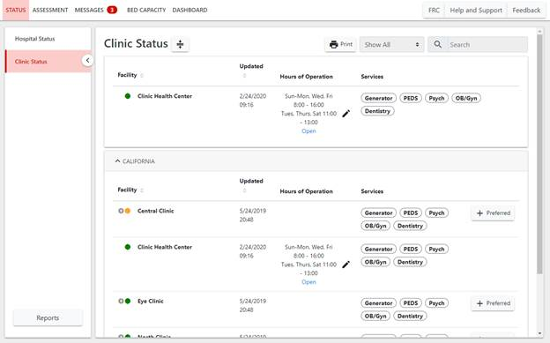
ReddiNet ® STATUS
TRAINING LINK: https://www.reddinet.net/support
Notes:
1. Click on your facility type status page (i.e. "Dialysis Status").
TRAINING LINK: https://www.reddinet.net/support
Circle with lightening bolt means that that facility is not currently logged in to the ReddiNet system
Green means the facility is open with no issue
We will cover the colored dots in a future slide…
Assessment module
Click on Service Level
Click on “Update”
Select your current service level and click “Update”
Accept when the “Confirm” box appears

Slide 15
ReddiNet ® Service Level
1
2
3
Notes:
You will need to communicate your service level.
TRAINING LINK: https://www.reddinet.net/support
Assessment tab
Click on Service Level
Select your sector
Your facility
Select your current service level and click “Update”
Accept when the “Confirm” box appears

Slide 16
Notes:
Select your current service level and click “Update”. a. If a facility is in an emergency and unable to update their service level, county authorities may update them.

Slide 17
9:30-9:45 MCC polls HHH to determine if able to receive patients to support hospital decompression
9:30-10:30
Patient in-take
HHH Objective 3
Notes:
Each participating LTC facility and HHH agency receive patient transfers to support hospital decompression efforts.
Hospitals are decompressing and seeking to transfer stable patients to your facility for post acute care.
Identify open beds and implement strategies to expand capacity and expedite admission process.
Will need to identify barriers that prevent rapid patient placement into LTC and HHH facilities in support of a surge event.
MCC initiates an LTC bed availability poll in ReddiNet.
MCC polls HHH sector via platform of choice (e.g. ReddiNet, email, survey monkey, Everbridge, etc.) to obtain bed availability

Slide 18
Capability 4. Medical Surge (HHH)
OBJECTIVES:
Identify triggers to activate Surge Plan
Identify if Policy Waivers require implementation
Notify appropriate personnel/patients
Coordinate patient destination if referring patients
Notes:
Capability 4. Medical Surge
Goal for Capability 4: Health care organizations — deliver timely and efficient care to their patients even when the demand for health care services exceeds available supply.
When an emergency overwhelms the HCC’s collective resources, the HCC supports the health care delivery system’s transition to contingency and crisis surge response and promotes a timely return to conventional standards of care as soon as possible.
Merriam-webster dictionary defines SURGE as “to rise suddenly to an excessive or abnormal value”
The Emergency Action Plan should encompass all elements of surge response, including:
A declaration of public health emergency
Requests for mutual aid
Communication with partners
Concept of operations for specific use of specific facilities:
What kinds of patients will be sent to which facilities
Identify types of patients based on case definition or triage scoring
Address any transportation issues
Establish a comprehensive public information strategy
Determine if specific just-in-time training will be required
Determine the need for, and implement, modified treatment protocols, altered clinical care standards, palliative care guidelines, or other care provisions.
IF your site is considered an alternate treatment area, CONSIDER:
Signage in English and Spanish as appropriate directing patients to correct location
Clear patient ingress and egress (entrances and exits)
Security for site and personnel
Transportation routes determined and communicated
Staffing of ACS for first 48 hours, using 12-hour shifts (i.e., first 4 shifts)
Power, water, and sanitation (toilets) in working order and with reserve supplies for at least first 48 hours
Rules and policies for alternate site of
operation
You have more patients than space, staff or stuff (supplies)
What actions can you take to resolve this situation?
ASC & Clinics with generators-powering stations, take on uncomplicated surgical cases, allow use of space for
HHH-offload patients from the hospital to accommodate surging to the hospital
ALL-work with less impacted facilities to continue care, track patients, extend operating hours
ALL-Consider expanding capacity through schedule alteration—e.g., increasing shift length, changing staffing ratios

Slide 19
10:30 ALL HCP Submit a Resource Request
Notes:
Your supplies are running low and below PAR levels. Assuming all other avenues have been exhausted ( you reached out to sister facilities, contracted vendors, and non-contracted/non-traditional vendors)
ASC: Objective 6
Dialysis: Objective 5
HHH: Objective 4

Slide 20
Resource Request
Resource Request forms should be submitted via ReddiNet during an MCI.
If ReddiNet is not available, RR may be submitted via email or fax.
Priority Code:
E – Emergent (<12 Hours)
U – Urgent (>12 Hours)
S - Sustainment
Notes:
During an MCI, Resource Request forms should be submitted via the ReddiNet utilizing the Resource Request tab.
You can request Supplies, Personnel or Equipment
When a RR is submitted via email or fax the MCC will need to complete the form for you which is labor intensive and can create unnecessary delays.
During the pandemic, due to the overwhelming number of requests, there came a point that resource requests were ONLY via ReddiNet, and facilities were required to open FREE accounts!
It needs to be specific. For example, if you needed personnel, you would need to indicate if a tech, LVN, RN, RT, etc. is needed. The number of hours/days and duration needed. Ideally indicate if it is a day, mid or night shift request and the shift is 6,8 or 12 hours.
Supplies are disposable, one-time use, like test kits
Equipment is something that would typically be returned. Examples include ventilators, generators, etc.
There is a priority code
E for Emergent, meaning the resource is needed within 12 hours
U is for Urgent. Items needed in greater than 12 hours
S is for Sustainment
BEFORE a RR is submitted, you need to confirm 3 things:
The resource requested is exhausted or nearly exhausted
Your facility is unable to obtain the resource from vendors, contractors, sister facilities, like facilities
Facility is unable to obtain the resource from other non-traditional sources (home depot, amazon, etc)

Slide 21
3
1
2
Notes:
1 click on the Resource request tab
2 pick the correct incident. For the exercise it will say DRILL or EXERCISE MRSE
3 select new RR

Slide 22
Notes:
Name of your facility
Facility ID is your facility code in our HCC database and can be found under general information – see next slide

Slide 23
Facility ID is the “CODE” found under General Information for your facility

Slide 24
Resource Request
Notes:
Some of the fields in the resource request will be pre-filled. However, the fields that are not, must be filled prior to submitting.
Many times, during an incident, you will not be at your desk, therefore, it is important to add phone number that you will be able to in the event there is questions from the MHOAC.
Describe Mission – in this field, you will describe the purpose and reason for your request. Why and for what are you requesting
During an event, Resource Request forms should be submitted via the ReddiNet utilizing the Resource Request tab.
You can request Supplies, Personnel or Equipment
It needs to be specific. For example if you needed personnel, you would need to indicate if a tech, LVN, RN, RT, etc is needed. The number of hours/days and duration needed. Ideally indicate if it is a day, mid or night shift request and the shift is 6,8 or 12 hours.
Supplies are disposable, one time use, like test kits
Equipment is something that would typically be returned. Examples include ventilators, generators, etc
There is a priority code
E for Emergent, meaning the resource is needed within 12 hours
U is for Urgent. Items needed in greater than 12 hours
S is for Sustainment
BEFORE a RR is submitted, you need to confirm 3 things:
the resource requested is exhausted or nearly exhausted
Your facility is unable to obtain the resource from vendors, contractors, sister facilities, like facilities
Facility is unable to obtain the resource from other non-traditional sources (home depot, amazon, etc)
Resource requests are submitted as a last resort. When you have exhausted all other avenues. When you’ve reached out to your sister facilities, to your established vendors and non-traditional vendors; remember to think outside the box. Once all of these avenues have been exhausted, you may click all 3 check boxes.
It is important that management or your command unit review the request. Once reviewed, add their name and information to the resource request.

Slide 25
ReddiNet ® STATUS
TRAINING LINK: https://www.reddinet.net/support
Notes:
1. Click on your facility type status page (i.e. "Dialysis Status").
TRAINING LINK: https://www.reddinet.net/support
Circle with lightening bolt means that that facility is not currently logged in to the ReddiNet system
Green means the facility is open with no issue
We will cover the colored dots in a future slide…
Assessment module
Click on Service Level
Click on “Update”
Select your current service level and click “Update”
Accept when the “Confirm” box appears

Slide 26
ReddiNet ® STATUS
TRAINING LINK: https://www.reddinet.net/support
Notes:
1. Verify the general information, click on the facility name
TRAINING LINK: https://www.reddinet.net/support

Slide 27
ReddiNet ® STATUS
Notes:
1. Click the Edit button under Hours of Operation.
TRAINING LINK: https://www.reddinet.net/support

Slide 28
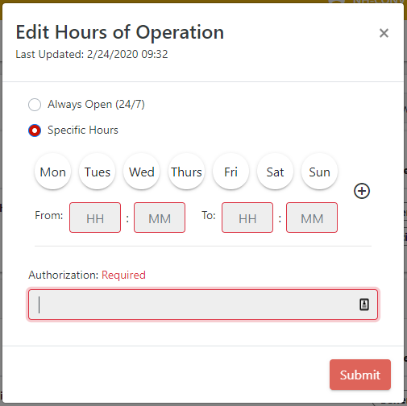
ReddiNet ®
Notes:
2. Select "Specific Hours".
3. Select the days that your facility is open.
4. Input your opening and closing times.
5. Optionally, you may add a second schedule by clicking on the "+".
6. Input the authorization.
7. Click "Submit".
TRAINING LINK: https://www.reddinet.net/support

Slide 29
ReddiNet ®
There are training videos and user guides available at https://support.reddinet.net/
The training environments are available for hands-on practice at https://www.reddinettraining.net/
Registration (gotowebinar.com)
Notes:
The next non-acute training is scheduled for October 19th at 10:00-11. You need to register
Your name, email and physical address, and organization will be needed to register
We will have a teams meeting with live ReddiNet instruction, tentatively scheduled for October 26th. I need to confirm with Lewis West.
You will need an account and it is best if you have a two screen set up so you can have your screen open on one monitor, while watching the instructor on the second monitor.
November 7th is a Tuesday and we will practice responding to a message, service level assessment and submitting a resource request.

Slide 30
Preparing for the Exercise
Review your emergency operations plan and power outage procedures
Train/review with your staff
Develop procedures if you don’t have them already
Develop your Exercise Plan
Determine which facility/agency specific plans/procedures you plan to test
Plan activities to test your procedures
Review your Communication Plan
Identify the methods your facility would use during a power outage
Test the plan
Notes:
Incorporate your areas of improvement identified from your last incident, exercise or drill.
Last year some areas of improvement included identified gaps with internal notification procedures and out of date employee contact lists
Issues with implementing SIP/evacuation plans with staff and visitors, primary communication system failure (need to develop alternate communication methods to support continuity of operations)
*Remember cell towers could be impacted, hindering traditional methods of communicating!
Another identified area for improvement included challenges with a process to provide supplies to field personnel within the HHH sector
And ALL sectors identified the need for ReddiNet training…please sign up for the Oct 19th class.
If you don’t have a policy or procedure addressing something in particular, reach out to other like facilities. No need to recreate the wheel! I am all about working smarter, not harder!!

Slide 31
Practice
Before the Exercise
Day of the Exercise
After the Exercise
Open ReddiNet Account
Obtain Username and Password
Practice log in
Attend training
Service Level Poll
Resource Request (Optional)
Service Level Poll
Respond to Message
Submit a Resource Request (Optional)
After Action Report & Improvement Plan
Due 60 days after the exercise for certification of participation
Notes:
The link for signup is available on our HCC website. The QR code is on the last slide

Slide 32
Requirements for Participation
Register for the County-wide exercise scheduled for November 21th, 2024
Participate
After Action Report within 60 days
Certificate of participation
Notes:
All exercises result in the development of an AAR.
The AAR is the document that summarizes key information related to evaluation. It has a line for Objectives you wanted to achieve, and columns next to it with a
P for performed without challenges,
S for some challenges encountered
M Major challenges identified
U for unable to be performed
The next section is the strengths identified
Areas for improvement
The last section is part of your improvement plan. Briefly describe the tasks to accomplish, the date you will accomplish them by and the responsible person.
The Homeland Security Exercise and Evaluation Program (HSEEP) has defined a standard format for the development of an AAR.
By using this format, jurisdictions ensure that the style and the level of detail in their AAR is consistent with other jurisdictions.
Consistency across jurisdictions allows the nation-wide emergency preparedness community to gain a broad view of capabilities.
The length, format, and development timeframe of the AAR depend on the exercise type and scope.
These parameters should be determined by the exercise planning team based on the expectations of elected and appointed officials as they develop the evaluation requirements in the design and development process.
The main focus of the AAR is the analysis of core capabilities.
Generally, AARs also include basic exercise information, such as the exercise name, type of exercise, dates, location, participating organizations, mission area(s), specific threat or hazard, a brief scenario description, and the name of the exercise sponsor and POC.
The AAR should include an overview of performance related to each exercise objective and associated core capabilities, while highlighting strengths and areas for improvement.
Therefore, evaluators should review their evaluation notes and documentation to identify the strengths and areas for improvement relevant to the participating organizations’ ability to meet exercise objectives and demonstrate core capabilities.

Slide 33
Exercise Documents
MSEL
Situation Manual
Controller/Evaluator Handbook
Exercise Plan
Exercise Evaluation Guide (EEG)
https://lacountyhcc.org

Slide 34
Timelines
Thurs Nov. 21, 2024
MRSE Exercise (Based on MSEL)
07:45AM Incident Occurred
08:00AM MAC (Medical Alert Center) Reddinet Service Level Poll (Mark as Read)
“Exercise, Exercise, Exercise”
09:00AM SIP and/or Evacuation Advisory
09:30AM MCC (Medical Coordination Center) Support Hospital Decomp
Communication, Support and Patient intake
10:30AM Submit Resource Request (Reddinet || Fax)
Continue executables and analysis
12:00PM Exit Exercise
Tues Dec. 10, 2024
MRSE Exercise Evaluation
Mon Jan. 20, 2025 (60 Days after Exercise)
After Action Report & Process Improvement Plan
Certificate of Participation

Slide 35
Special Thanks Too
DHS LA County EMS
LA County Healthcare Coalition
Kellyn Pak (Chief Disaster Services)
Kpak@dhs.lacounty.gov
Darren Verrette (PM Exercise)
Dverrette@dhs.lacounty.gov
Laurie Lee-Brown (PM Post-Acute)
Llee-Brown6@dhs.lacounty.gov
Nnabuike Nwanonenyi (PM Website)
Nwaon@dha.lacounty.gov

Slide 36
RESOURCES
Web page:
https://lacountyhcc.org
Notes:
Here are the links to the documents in our website.
My contact information is provided.
If you are with the Clinic Association, contact Lisa Fisher (213) 201-6506
If you have questions related to the exercise documents, contact our Exercise Coordinator, Darren Verrette (562) 378-2451

Slide 37
QUESTIONS Responses (We want to hear from you)

Slide 38
Notes:
Signs of a chemical release include difficulty breathing, eye irritation, loss of coordination, nausea or burning in the nose, throat and lungs. The presence of many dead insects or birds may indicate a chemical agent release
Hazardous Substance Release Warning Signs
a foul odor,
visible gases,
unusually colored flames, or.
the increased pitch of a relief valve on a pressurized container.
The public is typically alerted of a chemical release through a combination of immediate notifications to local emergency response teams, followed by public announcements via local radio, television broadcasts, and sometimes emergency alert systems, with the responsible facility required to provide detailed information about the release to the Local Emergency Planning Committee (LEPC) which can then disseminate it to the public

