Slide 1
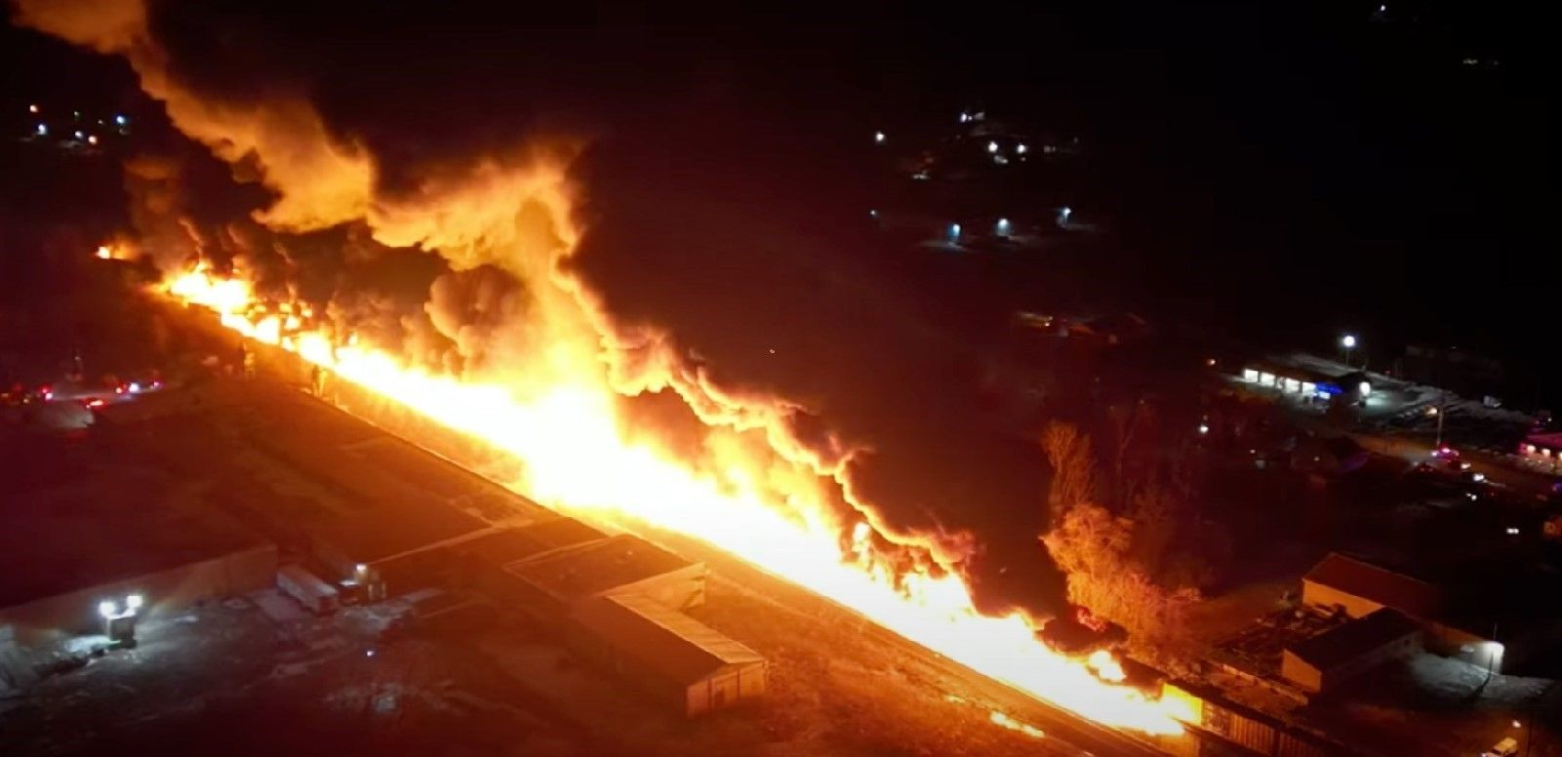
Participant Webinar
East Palestine, Ohio Train Derailment on 2/3/2023: NTSB [https://www.ntsb.gov/investigations/Pages/RRD23MR005.aspx] “Overhead view of derailment and early fire. (Courtesy of Eric’s Train Yard.)”)
This project was sponsored by the Los Angeles County Emergency Medical Services Agency and funded in part by the Hospital Preparedness Program, U.S. Department of Health and Human Services (HHS), Administration of Strategic Preparedness and Response (ASPR) grant funding. This award has been assigned the Federal Award Identification Number (FAIN) U3REP240735.

Slide 2
Welcome to the Medical Response and Surge Exercise Participant Webinar
Darren Verrette
Disaster Program Manager
Los Angeles County EMS Agency

Slide 3
Exercise Overview
Medical Response and Surge Exercise (MRSE)
MRSE Requirements
Threat / Hazard
Burn Resource Manual
Participation by Sector and Patient Allocation
Patient Allocation Table
Surveys and Polls
Exercise Essentials
Sector Specific Break Out Sessions

Slide 4
The MRSE
The Medical Response and Surge Exercise (MRSE) is an annual Hospital Preparedness Program (HPP) Cooperative Agreement requirement.

Slide 5
MRSE Requirements
Surge Capacity Requirements
Performance Measures and Data Collection Requirements

Slide 6
Surge Capacity
The Healthcare Coalition (HCC) must surge to 10% of its staffed bed capacity
Staffed beds means those beds which are equipped and available for patient use
L.A. County has approx. 17,000 staffed beds. 10% = 1,700 surge patients

Slide 7
MRSE Data Collection
Components
The MRSE requires a surge of the following bed types:
Emergency Department
General Medicine
Surgical
Post Critical Care (Burn Floor Beds)
ICU (Burn ICU)

Slide 8
Threat / Hazard
FIRE: BURN SURGE

Slide 9
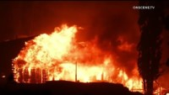
Southern California Fires
Notes:
Bridge Fire
Airport Fire
Line Fire
Potential for fire not just from brush fires but all around
Port of Los Angeles and Port of Long Beach
Train with tanker cars
Airports
Refineries
Industrial Plants
Structure Fires: Business and Residential

Slide 10
Burn Resource Manual (Burn Surge Plan)
Notes:
Los Angeles County has 3 Burns Centers
Torrance Memorial
LA General
Grossman Burn Center at UCLA Health West Valley
Total capacity 62 beds
The Burn Plan is to expand burn capacity in Los Angeles County in the event of a Burn Mass Casualty incident.
https://drive.google.com/file/d/1Q_cm_MeG06Cfz2ZlfO964noyiarUDyeB/view -

Slide 11
Burn plan utilizes the LA County trauma program.
15 trauma centers are designated as Burn Resource Centers (BRC):
Antelope Valley
Cedars Sinai
CHLA
California Hospital
Northridge
St. Mary’s
Henry Mayo
Huntington Hospital
Harbor UCLA
LA General
Long Beach Memorial
Pomona Valley
Holy Cross
Ronald Reagan UCLA
St. Francis
Notes:
Each BRC can take up to 20 critical burn patients for up to 72 hours
20 patients each x 15 BRC’s = Temporary increase in capacity to 300

Slide 12
Participation by Sector and Patient Allocation
9-1-1 Receiving Hospitals (69)
Hospitals without Emergency Departments (11)
Clinic and Urgent Care Sectors
Home Health Hospice and Long-Term Care Sectors
Ambulatory Surgery Center and Dialysis Sectors

Slide 13
Hospital
Sector:
9-1-1 Receiving Hospitals will test Burn Surge
Notes:
69 9-1-1 receiving

Slide 14
Patient Allocation: Hospitals
9-1-1 Receiving Hospitals (except Catalina Island) will receive a total of 25 victims
Twenty (20) will arrive by EMS (ReddiNet MCI Module)
Five (5) will walk-in
Catalina Island Medical Center will receive (ten) 10 victims in total by EMS (ReddiNet MCI Module)

Slide 15
Hospital Decompression
9-1-1 Receiving Hospitals will decompress to increase surge capacity.
No Actual Movement of Patients
Hospitals without Emergency Departments will receive decompression patients to support surge.
Participating HHH and LTC Sector facilities will receive decompression patients to support surge.
NOTE: 9-1-1 Receiving Hospitals, HHH, and LTC facilities to complete Hospital Decompression Survey.
Notes:
Hospital decompression survey is intended facilitate discussion with Command Staff to identify gaps and barriers to rapid discharge from Hospitals into HHH and LTC facilities. Your D/C planners and others know process perhaps can develop strategies to expedite process during a surge incident.

Slide 16
Hospital
Sector:
Hospitals without Emergency Departments will test Burn Surge
Test and support receiving decompression patients
Notes:
11 hospitals without Emergency Departments

Slide 17
Patient Allocation: Hospitals
Hospitals without Emergency Departments will receive a total of three (3) to five (5) walk-in victims from incident
Hospitals without Emergency Departments will simulate receiving ten (10) decompression patients from 9-1-1 receiving Hospitals
These patients will not be assigned via ReddiNet
The person(s) on site preparing for the exercise will create injects to simulate patient arrival.

Slide 18
Clinic and Urgent Care Sectors
Clinic and Urgent Care sectors have optional objectives:
Test burn plans / procedures
Test Shelter-in-Place
Test Evacuation Plans

Slide 19
Patient Allocation: Clinics and Urgent Care
Any Clinic or Urgent Care facility testing burn plans and procedures have the option to choose the number of walk-in patients they wish to receive to fulfill their objectives.
It is advisable to receive at least one (1) walk-in patient but no more than ten (10) walk-in patients from the incident.
These patients will not be assigned to clinics and urgent care facilities via ReddiNet
The person(s) on site preparing for the exercise will create injects to simulate patient arrival.
We will capture the number of Burn victims your facility selected in the After-Action Report survey

Slide 20
Long Term Care and Home Health Hospice Sectors
LTC and HHH have optional objectives:
Test and support Hospital Decompression efforts
Test Shelter-in-Place
Test Evacuation Plans

Slide 21
Patient Allocation: HHH and LTC Sector
Any LTC or HHH facility testing and supporting hospital decompression will select ten (10) patients to assist in relieving the pressure on hospitals.
These patients will not be assigned to facilities through ReddiNet
The person on site preparing for the exercise will create injects to simulate patient arrival.
We will capture the number of decompression patients your facility selected in the After-Action Report survey

Slide 22
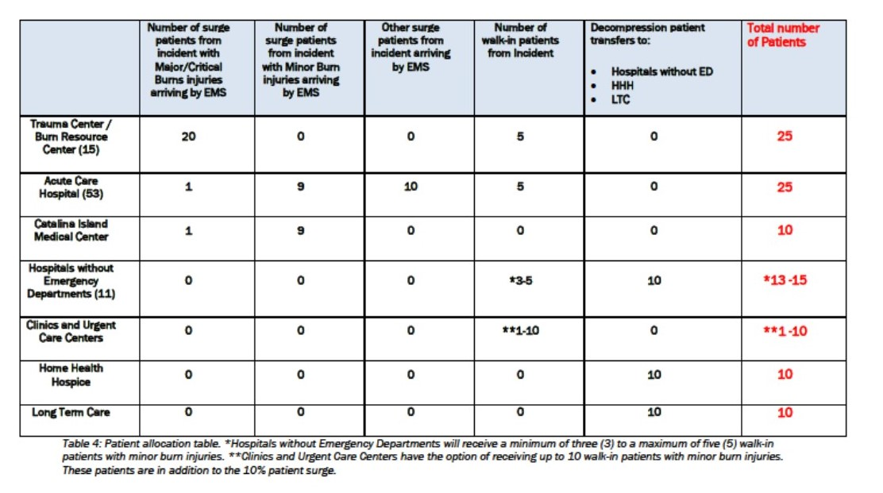
Notes:
Patient Allocation Table

Slide 23
Burn Victim List
Before the exercise, each participating facility (Hospitals, Clinics, and Urgent Care facilities) must download the Burn Victim list from the website.
Select the number and type of patients according to the patient allocation table.
Clinic and Urgent Care facilities do NOT select victims off the list that need admission. Select low acuity “clinic” victim types

Slide 24
Burn Victims
Clinical personnel can perform patient triage, determine treatment, determine if meets burn center criteria, follow-up needed, etc.
If you are a Hospital and you have patients that require transfer to a burn center, then compile a list and send list to the MAC for Burn Specialist. (MSEL Injects #24-27)
The Burn Specialist will prioritize patient transfers into Burn Centers.

Slide 25
Hospital Decompression Patient List
Before the exercise, Hospitals without Emergency Departments, HHH, and LTC facilities must download the Hospital Decompression Patient List from the website.
After downloading the list, the facility must select any 10 patients of their choice to process at their facility
Clinical personnel can perform patient triage or test intake processes.

Slide 26
Ambulatory Surgery Center and Dialysis Sectors
ASC and Dialysis have optional objectives:
Shelter-in-Place
Evacuation Plans

Slide 27
Provider Agencies
Mutual Aid
FOAC
Strike Teams
Types of Units:
  BLS
  ALS
  CCT
  Other

Slide 28
Surveys and Polls
An Assessment Poll titled; “Hospital Capacity Survey” will go out via ReddiNet to all 9-1-1 Receiving Hospitals at the beginning of the exercise
A survey titled “Hospital Decompression Survey” developed for Hospitals, Long Term Care, and Home Health Hospice entities. Download hardcopy from website and enter responses into Survey Monkey.
Notes:
An Assessment Poll titled; “Hospital Capacity Survey” will go out via ReddiNet to all participating hospitals at the beginning of the exercise
A survey titled “Hospital Decompression Survey” developed for Hospitals, Long Term Care, and Home Health Hospice entities. Download hardcopy from website and enter responses into Survey Monkey.
.

Slide 29
ReddiNet Assessment Poll:
Hospital Capacity Survey
Notes:
Information needed to fulfill ASPR performance measure
Questions number 4 and 5 – Hospitals with Burn Centers (LA General, Torrance Memorial
Important to distinguish between Burn Surge patients and Surge Patients without Burns
Have until close of business day to complete survey

Slide 30
Survey Monkey:
Hospital Decompression Survey
Notes:
Hospital decompression survey is intended facilitate discussion with Command Staff to identify gaps and barriers to rapid discharge from Hospitals into HHH and LTC facilities. Your D/C planners and others know process perhaps can develop strategies to expedite process during a surge incident

Slide 31
Exercise Essentials
Scenario
Scope of Exercise
Assumptions
MSEL
Resource Requesting
ARES
Conclusion of Exercise
Documentation
Registration

Slide 32
Exercise Scenario
A freight train carrying hazardous material derailed at a location near your facility. Several railcars were damaged and released a gaseous substance into the air. A subsequent explosion occurred with a brief fireball that had a horizontal expansion, approximately two blocks in one direction, that resulted in multiple persons attending a mass gathering event with burn injuries. The estimated number of persons with burns and other injuries is approximately 1,700. Approximately 800 persons sustained burns and minor injuries. Several railcars are fully engulfed, and a smoke plume, presumed toxic, is traveling in a North-East direction. Evacuation and Shelter-in-Place advisories are currently in effect.

Slide 33
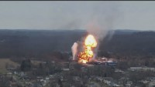
East Palestine, Ohio Train Derailment and Fire
Notes:
East Palestine, Ohio Train Derailment on 2/3/2023: NTSB [https://www.ntsb.gov/investigations/Pages/RRD23MR005.aspx] “Overhead view of derailment and early fire. (Courtesy of Eric’s Train Yard.)”)

Slide 34
MCI

Slide 35
MCI
At 8:00 a.m. the MAC will initiate a ReddiNet MCI poll
All 9-1-1 receiving hospitals respond to the poll and enter their bed availability
The MAC will then assign either one or two ambulances to each facility
Each facility must arrive the ambulance(s)
Update the MCI victim list in ReddiNet with all patients (EMS and walk-in) from the incident

Slide 36
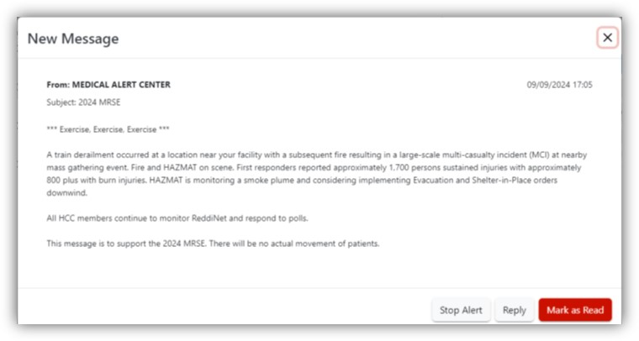
HCC ReddiNet
Message
MSEL Inject #4:
At 08:00 hours the MAC will send a message to all Sectors via ReddiNet
All HCP on ReddiNet acknowledge message by clicking on “Mark as Read”
Notes:
Acknowledge message

Slide 37
Exercise Scope
Command center activation is encouraged.
There will be no actual movement of patients.
Play will take place in the live ReddiNet system.
The exercise will begin at 8:00 a.m. and end at 12:00 p.m. Participating facilities who chose to end sooner than 12:00 p.m. may do so if all objectives and associated tasks are achieved.
There will be no request for mandatory County wide polls or resource requests after 11:00 a.m. to provide participants the opportunity to end sooner if able.

Slide 38
Exercise Assumptions
The scenario is plausible and meets criteria to activate applicable plans.
The time during the exercise is not reflective of actual time.

Slide 39
Master Scenario Event List (MSEL)
MSEL is a chronological list of simulated events (injects) that participants (players) will be asked to respond to during an exercise
Some injects are for all players such as the Service Level Poll
Some injects are for specific sectors and players such as Long-Term Care Bed availability Poll
It is okay to remove non-pertinent injects or add additional if needed to meet your objectives

Slide 40
Resource Requesting
MSEL Inject #8 and Inject # 29:
MCC will open a resource request incident to support the exercise titled:
“2024 MRSE Exercise”
Use this incident in ReddiNet for exercise related resource requests

Slide 41
Amateur Radio Emergency Service (ARES)
Great opportunity to invite ARES to your hospital to test back-up communications
ARES will setup Net Control at the MAC
ARES can transmit and receive messages, resource requests, bed availability reports, and more via HAM radio

Slide 42
Conclusion of Exercise
Hot-wash, Debrief
Participant Feedback Forms
60 days to complete and submit AAR/IP

Slide 43
Documentation
Exercise Objectives (Sector Specific)
Exercise Plan (ExPlan)
Situation Manual (SitMan)
Controller Evaluator Handbook
Exercise Evaluation Guide (Sector Specific)
Victim Cards
Master Scenario Event List (MSEL)
Participant Feedback Form
After-Action Report / Improvement Plan

Slide 44
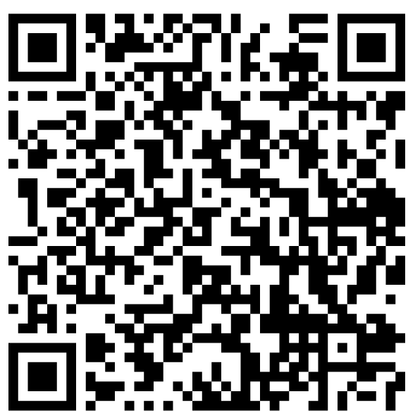
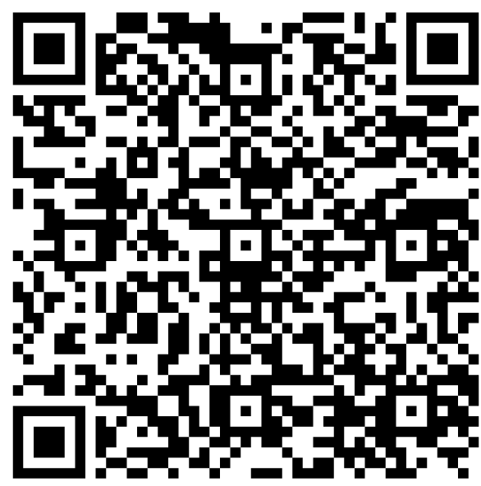
Websites
https://www.lacountyhcc.org/trainings-exercises-drills/mrse-medical-response-surge-exercise/2024-mrse -
https://dhs.lacounty.gov/emergency-medical-services-agency/home/disaster-programs/exercise-drills/

Slide 45
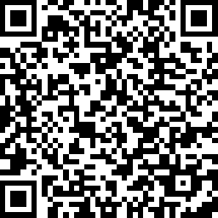
Exercise Registration
Please register your facility for the exercise
Registration will confirm your facility is planning to participate
Registration will provide point-of-contact information to EMS
Facility registration not individual players / participants
https://www.surveymonkey.com/r/7J9YCTX

Slide 46
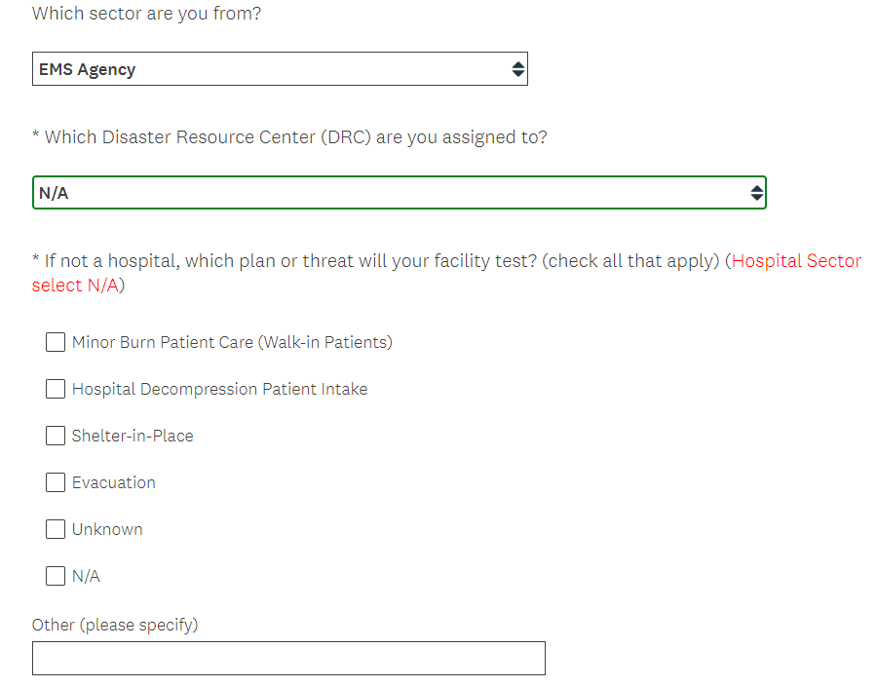
Exercise Registration
https://www.surveymonkey.com/r/7J9YCTX
Notes:
*Mandatory Field:
Clinic and Urgent Care Sectors option to test and receive minor burn patients / walk-in patients
HHH and LTC Sectors have option to test and receive Hospital decompression patients
All non-hospital sectors have option of Evacuation or Shelter-in-Place
Please indicate which plan or threat you are testing
Hospital sector select N/A – we know you are testing Burn Surge and Hospital Decompression

Slide 47
Questions
Type questions in chat or unmute

Slide 48

Thank you!
Darren Verrette
dverrette@dhs.lacounty.gov

