Slide 1
MRSE Participant Webinar September 24, 2024
Clinic & Urgent Care Preparation for the Medical Response and Surge Exercise (MRSE)
Presented by
Lisa Fisher, Vice President of Member Relations,
Community Clinic Association of Los Angeles County (CCALAC)
Member Driven. Patient Focused.

Slide 2
Welcome
Welcome
Introductions – Name, organization and Sector
Have you participated in a MRSE Drill?
What are your biggest concerns?
What are you looking forward to?
MRSE Participant Webinar
Member Driven. Patient Focused.

Slide 3
Agenda
Agenda
Welcome & Introductions
Overview of Objectives
Objectives 1 - 6 and Sample Tasks
Timeline and Injects
Post Drill Activities & Next Steps
Questions
MRSE Participant Webinar
Member Driven. Patient Focused.

Slide 4
MRSE Objectives
Los Angeles County
2024 Medical Response and Surge Exercise (MRSE)
Exercise Objectives
Objective 1 - Maintain awareness of the common operating picture by gathering and sharing real-time information related to the emergency and situational awareness
Objective 2 - Activate the Incident Command System
Objective 3 - Determine the clinic’s priorities for ensuring key functions
Objective 4 - Evaluate capabilities and resources for a burn surge incident
Objective 5 - Ensure processes and procedures are in place throughout response
Objective 6 - MHOAC Communications and Resource Requesting
MRSE Participant Webinar
Member Driven. Patient Focused.

Slide 5
MRSE Objectives
Los Angeles County
2024 Medical Response and Surge Exercise (MRSE)
Exercise Objective One
Objective 1 - Maintain awareness of the common operating picture by gathering and sharing real-time information related to the emergency and situational awareness through coordination with the Medical and Health Operational Area Coordinator (MHOAC) within [20 minutes]. (Capability 2)
Sample task(s):
• Develop information sharing procedures specific to the incident response and document these procedures for clinic staff within [XX] minutes of incident notification
• Identify and document information access and data protection procedures within [XX] minutes of incident notification
• Evaluate the ability to receive external communications, disseminate information internally to appropriate parties and response to external communications.
MRSE Participant Webinar
Member Driven. Patient Focused.

Slide 6
MRSE Objectives
Los Angeles County
2024 Medical Response and Surge Exercise (MRSE)
Exercise Objective Two
Objective 2 - Activate the Incident Command System to provide a structured and successful emergency response. (Capability 2)
Sample task(s):
• Complete HICS forms
• Review Emergency Operations Plan and Job Action Sheets with staff
• Communicate with clinical and non-clinical staff, patients, and visitors to notify them of ICS activation.
MRSE Participant Webinar
Member Driven. Patient Focused.

Slide 7
MRSE Objectives
Los Angeles County
2024 Medical Response and Surge Exercise (MRSE)
Exercise Objective Three
Objective 3 - Determine the clinic’s priorities for ensuring key functions are maintained throughout the emergency, including the provision of care to existing and new patients within a determined time frame. (Capability 2)
Sample task(s):
• Determine those services that are critical to patient care and those that could be suspended or transferred to a different facility (e.g., closing a clinic’s school-based site to preserve staff to manage an increased walk-in patient population at a primary site, or reallocating dental suites to accommodate walk-in use) and report back to the Command Center within [insert timeframe]
• Activate the facility’s Emergency Operations Plan (EOP) and notify all staff of plan activation within [25 minutes]
• Ensure the provision of continued staff and resources for Administrative and Finance functions throughout response.
MRSE Participant Webinar
Member Driven. Patient Focused.

Slide 8
MRSE Objectives
Los Angeles County
2024 Medical Response and Surge Exercise (MRSE)
Exercise Objective Three, Continued
Objective 3 - Determine the clinic’s priorities for ensuring key functions are maintained throughout the emergency, including the provision of care to existing and new patients within [insert timeframe].
Sample task(s):
• Consider the need for sheltering-in-place, facility lockdown, or evacuation, and notify all internal staff within [insert timeframe] of the decision to initiate any such actions
• Activate Continuity of Operations Plans (COOP) where applicable and include COOP status updates within staff briefings and operational objectives
• Put in place succession planning to maintain operations if primary positions become vacant due to the implications of the event
• Ensure that business operations are sustainable for a potentially long-term event, and identify strategies for sustainability in a long-term recovery plan and/or objectives
MRSE Participant Webinar
Member Driven. Patient Focused.

Slide 9
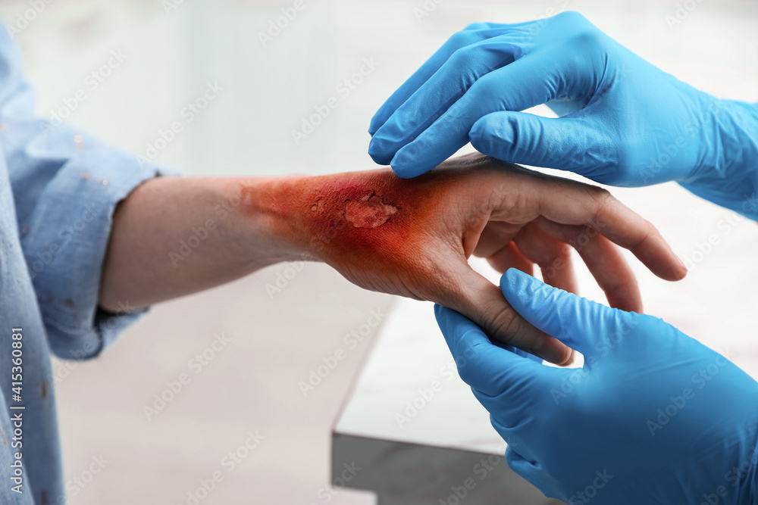
MRSE Objectives
Los Angeles County
2024 Medical Response and Surge Exercise (MRSE)
Exercise Objective Four
Objective 4 - Evaluate capabilities and resources for a burn surge incident in accordance with the Health Care Coalition (HCC)’s medical surge, burn surge, and resource sharing plans and policies. (Capability 4)
Sample task(s):
Complete any assigned functions for ambulatory surgical centers within the local health care coalition’s burn surge plan
Receive 1 – 10 walk-in patients with minor burns/injuries from the incident
Call back any clinical and non-clinical staff who may be used in non-traditional roles to assist in response efforts or to assist at other healthcare locations, and implement any HCC member staff sharing plans
Implement emergency equipment, supplies, and stocking strategies, and HCC resource sharing agreements
MRSE Participant Webinar
Member Driven. Patient Focused.

Slide 10
MRSE Objectives
Los Angeles County
2024 Medical Response and Surge Exercise (MRSE)
Exercise Objective Five
Objective 5 - Ensure processes and procedures are in place throughout response to provide the following to all clinical and non-clinical staff and their families: appropriate Personal Protective Equipment (PPE), psychological first aid, just-in-time training, and other interventions specific to the emergency to protect health care workers from illness or injury. (Capability 2)
Sample task(s):
• Conduct a safety briefing that addresses the availability and appropriate use of PPE, psychological first aid, and other available resources.
• Distribute just-in-time training materials to staff, such as job action sheets FAQs, and recommended PPE guidelines.
• Routinely evaluate the facility and workplace environment for any potential hazards or additional resources needs.
MRSE Participant Webinar
Member Driven. Patient Focused.

Slide 11
MRSE Objectives
Los Angeles County
2024 Medical Response and Surge Exercise (MRSE)
Exercise Objective Six
Objective 6 - MHOAC Communications and Resource Requesting (Capability 1)
Sample task(s):
• Establish access to communication systems (e.g., ReddiNet, VMed-28, etc.…)
• Respond to pertinent polls and/or surveys received from MHOAC
• Identify needs and submit appropriate ReddiNet resource request
MRSE Participant Webinar
Member Driven. Patient Focused.

Slide 12
Clinic & Urgent Care Injects
Time | Sector | Inject | Objective
8:00am | Partners with Reddinet | Acknowledge ** Exercise, Exercise, Exercise ** The 2024 Medical Response and Surge Exercise begins. *** Exercise, Exercise… | Objective 1
8:20-9:00am | Clinics & Urgent Care | Receive 0-10 walk-in patients from incident* | Objective 4
8:25-9:25am | Clinics & Urgent Care | Activation of the Incident Management Team (IMT)* | Objective 2
8:25-9:25am | Clinics & Urgent Care | Initial Incident Action Plan (IAP) development* | Objective 3
9:00am | Partners with Reddinet | Shelter-in-Place and Evacuation Advisory* | Objective 3
10:30-11:00am | All Sectors | Enter in one resource request into ReddiNet | Objective 6
MRSE Participant Webinar
Member Driven. Patient Focused.

Slide 13
Exercise Components
MRSE Participant Webinar
Member Driven. Patient Focused.

Slide 14
End of Exercise
• Collect all feedback from participants
Debrief with Team
• Adjourn
After Action Report & Survey Monkey (Due Mid January 2025)
Next Steps?
Register for the MRSE
Plan for the MRSE – November 21, 2024
Resources: LA County Healthcare Coalition (lacountyhcc.org)
MRSE Participant Webinar
Member Driven. Patient Focused.

Slide 15
MRSE Participant Webinar September 24, 2024
Questions?
Thank you!
Lisa Fisher, Vice President of Member Relations,
Community Clinic Association of Los Angeles County (CCALAC)
Member Driven. Patient Focused.

