Slide 1
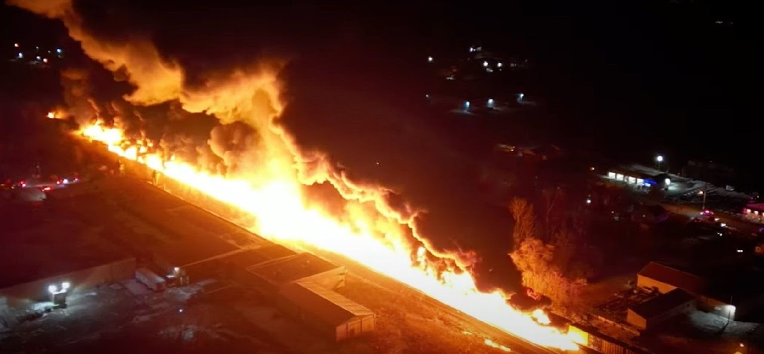
Los Angeles County 2024 MRSE Participant Webinar for Non-acute Sectors
Notes:
As Darren said, this is an exercise that is focusing on Burn Surge. For non-hospital sectors, we will focus on SIP/Evacuation in response to the toxic smoke plume providing an opportunity to evaluate the ability to continue or modify operations while determining the need to SIP or evacuate.
The goal is to exercise your plans, capabilities, and meet the objectives from the following slides.
Consider looking at your previous AAR /Improvement Plan as a guide from your previous drill, exercise or incident to build upon strengths and areas of improvement.
ALL sectors identified the need for ReddiNet training…
No matter what sector you represent, the idea of safety & continuing to care for YOUR patients is paramount, never to just “send them to the hospital”
This probably goes without saying, but any real incident takes priority over the exercise. Make sure during the exercise your staff know the designated word if an emergency arises. During our HealthCare Disaster Management Training, we use the word “Tinkerbell” in the event someone is really experiencing an emergency to differentiate from exercise play.

Slide 2
Exercise Overview
Exercise Name: Medical Response and Surge Exercise Burn focus
Exercise Date: November 21, 2024
Exercise Time: 0800-1200
Exercise Type: Functional
Exercise Goals:
Capability 1: Foundation for Healthcare & Medical Readiness
Capability 2: Health Care & Medical Response Coordination
Capability 3: Continuity of Health Care Service Delivery
Capability 4: Medical Surge
Notes:
Functional exercise: Simulates an emergency in the most realistic manner possible, short of moving resources to an actual site.
It is conducted in a “real—time” environment in an EOC or Command Post.
It is used to test and evaluate the capability of an organization to respond to an emergency using a simulated event
Some of you may choose to do a:
Tabletop exercise: which is a facilitated discussion of a plan in an informal, stress-free environment. Participants share capabilities and solve problems as a group based on their organizations existing plans and determine the objectives of the exercise
Full-scale exercise is usually lengthy and utilizes equipment, personnel with total coordination among many
We are going to discuss each capability and what objectives you can consider to meet these goals.
Some activities will overlap and can fulfill more than one capability.
Administration for Strategic Preparedness and Response (ASPR) Health Care Preparedness and Response Capabilities include:
Capability 1: Foundation for Health Care and Medical Readiness
Goal of Capability 1: The community has a sustainable Health Care Coalition – comprised of members with strong relationships – that can identify hazards and risks and prioritize and address gaps through planning, training, exercising, and acquiring resources.
(DRC HVA and TTX meetings, visiting our HCC website for resources and best practice documents, getting involved in sector specific workgroups)
Capability 2. Health Care and Medical Response Coordination
Goal for Capability 2: Health Care and Medical Response Coordination Health care organizations, the HCC, their jurisdiction(s), and the ESF-8 lead agency plan and collaborate to share and analyze information, manage, and share resources, and coordinate strategies to deliver medical care to all populations during emergencies and planned events
(DRC HVA and TTX meetings, visiting our HCC website for resources and best practice documents, getting involved in sector specific workgroups)
Capability 3: Continuity of Health Care Service Delivery
Goal of Capability 3: Health care organizations, with support from the HCC and the ESF-8 lead agency, provide uninterrupted, optimal medical care to all populations in the face of damaged or disabled health care infrastructure. Health care workers are well-trained, well-educated, and well-equipped to care for patients during emergencies. Simultaneous response and recovery operations result in a return to normal or, ideally, improved operations.
(Engagement with HCC activities, workgroups, webinars and exercises)
Capability 4. Medical Surge
Goal for Capability 4: Health care organizations — including hospitals, emergency medical services (EMS), and out-of-hospital providers — deliver timely and efficient care to their patients even when the demand for health care services exceeds available supply. The HCC, in collaboration with the Emergency Support Function-8 (ESF-8) lead agency, coordinates information and available resources for its members to maintain conventional surge response. When an emergency overwhelms the HCC’s collective resources, the HCC supports the health care delivery system’s transition to contingency and crisis surge response and promotes a timely return to conventional standards of care as soon as possible.
(Continuity of care…BCP/COOP, offered annually by the Disaster Section)
Capabilities and goals are different from the actual objectives, which we will cover as they arise in the MSEL
Things to think about:
What are YOUR plans?
Does your facility/agency have any plans for this type of incident?
Have you coordinated with public safety to identify how to respond to such an incident?
What are your top 3 concerns of your facility/agency?
What types of information would be released?
How would employees/patients be notified
Who makes the notifications?
Where do you get the information?

Slide 3
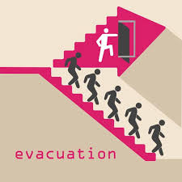
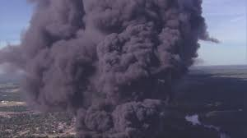
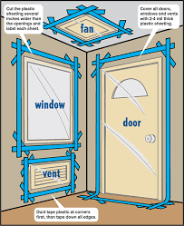
Critical Decisions & Actions for a Toxic Chemical Plume
Notes:
The goal of this breakout session is to look at the timeline of the MSEL and objectives and explore the critical decisions and actions you will need to take when faced with a toxic chemical plume near your facility.
Again, I encourage you to review your facility’s AAR from last year (Power outage) and look at the strengths and gaps, hopefully you can personalize the actions you will need to take to fulfill the objectives.
Start thinking about what information will help guide your decisions throughout this exercise?
Who makes the decisions?
At what point do you activate the Command Center?
PLAN ACTIVATION
Who activates this plan? (should be the incident commander)
Do you have a decision tree or matrix? Incident assessment worksheet?
INCIDENT MANAGEMENT
Does your EOP identify the designated Incident Commander? (IC=gathers all information related to the incident and coordinated and released via the command center.
IC has full authority and responsibility for the decision-making process for this response.
ICS Job Action Sheets #254 victim/patient tracking

Slide 4
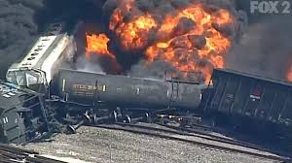
7:45 am
Notes:
11/21/2024 train derailment announced
FROM: Exercise Director for all Sectors (this is YOU, if you are running the exercise)
TO: All Participants
A freight train carrying hazardous material derailed at a location near your facility
•Several railcars were damaged and released a gaseous substance into the air. •A subsequent explosion occurred with a brief fireball that had a horizontal expansion approximately two blocks in one direction that resulted in multiple persons attending a mass gathering event with burn injuries. • Fire and HAZMAT are on scene of the incident. •First responders reported an estimated 1,700 persons injured with approximately 800 with burn injuries. •Others sustained minor injuries. •Several railcars are fully engulfed and a smoke plume, presumed toxic, is traveling in a North-East direction. •News crews respond to the scene and begin broadcasting. •First responders began triaging the victims in the Immediate, Delayed, and Minor categories and are preparing patients for transport to local hospitals. •HAZMAT considering Evacuation and Shelter-in-Place advisories.
Are your employees familiar with your policy regarding shelter in place?
If you are told there is danger of exposure, how versed are you and your staff on evacuation procedures?
When was the last time you exercised to SIP/evacuation?
Again, ask DO YOU KNOW WHEN TO:
Activate Incident Command?
Close the business?
Are you responsible for the customers, clients, or visitors in the building?
Should you turn on call-forwarding or alternative telephone answering systems or services? Do you change the recording to indicate that the business is closed and what patients should do if scheduled for say dialysis?
Where are disaster supplies, if needed?
At what point would you call emergency contacts?
***Cellular telephone equipment may be overwhelmed or damaged during an emergency.
Considerations:
Number of people in your facility (staff, patients, visitors)
Can you maintain current operations?
Are there services you should discontinue?
What if staff/patients want to leave?
What resources do you have on hand?
What protective measures need to be implemented?
Who determines when the facility is safe to resume normal operations?
Remain calm
Ensure patients/visitors are aware of the situation
Who does the Assessment:
Contact Building management or which company?
How large of a geographic area is impacted?
Is there a possibility of a need to evacuate?
What is the availability of other resources (law, fire)

Slide 5
ReddiNet®
Communication Tool
MCI
General Notifications
Polls
Assessment Polls
Service Level Polls
Resource Requests
Notes:
At this point, if you don’t have a ReddiNet account, NOW is the time to sign up for the actual exercise in November!
ReddiNet is our main communication platform, it is paid for by federal dollars and is FREE to you.
During COVID we were able to distribute an enormous amount of PPE, ventilators, monoclonal antibiotics, COVID test kits, and fulfill requests for staff through resource requests submitted via ReddiNet
Again, ReddiNet is our main communication platform. It is both Web and Satellite Based
ReddiNet is used by MAC, PH, Hospitals, Fire Departments, Police Depts, LTC, ASC, HHH, UCC, ESRD, CCALAC
Think about what triggers activation of your Communication Plan
What is the expected time frame to notify Internal and external customers?
What priorities do you have for leadership, staff, patients, sister facilities, geographically close facilities, Local EMS Agency etc.
When did you last test your communication plan?
What systems are included in your plan? Phone, text, email, mass messaging,
Maintain Communications: Initially you may want to review your EOP, specifically your communications plan
Determine if you need to activate your incident command system (ICS), consider using a 214 Activity Log
Review strategies
Key communications with:
Personnel on duty AND Personnel off duty (instruct to report or not)
Patient families
Medical Providers
Personnel families
Public Safety (EMS, transport providers, buses, etc.)
Media
ASC-contact your next surgical case, the physicians performing the surgery,
ESRD-clamp and disconnect procedures, arrangements for next wave of patients, contact the next shift, is there another Dialysis facility you could refer to? How do you prioritize patients

Slide 6
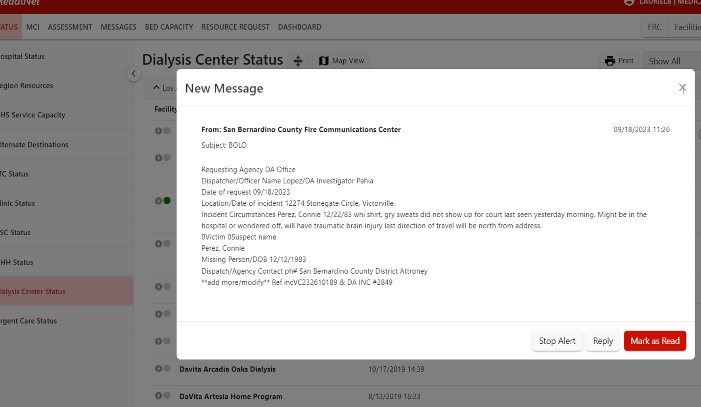
MSEL 8:00-8:05 am
8:00 am
ASC Dialysis and HHH Objective 1
Notes:
11/21/2024 8:00 am Inject (ignore actual message just an example!)
Remember Injects are a scripted piece of information or event in an exercise to trigger a response or decision
Message comes in via ReddiNet
EXERCISE Participants acknowledge message in ReddiNet. Read the message and click on the red box, “Mark as Read”
From: MEDICAL ALERT CENTER 11/21/2024 0800
Subject: 2024 MRSE
*** Exercise Exercise Exercise*** The message will read….
“A train derailment occurred at a location near your facility with a subsequent fire resulting in a large-scale multi-casualty incident (MCI) at nearby mass gathering event. Fire and HAZMAT on scene. First responders reported approximately 1,700 persons sustained injuries with approximately 800 plus with burn injuries. HAZMAT is monitoring a smoke plume and considering implementing Evacuation and Shelter-in-Place orders downwind.
All HCC members continue to monitor ReddiNet and respond to polls
This message is to support the 2024 MRSE. There will be no actual movement of patients”
THIS IS YOUR SITUATIONAL AWARENESS meeting objective 1: Maintain awareness of the common operating picture by gathering and sharing real time information in coordination with the MHOAC (Medical & Health Operational Area Coordinator)
What are some things you could do to meet this objective? Anyone want to offer suggestions?
Who will you gather more information from?
What is the process you use to share information?
Gaining situational awareness during an emergency is crucial for making informed decisions and ensuring safety. Some strategies to help you stay aware of your surroundings in such situations:
Stay Calm: Panic can cloud your judgment and hinder your ability to assess the situation. Take deep breaths and focus on staying composed.
Assess the Situation Quickly: Evaluate the nature of the emergency. Identify any immediate dangers, such as fire, flooding, or structural damage.
Gather Information:
Visual Observation: Look around for signs of danger, changes in the environment, or any cues from people around you.
Auditory Cues: Listen for alarms, emergency announcements, or unusual sounds that could indicate a problem.
Communicate: Use a phone or radio to receive updates from emergency services or to check in with others.
Identify Safe Areas: Determine if there are safe zones or escape routes. Understand where to go for shelter or evacuation.
Monitor News and Alerts: Keep up with official updates through news channels, emergency alert systems, or social media.
Stay Informed about Emergency Procedures: Familiarize yourself with the emergency protocols for your area or organization. This includes knowing evacuation routes, first aid procedures, and emergency contact numbers.
Use Technology:
Emergency Apps: Download and use emergency apps that provide real-time information and alerts.
GPS: Use GPS to navigate to safety or to assist emergency responders in locating you.
Observe Others: Pay attention to the behavior of others around you. Their actions can provide clues about the severity of the situation and potential responses.
Be Aware of Your Environment: Notice any changes in your surroundings, such as the behavior of people, the condition of infrastructure, or the development of hazards.
Keep a Mental Map: Maintain a mental map of your environment, noting key landmarks, exits, and potential hazards.
Prioritize Safety: Focus on actions that will ensure your safety and the safety of others. Avoid unnecessary risks or distractions.
Stay Flexible: Be prepared to adapt your plans as the situation evolves. New information or changing conditions may require a shift in your approach.
By staying observant and using these strategies, you can enhance your situational awareness and improve your ability to respond effectively during an emergency.

Slide 7
MSEL 8:00-8:05 am
9:00 am
ASC Dialysis and HHH Objective 1
Notes:
11/21/2024 9:00am Inject
FROM: Medical Coordination Center
TO: Healthcare Partners who have ReddiNet
*** Exercise, Exercise, Exercise *** MCC has been notified by Fire that HAZMAT issued a SIP and Evacuation advisory based upon proximity to the incident. A presumed toxic smoke plume is traveling in a NE direction from the incident.
Shelter-in-Place or Evacuation Advisory Message from the MCC via ReddiNet
EXERCISE Participants acknowledge message in ReddiNet. Read the message and click on the red box, “Mark as Read”
ASC & ESRD: Objective 3: Determine the facility’s priorities for ensuring key functions are maintained during the emergency, including the provision of care to existing and new patients.
What plan or document will you turn to? EOP, P&Ps, maybe your BCP? COOP?

Slide 8
9:00 am SIP & Evacuation Advisory
ASC, Dialysis Objective 3:
Determine facility priorities for ensuring key functions are maintained, including provision of care
HHH Objective 3: Activate and Implement Surge Plan
Notes:
At 9:00 am MCC sends following message via ReddiNet:
"Fire / HAZMAT recommend Shelter-in-Place and Evacuation due to presumed toxic smoke plume traveling Northeast of incident."
"All HCC members continue to monitor ReddiNet and respond to polls"
"This is an exercise there will be no actual movement of patients.“
Each non-acute care sector site will independently determine if they want to exercise this inject as either Shelter-in Place, or Evacuate, or no action
Sample Task(s) associated with this objective include: [Remove those that you are not testing]
• Determine those services that are critical to patient care and those that could be suspended or transferred to a different facility, and report back to the Command Center
• Coordinate the provision of continued staff and resources for Administrative and Finance functions throughout response
• Activate Continuity of Operations Plans (COOP) where applicable, and include COOP status updates within staff briefings and operational objectives
• Consider the need for sheltering-in-place, facility lockdown, or evacuation, and notify all internal staff within [insert timeframe] of the decision to initiate any such actions. If evacuation is required, hang facility closure signage
• Coordinate so that business operations are sustainable for a potentially long-term event, and identify strategies for sustainability in a long-term recovery plan and/or objectives
Once again, consider:
What criteria are used to determine whether the facility will SIP or evacuate?
Who will make that decision ?
What policy or procedure will you use to determine the next steps?
Do you have a COOP or BCP?
What about the communication plan with Emergency Contacts, staff, patients, family of patients?
Chronic Conditions:
Plan for Management:
ASC will need to communicate to future surgical case and figure out plan for the patients that were ready for discharge
ESRD should have a dietary plan for patients whose dialysis is going to be delayed or cancelled
Let patients/clients know how to monitor symptoms and know when to seek medical help.
Share information and Resources
Stay Informed:
Health Advisories: Follow health advisories and updates related to the emergency situation to stay informed about any potential health risks or recommended precautions

Slide 9
Shelter in Place
Objective 3:
Determine the facility’s priorities for ensuring key functions are maintained during the emergency, including the provision of care to existing and new patients.
What plan or document will you turn to for SIP?
What are key steps to consider?
Notes:
Review your Business Continuity Plan (BCP)/ Continuity of Operations Plan (COOP)
Continuing your business during a shelter-in-place event requires careful planning and adaptability.
Continuing operations for a dialysis center during a shelter-in-place event requires a focus on patient care, safety, and compliance. Here are key steps to consider:
Assess Regulatory Guidelines:
Stay updated on local and federal regulations regarding healthcare operations during emergencies. Who is this for ASC? ESRD?
Ensure compliance with guidelines from health authorities like the CDC and your state health department.
Develop a Communication Plan:
Inform patients about any changes to operations, safety protocols, and appointment schedules.
Use phone calls, texts, or digital platforms to maintain regular communication.
Enhance Safety Protocols:
Implement strict hygiene practices, including frequent sanitation of equipment and common areas.
Provide personal protective equipment (PPE) for staff and encourage its use among patients.
Evaluate Patient Needs:
Prioritize care for patients based on clinical necessity and individual circumstances.
Identify patients who may need home dialysis or alternative care options.
Adjust Staffing Plans:
Ensure adequate staffing by cross-training employees and having contingency plans in place.
Consider flexible work arrangements for staff to minimize exposure.
Telehealth Options:
Offer virtual consultations for non-emergency follow-ups and patient education.
Utilize telehealth platforms to maintain regular contact with patients.
Manage Transportation:
Coordinate transportation services for patients who may have difficulty traveling.
Explore partnerships with local transportation services to ensure patient access.
Monitor Supply Chains:
Regularly check inventory levels of essential supplies (dialysis equipment, medications, PPE).
Establish relationships with alternative suppliers to avoid shortages.
Emergency Protocols:
Develop and communicate protocols for handling COVID-19 cases among patients or staff.
Create a contingency plan for temporary closure or relocation if necessary.
Mental Health Support:
Provide resources for mental health support to both staff and patients during this stressful time.
Consider virtual support groups or counseling services.
Review Financial Management:
Assess your financial position and explore relief options (grants, loans) specific to healthcare facilities.
Monitor billing and reimbursement processes to ensure financial stability.
Feedback and Adaptation:
Regularly gather input from staff and patients to assess the effectiveness of your protocols.
Be ready to adjust your plans based on evolving circumstances and guidance.
By prioritizing patient care and safety while remaining adaptable, you can effectively continue operations at your ASC/dialysis center during a shelter-in-place event.

Slide 10
What does SIP look like?
What is the ideal location to shelter within a building?
What supplies would you need?
Is there a protocol to follow for securing the facility?
What about the ventilation system?
Notes:
Shelter-in-Place Hazardous Materials
Shelter-In-Place simply means seeking immediate shelter inside a building. This action may be taken during a release of toxic chemicals, biological or radioactive materials to the outside air or other emergency.
If the outside air quality is threatened or compromised, sheltering in place keeps you inside an area offering more protection.
Although rarely called for, Shelter-In-Place events usually last only a few hours. Emergency supply kits of food, water, and other items can be used during Shelter-In-Place events.
Does anybody know what type of room is ideal in case a Shelter In-Place is activated?
DO NOT GO TO THE BASEMENT!
Move to floors above ground level. Chemical agents tend to be heavier than air and settle at ground level
Shelter-In-Place in an interior room above ground without windows or with the least number of windows.
Once you have identified the most appropriate room, what should you next?
Shut and lock all windows and interior & exterior doors, this will create a tighter seal reducing the amount of seepage into the room.
Turn off all air conditioners and fans; be sure to shut off all heaters as well. Many buildings’ ventilation systems are remotely controlled by Facilities Management. If necessary, locally turn off heat, fans, air conditioning, or ventilation systems. Close vents as you are able
If you are able, close or cover all vents in the room for added protection.
Make a list of all the people in the room with you; make sure to get all emergency cell numbers as well. Please keep in mind that during an emergency event local phone lines may not work due to damage or a high volume of calls, texting may be a better option at that point
Do not use the elevator while making your way to the appropriate room, operating elevators can cause outside contaminated air to infiltrate the interior of the building.
What supplies should you grab?
If it is safe to do so and time permits, the following items would be very helpful and recommended:
Bottled water, juice or any other liquid that will keep your body hydrated.
Comfort foods such as candy, chips, gum or anything else you can find along the way.
Plastic garbage bags to use as portable bathrooms.
Plastic material to cover the doors and windows.
Tape of any sort, preferably Duct Tape (silver tape).
Medical kit or supplies.
Call 911 and let them know exactly where you are in the building, when it is safe to do so,. Include floor level and room number when relaying information to emergency personnel.
If needed, cover mouth and nose with a wet cloth for added protection. •
If the room has a radio or TV, please tune into local stations for more details and information.
DO NOT DRINK FAUCET OR TOILET WATER! EITHER OR BOTH MAY BE CONTAMINATED.
Is there anything you should not bring into your room during a Shelter In Place? Absolutely.
Do not bring in candles, weapons, or any kind of controlled substance unless prescribed by a physician. Do not bring in any items that could create carbon monoxide or release poisonous chemicals or gases. In case of a Shelter In-Place emergency: stay calm and alert to what is going on around you; often times the most useful way for you to help is by calling emergency services during an event.
Immediate Shelter-In-Place:
When the release is nearby and the need to seek shelter is immediate.
Stay inside a building.
If outside, enter nearest building.
Remain in place until advised by emergency personnel that it is safe to leave.
Delayed Shelter-In-Place:
When a release occurs off campus and there is time (30 minutes or more) to move people to large, enclosed areas.
Follow directions of emergency personnel to move quickly to a delayed Shelter-In-Place location.
Remain in place until advised by emergency personnel that it is safe to leave.
When advised of the all-clear:
Open doors and windows.
Return ventilation system to normal operations.

Slide 11
Evacuation
Objective 3:
Determine the facility’s priorities for ensuring key functions are maintained during the emergency, including the provision of care to existing and new patients.
What plan or document will you turn to for evacuation?
Key considerations
Notes:
Review your Business Continuity Plan (BCP)/ Continuity of Operations Plan (COOP)
Continuing your business during a shelter-in-place event requires careful planning and adaptability.
Continuing operations at a surgery center during an emergency requiring evacuation is critical for patient safety and care continuity. Here are essential steps to take:
Establish an Emergency Response Plan:
Develop a comprehensive evacuation plan that includes roles and responsibilities for staff.
Ensure the plan is regularly reviewed and practiced through drills.
Communicate with Staff and Patients:
Inform staff of the emergency response plan and evacuation procedures.
Keep patients informed about potential disruptions and how to reach them for updates.
Identify Safe Locations:
Designate safe evacuation routes and locations for both staff and patients.
Ensure these locations are equipped for patient care if needed.
Assess Patient Needs:
Prioritize the evacuation of patients based on medical urgency and mobility.
Prepare necessary medical records and medications for patients being evacuated.
Organize Transport:
Arrange for safe transportation for patients who require assistance.
Coordinate with local emergency services for transport if necessary.
Secure Medical Equipment and Supplies:
Identify critical medical equipment that needs to be transported.
Ensure that essential supplies (medications, PPE) are included in the evacuation.
Maintain Communication with Authorities:
Stay in contact with local emergency management and health authorities for updates and assistance.
Report your center's status and needs to ensure support during the evacuation.
Implement Continuity of Care Plans:
Have a plan for continuity of care for patients' post-evacuation, including referrals to nearby facilities.
Ensure access to patient medical records for ongoing treatment.
Monitor Staff Well-being:
Provide support for staff during and after the evacuation process.
Address mental health needs and ensure staff are informed about the next steps.
Debrief After Evacuation:
Conduct a debriefing session with staff to review the evacuation process.
Identify areas for improvement and update the emergency response plan accordingly.
Reassess Operations Upon Return:
Evaluate the facility for safety and readiness before resuming normal operations.
Communicate with patients about when services will resume and any changes to procedures.
By following these steps, you can help ensure the safety of patients and staff while maintaining continuity of care during an emergency evacuation.

Slide 12
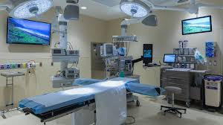
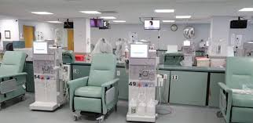
What does Evacuation entail?
ASC
Dialysis
Notes:
ASC
Mobility is an important part in effective and timely evacuations, and therefore facilities are expected to properly plan to identify patients who would require additional assistance, ensure that means for transport are accessible and available and that those involved in transport, as well as the patients and staff are made aware of the procedures to evacuate.
For outpatient facilities, such as ASCs and ESRD, the emergency plan is required to ensure that patients with limited mobility are addressed within the plan.
The plan should also address ways the facility will address identified patient needs that can’t be addressed by in house services in an emergency, such as just in time contracts or emergency transfers.
Ultimately, the delegations of authority and succession plans need to include plans on how the facility ensures patient safety is protected and patients will receive care at the facility or if transferred, under what circumstances transfers will occur
Evacuating a surgery center involves meticulous planning due to the critical nature of the procedures and the need to manage both patients and sensitive medical equipment. Here’s a comprehensive approach to ensure a safe and effective evacuation:
Develop an Evacuation Plan:
Designate Responsibilities: Assign roles to staff members, including evacuation coordinators, medical personnel, and support staff.
Evacuation Routes: Plan multiple evacuation routes and exits to accommodate different scenarios. Ensure that pathways are clear and accessible for patients, including those with mobility issues.
Assembly Points: Identify safe assembly points outside the facility where patients can be gathered and accounted for.
Patient Assessment and Prioritization:
Identify Critical Needs: Assess patients' medical conditions and prioritize those who are most vulnerable or in need of immediate assistance.
Prepare Medical Records: Ensure that patient medical records, including dialysis treatment schedules and emergency contacts, are readily accessible and can be taken during evacuation.
Communication Plan:
Notify Patients: Communicate clearly with patients about the evacuation process. Use calm and reassuring language.
Coordinate with Emergency Services: Inform local emergency services and provide them with information about the facility, including the number of patients and their needs.
Transportation Arrangements:
Secure Transport: Arrange for appropriate transportation for patients, especially those who require specialized equipment.
Medical Equipment: Ensure that essential medical equipment, such as portable dialysis machines, is transported safely if needed.
Staff Training and Drills:
Conduct Drills: Regularly practice evacuation drills with all staff to ensure they are familiar with procedures and roles.
Training: Train staff on how to assist patients with different needs and how to handle medical equipment during an evacuation.
Evacuation Execution:
Assist with Mobility: Help patients who need assistance moving, including those who use wheelchairs or have other mobility challenges.
Monitor Patient Safety: Continuously monitor patients for any health issues during the evacuation and provide immediate assistance if needed.
Post-Evacuation Care:
Provide Continuity of Care: Ensure that patients receive necessary medical care as soon as possible after evacuation, including any required dialysis treatments.
Reunite Patients: Make sure patients are accounted for and reunited with their families or caregivers.
Evaluate and Improve:
Debrief: After the evacuation, debrief with staff to evaluate the process and identify any issues or areas for improvement.
Update Plans: Revise the evacuation plan based on feedback and lessons learned to enhance preparedness for future emergencies.
DISALYSIS
Dialysed patients require special attention due to their unique vulnerabilities that extend beyond their health status. Once the dialysis process is initiated, patients become immobile and reliant on the machine for a duration of 2-6 hours.
The necessity of a power supply, as well as a water source for haemodialysis, further restricts their mobility.
From a physiological standpoint, any sudden interruption of an ongoing dialysis procedure can lead to hypovolaemia as blood and fluids have already been transferred from the patient to the machine
Given that patients with end-stage renal disease frequently experience anaemia, failure to return the blood to the patient prior to ending the dialysis session can result in symptomatic anemia.
Effective evacuation planning for such cases requires the consideration of three key factors:
the patients’ vulnerabilities
the evacuation setting &
the patients’ destination
These factors are connected and interdependent, thus requiring a comprehensive approach involving patients, caregivers, emergency medical services, and disaster planners. While discussions have taken place concerning the evacuation of various patient groups, there remains a dearth of guidance regarding the appropriate course of action for patients undergoing dialysis during an evacuation.
The objective of this discussion, therefore, is to address the evacuation of dialysed patients and develop evidence-based evacuation plans. By taking into account the specific needs and vulnerabilities of these patients, we can ensure their safety and well-being in emergency situations.
Evacuating a dialysis center requires careful planning due to the medical needs of patients who are dependent on regular dialysis treatments. Here’s a structured approach to ensure a safe and efficient evacuation:
Develop an Evacuation Plan: (you should have one. Good time to review)
Designate Responsibilities: Assign roles to staff members, including evacuation coordinators, medical personnel, and support staff.
Evacuation Routes: Plan multiple evacuation routes and exits to accommodate different scenarios. Ensure that pathways are clear and accessible for patients, including those with mobility issues.
Assembly Points: Identify safe assembly points outside the facility where patients can be gathered and accounted for.
Patient Assessment and Prioritization:
Identify Critical Needs: Assess patients' medical conditions and prioritize those who are most vulnerable or in need of immediate assistance.
Prepare Medical Records: Ensure that patient medical records, including dialysis treatment schedules and emergency contacts, are readily accessible and can be taken during evacuation.
Communication Plan:
Notify Patients: Communicate clearly with patients about the evacuation process. Use calm and reassuring language.
Coordinate with Emergency Services: Inform local emergency services and provide them with information about the facility, including the number of patients and their needs.
Transportation Arrangements:
Secure Transport: Arrange for appropriate transportation for patients, especially those who are bedridden or require specialized equipment.
Medical Equipment: Ensure that essential medical equipment, such as portable dialysis machines, is transported safely if needed.
Staff Training and Drills:
Conduct Drills: Regularly practice evacuation drills with all staff to ensure they are familiar with procedures and roles.
Training: Train staff on how to assist patients with different needs and how to handle medical equipment during an evacuation.
Evacuation Execution:
Assist with Mobility: Help patients who need assistance moving, including those who use wheelchairs or have other mobility challenges.
Monitor Patient Safety: Continuously monitor patients for any health issues during the evacuation and provide immediate assistance if needed.
Post-Evacuation Care:
Provide Continuity of Care: Ensure that patients receive necessary medical care as soon as possible after evacuation, including any required dialysis treatments.
Reunite Patients: Make sure patients are accounted for and reunited with their families or caregivers.
Evaluate and Improve:
Debrief: After the evacuation, debrief with staff to evaluate the process and identify any issues or areas for improvement.
Update Plans: Revise the evacuation plan based on feedback and lessons learned to enhance preparedness for future emergencies.

Slide 13
9:15 ReddiNet® Service Level Poll issued
A Service Level Poll is used to obtain real time facility operational status during an event or incident.
Status is color coded
Respond to Assessment Poll within 60 min.
OBJ 6 (ASC)
OBJ 5 (DIALYSIS)
OBJ 4 (HHH)
Notes:
ReddiNet is our main communication platform. It is both Web and Satellite Based
Objective 6 for ASCs is to send at least one RR with resource needs during the first operational period
Objective 5 for Dialysis Objective 5 - MHOAC Communications and Resource Requesting (Capability 1)
Sample task(s) to meet this objective: [Remove those that you are not testing]
• Establish access to communication systems (e.g., ReddiNet, VMed-28, etc.…)
• Respond to pertinent polls and/or surveys received from MHOAC
• Identify needs and submit appropriate ReddiNet resource request resource
This poll will come through in the assessment tab
Hospitals and Long-Term Care facilities; Green, Yellow, Orange, Red and Black RED means significant assistance from the jurisdiction is required.
Clinics, Home Health/Hospice, Dialysis and Urgent Care Centers – No Red
Ambulatory Surgery Centers and Psych facilities – No Orange or Red
Green (Normal Operations): No assistance from the jurisdiction is required. Agency is operational and is in business-as-usual mode. Can assist with response by accepting early discharged from hospitals.
Yellow (Under Control): No assistance from the jurisdiction is required. Center is operational and is in business-as-usual mode. Unable to accept additional patients.
Orange (Modified Services): Some assistance from the jurisdiction is required. Agency has begun to modify their services as they are unable to care for and/or reach all patients.
RED means significant assistance from the jurisdiction is required.
Black (No Services): Unable to care for/reach patients. Assistance from jurisdiction is required to reach patients who have been triaged as high risk. Should be referred to law enforcement and/or EMS providers in the affected area

Slide 14
9:15 am ReddiNet® Service Level Poll
Notes:
HHH, ESRD and UCC have the same color codes and definitions
ASC has no Orange
Green (Normal Operations): No assistance from the jurisdiction is required. Agency is operational and is in business-as-usual mode. Can assist with response by accepting early discharged from hospitals.
Yellow (Under Control): No assistance from the jurisdiction is required. Center is operational and is in business-as-usual mode. Unable to accept additional patients.
Orange (Modified Services): Some assistance from the jurisdiction is required. Agency has begun to modify their services as they are unable to care for and/or reach all patients.
Black (No Services): Unable to care for/reach patients. Assistance from jurisdiction is required to reach patients who have been triaged as high risk. Should be referred to law enforcement and/or EMS providers in the affected area.
Hospitals and Long Term Care facilities; Green, Yellow, Orange, Red and Black
Clinics, Home Health/Hospice, Dialysis and Urgent Care Centers – No Red
Ambulatory Surgery Centers and Psych facilities – No Orange or Red

Slide 15
09:15 am ReddiNet ® Service Level Poll
Select your sector
TRAINING LINK: https://www.reddinet.net/support
Notes:
1. Click on your facility type status page (i.e. "Dialysis Status").
TRAINING LINK: https://www.reddinet.net/support
Circle with lightening bolt means that that facility is not currently logged in to the ReddiNet system
Green means the facility is open with no issue
We looked at service level colors. Determine what your status is
Assessment module
Click on Service Level
Click on YOUR sector
Click on “Update”
Select your current service level and click “Update”
Accept when the “Confirm” box appears

Slide 16
ReddiNet ® Service Level
1
2
3
4
Notes:
You will need to communicate your service level.
TRAINING LINK: https://www.reddinet.net/support
Assessment tab
Click on Service Level
Select your sector
Your facility
Select your current service level and click “Update”
Accept when the “Confirm” box appears

Slide 17
Notes:
Select your current service level and click “Update”. a. If a facility is in an emergency and unable to update their service level, county authorities may update them.

Slide 18
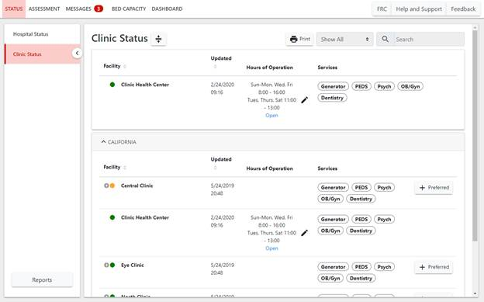
ReddiNet ® STATUS
TRAINING LINK: https://www.reddinet.net/support
Notes:
1. Click on your facility type status page (i.e. "Dialysis Status").
TRAINING LINK: https://www.reddinet.net/support
Circle with lightening bolt means that that facility is not currently logged in to the ReddiNet system
Green means the facility is open with no issue
We looked at service level colors. Determine what your status is
Assessment module
Click on Service Level
Click on “Update”
Select your current service level and click “Update”
Accept when the “Confirm” box appears

Slide 19
10:30 ALL HCP Submit a Resource Request (inject)
3
1
2
Notes:
Your supplies are running low and below PAR levels. Assuming all other avenues have been exhausted ( you reached out to sister facilities, contracted vendors, and non-contracted/non-traditional vendors)
Inject will come from your MSEL
Injects are specific scenario events or messages within the scenario that prompt players to implement the plans, policies, and/or procedures that require testing during the exercise. Each inject should be considered its own “event” within the timeline of the scenario.
1 click on the Resource request tab
2 pick the correct incident. For the exercise it will say DRILL or EXERCISE MRSE
3
ASC: Objective 6
Dialysis: Objective 5
HHH: Objective 4
select new RR

Slide 20
Resource Request
Resource Request forms should be submitted via ReddiNet during an MCI.
If ReddiNet is not available, RR may be submitted via email or fax.
Notes:
During an MCI, Resource Request forms should be submitted via the ReddiNet utilizing the Resource Request tab.
You can request Supplies, Personnel or Equipment
When a RR is submitted via email or fax the MCC will need to complete the form for you which is labor intensive and can create unnecessary delays.
During the pandemic, due to the overwhelming number of requests, there came a point that resource requests were ONLY via ReddiNet, and facilities were required to open FREE accounts!
It needs to be specific. For example, if you needed personnel, you would need to indicate if a tech, LVN, RN, RT, etc. is needed. The number of hours/days and duration needed. Ideally indicate if it is a day, mid or night shift request and the shift is 6,8 or 12 hours.
Supplies are disposable, one-time use, like test kits
Equipment is something that would typically be returned. Examples include ventilators, generators, etc.
There is a priority code
E for Emergent, meaning the resource is needed within 12 hours
U is for Urgent. Items needed in greater than 12 hours
S is for Sustainment
BEFORE a RR is submitted, you need to confirm 3 things:
The resource requested is exhausted or nearly exhausted
Your facility is unable to obtain the resource from vendors, contractors, sister facilities, like facilities
Facility is unable to obtain the resource from other non-traditional sources (home depot, amazon, etc)

Slide 21
Notes:
Name of your facility
Facility ID is your facility code in our HCC database and can be found under general information – see next slide

Slide 22
Facility ID is the “CODE” found under General Information for your facility
TRAINING LINK: https://www.reddinet.net/support
Notes:
If you click on your facility, under general information, you will see the code you will use on the RR form
This is also a good time to review the contact info to ensure it is correct

Slide 23
Resource Request-Covered
Notes:
Some of the fields in the resource request will be pre-filled. However, the fields that are not, must be filled prior to submitting.
Many times, during an incident, you will not be at your desk, therefore, it is important to add phone number that you will be able to in the event there is questions from the MHOAC.
Describe Mission – in this field, you will describe the purpose and reason for your request. Why and for what are you requesting
During an event, Resource Request forms should be submitted via the ReddiNet utilizing the Resource Request tab.
You can request Supplies, Personnel or Equipment
It needs to be specific. For example if you needed personnel, you would need to indicate if a tech, LVN, RN, RT, etc is needed. The number of hours/days and duration needed. Ideally indicate if it is a day, mid or night shift request and the shift is 6,8 or 12 hours.
Supplies are disposable, one time use, like test kits
Equipment is something that would typically be returned. Examples include ventilators, generators, etc
There is a priority code
E for Emergent, meaning the resource is needed within 12 hours
U is for Urgent. Items needed in greater than 12 hours
S is for Sustainment
BEFORE a RR is submitted, you need to confirm 3 things:
the resource requested is exhausted or nearly exhausted
Your facility is unable to obtain the resource from vendors, contractors, sister facilities, like facilities
Facility is unable to obtain the resource from other non-traditional sources (home depot, amazon, etc)
Resource requests are submitted as a last resort. When you have exhausted all other avenues. When you’ve reached out to your sister facilities, to your established vendors and non-traditional vendors; remember to think outside the box. Once all of these avenues have been exhausted, you may click all 3 check boxes.
It is important that management or your command unit review the request. Once reviewed, add their name and information to the resource request.

Slide 24
ReddiNet ® STATUS
Notes:
1. Click the Edit button under Hours of Operation. If you have trouble navigating ReddiNet, there is a training link I encourage you to contact them.
TRAINING LINK: https://www.reddinet.net/support

Slide 25
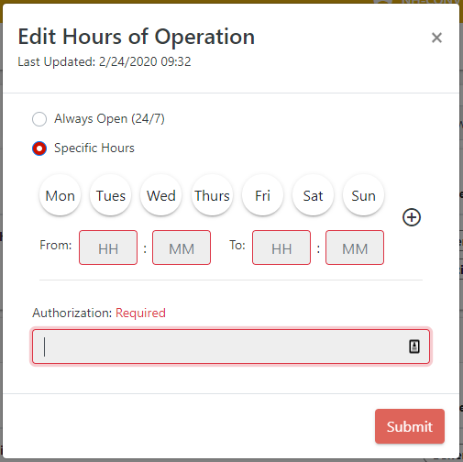
ReddiNet ®
Notes:
2. Select "Specific Hours".
3. Select the days that your facility is open.
4. Input your opening and closing times.
5. Optionally, you may add a second schedule by clicking on the "+".
6. Input the authorization.
7. Click "Submit".
TRAINING LINK: https://www.reddinet.net/support

Slide 26
ReddiNet ®
There are training videos and user guides available at https://support.reddinet.net/
The training environments are available for hands-on practice at https://www.reddinettraining.net/
Registration (gotowebinar.com)
Notes:
The next non-acute training is scheduled for October 19th at 10:00-11. You need to register
Your name, email and physical address, and organization will be needed to register
We will have a teams meeting with live ReddiNet instruction, tentatively scheduled for October 26th. I need to confirm with Lewis West.
You will need an account and it is best if you have a two screen set up so you can have your screen open on one monitor, while watching the instructor on the second monitor.
November 7th is a Tuesday and we will practice responding to a message, service level assessment and submitting a resource request.

Slide 27
Preparing for the Exercise
Review your emergency operations plan and SIP/Evacuation plans
Train/review with your staff
Develop procedures if you don’t have them already
Develop your Exercise Plan
Determine which facility/agency specific plans/procedures you plan to test
Plan activities to test your procedures
Review your Communication Plan
Identify the methods your facility would use
Test the plan
Notes:
If you don’t have a policy or procedure addressing something in particular, reach out to other like facilities. No need to recreate the wheel! I am all about working smarter, not harder!!
Disaster start with local response, then county, then state, then feds
Remember disproportionally affected populations. ESRD patients are just one of many! The very young and very old, visual/hearing/mobility impaired, language challenged, low socio-economic people,
Are there resources you can provide? Shelters,

Slide 28
Practice
Before the Exercise
Day of the Exercise
After the Exercise
Open ReddiNet Account
Obtain Username and Password
Practice log in
Attend training
Service Level Poll
Resource Request (Optional)
Respond to Message
Service Level Poll
Submit a Resource Request (Optional)
After Action Report & Improvement Plan
Due 60 days after the exercise for certification of participation
Notes:
The link for signup is available on our HCC website. The QR code is on the last slide

Slide 29
Requirements for Participation
Register for the County-wide exercise scheduled for November 21st, 2024
Participate
After Action Report within 60 days
Certificate of participation
Notes:
All exercises result in the development of an AAR.
The AAR is the document that summarizes key information related to evaluation. It has a line for Objectives you wanted to achieve, and columns next to it with a
P for performed without challenges,
S for some challenges encountered
M Major challenges identified
U for unable to be performed
The next section is the strengths identified
Areas for improvement
The last section is part of your improvement plan. Briefly describe the tasks to accomplish, the date you will accomplish them by and the responsible person.
The Homeland Security Exercise and Evaluation Program (HSEEP) has defined a standard format for the development of an AAR.
By using this format, jurisdictions ensure that the style and the level of detail in their AAR is consistent with other jurisdictions.
Consistency across jurisdictions allows the nation-wide emergency preparedness community to gain a broad view of capabilities.
The length, format, and development timeframe of the AAR depend on the exercise type and scope.
These parameters should be determined by the exercise planning team based on the expectations of elected and appointed officials as they develop the evaluation requirements in the design and development process.
The main focus of the AAR is the analysis of core capabilities.
Generally, AARs also include basic exercise information, such as the exercise name, type of exercise, dates, location, participating organizations, mission area(s), specific threat or hazard, a brief scenario description, and the name of the exercise sponsor and POC.
The AAR should include an overview of performance related to each exercise objective and associated core capabilities, while highlighting strengths and areas for improvement.
Therefore, evaluators should review their evaluation notes and documentation to identify the strengths and areas for improvement relevant to the participating organizations’ ability to meet exercise objectives and demonstrate core capabilities.

Slide 30
Exercise Documents
MSEL
Situation Manual
Controller/Evaluator Handbook
Exercise Plan
Exercise Evaluation Guide (EEG)
https://lacountyhcc.org
Exercise Registration Link:
https://www.surveymonkey.com/r/7J9YCTX

Slide 31
Resources
Ready LA County
https://ready.lacounty.gov/
MyShake early EQ warning
https://myshake.berkeley.edu/
American Red Cross
https://www.redcross.org/
Text “GETEMERGENCY” to 90999
Los Angeles Health Alert Network
http://publichealth.lacounty.gov/lahan/
Animal Care & Control
https://animalcare.lacounty.gov/
Notes:
Ready LA County
The County of Los Angeles uses Alert LA County to contact the public during a Countywide emergency. Additionally, Alert LA County is used in unincorporated communities and certain cities where fire and/or law enforcement services are contracted to the County Fire Department and Sheriff’s Department. Alert LA County sends shelter-in-place instructions, evacuation, and other emergency messages. It has accessibility features for people with disabilities and others with access and functional needs. You can also select your preferred language for notifications.
MySHake is early warning available for EQ. Depending on where you are in relation to the epicenter, will determine how early of a warning you will get.
ARC has a lot of resources, including an app that covers 40 different all hazard/sever weather alerts. Text “GETEMERGENCY” to 90999
LAHAN is the public health alerts and notifications program for Los Angeles County.
It is designed for emergency preparedness information sharing, distribution of pertinent public health related events and alerting materials, dissemination of treatment and prevention guidelines, coordinated disease investigation efforts, preparedness planning, and other initiatives that strengthen state and local preparedness.
Animal Care & Control
Mission is Advancing the well-being of animals and people in the County of Los Angeles.
This is achieved by:
Protecting people and animals through compassionate care, effective enforcement, education, and intervention.
Partnering with stakeholders, communities, and volunteers to address community needs.
Providing expertise, resources, and professional services to promote and inspire humane care of animals and enhance the human/animal bond.
Professionalizing our workforce through leadership development, ongoing education, and continuous improvement of best practices.
Promoting a diverse, equitable, and inclusive environment for our workforce and communities.

Slide 32
RESOURCES
Web page:
https://lacountyhcc.org
Registration Link:
https://www.surveymonkey.com/r/7J9YCTX
Contact:
Laurie Lee-Brown, MSN, RN, PHN, MICN
Senior Nursing Instructor/Disaster Program Manager
(562) 378-2459
Llee-brown6@dhs.lacounty.gov
Notes:
Here are the links to the documents in our website.
My contact information is provided. If I am unavailable, my message will indicate who is covering for me.
If you have questions related to the exercise documents, contact our Exercise Coordinator, Darren Verrette (562) 378-2451

