Slide 1
How to Create Inject Cards or Prompts for the FRC Exercise
You will need to create your own inject cards or prompts from the Patient and Seeker data

Slide 2
Go to Healthcare Coalition Website
https://www.lacountyhcc.org/trainings-exercises-drills/frc-family-reunification-center/2024-frc -

Slide 3
Click on “Patient and Seeker Data (EMO Access Only)” link to download the Excel document

Slide 4
Create Prompt for Inject #6
You will need to create your own inject cards or prompts from the Patient and Seeker data

Slide 5
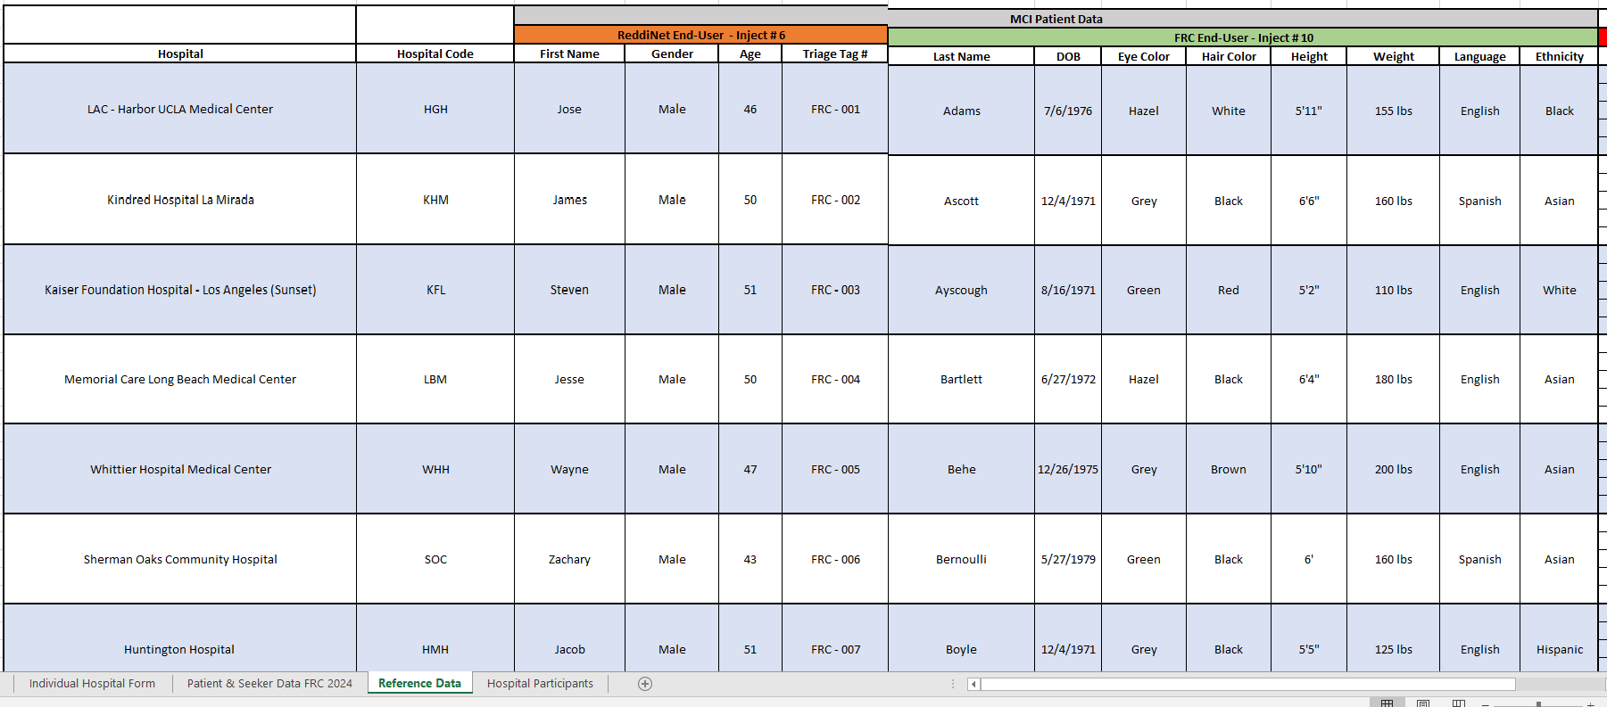

Inject #6: Select the Reference Data tab, find your Hospital in column B.

Slide 6

Inject #6: ReddiNet End-User updates MCI victim list and enters “ambulance patient” data: 1. First name, 2. Sex 3. Age, 4. Triage Tag #
Search for your Hospital in column B
Copy data from the following columns onto a word document:
  Column D = First Name: Jose
  Column E = Sex: Male
  Column F = Age: 46
  Column G = Triage Tag#: FRC-001

Slide 7
Create Prompt for Inject #7

Slide 8
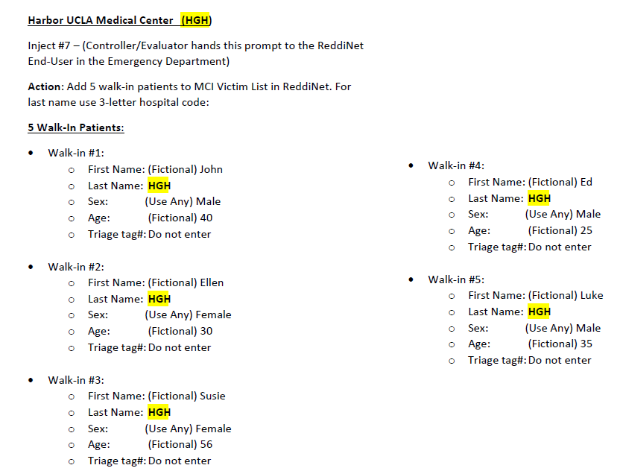
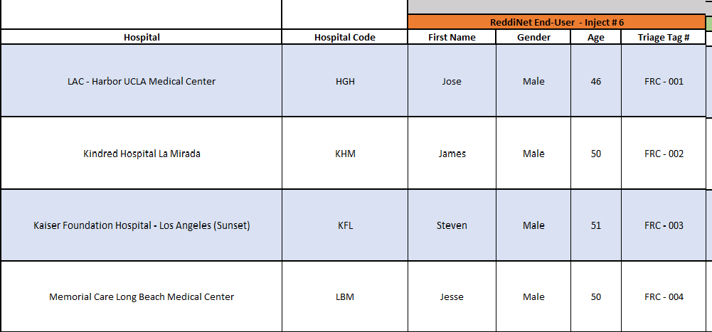

Inject #7: ReddiNet End-User enters five (5) walk-in patients into the MCI victim list. Use fictional first name and gender for each. Use your hospital's 3-letter hospital code for the last names.
Search for your Hospital in column B
Use the 3-letter hospital code in column C as the last name for the 5 walk-in patients

Slide 9
Create Prompt for Inject #9
You will need to create your own inject cards or prompts from the MSEL

Slide 10
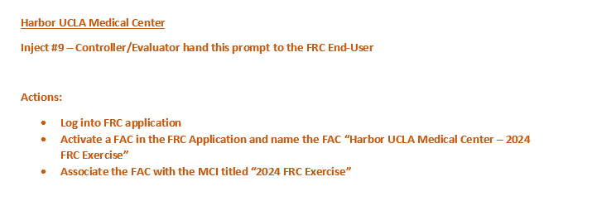
Inject #9: FRC End-User logs into the FRC application and activates a "FAC“.
(Activate only 1 FAC at your facility)
Create a written prompt or verbally inform the FRC End-User to log into the FRC application and activate a FAC.
Name the newly activated FAC “[Your Hospital Name] - FRC Exercise” and associate it with the MCI titled “2024 FRC Exercise”.

Slide 11
Create Prompt for Inject #10
You will need to create your own inject cards or prompts from the Patient and Seeker data
Hospitals with emergency departments. Have your FRC end-user update the profile for the ambulance patient. (See slide 12)
Hospitals without emergency departments. Have your FRC end-user register the Patient into the FRC application. (See slide 13)

Slide 12
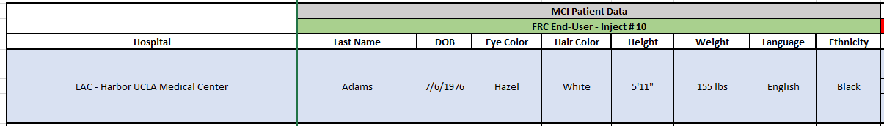

Inject #10: Update Patient Profile (Hosp. with ED)
Across the row from your Hospital, copy data from the following columns onto a document:
Column H = Last Name: Adams
Column I = DOB: 7/6/1976
Column J = Eye Color: Hazel
Column K = Hair Color: White
Column L = Height: 5’11”
Column M = Weight: 155 lbs.
Column N = Language: English
Column O = Ethnicity: Black

Slide 13
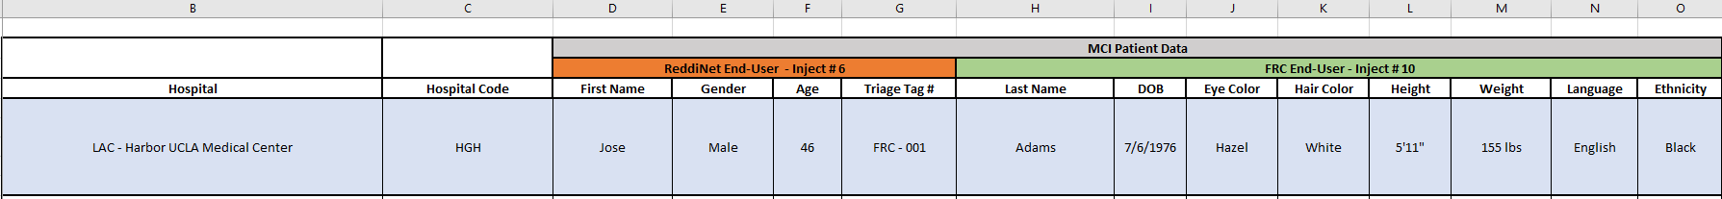
Inject #10: Register Patient (Hosp. without ED)
Across from your Hospital in column B, copy data from the following columns onto a document:
Column D = First Name: Jose
Column E = Gender: Male
Column H = Last Name: Adams
Column I = DOB: 7/6/1976
Column J = Eye Color: Hazel
Column K = Hair Color: White
Column L = Height: 5’11”
Column M = Weight: 155 lbs.
Column N = Language: English
Column O = Ethnicity: Black

Slide 14
Create Prompt for Inject #11
You will need to create your own inject cards or prompts from the Patient and Seeker data

Slide 15
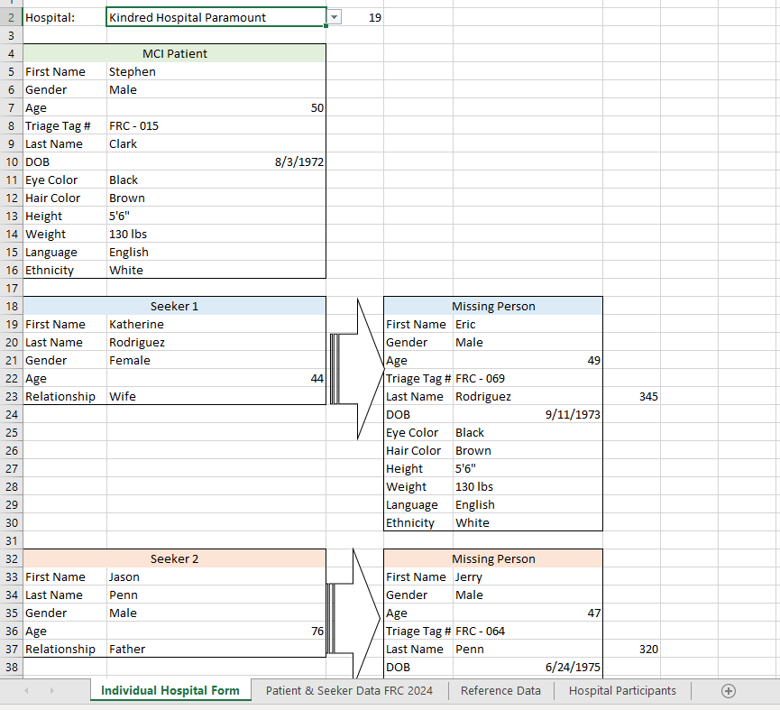
Inject #11: Select the Individual Hospital Form tab.

Slide 16
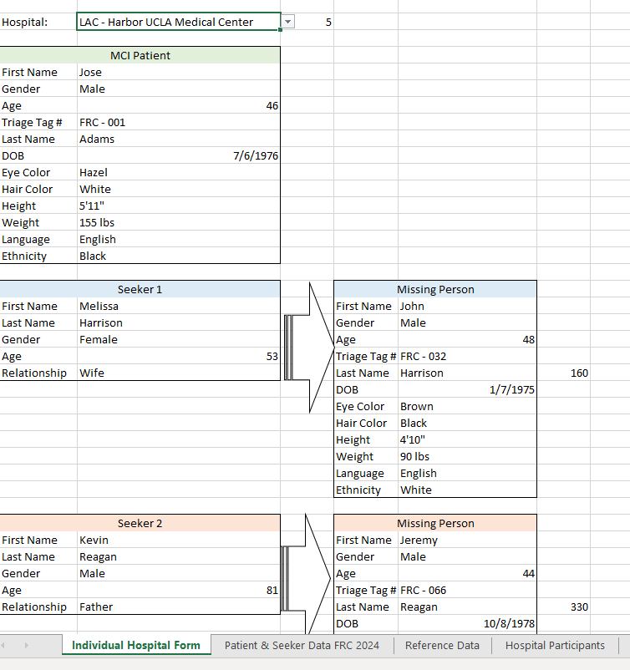
Inject #11: Register the five (5) Seekers into the FRC "FAC".
Select your Hospital from the drop-down menu.
Your assigned Missing Person and assigned Seeker (#1-5) information will auto populate the fields in the columns directly below.
The Missing Person information in the fields to the right (→) is the reunification information for your assigned Seeker.

Slide 18
FAQ:
How do you associate a FAC with an MCI? HASC will provide training. ReddiNet Help and Support
Will copies of the slides be provided? Yes
How many players are recommended? No minimum or maximum number, the number of players needed is at the discretion of your facility.
Do we have to activate the IMT/Command Center if we activate the FRC? No, IMT/Command Center activation is not required. However, you can expand the scope of the exercise at your discretion.
Please clarify if the five (5) family members are looking for one (1) patient? The five (5) family members are looking for different patients. Each patient will have five (5) family members searching for him and each of those family members will go to a different hospital. (Inject #11)
Is the 3-letter hospital code for the five (5) that we’re making up? Yes, use the 3-letter hospital code as the last name for the five (5) walk-in patients. (Inject #7)

Slide 19
FAQ:
Are we getting five (5) seekers and one (1) patient – six (6) total? Yes. Each facility will enter six (6) victims into the MCI victim list (Injects #6 & #7) and five (5) seekers into the FRC application. (Inject #11) Except Non-ED facilities. Non-ED facilities will register one (1) Patient and five (5) Seekers into the FRC application. (Injects #10 and #11)
For the seekers coming in looking for patients at other facilities, is it my hospitals responsibility to enter this data? Yes, your facility will register the five (5) seekers according to the training end-users receive by ReddiNet.
Are we basically putting in the seeker under the seeker data? Correct.
Is there training on how to register patients on ReddiNet MCI? Yes, you can find training videos on the ReddiNet website. ReddiNet Help and Support
Is there a way we can play around with inputting info on the FRC on our own? Yes, in the Training Environment. You will need to contact ReddiNet for a username and password to access the training platforms. ReddiNet Help and Support
Where can I find the 3-digit code for my facility? It’s located on the “Patient and Seeker Data” document. You can download the document from our HCC website.

Slide 20
END

