Slide 1
Exercise Evaluation Conference
Medical Response and Surge Exercise - Pediatric Surge
and
Health Care Coalition Power Outage Exercise

Slide 2
Kellyn Pak HPP Program Manager EMS Agency
Welcome
to the
Exercise Evaluation Conference

Slide 3
Darren Verrette Disaster Program Manager EMS Agency
Please turn off your video
Mute microphones
Type questions into chat

Slide 4
Exercise Evaluation Webinar
8:00 – 8:05 WELCOME & INTRODUCTIONS
8:05 – 8:30 EXERCISE EVALUATION OVERVIEW
8:30 – 9:00 TEAMS BREAKOUT SESSIONS WITH SECTORS:
AMBULATORY SURGERY CENTERS / CLINICS / URGENT CARES
DIALYSIS
HOME HEALTH / HOSPICE
HOSPITALS by DRC REGION
LONG TERM CARE
OTHERS
9:00 – 9:20 BREAK (DRC COORDINATORS MEET FROM 9:00 to 9:10) – BREAKOUT ROOM
9:20 – 10:10 SECTOR PRESENTATIONS / BRIEF OUTS
10:10 – 10:25 AFTER-ACTION REPORT / IMPROVEMENT PLAN
10:25 – 10:30 CLOSING REMARKS

Slide 5
Medical Response and Surge Exercise - Pediatric Surge and Health Care Coalition Power Outage Exercise
Exercise Evaluator Overview

Slide 6
Why Exercise Evaluation?
To share the HCC sectors level of participation
To share the Facility strengths and gaps
To share the Exercise strengths and gaps

Slide 7
Healthcare Coalition (HCC) Sectors
Ambulatory Surgery Centers
Community Clinics
Dialysis Centers
Emergency Medical Services (EMS) Agency
Home Health/Hospice Agencies
Hospitals
Long Term Care Centers
Provider Agencies (Private and Public)
Public Health Departments
Urgent Care Centers

Slide 8
HCC Members Registered to Participate
Total HCC Members Registered = 332
Ambulatory Surgery Centers (ASC) = 41
Community Clinics = 37
Dialysis Centers = 97
Home Health/Hospice (HHH) = 38
Hospitals = 88
Long Term Care (LTC) Facilities = 27
Provider Agencies = 2
Urgent Care (UC) Facilities = 0
Other = 2

Slide 9
Exercise
Date of Exercise: Thursday, November 16, 2023
Goal: Pediatric Patient Surge and Power Outage Exercise
Scenario: Evacuation of Children's Hospital Los Angeles due to loss of water and random power outages occurring throughout County for extended periods of time.
Core Capabilities: Office of the Assistant Secretary for Preparedness and Response for 2017-2022 Healthcare Preparedness and Response:
Capability 1: Foundation for Healthcare and Medical Readiness
Capability 2: Healthcare and Medical Response Coordination
Capability 3: Continuity of Health Care Service Delivery
Capability 4: Medical Surge

Slide 10
Activities
Participants tested the Pediatric Surge Plan and other surge strategies
Non-acute care facilities tested power outage plans, downtime procedures, continuity of operations activities, and other pertinent plans
ReddiNet and more…

Slide 11
Statistics by HCC Sector
Ambulatory Surgery Centers (ASC) – 99 on ReddiNet / 41 Registered:
Facilities responded to Service Level Poll: 7
Resource Requests Received: 1
Community Clinics – 296 on ReddiNet / 37 Registered:
Facilities responded to Service Level Poll: 19
Resource Requests Received: 6
Dialysis Centers – 132 on ReddiNet / 97 Registered:
Facilities responded to Service Level Poll: 34
Resource Requests Received: 16

Slide 12
Statistics by HCC Sector
Home Health/Hospice (HHH) – 195 on ReddiNet / 38 Registered:
Facilities responded to Service Level Poll: 10
Resource Requests Received: 5
Hospitals – 90 on ReddiNet / 88 Registered:
Facilities responded to Service Level Poll: 64
Resource Requests Received: 66
Long Term Care (LTC) Facilities – 320 on ReddiNet / 27 Registered:
Facilities responded to Service Level Poll: 3
Resource Requests Received: 1
Facilities responded to LTC Bed Availability Poll: 5
Urgent Care (UC) Facilities – 40 on ReddiNet / 0 Registered:
Facilities responded to Service Level Poll: 0
Resource Requests Received: 0

Slide 13
Statistics by HCC Sector
Provider Agencies (Public and Private) – 2 Registered:
Resource Requests Received: 0
Fire Operational Area Coordinator (FOAC) Activation:
L.A. County Fire
Conference call with Providers (Public and Private)
Requested Ambulances
Location: Children’s Hospital Los Angeles
Number of BLS ambulances available: 51
Number of ALS ambulances available: 15
Number of CCT ambulances available: 6

Slide 14
Non-HCC Participant
Amateur Radio Emergency Service (ARES) – HAM Radio:
ARES setup Net-Control outside the MAC / MCC
Received Situation Status reports
Received MRSE Assessment Poll report
Resource Request
Great resource

Slide 15
Hospital Surge Capacity Requirement
The HCC must surge to 20% of Hospitals staffed pediatric bed capacity
2,453 staffed pediatric beds in Los Angeles County
2,453 staffed pediatric beds multiplied by 20% = 490 pediatric surge patients
Notes:
Staffed beds mean those beds which are equipped and available for patient use. Staffed beds include those that are occupied and those that are vacant.

Slide 16
Hospital Data Collection Requirements
An Assessment Poll titled, “2023 Medical Response and Surge Exercise - Hospital Capacity Survey” went out to all participating hospitals at the beginning of the exercise.
Notes:
Completion of the survey was a required component.

Slide 17
Assessment Poll Results: 2023 Medical Response and Surge Exercise – Hospital Capacity Survey
ReddiNet Assessment Poll:
Number of HPP Hospitals Polled: 66
Number of HPP Facilities Responded to Poll: 57
Number of HPP Facilities Did Not Respond to Poll: 9
Notes:
We created an alternative area to capture the data in Jotform. The deadline to submit the data is December 15, 2023.

Slide 18
Assessment Poll Results (Cont.): 2023 Medical Response and Surge Exercise – Hospital Capacity Survey
Number of staffed Emergency Department beds that can be used for Pediatric patients at the beginning of the exercise, prior to receiving patients = 819
Number of staffed General Pediatric / Acute Care Pediatric beds at the beginning of the exercise, prior to receiving patients = 785
Number of staffed Pediatric ICU beds at the beginning of the exercise, prior to receiving patients = 87
Number of staffed Neonatal ICU beds at the beginning of the exercise, prior to receiving patients = 331
Number of staffed Pediatric Dialysis beds at the beginning of the exercise, prior to receiving patient = 43
Number of existing pediatric inpatients at the beginning of the exercise = 445
Notes:
The data is essential to demonstrate compliance with ASPR HPP program requirements.

Slide 19
Assessment Poll Results (Cont.): 2023 Medical Response and Surge Exercise – Hospital Capacity Survey
Number of existing adult inpatient at the beginning of the exercise = 9,678
Number of existing inpatients (pediatric and adult) who could be discharged to accommodate pediatric surge patients (decompress) = 1,447
Number of pediatric surge patients requiring admission for inpatient care based on triage assessment = 234
Number of pediatric surge patients that required admission that need transfer to another facility due to no capacity or service not available = 72
Number of pediatric surge patients requiring outpatient care who will not be admitted based on your triage assessment = 33
Number of existing pediatric inpatients and pediatric surge patients requiring admission for inpatient care with an appropriate staffed bed and after safe discharge of patients from the original patient census = 420
Notes:
The data is essential to demonstrate compliance with ASPR HPP program requirements.

Slide 20
ReddiNet MCI Victim List:
ReddiNet MCI Data:
Number of Hospitals received MCI poll: 68
Number of Patients sent by MAC: 73
Number of Ambulances sent by MAC: 73
Number of Ambulances “Arrived” by Hospitals: 53
Number of Hospitals entered MCI victim data: 54
Number of Patients entered in MCI Victim List: 306

Slide 21
Take Away’s: Lessons Learned
EMS Agency Medical Coordinator Center (MCC):
Many artificialities (SimCell, Patient Distrib., Messages, etc.)
Difficult to gauge if adequately tested plans - Peds Surge Plan or Power Outage Plans
Need your feedback:
Peds Surge – Would your facility be able to meet required bed thresholds for Tier level in Peds Surge Plan?
Power Outage – How can we (EMS MCC) better support?

Slide 22
Take Away’s: Lessons Learned (continued)
EMS Agency Medical Coordinator Center (MCC):
ReddiNet worked well as primary communication tool for HCC:
Messaging
MCI Management
MCI Victim List (FRC Application)
Assessment Poll
HAvBED Poll
Service Level Poll (color coded)
LTC Bed Availability Poll
Resource Requesting

Slide 23
Take Away’s: Lessons Learned (continued)
EMS Agency Medical Coordinator Center (MCC):
SimCell worked well for outgoing calls to Hospitals:
65 Hospitals to call
35 calls to EMOs – not needed
30 calls to other staff – engaged staff in intake process, asked good questions
10 did not answer
We (EMS MCC) could have:
Worked on patient distribution based upon HAvBED data and Pediatric Surge Plan rather than SimCell
Engage more with non-acute sector with power outage component
Engage more with non-acute sector to promote participation

Slide 24
Medical Response and Surge Exercise - Pediatric Surge and Health Care Coalition Power Outage Exercise
Questions?

Slide 25
Breakout Sessions
Sector: Hospital by DRC Region:
Region 1 (California/Kaiser)
Region 2 (Cedars/UCLA)
Region 4 (South Bay)
Region 5 (Henry Mayo)
Region 6 (LAC+USC)
Region 7 (Long Beach)
Region 8 (PIH-Whittier)
Region 9 (Pomona)
Region 10 (Saint Joseph)
Sectors: Non-Hospital
ASC, Clinics, Urgent Care
Home Health / Hospice
Long Term Care
Dialysis
*Provider Agencies (Public and Private)
*EMS Agency
*Public Health
*OEM
*Others
*Stay in main TEAMS room

Slide 26
Breakout sessions are now open

Slide 27
Sectors: Provider Agencies (Public and Private) EMS Agency Public Health OEM Others
Caitlin Harvey Disaster Services Analyst L.A. County Department of Public Health
Breakout Session

Slide 28
Breakout Session Facility Questions Survey
What were the major strengths identified during your exercise?
What were the major gaps (improvement needed) identified during your exercise?
What are some of the major actions that need to be accomplished over the next year?

Slide 29
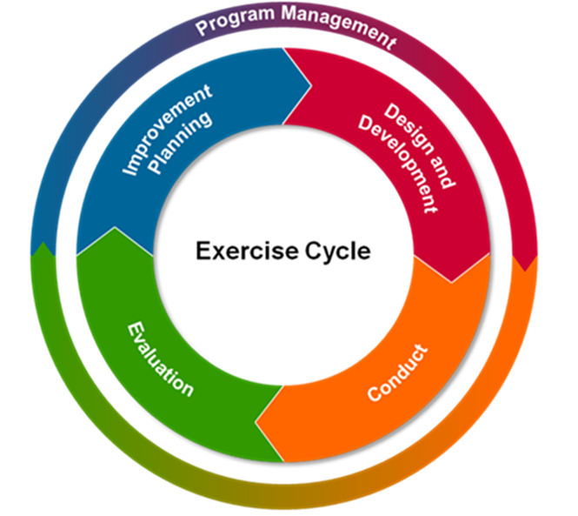
Breakout Session Exercise Questions Survey
What were some of the exercise design strengths? (i.e., material, documents, website, participant training, etc.)
What were some of the exercise design issues? (i.e., documents, website, participant training, etc.)
What suggestions do you have to help the Exercise Planning Team plan for the 2024 Exercise?

Slide 30
Thank you!
BREAK
9:00am – 9:20am
Event will resume at 9:20 a.m. in the main TEAMS room

Slide 31
Welcome Back
Sector Brief Outs:
Ambulatory Surgery Centers, Clinics, Urgent Cares
Dialysis
Long Term Care
Home Health / Hospice
Hospital

Slide 32
After-Action Report / Improvement Plan
Darren Verrette
EMS Agency

Slide 33
What Next?
Gather documents and compile data
Prepare a facility level After-Action Report / Improvement Plan

Slide 34
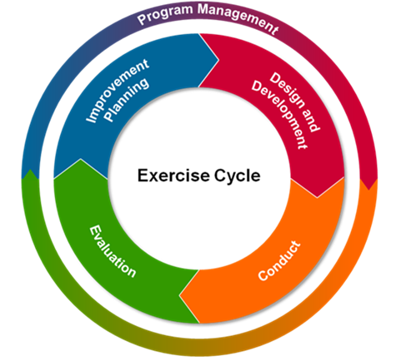
HSEEP Exercise Documents
Participant Feedback Forms
Exercise Evaluation Guide (Sector Specific)
After-Action Report / Improvement Plan

Slide 35
Participant Feedback Form Part I: General Info Part II: Exercise Design Feedback Part III: Capabilities Feedback - Strengths - Areas of Improvement - Training that will help you - Materials most helpful - Recommendations

Slide 36
Exercise Evaluation Guide (Sector Specific) Contains: - Exercise Objectives - Critical Tasks - Evaluator’s Observation Notes

Slide 37
Traditional After-Action Report / Improvement Plan (AAR/IP) Contains: - Cover Page - Exercise Overview - Analysis of Capabilities - Overview of Performance - Improvement Plan

Slide 38
New Tool: MRSE After-Action Reporting Tool https://www.surveymonkey.com/r/Y8QZCTC
We developed a survey in Survey Monkey that we are calling the, “2023 Medical Response and Surge Exercise After-Action Report Survey”.
This tool is intended to replace the traditional Word or PDF AARs usually submitted to the EMS Agency.
The tool makes it easier to collect and analyze the large volume of data normally submitted.
It is sector specific; participants will only see the objectives pertinent to their sector. Approximately 12 to 15 questions and 15 minutes to complete.
The tool will capture participants:
Contact Information
Facility / DRC Region / Sector
Overall Assessment
Strengths
Areas for Improvement
Corrective Action Plan
And other feedback

Slide 39
MRSE After-Action Reporting Tool
You may need a traditional AAR/IP for auditors / surveyors
We are asking that you use the AAR tool in SurveyMonkey for us
You do not have to send us (EMS Agency) a Word or PDF AAR
This will meet your AAR submission requirement for EMS Agency only
Survey (AAR) is due by January 15, 2024

Slide 40
Thank you!
Questions?

Slide 41
End Slide

