Slide 1
ReddiNet®
Isabel Sanchez
Disaster Program Manager
HPP Compliance Program
L.A. County EMS Agency
P: 562-378-1642
E: ISanchez2@dhs.lacounty.gov
Notes:
Rapid Emergency Digital Data Information Network
Isabel Experience Background
Cargo Inspections and Logistics (Import/Export/ Domestic; including HazMat clean up operations; private sector
Hospital Emergency Management (including HPP Grant Management; HazMat/Decon operations; private sector)
Los Angeles County EMS Agency (HPP Compliance program and Logistics)

Slide 2
Objectives
Identify ReddiNet® functions during a Mass/Multi Casualty Incident (MCI)

Slide 3
Functions
MCI
General Notifications
Ambulance Arrivals
Patient Tracking
Polls
ED Capacity
HAvBED
Assessment
Service Level
Resource Requests

Slide 4
About ReddiNet®
What is ReddiNet?
Communication Tool
Web & Satellite Based
Who uses ReddiNet?
Medical Alert Center (MAC)
Public Health
Hospitals
Surgical Centers, LTC & Clinics
Fire Departments
Police Departments
Notes:
Anyone with a username and password can log in from any computer to the web-based system. If your internet goes down, you can still use the satellite based system, which all Base Station hospitals have.

Slide 5
Medical Alert Center (MAC)
What is MAC?
The Operations & Communications arm of Los Angeles County Department of Health Services (DHS).
Why does MAC use ReddiNet®?
Gather and relay information from field operations to hospitals and vice versa.
Obtain number of patients involved in MCI and their acuity level.(Immediate, Delayed, Minor)
Obtain and communicate bed availability
Assist with patient distribution and notifications of incoming patients to hospitals.
Notes:
What is MAC?
The Operations & Communications arm of Los Angeles County Department of Health Services (DHS).
Why does MAC use ReddiNet?
MAC role/responsibility
Gather and relay information from the field and hospitals
Obtain the estimated number of patients involved in an MCI and their classification
Immediate, Delayed, and Minor
Obtain and communicate bed availability
Assist with patient distribution & notification of incoming patients to hospitals

Slide 6
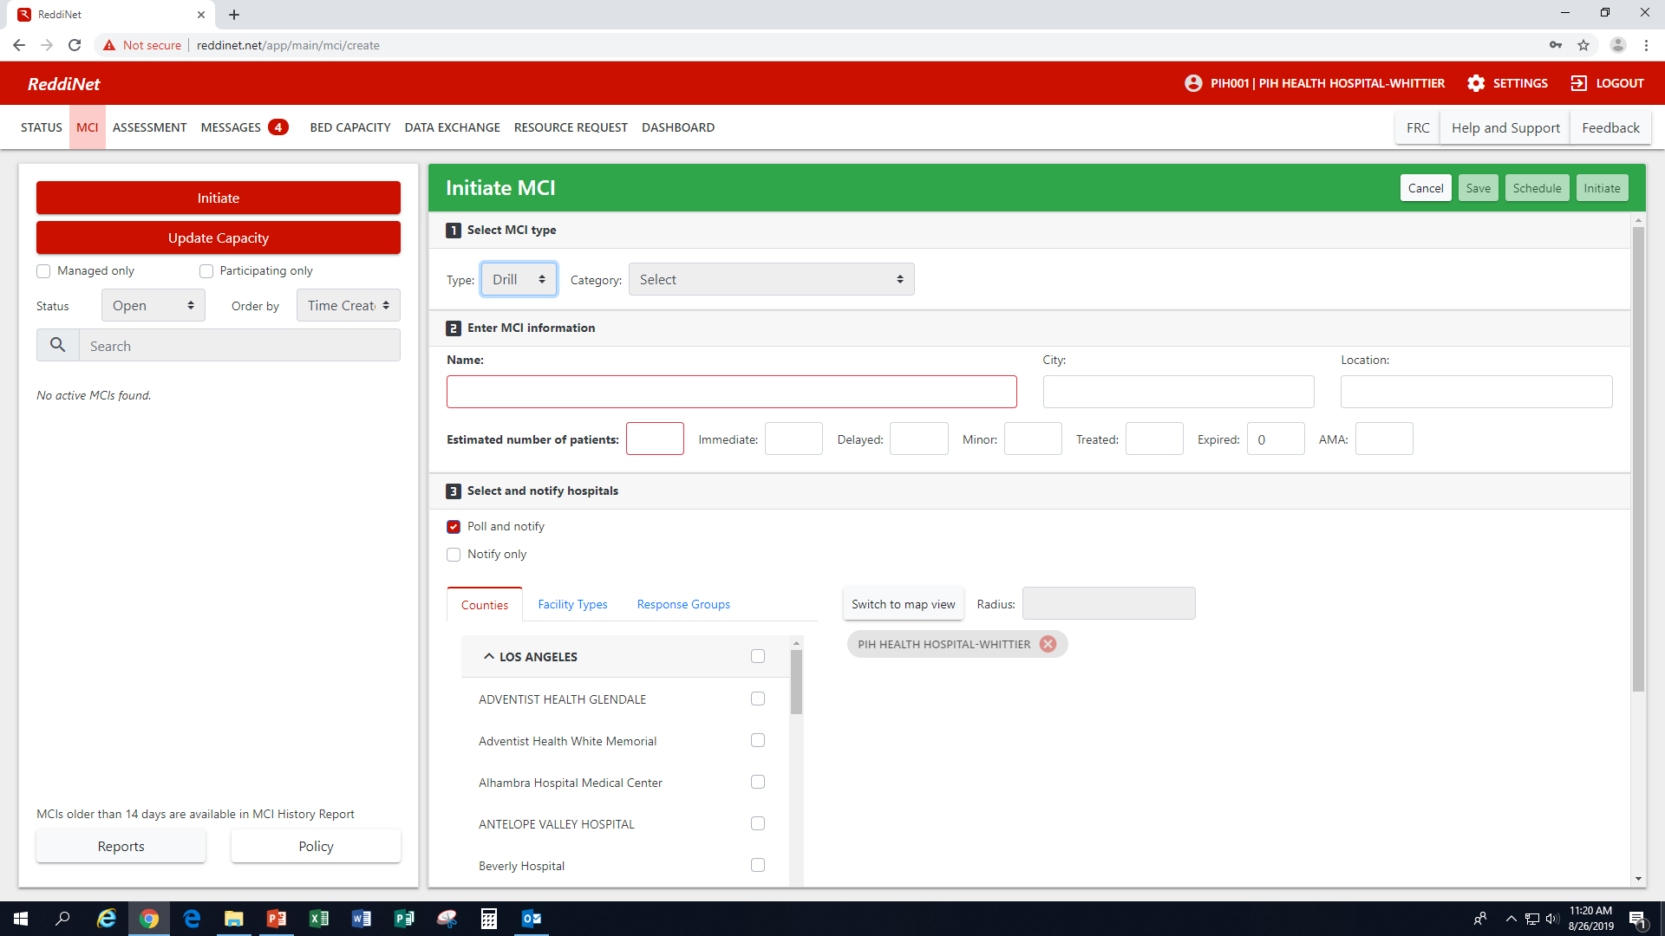
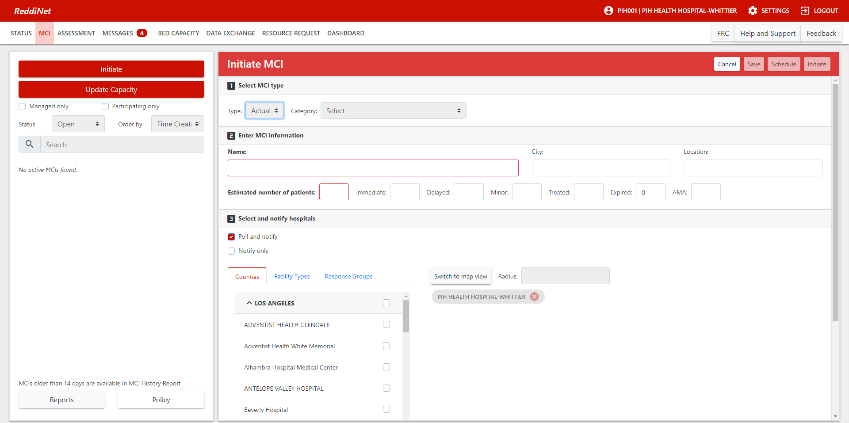
MCI Activation
Notes:
When something happens in the community – shooting, vehicle(s) accidents, trail derailments, fires, civil unrest, etc., an MCI may be activated by the MAC by region, county-wide or to specific hospitals in the affected areas.
There are two options for MCI activation. Real events, red banner; and, Drill events, green banner. So you know the difference right away just by looking at the color of the banner.

Slide 7
General Notification
Notes:
Once the MCI is activated by MAC, a general notification message goes out to notify of the incident. Acknowledge message by clicking either button to move on to another screen.

Slide 8
ED Bed Capacity Poll
Initial ED Bed Capacity Poll (MCI Poll) is sent to all hospitals within geographic proximity to the incident
Done within minutes of initial notification
Hospitals should respond to the poll as soon as possible
Notes:
Upon activation of the MCI and general notification being sent out, an ED bed capacity poll is also sent out to hospital in the geographic area of the incident. There is a very quick turn around time to respond to this poll. (1-2 minutes) – explanation of why the quick turnaround is on the next slide

Slide 9
Field Medical Communications
Results of hospital bed poll given to Field Medical Communications
Victims are triaged for transportation according to acuity, available beds and nearest appropriate facility
Patients are assigned to a specific ambulance/rescue/ squad number
Field Medical Communications notifies MAC of patient destination
MAC then notifies the receiving hospital
Notes:
In a disaster situation Involving a ‘surge’, MAC works with EMS personnel to determine patient destination. This is why we need the results of the ED bed capacity poll quickly. Field operations needs to know where the patients will be taken once triaged and the hospitals needs to be notified that they’re getting a patient(s).

Slide 10
Notification of Incoming Patients
Notes:
Note: When messaging is coming in, you cannot exit the screen until you stop the alert or close the window.

Slide 11
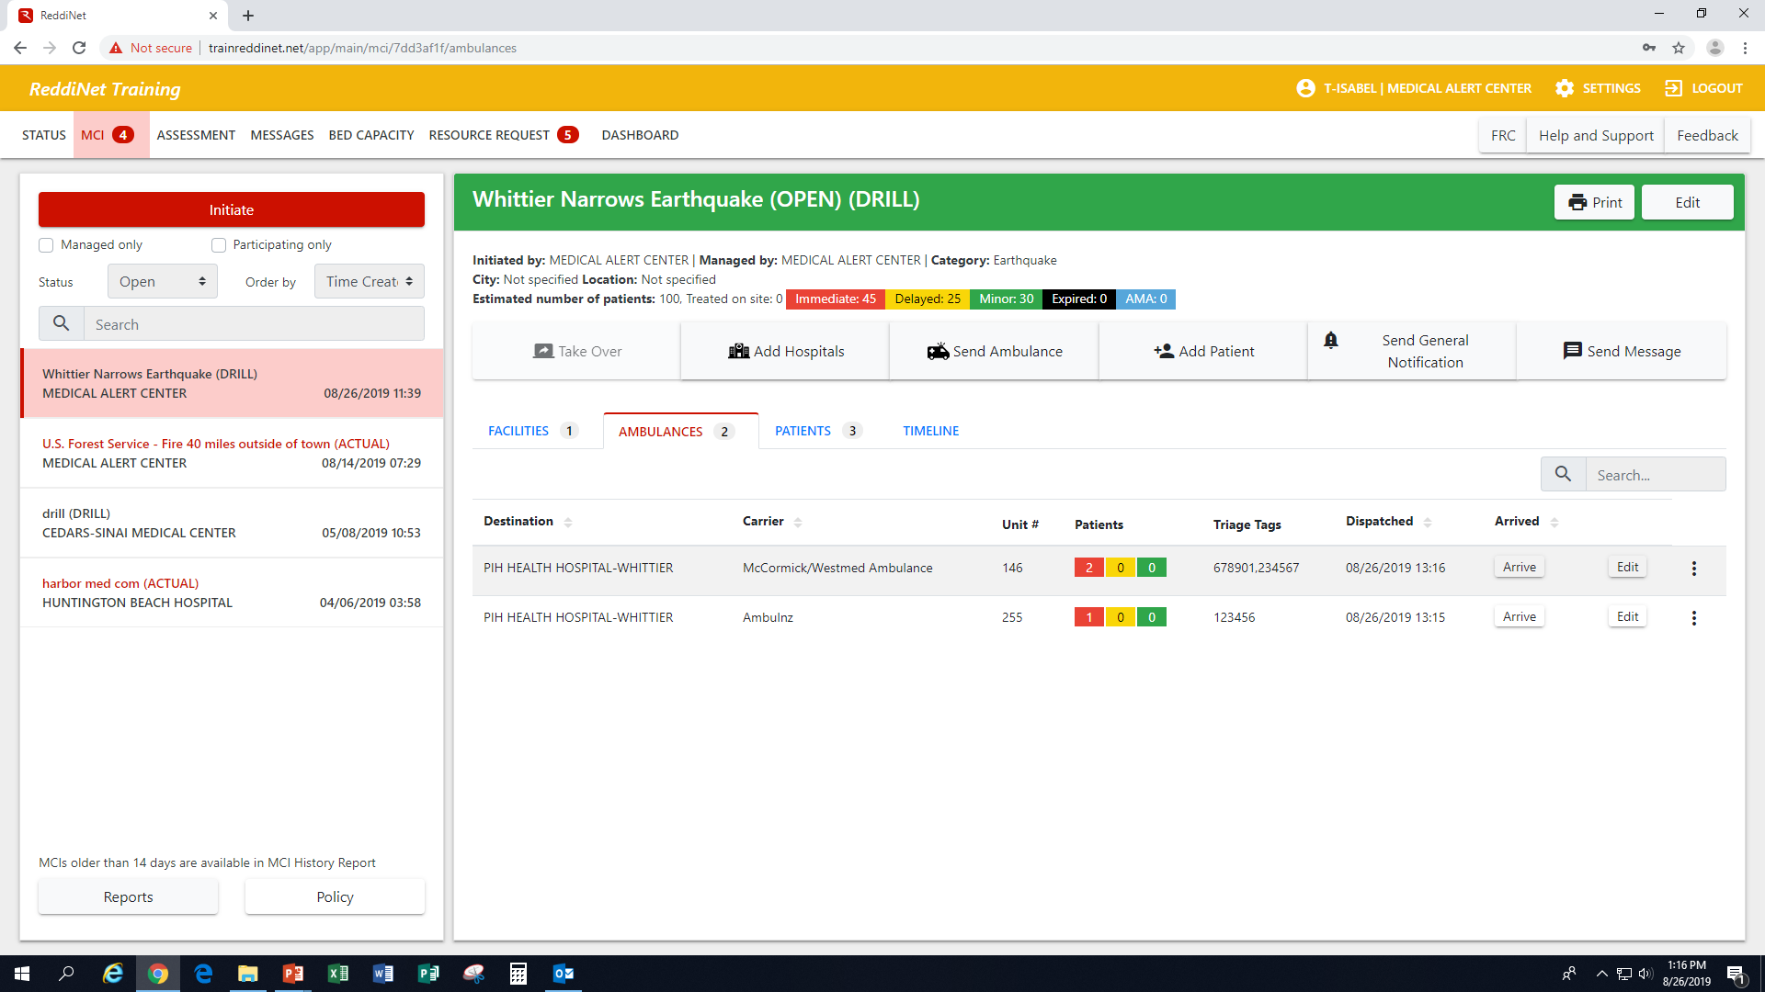
Ambulance Arrival
Notes:
If your facility was assigned an ambulance, when that ambulance arrives at your facility, you will need to arrive that ambulance. Simply click on the arrive button which will populate a time stamp which you will then click to submit

Slide 12
Patient Tracking
Subsequent to the arrival of ambulances, the hospital:
Completes the ‘victim list’ using the Add Patient feature
Provide patient specific information (HIPAA compliant)
Notes:
Patient names that are entered into the ‘victim list’, are entered via the “Add Patient” sub-tab.

Slide 13
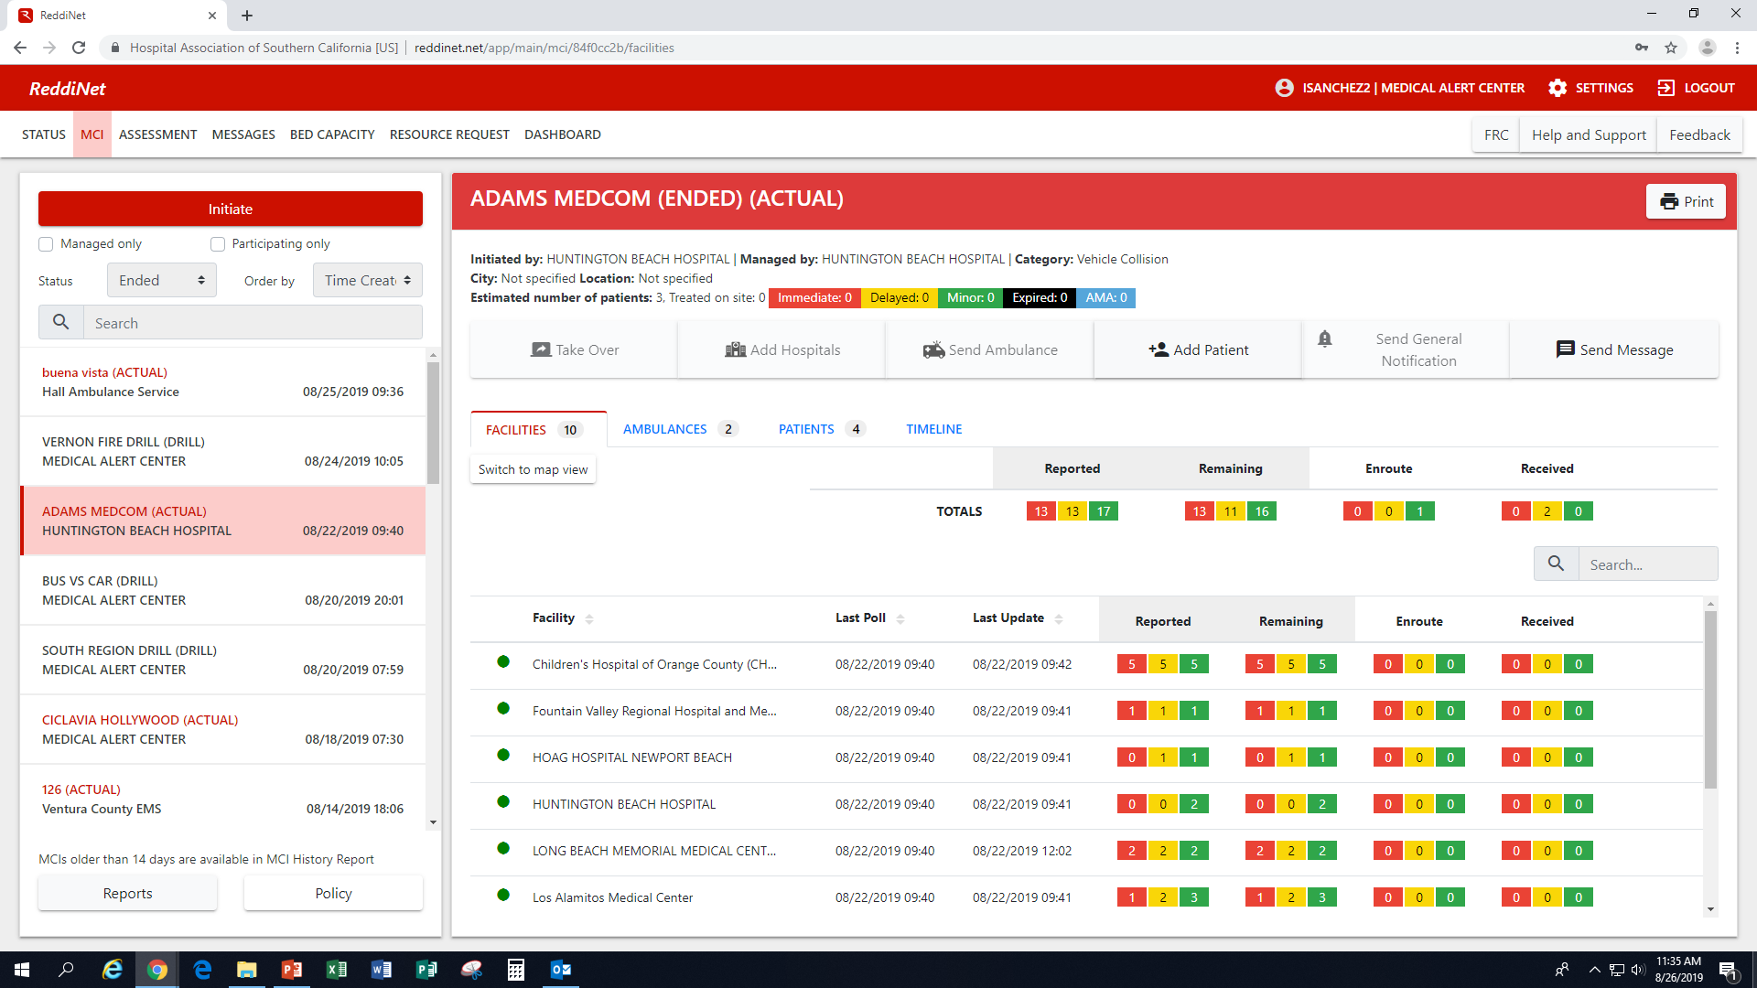
Patient Tracking
Notes:
MCI Patient tracking – in this screen you will be able to see
how many facilities are receiving patients
how many patients are going to each facility
acuity level of each patient
From this screen you can view the ambulances assigned to your facility and you can add patients once the ambulances arrive.
In the next couple of slides, we will see screen shots of how to arrive those ambulances and how to add a patient

Slide 14
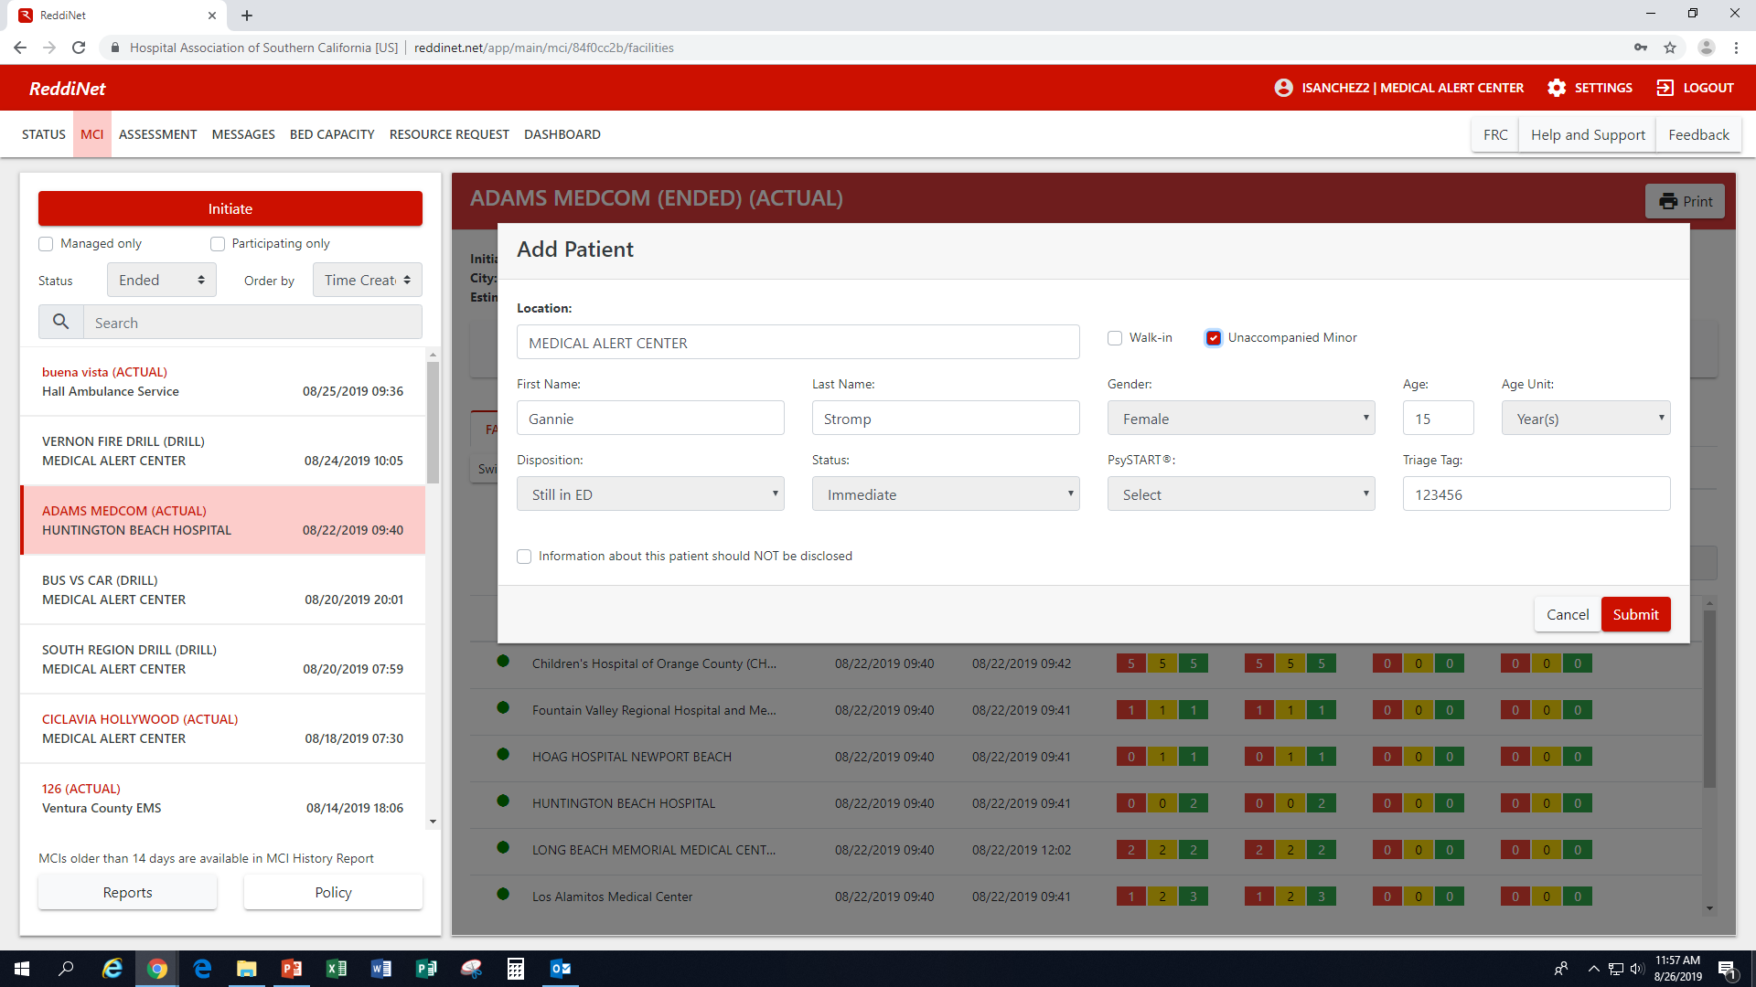
Patient Tracking – Add Patient
Adding patient information
Drop down fields vs. free text fields
Notes:
Free text fields can be used to enter descriptive information about a John or Jane Doe patient (i.e. tattoos, birth marks, scars, hair color, clothing)

Slide 15
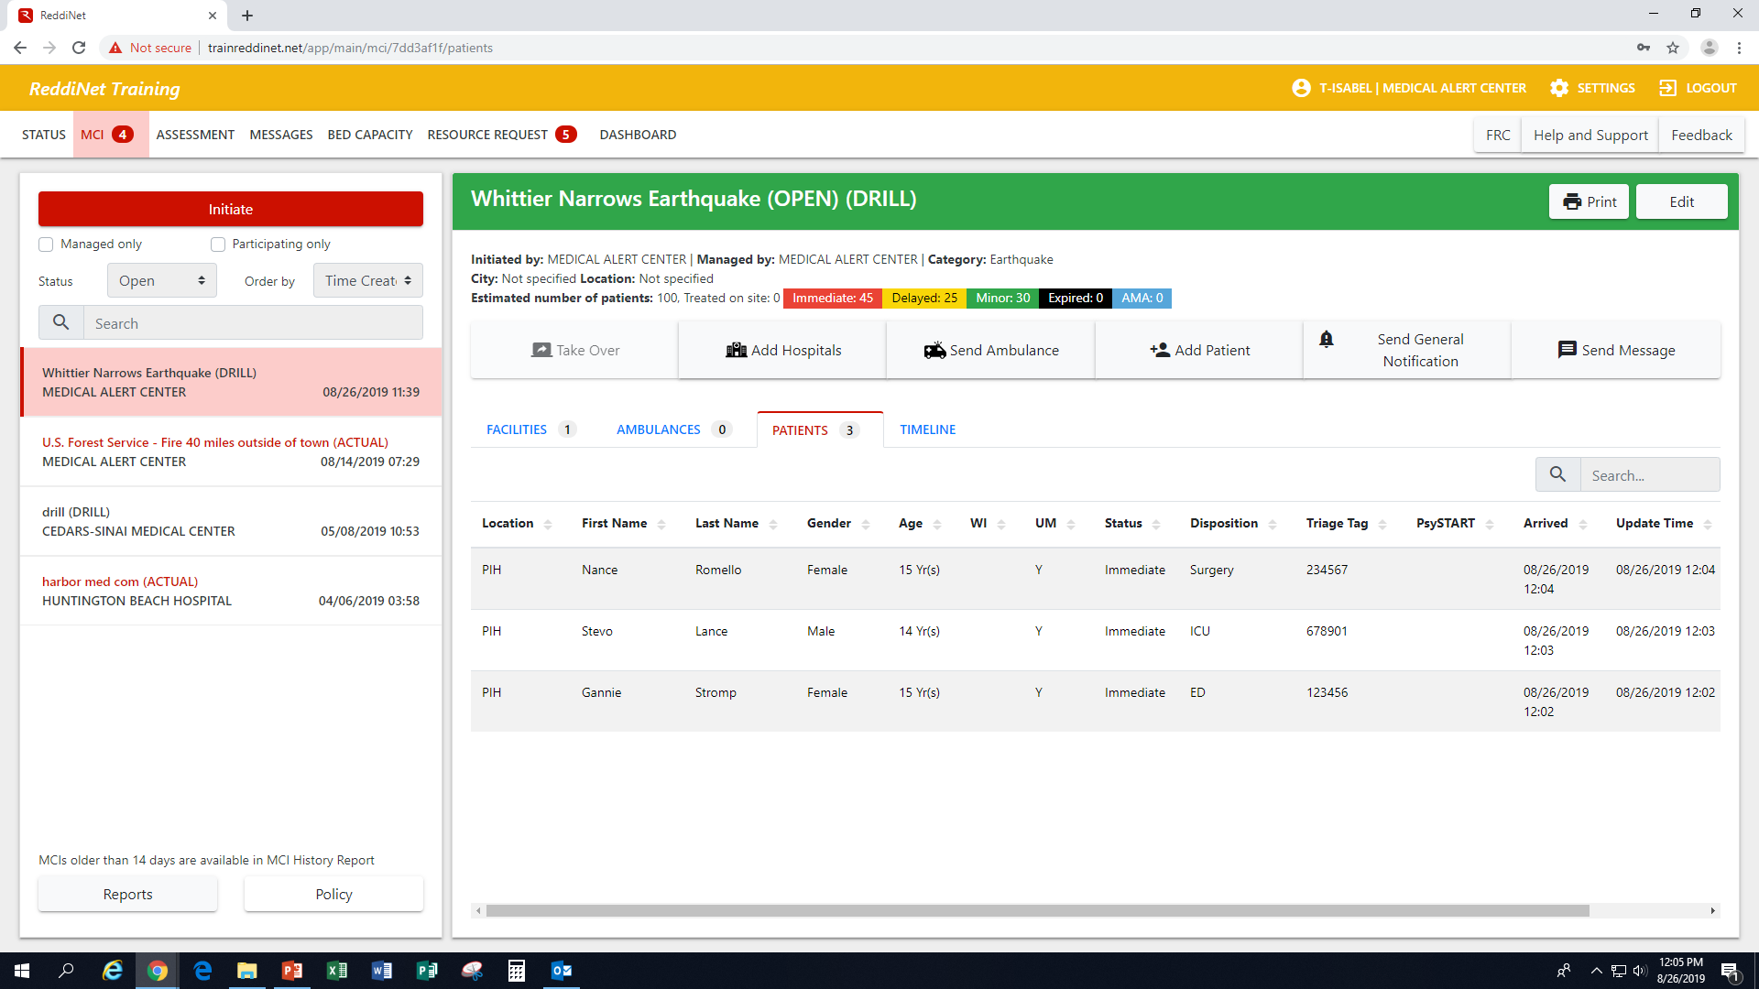
Patient Tracking – Victim List
Notes:
No HIPAA related information!

Slide 16
Hospital Role during an MCI
Recap:
Respond to the ED Bed Capacity poll with the number of Immediate, Delayed, and Minor patients that can be accepted within 1-2 minutes
Monitor ReddiNet for MAC notification of the number of Immediate, Delayed, and Minor patients assigned that are en route
Notify MAC via the ReddiNet when victims arrive by arriving ambulances
Report victim/patient information to MAC within 72 hours via ReddiNet
Notes:
Summary: Hospital role slide is specific to the MCI response.

Slide 17
Service Level Poll
A Service Level Poll is used to obtain real time facility operational status during an event or incident.
Status is color coded
Respond to Assessment Poll within 60 min.
Normal Under Modified Limited No Services
Control Services Services
Notes:
This poll will come through in the assessment tab
Hospitals and Long Term Care facilities; Green, Yellow, Orange, Red and Black
Clinics, Home Health/Hospice, Dialysis and Urgent Care Centers – No Red
Ambulatory Surgery Centers and Psych facilities – No Orange or Red

Slide 18
Service Level Poll

Slide 19
Assessment Poll
An Assessment Poll is used to obtain accurate and current estimates of staff, supplies, equipment, patient needs, facility damage, resources needed and available resources.
Assessment Polls are event or incident driven.
Respond to Assessment Polls within 30 min.
Notes:
The questions of an assessment poll are dependent on the type of emergency.
Pandemic (N95s, Tents, Gloves, Isolation Gowns, Tamiflu)
Earthquake (facility/structure integrity, water, power: responses are color coded; colors may vary depending on sector)
HazMat (Decon capabilities, PPE, Shelter In Place)
Receipt of patients from incidents outside of our area/county.

Slide 20
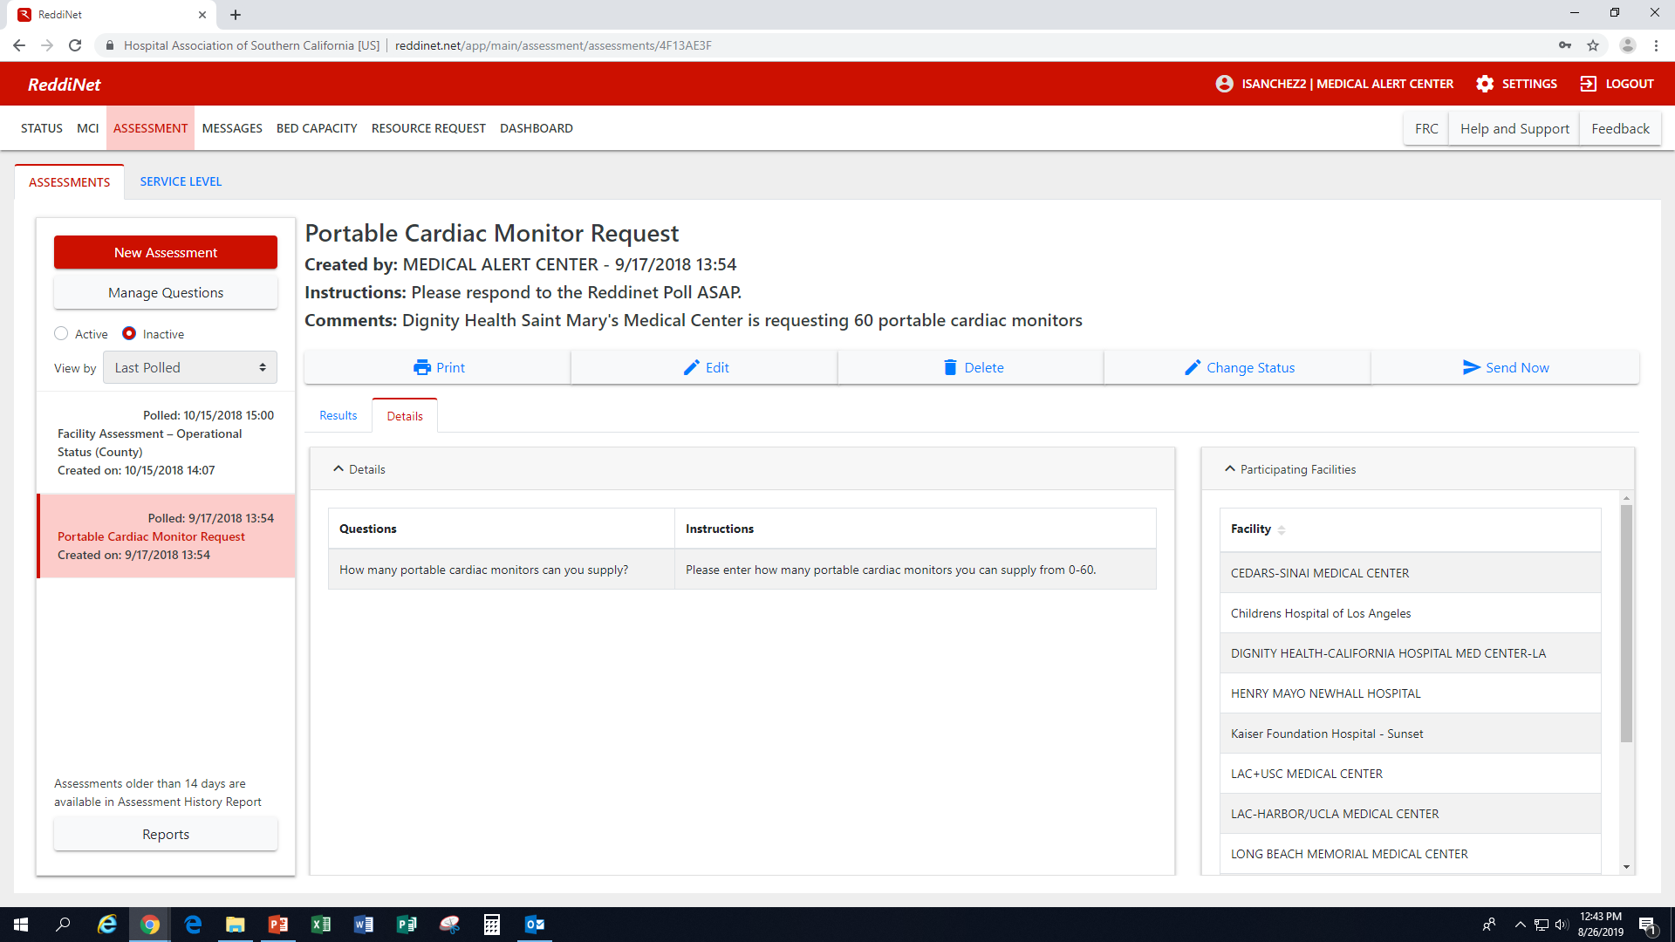
Facility Assessment Poll
Notes:
This poll will come through in the Assessment Tab
Specific to the operational status of your facility.
When the facility assessment poll comes in, click on the date on the left side column in the Update History section. Then click Update answers. See next screen shot

Slide 21
Hospital Available Beds for Emergencies and Disasters (HAvBED)
Standardized nationwide system for reporting available ICU, Med/Surg, Burn, PICU, OR, Isolation, Pediatric, Psychiatric beds, ventilators and Decon capabilities
To obtain accurate bed availability data for effective coordination of patient movement or transfer during an incident
“Available Bed”
Vacant; Licensed and Supported (space, equipment, staff)
Current
May include unlicensed beds, i.e., surge cots, etc.
Burn Surge/PEDS Surge activation –
Receive number of patients agreements indicate, regardless of the number of beds available
Notes:
BURN/PEDS SURGE Activations: Although a HAvBED poll will be received, Trauma/Burn centers and facilities participating in the PEDS surge program will receive the number of patients the agreements indicates, regardless of the number of beds available.
California regions also agreed to add ReddiNet specific bed types
Trauma
NICU
Telemetry
And a few others county specific
Hospitals may be asked to receive patients from anywhere in the nation that is having a catastrophic disaster. (i.e. during Covid-19 we took patients from Imperial Valley)

Slide 22
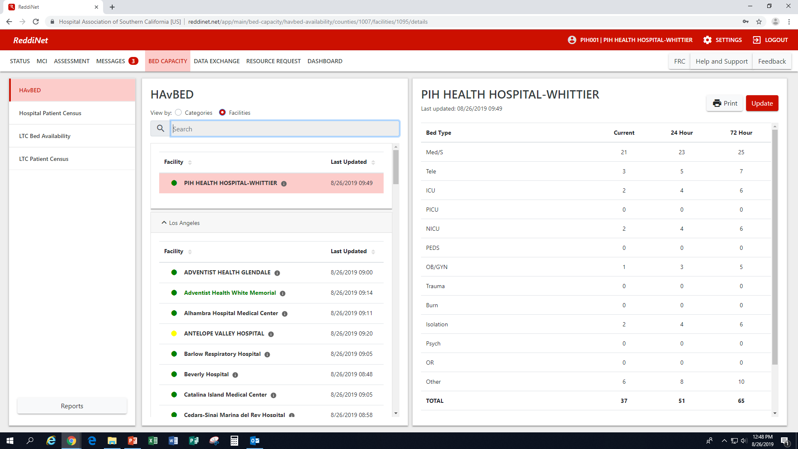
HAvBED
Notes:
This poll will come through in the Message tab – this poll is sent out at approximately 8:58am and 20:58pm

Slide 23
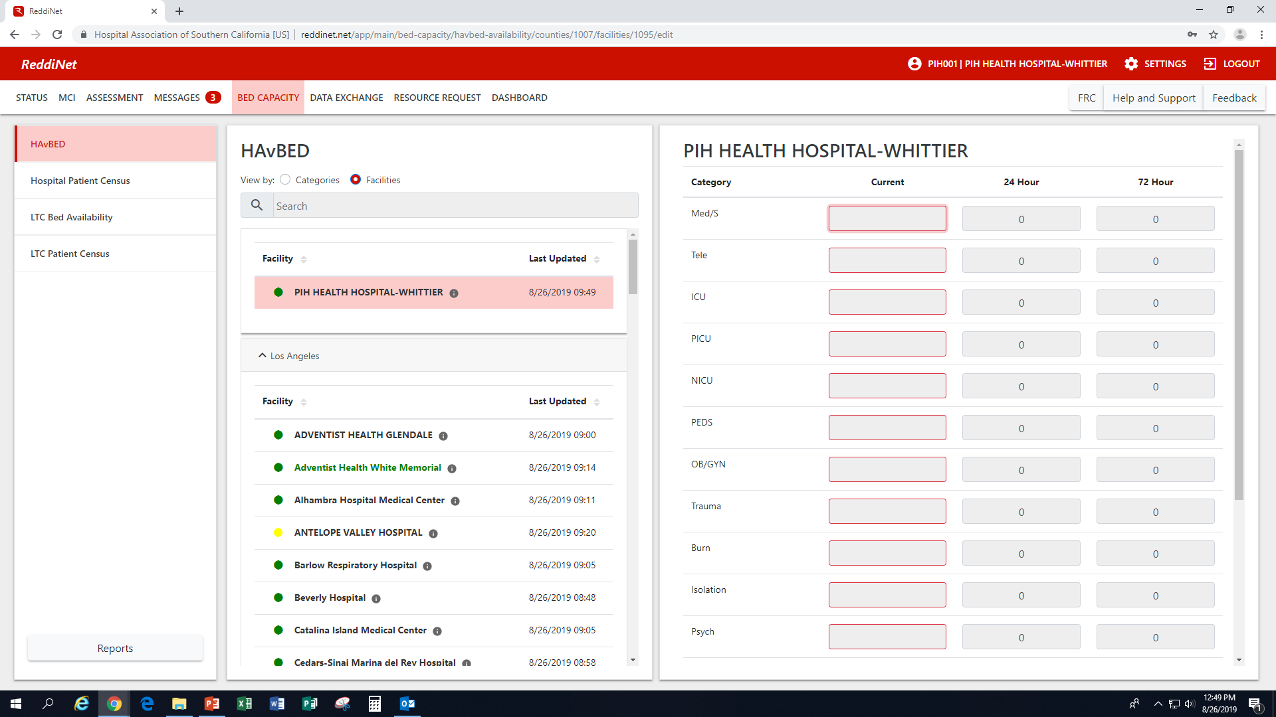
HAvBED

Slide 24
Resource Request
Resource Request forms should be submitted via ReddiNet during an MCI.
If ReddiNet is not available, RR may be submitted via email or fax.
Notes:
During an MCI, Resource Request forms should be submitted via the ReddiNet utilizing the Resource Request tab.

Slide 25
Resource Request
Notes:
Some of the fields in the resource request will be pre-filled. However, the fields that are not, must be filled prior to submitting.
Many times, during an incident, you will not be at your desk, therefore, it is important to add phone number that you will be able to in the event there is questions from the MHOAC.
Describe Mission – in this field, you will describe the purpose and reason for your request. Why and for what are you requesting
Resource requests are submitted as a last resort. When you have exhausted all other avenues. When you’ve reached out to your sister facilities, to your established vendors and non-traditional vendors; remember to think outside the box. Once all of these avenues have been exhausted, you may click all 3 check boxes.
It is important that management or your command unit review the request. Once reviewed, add their name and information to the resource request.

Slide 26
Questions

