Slide 1
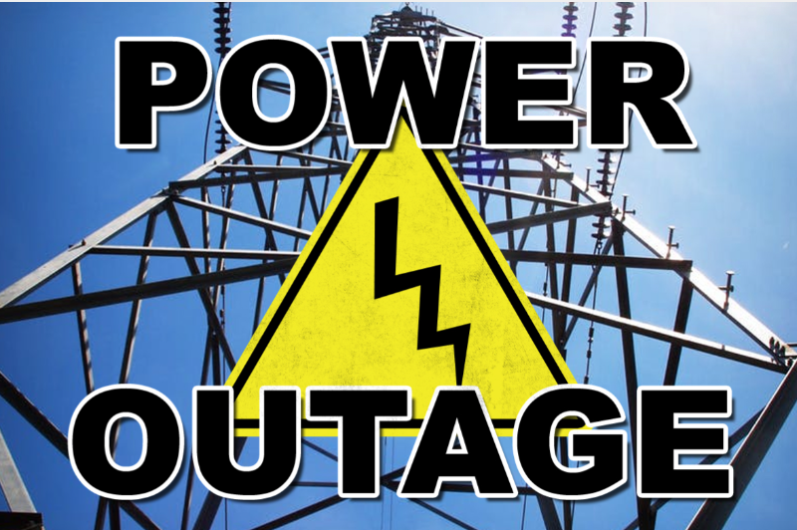
Los Angeles County 2023 MRSE Participant Webinar for Non-acute Sectors
Notes:
As Darren said, this is an exercise that is focusing on pediatric surge and power outage.
Due to the unique characteristics and variation of each sector, the power outage component was added to provide the non acute sectors an opportunity to evaluate the ability to continue or modify operations while experiencing a power outage.
The goal is to exercise your plans, capabilities, and meet the objectives from the following slides.
Remember to look at your previous AAR /Improvement Plan as a guide from your previous drill, exercise or incident to build upon strengths and areas of improvement.
Incorporate your areas of improvement identified from your last incident, exercise or drill.
Last year some areas of improvement included identified gaps:
Issues with internal notification procedures and out of date employee contact lists
Issues with implementing SIP/evacuation plans with staff and visitors, primary communication system failure (need to develop alternate communication methods to support continuity of operations)
*Remember cell towers could be impacted, hindering traditional methods of communicating!
Another identified area for improvement included challenges with a process to provide supplies to field personnel within the Home Health/Hospice sector
And ALL sectors identified the need for ReddiNet training…please sign up for the Oct 19th class.
No matter what sector you represent, the idea of safety & continuing to care for YOUR patients is paramount, never to just “send them to the hospital”
This probably goes without saying, but any real incident takes priority over the exercise. Make sure during the exercise your staff know the designated word if an emergency arises. During our HealthCare Disaster Management Training, we use the word “Tinkerbell” in the event someone is really experiencing an emergency to differentiate from exercise play.

Slide 2
Exercise Overview
Exercise Name: Medical Response and Surge Exercise (MRSE) Pediatric Surge & Power Outage
Exercise Date: November 16, 2023
Exercise Time: 0800-1200 (Power outage ~ 9:00)
Exercise Type: Functional
Exercise Goals:
Capability 1: Foundation for Healthcare & Medical Readiness
Capability 2: Health Care & Medical Response Coordination
Capability 3: Continuity of Health Care Service Delivery
Capability 4: Medical Surge
Notes:
Functional exercise: Simulates an emergency in the most realistic manner possible, short of moving resources to an actual site.
Conducted in a “real—time” environment in an EOC or Command Post.
Used to test and evaluate the capability of an organization to respond to an emergency using a simulated event
Some of you may choose to do a:
Tabletop exercise: which is a facilitated discussion of a plan in an informal, stress-free environment. Participants share capabilities and solve problems as a group based on their organizations existing plans and determine the objectives of the exercise
Full-scale exercise is usually lengthy and utilizes equipment, personnel with total coordination among many
We are going to discuss each capability and what objectives you can consider to meet these goals.
Some activities will overlap and can fulfill more than one capability.
Administration for Strategic Preparedness and Response (ASPR) Health Care Preparedness and Response Capabilities include:
Capability 1: Foundation for Health Care and Medical Readiness
Goal of Capability 1: The community has a sustainable Health Care Coalition – comprised of members with strong relationships – that can identify hazards and risks and prioritize and address gaps through planning, training, exercising, and acquiring resources.
Capability 2. Health Care and Medical Response Coordination
Goal for Capability 2: Health Care and Medical Response Coordination Health care organizations, the HCC, their jurisdiction(s), and the ESF-8 lead agency plan and collaborate to share and analyze information, manage, and share resources, and coordinate strategies to deliver medical care to all populations during emergencies and planned events.
Capability 3: Continuity of Health Care Service Delivery
Goal of Capability 3: Health care organizations, with support from the HCC and the ESF-8 lead agency, provide uninterrupted, optimal medical care to all populations in the face of damaged or disabled health care infrastructure. Health care workers are well-trained, well-educated, and well-equipped to care for patients during emergencies. Simultaneous response and recovery operations result in a return to normal or, ideally, improved operations.
Capability 4. Medical Surge
Goal for Capability 4: Health care organizations — including hospitals, emergency medical services (EMS), and out-of-hospital providers — deliver timely and efficient care to their patients even when the demand for health care services exceeds available supply. The HCC, in collaboration with the Emergency Support Function-8 (ESF-8) lead agency, coordinates information and available resources for its members to maintain conventional surge response. When an emergency overwhelms the HCC’s collective resources, the HCC supports the health care delivery system’s transition to contingency and crisis surge response and promotes a timely return to conventional standards of care as soon as possible.
Critical Decisions and Considerations need to be made. We will address some of these as we go through each capability and objectives with tasks
Number of people in your facility (staff, patients, visitors)
Are you able to maintain current operations?
Are there services you should discontinue?
What if staff/patients want to leave?
What resources do you have on hand?
What protective measures need to be implemented?
Activate Incident Command?
Decontamination?
Establish & maintain public reception area?
Remain calm
Consider shutting down air intake into the ventilation system (could be airborne particles)
Ensure patients/visitors are aware of the threat
Update your IC on the operational status of your facility and impact on patient care
Personnel to remain with patients
AOD notified
Overhead page “Code XX” We have been advised of an emergency nearby. For your safety, everyone is to remain inside and SIP until we are notified the emergency is over.
Assessment:
Contact utility company?
How large of a geographic area is impacted?
Do you have back up power? Fuel?
Is there a possibility of a need to evacuate?
What is the availability of other resources (law, fire)
Census of personnel, patients, and visitors. All ambulatory?
Activate the Command Center?
Develop and Implement Incident Action Plan (goals, objectives, and strategies for an operational period)
Who determines when the facility is safe to resume normal operations?
PLAN ACTIVATION
Who activates this plan? (should be the incident commander)
Do you have a decision tree or matrix? Incident assessment worksheet?
INCIDENT MANAGEMENT
Does your EOP identify the designated Incident Commander? (IC=gathers all information related to the incident and coordinated and released via the command center. IC has full authority and responsibility for the decision-making process for this response
IC activate “Code______”
ICS Job Action Sheets #254 victim/patient tracking
ROLES & RESPONSIBILITIES
PIO, Liaison Officer, Safety Officer, Operations Section Chief, Planning Chief, Logistics Section, Personnel
What are YOUR plans?
Does your facility/agency have any plans for this type of incident?
Have you coordinated with public safety to identify how to respond to such an incident?
What are your top 3 concerns of your facility/agency?
What types of information would be released?
How would employees/patients be notified
Who makes the notifications?
Where do you get the information?

Slide 3
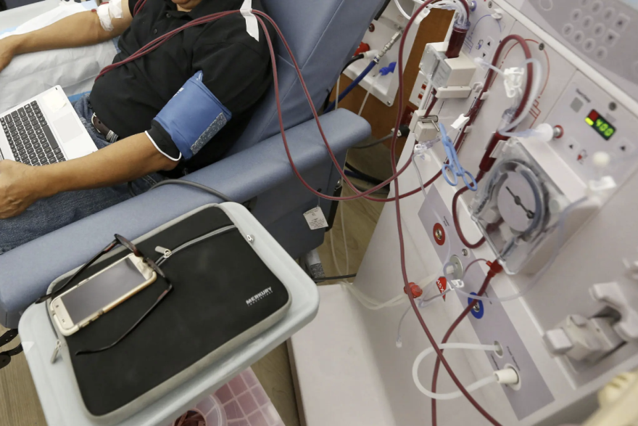
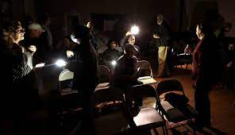
Critical Decisions & Actions for a Power Outage
What triggers or incident information would cause you to consider to discontinue services?
Notes:
We all know that when the power goes out, refrigerators, heaters and air conditioners stop running.
Homes go dark, and desktop computers shut down.
For the most part, those are mere inconveniences.
BUT…If you need dialysis or chemotherapy at a facility, or you have an infant in a neonatal intensive care unit or a loved one on a hospital ventilator, a loss of power carries far more dire implications.
California’s recurrent power outages this year by Pacific Gas & Electric Co. and Southern California Edison, have forced patients and healthcare providers to think about how they get/provide care when the power is cut.
Outpatient treatment centers have disaster plans in place, which cover the possibility of temporary power outages, but continuous power shut-offs, sometimes lasting for days and then happening again within a week or two, were never what those plans were intended for!
All California hospitals must have backup generators and enough diesel fuel on hand to run for 72 hours without electricity. The generators kick in within 10 seconds of a power shut-off.
The generators are intended primarily to power the critical-care functions of a hospital — operating and emergency rooms; labor centers; the monitoring of patients’ heart rates, breathing and blood pressure — and officials will keep those functions going even if it means turning off the building’s air conditioning or heat.
I wanted to give you ideas to consider prior to the exercise.
Critical Decisions and Actions:
DO YOU KNOW WHEN TO:
Activate Incident Command?
Close the business?
Are you responsible for the customers, clients, or visitors in the building?
Should you turn on call-forwarding or alternative telephone answering systems or services? Do you change the recording to indicate that the business is closed and what patients should do if scheduled for say dialysis?
Are your employees familiar with your building's mechanical systems check for power surges?
If you are told there is danger of explosion, how versed are you and your staff on evacuation procedures?
Where are disaster supplies, such as, battery-powered radios, flashlights, batteries, etc.
At what point would you call emergency contacts?
***Cellular telephone equipment may be overwhelmed or damaged during an emergency.
Considerations:
Number of people in your facility (staff, patients, visitors)
Can you maintain current operations?
Are there services you should discontinue?
What if staff/patients want to leave?
What resources do you have on hand?
What protective measures need to be implemented?
Who determines when the facility is safe to resume normal operations?
Remain calm
Ensure patients/visitors are aware of the situation
Who does the Assessment:
Contact utility company?
How large of a geographic area is impacted?
Is the backup power fired up??
Do you have back up power? Fuel?
Is there a possibility of a need to evacuate?
What is the availability of other resources (law, fire)
Activate the Command Center?
PLAN ACTIVATION
Who activates this plan? (should be the incident commander)
Do you have a decision tree or matrix? Incident assessment worksheet?
INCIDENT MANAGEMENT
Does your EOP identify the designated Incident Commander? (IC=gathers all information related to the incident and coordinated and released via the command center. IC has full authority and responsibility for the decision-making process for this response
IC activate “Code______”
ICS Job Action Sheets #254 victim/patient tracking
ROLES & RESPONSIBILITIES
PIO, Liaison Officer, Safety Officer, Operations Section Chief, Planning Chief, Logistics Section, Personnel

Slide 4
Power Outage Challenges:
Lighting
Security Systems
Elevators
Fire Alarms
HVAC
Pharmaceuticals
Electronic Health Records
Notes:
I just wanted to give you a visual of power outages!
The very BASIC challenges of a power outage is listed (yellow triangles represent outages, the calendar icon represents scheduled outages)
Los Angeles alone accounted for 5,787 blackout events affecting the equivalent of 6.4 million utility customers. This picture was snipped from the internet the day after our “Tsunami warning” on 9/5/2023
Los Angeles County, CA 33,650 outages reported (0.6% of Total Accounts - 5,247,233)
Typically, power outages last 1-2 hours in CA
A rotating outage typically lasts one to two hours. An artificiality of this exercise is that there will be prolonged & widespread power outages.
FEMA & ASPR published “Healthcare Facilities and Power Outages
Guidance for State, Local, Tribal, Territorial, and Private Sector Partners” August 2019
During a disaster or other energy emergency that cannot be remedied quickly, the emergency plan for smaller facilities is NOT to evacuate patients to larger hospitals -last resort option.
Additionally, in the event of an evacuation due to an energy emergency, staffing shortages or lack of training on emergency preparedness could create additional barriers for service delivery among healthcare facilities leading to additional health complications and potential detriments leading up to loss of lives.
Recommendations For Leaders
Below are some best practices that the NGA (National Governors Association) Center gathered from the roundtable experts’ discussion that could support leaders in providing opportunities that best position healthcare facilities when energy stressor events occur, prioritizing healthcare facility energy resilience.
Emergency Communication Plans: Establishing communication plans between state and local governments, utilities and healthcare facilities can help ensure appropriate prioritization for high-risk facilities
Critical System Planning: Backup generation may not be sufficient to meet all energy needs for healthcare facilities.
Decisions on which critical systems should be prioritized may need to be considered before an energy stressor event occurs and exacerbates existing challenges.
Although CMS and state regulations require on-site backup generation, practices for fuel storage, scheduled maintenance and technical staff to maintain and repair systems, vary widely across healthcare facilities.
Coordinating Exercises: Participate in the healthcare sector in emergency response exercises, including energy emergency exercises.
Evaluating Vulnerabilities Study energy system vulnerabilities and potential restoration delays to energy restoration to pre-plan needed support to those facilities that are most vulnerable and most likely to suffer a longer duration outage.
Engaging Utilities: It is critical that healthcare facilities, healthcare providers of all training levels and utilities are engaged in planning for energy assurance to ensure the best energy resilience for healthcare facilities. Such partnerships would allow healthcare facilities and utilities to explore jointly energy systems, such as microgrids, that might otherwise be cost prohibitive.
Engaging Healthcare Facilities in Planning: Governors can incorporate healthcare facilities and their specific needs to maintain care provision at a range of facility types into state energy security plans and emergency response exercises. These facilities could include direct care facilities such as; nursing homes, skilled nursing facilities, and rehab hospitals, inpatient and outpatient mental health and substance use treatment facilities; and supports for in-home care providers.
Preparing for Worst-Case Scenarios: Planning and preparation are required to modernize emergency infrastructure in healthcare facilities. Such planning can positively affect service delivery in the event of an energy emergency. Three days without power, in what has been termed a “black sky event,” can have cascading effects for healthcare facilities and could lead to a facility being evacuated for a non-energy related issue (e.g., water, wastewater, climate control) that is essential for the provision of care. According to the FEMA/HHS report used to inform this project, evacuation and relocation of patients in healthcare facilities is never a best practice and should be avoided if possible as it may lead to destabilizing patients, injuries, other new health concerns and poorer overall health outcomes. Improving facility preparations and infrastructure improvements can help provide supportive care environments in the event of prolonged outages.

Slide 5
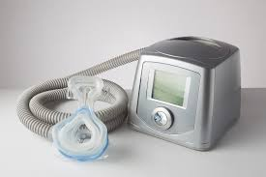
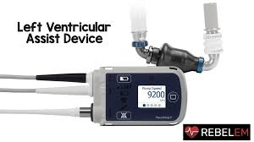
Power Outage Challenges:
Respirators (Oxygen concentrators)
Hemodialysis machines
Suction machines
Intermittent positive pressure breathing (IPPB) machines
Pressure pads/pumps
Motorized wheelchairs
LVADs
Notes:
Power Outage challenges…Particularly for users of durable medical equipment and probably impacts HHH the most (aside from hospitals)
Things to think about:
What is your process to assist electricity dependent individuals?
Do you have a mechanism in place to Identify those individuals most at risk? How do you prioritize?
Is there an identified shelter in your region that would have a generator?
Is there a nearby ASC who could provide electricity (act as a powering station) to electrical dependent individuals?
What does that look like?...Do you have MOUs in place with such facilities?
What would the liability look like for taking on such patients-do you have a policy?
What are the threats to cell service from power outages?
What if you are unable to call 9-1-1 OR unable to charge phone?
Cell and internet availability is dependent on each cell tower and internet data center feeding your area (most have back up for a few hours, many have generators that can run indefinitely as long as they have fuel)
SCE and PG&E have program for customers that are dependent on life support equipment at home:
There is a resource booklet on-line for home medical device users.
It is an established plan that provides information for patients, caregivers and responders.
Includes the name of the device and model number, contacts such as Device supplier/manufacturer, local power company, FD, Ambulance Service, Home Care Agency, Health Care Provider numbers, and general information about back up systems, what other power sources could operate the device, and specific information related to their specific device in relation to a power outage
•SoCal Edison Medical Baseline Program:
https://www.sce.com/wps/portal/home/residential/assist ance/medical-baseline/
•PG&E Medical Baseline Program:
https://www.pge.com/en_US/residential/save-energymoney/help-paying-your-bill/longer-termassistance/medical-condition-related/medical-baselineallowance/medical-baseline-online-sign-up.page
•Vulnerable Customer Program- households with one or more individual who have self-certified that they have serious illness or condition that could become life-threatening if electric or gas is shut off
https://www.pge.com/en_US/residential/save-energymoney/help-paying-your-bill/longer-term-assistance/medical condition-related/vulnerable-customer.page

Slide 6
Power Outlet Trivia
What color is the electrical outlet that indicates it is hooked up to emergency backup power?

Slide 7
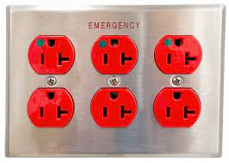
Emergency Power Outlets
NORMAL POWER
EMERGENCY POWER
Power outlets that do not have a red plate are NOT on emergency power
In the event of a power failure no power will be supplied to these outlets
Notes:
Red Color Outlet
The red color outlet (also known as receptacle or socket outlet) are hospital grade (AKA medical grade) receptacles which means the outlets are connected to the emergency backup power. The bright red color outlet can be easily identified by the paramedic staff e.g. doctors and nurses where they need to quickly connect the life saving equipment in case of emergency.
The backup power can be either from batteries (power storage) or generators (power generation). The hospital grade red colored outlet (there may be an indicator LED or a green dot on it) are connected to the utility power as well as backup power. An online UPS system is used (for pure sine wave to operate the critical and sensitive medical equipment) in case of battery storage whereas manual or automatic generators are used for backup power in case of disaster or power outage from the local power distributors.
Why are Hospital’s Electrical Outlets Upside Down Instead of Right Side Up?
The newer 3-prong outlets are installed upside down in hospitals because a partially plugged-in right side up outlet may create chaos in case a fork or any other metallic tool falls down on the upper two terminals (Hot & Neutral) which leads to a short circuit and hazardous fire. This is the reason why they install the receptacles in hospitals in an upside-down position instead of right side up.
As we know that in a three prong plug and outlet (also known as socket), the narrow blade is for Hot (live), the wide blade is for Neutral, and the longer Pin is for ground as a safety purpose.

Slide 8
Capability 1: Foundation for Healthcare & Medical Readiness
OBJECTIVE:
Engage in Emergency Preparedness activities that ensure medical readiness:
Engagement with HCC activities
HVA (Independent and regional)
Exercises and Drills
Policies & Procedures
Notes:
ASPR (Administration for Strategic Preparedness and Response) Health Care Preparedness and Response Capabilities include:
Capability 1: Foundation for Health Care and Medical Readiness
Goal of Capability 1: The community has a sustainable Health Care Coalition – comprised of members with strong relationships – that can identify hazards and risks and prioritize and address gaps through planning, training, exercising, and acquiring resources.
BE A PART of the HCC (Last year I sent out the DRC coordinator meeting schedule so you could participate with regional meetings specific to YOUR area) PLEASE contact me if you are unaware of your regions DRC.
Each year they meet to conduct a regional HVA (Hazardous Vulnerability Analysis) and do a tabletop exercise relevant to the SWHME or (now) the county-wide exercise.
HVA (Hazardous Vulnerability Analysis) is identifying your top threats and having an all-hazards approach
EXERCISES & DRILLS-testing to vulnerabilities, maintaining training rosters
POLICIES & PROCEDURES-annual training and education expectations
***THIS IS a REQUIREMENT BY CMS EP requirements for reimbursement
This could be:
*Review generator usage and maintenance (ASCs, some ESRD, clinics and HHH have generators)
What kind of back up power system do you have?
When was the last time staff were oriented to generator usage and policies?
When was the last maintenance on the unit? OR when was the last test of the equipment?
Do you have in-house engineers that perform generator maintenance tasks?
Do you test weekly? Monthly?
How much fuel do you have on hand?
How many hours will that buy you?
** These are Readiness activities
Internal and external communication between key response partners
Personnel and scene safety
Available resources for surge of patients
Available resources to facilitate transfer of patients if necessary
Ability to establish shared situational awareness and a common operating picture
Does your organization have an emergency preparedness plan to address potential surge issues?
If so, does that plan address appropriate training and equipment, referral and transfer to tertiary centers, and ability to hold and stabilize patients when necessary?
What resources such as action planning procedures and forms are used to document and guide the response and recovery process?

Slide 9
Capability 2. Health Care and Medical Response Coordination
OBJECTIVES:
Maintain situational awareness
Maintain appropriate communications
Activate the Incident Command
system/Command Center
Notes:
Capability 2. Health Care and Medical Response Coordination
The Goal for this Capability is
1) Health care organizations, the HCC, their jurisdiction(s), and the ESF-8 lead agency:
*plan and collaborate to share and analyze information
*manage, and share resources
*coordinate strategies to deliver medical care to all populations during emergencies and planned events
2) Maintain awareness of the common operating picture by gathering and sharing real-time information related to the emergency, the current state of the health care delivery system, and situational awareness through coordination with the Medical and Health Operational Area Coordinator (MHOAC) and local Health Care Coalition (HCC) partners as appropriate for your policies and procedures.
3) Activate the Incident Command System (ICS) and the facility’s Command Center (if applicable) within a reasonable timeframe as established by your Emergency Operations Plan (EOP). Critical Task: [Insert task from frameworks, plans, or SOPs]
So lets think about what tasks can meet these objectives:
Endsley’s Situational Awareness Model has 3 levels of awareness:
1-Perception of data and the elements of the environment (Gathering data) WHO do you gather your information from?
2-Comprehension of the meaning and significance of the situation (Recognize and understand)
3-Projection of future states/events (Anticipation)
Who is in CONTROL to make DECISIONS?
If ACTION is your RESPONSE, what actions do you take and when? Who makes the decisions?

Slide 10
Capability 2 cont’d. Health Care and Medical Response Coordination – MAINTAIN COMMUNICATION
Activate the communication plan
Test redundant communication systems
Determine information sharing procedures
Update operational status via ReddiNet®
Notes:
After gathering the SITUATIONAL AWARENESS…..
What is the time frame to trigger pulling out and activating your communication plan?
What communications systems do you have in your plan?
Landlines?
FAX
Satellite Phones
Radios
Texts
Remember if you use communications during the exercise, indicate this is an exercise so real events are not confused with exercise play.
In the communication plan, ESRD priority contact is Network 18
When did you last update the plan?
Who is listed in the communication plan?
Personnel on duty AND Personnel off duty (instruct to report or not)
Patient/client alert notifications?
Patient Family alert notifications
Medical Providers
Personnel families
Public Safety (EMS, transport providers, buses, etc.)
Media
Local EMS Agency?
Geographically close facilities, etc.
ASC-contact your next surgical case, the physicians performing the surgery,
ESRD-clamp and disconnect procedures, arrangements for next wave of patients, contact the next shift, is there another Dialysis facility you could refer to? How do you prioritize patients?
HHH-What is the procedure if you are unable to contact your patients? Staff?
Do you regularly test your communication methods?
Will they work? Keep in mind,
Cell phones may be initially overloaded
Email/internet is tied to electricity/routers and cables
Facility phones (if VOIP-Voice over Internet Protocol, which allows you to make voice calls using a broadband internet connection instead of a regular (analog) phone line) requires power?
Do you subscribe to LAHAN or CAHAN? This is the official public health altering and notification program in LA and California
Who would you communicate with to gather more information?
ReddiNet is our main communication platform. There are over 1,000 facilities that we would be communicating with!
If you don’t have ReddiNet, contact me and I will provide you with the link to set up your free account
Consider this prior to 10/19
Internal and external communications should be conducted according to your EOP

Slide 11
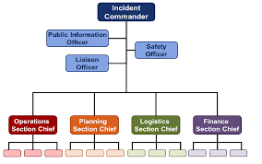
Capability 2. Health Care and Medical Response Coordination – ACTIVATE THE ICS
Review the EOP & Job Action Sheets with staff
Complete the ICS forms
Determine information sharing procedures
Update operational status via
ReddiNet®
Notes:
What is the primary goal of the incident command system?
ICS is the model tool for command, control, and coordination of a response and provides a means to coordinate the efforts of individual agencies as they work toward the common goal of stabilizing the incident and protecting life, property, and the environment.
STEP 1 – SIZE UP THE SITUATION
Size up begins by answering some questions:
• What is the nature of the incident?
• What hazards are present?
• How large an area is affected?
• How can the area be isolated?
• What location would make for a good staging area?
• What entrance/exit/safe routes would be good for the flow of response personnel and equipment?
Size up reports should include:
• A description of the situation.
• Obvious conditions (e.g. hazards).
• Initial actions taken.
• Obvious safety concerns.
• Assumption, identification and location of Command Post.
• Request or release of resources.
STEP 2 – IDENTIFY CONTINGENCIES Murphy’s Law applies to incident management.
• Nothing is as easy as it looks.
• Everything takes longer than expected.
• If anything can go wrong, it will.
STEP 3 – DETERMINE OBJECTIVES
• Measurable.
• Used to monitor incident progress and establish priorities.
• Based on size up and contingencies, what do you want to do?
STEP 4 – IDENTIFY NEEDED RESOURCES
• What resources are needed?
• Do you have them?
• Where will you get them?
• How long will it take to get them?
• Special requirements?
STEP 5 – BUILD AN INCIDENT ACTION PLAN AND MANAGEMENT STRUCTURE
• Responsibilities
• Chain of Command
• Coordination F - Finance/Administration L - Logistics O - Operations P - Planning/Intelligence
STEP 6 – TAKE ACTION Possible actions for incident stabilization:
• Establishing command/ICS
• Requesting/mobilizing resources
• Setting up a staging area
• Isolating the area
• Treating/assisting the injured
• Setting up entrance/site/safe routes
• Issuing warnings
• Initiating Evacuation
• Establishing liaison
• Issuing notifications
Local EMS Agency, leadership, staff, patients, sister facilities, geographically close facilities, etc.
Consider activating your communication plan
Maintain Communications: Initially you may want to review your EOP, specifically your communications plan
Determine if you need to activate your incident command system (ICS), consider using a 214 Activity Log
Review strategies
ReddiNet is our main communication platform. There are over 1,000 facilities that we would be communicating with!
If you don’t have ReddiNet, contact me and I will provide you with the link to set up your free account

Slide 12
Capability 3: Continuity of Health Care Service Delivery
OBJECTIVES:
Determine the facility’s priorities for ensuring key functions are maintained:
Provision of care
JIT Training
Coordinate staff and resources
Resource Request
BCP activation
Patient tracking
HIPAA
Identify strategies for recovery
Notes:
Capability 3: Continuity of Health Care Service Delivery
Goal of Capability 3: Health care organizations, with support from the HCC and the ESF-8 lead agency, provide uninterrupted, optimal medical care to all populations in the face of damaged or disabled health care infrastructure. Health care workers are well-trained, well-educated, and well-equipped to care for patients during emergencies.
This would possibly trigger the Business Continuity Plan (BCP).
IF you need resources to maintain services, who will you ask?
Vendors
Partners
PHD
County
If you have a generator (ASC)
When was the last in-service conducted on your generator?
How many hours of fuel do you have on hand?
contact your next surgical case, the physicians performing the surgery,
What is the time frame to trigger notifications/action?
ESRD- at what point do you clamp and disconnect? Do you have a back-up facility to refer to? How do you track patient movement? 3-day Emergency diet instructions with fluid limits distributed?
ALL-how will you manage patient care during a power outage?
Who would you communicate with? Local EMS Agency, leadership, staff, patients, sister facilities, geographically close facilities, etc.
Consider activating your communication plan
Consider HIPAA During Disasters (“IMMINENT DANGER: Providers can share patient information with anyone as necessary to prevent or lessen a serious and imminent threat to the health and safety of a person or the public -- consistent with applicable law and the provider's standards of ethical conduct” (California Office of Health Information Integrity) See 45 CFR 164.512(j))
Simultaneous response and recovery operations result in a return to normal or, ideally, improved operations

Slide 13
Capability 4. Medical Surge
OBJECTIVES:
Identify triggers to activate Surge Plan
Identify if Policy Waivers require implementation
Notify appropriate personnel/patients
Coordinate patient destination if referring patients
Notes:
Capability 4. Medical Surge
Goal for Capability 4: Health care organizations — deliver timely and efficient care to their patients even when the demand for health care services exceeds available supply.
When an emergency overwhelms the HCC’s collective resources, the HCC supports the health care delivery system’s transition to contingency and crisis surge response and promotes a timely return to conventional standards of care as soon as possible.
Merriam-webster dictionary defines SURGE as “to rise suddenly to an excessive or abnormal value”
The Emergency Action Plan should encompass all elements of surge response, including:
A declaration of public health emergency
Requests for mutual aid
Communication with partners
Concept of operations for specific use of specific facilities:
What kinds of patients will be sent to which facilities
Identify types of patients based on case definition or triage scoring
Address any transportation issues
Establish a comprehensive public information strategy
Determine if specific just-in-time training will be required
Determine the need for, and implement, modified treatment protocols, altered clinical care standards, palliative care guidelines, or other care provisions.
IF your site is considered an alternate treatment area, CONSIDER:
Signage in English and Spanish as appropriate directing patients to correct location
Clear patient ingress and egress (entrances and exits)
Security for site and personnel
Transportation routes determined and communicated
Staffing of ACS for first 48 hours, using 12-hour shifts (i.e., first 4 shifts)
Power, water, and sanitation (toilets) in working order and with reserve supplies for at least first 48 hours
Rules and policies for alternate site of
operation
You have more patients than space, staff or stuff (supplies)
What actions can you take to resolve this situation?
ASC & Clinics with generators-powering stations, take on uncomplicated surgical cases, allow use of space for
HHH-offload patients from the hospital to accommodate surging to the hospital
ALL-work with less impacted facilities to continue care, track patients, extend operating hours
ALL-Consider expanding capacity through schedule alteration—e.g., increasing shift length, changing staffing ratios

Slide 14
Exercise Documents
MSEL
Situation Manual
Controller/Evaluator Handbook
Exercise Plan
Exercise Evaluation Guide (EEG)
https://lacountyhcc.org

Slide 15
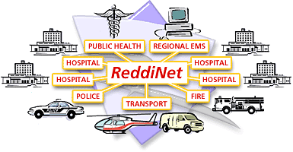
ReddiNet®
Communication Tool
MCI
General Notifications
Polls
Assessment Polls
Service Level Polls
Resource Requests
Notes:
At this point, if you don’t have a ReddiNet account, NOW is the time to sign up.
ReddiNet is our main communication platform, it is paid for by federal dollars and is FREE to you.
During COVID we were able to distribute an enormous amount of PPE, ventilators, monoclonal antibiotics, COVID test kits, and fulfill requests for staff through resource requests submitted via ReddiNet
The next few slides are a peak into ReddiNet. The next training session for ReddiNet is scheduled for October 19^{th,,} 10-11 am, where Lewis West, an employee and SME will guide you through the very basic steps to logging in, answering a poll, identifying your facility status and verification of your operating hours, as well as capabilities.
Again, ReddiNet is our main communication platform. It is both Web and Satellite Based
ReddiNet is used by MAC, PH, Hospitals, Fire Departments, Police Depts, LTC, ASC, HHH, UCC, ESRD, CCALAC
Think about what triggers activation of your Communication Plan
What is the expected time frame to notify Internal and external customers? What priorities do you have for leadership, staff, patients, sister facilities, geographically close facilities, Local EMS Agency etc.
When did you last test your communication plan?
What systems are included in your plan? Phone, text, email, mass messaging,
ASC-contact your next surgical case, the physicians performing the surgery,
ESRD-clamp and disconnect procedures, arrangements for next wave of patients, contact the next shift, is there another Dialysis facility you could refer to? How do you prioritize patients
HHH-What provisions are made for power dependent patients?
Clinics & Urgent Care facilities-how to you anticipate/handle walk-ins?
Maintain Communications: Initially you may want to review your EOP, specifically your communications plan
Determine if you need to activate your incident command system (ICS), consider using a 214 Activity Log
Review strategies
Key communications with:
Personnel on duty AND Personnel off duty (instruct to report or not)
Patient families
Medical Providers
Personnel families
Public Safety (EMS, transport providers, buses, etc.)
Media

Slide 16
Master Scenario Event List (MSEL)
Notes:
From 06-0800
• At 06:00 hours a large underground explosion occurred in a Metrorail tunnel near Children’s Hospital Los Angeles (CHLA) • People are appearing with various injuries and complaints • First responders arrive on scene and newscasting begins • Damage assessment of area impacted by the explosion • At 07:30 MCI has cleared and all patients from the incident have been transported to various emergency departments in the County. • Metrorail and utility crews remain on scene assessing damage to the tunnel and other infrastructure
0800 ReddiNet message to all HCP (Healthcare Participants)
The Medical Alert Center (MAC) initiates a MCI poll titled, "Metrorail Tunnel Explosion" and sends a ReddiNet message informing all Hospitals of an underground explosion in the Metrorail tunnel under Vermont between Sunset and De Longpre near CHLA. MAC begins assigning victims to 9-1-1 receiving hospitals
EXPECTED ACTION: Acknowledge message
8:00am
Message ReddiNet Evacuation of Children's Hospital Los Angeles (CHLA) MAC All Health Care Partners (HCP) on ReddiNet Children’s Hospital Los Angeles (CHLA) requires a full evacuation due to loss of water. Hospital administration reports the water interruption is related to the explosion that occurred in the nearby Metrorail tunnel. Engineers estimate CHLA will be without water for a minimum of 48 hours. CHLA evacuating all patients. The current census of CHLA is 490 patients
Exercise participants acknowledge ReddiNet message All players ASC, Clinic, HHH, and Urgent Care: Objective 1 Dialysis and Long Term Care: Objective 2

Slide 17
Notes:
This is a sample of the message that will pop up. Click on the red “Mark as Read” after you stop the alert and read the message.

Slide 18
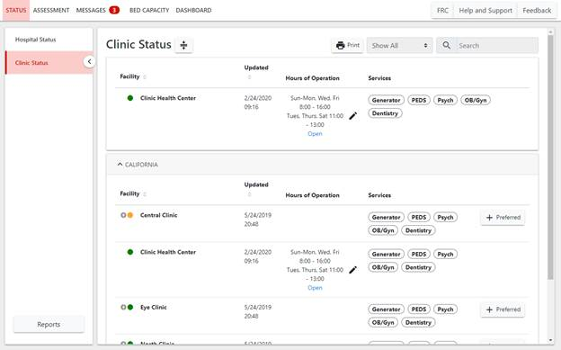
ReddiNet ® STATUS
TRAINING LINK: https://www.reddinet.net/support
Notes:
1. Click on your facility type status page (i.e. "Dialysis Status").
TRAINING LINK: https://www.reddinet.net/support
Circle with lightening bolt means that that facility is not currently logged in to the ReddiNet system
Green means the facility is open with no issue
We will cover the colored dots in a future slide…
Assessment module
Click on Service Level
Click on “Update”
Select your current service level and click “Update”
Accept when the “Confirm” box appears

Slide 19
ReddiNet ® STATUS
TRAINING LINK: https://www.reddinet.net/support
Notes:
1. Verify the general information, click on the facility name
TRAINING LINK: https://www.reddinet.net/support

Slide 20
ReddiNet ® STATUS
Notes:
1. Click the Edit button under Hours of Operation.
TRAINING LINK: https://www.reddinet.net/support

Slide 21
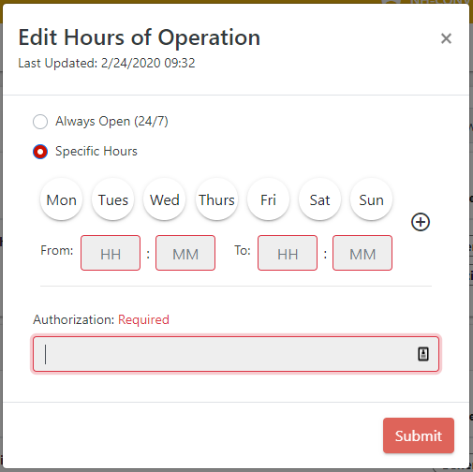
ReddiNet ®
Notes:
2. Select "Specific Hours".
3. Select the days that your facility is open.
4. Input your opening and closing times.
5. Optionally, you may add a second schedule by clicking on the "+".
6. Input the authorization.
7. Click "Submit".
TRAINING LINK: https://www.reddinet.net/support

Slide 22
ReddiNet ® STATUS
1
TRAINING LINK: https://www.reddinet.net/support
Notes:
1. Click "Generator“ if you need to update your generator status-see next slide
TRAINING LINK: https://www.reddinet.net/support

Slide 23
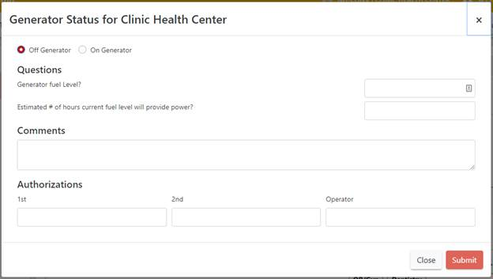
ReddiNet STATUS
2
3
4
5
Notes:
See questions regarding the generator status
TRAINING LINK: https://www.reddinet.net/support

Slide 24
ReddiNet® Service Level Poll
A Service Level Poll is used to obtain real time facility operational status during an event or incident.
Status is color coded
Respond to Assessment Poll within 60 min.
Notes:
ReddiNet is our main communication platform. It is both Web and Satellite Based
ReddiNet is used by MAC, PH, Hospitals, Fire Departments, Police Depts, LTC, ASC, HHH, UCC, ESRD, CCALAC
This poll will come through in the assessment tab
Hospitals and Long-Term Care facilities; Green, Yellow, Orange, Red and Black
Clinics, Home Health/Hospice, Dialysis and Urgent Care Centers – No Red
Ambulatory Surgery Centers and Psych facilities – No Orange or Red
Green (Normal Operations): No assistance from the jurisdiction is required. Agency is operational and is in business-as-usual mode. Can assist with response by accepting early discharged from hospitals.
Yellow (Under Control): No assistance from the jurisdiction is required. Center is operational and is in business-as-usual mode. Unable to accept additional patients.
Orange (Modified Services): Some assistance from the jurisdiction is required. Agency has begun to modify their services as they are unable to care for and/or reach all patients.
Black (No Services): Unable to care for/reach patients. Assistance from jurisdiction is required to reach patients who have been triaged as high risk. Should be referred to law enforcement and/or EMS providers in the affected area

Slide 25
ReddiNet® Service Level Poll
Notes:
HHH, ESRD and UCC have the same color codes and definitions
ASC has no Orange
Green (Normal Operations): No assistance from the jurisdiction is required. Agency is operational and is in business-as-usual mode. Can assist with response by accepting early discharged from hospitals.
Yellow (Under Control): No assistance from the jurisdiction is required. Center is operational and is in business-as-usual mode. Unable to accept additional patients.
Orange (Modified Services): Some assistance from the jurisdiction is required. Agency has begun to modify their services as they are unable to care for and/or reach all patients.
Black (No Services): Unable to care for/reach patients. Assistance from jurisdiction is required to reach patients who have been triaged as high risk. Should be referred to law enforcement and/or EMS providers in the affected area.
Hospitals and Long Term Care facilities; Green, Yellow, Orange, Red and Black
Clinics, Home Health/Hospice, Dialysis and Urgent Care Centers – No Red
Ambulatory Surgery Centers and Psych facilities – No Orange or Red

Slide 26
ReddiNet ® Service Level
1
2
3
Notes:
You will need to communicate your service level.
TRAINING LINK: https://www.reddinet.net/support
Assessment tab
Click on Service Level
Select your sector
Your facility
Select your current service level and click “Update”
Accept when the “Confirm” box appears

Slide 27
Notes:
Select your current service level and click “Update”. a. If a facility is in an emergency and unable to update their service level, county authorities may update them.

Slide 28
Resource Request
Resource Request forms should be submitted via ReddiNet during an MCI.
If ReddiNet is not available, RR may be submitted via email or fax.
Notes:
During an MCI, Resource Request forms should be submitted via the ReddiNet utilizing the Resource Request tab.
You can request Supplies, Personnel or Equipment
When a RR is submitted via email or fax the MCC will need to complete the form for you which is labor intensive and can create unnecessary delays.
During the pandemic, due to the overwhelming number of requests, there came a point that resource requests were ONLY via ReddiNet, and facilities were required to open FREE accounts!
It needs to be specific. For example, if you needed personnel, you would need to indicate if a tech, LVN, RN, RT, etc. is needed. The number of hours/days and duration needed. Ideally indicate if it is a day, mid or night shift request and the shift is 6,8 or 12 hours.
Supplies are disposable, one-time use, like test kits
Equipment is something that would typically be returned. Examples include ventilators, generators, etc.
There is a priority code
E for Emergent, meaning the resource is needed within 12 hours
U is for Urgent. Items needed in greater than 12 hours
S is for Sustainment
BEFORE a RR is submitted, you need to confirm 3 things:
The resource requested is exhausted or nearly exhausted
Your facility is unable to obtain the resource from vendors, contractors, sister facilities, like facilities
Facility is unable to obtain the resource from other non-traditional sources (home depot, amazon, etc)

Slide 29
3
1
2
Notes:
1 click on the Resource request tab
2 pick the correct incident. For the exercise it will say DRILL or EXERCISE MRSE
3 select new RR

Slide 30
Notes:
Name of your facility
Facility ID is your facility code in our HCC database and can be found under general information – see next slide

Slide 31
Facility ID is the “CODE” found under General Information for your facility

Slide 32
Resource Request
Notes:
Some of the fields in the resource request will be pre-filled. However, the fields that are not, must be filled prior to submitting.
Many times, during an incident, you will not be at your desk, therefore, it is important to add phone number that you will be able to in the event there is questions from the MHOAC.
Describe Mission – in this field, you will describe the purpose and reason for your request. Why and for what are you requesting
During an event, Resource Request forms should be submitted via the ReddiNet utilizing the Resource Request tab.
You can request Supplies, Personnel or Equipment
It needs to be specific. For example if you needed personnel, you would need to indicate if a tech, LVN, RN, RT, etc is needed. The number of hours/days and duration needed. Ideally indicate if it is a day, mid or night shift request and the shift is 6,8 or 12 hours.
Supplies are disposable, one time use, like test kits
Equipment is something that would typically be returned. Examples include ventilators, generators, etc
There is a priority code
E for Emergent, meaning the resource is needed within 12 hours
U is for Urgent. Items needed in greater than 12 hours
S is for Sustainment
BEFORE a RR is submitted, you need to confirm 3 things:
the resource requested is exhausted or nearly exhausted
Your facility is unable to obtain the resource from vendors, contractors, sister facilities, like facilities
Facility is unable to obtain the resource from other non-traditional sources (home depot, amazon, etc)
Resource requests are submitted as a last resort. When you have exhausted all other avenues. When you’ve reached out to your sister facilities, to your established vendors and non-traditional vendors; remember to think outside the box. Once all of these avenues have been exhausted, you may click all 3 check boxes.
It is important that management or your command unit review the request. Once reviewed, add their name and information to the resource request.

Slide 33
ReddiNet ®
There are training videos and user guides available at https://support.reddinet.net/
The training environments are available for hands-on practice at https://www.reddinettraining.net/
Registration (gotowebinar.com)
Notes:
The next non-acute training is scheduled for October 19th at 10:00-11. You need to register
Your name, email and physical address, and organization will be needed to register
We will have a teams meeting with live ReddiNet instruction, tentatively scheduled for October 26th. I need to confirm with Lewis West.
You will need an account and it is best if you have a two screen set up so you can have your screen open on one monitor, while watching the instructor on the second monitor.
November 7th is a Tuesday and we will practice responding to a message, service level assessment and submitting a resource request.

Slide 34
Preparing for the Exercise
Review your emergency operations plan and power outage procedures
Train/review with your staff
Develop procedures if you don’t have them already
Develop your Exercise Plan
Determine which facility/agency specific plans/procedures you plan to test
Plan activities to test your procedures
Review your Communication Plan
Identify the methods your facility would use during a power outage
Test the plan
Notes:
Incorporate your areas of improvement identified from your last incident, exercise or drill.
Last year some areas of improvement included identified gaps with internal notification procedures and out of date employee contact lists
Issues with implementing SIP/evacuation plans with staff and visitors, primary communication system failure (need to develop alternate communication methods to support continuity of operations)
*Remember cell towers could be impacted, hindering traditional methods of communicating!
Another identified area for improvement included challenges with a process to provide supplies to field personnel within the HHH sector
And ALL sectors identified the need for ReddiNet training…please sign up for the Oct 19th class.
If you don’t have a policy or procedure addressing something in particular, reach out to other like facilities. No need to recreate the wheel! I am all about working smarter, not harder!!

Slide 35
Practice
Before the Exercise
Day of the Exercise
After the Exercise
Open ReddiNet Account
Obtain Username and Password
Practice log in
Attend training
Service Level Poll
Resource Request (Optional)
Service Level Poll
Respond to Message
Submit a Resource Request (Optional)
After Action Report & Improvement Plan
Due 60 days after the exercise for certification of participation
Notes:
The link for signup is available on our HCC website. The QR code is on the last slide

Slide 36
Requirements for Participation
Register for the County-wide exercise scheduled for November 16th, 2023
Participate
After Action Report within 60 days
Certificate of participation
Notes:
All exercises result in the development of an AAR.
The AAR is the document that summarizes key information related to evaluation. It has a line for Objectives you wanted to achieve, and columns next to it with a
P for performed without challenges,
S for some challenges encountered
M Major challenges identified
U for unable to be performed
The next section is the strengths identified
Areas for improvement
The last section is part of your improvement plan. Briefly describe the tasks to accomplish, the date you will accomplish them by and the responsible person.
The Homeland Security Exercise and Evaluation Program (HSEEP) has defined a standard format for the development of an AAR.
By using this format, jurisdictions ensure that the style and the level of detail in their AAR is consistent with other jurisdictions.
Consistency across jurisdictions allows the nation-wide emergency preparedness community to gain a broad view of capabilities.
The length, format, and development timeframe of the AAR depend on the exercise type and scope.
These parameters should be determined by the exercise planning team based on the expectations of elected and appointed officials as they develop the evaluation requirements in the design and development process.
The main focus of the AAR is the analysis of core capabilities.
Generally, AARs also include basic exercise information, such as the exercise name, type of exercise, dates, location, participating organizations, mission area(s), specific threat or hazard, a brief scenario description, and the name of the exercise sponsor and POC.
The AAR should include an overview of performance related to each exercise objective and associated core capabilities, while highlighting strengths and areas for improvement.
Therefore, evaluators should review their evaluation notes and documentation to identify the strengths and areas for improvement relevant to the participating organizations’ ability to meet exercise objectives and demonstrate core capabilities.

Slide 37
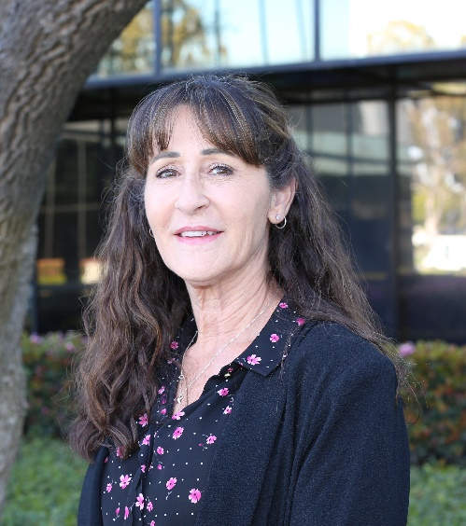
RESOURCES
Web page:
https://lacountyhcc.org
Contact:
Laurie Lee-Brown, MSN, RN, PHN, MICN
Senior Nursing Instructor/Disaster Program Manager
(562) 378-2459
Llee-brown6@dhs.lacounty.gov
Notes:
Here are the links to the documents in our website.
My contact information is provided.
If you are with the Clinic Association, contact Lisa Fisher (213) 201-6506
If you have questions related to the exercise documents, contact our Exercise Coordinator, Darren Verrette (562) 378-2451

