Slide 1
Los Angeles County MRSE
Los Angeles County Medical Response Surge Exercise (MRSE)
Scenario – Industrial Accident/Utility Failure
Choosing how to play – https://dhs.lacounty.gov/emergency-medical-services-agency/home/disaster-programs/exercise-drills/#1687377561836-cb2bc8fd-14c2
Download Exercise Evaluation Guide, Master Scenario Event List, Situation Manual and Exercise Plan
Choose activities that align with Objectives from your (Incident Action Plan) IAP - NHICS form 200
Make sure to sign up for participation - https://www.eventbrite.com/e/medical-response-and-surge-exercise-radiological-response-plan-evaluation-tickets-408045353637
Open ReddiNet and use to submit status and resource requests
Complete debrief and after-action report; submit AARs to LA EMS

Slide 2
Los Angeles County MRSE
Los Angeles County Medical Response Surge Exercise (MRSE)
Participant Seminar October 11th – See handouts
Will be held November 17th and will be the only community based functional exercise this year.
Objectives for this year’s exercise –
1. Activate Emergency Operations Plan – Utility Failure
2. Activate Communication Plan
3. Activate Surge Plan
4. Implement NHICS
5. Plan for Behavioral Health Services

Slide 3
Los Angeles County MRSE
Activate Incident Management Team –
Incident Commander gives appointment/vests to command staff and general staff
Suggested General and Command Staff activations –
Safety Officer, Operations, Planning, Logistics, Resident Services, Infrastructure, Liaison, Medical Director
Incident Commander opens Command Center and communicates to staff

Slide 4
Los Angeles County MRSE
Develop an Incident Action Plan -
Planning Chief and IC fill out Incident Action Plan form 200 or 201+202+203+204+215A
All staff receive job action sheets for SIP or Evac depending on chosen objectives; if no JAS then give tasks based on EOP
All staff complete tasks and regroup at end of operational period
NHICS Forms - https://www.cahfdisasterprep.com/nhics

Slide 5
Los Angeles County MRSE
Alert and notify response partners -
https://www.reddinet.net/app/login
Complete ReddiNet Service Poll
Optional fill out resource request
Simulate notification to other response partners (HFID, Regional Center)
Simulate notification to families
Simulate notification to residents

Slide 6
Los Angeles County MRSE
Implement Shelter-in-place or evacuation plans -
Assign tasks for either depending on what you want to simulate
Use job action sheets or EOP to direct tasks
Evaluator needs to monitor how tasks are assigned from the EOP and capture tasks needed that are not in EOP
Ops, Resident Services, Infrastructure are walking through tasks
If choosing Evac, then make sure staging areas are identified inside

Slide 7
Objectives and Activities
Foundation for Health Care and Medical Readiness – Capability One
Obj. 2 Identify Risk and Needs – activities that are likely to apply
Assess Health Care Resources
Prioritize Resource Gaps and Mitigation Strategies
Assess and Identify Regulatory Compliance Requirements
Health Care and Medical Response Coordination – Capability Two
Obj. 2 Utilize Information Sharing Procedures and Platforms
Utilize Communications Systems and Platforms
Identify Information Access and Data Protection Procedures

Slide 8
Objectives and Activities
Health Care and Medical Response Coordination – Capability Two
Obj. 3 Coordinate Response Strategy, Resources, and Communications
Identify and Coordinate Resource Needs during an Emergency
Coordinate Incident Action Planning During an Emergency
Communicate with Health Care Providers, Non-Clinical Staff, Patients, and Visitors during an Emergency
Continuity of Health Care Service Delivery – Capability Three
Obj. 1 Identify Essential Functions for Health Care Delivery
Maintaining key functions

Slide 9
Objectives and Activities
Continuity of Health Care Service Delivery – Capability Three
Obj. 3 Maintain Access to Non-Personnel Resources during an Emergency
Assess Supply Chain Integrity
Assess and Address Equipment, Supply, and Pharmaceutical Requirements
Obj. 5 Protect Workers’ Safety and Health
Distribute Resources Required to Protect the Health Care Workforce
Train and Exercise to Promote Responders’ Safety and Health
Address Health Care Worker Resilience

Slide 10
Objectives and Activities
Medical Surge– Capability Four
Obj. 1 Plan for a Medical Surge
Incorporate Medical Surge Planning into Emergency Operations Plan
Obj. 2 Respond to a Medical Surge
Implement Medical Surge Response– think cohort zones, staffing
Respond to Behavioral Health Needs during a Medical Surge Response
Enhance Infectious Disease Preparedness and Surge Response
Distribute Medical Countermeasures (vaccine) during Medical Surge Response
Manage Mass Fatalities

Slide 12
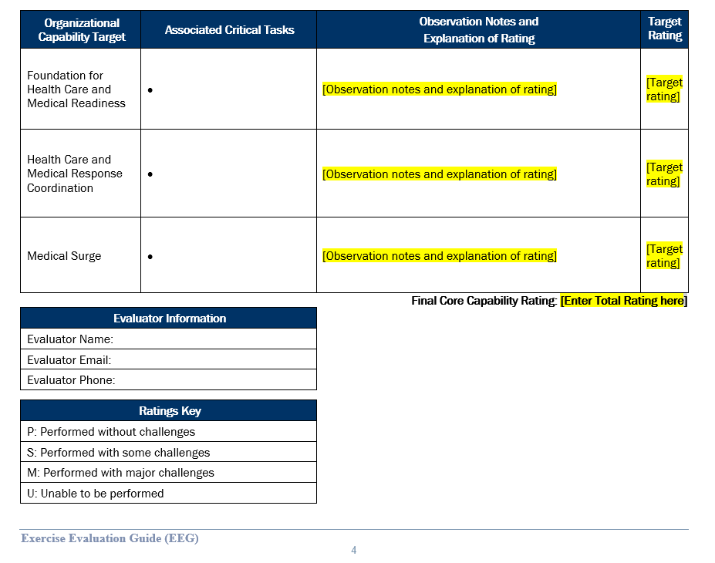

Slide 13
Questions?
Jason Belden – jbelden@cahf.org, 916-432-5194
Thank you for joining us today!
www.cahfdisasterprep.com/lacounty

