Slide 1
LOS ANGELES COUNTY
2023 MEDICAL RESPONSE AND SURGE EXERCISE (MRSE) PARTICIPANT WEBINAR
EXERCISE PLANNING 101
Essence Wilson, Senior Nursing Instructor
Disaster Program Manager
eswilson@dhs.lacounty.gov
562-378-2442

Slide 2
PRESENTATION OBJECTIVES
At the end of this presentation, each participant will be able to:
Define 3 types of exercise – tabletop, functional and full-scale
Verbalize at least 3 components needed to plan/conduct an exercise
Understand the purpose of each component and how they relate to each other
Discuss how to adapt the LA County Master Scenario Events List (MSEL) to suit the needs of their facility or agency

Slide 3
EMS AGENCY
Support agency – responsible for coordinating care during a large-scale disaster or incident either within the Medical Alert Center (MAC) or Medical Coordination Center (MCC)
Not affiliated with CMS nor any other regulatory body, however, exercising with us may assist sectors in meeting some regulatory requirements
Mission is to support and train medical sectors to be prepared for a disaster
Overarching goal during a disaster: Each patient receive the correct care at the correct facility that can meet their needs
Notes:
Presenter Notes
2022-10-11 23:06:27
--------------------------------------------
A) You are all from different healthcare sectors however, you all have some things in common. You care for patients
You all want your patients to continue to receive the correct care even during disasters
You want to meet regulations and standards set by your different sectors including CMS, The Joint Commission, and other regulatory agencies B) Bullet point 1. – one of the documents that we will be reviewing refers often to either the MAC or the

Slide 4
DEFINITIONS OF 3 TYPES OF EXERCISES
Tabletop exercise (TTX)
Facilitator guided discussion on one or more scenarios. Focus on policies and procedures
Simulated operational environment. Designed to exercise specific team members, processes and/or resources
Typically, a lengthier exercise that takes place on location using equipment and personnel that would be called upon in an actual event (most realistic)
Functional exercise
Full-scale exercise
Community Wide - An exercise that involves more that just your facility or agency
Notes:
Presenter Notes
2022-10-11 23:06:28
--------------------------------------------
Not HSEEP definitions – if you don’t know what HSEEP is don’t worry about it TTX all discussion based. Commonly held prior to a functional or full scale exercise
Functional – the EMS Agency holds a functional exercise yearly for the Great Shake Out
Full scale is you are exercising as if responding to a real event. Examples include if you are accepting patients then use real people as patients or you could use paper patients. If using the same MCI scenario, 2 responders would carry 1 patient on a stretcher. An example of a full scale community wide exercise is the annual Statewide Medical and Health Exercise (SWMHE) Full scale is most realistic e.g. if accepting additional patients then use volunteers or paper patients at the very least.
Tabletop Exercise (TTX): A tabletop exercise involves key personnel discussing simulated scenarios in an informal setting. TTXs can be used to assess plans, policies, and procedures.

Slide 5
EXERCISE COMPONENTS
Objectives
Scenario
Master Scenario Events List (MSEL)
Exercise Evaluation/Participant Feedback
After Action Report (AAR)
Improvement Plan (IP)
2023 MRSE
Notes:
Presenter Notes
2022-10-11 23:06:29
--------------------------------------------
There are many documents that can support an exercise – those listed above that we will be looking at today plus exercise plan, situation manual (TTX), controller/evaluator manual, etc. There are also terms like Public Health capabilities. If you are part of a large organization or have a robust facility or agency you may wish to look at these other documents on the EMS Agency website once they are posted there to see if you need additional documents or guidance. Sometimes things get a bit muddy when you are starting out or are a small facility or agency.

Slide 6
OBJECTIVES
Objectives are what you would like to test e.g., communication, triage, contacting specialists, etc.
Review previous AARs and IPs
For each objective, list steps on how the objective could be tested – example to follow
Need to be measurable
Notes:
Presenter Notes
2022-10-11 23:06:29
--------------------------------------------
Recommend testing only 2-3 objectives per exercise
For this presentation we will use communication as our sample objective

Slide 7
OBJECTIVE EXAMPLE
OBJECTIVE: Communication
Maintain situational awareness by gathering and sharing real-time information related to the emergency and the current state of the (facility/agency) through coordination with ….(staff, EMS Agency, etc.)
Sample Task(s):
Activate communication plan/policy or develop a process for sharing of information related to the incident with on-duty staff and those who are scheduled to work within 30 minutes of incident notification
Respond to communication received from local healthcare partners and/or EMS Agency MCC, e.g., service level request, resource availability and/or capabilities.
Utilize and test redundant communication systems [insert specific systems to test, such as text messaging, email, mass notification software, etc. – refer to your communication plan/policy] to notify staff, response partners and EMS Agency MCC as applicable.
Notes:
Presenter Notes
2022-10-11 23:06:30
--------------------------------------------
Determine your own steps for each objective
Sample objectives for each sector can be found on the EMS Agency website

Slide 8
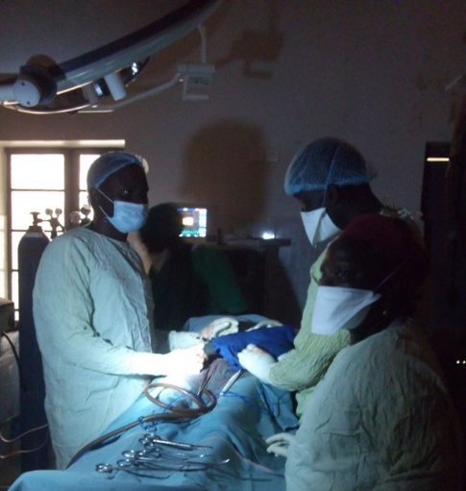
SCENARIO
The scenario should be developed after the objectives have been determined so that it can test the objectives
However, with the Medical Response & Surge Exercise (MRSE), the scenario has already been set – Pediatric surge and healthcare coalition power outage
Scenario should be relevant, and include situations that will test the objectives i.e., based on your Hazard Vulnerability Analysis/Assessment (HVA)
Notes:
Presenter Notes
2022-10-11 23:06:31
--------------------------------------------
Scenario should be one that can test all the objectives that you wish to use. You can always adjust the scenario to suit what you want to test.
Look at your hazard vulnerability analysis/assessment to assist with choosing a relevant scenario e.g. a hurricane may not be applicable to southern California

Slide 9
MASTER SCENARIO EVENTS LIST (MSEL)
Chronological listing of events
Used in an exercise
Based on the scenario and sample tasks for each objective
Each row is called an inject with a time assigned to it
Column headings may include, but not limited to inject number, time, from and to actual message/information, expected action
MSEL for the MRSE has more columns
Only exercise controllers should have access to the MSEL
Notes:
Presenter Notes
2022-10-11 23:06:32
--------------------------------------------
Not needed in an actual event as it will self propel
An inject is an event or message that is injected into the MSEL Inject example –
It could include other columns such as the MSEL from this year’s SWMHE

Slide 10
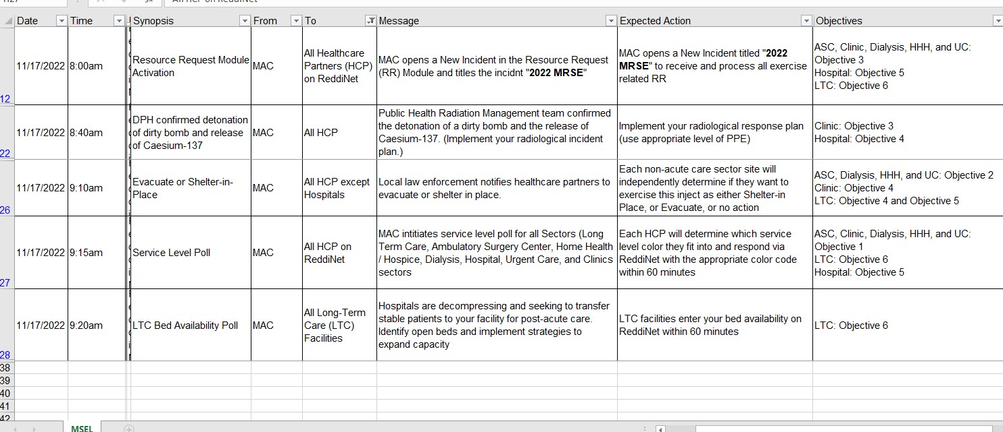
EXCERPT FROM MRSE MSEL
Notes:
Presenter Notes
2022-10-11 23:06:33
--------------------------------------------
MSEL example

Slide 11
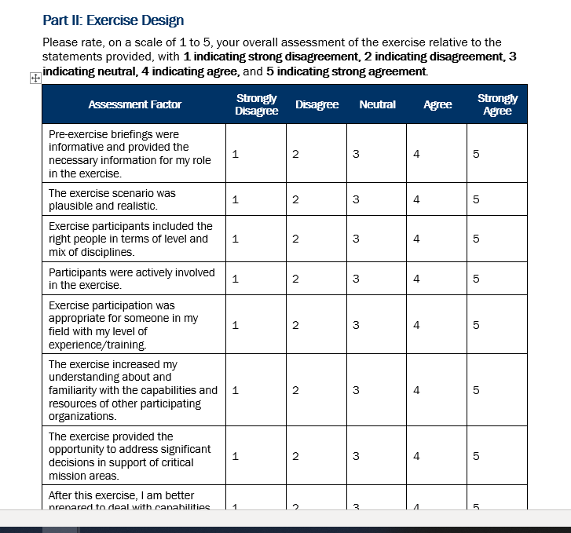
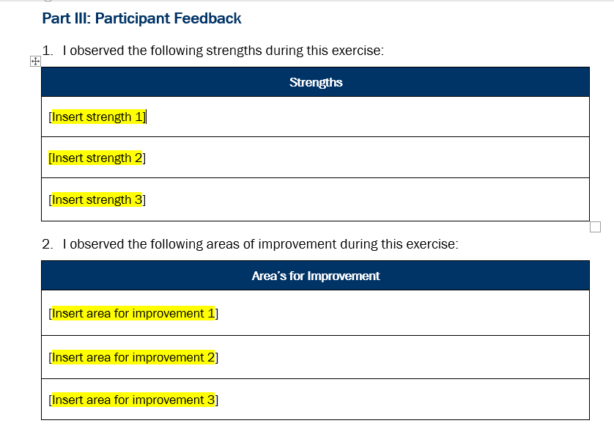
EXERCISE EVALUATION – PARTICIPANT FEEDBACK FORM
Exercise evaluation guides are available on the LACountyHCC.org website along with a Participant Feedback Form
Anyone who participates in any way (player, controller, evaluator, etc.) should complete a feedback form
Information from evals and feedback should be collated, organized and put into an After-Action Report (AAR)

Slide 12
AFTER ACTION REPORT (AAR)
/IMPROVEMENT PLAN (IP)
Can be two documents or combined into one
AAR contains information on how the exercise went – did you meet your objectives by completing the sample tasks?
Which areas did you do well in (strengths)
Which areas need some improvement
Improvement plan should be based on the areas for improvement
AARs for the MRSE are due 60 days after the exercise (mid January 2024)
Notes:
Presenter Notes
2022-10-11 23:06:35
--------------------------------------------
Go hand in hand so for the SWMHE purposes, they are included in 1 document that is on the EMS Agency website
We will look at the 3 sections in this document – 1 and 2 are the AAR and the 3rd section is the improvement plan area

Slide 13
AFTER ACTION REPORT (CONTD.)
List top 3 strengths
We were able to contact all staff both in the facility and those scheduled to work later in the day
List top 3 areas for improvement
We were unable to contact all appropriate staff as the call list did not contain everyone’s current numbers
Notes:
Presenter Notes
2022-10-11 23:06:36
--------------------------------------------
Continuing to use the communication objective list top 3 of both strengths and areas for improvement (we don’t like the term weaknesses) There should always be some areas for improvement. Please don’t leave this area blank.
SHOW EVAL SUMMARY FROM JCHS

Slide 14
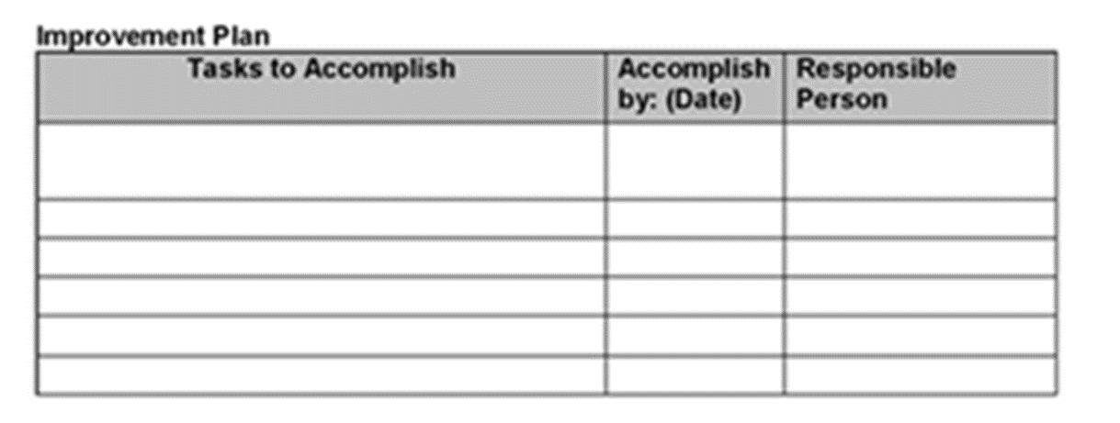
IMPROVEMENT PLAN
Improvement plan is based on your areas for improvement
Based on the previous example - We were unable to contact all appropriate staff as the call list did not contain everyone’s current numbers
Enter the date to be accomplished and the person responsible for completing the task
Notes:
Presenter Notes
2022-10-11 23:06:37
--------------------------------------------
What task needs to be accomplished? – Update the call list
Enter a realistic date to be accomplished and who is responsible. Enter their name. SHARE JCHS IMPROVEMENT PLAN

Slide 15
EMS AGENCY DISASTER PROGRAM MANAGERS
Hospitals, Pediatric Surge, Trauma Surge, HDMT:
Essence Wilson
Email: eswilson@dhs.lacounty.gov
Phone: 562-378-2442
Ambulatory Surgery Centers, Dialysis Centers, Home Health/Hospice Agencies, Urgent Cares:
Laurie Lee-Brown
Email: llee-brown6@dhs.lacounty.gov
Phone: 562-378-2459
Clinics, Long Term Care Facilities, EMS Providers, Emerging Infectious Diseases:
Nnabuike “BK” Nwanonenyi
Email: nwanon@dhs.lacounty.gov
Phone: 562-378-2460

Slide 16
REFERENCES
Homeland Security Exercise and Evaluation Program (HSEEP) https://www.fema.gov/sites/default/files/2020-04/Homeland-Security-Exercise-and-Evaluation-Program-Doctrine-2020-Revision-2-2-25.pdf
Exercises. (2023). Ready. https://www.ready.gov/business/training/testing-exercise/exercises

Slide 17
Resource Links
Lacountyhcc.org
https://dhs.lacounty.gov/emergency-medical-services-agency/home/disaster-programs/

Slide 18
THANK YOU

