Slide 1
Participant Webinar
This project was sponsored by the Los Angeles County Emergency Medical Services Agency and funded in part by the Hospital Preparedness Program, U.S. Department of Health and Human Services (HHS), Administration of Strategic Preparedness and Response (ASPR) grant funding. This award has been assigned the Federal Award Identification Number (FAIN) U3REP190605.

Slide 2
Exercise Overview
Darren Verrette
Disaster Program Manager
Los Angeles County EMS Agency

Slide 3

Exercise Overview
MRSE
Pediatric Surge
MRSE Data Gathering
Power Outage
Mass/Multi-Casualty Incident (MCI)
Exercise Essentials

Slide 4
Why
MRSE?
The Medical Response and Surge Exercise (MRSE) is an annual Hospital Preparedness Program (HPP) Cooperative Agreement requirement. As of HPP Budget Period 3, HCCs must complete the MRSE annually
Notes:
Currently in HPP Budget Period 5, which began July 1, 2023, and ends June 30, 2024

Slide 5
MRSE
Purpose?
The purpose of the MRSE is to provide HCCs with an opportunity to test their surge response and preparedness capabilities. The scenario used in the MRSE is defined by the HCC, but all exercises will test an HCC and its members’ capacity to accommodate a surge of patients equal to at least 20% of its staffed bed capacity

Slide 6
MRSE Components:
MRSE is a Functional Exercise
Surge Capacity Requirements
Data Collection Requirements
Notes:
Functional Exercise (FE): A functional exercise examines and/or validates the coordination, command, and control between various Multi-Agency coordination centers (e.g., emergency operation center, joint field office, etc.). A functional exercise does not involve any “boots on the ground” (i.e., first responders or emergency officials responding to an incident in real time).

Slide 7
Why Pediatric Surge Exercise?
ASPR requires following annex / exercise:
Emerging Infectious Disease (EID)
Burn
Chemical
Radiological
Pediatric
Meets deliverable for HPP 5 - Year Project Period (2019 to 2024).

Slide 8
Pediatric Surge
The Healthcare Coalition (HCC) must surge to 20% of its staffed pediatric bed capacity
Staffed beds means those beds which are equipped and available for patient use
Notes:
Staffed beds mean those beds which are equipped and available for patient use. Staffed beds include those that are occupied and those that are vacant.

Slide 9
Pediatric Beds 2,453
Pediatric Surge 490
Notes:
The HCC has 2,453 staffed pediatric beds. To determine 20%, we use the following formula (2,453 staffed pediatric beds multiplied by 20% = 490 pediatric surge patients)

Slide 10
How
Surge Peds?
Scenario: Evacuate Children’s Hospital Los Angeles that will just happen to have 490 patients
Will distribute pediatric patients according to the Los Angeles County Pediatric Surge Plan

Slide 11

Pediatric Surge Plan

Slide 12
Pediatric Surge Plan:
Patient Allocation
Most hospitals in the County have been assigned to a tier level in the Pediatric Surge Plan based on pediatric capability
The plan has 7 tier levels (1-7)
Facilities that can accommodate the youngest and most critically ill or injured pediatric patients are assigned to tier 1
Hospitals in tiers 1 through 6 receive pediatric patients

Slide 13
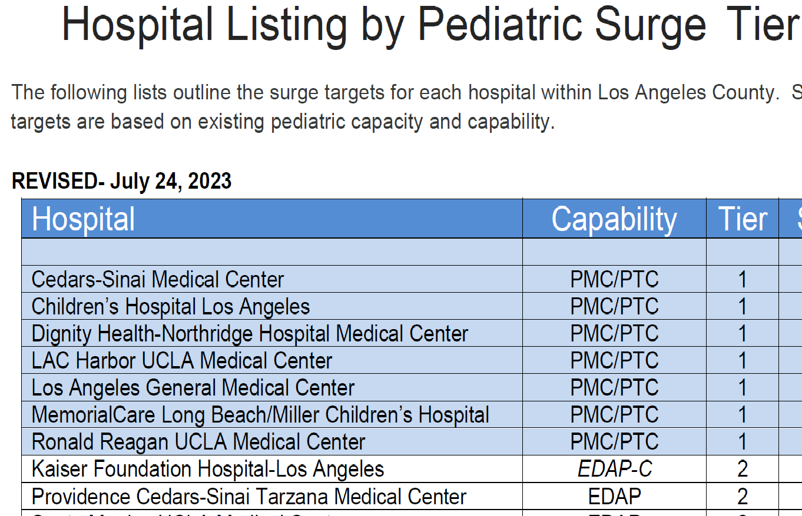
Pediatric Surge Plan: Patient Allocation
Notes:
Not counting CHLA there are 63 hospitals in total in Tiers 1 - 6

Slide 14
Pediatric Surge Plan: Patient Allocation
Hospitals without emergency departments and no pediatric capability are assigned to tier 7
Some hospitals are undesignated and have not been assigned to a tier category in the Pediatric Surge Plan
Hospitals in tier 7 and undesignated do not receive pediatric patients. They receive adult patients transferred out from tier 1 through 6 hospitals that are decompressing to make space for pediatric patients

Slide 15
Exercise: Patient Movement
Each hospital will be allocated a pre-determined number of pediatric patients based on the assigned tier level:
Tier 1 to Tier 3 Hospitals: 12 pediatric patients each
Tier 4 to Tier 5 Hospitals: 7 pediatric patients each
Tier 6 Hospitals: 5 pediatric patients each
Tier 7 Hospitals: 0 pediatric patients
Undesignated Hospitals: 0 pediatric patients
Notes:
63 hospitals in total in Tiers 1 – 6 (Not counting CHLA)
Tier 1 to Tier 3 Hospitals: 12 pediatric patients each (18 hospitals in these tiers – not counting CHLA)
Tier 4 to Tier 5 Hospitals: 7 pediatric patients each (25 hospitals in these tiers)
Tier 6 Hospitals: 5 pediatric patients each (20 hospitals in this tier)

Slide 16
Exercise:
Patient Movement
Each participating hospital will receive pre-assigned types of pediatric patients according to tier level:
Tier 1 to Tier 3 hospitals will receive the youngest and most critical cases
Tier 4 to Tier 6 hospitals will receive older more stable patients
Tier 7 and undesignated hospitals will not receive pediatric patients. Will receive 10 adult victims each (patient transfers) to support hospital decompression efforts

Slide 17
Victim List: Pediatric
Before the exercise, each participating hospital assigned to Pediatric Surge Plan tiers 1 through 6 must download the Pediatric Victim list from the EMS Agency website:
https://dhs.lacounty.gov/emergency-medical-services-agency/home/disaster-programs/exercise-drills/ - 1648150843740-ab025eee-cd58
Do NOT print the entire list after downloading.

Slide 18
Victim List: Pediatric
The TRAIN tool has been included for everyone’s benefit. It is a reverse triage tool used to determine the resources needed to transport a pediatric patient.
Technically only the sending hospital and/or SimCell should need to use it, but it’s worth having on the Victim Cards as a thought exercise for everyone.
Notes:
https://www.stanfordchildrens.org/en/research-innovation/train

Slide 19
Victim List: Pediatric
SimCell will facilitate pediatric patient movement on the day of the exercise.
There will be no actual movement of patients.
SimCell will act as CHLA and call each receiving facility and provide patient assignment information from the Pediatric Victim List.

Slide 20
Victim List: Pediatric
The SimCell caller will relay which patients on the list downloaded from the website are assigned to the contacted hospital.
Script:
Hello, this is SimCell. May I speak with (POC)?
This is an Exercise
I am calling from CHLA to give you your pediatric patient assignments
You will receive (12, 7, 5) pediatric patients
Are you ready?
Your patients are numbers (1,2,3, etc.) on the list
Would you like to confirm and relay to me your assigned patients?
Thank you
Notes:
Beginning at 8:20am

Slide 21
Victim List: Pediatric
When Hospitals register for the exercise, each facility must provide the point of contact information including the name, title or position, and telephone number of the person who will receive the facility's pediatric victim list information on the day of the exercise.

Slide 22
Victim List: Pediatric
Clinical personnel will perform patient triage and determine if patients will require inpatient care and admission versus outpatient care based on the data provided on the victim cards. Patients who require inpatient care and admission will need an appropriate, staffed bed in this exercise

Slide 23
Victim List: Adult
Before the exercise, Tier 7 and participating undesignated hospitals must download the Adult Victim list from the EMS Agency website:
https://dhs.lacounty.gov/emergency-medical-services-agency/home/disaster-programs/exercise-drills/ - 1648150843740-ab025eee-cd58

Slide 24
Victim List: Adult
After downloading the victim list, the facility must select any 10 victims of their choice to process at their facility
Clinical personnel will perform patient triage and determine if patients will require inpatient care and admission versus outpatient care based upon the selected victim cards. Patients who require inpatient care and admission will need an appropriate, staffed bed in this exercise

Slide 25
Peds Exercise:
Long Term Care Sector
Support Hospital decompression efforts
MSEL inject to update ReddiNet bed capacity poll – LTC facilities respond to poll and update ReddiNet
Optional: Download adult victim list from EMS Agency website
Select as many victims as needed to support objectives
Request your clinical personnel to perform patient assessments to support your intake and bed assignment processes

Slide 26
Peds Exercise:
Provider Agencies
Mutual Aid
FOAC
Strike Teams
Types of Units:
  BLS
  ALS
  CCT
  Other

Slide 27
MRSE Data Collection
Components
The MRSE is a functional exercise and has very specific surge capacity requirements and data collection elements. HCC must surge to 20% of pediatric staffed beds by the designated bed types:
Emergency Department
General Pediatric / Acute Care
Pediatric ICU
Neonatal ICU
Pediatric Dialysis

Slide 28
MRSE Data Collection
Components
An Assessment Poll titled, “2023 Medical Response and Surge Exercise - Hospital Capacity Survey” will go out to all participating hospitals at the beginning of the exercise
This is where hospitals record data

Slide 29
Assessment Poll:
2023 Medical Response and Surge Exercise
– Hospital Capacity Survey

Slide 30
Power Outage
https://www.fema.gov/sites/default/files/2020-07/healthcare-facilities-and-power-outages.pdf
Notes:
https://www.fema.gov/sites/default/files/2020-07/healthcare-facilities-and-power-outages.pdf
For the other non-Hospital sectors in our HCC, we are testing power outage plans.
Incorporated power outage to facilitate play for the non-hospital sectors of our Health Care Coalition
ASC
Clinics
Dialysis
HHH
Urgent Care Centers

Slide 31
Power Outage
Facilities can test internal plans and processes in response to power outages
Facilities can implement and test strategies outlined in the Los Angeles County Emergency Medical Services Healthcare Surge Planning Guide.
Facilities could also implement and test downtime procedures and Business Continuity Plans or any relevant plan or process of their choice
Notes:
Facilities can implement and test strategies outlined in the Los Angeles County Emergency Medical Services Healthcare Surge Planning Guide. Such as ASC’s setting up charging stations to support HHH and others on DME that require power.

Slide 32
Power Outage
Hospitals can incorporate power outage into their exercise; however, they cannot divert pediatric patients due to power outage

Slide 33
Power Outage
Assumption: Power outage is occurring for an extended period

Slide 34
Power Outage
Module 3 in the Situation Manual outlines key issues and subjects related to power outages
The Master Scenario Event List (MSEL) supports play for the power outage scenario
Please refer to the MSEL for specific time-sensitive tasks and responses to ReddiNet messages and polls

Slide 35
MCI

Slide 36
MCI
Incorporated MCI as a pre-exercise component of the scenario to facilitate activities for 9-1-1 receiving Hospitals wanting to expand the exercise internally
Participating 9-1-1 receiving Hospitals can add additional victims if needed to meet accrediting requirements
MAC will support the MCI component until 8:00am

Slide 37
MCI
Scenario: “At 06:00 hours a large underground explosion occurred in a Metrorail tunnel under Vermont Avenue between Sunset Boulevard and De Longpre Avenue near Children’s Hospital Los Angeles (CHLA)”
The MAC will initiate an MCI poll titled, "Metrorail Tunnel Explosion" and send a ReddiNet message informing all Health Care Partners (HCP) of an underground explosion in Metrorail tunnel under Vermont between Sunset and De Longpre near CHLA

Slide 38
MCI
All 9-1-1 receiving Hospitals respond to MCI poll
MAC will assign ambulances with victims to 9-1-1 receiving Hospitals via ReddiNet
All 9-1-1 receiving Hospitals arrive ambulances and update MCI victim list – okay to use fictional data
All other HCP on ReddiNet acknowledge message
No further action required
The MCI will remain open for the duration of the exercise

Slide 39
MCI
Optional: Download adult victim list from EMS Agency website
Select as many victims as needed to support objectives
Request your clinical personnel to perform patient triage or other clinical tasks to support your objectives

Slide 40
Exercise Essentials
Scenario
Scope of Exercise
Assumptions
MSEL
Resource Requesting
ARES
Conclusion of Exercise
Documentation
Registration

Slide 41
Exercise Scenario
At 06:00 hours a large underground explosion occurred in a Metrorail tunnel under Vermont Avenue between Sunset Boulevard and De Longpre Avenue near Children’s Hospital Los Angeles (CHLA)
The Los Angeles City Fire Department has cleared the scene and all patients from the incident have been transported to various emergency departments in the County. Metrorail and utility crews remain on scene assessing damage to the tunnel and other infrastructure
(This pre-exercise component of the scenario is to facilitate activities for 9-1-1 receiving Hospitals wanting to expand the exercise internally)

Slide 42
Exercise Scenario (continued:)
At 08:00 hours CHLA requires a full evacuation due to loss of water. The current census of CHLA is 490 patients. CHLA has power. Telephones and internet-based platforms are operational

Slide 43
Exercise Scenario (continued:)
At 09:00 hours received report of power outages sporadically occurring throughout the County
(This exercise component is to support play for the non-Hospital sectors)
(Hospitals can choose to incorporate this optional component into their exercise. However, if included, hospitals cannot divert pediatric patients due to power outage)

Slide 44
Exercise Scope
There will be no actual movement of patients. The Medical Alert Center will start the exercise at 8:00 a.m. and end at 12:00 p.m. Play will take place in the live ReddiNet system

Slide 45
Exercise Assumptions
The scenario is plausible and meets criteria to activate applicable plans.
The time period for the power outage component is based upon an extended time period and not actual time.

Slide 46
Master Scenario Event List (MSEL)
MSEL is a chronological list of simulated events (injects) that participants (players) will be asked to respond to during an exercise
Some injects are for all players such as the Service Level Poll
Some injects are for specific sectors and players such as Long-Term Care Bed availability Poll
It is okay to remove non-pertinent injects or add additional if needed to meet your objectives

Slide 47
Resource Requesting
MAC will open a resource request incident to support the exercise titled:
“2023 MRSE Exercise”
Use this incident in ReddiNet for exercise related resource requests

Slide 48
Resource Requesting
Critical Pediatric Resource: (MSEL #23)
“Hospital command center identifies a critical pediatric resource need that is unavailable in their health care system (pediatric equipment, pediatric supplies, pediatric specific pharmaceuticals, pediatric staff, PPE for pediatric patients, etc.)”

Slide 49
Amateur Radio Emergency Service (ARES)
Great opportunity to invite ARES to your hospital to test back-up communications
ARES will setup Net Control at the MAC
ARES can transmit and receive messages, resource requests, bed availability reports, and more via HAM radio

Slide 50
Conclusion of Exercise
Hot-wash, Debrief
Participant Feedback Forms
60 days to complete and submit AAR/IP

Slide 51
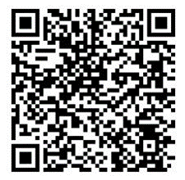
Documentation
Exercise Objectives (Sector Specific)
Exercise Plan (ExPlan)
Situation Manual (SitMan)
Controller Evaluator Handbook
Exercise Evaluation Guide (Sector Specific)
Victim Cards
Master Scenario Event List (MSEL)
Participant Feedback Form
After-Action Report / Improvement Plan
https://dhs.lacounty.gov/emergency-medical-services-agency/home/disaster-programs/exercise-drills/ - 1648150843740-ab025eee-cd58

Slide 52

Exercise Registration
Please register your facility for the exercise
Registration will confirm your facility is planning to participate in the exercise.
Registration will provide point-of-contact information to EMS (event organizers)
Registration is required to receive participation credit
Facility registration is required, not individual exercise players / participants
https://www.eventbrite.com/e/medical-response-and-surge-exercise-pediatric-surge-and-hcc-exercise-tickets-676653497827?aff=oddtdtcreator

Slide 53
Poll
Please complete the poll.
Type URL below in address bar or scan QR code to begin poll:
https://pollev.com/dverrette777

Slide 54
Answers
1. True
2. True
3. True
4. True
5. True
6. True
7. True
8. True
9. False
10. True
11. True
12. Emergency Department, General Pediatric, Pediatric ICU, Neonatal ICU, Pediatric Dialysis
13. Yes
14. False

Slide 55
Questions
Type questions in chat or unmute

Slide 56

Thank you!
Darren Verrette
dverrette@dhs.lacounty.gov

