Slide 1
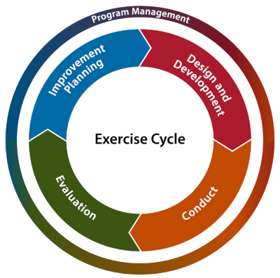
2023 Family Reunification Center (FRC) Exercise July 27, 2023
Welcome
FRC Exercise Briefing

Slide 2
2023 Family Reunification Center (FRC) Exercise
FRC exercise meets the Hospital Preparedness Program (HPP) grant requirements:
10.9.2 “All participants will receive Six Hundred and Sixty Dollars ($660) to maintain system participation in the FRC application provided through ReddiNet”
10.7.1 All participants will receive Six Thousand Dollars ($6,000) to participate in exercises and drills in conjunction with County and community partners to ensure hospital preparedness, including but not limited to:
10.7.1.3 “Conduct Family Reunification Center (FRC) training and tabletop exercise.”

Slide 3
2023 Family Reunification Center (FRC) Exercise
2013 Family Information Center (FIC) Guide
Hospital Specific FIC Plans
Notes:
County of Los Angeles Office of Emergency Management and Department of Mental Health coordinate and operate Family Assistance Center (FAC)
Hospitals coordinate and operate Family Information Centers (FIC)

Slide 4
Two Components
FRC Application Training
FRC Exercise

Slide 5
FRC Application Training
ReddiNet provided training on March 21, 2023
Make-up session scheduled for April 20, 2023
ReddiNet will provide additional training as we draw closer to the exercise
Training occurs in the training environments
Username to register
Can schedule webinar training for ReddiNet or FRC applications at https://calendly.com/reddinet/training?month=2022-02

Slide 6
Scope of Exercise:
The FRC exercise is a functional exercise for Hospital Preparedness Program (HPP) fund recipients. There will be no actual movement of patients. The exercise will last two hours or when all task are achieved. Play will take place in the live ReddiNet and FRC systems.
The exercise will allow end-users (players) to test accessing the FRC application, data entry, data gathering, and information sharing to support family reunification efforts.

Slide 7
Exercise Participants:
Participants | Role | Extent of Play
Emergency Managers and/or Designee | Controller / Evaluator | Facilitate and evaluate play, Provide injects with needed patient and seeker data to players
*ReddiNet End Users (ED Charge Nurse, MICN, ED staff, etc.) | Player | Hospital ReddiNet MCI Module Management
FRC Application End Users (Registration staff, admission team, etc.) | Player | Hospital FRC Application Management
EMS Agency / MAC | Player | Countywide ReddiNet Messaging and MCI Module Management
*Non-ED facilities will not have ReddiNet End-Users
Notes:
Non-ED facilities will not have ReddiNet End-Users
ReddiNet
Login - Family Reunification Center (reddinet.net)

Slide 8
Exercise Assumption:
Incident meets criteria to activate your Family Reunification Center plan at your site.
Notes:
Command Center Activation not required
Not necessary to register seeker can conduct global search

Slide 9
Scenario:
A large-scale multi-casualty incident (MCI) has occurred, and multiple patients have been transported to hospital emergency departments throughout the county. Your facility has received one (1) patient via ambulance. Five (5) additional patients have self-dispatched to your facility by private auto and walked-into the emergency department. You have a total of six (6) patients from the incident in your emergency department. The patient that arrived by ambulance is initially amnestic to the incident and is only able to provide first name, age, and DOB. The patient is otherwise stable in the delayed category. The patient has no identification or cell phone and cannot recall family contact information. The other patients who self-dispatched are stable and require observation only.

Slide 10
Scenario: (Non-ED)
A large-scale multi-casualty incident (MCI) has occurred, and multiple patients have been transported to hospital emergency departments throughout the county. Your facility has received one (1) patient by private auto. You have one (1) patient from the incident in your facility. The patient was initially amnestic to the incident and is only able to provide his first name, last name, and DOB. The patient is otherwise stable and in the delayed category. The patient has identification but no cell phone and cannot recall family contact information.
Notes:
11 non-ED Hospitals:
Barlow
City of Hope
Kindred Hospitals (La Mirada, Paramount, San Gabriel, South Bay)
LA Downtown Medical Center
Los Angeles Community Hospital
Miller Children's Hospital
Rancho
Southern California Hospital at Hollywood

Slide 11
Exercise Play:
Exercise will start at 9:00 a.m. and end at 11:00 a.m. or when all tasks are achieved. Which ever occurs first.

Slide 12
Master Scenario Events List (MSEL):
Inject # | Time | Inject Mode | Synopsis | From | To | Message | Expected Action | Responsible Organization
1 | 8:00am | In Person | Player Check-in | Controller / Evaluator (C/E) | Players | Player, Controller, Evaluator - Check In | All players check-in and receive appropriate materials. | All Players
2 | 8:45am | In Person | Player Briefing | C/E | Players | Player Briefing (Plan a 15 Min Brief) | Exercise director / facilitator conducts exercise and safety briefing. | All Players
3 | 9:00am | ReddiNet | Start Exercise (StartEx) | Medical Alert Center (MAC) | Hospitals | Start Exercise | Exercise participants initiate play. | All Players
4 | 9:00am | ReddiNet | MCI Initiated | MAC | Hospitals | MAC initiates MCI poll titled "2023 FRC Exercise" | Respond to MCI poll. Input bed availability data into ReddiNet MCI module (minimum quantities 2 Immediate, 2 Delayed, 2 Minor) | Hospital ReddiNet End-Users
5 | 9:00am to 9:10am | ReddiNet | MAC inputs patient destination | MAC | Hospitals | Each hospital will receive one (1) ambulance with one (1) "ambulance patient" | ReddiNet End-User arrives the ambulance in the ReddiNet MCI Module | Hospital ReddiNet End-Users
6 | 9:00am to 9:15am | In Person | Provide pre-designated patient demographic data | C/E | ReddiNet End User | C/E provides the pre-designated "ambulance patient" information to the ReddiNet End-User. The information is needed to update the MCI victim list. The information is regarding the "ambulance patient" who arrived at the Emergency Department by ambulance and contains the patient's first name, gender, age, and triage tag# | ReddiNet End-User updates MCI victim list and enters "ambulance patient": 1. First name, 2. Gender, 3. Age, 4. Triage Tag # | Hospital ReddiNet End-Users
7 | 9:15am to 9:30am | In Person | Add five (5) additional walk-in patients to the MCI victim list | C/E | ReddiNet End User | C/E informs ReddiNet End-User to enter five (5) additional walk-in patients to the MCI victim list. Use fictional first names and your hospital's three 3- letter hospital code as the last names. | ReddiNet End-User enters five (5) walk-in patients into the MCI victim list. End user must check the box labeled "Walk-In" when adding walk-in patients. Use fictional first names, and gender. Do not enter a triage tag number. Use your hospital's 3-letter hospital code for the last names. | Hospital ReddiNet End-Users
8 | 9:30am | ReddiNet | MAC sends message to all hospitals that the County has activated a FAC to support family reunification | MAC | Emergency Manager | A Family Assistance Center (FAC) has been activated at a location near the MCI. | Emergency Manager mobilizes Family Information Center (FIC) team and briefly discuss internal triggers required to activate the FIC plan. | Hospital EM and FIC team
9 | 9:40am | In Person | FRC End-User logs into Family Reunification Center (FRC) application and activates a "FAC" | C/E | FRC End-User | Designated FRC End-User of the FIC team logs into the FRC application and activates a "FAC" | 1. FRC End-User logs into the FRC application. 2. FRC End-User activates a "FAC" in the FRC application and names the "FAC" your hospital name followed by "- FRC Exercise" (e.g. "ACME Hospital - FRC Exercise"). 3. FRC End-User associates the "FAC" with the MCI titled "2023 FRC Exercise". | FRC End-User
10 | 9:40am | In Person | FRC End-User updates MCI patient profile in FRC application | C/E | FRC End-User | C/E provides the pre-designated "ambulance patient" information to the FRC End-User. The data is needed to update the "ambulance patient" profile in the FRC application. The information is regarding the "ambulance patient" who arrived in the Emergency Department by ambulance. | FRC End-User searches for the "ambulance patient" profile in the FRC application and updates the profile with the following eight (8) data elements: 1. Last name. 2. DOB. 3. Eye Color. 4. Hair Color. 5. Height. 6. Weight. 7. Language. 8. Ethnicity | FRC End-User
11 | 9:50am | In Person | Register the five (5) pre-designated seekers into the FRC "FAC" | C/E | FRC End-User | Five (5) unrelated persons (designated seekers) each seeking a family member (missing person) involved in the incident arrived at your hospital. The missing persons (patients) are located at other facilities. C/E provides the Seeker data to the FRC End-User to Register into the "FAC" | Register each Seeker into the FRC "FAC" from data provided by C/E. (Seekers will have all demographic data of the missing person) | FRC End-User
12 | 10:00am | In Person | Facilitate family reunification | C/E | FRC End-User | Inform the FRC End-User to locate and reunite each Seeker with the correct missing person (patient) in the FRC application and inform the family (C/E) of their location. | Locate and reunite each designated Seeker with the correct missing person (patient) in the FRC application and inform the seeking-person (family member) of the missing-person's location only | FRC End-User
13 | 10:00am to 11:00am | In Person | De-activate FAC | C/E | FRC End-User | Inform the FRC End-User to deactivate "FAC" in FRC when all five (5) Seekers have been informed of the missing person's location | FRC End-User deactivates "FAC" in FRC when all five (5) seekers have been informed of the missing persons location | FRC End-User
14 | 11:00am | ReddiNet | End Exercise (End Ex) | MAC | Hospitals | End Exercise | End all exercise play and activity | All Players
15 | 11:00am to 11:30am | In Person | Debrief | C/E | All Players | Huddle all players for a debrief | Conduct debrief and have all players complete a participant feedback form | All Players

Slide 13
Non-ED Master Scenario Events List (MSEL):
Inject # | Time | Inject Mode | Synopsis | From | To | Message | Expected Action | Responsible Organization
1 | 8:00am | In Person | Player Check-in | Controller / Evaluator (C/E) | Players | Player, Controller, Evaluator - Check In | All players check-in and receive appropriate materials. | All Players
2 | 8:45am | In Person | Player Briefing | C/E | Players | Player Briefing (Plan a 15 Min Brief) | Exercise director / facilitator conducts exercise and safety briefing. | All Players
3 | 9:00am | ReddiNet | Start Exercise (StartEx) | Medical Alert Center (MAC) | Hospitals | Start Exercise | Exercise participants initiate play. | All Players
4 | 9:00am | ReddiNet | MCI Initiated | MAC | Hospitals | MAC initiates MCI poll titled "2023 FRC Exercise" | Respond to MCI poll. Input bed availability data into ReddiNet MCI module (minimum quantities 2 Immediate, 2 Delayed, 2 Minor) | Hospital ReddiNet End-Users
5 | 9:00am to 9:10am | ReddiNet | MAC inputs patient destination | MAC | Hospitals | Each hospital will receive one (1) ambulance with one (1) "ambulance patient" | ReddiNet End-User arrives the ambulance in the ReddiNet MCI Module | Hospital ReddiNet End-Users
6 | 9:00am to 9:15am | In Person | Provide pre-designated patient demographic data | C/E | ReddiNet End User | C/E provides the pre-designated "ambulance patient" information to the ReddiNet End-User. The information is needed to update the MCI victim list. The information is regarding the "ambulance patient" who arrived at the Emergency Department by ambulance and contains the patient's first name, gender, age, and triage tag# | ReddiNet End-User updates MCI victim list and enters "ambulance patient": 1. First name, 2. Gender, 3. Age, 4. Triage Tag # | Hospital ReddiNet End-Users
7 | 9:15am to 9:30am | In Person | Add five (5) additional walk-in patients to the MCI victim list | C/E | ReddiNet End User | C/E informs ReddiNet End-User to enter five (5) additional walk-in patients to the MCI victim list. Use fictional first names and your hospital's three 3- letter hospital code as the last names. | ReddiNet End-User enters five (5) walk-in patients into the MCI victim list. End user must check the box labeled "Walk-In" when adding walk-in patients. Use fictional first names, and gender. Do not enter a triage tag number. Use your hospital's 3-letter hospital code for the last names. | Hospital ReddiNet End-Users
8 | 9:30am | ReddiNet | MAC sends message to all hospitals that the County has activated a FAC to support family reunification | MAC | Emergency Manager | A Family Assistance Center (FAC) has been activated at a location near the MCI. | Emergency Manager mobilizes Family Information Center (FIC) team and briefly discuss internal triggers required to activate the FIC plan. | Hospital EM and FIC team
9 | 9:40am | In Person | FRC End-User logs into Family Reunification Center (FRC) application and activates a "FAC" | C/E | FRC End-User | Designated FRC End-User of the FIC team logs into the FRC application and activates a "FAC" | 1. FRC End-User logs into the FRC application. 2. FRC End-User activates a "FAC" in the FRC application and names the "FAC" your hospital name followed by "- FRC Exercise" (e.g. "ACME Hospital - FRC Exercise"). 3. FRC End-User associates the "FAC" with the MCI titled "2023 FRC Exercise". | FRC End-User
10 | 9:40am | In Person | FRC End-User registers designated patient into FRC application | C/E | FRC End-User | C/E provides pre-designated patient data to the FRC End User. The data is needed to register the desginated patient into the FRC system. | FRC End User enters the patient data into the FRC application with the following eleven (11) data elements: 1. Triage tag #. 2. First Name. 3. Last name. 4. DOB. 5. Gender. 6. Eye Color. 7. Hair Color. 8. Height. 9. Weight. 10. Language. 11. Ethnicity | FRC End-User
11 | 9:50am | In Person | Register the five (5) pre-designated seekers into the FRC "FAC" | C/E | FRC End-User | Five (5) unrelated persons (designated seekers) each seeking a family member (missing person) involved in the incident arrived at your hospital. The missing persons (patients) are located at other facilities. C/E provides the Seeker data to the FRC End-User to Register into the "FAC" | Register each Seeker into the FRC "FAC" from data provided by C/E. (Seekers will have all demographic data of the missing person) | FRC End-User
12 | 10:00am | In Person | Facilitate family reunification | C/E | FRC End-User | Inform the FRC End-User to locate and reunite each Seeker with the correct missing person (patient) in the FRC application and inform the family (C/E) of their location. | Locate and reunite each designated Seeker with the correct missing person (patient) in the FRC application and inform the seeking-person (family member) of the missing-person's location only | FRC End-User
13 | 10:00am to 11:00am | In Person | De-activate FAC | C/E | FRC End-User | Inform the FRC End-User to deactivate "FAC" in FRC when all five (5) Seekers have been informed of the missing person's location | FRC End-User deactivates "FAC" in FRC when all five (5) seekers have been informed of the missing persons location | FRC End-User
14 | 11:00am | ReddiNet | End Exercise (End Ex) | MAC | Hospitals | End Exercise | End all exercise play and activity | All Players
15 | 11:00am to 11:30am | In Person | Debrief | C/E | All Players | Huddle all players for a debrief | Conduct debrief and have all players complete a participant feedback form | All Players
Notes:
11 non-ED Hospitals:
Barlow
City of Hope
Kindred Hospitals (La Mirada, Paramount, San Gabriel, South Bay)
LA Downtown Medical Center
Los Angeles Community Hospital
Miller Children's Hospital
Rancho
Southern California Hospital at Hollywood

Slide 14
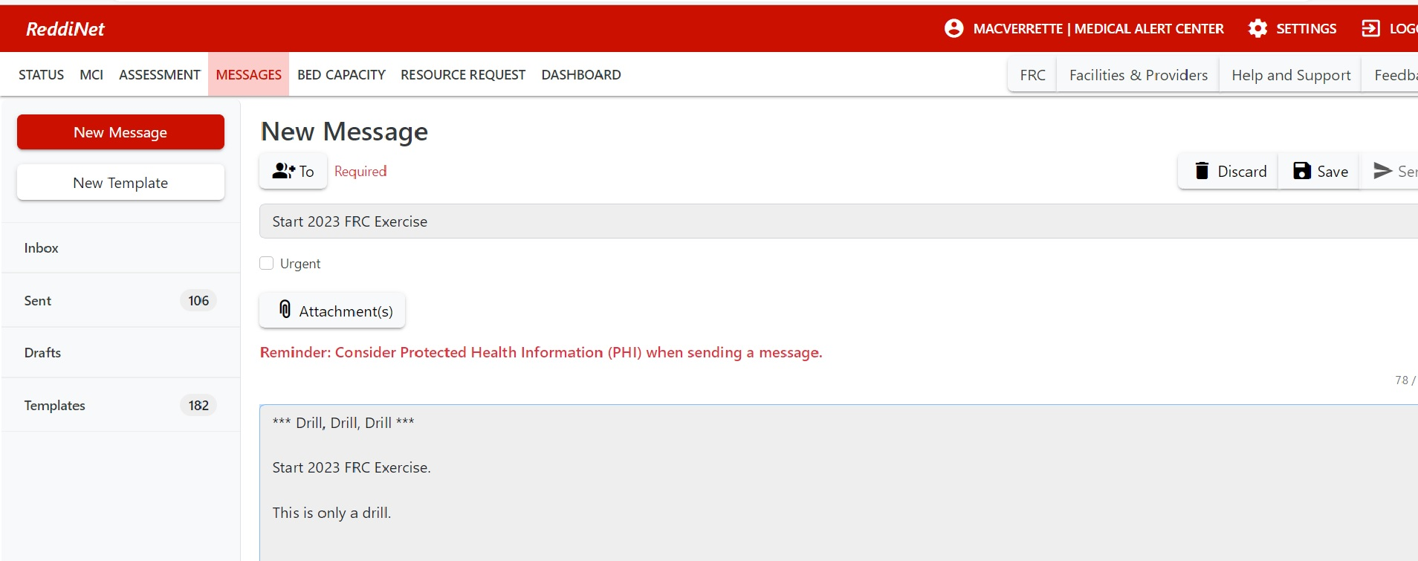
ReddiNet Message Screen:
Notes:
ReddiNet Message Screen:
Inject #3

Slide 15
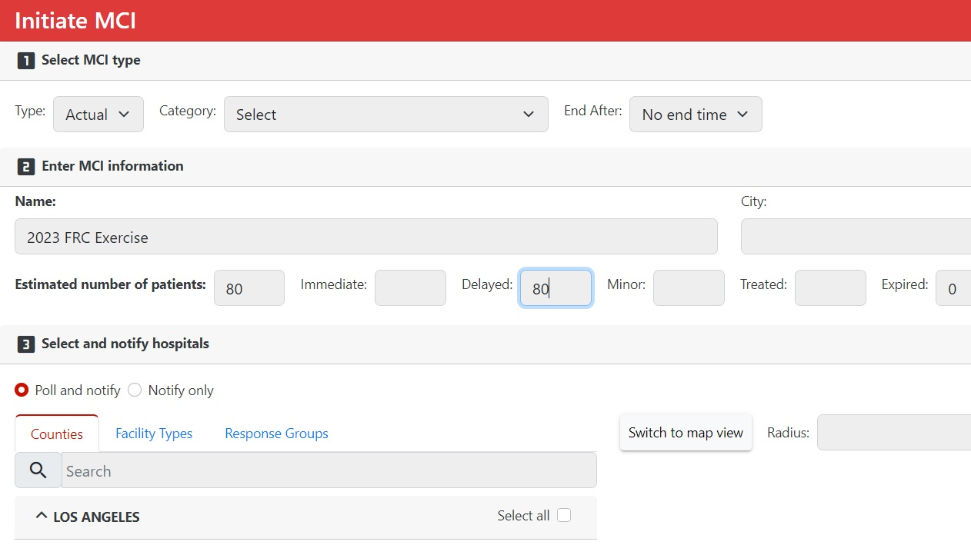
ReddiNet MCI Screen:
Notes:
ReddiNet MCI Screen:
Inject #4
Non-ED’s will not be assigned MCI patients in ReddiNet

Slide 16
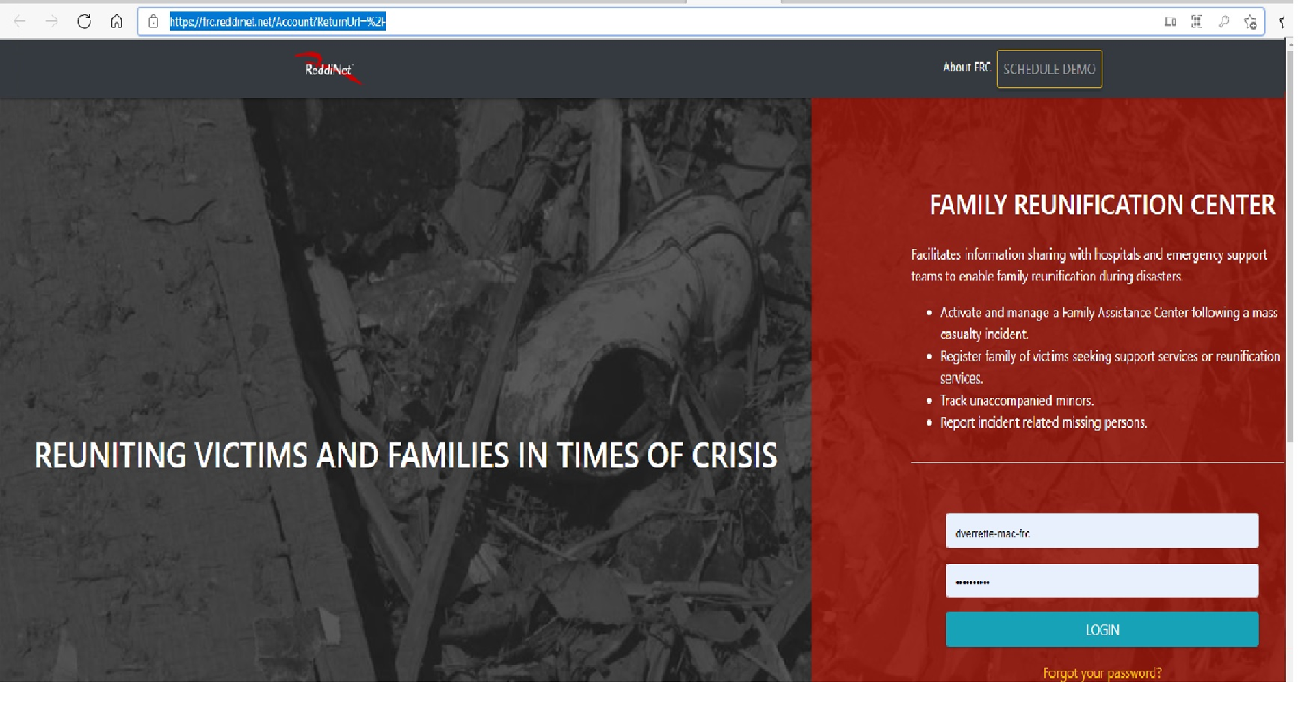
Notes:
FRC Login Screen
Inject #9

Slide 17
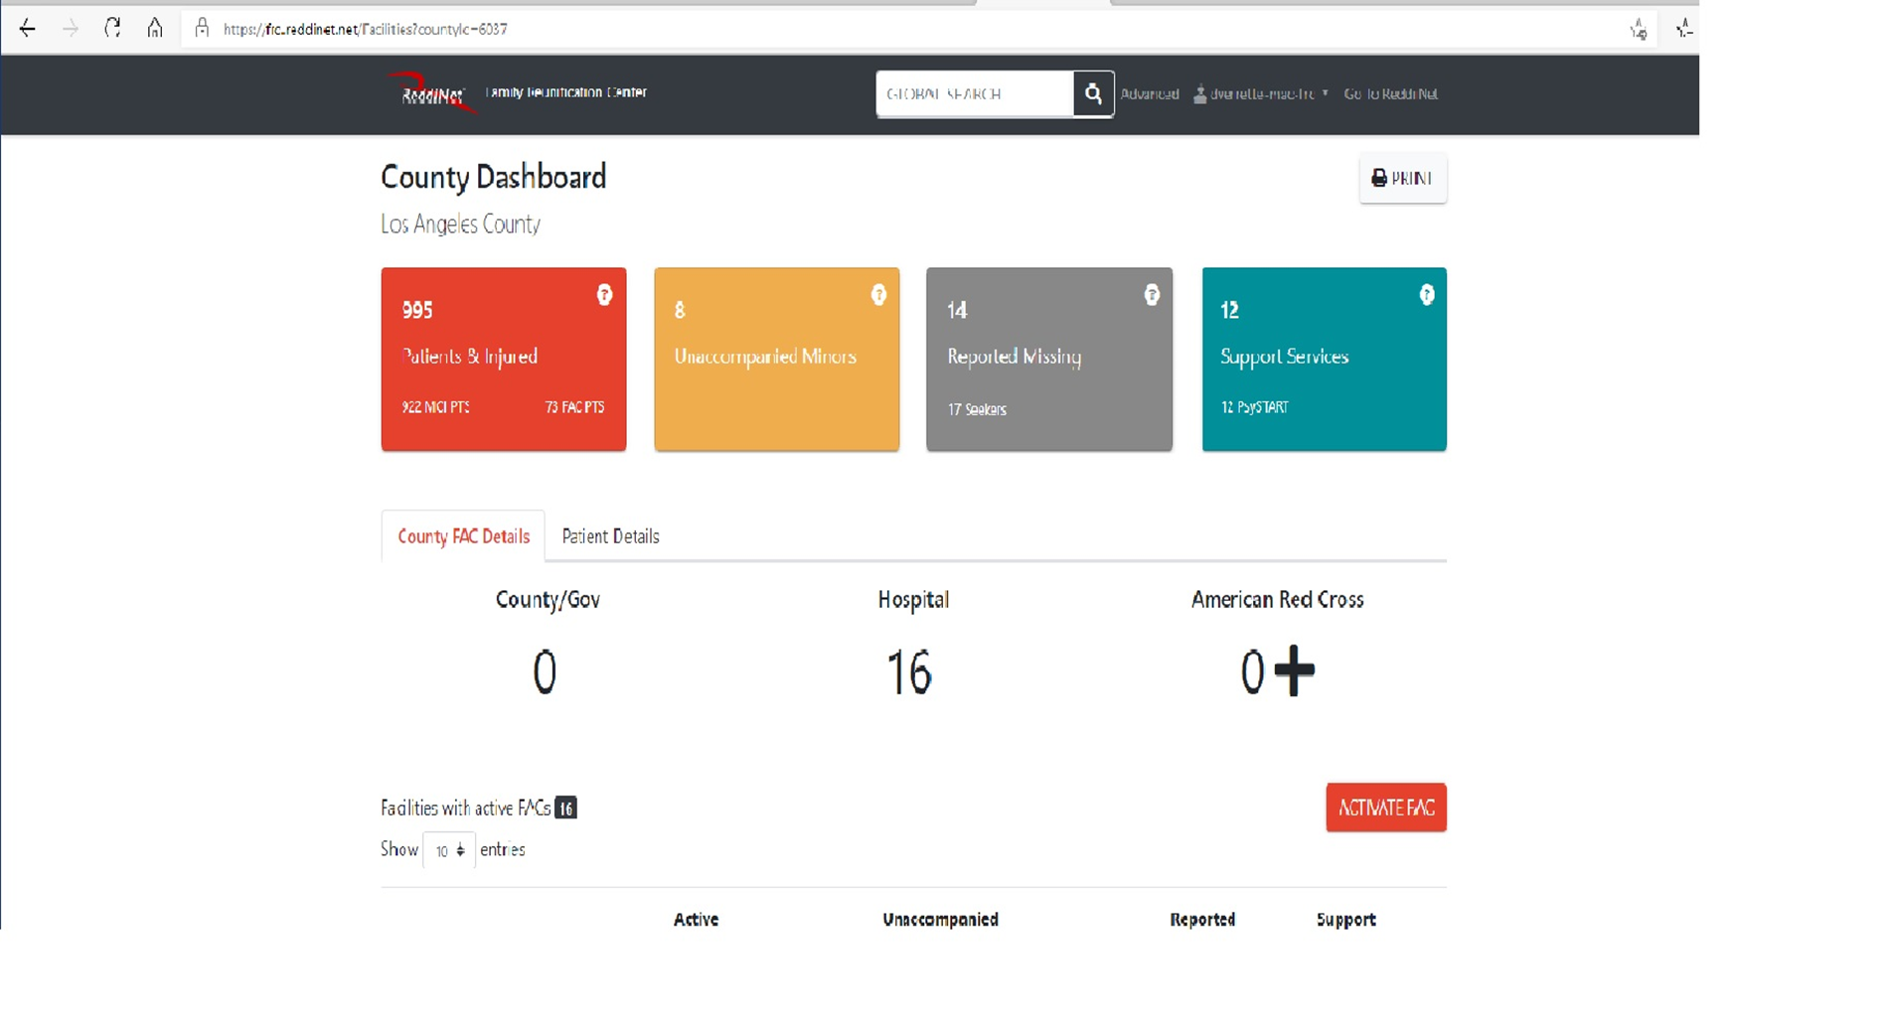
FRC Application Dashboard:
Notes:
FRC Application

Slide 18
Patient and Seeker Data:
Patient Data
Seeker Data

Slide 19
EMS Agency Website: Exercises and Drills

Slide 20
Inject #10: Non-ED

Slide 21
Injects:

Slide 22
Player Role After Exercise
Conduct debrief with players at your facility
Complete and submit a Participant Feedback form

Slide 23
Confirmation of Exercise Participation:
AAR / IP Submission
Within 60 days following exercise

Slide 24
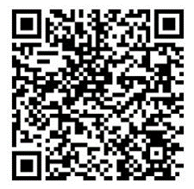
Documentation: Available on EMS Agency Website: https://dhs.lacounty.gov/emergency-medical-services-agency/home/disaster-programs/exercise-drills/
Exercise Plan
Controller / Evaluator Handbook
Exercise Evaluation Guide
Participant Feedback Form
After-Action Report/Improvement Plan
Master Scenario Event List (MSEL)
Patient and Seeker Data – (EMO Only)

Slide 25
Questions?

Slide 26
Thank You

