Slide 1
My Health LA Mental Health Prevention
Implementation: Questions, Challenges, Successes and Some Best Practices and Guidelines
December 2, 2020

Slide 2
Congrats!
All agencies started as of Aug. 1!
Hundreds of staff trained. Training is ongoing – on MHLA website. Monthly notices of new staff trained and verified.
Payments made for July and August.
Robocall went out last week.
Grief and loss coming soon.

Slide 3
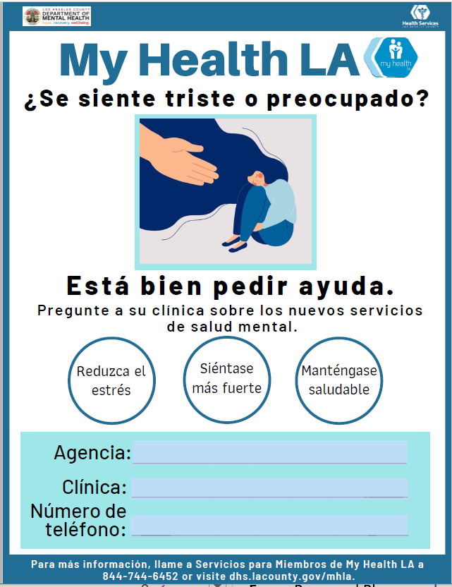

Slide 4
Helping MHLA Participants See the Benefits
Improve ability to relax.
Learn to utilize deep breathing exercises.
Reduce number of days each week you experience problems with sleep or concentration.
Learn better ways to communicate thoughts and feelings and reduce tension or arguments at home.

Slide 5
Review: Screening Process?
All MHLA participants must undergo screening process, which is two parts:
1. Administration of PHQ-9 (& GAD-7 when appropriate).
2. Review of the results with the participant along with any other pertinent info from health professional.
It is highly recommended during this screening that the dialogue include a review for possible risk factors, and a review of what their protective factors are for managing problems, worries, and concerns.

Slide 6
Frequency and use of questionnaires/measures: (The PHQ-9 and as appropriate, GAD-7)
Contractually:
First, as part of the 2-part screening process.
Then, if participant is in services, quarterly and at the end of the curriculum, or during discharge.
DMH best practice:
More frequent basis once a participant is in services.
Suggestions: During each MH Prevention service session, every other MH Prevention Service session, or monthly intervals

Slide 7
Documentation of Screening Process:
Include:
Questionnaire/measure score
Responses to questions
Outcome of screening process (4 possibilities):
Participant doesn’t screen positive for MH prevention services.
Participant meets criteria for MH prevention services and decides to receive them.
Participant meets criteria for MH prevention services but declines.
Participant meets criteria for treatment, not prevention.

Slide 8
Documentation of Prevention Practice:
Include all necessary elements, such as:
Which Prevention Practice
Individual or group
Face-to-face or by phone
Narrative of what happened
Score of PHQ-9/GAD-7 if administered.
Note: Documentation templates are provided on the MHLA website for guidance.

Slide 9
Referral for Treatment:
Reminder that these are prevention services.
Use clinical judgment on whether to refer for treatment (based on more than just scores); consult with your mental health lead.
Can refer for specialty mental health treatment to DMH by calling 1-800-854-7771.
Can also provide treatment at clinic.

Slide 10
Technical Assistance/Site Visits:
TA calls – most clinics have participated in calls.
Will be conducted by DMH.
Site visits will take place soon.
They will be virtual.
Will be done by teams of two of DMH staff.
Will start in 2021.

Slide 11
Services and Data Submission:
Prevention services can be provided the same day as primary care services.
You can put the actual cost on the claim and AIA will pick up as part of the data collection.
Include a diagnosis code.

Slide 12
Data Submission:
H0002: Complete Screening Process (must have scores).
H2014: Services (may have scores).
Scores go in the modifier, when applicable.
First box: P1 or G1. Second box: Two-character score. Example for seven enter “07”
If there is no score, leave modifier blank. Only put “00” if the score is zero.

Slide 13
Data:
Many clinics provided no claims in July – the claims are part of how we know that you are providing services.
We reached out to each of you.
For those that did submit data, working with some clinics to fix it (will do for July, August and September).
Early findings in data.

Slide 14
Clinical Workflow: What does your process look like from screening to discharge? Hearing from a few clinics on best practices.
Two-part Screening Process
Prevention Services
Discharge

Slide 15
Best Practices:
AltaMed Health Services
Samuel Dixon Family Health Center
Comprehensive Community Health Centers
Parktree Community Health Center
East Valley Community Health Center

Slide 16
Questions for the Chat:
Which staff are providing services?
Are stressors over COVID coming up?
Mostly individual or group?
What challenges/opportunities does doing this remotely present?

Slide 17
Discussion:
Engaging MHLA participants – ideas on what’s working?
Screening:
Which staff are administering questionnaires/measures?
Which staff are doing Part 2 of the screening process?
Challenges?

Slide 18
Questions for DMH/DHS?
Robert Levine rlevine@dmh.lacounty.gov
Anna Gorman agorman@dhs.lacounty.gov
Francia Nava fnava@dhs.lacounty.gov

