Slide 1
Donning and Doffing PPE with PAPR

Slide 2
Objectives
Understand the role of the trained observer and buddy/doffing assistant
Demonstrate how to safely don & doff PPE during ANY highly contagious biological incident

Slide 3
Trained Observer
Leads, protects, and guides others through the process of safely and correctly donning and doffing of PPE
Coaches and monitors each step of the donning/doffing procedure
Acts as a safety monitor to provide safety oversight
Does not serve as a doffing assistant
Reads aloud the donning/doffing checklist

Slide 4
Trained Observer
Maintains situational awareness
Keeps the big picture in mind, always prepare as if something wrong could happen.
Establishes red flag words
Engages in closed loop communication
Ensures that doffing is at a slow, deliberate, and methodical pace.

Slide 5
Buddy/Doffing Assistant
Assists in the donning and doffing of PPE
Ensures tarp and clean stools are provided by receiving facility
Ensures the doffing area is prepped (waste bins, bleach pads, etc. are positioned properly)
Dispenses hand sanitizer (and bleach wipes) if hands free sanitizer is not available.
Gathers tarp for disposal

Slide 6
Trained Observer & Buddy
Recommended PPE
Fluid-resistant gown to at least mid-calf
Full face shield
Two pairs of gloves. Outer gloves should have extended cuffs.
Fluid-resistant boot covers.

Slide 7
Donning PPE with PAPR

Slide 8
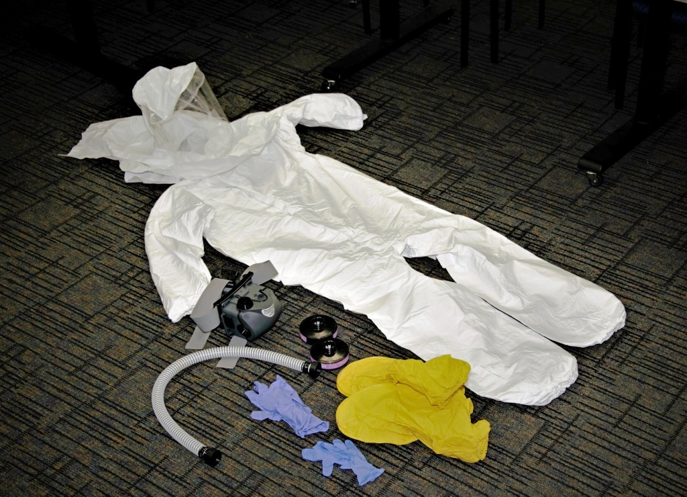
Dress for Success - Donning
Assemble equipment
Coveralls
PAPR (hose, blower unit, belt, air filters x 2)
Extended cuff gloves
Nitrile gloves
Hood
Boot covers
Apron/Outer gown
Set up chair or stool
Reduce falling hazard

Slide 9
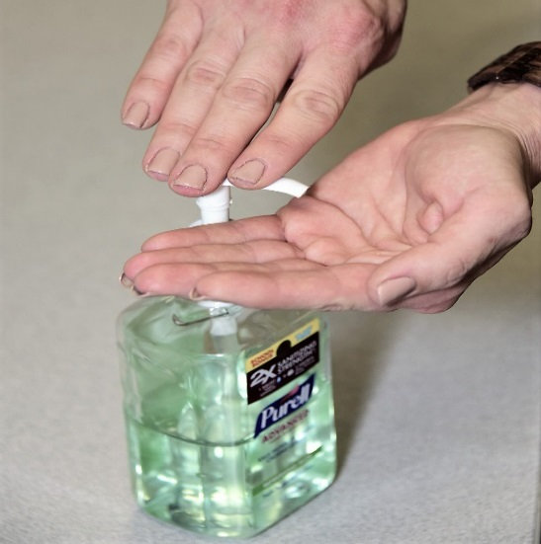
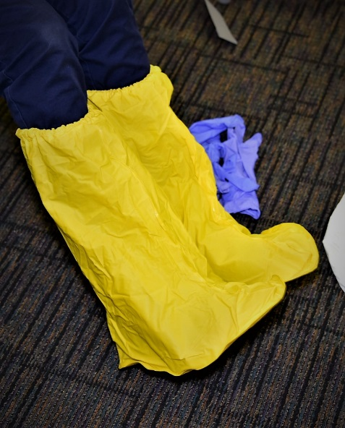
Dress for Success - Donning
Hand sanitize
Don boot covers
Boot covers will fit over your work boots

Slide 10
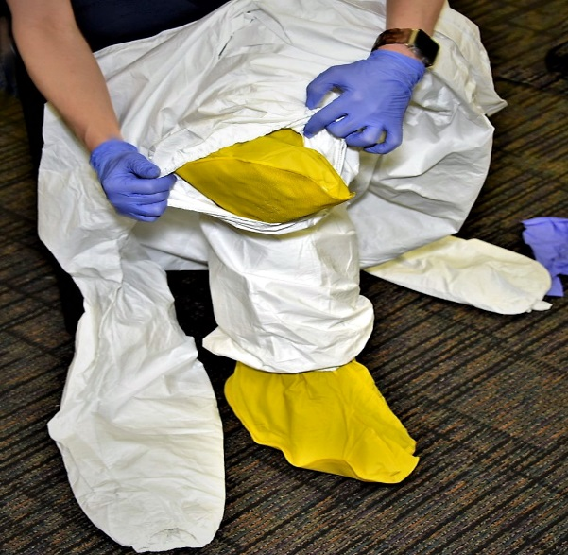
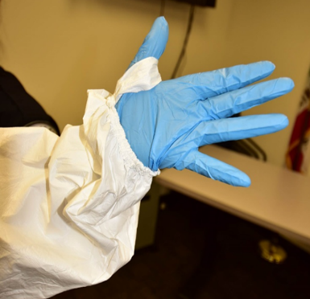
Dress for Success - Donning
Put on inner pair of gloves
Put on coverall
Place thumb loops over gloved hands

Slide 11
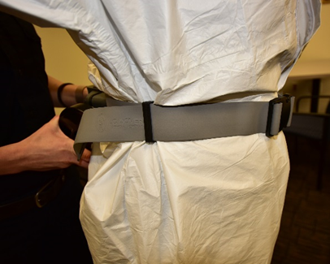
Dress for Success - Donning
Zip coverall to mid chest
Wrap blower unit around the waist
Blower unit should fit in small of back
Tighten belt and tuck excess strap around the waist

Slide 12
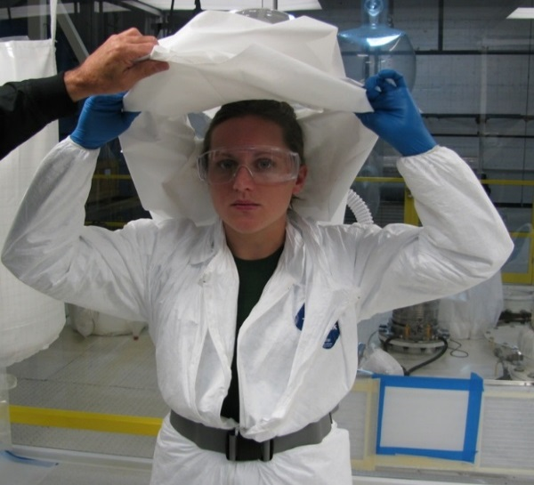
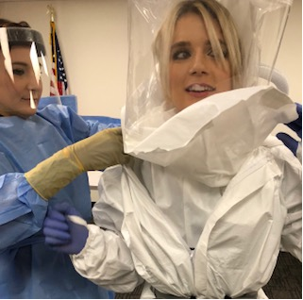
Dress for Success- Donning
Turn on blower
Place hood over head
Assistance will be needed
Tuck the inner shrouds into the suit

Slide 13
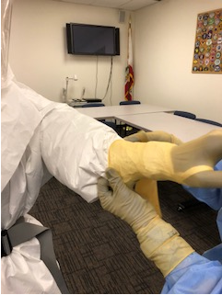
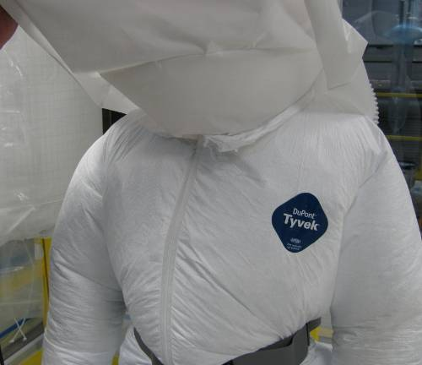
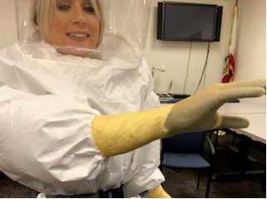
Dress for Success - Donning
Zip up suit fully
Don outer gloves

Slide 14
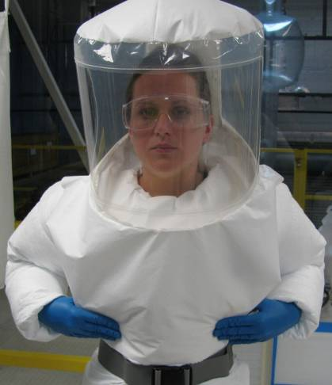
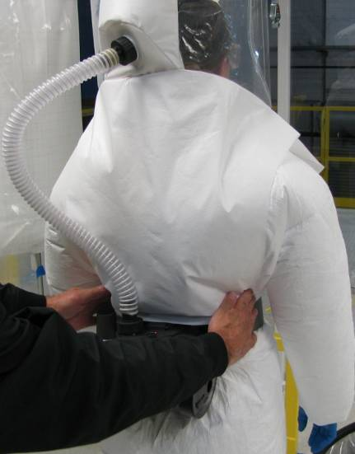
Donning the Clear Hood
Smooth outer skirt in place over chest and back
Remove adhesive backing on the front and rear tabs (4 places) and press tabs to suit

Slide 15
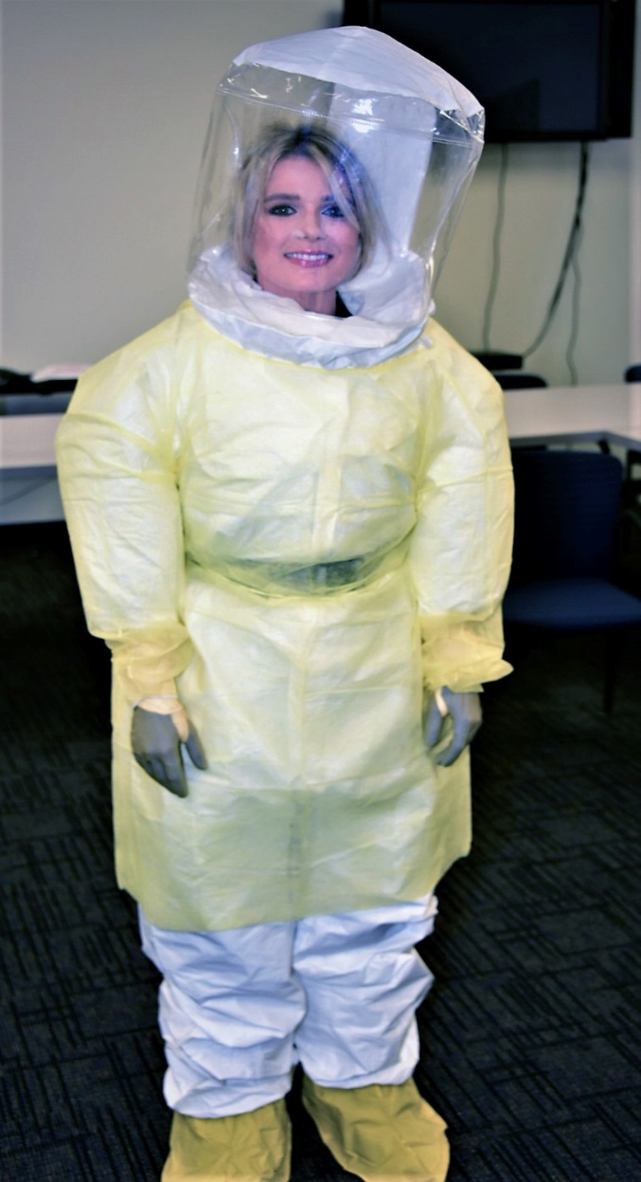
Dress for Success - Donning
Put on apron/outer gown as an additional layer for the front of the body
It should cover the outer shroud and tied securely to the back.

Slide 16
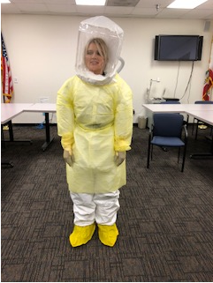
Dress for Success - Donning
Perform safety check
Feel air flow in hood
Check that exhalation holes are open
Belt securely snapped and tightened
Joints covered
Ankles
Wrists
Begin providing patient care

Slide 17
Doffing PPE with PAPR

Slide 18
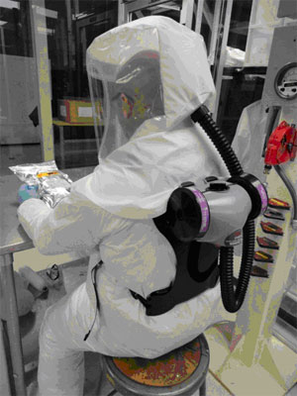
Key Safe Practices - Doffing
Guidelines:
Blower, belt, and hose may be reusable depending on the progression of illness
Suit, booties & hood are disposable
Avoid body fluids
Keep hands away from face
Apply hand sanitizer to gloves at each stage of doffing
Sanitizer will be dispensed by the buddy

Slide 19
Key Safe Practices - Doffing
Each step must be read out loud by trained observer
Take your time - be slow and meticulous
Use bleach wipes to clean visible gross contamination
Change gloves as necessary if you feel they have been contaminated

Slide 20
Key Safe Practices - Doffing
Establish clear delineation between “clean” and “dirty” areas
For recommended lay out see figure to the right →→→
“Clean”
Ambulance
Tarp -“Dirty”
Waste bin
Stool
P
a
d
Pa
d
Stool
Waste bag reusable items
Extra Waste bag

Slide 21
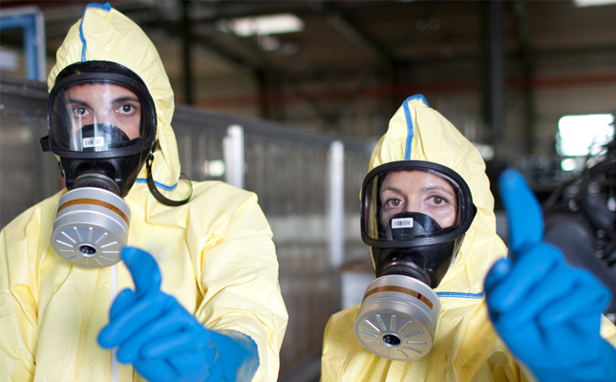
Safe Removal - Doffing
The following slides are a brief overview of the doffing process.
Please refer to the doffing checklist for detailed instructions on how to properly and safely remove PPE.

Slide 22
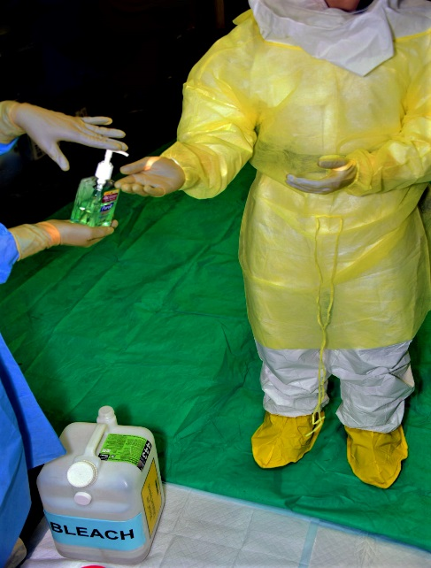
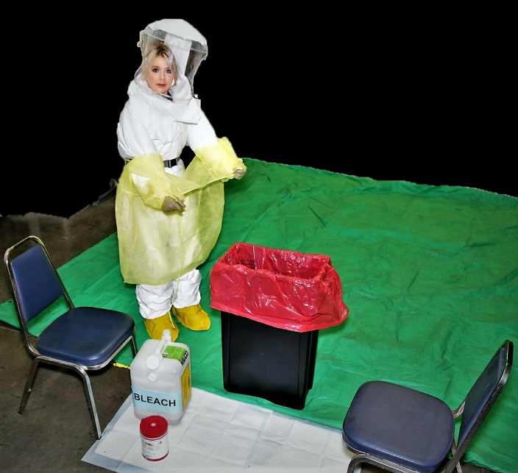
Safe Removal - Doffing
Inspect PPE for contamination
Disinfect outer gloves with hand sanitizer
Remove apron/outer gown and discard

Slide 23
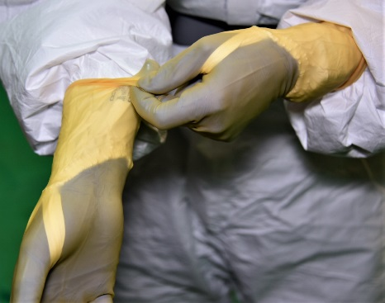
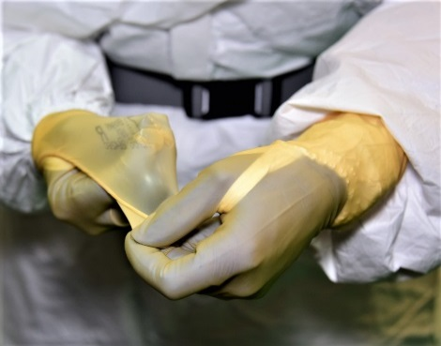
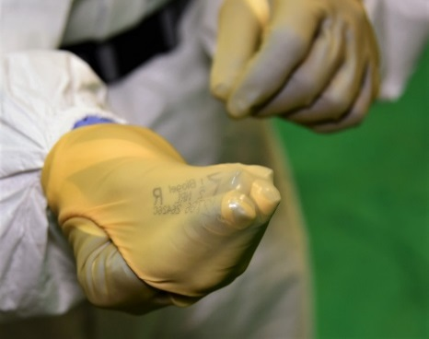
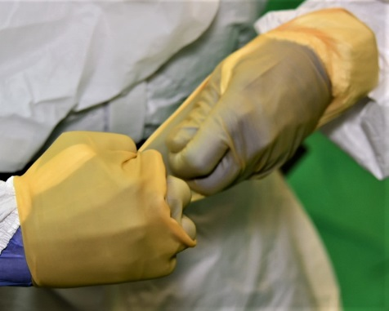
Safe Removal - Doffing
Disinfect outer gloves
Remove outer gloves using the Beak Method

Slide 24
Beak Method Glove Removal

Slide 25
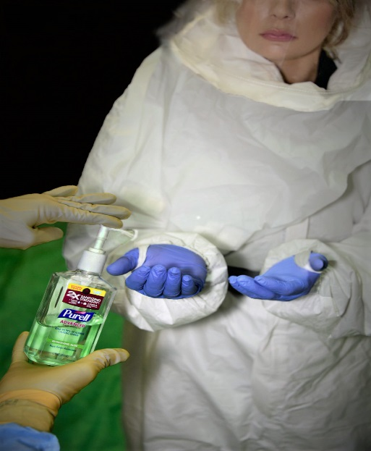
Safe Removal - Doffing
Inspect inner gloves for holes or tears
Disinfect inner gloves

Slide 26
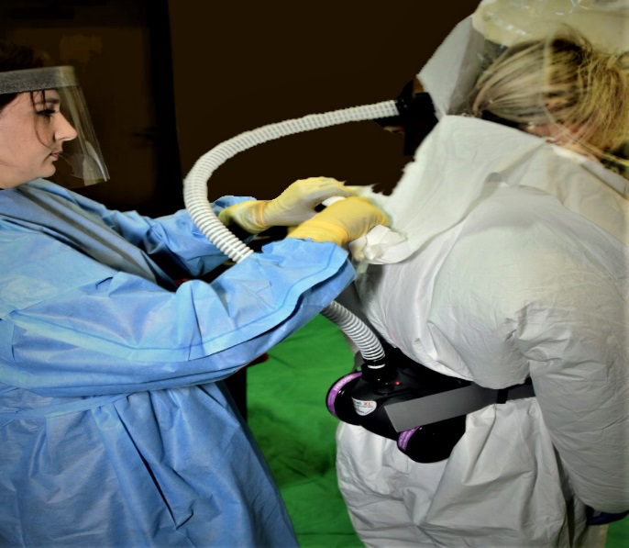
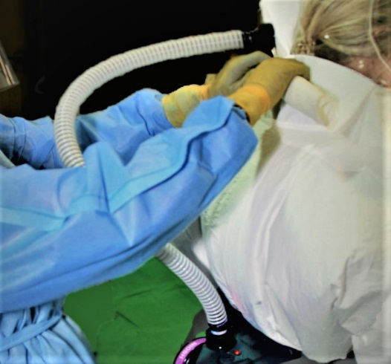
Removing the PAPR with Hood
Turn around to have your back face your buddy
Buddy will roll the bottom of the hood towards the shoulder forming a cuff

Slide 27
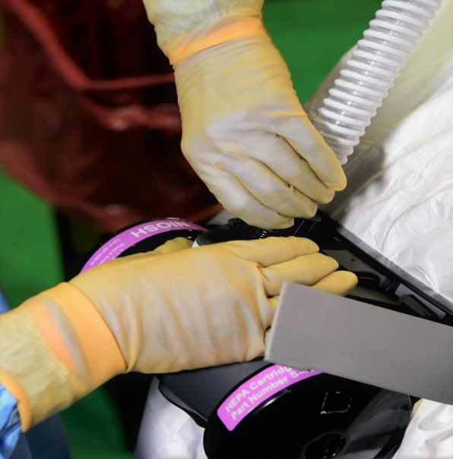
Removing PAPR with Hood
Buddy will:
Turn off PAPR blower unit.
Detach hose from both ends
Place hose in waste bin

Slide 28
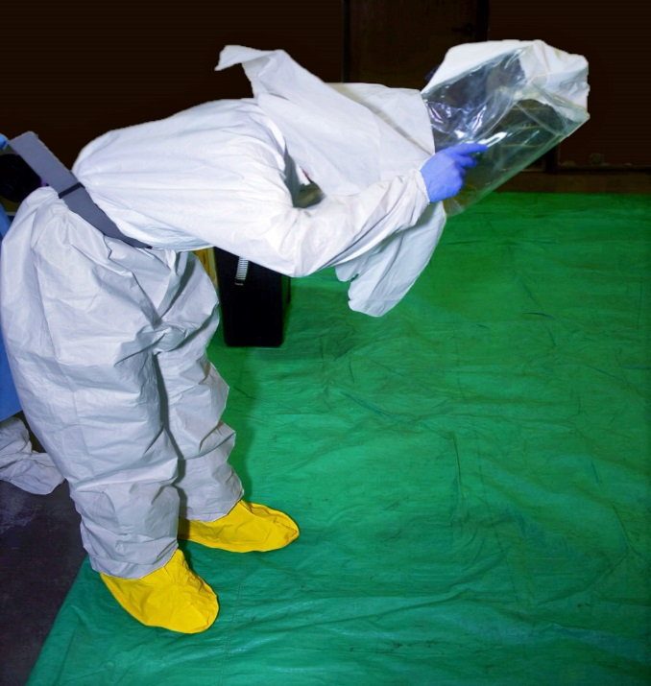
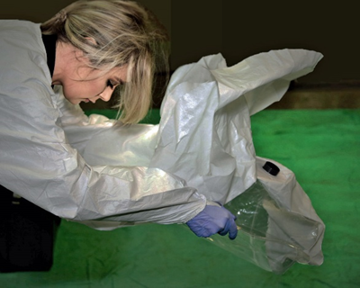
Removing PAPR with Hood
Once hose is removed, the person in PPE will:
Bend forward at the waist
Grab hood by the ears
Pull hood slowly away from head
Discard hood
DO NOT TOUCH FACE OR ADJUST HAIR WHEN HOOD IS REMOVED

Slide 29
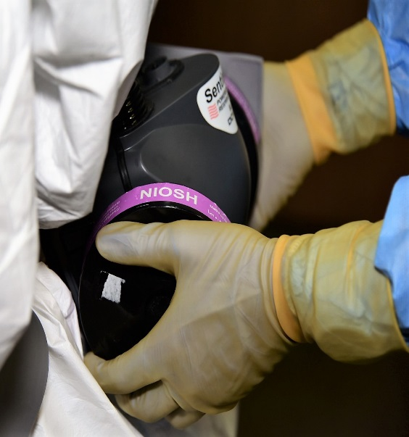
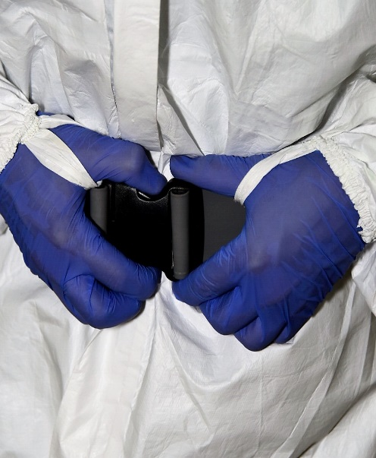
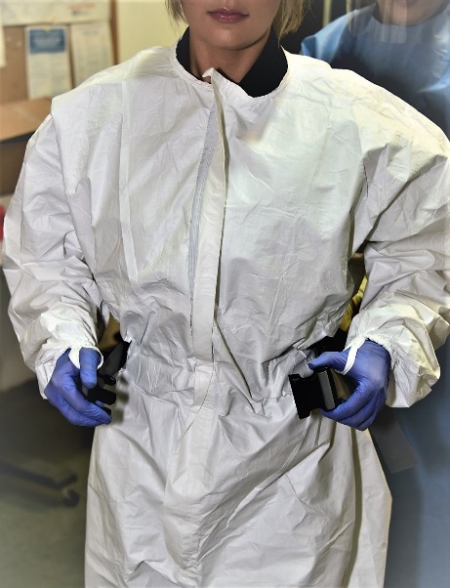
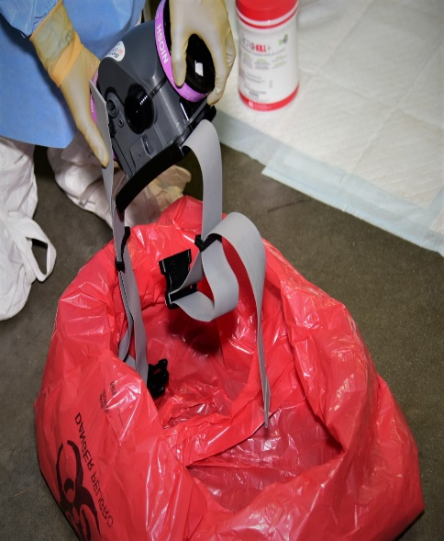
Removing PAPR with Hood
Buddy will hold the PAPR blower unit
Person in PPE will unclasp his/her belt
Buddy will place PAPR blower unit in biohazard waste bag for reusable items outside of tarp

Slide 30
Disinfect Gloves
Disinfect gloves both the buddy and person in PPE:
Buddy will disinfect gloves FIRST.
Without picking up the hand sanitizer, the buddy will pump hand sanitizer into hand and swipe the pump with sanitizer in one sweeping motion before rubbing gloved hands together.
This ensures the pump is sanitized before proceeding.
The buddy can now pick up the hand sanitizer and dispense

Slide 31
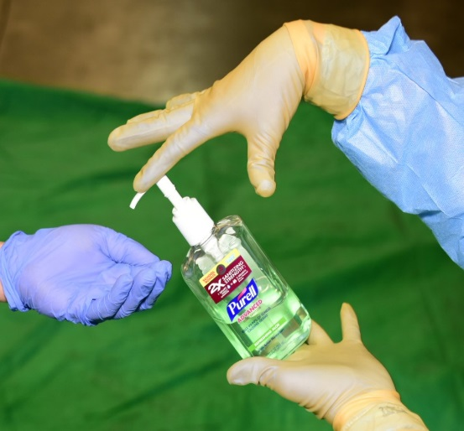
Removing the Coverall
Unzip suit
Pull sleeves inside out
Disinfect gloves with hand sanitizer

Slide 32
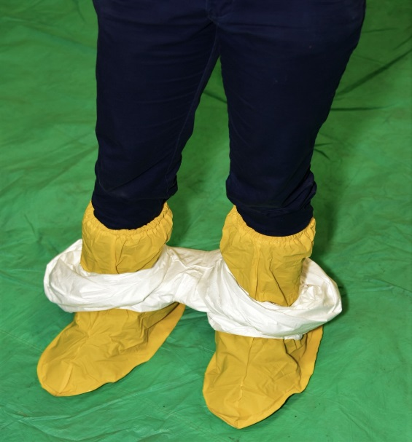
Removing the Coverall
Tightly roll the suit outward and down “inside out” as far down as possible toward ankles
Only touch the inside of the coverall

Slide 33
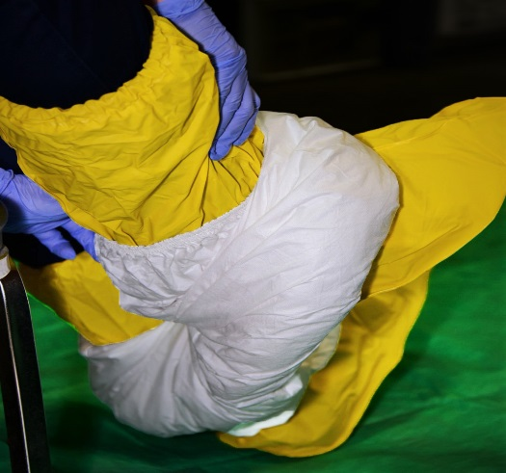
Removing the Coverall
Once suit is rolled down to ankles, sit on the clean stool
Remove feet out of the suit one at a time
Both feet should remain on tarp
Dispose of suit
Disinfect gloves with hand sanitizer

Slide 34
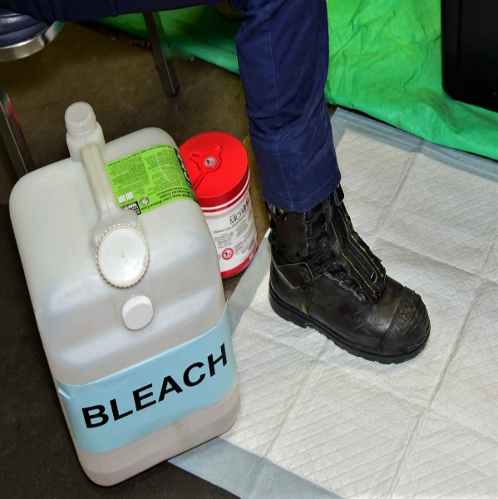
Removing the Boot Covers
Remain seated on stool
Remove feet out of boot cover one at a time and place it on the bleached pad next to the stool

Slide 35
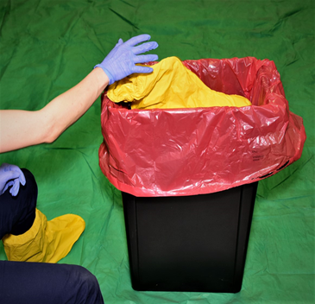
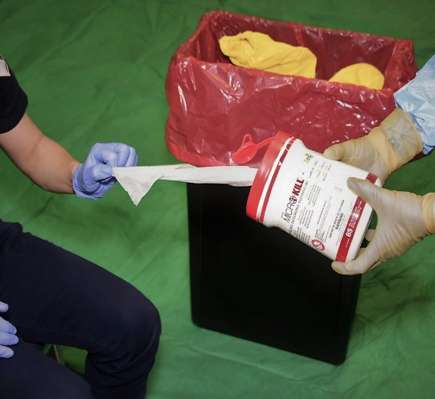
Removing Boot Covers
Discard boot covers
Disinfect gloves
Buddy will dispense bleach wipes
Wipe shoes with bleach wipes from top to bottom

Slide 36
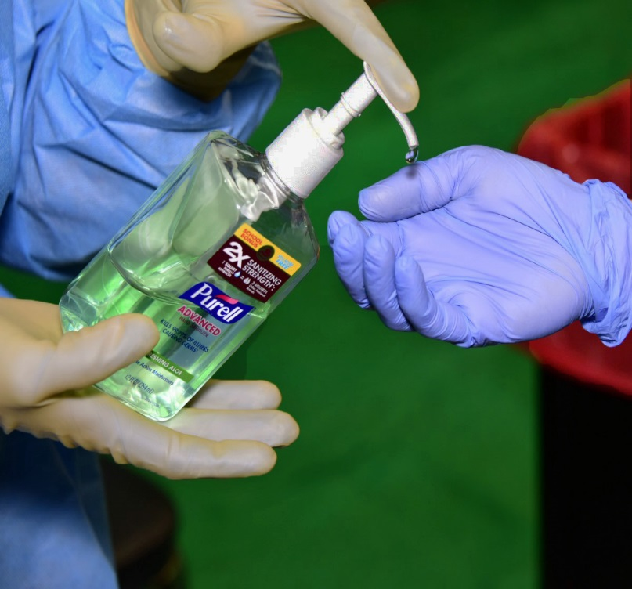
Stepping Onto Clean Zone
Now stand and step onto the clean zone
Disinfect gloves with hand sanitizer
Remove and discard gloves

Slide 37
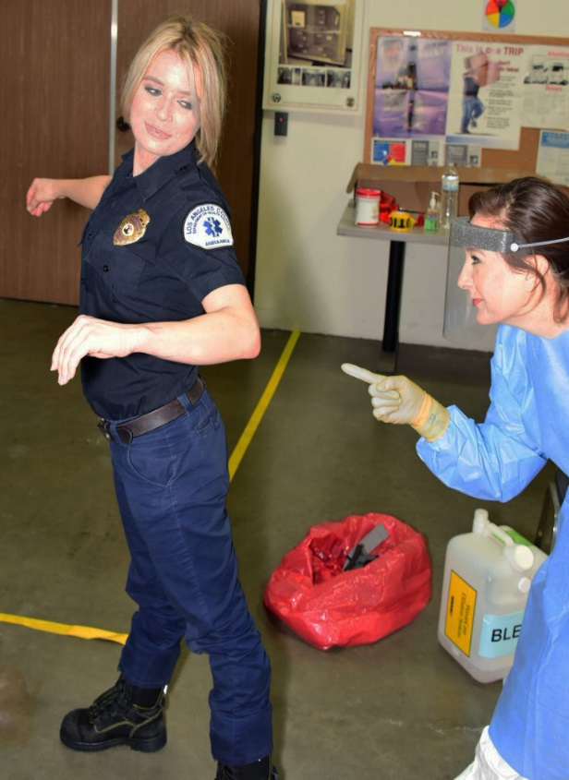
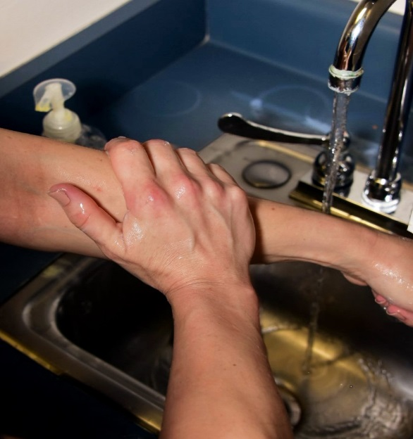
Stepping Onto Clean Zone
Inspect hands for contamination
Perform hand hygiene using hand sanitizer
Inspect clothing for holes, tears, or contaminants.
Wash hands and forearms with soap and water for at least 20 seconds

