Slide 1
Pre-existing Vascular Access Device (PVAD)

Slide 2
Pre-existing Vascular Access Device (PVAD)
A venous catheter inserted into a central vein (without valves) to provide direct access to the patient’s vascular system. The distal end of the catheter is usually located in the superior vena cava.
Notes:
The catheter usually is “heparinized” so flushing is necessary.

Slide 3
Why are they used ?
Patients with chronic serious medical conditions
PVAD’s provide vascular access through a synthetic tube that is inserted beneath the skin
Consistent pathway for
Medication
nutrient administration
Dialysis
Blood withdrawal.
This device spares patients the repeated pain/discomfort of “searching” for peripheral venous access and needle sticks.

Slide 4
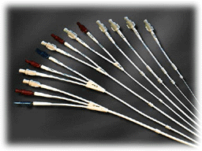
Types - External
External Access - A tube can be seen sticking out of the patient
Short-Term single or multi-lumen catheter
Peripheral inserted central catheter (PICC)
Hickman catheter
Broviac catheter
Groshong catheter
Accessible by PMs

Slide 5
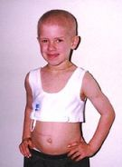
External Access Devices
Patients with these devices come in all age ranges
Many are immunosuppressed because of treatments for their disease process

Slide 6
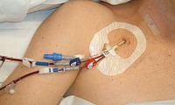
Multi-Lumen
Notes:
Hickman Catheter

Slide 7
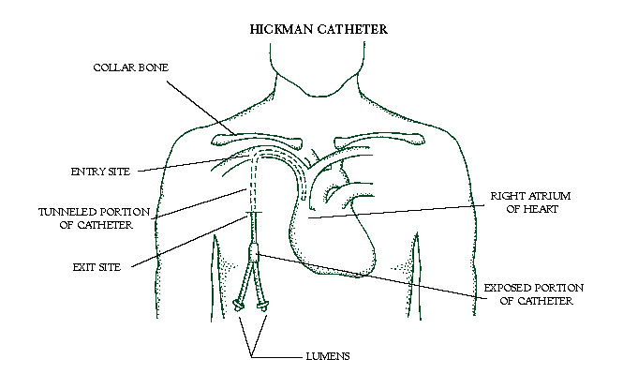
Hickman Catheter
Notes:
Most external lines that patients are allowed to go home with are inserted into the venous system.

Slide 8
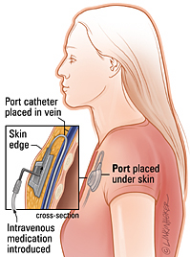
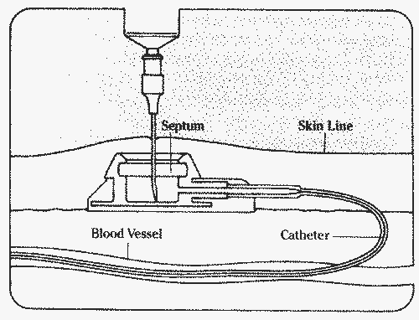
Types - Internal
Internal Access:
Implanted ports
Fistulas
NO tube can be seen on patient’s skin exit site
NOT accessible by PMs

Slide 9
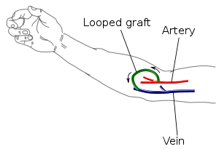
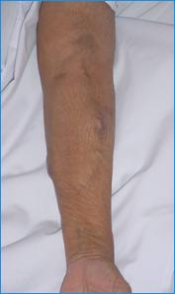
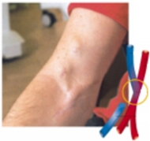
Internal Access Devices
Any access that is subcutaneous and requires access through the skin
NOT to be accessed by prehospital personnel
Notes:
Internal access devices are difficult to access by trained individuals. If you are unsure of the device ask a bystander or guidance from the hospital.

Slide 10
When May You Access a PVAD?
Cardiopulmonary arrest
Extremis due to circulatory shock
Base Hospital discretion
Notes:
Before accessing any device, the provider should be clear on the device they are accessing. At no time should you access a device that is connected to an artery.

Slide 11
WHY might you access a PVAD?
Administration of IV fluids
Normal Saline
Administration of all IV route medications

Slide 12
What Could Go Wrong?
Infection
Air embolism
Thrombosis
Catheter damage
Notes:
Reported problems in literature
Infection (3-60%)
Air Embolism (Rare)
Thrombosis (4-10%)

Slide 13
Common Causes of Infection
Failure to maintain aseptic technique
Immunosuppressed patient
Irritated suture line
Failure to comply with routine dressing change care

Slide 14
Infection Prevention
Hand washing or use of an alcohol based hand gel.
Use STERILE gloves at all times when handling the catheter injection port.
Prep the injection port with an alcohol swab twice (x2).
Obtain new gloves or supplies if they become contaminated.
Notes:
Remember do no harm. Infection prevention will help improve patient outcome.

Slide 15
Air Embolism
Introduction of air into the circulatory system.
Since the PVAD provides a direct line into the central circulation, the introduction of air into these devices can be very hazardous.

Slide 16
Air Embolism Signs/Symptoms
Sudden respiratory distress
Decreased blood pressure
Weak pulse
Sudden change in LOC Immediately place the patient in left lateral Trendelenburg position and clamp catheter should this occur.

Slide 17
Air Embolism Prevention
DO NOT remove injection cap from catheter.
Insure the catheter is clamped after use.
DO NOT allow IV fluid to run dry.
ALWAYS expel air from preload syringe prior to administration.

Slide 18
PVAD Thrombosis
A blood clot within the vascular system caused by improper handling and/or maintenance of the PVAD.
Dislodgement of this clot can cause vascular damage and/or a pulmonary embolus.

Slide 19
Thrombosis Signs/Symptoms
Mild to Moderate neck pain
Ipsilateral swelling of the arm, neck and face
Fever, malaise
Inability to aspirate blood through catheter

Slide 20
Thrombosis Prevention
If resistance is met, DO NOT force medications or fluid through catheter.
Follow medication administration with at least a 5 ml Normal Saline flush.

Slide 21
Catheter Damage
Damaged catheters are no longer a benefit to the patient and could be potentially harmful.
If damage should occur, immediately clamp catheter between damaged area and skin exit site with padded hemostats.
Notes:
Care should always be taken when working with these devices. Although intended for multiple uses for a long period of time rough handling could cause damage and the need for replacement.

Slide 22
Needleless Systems
Most needless systems will work with these devices.
Avoid using small syringes since they tend to create too much pressure in the catheter, which can cause the catheter to collapse or rupture. 10ml syringe works the best

Slide 23
Blood Withdrawal
Although most of these devices have the ability to withdraw blood for diagnostic tests, some recommend against withdrawing blood samples.
Blood samples are NOT to be withdrawn from a PVAD by prehospital personnel.
Notes:
For simplicity and less confusion this is the recommended policy for prehospital use.
Broviac catheters because of size should not be used for blood withdrawal
Groshong catheters tend to kink more or tear with frequent blood withdrawals.

