Slide 1
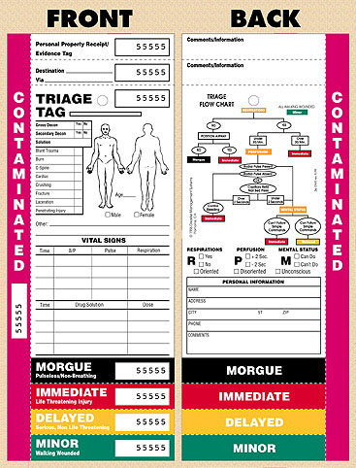
Mass Fatality Management Guide for Healthcare Entities
TRIAGE TAGS
Based on the START system – Simple Triage And Rapid Transport
Used by field personnel only
Only patients triaged in the field will have tags
Tag number should be documented by the receiving facility
Tag becomes part of patient’s medical record

Slide 2
Mass Fatality Management Guide for Healthcare Entities
TRIAGE TAGS
Patient needs to be re-triaged on arrival by facility personnel
Tag should not be changed by receiving facility
Even if the patient is placed in a different category once received
e.g. tagged minor in field, but hospital identifies as delayed
When receiving facility identification band has been applied, tag should be removed and placed in the medical record

Slide 3
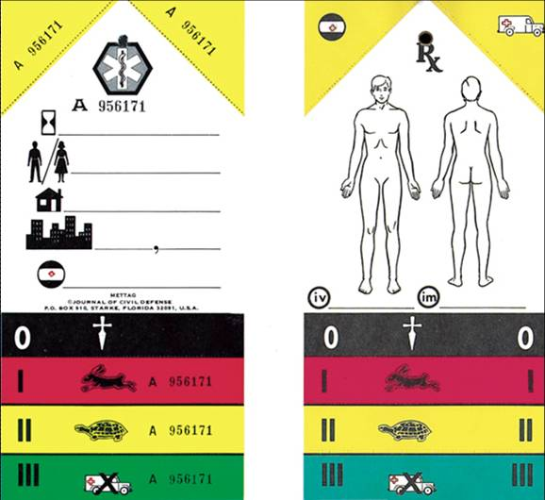
Mass Fatality Management Guide for Healthcare Entities
TRIAGE TAG EXAMPLES
There are different types and styles of triage tags.

Slide 4
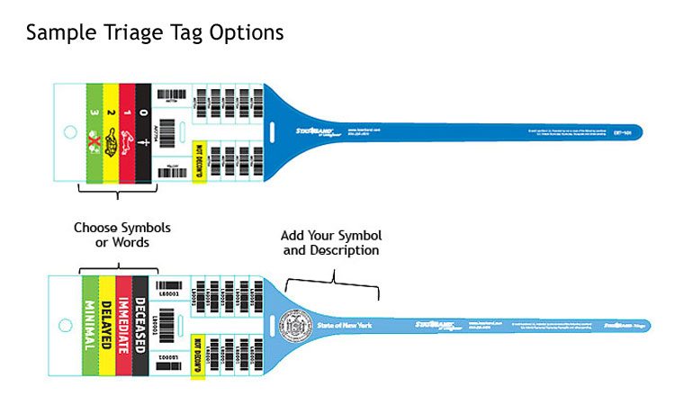
Mass Fatality Management Guide for Healthcare Entities
TRIAGE TAG EXAMPLES

