Slide 1
FY 2021-22 COST REPORT TRAINING
LOS ANGELES COUNTY
DEPARTMENT OF MENTAL HEALTH
Presented by: Yonas Habtu
Sara Lee Dato
Tracy Namkung

Slide 2
Housekeeping + Opening Remarks
Welcome
Microphones are muted
Q&A at the end of training as time permits
This session is being recorded. The recording and PowerPoint will be posted on the DMH Cost Report training website: https://dmh.lacounty.gov/for-providers/administrative-tools/cost-report-training-materials/
Notes:
There will be breaks to ask questions.
Please use the “Raise Hand” feature.
When it’s your turn, we will call on you and unmute you.
You can send your question in the chat.

Slide 3
Training Objectives
Review important dates for the FY 2021-22 Cost Report
Provide updates from DHCS
Provide important highlights such as: new revenues/fundings, FMAP, common errors during the cost report preparation
Provide Cost Report Contact Information
Answer questions

Slide 4
Important Dates
October 19, 2022 (tentative date) - Final Shift Request Training
Final Shift Request Training to be conducted by Office of Financial Services
October 28, 2022 - Deadline to submit FY 2021-22- Cost Report Package
Cost Report must be received by the CR Section by 5:00 p.m. on October 28, 2022.
Cost Report submission extension is subject to approval.
Effective October 31, 2022, or the next day after the extended deadline
Assessment of $100 per calendar day will be incurred for late fee until CR is received.
November 28, 2022
Deadline to submit requests for the FY 2021-22 Final Shift of Funds Amendment, regardless of the Cost Report submission due date. After OFS issues the final shift request form, it will be posted on DMH Cost Report training website and contractors will be notified.

Slide 5
DHCS Updates
State template is still pending, no updates on availability at this time;
LAC-DMH will post the final version on the DMH Cost Report training website once released by State DHCS, and will inform all contractors;
No major changes from FY 2020-21 Cost Report Template.

Slide 6
DHCS Updates, Cont.
Lower of Cost or Charge Medi-Cal reimbursement principle will continue to be waived for FY 2021-22 due to COVID 19 pandemic;
New Settlement Type for FFPSA - Family First Prevention Services Act
“…..The state will reimburse the MHP 50 percent of the non-federal share if the service was provided to a child under 21 and has an HV modifier. If the child has unsatisfactory immigration status and is only eligible for these specific services as a result of FFPSA, SD/MC will deny the service line unless the HV modifier is present. If the HV modifier is present, the state will reimburse the MHP for 100 percent of the non-federal share of the cost of FFPSA services...”
Source: BEHAVIORAL HEALTH INFORMATION NOTICE NO. 21-055

Slide 7
Highlights in FY 2021-22 Cost Report
Lower of Cost, CMA or Charge Medi-Cal reimbursement principle will continue to be waived for FY 2021-22 due to COVID 19 pandemic for specialty mental health services;
Due to the delay in the release of the FY 2021-22 final cost report template from State DHCS, LE Cost Report should be completed using the draft file and must be transferred to the final version after DHCS issuance (refer to Attachment 11);
LE will have the option to transfer the cost report data to the final template on their own or allow County analyst to complete the transfer on their behalf;
Medi-Cal Access Program (MCAP) - County CIOB 701U-P Report has MCAP Payor; If the LE prepares the cost report based on internal records, MC approved Aid Code E6, E7, 0E, or 0G are MCAP Eligible Services.

Slide 8
Highlights in FY 2021-22 Cost Report, Cont.
Federal Medicaid Assistance Percentage (FMAP)

Slide 9
New Revenue/Funding Types This Year
MHSA Full Service Partnership Incentives Invoice;
MHSA Alternative Crisis Services Startup Fund Invoice;
MHSA Housing Supportive Services Program;
Claimable costs are reimbursed by the following contracts
Legal Entity - Mental Health;
Legal Entity - Institution for Mental Disease (IMD), Enriched Residential Services (ERS)
or Psychiatric Health Facilities (PHF);
Legal Entity - Restorative Care Village Crisis Residential Treatment Program (CRTP);
Legal Entity - Urgent Care Services

Slide 10
Update in LAC Forms
Due to fundings being awarded in different contracts, LAC 102 and supplemental schedules are updated to report units of service applicable to the respective contract(s)
LAC 102_MH – includes categorical funds, CGF, and MHSA funded programs in the MH contracts
LAC 102_IMD_ERS_PHF contract
LAC 102_UCC contract
10B is the supplemental schedule for EPSDT units:
If the LE opt to report EPSDT units based on their internal records, please use the 10B tabs that are now embedded in the Cost Report template.
10B_MH_(optional)
10B_IMD_ERS_PHF_(optional)
10B_UCC_(optional)

Slide 11
Payroll Protection Program
Please continue to enter the amount of the PPP loan spent on eligible activities from the costs related to FY 2021-22 in MH1961 or MH1962.

Slide 12
Common Problems Noticed During Desk Review
MH1900_Info: Certain cells containing default input need not be changed. Pay attention in answering Yes or No in the field asking if your LE is reporting SD/MC units;
MH1901_A_Schedule:
Contractors with County Non Medi-Cal Contract Rate(s), such as IMD providers, must enter the County Non Medi-Cal Contract Rate(s) in this form;
Published Charge - Customary schedule of charges to the public for clients in need of SMHS. Each contractor has its own rates and may not use the County’s CMA Rate or the Provisional Rate, which are different. In addition, PC is not applicable to Modes 45 and 60.

Slide 13
Common Problems Noticed During Desk Review, Cont.
MH1901_B_Schedule:
Total units: may include any unbilled services. If you include unbilled services in the Total Units, ensure to submit these services to the County in order to reflect on the County Chief Information Office 701U-P Report;
Once cost reports are submitted to the State, total units for each Mode and Service Function Code can no longer be changed. Any change will need to go through the revised cost report process;
County Chief Information Office Bureau (CIOB) confirmed that there are no MC services with approved Aid Code E2, E4, or E5; hence, all MCHIP units should be reported under Enhanced FMAP CHIP columns;
Non Medi-Cal units column is formulated, make sure that there are no negatives under this column.

Slide 14
Common Problems Noticed During Desk Review, Cont.
Service Function Code (SFC) in MH1901_B_Schedule needs to be 2 digits and in TEXT format;
Community Outreach Services (COS) for Mode 45 UOS and Case Management Support (CMS) Services Mode 60 and SFC 60 are recorded in minutes in 701-UP. The cost report requires to report Mode 45 and CMS Services in Hours;
For Mode 60 and SFCs 70, 71, 72, 75, & 78 services, must enter “1” in MH1901_B_Schedule Total Unit column.

Slide 15
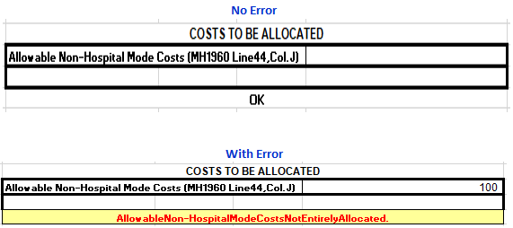
Common Problems Noticed During Desk Review, Cont.
MH1901_C_Schedule: ensure there is no error in this form.
If contractor is reporting any unit in MH1901_B_Schedule, the associated costs should be allocated in this form.

Slide 16
Common Problems Noticed During Desk Review, Cont.
MH1960: Contractors do not need to input direct and indirect costs on this schedule. The cells that require data contain formulas that will populate from the LAC 101 form;
MH1966:
Cost per Unit of Service: Contractors are to review the cost per unit of service. Contractors must re-examine their supporting schedules and records if the cost per unit of service do not seem reasonable;
Published charge rates flow through in this form, contractors may compare the unit cost against the PC, which is not applicable this year.

Slide 17
Common Problems Noticed During Desk Review
MH1992: Contractors do not need to input any amount in this form – County will complete all contractor MH1992 forms before submission to the State;
Crosscheck and make necessary corrections for any ERROR messages displayed in LAC 102 schedules and 10B schedules.

Slide 18
Common Problems Noticed During Desk Review, Cont.
Attachment 9A: All direct charge has to be reconciled with the payment received from County. Due to invoice fundings being awarded in different contracts, Attachment 9A is updated to report applicable direct charge to the respective contract(s);
Attachment 10A: Each Medi-Cal revenue by settlement group in 10A must match with MH1901_B_Schedule. Total revenue in 10A must match with LAC103.

Slide 19
Important Reminders
Units of Service (UOS) Reconciliation: Total units and Medi-Cal units are reconciled periodically (Monthly or Quarterly). If any variances are found, it should be resolved with Central Business Office (CBO);
Non-EPSDT local match: As shown on the FMAP schedule, non-EPSDT such as Regular SD/MC, BCCTP, and Pregnancy beneficiaries require local match to draw down FFP;
Provisional Rate: Is the interim rate. In some cases, it may be the same or lower than Published Charge, but it should not be higher than Published Charge;
Contact your assigned Cost Report Analyst if assistance is needed.

Slide 20
Documents to be included with Cost Report Submission
Every Legal Entity/Agency must submit a Cost Report, Attachment 4 and 5;
4 – Cost Report Letter of Certification
5 – Source of UOS data (Contractor’s internal records or 701-UP with run date)
LE needs to submit Attachment 9A, 10A, 11, if applicable;
9A – Non-MC Direct Charge expenditures by funded program
Complete 9A for manual invoices
10A – Third Party Revenue by funded program & payor source
Complete 10A if LE fills in 3rd party Revenue in Sch. B and LAC 103
11 – LE Re-Entering Options
Complete the form to provide the response to export data to final cost report template by County or by LE

Slide 21
Documents to be included with Cost Report Submission, Cont.
Supporting Documents:
Client Units of Service Reports (if the LE is using internal records)
Third Party Revenue Records
Indirect Cost Allocation Plan
Fixed Assets Depreciation Schedule
Trial Balance Sheet with applicable to DMH contract services
Invoice payment logs (Special program payments)

Slide 22
How to Submit the FY 2021-22 Cost Report
The deadline to submit the FY 2021-22 Cost Report is October 28, 2022, or as otherwise approved by County;
We will continue to accept the electronic copies via email this year;
Email complete Cost Report package to your assigned cost report analyst.
Reference Attachment 2 for submission details.

Slide 23
Cost Report Desk Review
What’s the next step after Contractors submit the original Cost Reports?
Cost Report Analysts will notify Contractors of any concern and/or request for corrections via email;
Contractors need to submit corrections as soon as possible;
The final correction on annual cost report must be signed & dated, and include a new Cost Report Letter of Certification.
The complete Cost Report Analysts assignment list can be found in the DMH Cost Report training website.
https://dmh.lacounty.gov/for-providers/administrative-tools/cost-report-training-materials/

Slide 24
Other Important Reminders:
FINAL SHIFT – If contractors need to request final shift, please submit final shift change request to Myles Kang at fsb@dmh.lacounty.gov no later than November 28, 2022.
Annual Expenditure Report (AER) for UCC contracts – The AER is due no later than 30 calendar days after the Cost Report due date (refer to your contract Financial Exhibit A, Paragraph K)

Slide 25
Cost Report Revisions
You will have an opportunity to submit revised Cost Reports prior to the DHCS commencement of the SD/MC reconciliation and CR Settlement process;
For the revision of prior year cost reports, please contact Tracy Namkung @ Settlement Section for further instructions.
Email: tnamkung@dmh.lacounty.gov

Slide 26
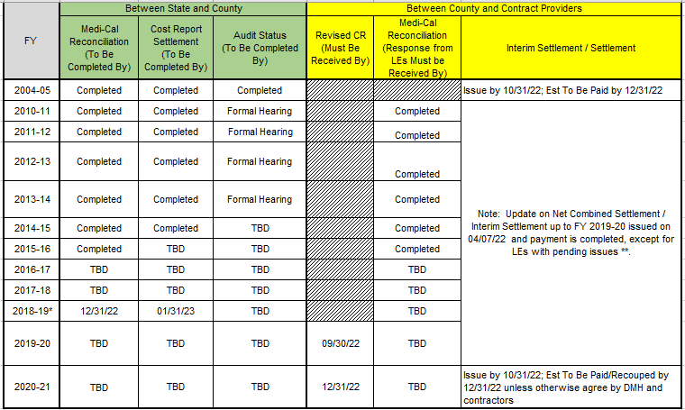
Proposed DHCS Audit and Settlement Timeframe for SD/MC Cost Report As of August 31, 2022

Slide 27
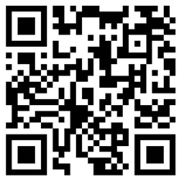
Q&A
Please use the raise your hand feature so we can unmute your microphone, or type your question in the chat box;
If you have other questions after this session, please email your questions to the Cost Report Mailbox: CostReportMailbox@dmh.lacounty.gov;
Click the link below and follow the instructions to complete your mandatory Cost Report Training attendance requirement.
https://forms.office.com/g/GYL7J7fXJ1
Or, scan the barcode to complete the form.

Slide 28
Key Contact Information
The Cost Report Analysts assignment list, DHCS Cost Report Instruction Manual, Cost Report template, attachments, and submission criteria can be found in the DMH Cost Report training website
https://dmh.lacounty.gov/for-providers/administrative-tools/cost-report-training-materials/
EXAMPLE

Slide 29
Key Contact Information, Cont.
Key Contact | Contract Email or Phone Number
Settlement Section: | tnamkung@dmh.lacouty.gov
Provider Reimbursement: | Ylula@dmh.lacouty.gov
CIOB Helpdesk: | (213) 351-1335
Financial Service Bureau (FSB): | FSB@dmh.lacounty.gov
Central Business Office (CBO): | CBO@dmh.lacounty.gov
Cost Report Mailbox: | costreportmailbox@dmh.lacounty.gov

