Slide 1
FY 2020-21 COST REPORT TRAINING
LOS ANGELES COUNTY
DEPARTMENT OF MENTAL HEALTH
Present by: Sara Dato
Tracy Namkung
Christina Liu

Slide 2
Housekeeping + Opening Remarks
Welcome
Microphones are muted
Q&A at the end of training as time permits
This session is being recorded. The recording and PowerPoint will be posted on the DMH Cost Report training website: https://dmh.lacounty.gov/for-providers/administrative-tools/cost-report-training-materials/
Notes:
There will be breaks to ask questions.
Please use the “Raise Hand” feature.
When it’s your turn, we will call on you and unmute you.
You can send your question in the chat.

Slide 3
Training Objectives
Review important dates for the FY 2020-21 Cost Report
Provide updates from DHCS
Ensure contractors understand how to complete their FY 2020-21 Cost Report
Provide Cost Report Contact Information
Answer questions

Slide 4
Important Dates
August 30, 2021 - Cost Report submission Extension Request deadline.
Provide written justification and length of time needed to submit.
Submit extension requests to CostReportMailbox@dmh.lacounty.gov
Email Subject: Request for Extension to FY 20-21 CR Deadline – CONTRACTOR NAME
Written approval of extension must be received from DMH in order to be considered granted.
September 30, 2021 - Deadline to submit FY 2021- Cost Report Package
CR must be received by the CR Section by 5:00 p.m. on September 30, 2021.

Slide 5
Important Dates, Cont.
October 1, 2021, or the next day after the extended deadline
Assessment of $100 per calendar day will be incurred for late fee until CR is received.
October 29, 2021
Deadline to submit requests for the FY 2020-21 Final Shift of Funds Amendment.
Notes:
Check contract

Slide 6
DHCS Updates
The DHCS training date is not decided yet.
We will post FY 2020-21 Cost Report Template on the training website once it’s ready from State and inform all contractors.
Lower of Cost or Charge Medi-Cal reimbursement principle will continue to be waived for FY 2020-21 due to COVID 19 pandemic.

Slide 7
Changes in FY 2020-21 Cost Report
Lower of Cost, CMA or Charge Medi-Cal reimbursement principle will continue to be waived for FY 2020-21 due to COVID 19 pandemic for specialty mental health services.
Federal Medical Assistance Percentages (FMAP) carry forward from FY 2019-20 March – June Period, except for Enhanced Children Medi-Cal and Medi-Cal Access Program effective Oct, 2020. (See MH 1979 of the CR template for details)

Slide 8
Changes in FY 2020-21 Cost Report, Cont.
Continuum of Care Reform (CCR) for Short-Term Residential Therapeutic Program (STRTP)
Example - If the contractor provides mixture of services, it should have one line with “CCR” for STRTP service, and another line with “CR” for other regular services.

Slide 9
Changes in FY 2020-21 Cost Report, Cont.
State Fund Beneficiaries settlement group on MH1901B
It includes SB-75 as well as other beneficiaries with unsatisfactory immigration status that the State pays for.
SB-104 which expanded SB-75 up through age 25 claims reported under SB-75 Payor in the 701UP Report.
The total regular SD/MC and Medi-Medi Crossover units of services are combined in SD/MC units of services.

Slide 10
New Revenue/Funding Types This Year
Coronavirus Aid, Relief, and Economic Security (CARES) Act
May only be used to cover costs that are necessary expenditures incurred due to the public health emergency with respect to the COVID-19.
Children’s Outreach Triage Team (COTT) and Adult Outreach Triage Team (OTT)
Services provided under OTT and COTT programs shall be based on actual costs consistent with cost reimbursement methodology.
The UOS and cost need to be entered in Attachment 11.
Do not include UOS in total UOS count for SMHS.
Total cost should be direct charge.

Slide 11
New Supplemental Schedule

Slide 12
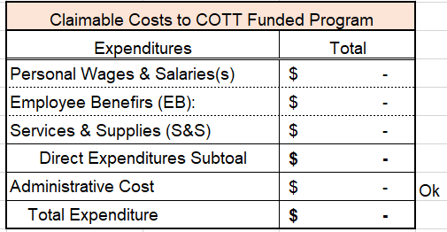
Attachment 11
If the contractor received funding for the OTT/COTT program, complete Attachment 11.
Please report Claimable Costs in the highlighted red boxes above.
2. Mode and SF must type in 2 digits in text format. Ex: “04”
3. UOS: Report Total UOS, MC UOS by settlement group and time period, and non-MC UOS.
4. Allocated Cost: Report Allocated cost by each Mode and SF.
Notes:
Put screenshot here.

Slide 13
Paycheck Protection Program
Providers that received a loan through the Paycheck Protection Program needs to enter the amount of the loan spent on eligible activities from the costs in MH1961 or MH1962.

Slide 14
Common Problems Noticed During Desk Review
Published Charge: Customary schedule of charges to the public for clients in need of SMHS. Each contractor has its own rates and may not use the County’s CMA Rate which is different than its own.
Provisional Rate: Interim reimbursement/billing rate for SMHS, not used for PC
Total units: may include any unbilled services. If you include unbilled services in the Total Units, ensure to submit these services to the County in order to reflect on the County Chief Information Office 701U-P Report.
Units of Service Reconciliation: Total units and Medi-Cal units are reconciled periodically (Monthly or Quarterly). If any variances are found, it should be resolved with Central Business Office (CBO).
MH1901 B: Enhanced FMAP Non-CHIP (Aid Code E2, E4, E5) and Enhanced FMAP CHIP (2 different periods in Cost Report)
SFC in MH1901 B needs to be 2 digits and in TEXT format.

Slide 15
Common Problems Noticed During Desk Review, Cont.
Community Outreach Services (COS) UOS and Case Management Support (CMS) Services are in minutes in 701 UP. The cost report requires Mode 45 and CMS in Hours.
For Mode 60 and SFCs 70, 71, 72, 75, & 78 services, put enter “1” in MH1901 B Total Unit column.
Attachment 9A: All direct charge has to be reconciled with the payment received from County
Attachment 10A: Each Medi-Cal revenue by settlement group in 10A must match with MH1901 B. Total revenue in 10A must match with LAC103.
Attachment 10B: EPSDT Units should be within Medi-Cal units by each Mode and SFC, by settlement group, and funded program.
County will use CBO Bulletin No. NGA 20-011 for local match requirement: EPSDT and MCHIP – MEDI-CAL.
Crosscheck and make necessary corrections for any ERROR messages displayed in LAC102.

Slide 16
Documents to be included with Cost Report Submission
Every Legal Entity/Agency must submit a Cost Report, Attachment 4 and 4A.
4 – Cost Report Letter of Certification*
4A – Source of UOS data (Contractor’s internal records or 701-UP with run date)*
LE needs to submit Attachment 9A, 10A, 10B, or 11, if applicable.
9A – Non MC Direct Charge expenditures by funded program*
Complete 9A for manual invoices.
10A – Third Party Revenue by funded program & payor source*
Complete 10A if LE fills in 3rd party Revenue in Sch. B and LAC 103.
10B – Source of EPSDT data and SGF computation schedule*
Complete 10B if LE chooses to use internal records to calculate UOS in 4A.
11 – OTT_COTT Costs and Units
Complete 11 if the contractor received funding for the OTT/COTT program.
Supporting Documents:
Client Units of Service Reports (if the LE is using internal records)
Third – Party Revenue Records
Indirect Cost Allocation Plan
Fixed Assets Depreciation Schedule
Trial Balance Sheet
Invoice payment logs (Special program payments)

Slide 17
How to Submit the FY 2020-21 Cost Report
The deadline to submit the FY 2020-21 Cost Report is September 30, 2021, or as otherwise approved by County.
Due to COVID 19 condition and move to new Headquarter, we will accept the electronic copies via email this year.
Email complete Cost Report package to your assigned cost report analyst.
Reference Attachment 2 for submission details.

Slide 18
Cost Report Desk Review
What’s the next step after Contractors submit the original Cost Reports?
Cost Report Analysts will notify Contractors on concerns and/or request for corrections via email.
Contractors need to submit corrections as soon as possible.
The final correction on annual cost report must be signed & date and include a new Cost Report Letter of Certification.
The complete Cost Report Analysts assignment list can be found in the DMH Cost Report training website.
https://dmh.lacounty.gov/for-providers/administrative-tools/cost-report-training-materials/

Slide 19
Final Shift
If agencies need to request final shift, please submit final shift change request to Myles Kang at fsb@dmh.lacounty.gov within 30 days after the cost report submission deadline/extended deadline if approved.

Slide 20
Cost Report Revisions
You will have an opportunity to submit revised Cost Reports prior to the DHCS commencement of the SD/MC reconciliation and CR Settlement process.
For the revision of prior year cost reports, please contact Tracy Namkung @ Settlement Section for further instructions.
Email: tnamkung@dmh.lacounty.gov

Slide 21
Proposed DHCS Audit and Settlement Timeframe for SD/MC Cost Report As of August 31, 2021

Slide 22
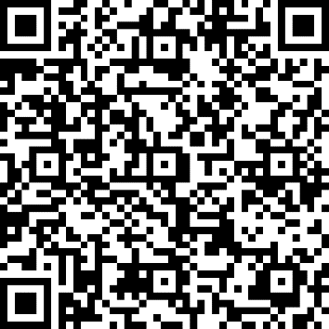
Q&A
Please use the raise your hand feature so we can unmute your microphone, or type your question in the chat box.
If you have other questions after this session, please email your questions to the Cost Report Mailbox: CostReportMailbox@dmh.lacounty.gov
Click the link below and follow the instructions to complete your mandatory Cost Report Training attendance requirement.
https://forms.office.com/g/iDxN05MMTZ
Or, scan the barcode to complete the form.

Slide 23
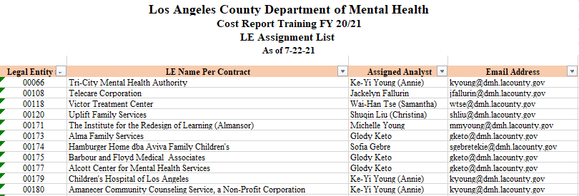
Key Contact Information
The Cost Report Analysts assignment list, DHCS Cost Report Instruction Manual, Cost Report template, attachments, and submission criteria can be found in the DMH Cost Report training website.
https://dmh.lacounty.gov/for-providers/administrative-tools/cost-report-training-materials/
Settlement Section:
Tracy Namkung tnamkung@dmh.lacounty.gov
Provider Reimbursement: Ylula@dmh.lacouty.gov
CIOB Helpdesk: (213) 351-1335
Financial Service Bureau (FSB): FSB@dmh.lacounty.gov
Central Business Office (CBO): CBO@dmh.lacounty.gov
Cost Report Mailbox: costreportmailbox@dmh.lacounty.gov
EXAMPLE

