Slide 1
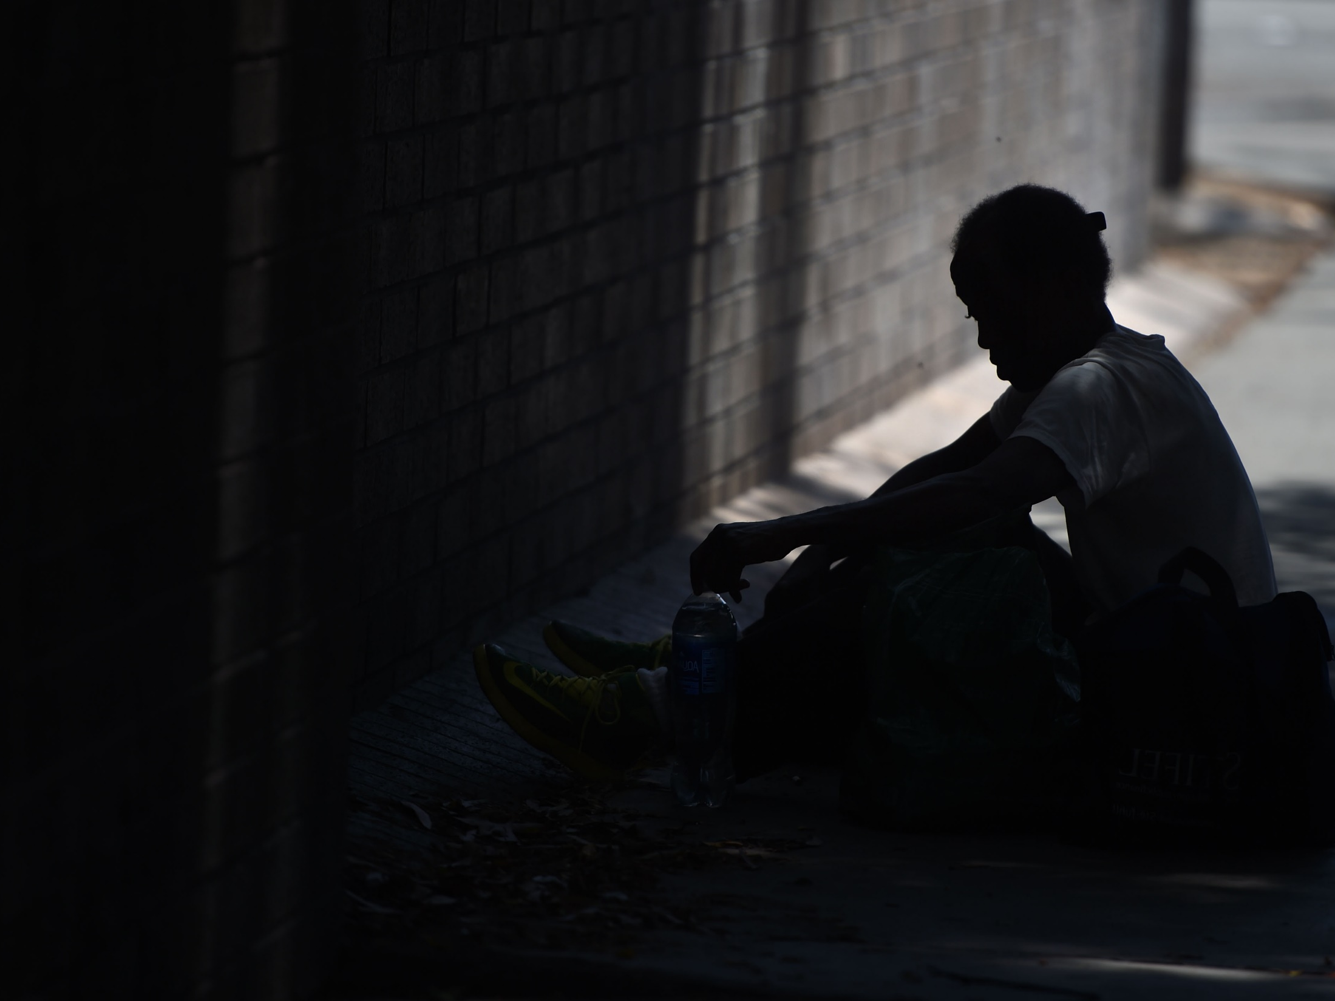
Phil Ansell
Director, Homeless Initiative
Department of Mental Health Housing Summit
April 25, 2018

Slide 2
CRISIS OF HOMELESSNESS
LA County has a major homelessness crisis, which is further exacerbated by a housing affordability crisis.
Nearly 58,000 people experienced homelessness on a given night in 2017.
Nearly ¾ of homeless people are unsheltered.
In the Los Angeles Metro Area, as of 2015, 57% of renters were cost-burdened (paying more than 30% of income for housing) and 31% of renters were severely cost-burdened (paying more than 50% of income for housing).

Slide 3
HOMELESS COUNT 2017
Total Homeless Population
(includes Glendale, Long Beach and Pasadena)
Total Homeless Population -
Sheltered and Unsheltered
23% increase in 2017
24% increase in 2017
Data provided by the Los Angeles Homeless Services Authority (LAHSA)

Slide 4
HOMELESS COUNT 2017 BY SERVICE PLANNING AREA (SPA)
Data provided by the Los Angeles Homeless Services Authority (LAHSA)

Slide 5
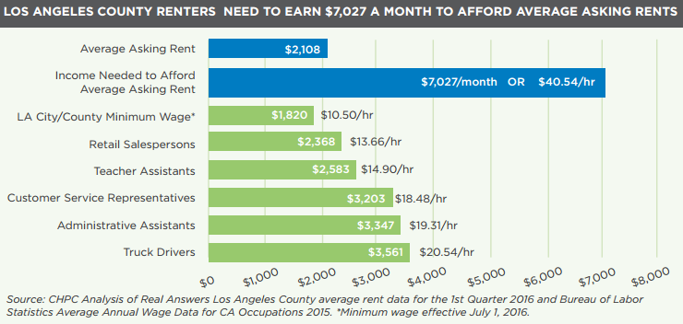
AFFORDABLE HOUSING CRISIS
MEDIAN RENT IN LA COUNTY HAS INCREASED 28% SINCE 2000 WHILE MEDIAN RENTER HH INCOME HAS DECLINED 8% WHEN ADJUSTED FOR INFLATION

Slide 6
AFFORDABLE HOUSING CRISIS
SHORTFALL OF 549,197 AFFORDABLE RENTAL UNITS FOR LOWEST-INCOME RENTERS
Los Angeles Metro area is the most cost-burdened in the United States. 48% of all residents in LA County pay more than 30% of their income on rent. 82% of the lowest income residents pay more than 50% of their income on rent.

Slide 7
COUNTY HOMELESS INITIATIVE
Seizing the moment: Historic opportunity to combat homelessness throughout LA County
Launched on August 17, 2015
Initial Goal: Develop a comprehensive set of recommended County strategies to combat homelessness, including strategies in which cities can participate
Process: Inclusive and collaborative planning process with participation from 25 County departments, 30 cities, and over 100 community organizations
18 Policy Summits
4 Focus Groups with Homeless
200 Public Comments
2 Community Meetings

Slide 8
MEASURE H
¼ cent County Sales tax that will generate an estimated $355 million annually for 10 years to be used to prevent and combat homelessness.
BOARD ORDINANCE PLACES MEASURE H ON MARCH 7, 2017 COUNTYWIDE BALLOT TO PREVENT AND COMBAT HOMELESSNESS
PASSAGE OF MEASURE H WITH 69.34% VOTER APPROVAL
12/06/16
02/07/17
03/07/17
06/13/17
BOARD DIRECTS CEO TO CONDUCT A MEASURE H REVENUE PLANNING PROCESS TO DEVELOP FUNDING RECOMMENDATIONS FOR FY 17/18 – FY 19/20
BOARD APPROVES FINAL FUNDING RECOMMENDATIONS FOR FY 17/18 AND TENTATIVE RECOMMENDATIONS FOR FY 18/19 AND 19/20
Projected to help 45,000 families and individuals move from homelessness to permanent housing, and enable 30,000 more to avoid becoming homeless – within the first 5 years.

Slide 9
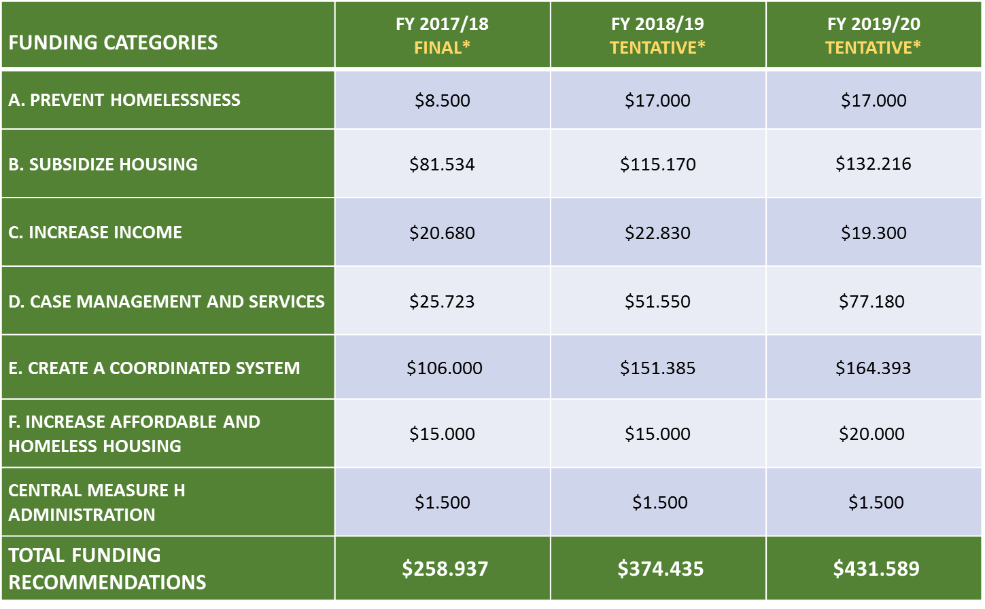
APPROVED FUNDING RECOMMENDATIONS
*Funding in millions

Slide 10
MEASURE H IMPLEMENTATION
MEASURE H
SPECIAL FUND
COUNTY DEPARTMENTS/
AGENCIES
COMMUNITY-BASED AND
OTHER PROVIDERS
Revenue from Measure H flows from County Departments and lead agencies into communities countywide, where it is put to work based on need.

Slide 11
MEASURE H IMPACT (July – Dec 2017)
7,297 individuals entered crisis, bridge, and interim housing including 811 individuals discharged from institutions
Approximately 3,350 homeless families and individuals secured permanent housing through specific HI strategies including:
1,385 rapid re-housing participants
1,064 individuals from emergency shelter
483 disabled adults pursuing SSI were housed

Slide 12
MEASURE H IMPACT (July – Dec 2017)
4,038 individuals have been engaged by Outreach Teams
3,143 youth were assessed using Next Step Tool
4,261 disabled individuals were assisted with applications for SSI and Veterans Disability Benefits
2,556 inmates received jail in-reach services

Slide 13
MEASURE H IMPACT (July – Dec 2017)
1,280 clients were linked to new Intensive Care Management Services
658 families received prevention services
948 deputies and sergeants participated in First Responders Training
(Data is from Oct. 2016 - Dec. 2017)

Slide 14
IMPLEMENTATION HIGHLIGHTS
STRATEGY A1: HOMELESS PREVENTION PROGRAM FOR FAMILIES
LEAD AGENCY: LAHSA
658 families assisted with prevention services through the Family Solutions Center
Of those 658 families, 143 families exited the program and 92 (64 percent) either retained their housing or transitioned into other permanent housing

Slide 15
IMPLEMENTATION HIGHLIGHTS
STRATEGY B3: PARTNER WITH CITIES TO EXPAND RAPID REHOUSING
LEAD AGENCY: LAHSA / DHS
6,110 new participants were enrolled into the Rapid Rehousing (RRH) Program
1,385 RRH participants were placed in permanent housing
423e participants obtained employment
A total of 13,716 participants participated in the RRH program (including both new enrollees and those enrolled prior to July 2017)

Slide 16
IMPLEMENTATION HIGHLIGHTS
STRATEGY B4: FACILITATE UTILIZATION OF FEDERAL HOUSING SUBSIDIES
LEAD AGENCY: HACoLA / DCFS
HACoLA received 193 requests to participate in the Homeless Incentive Program (HIP)
Since 2016, HIP has secured 374 rental units and housed 234 homeless individuals and families
The Public Housing Authorities of LA County, LA City, Pomona, Burbank, Pasadena, Redondo Beach, Glendale, Long Beach, and Compton have dedicated 2,089 tenant-based subsidies for permanent supportive housing this Fiscal Year
Executed agreements with LA City and Long Beach to provide Measure H funding for landlord incentives

Slide 17
IMPLEMENTATION HIGHLIGHTS
STRATEGY B7: INTERIM/BRIDGE HOUSING FOR THOSE EXITING INSTITUTIONS
LEAD AGENCY: LAHSA / DHS / DPH
DHS provided interim housing to 811 individuals who were discharged from institutions, including 378 from jail/prison and 155 from hospitals
81 participants exited to a permanent housing destination

Slide 18
IMPLEMENTATION HIGHLIGHTS
STRATEGY C4, C5, C6: COUNTYWIDE SUPPLEMENTAL SECURITY/SOCIAL SECURITY DISABILITY INCOME AND VETERANS BENEFITS ADVOCACY
LEAD AGENCY: DHS
Countywide Benefits Entitlement Services Teams (CBEST) assisted 4,261 disabled individuals with applications for SSI and Veterans Disability Benefits
1,052 individuals are now linked to and have access to mental health services
1,212 participants now have access to health services

Slide 19
IMPLEMENTATION HIGHLIGHTS
STRATEGY D2: EXPANSION OF JAIL IN-REACH
LEAD AGENCY: DHS / SHERIFF
2,556 inmates received Jail In-Reach services
2,196 inmates were assessed with the VI-SPDAT
139 participants were placed in bridge housing upon release

Slide 20
IMPLEMENTATION HIGHLIGHTS
STRATEGY D7: PROVIDE SERVICES AND RENTAL SUBSIDIES FOR PERMANENT SUPPORTIVE HOUSING
LEAD AGENCY: DHS / DMH / DPH
1,280 clients linked to new Intensive Case Management Services slots
637 clients approved for federal rental subsidies
354 clients received local rental subsidies
248 clients were placed in permanent housing

Slide 21
IMPLEMENTATION HIGHLIGHTS
STRATEGY E4: FIRST RESPONDER TRAINING
LEAD AGENCY: SHERIFF
948 Sheriff’s deputies and sergeants were trained
251 County non-law enforcement first responders were trained (Fire, Vector Control District, Dept. of Park and Recreation, Dept. of Animal Care and Control)
Training for other municipal police officers continues

Slide 22
IMPLEMENTATION HIGHLIGHTS
STRATEGY E6: COUNTYWIDE OUTREACH SYSTEM
LEAD AGENCY: LAHSA / DHS / DMH / SHERIFF
County outreach teams:
Connected 2,738 individuals to services
Placed 441 individuals into interim housing
Linked 359 individuals to a permanent housing program
New program components:
Countywide Web Portal for Outreach Requests
CES Outreach Coordinators

Slide 23
IMPLEMENTATION HIGHLIGHTS
STRATEGY E8: ENHANCE THE EMERGENCY SHELTER SYSTEM
LEAD AGENCY: LAHSA
Since July 2017, contracts were awarded to service providers for 302 new Crisis and Bridge Housing beds for Youth and Single Adults
7,297 individuals entered crisis, bridge, and interim housing
1,064 individuals were placed in permanent housing
(Data includes all participants served in programs funded in whole or in part by Measure H)

Slide 24
HOMELESS INITIATIVE ACTIVITIES
2nd Annual Homeless Initiative Conference
Jobs Combatting Homelessness
Measure H Funding Recommendations for FY 18-19
Homeless Initiative Quarterly Newsletter
ADU Design Competition (Strategy F4)
Housing Innovation Challenge (Strategy F7)
Outreach Web Portal (Strategy E6)
Older Adults Pilot
Faith

Slide 25
COLLABORATION IS KEY
Homelessness is a regional problem that can only be effectively addressed with a commitment to action by the County, cities, community providers, business community, and faith organizations across the County.

Slide 26
QUESTIONS
LA COUNTY HOMELESS INITIATIVE
Kenneth Hahn Hall of Administration
500 West Temple Street, Room 493
Los Angeles, CA 90012
homelessinitiative@lacounty.gov
@CountyHomelessInitiatve
FOR UP TO DATE INFORMATION VISIT US AT:
HTTP://HOMELESS.LACOUNTY.GOV

