Slide 1


DPSS Benefits and Services: Building a Partnership to Serve Homeless Customers Together
County of Los Angeles
Department of Public Social Services
"To Enrich Lives Through Effective and Caring Service"
Bill Taylor, Director
Homeless Services, LA County Department of Public Social Services

Slide 2
Workshop Purpose
County of Los Angeles
Department of Public Social Services
Each year the Department of Public Social Services (DPSS) provides critical benefits and services to over 70,000 homeless adults and almost 30,000 homeless families participating in the General Relief and CalWORKs Program.
The panel of DPSS experts will be sharing key information about vital DPSS benefits and services, and how best to help homeless clients access these services.
"To Enrich Lives Through Effective and Caring Service"

Slide 3
Table of Contents
County of Los Angeles
Department of Public Social Services
Time Pages
CalWORKs Program………………………………………………... 4-9
GAIN Program..…………………………………………………........ 10-15
General Relief Program.………………………………………….... 16-21
GROW Program…………………………………………………….. 22-26
Medi-Cal Program…………………………………………………... 27-33
In-Home Supportive Services……………………………………... 34-40
CalFresh Program…………………………………………………… 41-45
Your Benefits Now…………………………………………………… 46-51
Resources……………………………………………………………... 52
"To Enrich Lives Through Effective and Caring Service"

Slide 4


County of Los Angeles
Department of Public Social Services
"To Enrich Lives Through Effective and Caring Service"
Adriana Michel, HSA I
CalWORKs Program

Slide 5

CalWORKs Overview
County of Los Angeles
Department of Public Social Services
Through CalWORKs, families receive money each month to help pay for housing, food and other necessary expenses.
CalWORKs provides temporary financial assistance and employment-focused services through Greater Avenues for Independence (GAIN) to families with minor children who have income and property below State maximum limits for their family size.
Refugee Cash Assistance (RCA) provides financial assistance to refugee families, couples, or individuals without children.
Applicants may apply for:
An Immediate Need payment which is an advance of the family’s CalWORKs grant in the amount not to exceed $200.
Any of the Homeless Assistance Programs.
"To Enrich Lives Through Effective and Caring Service"

Slide 6
Basic Eligibility Requirements
County of Los Angeles
Department of Public Social Services
The family’s net monthly income (after applicable disregards) must be less than the Maximum Aid Payment (MAP) for family size. For example, the MAP for a family of three is currently $714 (Effective October 1, 2016).
At least one parent must be unemployed, deceased, disabled or absent.
The principal wage earner in a two-parent family must not be employed more than 100 hours a month at the time of application.
Children must live with a parent or relative caregiver.
Aided family members must be a U.S. Citizen or eligible legal immigrant.
Cash on-hand is limited to $2,250. The limit is $3,500 for families if one member of the family is 60 years or older.
"To Enrich Lives Through Effective and Caring Service"

Slide 7

Time Limit/Exception
County of Los Angeles
Department of Public Social Services
Currently, most adults can only receive 48 months of cash aid. There is no time limit on cash aid for children.
Some exemptions apply, e.g., victims of domestic violence or those deemed to be permanently or temporarily disabled.
"To Enrich Lives Through Effective and Caring Service"

Slide 8
Where and How to Apply
County of Los Angeles
Department of Public Social Services
There are 24 CalWORKs District Offices throughout Los Angeles County in which a family can apply for aid.
The application can be done in person or on-line via Your Benefits Now link on the dpss.lacounty.gov webpage.
The Department has a ‘No Wrong Door’ policy that allows families to apply at any office. The case will be transferred to the appropriate office based on the case address.
"To Enrich Lives Through Effective and Caring Service"

Slide 9
CalWORKs Overview
County of Los Angeles
Department of Public Social Services
State-Funded Homeless Programs | County Supplemental Homeless Assistance Programs
Temporary Homeless Assistance (HA) – Provides a homeless CalWORKs family with up to 16 consecutive calendar days of temporary shelter payments to stay in a hotel/motel or commercial establishment. | Temporary+14: Provides a homeless CalWORKs Welfare-to-Work (WtW) family who has exhausted or is ineligible to the State’s Temporary HA Program with up to 14 days of temporary shelter payments to stay in a hotel/motel or commercial establishment.
Permanent HA – Provides a homeless CalWORKs family with a payment to cover move-in costs required by a landlord as a condition of assuming occupancy and utility turn-on fees required for gas, electricity and/or water. | Moving Assistance – Provides a CalWORKs WtW family with a payment of up to $2,500 to pay for move-in costs required by a landlord as a condition of assuming occupancy, utility turn-on fees required for gas, electricity, or water, moving costs (e.g. truck rental), and the purchase of a stove and/or refrigerator.
Permanent HA Arrearages – Provides a CalWORKs family who is at-risk of homelessness with a payment to cover up to two months of back due rent when facing an eviction. | Emergency Assistance to Prevent Eviction – Provides a CalWORKs WtW family who is at-risk of homelessness with up to $3,000 to help pay rent and/or utilities for up to two months in arrears to assist the family in maintaining permanent housing.
Note: Temporary HA and Permanent HA (including Permanent HA Arrearages) are available once every 12 months. HA (Temporary and/or Permanent) based on an exception is available once at any point during the 12 months. The exceptions include when the cause of homelessness is due to: domestic violence, prior residence becoming uninhabitable, a medically verified physical or mental illness, or a State or federally declared natural disaster. All other homeless programs are once-in-a-lifetime (some may be accessed again with exceptions). | 4-Month Rental Assistance Program – Provides a formerly homeless CalWORKs WtW family living in non-subsidized permanent housing with a rental subsidy for four consecutive months. If the family is participating in the GAIN Family Stabilization Program, the family may receive up to eight consecutive months of rental subsidy payments.
"To Enrich Lives Through Effective and Caring Service"

Slide 10


County of Los Angeles
Department of Public Social Services
"To Enrich Lives Through Effective and Caring Service"
Ana White, HSA I
GAIN Program

Slide 11

GAIN Welfare-to-Work Program
County of Los Angeles
Department of Public Social Services
Greater Avenues for Independence (GAIN) is Los Angeles County’s Welfare-to-Work (WtW) Program.
GAIN provides services to CalWORKs recipients who are:
  Required to participate in WtW activities;
  Exempt not required to participate but volunteers.
"To Enrich Lives Through Effective and Caring Service"

Slide 12
Time Clocks
County of Los Angeles
Department of Public Social Services
CalWORKs
48-Month Time Clock
Within the 48 months that participants can receive the adult portion of the CalWORKs cash aid, participants have 24 months to participate in more flexible types of activities such as:
  Adult Basic Education,
  English as a Second Language,
  GED, etc.
    After exhausting the WtW 24-Month Time Clock, participants must meet CalWORKs federal participation requirements to maintain their full CalWORKs grant.
GAIN
24-Month Time Clock
"To Enrich Lives Through Effective and Caring Service"

Slide 13
GAIN Services
County of Los Angeles
Department of Public Social Services
Assisting with and making referrals to job preparation activities;
  Job preparation (interview skills, resume development, online test taking);
  Job Search;
  Barrier removal (Mental Health, Substance Use Disorder, Domestic Violence, Learning Disability, and Family Stabilization);
  Subsidized employment;
  Skills assessments;
  Referrals to education/training providers.
"To Enrich Lives Through Effective and Caring Service"

Slide 14
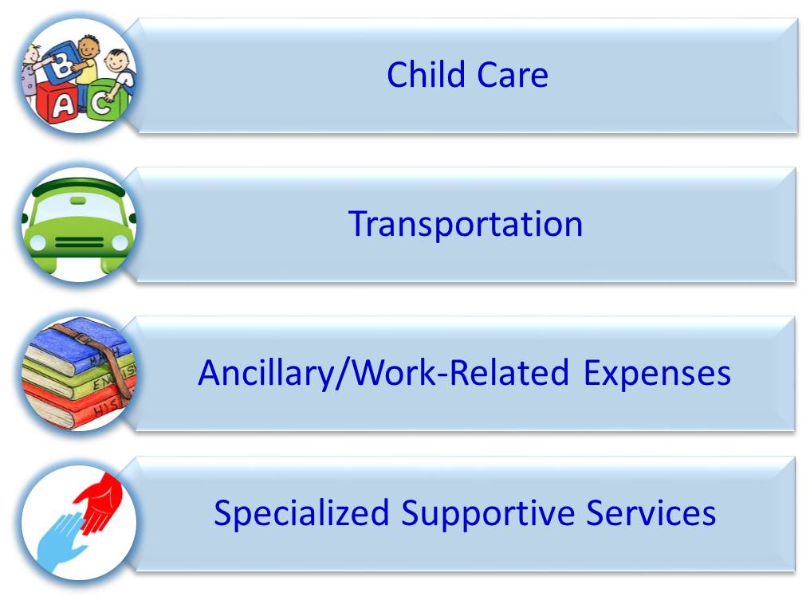
GAIN Supportive Services
County of Los Angeles
Department of Public Social Services
"To Enrich Lives Through Effective and Caring Service"

Slide 15
Family Stabilization (FS) Program
County of Los Angeles
Department of Public Social Services
Purpose
Destabilizing Situations
(not limited to)
Highlights
  Help participants to identify barriers that may be destabilizing their family and interfering with their participation in WtW activities.
  Homelessness or imminent risk of homelessness;
  Lack of safety due to domestic violence;
  Untreated or undertreated behavioral needs, including mental health or substance abuse related needs; and/or
  Other non-medical needs.
  Intensive Case Management;
  Children of participants enrolled in FS are eligible to receive mental health treatment services;
  Co-located Care Coordinators and Health Coordinators provide various community resources and provide additional support in addressing situations.
"To Enrich Lives Through Effective and Caring Service"

Slide 16

County of Los Angeles
Department of Public Social Services
"To Enrich Lives Through Effective and Caring Service"
General Relief (GR)
Cynthia Evans, HSA I
General Relief Program

Slide 17
General Relief Program
County of Los Angeles
Department of Public Social Services
The General Relief (GR) Program provides cash and supportive services to indigent adults who do not qualify for State or federal public assistance programs. GR is a 100% County-funded program.
Approximately 83,000 persons currently receive GR benefits.
The maximum monthly grant for one person is $221 and $375 for two persons, benefits are issued through an Electronic Benefit Transfer card or Direct Deposit.
Applications can be made:
  In-Person
  Fax
  Mail
  Online via Your Benefits Now (YBN)
"To Enrich Lives Through Effective and Caring Service"

Slide 18
Who’s Eligible to GR?
County of Los Angeles
Department of Public Social Services
Monthly net income is lower than the maximum GR grant of $221 for one person.
Personal property valued at $500 per person.
Motor vehicle is valued at $4,500 or less. Only one motor vehicle may be retained.
Cash on hand or in a bank account is valued at $50 per person or $100 per family at application, or $1,500 or less after approval.
Real Property (home) has an assessed value of $34,000 or less.
"To Enrich Lives Through Effective and Caring Service"

Slide 19
GR Eligibility
County of Los Angeles
Department of Public Social Services
Employable adults must participate in General Relief Opportunities for
Work (GROW).
Persons who self-declare they are unable to work due to a mental or physical disability must provide verification of the disability.
"To Enrich Lives Through Effective and Caring Service"

Slide 20
Supportive and Advocacy Services
County of Los Angeles
Department of Public Social Services
Mandatory Substance Use Disorder Recovery Program
Countywide Benefits Entitlement Service Team (CBEST)
"To Enrich Lives Through Effective and Caring Service"

Slide 21
Supportive and Advocacy Services
County of Los Angeles
Department of Public Social Services
General Relief Crisis Housing Program
  Provides shelter beds for GR applicants
General Relief (GR) Housing Subsidy and Case Management Project
  Provides a rental subsidy up to $475 per month
Single Adult Model
  Provides a permanent housing subsidy up to $750
DPSS/Sheriff Homeless Release Project
  Offers a pre-approval of GR, CalFresh, and referral for Medi-Cal; upon release, the issuance of a EBT card and/or housing voucher is processed the same day.
"To Enrich Lives Through Effective and Caring Service"

Slide 22


County of Los Angeles
Department of Public Social Services
"To Enrich Lives Through Effective and Caring Service"
Vardan Poghosyan, HSA I
GROW Program

Slide 23

Purpose of GROW
County of Los Angeles
Department of Public Social Services
DPSS implemented the General Relief Opportunities for Work (GROW) Program in February 1999, to assist employable General Relief (GR) participants achieve self-sufficiency.
GROW is mandatory for employable GR participants..
"To Enrich Lives Through Effective and Caring Service"

Slide 24
Purpose of GROW
County of Los Angeles
Department of Public Social Services
Employable GR participants may receive GR benefits for nine months in a 12 month period if they participate in 20 hours of GROW activities per week.
Unemployable GR participants may participate on a voluntary basis.
The GROW caseload is approximately 31,000
"To Enrich Lives Through Effective and Caring Service"

Slide 25
Purpose of GROW
County of Los Angeles
Department of Public Social Services
After completion of the GROW Orientation and an employment Appraisal, participants are enrolled in GROW Services/Activities within five main service components:
  Employment Development
  Education Services
  Youth Services
  Training Services
  Supportive Services
"To Enrich Lives Through Effective and Caring Service"

Slide 26
Veterans Outreach Program
County of Los Angeles
Department of Public Social Services
A partnership with the United States Department of Veterans Affairs and the Supportive Services for Veterans and Families Program.
The goals are to:
  reduce homelessness for veterans;
  provide expedited eligibility determination for veterans’ benefits; and
  assist veterans to become self-sufficient through employment.
"To Enrich Lives Through Effective and Caring Service"

Slide 27


County of Los Angeles
Department of Public Social Services
"To Enrich Lives Through Effective and Caring Service"
Luis Ontiveros, HSA I
Medi-Cal Program

Slide 28

Medi-Cal Overview
County of Los Angeles
Department of Public Social Services
Medi-Cal is the name for the Federal Medicaid Program in California.
Medi-Cal is a public health insurance program that provides health care coverage for individuals with limited income and resources.
As part of Health Care Reform, the goal is to increase the enrollment of uninsured individuals:
  Outreach at non-traditional sites (hospitals, clinics, schools, the Health and Nutrition Mobile Office, etc.).
  Partnership with other county departments, and community agencies.
"To Enrich Lives Through Effective and Caring Service"

Slide 29
Who can receive Medi-Cal?
County of Los Angeles
Department of Public Social Services
Children under 19 years of age
Adults 19-64 years of age
Parents/Caretaker Relatives
Pregnant women
Persons in skilled nursing facilities
Seniors 65 and older
Disabled Individuals (Meeting Social Security Administration disability criteria)
"To Enrich Lives Through Effective and Caring Service"

Slide 30
Who can receive Medi-Cal?
County of Los Angeles
Department of Public Social Services
MAGI MEDI-CAL
Single childless adults (19-64)
Children (under age 19)
Pregnant Women
Parent/Caretaker Relatives
Eligibility is determined based on corresponding Federal Poverty Level (FPL) for a specified MAGI population, and is calculated based on rules from the Internal Revenue Service.
Deprivation requirement is no longer considered and resources are exempt from the eligibility determination.
NON-MAGI MEDI-CAL
Aged (65 or over), Blind, or Disabled
Long-Term Care
Foster Care/Former Foster Care Children
Supplemental Security Income (SSI)
Medicare Savings Program
Medically Needy (MN)
Sneede
Home and Community Based Waiver
250% Working Disabled Program
Pickle Program
Minor Consent
"To Enrich Lives Through Effective and Caring Service"

Slide 31
Requirements for Medi-Cal Eligibility
County of Los Angeles
Department of Public Social Services
Residency
  The person must be a California resident.
Citizenship and Immigration Status
  U.S. citizens or non-citizens with satisfactory immigration status may receive full-scope coverage.
  Non-citizens without satisfactory immigration status may receive coverage limited to emergency, skilled nursing and pregnancy-related care.
Note: Due to the implementation of Senate Bill (SB) 75 in May 2016, all children under 19 years of age are eligible to full-scope Medi-Cal (MC) regardless of immigration status.
"To Enrich Lives Through Effective and Caring Service"

Slide 32
Requirements for Medi-Cal Eligibility
County of Los Angeles
Department of Public Social Services
Resources
The person’s principal residence is not counted in determining resources and eligibility.
  Resources must not exceed the limits based on family size. For example, resources for a family of four may not exceed the limit of $3,300.
The resource test only applies to eligibility determinations for the following populations:
  Aged
  Blind
  Disabled
  Long-Term Care
"To Enrich Lives Through Effective and Caring Service"

Slide 33
How to Apply for Medi-Cal
County of Los Angeles
Department of Public Social Services
On-line via Your Benefits Now (YBN) by logging on to https://www.dpssbenefits.lacounty.gov
Request an application by calling the Los Angeles County Customer Service Center (866) 613-3777.
Visit us at http://dpss.lacounty.gov and click on Health Care for a Medi-Cal application.
In person at any Department of Public Social Services (DPSS) District Office or outreach site.
Through Covered California at CoveredCA.com, or by calling (800) 300-1506.
"To Enrich Lives Through Effective and Caring Service"

Slide 34


County of Los Angeles
Department of Public Social Services
"To Enrich Lives Through Effective and Caring Service"
Cinthie Lopez-Paz, HSA I
IHSS Program

Slide 35


In-Home Supportive Services (IHSS):
County of Los Angeles
Department of Public Social Services
Pays for services provided to aged, blind, or disabled individuals so they may remain safely in their own homes.
Is an alternative to costly out-of-home care, such as a nursing home or board and care facility.
Pays for health and safety-related services, such as personal care and domestic services.
Does not pay for comfort-related services, such as friendly visits and pet care.
"To Enrich Lives Through Effective and Caring Service"

Slide 36
Eligibility
County of Los Angeles
Department of Public Social Services
  Linkage
  Age 65+, disabled, or blind
  AND
  Receiving SSI/SSP; or
  Meeting SSI/SSP criteria except for income or citizenship/
  immigration status and be eligible for Medi-Cal.
  Income
  Paying a share of cost for Medi‑Cal and IHSS benefits if income is above SSI/SSP limits
  Property
  Limits: Individual – $2,000
  Couple – $3,000
"To Enrich Lives Through Effective and Caring Service"

Slide 37
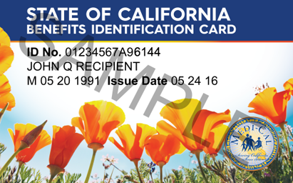
Eligibility
County of Los Angeles
Department of Public Social Services
Residency
  U.S. citizen, legal permanent resident, or qualified alien; and
  California resident; and
  Living in his/her own home that is not a nursing home or other out‑of‑home care facility
Health Certification
Health care certification from a licensed health care professional, indicating the IHSS applicant:
    Is unable to independently perform some activity of daily living; and
    Without IHSS, would be at risk for placement in out-of-home care.
"To Enrich Lives Through Effective and Caring Service"

Slide 38

Application Process
County of Los Angeles
Department of Public Social Services
Application taken by phone: (888) 944-4477 or
(213) 744-4477.
IHSS Social Worker
conducts in-home assessment to determine:
  Types of services needed, based on ability to perform certain tasks independently and safely; and
  Amount of time needed for each service.
Applicant notified in writing of approval or denial within 45 days.
If approved, applicant (now a “recipient”) must hire a provider.
  Recipient is considered the provider’s employer and is responsible for:
    Hiring
    Training
    Supervising
    Firing
"To Enrich Lives Through Effective and Caring Service"

Slide 39
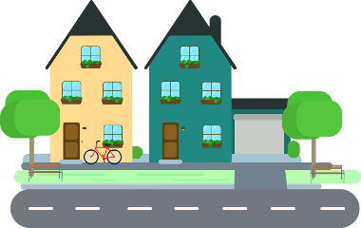
Own Home Requirement
County of Los Angeles
Department of Public Social Services
Own Home Definition
“…the place in which the individual chooses to reside. An individual’s ‘own home’ does not include an acute care hospital, skilled nursing facility, intermediate care facility, or a board and care facility. A person receiving an SSI/SSP payment for a nonmedical out-of-home living arrangement is not considered to be living in his/her home.”
Factors for Consideration
IHSS recipients must be able to receive authorized IHSS services at their own home.
Own home must be a legal residence.
Changes in living arrangements must be reported within 10 calendar days.
"To Enrich Lives Through Effective and Caring Service"

Slide 40


What is Considered a Home?
County of Los Angeles
Department of Public Social Services
House
Apartment
Townhouse
Condo
RV
In an RV park – own home if RV stays in one RV park.
Outside the home of a relative or friend – own home if RV is parked legally.
Motel room
Own home if individual stays there continuously, not just on a night-to-night basis.
Home of relative or friend (while looking for permanent home)
Long-term homeless shelter or transitional housing
If individual stays there continuously and authorized services limited to those not provided by the shelter (e.g., meal preparation).
"To Enrich Lives Through Effective and Caring Service"

Slide 41


County of Los Angeles
Department of Public Social Services
"To Enrich Lives Through Effective and Caring Service"
Carlos Portillo, HSA I
CalFresh Program

Slide 42

What is CalFresh?
County of Los Angeles
Department of Public Social Services
The new name for California’s Food Stamp Program is “CalFresh.”
The purpose of this program is to promote and safeguard the health and well-being of low-income individuals and households by increasing their food purchasing power and raising their levels of nutrition.
A person who is approved to receive CalFresh benefits is issued an Electronic Benefit Transfer (EBT) card, just like an ATM card, to purchase food at various supermarkets or grocery stores.
Who can get CalFresh benefits?
Low-income persons who do not have enough money to buy the food they need to stay healthy.
U.S. Citizens or legal non-citizens.
All persons in the household do not have to be related or have children in order to be eligible for CalFresh benefits.
In California, persons receiving SSI/SSP are not eligible for CalFresh benefits.
"To Enrich Lives Through Effective and Caring Service"

Slide 43
Application Process
County of Los Angeles
Department of Public Social Services
STEP 1 – Completing the application
There are 3 easy ways to apply for CalFresh
Apply On-Line: By using our YBN website
dpss.lacounty.gov
In Person – At the following locations:
  Local DPSS CalFresh District Office
  Certain Community and Faith-Based Organizations
  visit calfreshoutreach.lacounty.gov for more information
  At convenient Community CalFresh Outreach Sites
By Mail: Call the Customer Service Centers at:
Local phone numbers: (626) 569-1399; (310) 258-7400; (818) 701-8200 or Toll Free (866) 613-3777.
"To Enrich Lives Through Effective and Caring Service"

Slide 44
Application Process
County of Los Angeles
Department of Public Social Services
STEP 2 – The Interview
The application interview is an official and confidential discussion of the household’s circumstances, which directly relate to the determination of CalFresh eligibility and benefits issuance.
By telephone, or face-to-face ([Not required] only at the request of the applicant) at the local DPSS office.
STEP 3 – Verifications
CalFresh applicants will be asked to provide verification or proof of the information they include in their applications.
STEP 4 – Approval or Denial
DPSS is required to notify all applicants of the decision on their case within 30 days of the date of their application.
"To Enrich Lives Through Effective and Caring Service"

Slide 45


CalFresh Outreach & Marketing Efforts
County of Los Angeles
Department of Public Social Services
We continue to build on the strong and broad partnership built over the past years with community organization, agencies, County Departments and cities. Our goal is to enhance and expand the collaboration with our community partners.
How to access the CalFresh Outreach Toolkit:
CalFreshoutreach.lacounty.gov
"To Enrich Lives Through Effective and Caring Service"

Slide 46


County of Los Angeles
Department of Public Social Services
"To Enrich Lives Through Effective and Caring Service"
Your Benefits Now (YBN)
Carlos Portillo, HSA I
CalFresh Program

Slide 47

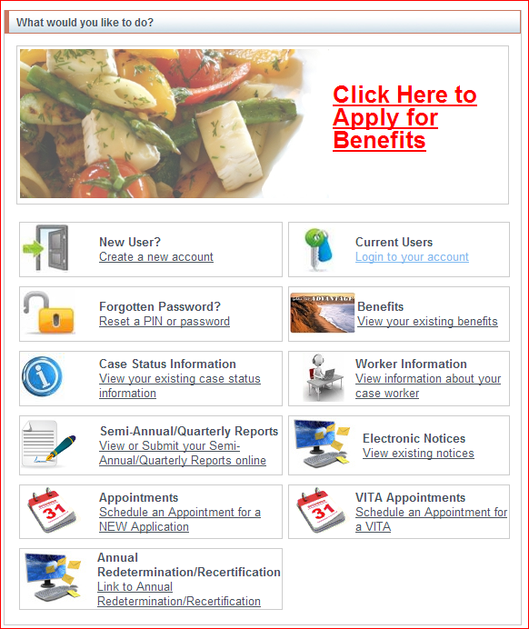
Your Benefits Now Home Page
County of Los Angeles
Department of Public Social Services
Apply Online
Submit QR/SAR
View eNotices
Schedule Appointment
View Case Status
Worker Information
Submit Annual RD/RC
"To Enrich Lives Through Effective and Caring Service"

Slide 48
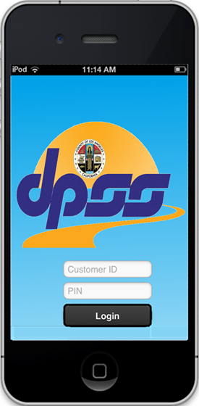


DPSS Mobile App – Your Benefits Now (YBN)
County of Los Angeles
Department of Public Social Services
"To Enrich Lives Through Effective and Caring Service"

Slide 49
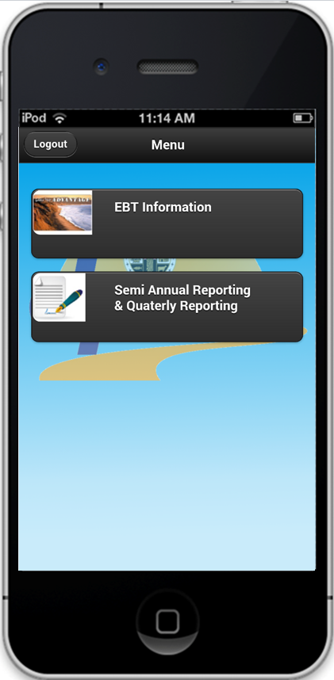
Menu Page
County of Los Angeles
Department of Public Social Services
LA County DPSS Mobile app allows users to:
  View their EBT balance
  Take a picture to upload proof of the changes reported on their Semi Annual Report(SAR-7) or Quarterly Report(QR-7)
"To Enrich Lives Through Effective and Caring Service"

Slide 50
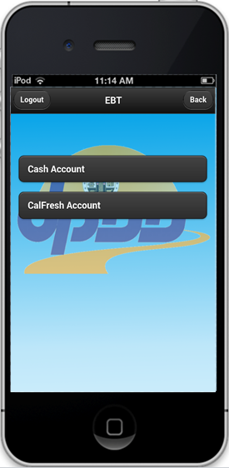
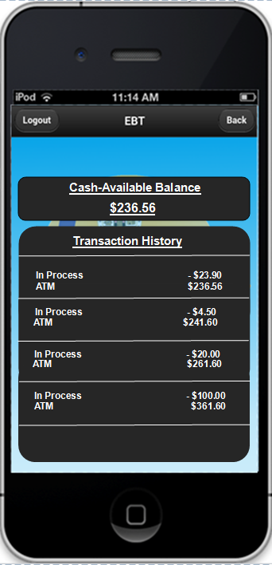
EBT Account (View Balance & Transaction History
County of Los Angeles
Department of Public Social Services
EBT INFORMATION:
Available balance
Transaction History
Status/Post Date
Transaction Amount
Merchant Information
Balance after transaction
"To Enrich Lives Through Effective and Caring Service"

Slide 51
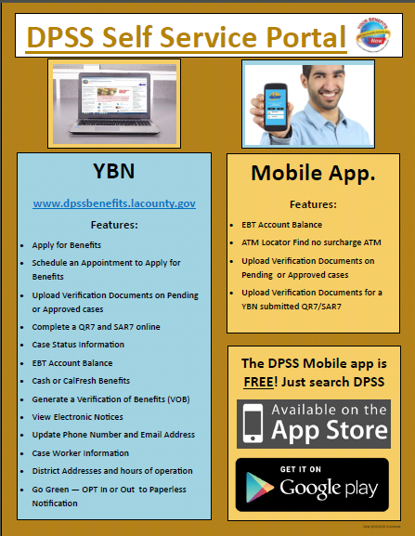
County of Los Angeles
Department of Public Social Services
"To Enrich Lives Through Effective and Caring Service"

Slide 52
RESOURCES
County of Los Angeles
Department of Public Social Services
For additional information, visit our website by clicking or copying the following links:
Department of Public Social Services (DPSS)
http://dpss.lacounty.gov/wps/portal/dpss
For additional information regarding our individual programs, visit their website:
General Relief (GR)
http://dpss.lacounty.gov/wps/portal/dpss/main/programs-and-services/general-relief
General Relief Opportunities for Work (GROW)
http://dpss.lacounty.gov/wps/portal/dpss/main/programs-and-services/general-relief-opportunities-for-work
California Work Opportunity and Responsibility to Kids (CalWORKs)
http://dpss.lacounty.gov/wps/portal/dpss/main/programs-and-services/calworks
Greater Avenues for Independence (GAIN)
http://dpss.lacounty.gov/wps/portal/dpss/main/programs-and-services/greater-avenues-for-independence
Medi-Cal
http://dpss.lacounty.gov/wps/portal/dpss/main/programs-and-services/health-care
In-Home Supportive Services (IHSS)
http://dpss.lacounty.gov/wps/portal/dpss/main/programs-and-services/in-home-supportive-services
CalFresh
http://dpss.lacounty.gov/wps/portal/dpss/main/programs-and-services/calfresh
Your Benefits Now (YBN)
https://www.yourbenefits.laclrs.org
"To Enrich Lives Through Effective and Caring Service"

Slide 53
Questions?

