Slide 1
Navigating the Substance Use Treatment Network and Benefit Package
Los Angeles County Health Agency
Department of Public Health
Substance Abuse Prevention and Control
Notes:
Good morning. We are with the Los Angeles County Department of Public Health Substance Abuse Prevention and Control.

Slide 2
OBJECTIVES FOR THIS WORKSHOP
Describe the County’s Substance Use Disorder (SUD) System of Care
Discuss successes/barriers you have experienced in linking clients
Explain how the benefits package can help housing/homeless service providers and clients

Slide 3

Are your clients successfully connecting with SUD treatment?
What could be improved to increase
SUD referrals and admissions?
How can our network providers better serve individuals who are homeless?
Have you and your clients been satisfied with the services received from SAPC and
our SUD providers?
Notes:
As we walk through our system of care, we invite you to consider the following questions in terms of your experiences with SUD treatment services.

Slide 4
substance Abuse prevention and control (SAPC)

Slide 5

What is a Substance Use Disorder (SUD)?
Chronic illness characterized by clinically significant impairments in health and social functions
Includes the misuse, dependence, and addiction to alcohol and/or legal or illegal substances
Encompass a range of severity levels, from problem use to dependence and addiction
A best course of action determined by the level of severity of the SUD
Notes:
The healthcare system has been in transition since adoption of the Affordable Care Act (ACA) in 2010. With expansion of the Medi-Cal eligible population in January 2014 and the State’s submission of the Drug Medi-Cal Organized Delivery System (DMC-ODS) Waiver to the Centers for Medicare and Medicaid (CMS) in November 2014, the substance use disorder (SUD) system is on the pathway to parity with the physical and mental health systems. This will be a long, and at times challenging transition for our field, but necessary to improve the quality and availability of services that will lead to better health and social outcomes for our clients.

Slide 6
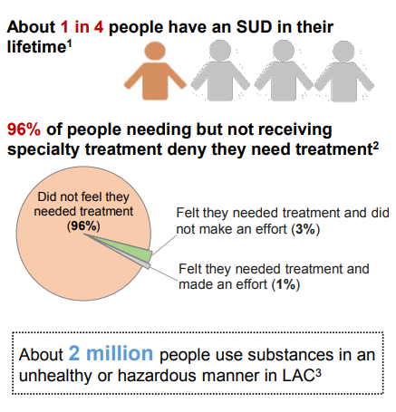
Notes:
60-80 million people (20-25% of total US population) use at a risky level
Ask: What are Risky levels
21 million people (7% of total US population) have problems needing treatment, but are not receiving it
Ask crowd why folks aren’t receiving tx
2 million people (<1% of total US population) are receiving treatment
Meaning that only 8 percent of folks who need SUD tx are getting it. That means 92% of folks who need it aren’t getting it. Why??

Slide 7
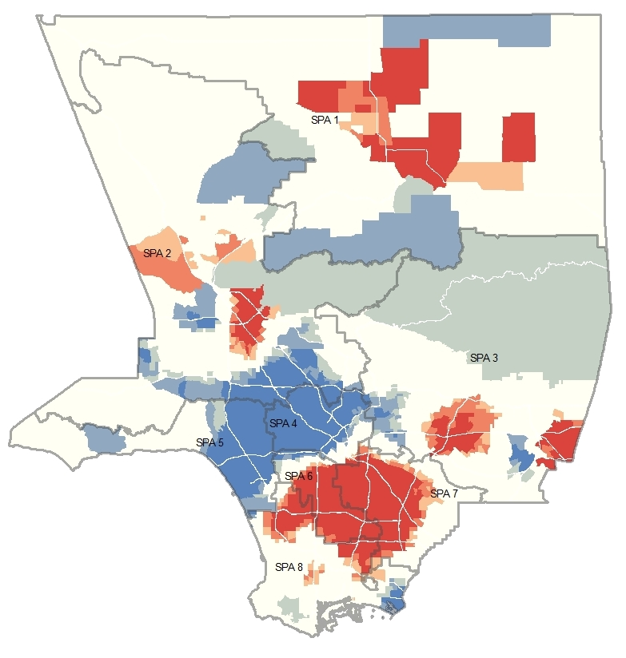
Drug Medi-Cal Eligible “Hot Spots”
Red areas indicate the highest concentration of DMC eligible people; Blue areas indicate the lowest concentration of DMC eligible people.

Slide 8
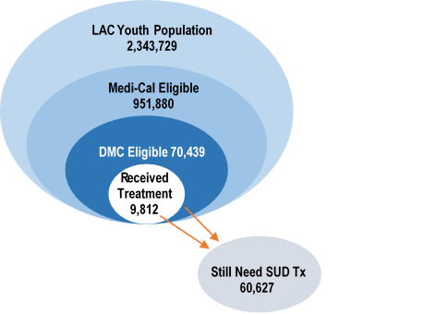
MEDI-CAL POPULATION AND TREATMENT
YOUTH
ADULTS
6%
4%

Slide 9

SAPC Vision: All people and communities in Los Angeles County have a chance to pursue their dreams and to fulfill their promise without the burden of alcohol or drug abuse and addiction.
SAPC Mission: Leads and facilitates the delivery of a full spectrum of prevention, treatment and recovery support services proven to reduce the impact of substance abuse and addiction.
START-ODS Goal: Provide countywide access to “Precision Addiction Medicine” with the right service, at the right time, for the right duration, in the right setting.

Slide 10
About Our Patients: FY 2015-2016
55,985 SUD treatment admissions (not unique clients)
26.3% Mental Health Issues
15.3% Medical Problems
19.0% Disability
33.8% Speak language other than English at home
14.8% Criminal justice involved
Notes:
This is a snapshot of SAPC’s patient base.
Read slide stats.

Slide 11
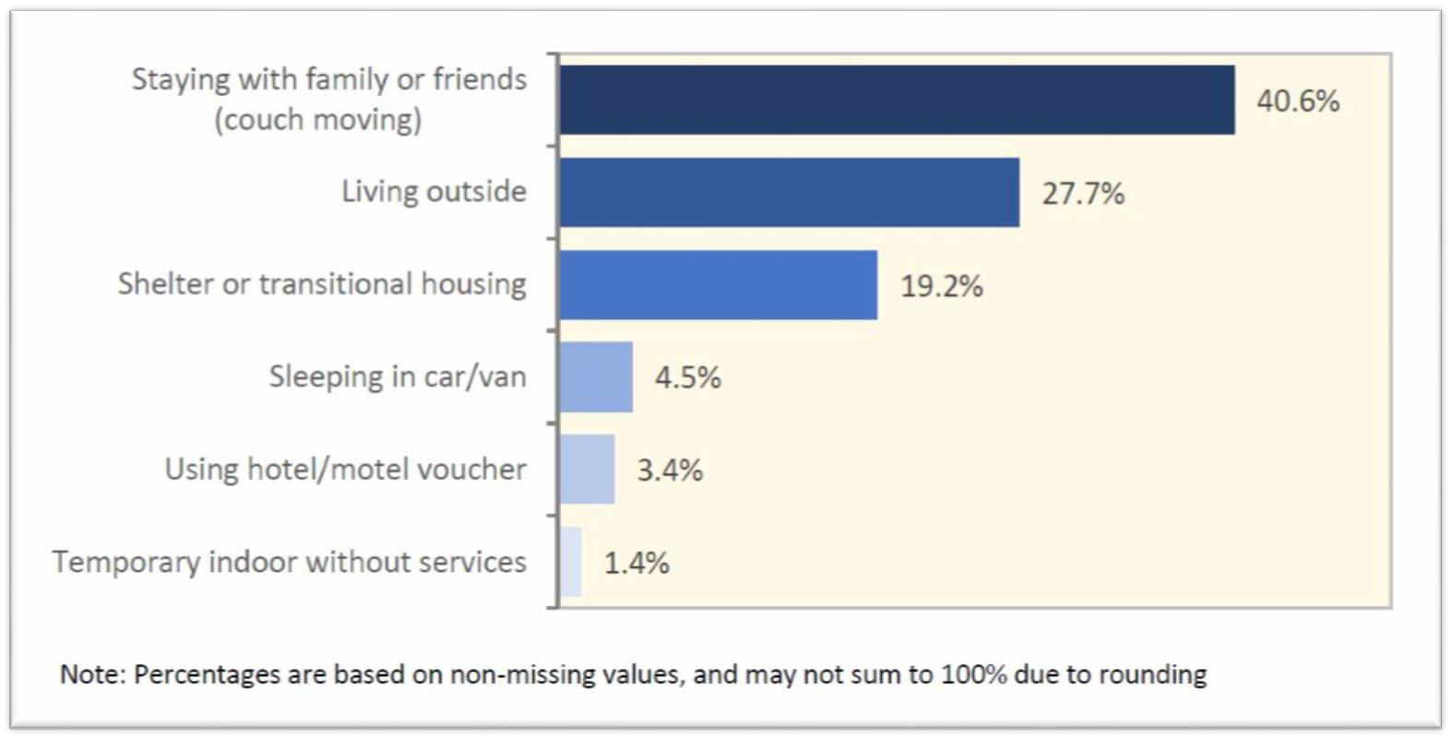
Homeless and Unstably Housed Patients
21.5% or 9,166 patients were homeless or unstably housed at
admission in FY 15-16.
Living Arrangements Among Homeless Patients, FY 15-16
Notes:
Approximately 1/3 report stable housing at discharge

Slide 12
Age of First Primary Drug Use
11 or Under 4.3%
12-17 43.1%
18-25 34.6%
26 and Over 18.0%
Drug of Choice
Heroin 40.3%
Methamphetamine 21.6%
Marijuana 13.9%
Alcohol 13.4%
Prescription drug 6.0%
Cocaine 3.7%
ABOUT OUR PATIENTS
Race/Ethnicity
Hispanic/Latino 46.5%
White 34.5%
Black/African American 13.9%
Asian/Pacific Islander 13.4%
American Indian/Alaska Native 6.0%
Other 2.6%
Age
12-17 6.9%
18-25 15.0%
26-44 44.7%
45-64 31.1%
65+ 2.2%
Notes:
Read slide

Slide 13

START-ODS
SYSTEM TRANSFORMATION TO ADVANCE RECOVERY AND TREATMENT
Los Angeles County’s Substance Use Disorder Organized Delivery System
Participation in California’s Medi-Cal 2020 Waiver is the greatest opportunity in recent history to design and implement a substance use disorder (SUD) system of care that has the financial and clinical resources to more fully address the complex needs of all our patients.
Notes:
The SUD Organized Delivery System Waiver comes with significant opportunities to improve our system of care, but also comes with significant expectations of our providers.
New opportunities to provide better care for our clients include: The provision of case management, care coordination both within the SUD system and with other systems such as health and mental health, recovery support services, physician consultation services for DMC physicians, and enhanced access to medication-assisted treatment.
The higher expectations of our providers include: Required use of evidence-based practices (EBP) such as Motivational Interviewing and Cognitive Behavioral Therapy, required use of the ASAM Criteria and DSM-5 diagnoses to determine medical necessity and the appropriate level of care, and enhanced documentation that is more detailed and frequent than previously provided.
The SUD Organized Delivery System Waiver is an unprecedented opportunity to truly transform and upgrade our system of care, and its success will depend heavily on SAPC and its providers to effectively work together to serve our patients.
SAPC is fully committed to do what it can to ensure providers have the tools in terms of training, finances, and support to accomplish the goals of the SUD Organized Delivery System Waiver, and will rely on its providers for their active participation in this process. SAPC will be holding various workgroups focused on several key aspects of the waiver in the coming months, and will rely on providers to attend and participate so they can help to shape and build our redesigned system of SUD care.

Slide 14
California’s Medi-cal 2020 waiver
Key components of the DMC-ODS section of the waiver:
Significantly expands the DMC reimbursable benefit package
Relies on the ASAM Criteria for placement determinations
Emphasizes use of select evidence-based practices
Requires utilization management and quality improvement efforts
Transfers more administrative oversight and accountability to counties
Enables higher DMC rates and use of alternative payment models
Expects efficient use of resources and reductions in overall health costs
Prioritizes integration and coordination of care with physical and mental health services and systems, including health plans
Notes:
The last is a key component you will see throughout our presentation.

Slide 15
SUBSTANCE USE DISORDER BENEFIT PACKAGE

Slide 16
Los Angeles County’s SUD Benefit Package
Outpatient for At-Risk Youth and Young Adults
Outpatient
Recovery Support Services
CASE MANAGEMENT
Support Transitions in Care
Integration of Care
Service Linkages
Opioid Treatment Programs/ Medication- Assisted Treatment
Intensive Outpatient
Recovery Bridge Housing
Residential
Withdrawal Management

Slide 17
START-ODS Benefit Package
Service | Services | Time | Duration
Outpatient Services for At-Risk | Intake Services Intake and Assessment Treatment Planning Direct Services Individual Counseling Group Counseling Patient Education Case Management | Youth (12-20): No more than 4 hours of service per 60-days, including up to 2 hours for intake services Adults (21+): Service is not available | Youth and young adults can receive one episode of services every 60-days, if additional services are needed the individual may be more appropriate for outpatient services
Outpatient Services | Intake and Assessment Treatment Planning Individual Counseling Group Counseling Family Therapy Collateral Services Patient Education Crisis Intervention Medication Services Case Management Discharge Planning | Youth (under 18): 0 to 6 hours of service per week Adults (over 18): 0 to 9 hours of service per week | Available to youth and adults. No limit if medically necessary and in accordance with the individualized treatment plan.
Notes:
So, as any managed care model of care, START-ODS has a benefit package of services, with limits depending on age, and as indicated by medical necessity. This slide has the scope of services for outpatient. Most services include intake assessment, treatment planning, counseling (individual or group); in the case of outpatient, there is crisis intervention, case management.

Slide 18
START-ODS Benefit Package
Service | Services | Time | Duration
Intensive Outpatient Services | Intake and Assessment Treatment Planning Individual Counseling Group Counseling Family Therapy Collateral Services Patient Education Crisis Intervention Medication Services Case Management Discharge Planning | Youth (under 18): 6 to 19 hours of service per week Adults (over 18): 9 to 19 hours of service per week Perinatal 9 to 30 hours of service per week | Available to youth and adults. No limit if medically necessary and in accordance with the individualized treatment plan.
Notes:
The intensive outpatient covers 6-30 hours per week. (at one point SAPC had day care services primarily for perinatal women.)

Slide 19
START-ODS Benefit Package
Service | Services | Time | Duration
Residential Treatment | Intake and Assessment Treatment Planning Individual Counseling Group Counseling Family Therapy Collateral Services Patient Education Crisis Intervention Medication Services Safeguarding Meds Transportation Case Management Discharge Planning | Requires prior County authorization Initial 60-day authorization for adults and 30 days for youth, with extensions based on medical necessity Los Angeles County may fund more than two stays per year based on medical necessity or early discharge | Youth (under 18): No authorization limits as long as medical necessity establishes the need for ongoing residential service Young Adults (18-20): No authorization limits as long as medical necessity establishes the need for ongoing residential service Adults (over 21): Initial authorization for 60 days with continued services based on medical necessity Perinatal Females: Up to length of the pregnancy and through the last day of the month that the 60th day after delivery occurs Criminal Justice: Extension up to 6-months if medically necessary

Slide 20
START-ODS Benefit Package
Service | Services | Time | Duration
Withdrawal Management | Intake and Assessment Observation Medication Services Discharge Planning | Up to 14 days of service per episode. No authorization required except for minors. | Available only to adults and as medically necessary. Youth services based on medical necessity.
Opioid Treatment Program and Medication- Assisted Treatment | Prescribe Medications: Methadone Buprenorphine Disulfiram Naloxone Medical Psychotherapy Intake and Assessment Treatment Planning Individual Counseling Group Counseling Patient Education Family Therapy Patient Education Crisis Intervention Medication Services Case Management Discharge Planning | 50-200 minutes of counseling per calendar month, although additional services may be provided based on medical necessity | Available only to adults (18 year of age and up). Youth may be provided services based on medical necessity. These programs couple the daily or several times weekly use of prescribed opioid agonist medication with counseling to maintain stability for those with severe opioid use disorder
Notes:
Withdrawal management (detox) is up to 14 days; no authorization for minors needed. Opioid Treatment Program. 1-3 hours of counseling per month and that time can be spent on family therapy, patient education, etc. It aims to maintain stability of patients with severe opioid use disorder.

Slide 21
START-ODS Benefit Package
Service | Services | Time | Duration
Recovery Support Services | Individual Counseling Group Counseling Recovery Monitoring Recovery Coaching Relapse Prevention Linkages to Services Educational Vocational Family Supports Community Supports Housing Transportation Case Management | Youth (12-17): No more than 6 hours per month Adults (18+): No more than 7 hours per month | Available to youth and adults who have completed substance use treatment. The benefit is generally available for up to 6 months.
Recovery Bridge Housing | Safe living space that is supportive of recovery for adults who are receiving outpatient, intensive outpatient and opioid treatment program services. Requires an Authorization | - Up to 180 days per calendar year for eligible patients - Up to the length of pregnancy and postpartum period of 60 days based on medical necessity for females. | Available only for adults.

Slide 22
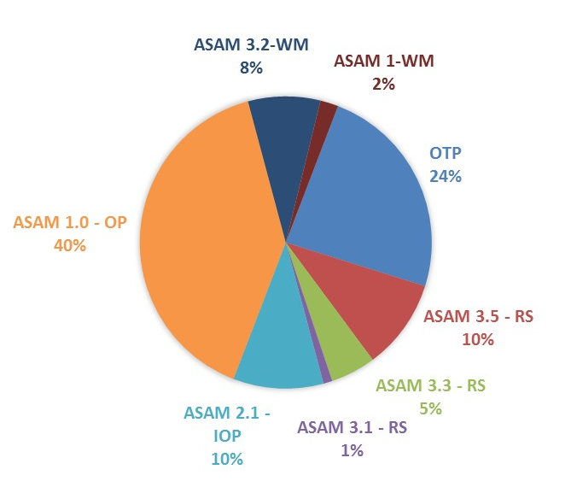
Estimated Utilization by Level of Care
Notes:
Applied this adjusted % breakdown to all three levels (low, medium, & high) of estimation.

Slide 23
Case Management
Three core case management functions:
  Connection:
  Establish connections through referrals that link patients to housing, educational, social, prevocational, vocational, rehabilitative, or other community services.
  Coordination:
  Care coordination to address fragmentation of care and help improve navigation and access to treatment across the different systems of care
  Communication:
  Ensures clear lines of communication between patients and others
SUD case managers are at minimum registered SUD counselors
Notes:
From the earlier diagram, you can see that case management is a critical foundation that ties all services together to ensure an integrated and coordinated system

Slide 24
ELIGIBILITY
AND
ACCESS
Notes:
How does a client access SUD services in LA County and how does one become eligible for those services?

Slide 25
Eligibility
Youth, young adults and adults can access no-cost (no fees) substance use treatment services at any provider in the network if they meet the following criteria and meet medical necessity:
Medi-Cal Eligible or Enrolled
(active benefits are not required at time of screening, referral, or intake)
OR
My Health LA Eligible or Enrolled
(active participation is not required at time of screening, referral, or intake)
OR
Other County-Funded Program Participant
(such as AB 109, Drug Court, CalWORKs, General Relief)
Los Angeles County Resident
+
Notes:
Youth, young adults and adults can receive SUD treatment at no cost and with no fees, provided they are a County resident and are Medi-Cal eligible or enrolled. Also, there are other County funded programs, such as AB109 and Drug Courts that refer residents to SAPC services.

Slide 26




Main Entryways into the Specialty SUD System
Self-Referrals &
County Stakeholders*
Whole Person Care: Substance Use Disorder Engagement, Navigation and Support (SUD-ENS) Program
1. SASH
2. CENS
Communication & care coordination
3. Direct-to-provider
Substance Abuse Service Helpline (SASH)
Responsible for initial
screening and referral to
SUD provider
1-844-804-7500
Operates 24 hours per day and
365 days per year
Client Engagement &
Navigation Services (CENS)
SUD assessors and navigators at
co-located State, County
and city sites
SUD Providers
Responsible for delivery of SUD services
*No wrong door approach
Notes:
This provides an illustration how clients and your staff are able to enter our SUD system of care.

Slide 27


#1: Substance Abuse Service Helpline (SASH)
Toll-free number: 1-844-804-7500
Call agents available 24 hours per day 365 days per year
Screening and referral services for youth, young adults, and adults
Assessment appointment scheduled during business hours
Agents provide a warm hand-off to SUD treatment providers

Slide 28
#2: Client Engagement Navigation Services (CENS)
Targets those who require face-to-face and higher touch interactions to access SUD treatment (primarily through County including the criminal-justice-involved, uninsured, homeless, and/or with co-occurring disorder)
Conduct outreach and engagement, Medi-Cal/MHLA enrollment, screening, referral, client/agency/community education, service navigation, ancillary linkages
Area Offices | Co-Located Sites
One CENS Area Office in each SPA Receives referrals from DPSS CalWORKs and General Relief, DCFS, Superior Court | Probation Department HUBS, Area Offices Sheriff’s Department Jails Los Angeles Superior Courts Urgent Care Centers, Psychiatric ERs FQHCs, Hospital ERs Homeless Encampments, Permanent Supportive Housing
Notes:
The CENS assist on a one-on-one level, usually individuals who are involved with law enforcement or access other public services. They are co-located.

Slide 29

#3: Direct to SUD Providers
Client
County Departments/Programs (e.g., DHS-Whole Person Care)
Service Providers (e.g., homeless service organizations)
Health Plans
Courts
Schools
Other Government and Non-Government Agencies
Other Institutions
No Wrong Door Approach
Notes:
The Whole Person Care (WPC) Program provides comprehensive and coordinated services to the sickest, most marginalized LA County Medi-Cal beneficiaries. Program participants are assigned to Community Health Workers, who then link and assist them in navigating needed health and social services such as SUD treatment, housing, medical and mental health services, etc. If needed, Community Health Workers assist participants in accessing SUD treatment by, for example, contacting the SASH.
Bottom line: No wrong door approach

Slide 30
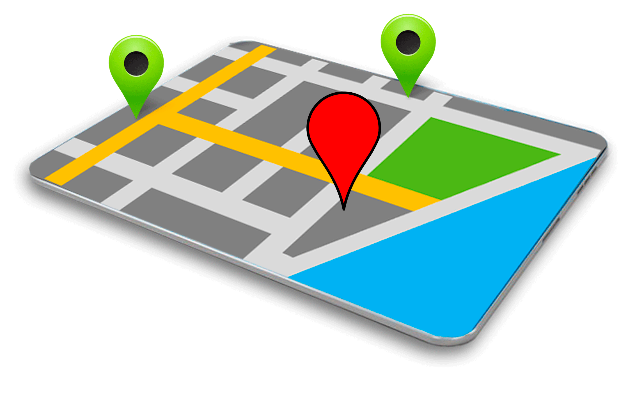
Service and Bed Availability Tool (SBAT)
What? User-friendly SUD treatment services locator and provider directory of bed availability and intake slots.
How? Publicly accessible, web-based platform
Who? SASH, CENS, general public, providers
When? Updated regularly (daily)
Where? Available At: http://sapccis.ph.lacounty.gov/sbat/
Notes:
All three entry points may use the SBAT to identify available providers.

Slide 31
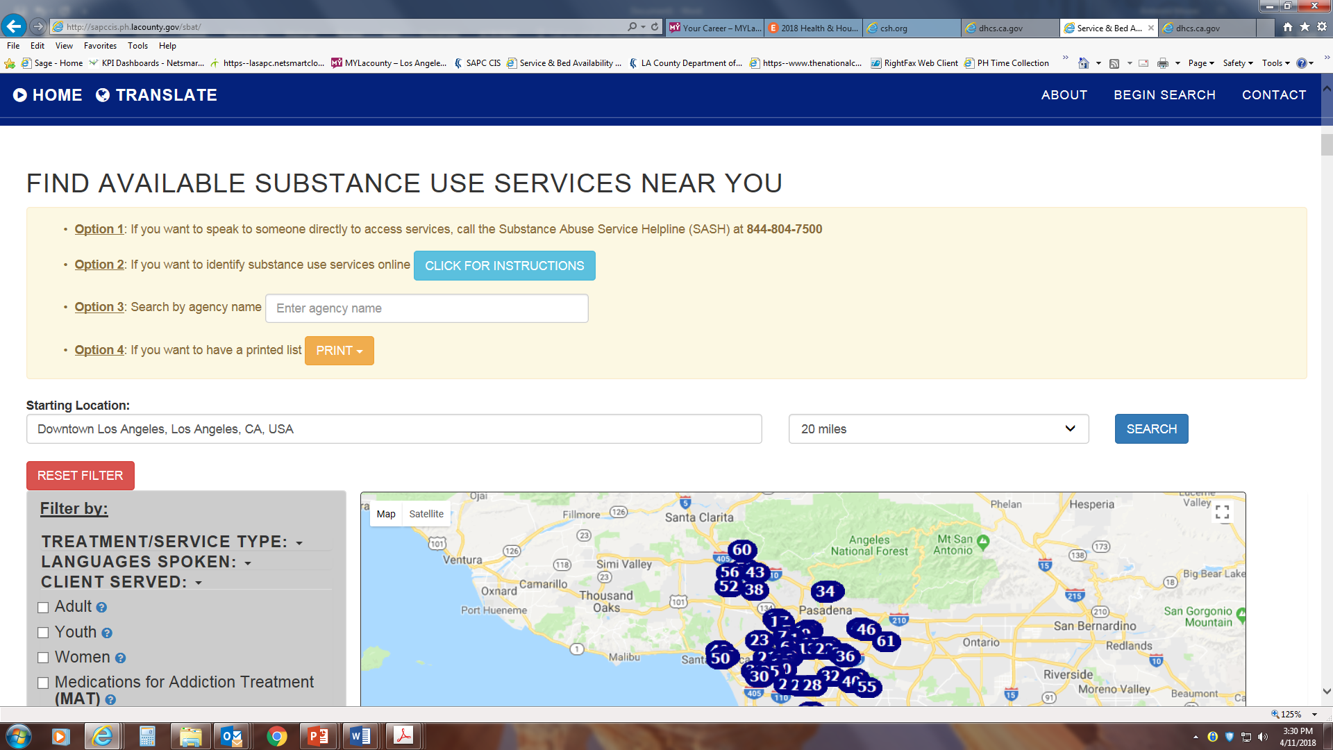
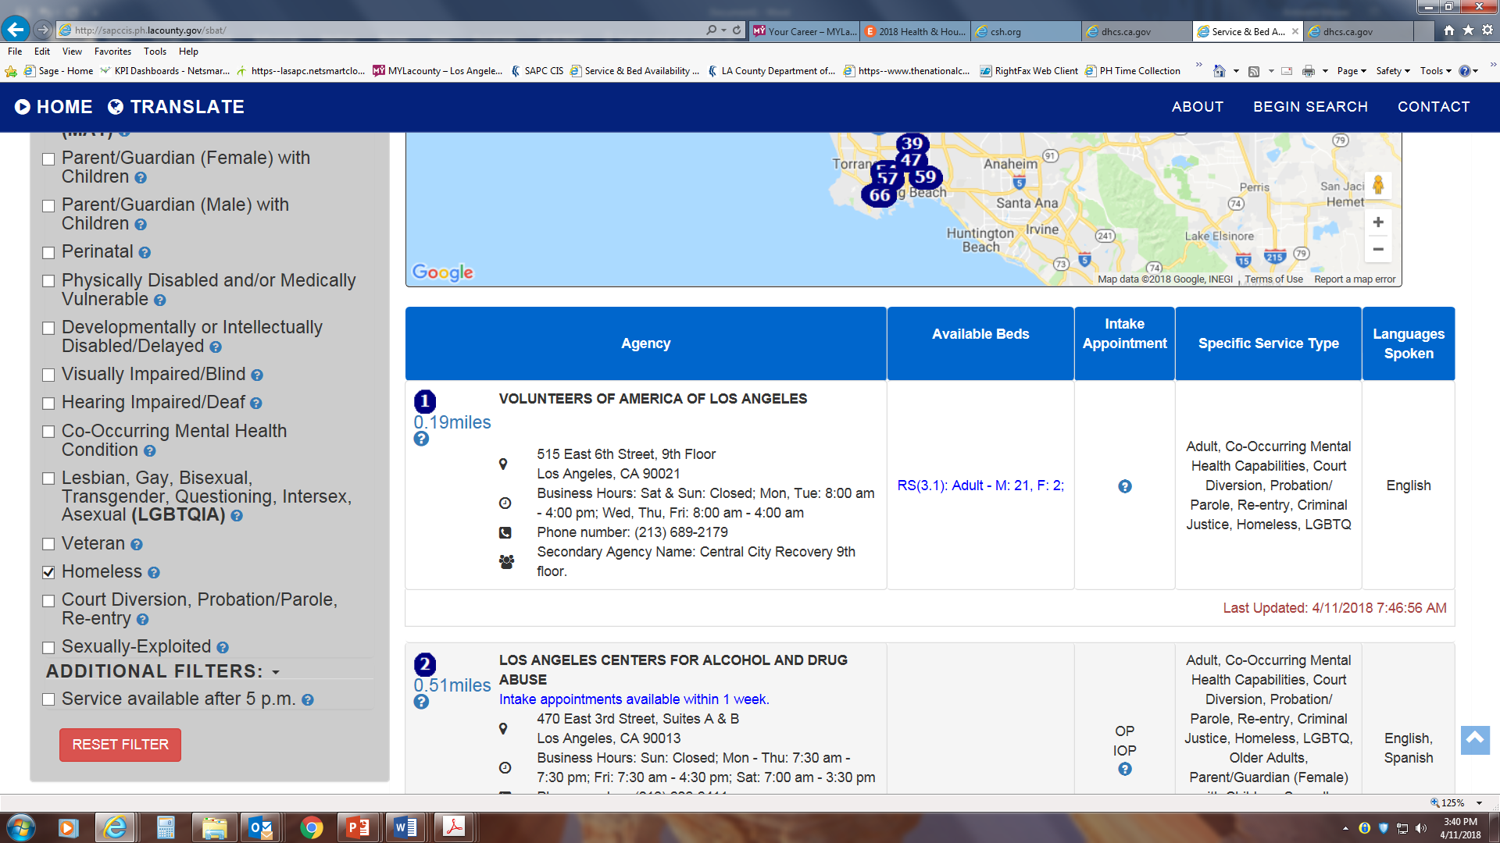
Notes:
This slide shows the type information found on the SBAT. Agency, address, services available, specialty services and languages spoken by staff. Emphasize filter function on “Clients Served” which gives a list of providers that serve the youth, adult, and parents with children populations.

Slide 32
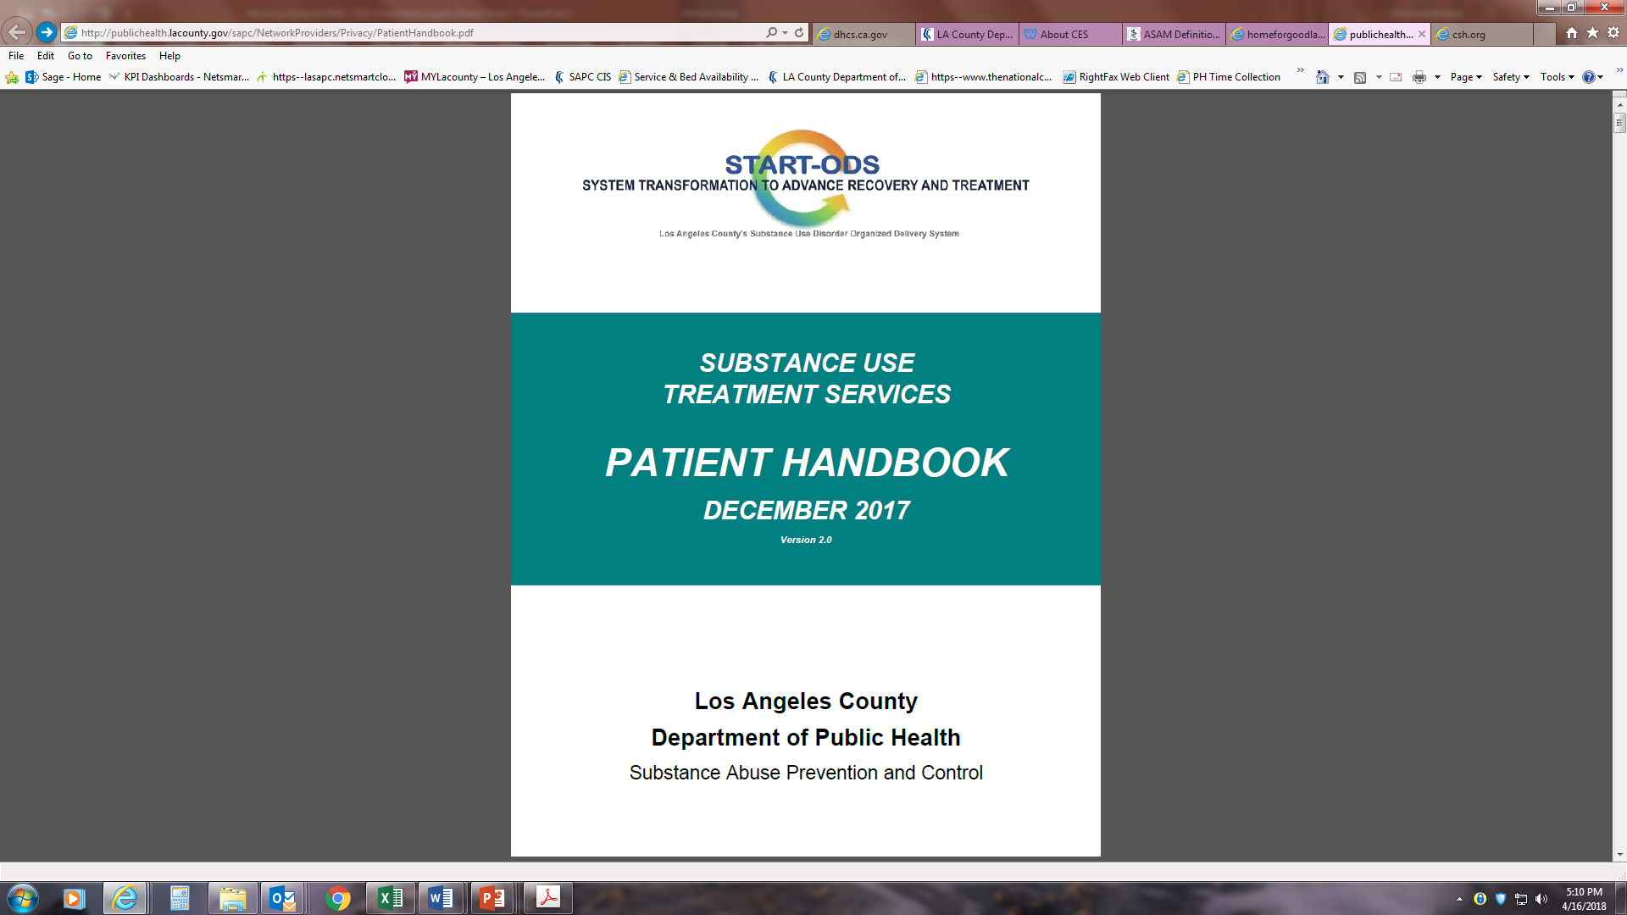
Available At: http://publichealth.lacounty.gov/sapc/NetworkProviders/Privacy/PatientHandbook.pdf
Patient Handbook
KEY COMPONENTS
Eligibility
Member Assistance
Benefit Package
Provider Selection Process
Appeals/Grievance Process
Member Rights
Member Responsibilities
Confidentiality
Notes:
Our patient handbook provides all required information related to the benefit package, provider section, appeals and grievance process, member rights and responsibilities and strict confidentiality provisions.

Slide 33
SUD BENEFIT PACKAGE and services for homeless

Slide 34
Los Angeles County’s SUD Benefit Package
MEDI-CAL MANAGED CARE HEALTH PLANS
L.A. CARE, HEALTH NET
Recovery Support Services
Outpatient for At-Risk Youth and Young Adults
Outpatient
CASE MANAGEMENT
Support Transitions in Care
Integration of Care
Service Linkages
COUNTY HEALTH AGENCY
HEALTH SERVICES MENTAL HEALTH
PUBLIC HEALTH
Intensive Outpatient
Opioid Treatment Programs/ Medication- Assisted Treatment
COUNTY SERVICES
HOMELESS SERVICES JUSTICE SERVICES
FAMILY SERVICES
Residential
COMMUNITY SERVICES
HOUSING SERVICE PROVIDERS
SOCIAL SERVICE PROVIDERS
OTHER COMMUNITY BASED PROVIDERS
Withdrawal Management
Recovery Bridge Housing
Notes:
Ensuring integrated and coordinated care through our various partners and stakeholders

Slide 35
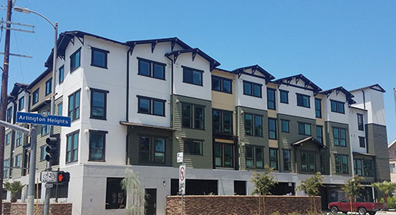
Measure H-Funded CENS Activities
CENS at Permanent Supportive Housing (PSH) Sites
Funded under Homeless Strategy D7

Slide 36
Measure H-Funded CENS Activities
Goal: to prevent eviction due to relapse by connecting residents to substance use disorder (SUD) treatment.
Targets:
  Individuals residing at or matched to project-based and scattered PSH sites throughout Los Angeles County.
  PSH residents who have relapsed and who are referred to CENS for SUD screening and referral.
Number to be served: Approximately 1/3 of D7 participants will receive CENS services.

Slide 37
Other Co-Located Services
SAPC providers are co-located at Family Solutions Centers countywide to provide SUD screening, referral, and education services.
SPA | FSC Sites
1 | Valley Oasis
2 | LA Family Housing
3 | Union Station Homeless Services
4 | People Assisting the Homeless
5 | St. Joseph Center
6 | Special Services for Groups - HOPICS
7 | The Whole Child
8 | Harbor Interfaith
Notes:
FSC SUD Counselors can provide access and information on SUD providers that serve families/parents with child/ren.

Slide 38
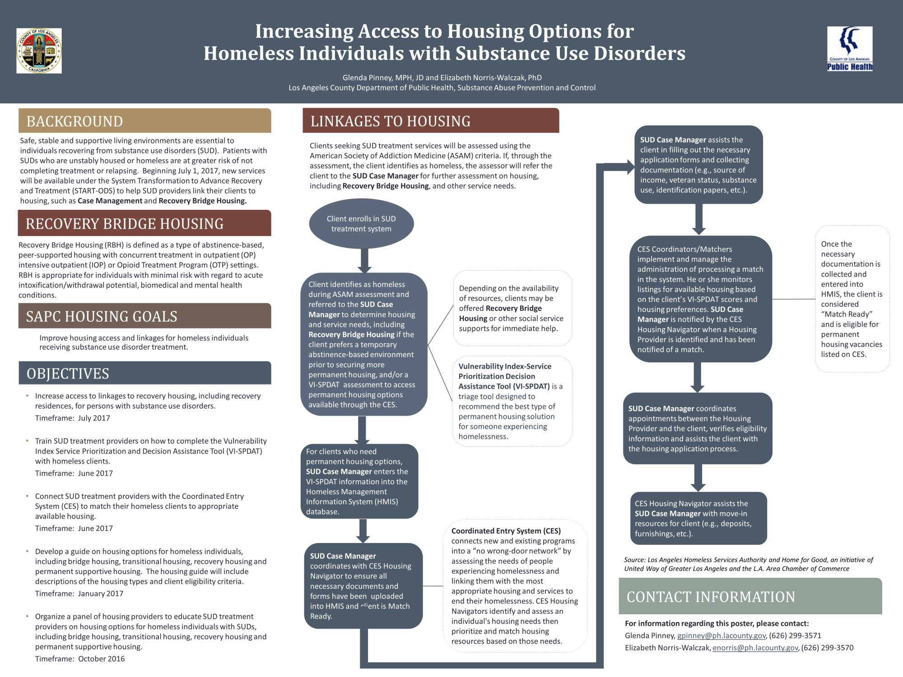
Notes:
19 providers who currently have access to HMIS
SUD Case Manager¹ conducts the CES Survey Packet for Adults including VI-SPDAT, or Next Step Tool for Youth²
SUD Case Manager enters or updates information into Homeless Management Information System (HMIS)³
SUD Case Manager advises the CES agency that patient information has been entered into HMIS

Slide 39
SUD CASE MANAGERS & HOMELESS SERVICE COORDINATION
Connection
Conduct housing assessments (e.g., CES Survey Packet for Adults including VI-SPDAT, and Next Step Tool for Youth)
Refer clients to housing and homeless service agencies; including the lead CES providers for youth, adult, or families (211)
Assist clients with gathering documentation
and completing housing application forms
12

Slide 40
SUD CASE MANAGERS & HOMELESS SERVICE COORDINATION
Coordination:
Identify RBH provider using SBAT and schedule an appointment for RBH placement
Verify all forms and documents are uploaded to HMIS
Inform CES Housing Navigator of client’s entry to HMIS
Schedule appointments between the client and the Housing Provider
Work with the CES Housing Navigators on move-in resources
13

Slide 41
SUD CASE MANAGERS & HOMELESS SERVICE COORDINATION
Communication:
Update RBH or other Housing Providers of client’s treatment status
Enter and update information into HMIS
Follow up with the CES agencies about the status of matching patients to housing
Educate the client on landlord-tenant responsibilities,
budgeting, and life skills

Slide 42
Recovery Bridge Housing
A type of abstinence-based housing that provides a safe interim living environment for SAPC clients, including those in Medications for Assisted Treatment (MAT).
Eligibility Criteria: ☑ 18 years or older
☑ Homeless or unstably housed
☑ Concurrently enrolled in Outpatient, Intensive Outpatient, Outpatient Withdrawal Management, or Opioid Treatment Program
Length of Stay:
Up to 180 days for general clients, and up
to 60 days postpartum for perinatal clients
Capacity:
750 beds for the initial year, FY 2017-18
Notes:
Part of housing strategy B7

Slide 43
Recovery Bridge Housing
Funding Support: • Measure H for those exiting institutions
Other applicable SAPC funding sources
Referral Process: ☑ Clients are referred for SUD assessment.
If client meets criteria for OP/IOP/OP-WM/ OTP treatment and for RBH, the SUD case manager then initiates the referral to an RBH provider.
SUD Case Manager: ☑ Refer patients to RBH.
Conduct CES housing assessment and/or refer clients to housing resources at the beginning of treatment.

Slide 44
resources

Slide 45
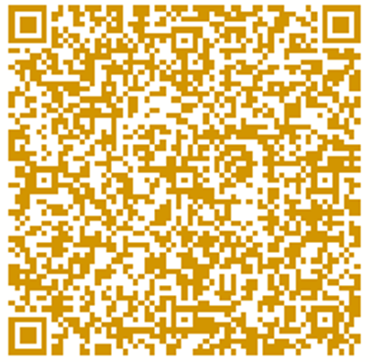
Substance Abuse Services Hotline (SASH):
1-844-804-7500
SAPC Email
  SUDTransformation@ph.lacounty.gov
SAPC Website’s Public and Patient Portal:
  http://publichealth.lacounty.gov/sapc/PatientPublic.htm
Service and Bed Availability Tool:
http://sapccis.ph.lacounty.gov/sbat/
Notes:
We have a number of resources ….

Slide 46
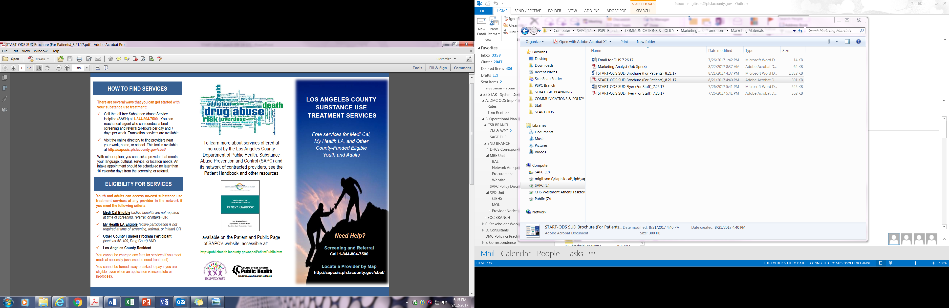
Brochure
QUICK REFERENCE GUIDE
Eligibility for Services
Screening
How to Find Services
Available Services
English Version:
http://publichealth.lacounty.gov/sapc/PatientPublic/Brochure.pdf
Spanish Version:
http://publichealth.lacounty.gov/sapc/PatientPublic/BrochureSpanish.pdf
Notes:
Our patient brochure is an abbreviated version of our patient manual. This describes who is eligible and how to find services. We have a Spanish version on our website. You’re welcome to download and print these.

Slide 47
Other DPH Resources
Public Health Clinics
  14 centers countywide plus a satellite site on Skid Row
  Offer screening and treatment of sexually transmitted diseases (STD) and tuberculosis (TB); and immunizations
  Services are free to low cost
  Locations: http://publichealth.lacounty.gov/chs/phcenters.htm
Notes:
Distinguish how each systems’ services are accessed separately -- SUD services are accessed through the SAPC system.

Slide 48
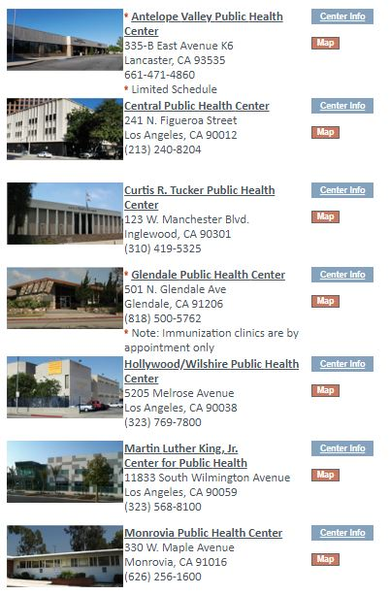
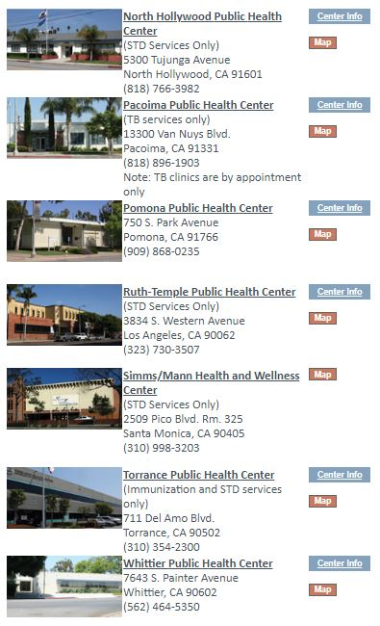

Slide 49
Are your clients successfully connecting with SUD treatment?
What could be improved to increase
SUD referrals and admissions?
How can our network providers better serve individuals who are homeless?
Have you and your clients been satisfied with the services received from SAPC and
our SUD providers?
Notes:
Thank you for your time. We appreciate your invitation and look forward to future opportunities to collaborate on ways to engage your clients in our system of care. We’ll gladly take up any questions/suggestions you might have for us.

Slide 50
Thank You!
Michelle Gibson, MPH
Chief, Strategic and Network Development Branch
Los Angeles County Department of Public Health
Substance Abuse Prevention and Control
626-299-3244
migibson@ph.lacounty.gov
Antonne Moore, M.Ed.
Chief, Marketing and Beneficiary Engagement Unit
Los Angeles County Department of Public Health
Substance Abuse Prevention and Control
626-299-4133
anmoore@ph.lacounty.gov

