Slide 1
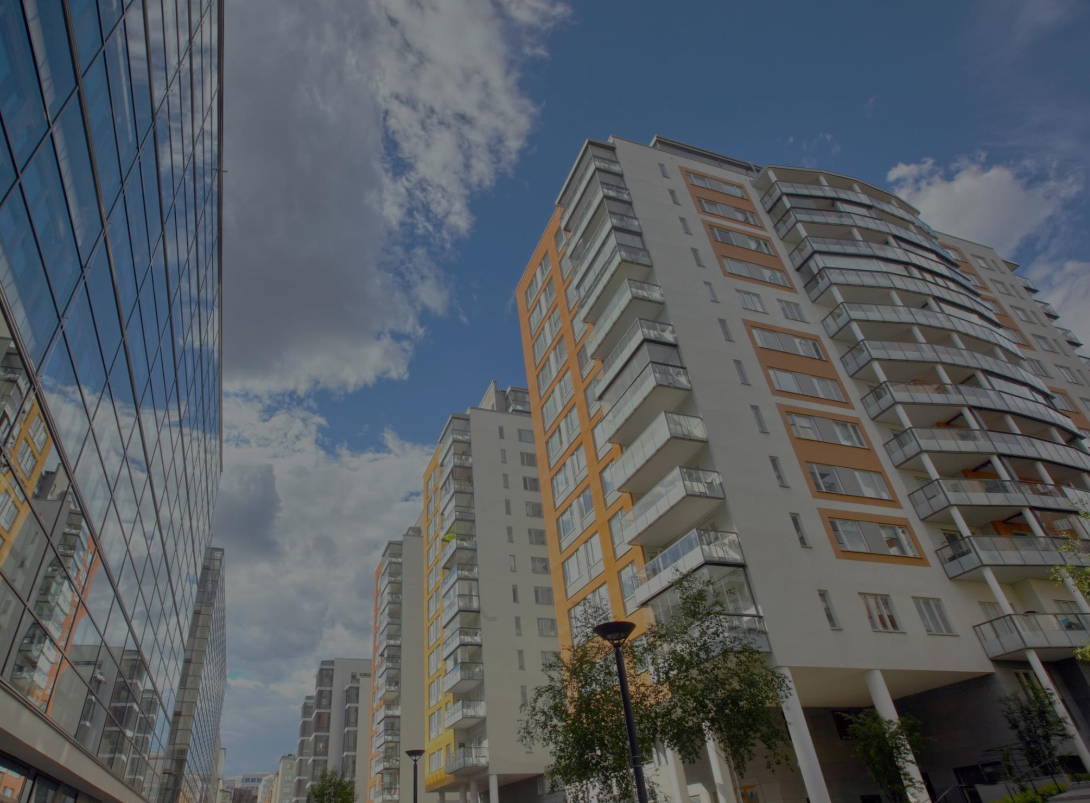
Housing and Jobs Collaborative
LOS ANGELES COUNTY DEPARTMENT OF HEALTH SERVICES

Slide 2
Housing and Jobs Collaborative
Launched January 2016.
Goal: Place 800 households per fiscal year.

Slide 3
Target population
Adult single non-chronically homeless individuals not requiring long term or significant service needs.
Adults who are not disabled those that can return to gainful employment with re-training or with connections back to their former area of employment.
Individuals identified as needing a short-term rental subsidy.

Slide 4
Case Management
Case management includes a “whatever it takes” approach consistent with the DHS Statement of Work.
HJC agencies will conduct a thorough assessment with each participant and keep it in their files.
Case managers should set realistic goals for employment and the type of housing resources available and suitable for their income/earning potential.

Slide 5
Employment services
Employment Services Plan should ensure that HJC participants will have access to a range of employment-related supports including:
  Employment search and job search seminars
  Resume building
  Practice interviews
  Computer skills training and vocational classes
  Employment readiness counseling and support groups
  Other training, courses, and educational opportunities that lead to gainful employment
Participants who require a longer period of support should be directed to supportive employment opportunities as a transition to conventional employment.

Slide 6
RENTAL ASSISTANCE
Rental subsidies will be managed by Brilliant Corners under current contract with DHS.
Brilliant Corners provides assistance in locating housing AND negotiating lease and rental agreements with landlords.
Move-in assistance and ongoing rental payments.
Landlord relations, mediation, and retention assistance.

Slide 7
HOW TO refer participants
Coordinated Entry System

Slide 8
County wide hjc providers
Mental Health America of Los Angeles, Antelope Valley
LA Family Housing
Union Station Homeless Services
St. Joseph Center
SSG/HOPICS
PATH
Mental Health America of Los Angeles, Long Beach

Slide 9
Contact information
Josh Legere, Program Manager
(213)399-6010
jlegere@dhs.lacounty.gov

