Slide 1
CES Rapid Rehousing

Slide 2
LAHSA Rapid Re-housing Program
2012- Rapid Re-housing for families pilot program begins
January 2016- Rapid Re-housing for Adults and Veterans (RRAV) launched
October 2016- CES for Adults and Youth Rapid Re-housing program launched
July 2017- Rapid Re-housing for Adults and Youth was first funded by Strategy B3
January 2018- DV/IPV Rapid Re-housing pilot program begins.

Slide 3
Rapid Rehousing Overview
Rapid Rehousing is a category within Permanent Housing.
Rapid Rehousing connects individuals and households experiencing homelessness to permanent housing through a tailored package of assistance that may include the use of time‐limited financial assistance and targeted supportive services.
Rapid Rehousing programs assist individuals, youth and families living on the streets or in emergency shelters solve the practical and immediate challenges to obtaining permanent housing while reducing the amount of time they experience homelessness, avoiding a near‐term return to homelessness, and linking to community resources that enable them to achieve housing stability in the long‐term.

Slide 4
Program Overview: Best Practices
Harm Reduction
Housing First
Crisis Response
Progressive Engagement
Trauma Informed
Consumer Choice
Notes:
Housing first, crisis response, consumer choice, trauma informed care, harm reduction, progressive engagement.
You will be learning more about these best practices in your learning communities.

Slide 5
Rapid Rehousing: Eligibility Criteria
Must be determined to be Homeless.
HUD Category 1: Literally Homeless
HUD Category 4: Fleeing/Attempting to Flee DV
Must meet Income guidelines below 50% Area Median Income (AMI).
Must be currently residing in Los Angeles County.

Slide 6
Supportive Services-Activities
Supportive Services | Activities
Case Management | Connection to crisis & bridge housing, mainstream benefits, employment services, legal services, physical health services, mental health services and other supportive services needed. Providing education lease agreements and violations Developing a housing stability plan with clients. Work with participants to create budgets Meeting with clients regularly to ensure progress in being achieved with goals established in the housing stability plan.
Housing Identification Search and Placement | Locating appropriate housing that meets the needs and expressed desires of the participant. Meeting with property owners, property management companies to increase permanent housing opportunities for participants. Provide transportation assistance for appointments
Housing Support Services | Completing housing inspection to ensure the housing meets habitability standards. Assisting participants with understanding the requirements of the lease, lease violations, the lease up process and expectations for tenancy.
Reunification Services | Connecting the individual/household to family or friends that will ultimately lead to a permanent housing placement
Housing Stabilization | Conducting home visits to follow up with participants
Landlord Support | Working with client and landlords to resolve housing issues and or lease violations. Provide dispute mediation Respond to issues in a timely manner

Slide 7
Supportive Services-Case Management
After enrolling a participant into RRH, you can enroll them into Bridge or Crisis until you find a permanent unit.
* First Bridge, then Crisis only if Bridge is not available.
Case Management & Supportive Services
Housing Stability Plan
The Housing Stability Plan is created
Build rapport, connect to mainstream benefits, Health Services, Tenant Education, Legal Services,
Education, Vocation, Employment Services
Crisis/ Bridge Housing
First, check if the participant is in HMIS and if the CES Assessment is completed.
CES Assessment
Notes:
Check if in HMIS, complete eligibility forms, and intake forms to enr
You have 30 days to complete the NEXT STEP TOOL. In case you have to develop rapport. NEXT STEP might be retraumatizing.
EMPHASIZE the Housing Stability Plan!
INCLUDE Monthly UPDATES – YELLOW LINE
Put day counts at each section
Put the pictures on the right side, and writing on the other.

Slide 8
Supportive Services-Housing Supportive Services
Tenant Education
How to be a good neighbor,
Lease requirements and violations,
Paying rent and bills on time,
Budgeting,
Where’s the nearest food bank,
bus stop, etc.
Housing Location
Landlord Negotiation
Housing Inspection
Must meet habitability standards.

Slide 9
Supportive Services -Reunification
Reunification
Advocacy
Connect to family or friends.
We want to do our best to divert or prevent entering the homeless system.
Successful Permanent Housing Placement
Notes:
INCLUDE Monthly UPDATES – YELLOW LINE
Put day counts at each section
Put the pictures on the right side, and writing on the other.

Slide 10
Supportive Services-Housing Stabilization
Housing Stabilization is a critical period!
Symptoms may resurface. Entering permanent housing can be stressful!
Frequent home visits to ensure progress with their Housing Stability Plan!
Connect the client to resources in the community.
Dispute mediation
NOW ENTERING
HOUSING STABILIZATION
Notes:
INCLUDE Monthly UPDATES – YELLOW LINE
Put day counts at each section
Put the pictures on the right side, and writing on the other.

Slide 11
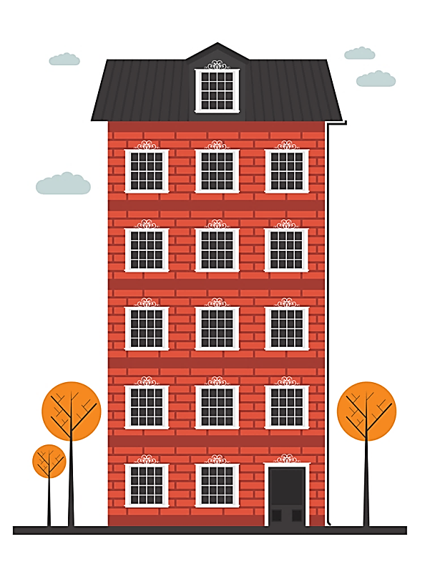
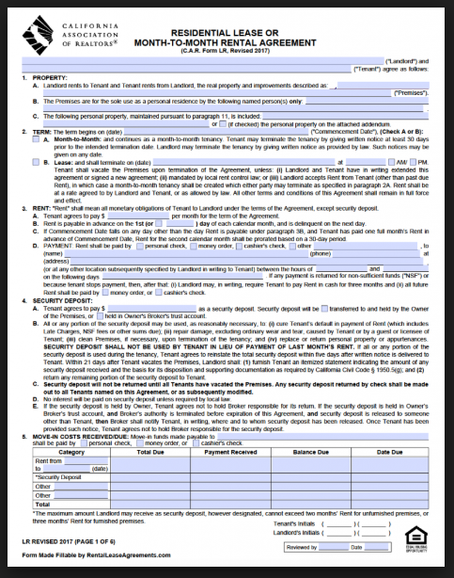
Financial Services: Rental, Move-In, Utility
Security Deposit,
Rental Assistance,
Rental Arrears
Application Fees,
Broker Fee, Landlord Incentive,
Essential Furnishings, Storage Fees, Rental Van and Move-In
Utility Deposit,
Utility Assistance,
Utility Arrears

Slide 12
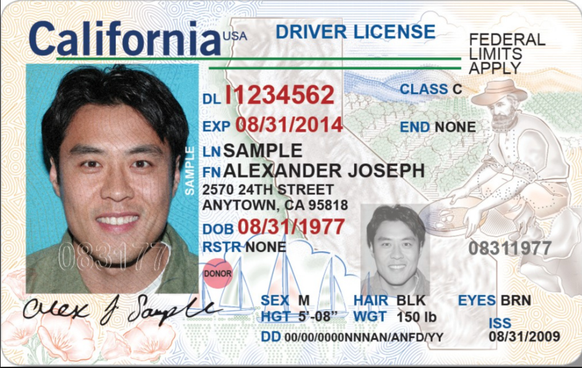
Financial Services: General Housing Assistance
Training Program
Birth Certificate,
California ID,
documents needed for housing and employment
Employment uniforms, tools, driver’s license fees, short training, certification
Bus Pass

Slide 13
Financial Services: Reunification Services
Transportation for relocation

Slide 14
Who is LAHSA funded?
SERVICE PLANNING AREA (SPA) | YOUTH PROVIDERS | ADULT PROVIDERS | FAMILY PROVIDERS
SPA 1: Antelope Valley | Valley Oasis | Valley Oasis | Valley Oasis
SPA 2: San Fernando Valley | The Village Family Services | LA Family Housing | LA Family Housing
SPA 3: San Gabriel Valley | Hathaway-Sycamores | Volunteers of America Los Angeles | Union Station Homeless Services
SPA 4: Metro Los Angeles | Covenant House | The People Concern, People Assisting the Homeless | People Assisting the Homeless
SPA 5: West Los Angeles | St. Joseph Center | St. Joseph Center, People Assisting the Homeless, The People Concern | St. Joseph Center
SPA 6: South Los Angeles | Coalition for Responsible Development, Volunteers of America Los Angeles | Special Services for Groups, St. Joseph’s Center, Volunteers of America Los Angeles | Special Services for Groups
SPA 7: East Los Angeles | Jovenes | People Assisting the Homeless | The Whole Child
SPA 8: South Bay | Harbor Interfaith Services | Harbor Interfaith Services, People Assisting the Homeless, 1736 Family Crisis Center | Harbor Interfaith Services

Slide 15
Contact Information
Charisse Mercado
LAHSA Rapid Rehousing Coordinator
Email: Cmercado@lahsa.org

