Slide 1




Housing Resources & Services for Youth in LA:
Today & Tomorrow
Leticia Colchado, LA County CEO
Jaclyn Grant, LAHSA
Gregory Breuer, DCFS
Mary Romero, DMH

Slide 2
Today’s Adventure
Homeless Initiative & Measure H
Youth Coordinated Entry System (YCES)
DCFS Youth Housing Resources
DMH Youth Housing Resources
Q&A

Slide 3
Homeless Initiative & Measure H
Seizing the Moment: Historic opportunity to combat homelessness throughout LA County
  Launched in August 2015
  Initial Charge of developing a comprehensive set of recommended County Strategies to combat homelessness
  HI lead an Inclusive and Collaborative process involving over 1,100 experts and community members focused on what works
  18 Policy Summits and 4 Focus Groups identified the key issues impacting homelessness and resulting strategies.
    Initial plan did not include “carve-outs” for special populations
  12/15/15 - Board adopted motion identifying Transition Age Youth as a priority population and directed CEO to allocate $5 Million of initial HI funding to Enhance Services for Transition Age Youth

Slide 4
Homeless Initiative & Measure H
On February 9, 2016, the Board of Supervisors adopted a coordinated set of 47 strategies to combat homelessness, including strategies in which cities, businesses and faith leaders can participate
New one-time funding approved: $99.7 million
Key Principles Guiding Strategies
  Collaboration among County, Cities, and Community Partners
  Investing in Proven Strategies
  Leveraging mainstream health, social services and criminal just systems
  Seamless, client-centered services
  Ongoing Funding Secured through Measure H
    $355 Million per year for 10 years
    4 New Strategies Added

Slide 5
Homeless Initiative & Measure H
51 strategies covering 6 areas, 3 of which include youth focus:
Prevent Homelessness
  Strategy A4- Prevent discharges from Foster Care and Probation
Subsidize Housing
  Strategy B3 – Rapid Rehousing for Youth
  Strategy B7 – Interim and Bridge Housing for those Exiting Institutions
Create a Coordinated System
  Strategy E7 – Strengthen the Coordinated Entry System
  Strategy E8 – Enhance the Emergency Shelter System
  Strategy E14 – Enhanced Services for Transition Age Youth

Slide 6



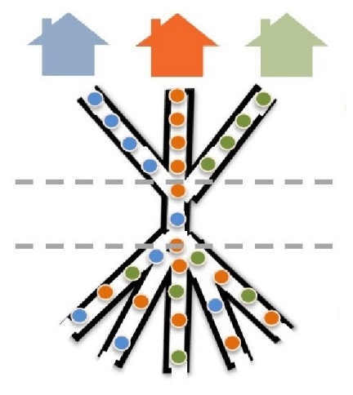
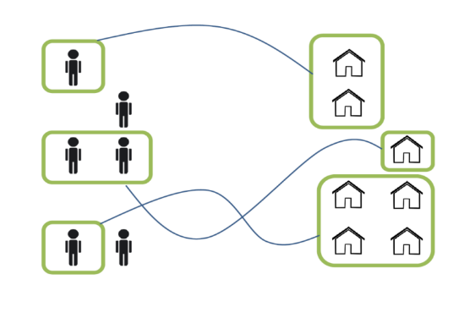
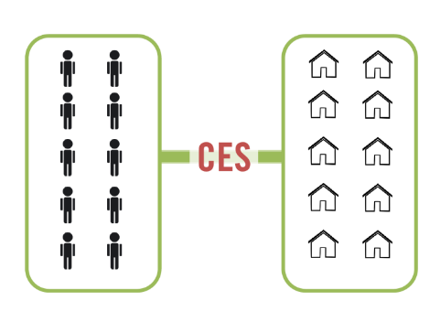
Coordinated Entry System (CES)
A countywide system that brings together new and existing resources to connect people experiencing homelessness with housing and services in alignment with individual needs

Slide 7
Coordinated Entry System (CES)
Coordinated Entry System
Families
Adults
Youth
To create a system that is more:
Effective
Efficient
Fair
for everyone experiencing homelessness

Slide 8
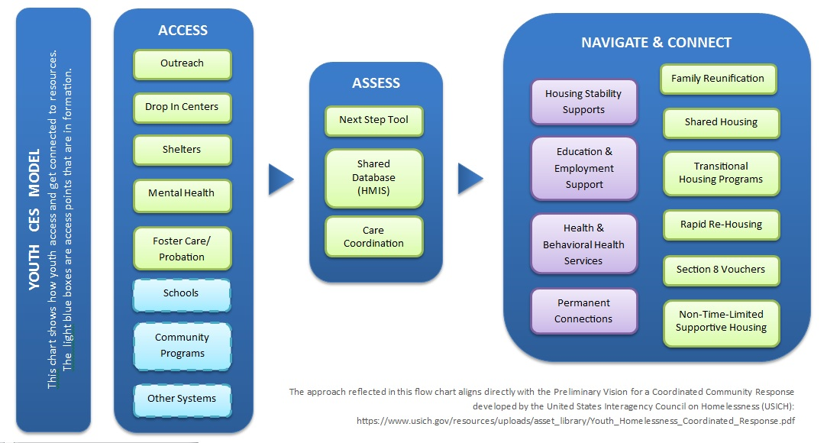
Youth Coordinated Entry System (YCES)

Slide 9
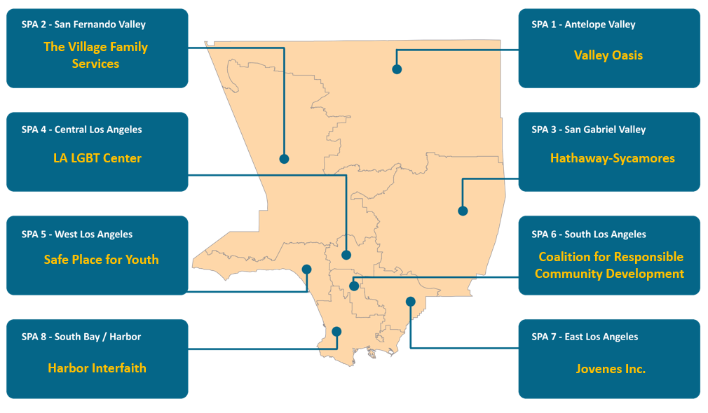
Youth Coordinated Entry System (YCES)

Slide 10
DCFS Housing Resources

Slide 11
I. Definition of TAY in Los Angeles County
Transition Age Youth (TAY) refers to individuals who are between the ages of 16-25 years old.
The TAY System of Care (TAY-SOC) Bureau of the Los Angeles County Department of Mental Health (DMH) provides an array of mental health and supportive services for Seriously Emotionally Disturbed (SED) and Severe and Persistently Mentally Ill (SPMI) TAY. Some of the priority populations include the following:
- TAY struggling with substance abuse issues
- TAY who are homeless or at-risk of homelessness
- TAY aging out of the children’s mental health, child welfare, or juvenile justice systems
- TAY leaving long-term institutional care
- TAY experiencing their first episode of major mental illness

Slide 12
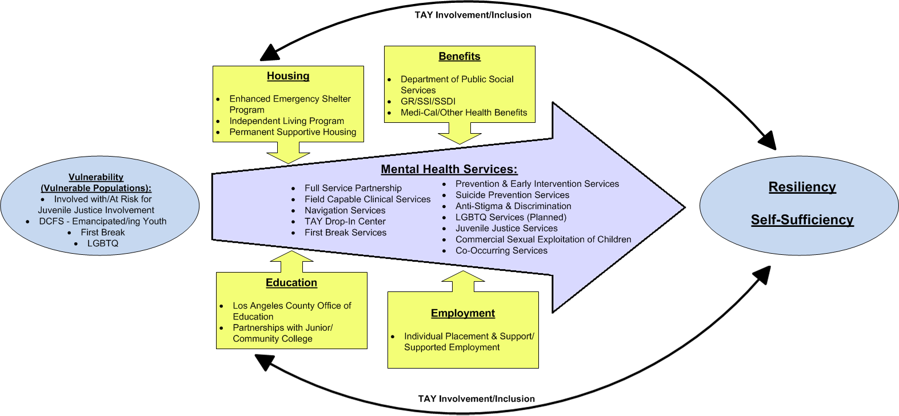
TAY ROADMAP TO RESILIENCY & SELF SUFFICIENCY

Slide 13
TAY Navigation and Housing Specialist Teams
TAY Navigator
  Master’s level clinician.
  Conduct brief screenings to assess mental health and housing needs, and provide linkages and referrals to appropriate services and supports.
  Participate in MHSA outreach presentations in collaboration with Service Area staff, Outreach Specialists, and FSP providers to promote knowledge about MHSA and increase utilization of the FSP program services.
  Develop and maintain relationships with various community-based organizations.

Slide 14
TAY Navigation Team
Assist SED/SPMI youth with navigating through the various human services systems to achieve effective linkages to needed mental health, housing, and other essential services.
Fiscal Year | Number of TAY Referrals
2014-2015 | 2,533
2015-2016 | 1,945
Total | 4,478

Slide 15
TAY Drop-In Centers
Provide temporary safety and basic supports for Seriously Emotionally Disturbed (SED) and Severe and Persistently Mentally Ill (SPMI) TAY who are living on the streets in unstable living situations.
Provide “low-demand, high tolerance” environments in which TAY can make new friends, participate in social activities, access computers, books, music, and games.
As the youth is ready, staff persons can connect them to the services and supports they need in order to work toward stability and recovery.
Drop-In Center services include, but not limited to the following:
Showers
Meals
Clothing
Computer/Internet Access
DVD and Games
Social Activities
Peer Support Groups
Linkage to Mental Health & Case Management Services
Linkage to Substance Abuse Treatment Services
Educational Services
Employment Assistance
Housing Assistance
And more

Slide 16
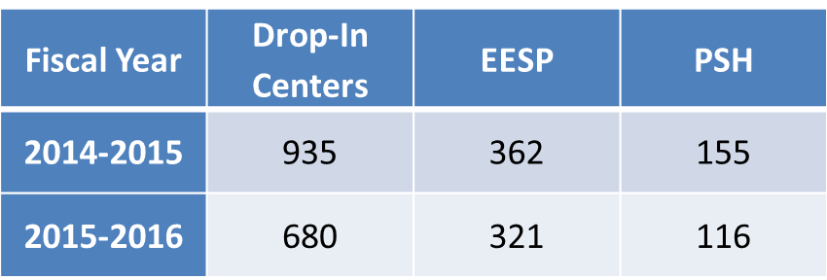
TAY Drop-In Centers
MHSA Funded TAY Drop-In Center Locations:
Los Angeles LGBT Center (Youth Center on Highland) 1220 N Highland, Los Angeles (661) 266- 4783
Pacific Clinics (Hope Center) 13001 Ramona Blvd, Irwindale (626) 337- 3828
Daniel's Place(Step-Up on Second Street, Inc.) 1619 Santa Monica Blvd, Santa Monica (310) 392-5885
The Village Family Services Drop-In Center 6801 Coldwater Canyon Ave, North Hollywood (818) 738-7327
Penny Lane(Yellow Submarine) 43520 Division Street, Lancaster (661) 266-4783
Penny Lane(With A Little Help From My Friends) 5628 E Slauson Ave, Commerce (323) 480-9276
Good Seed(Good Seed Drop-In Center) 2814 W Martin Luther King Blvd, Los Angeles (323) 992-0042
Good Seed(On Pine Youth Drop-In Center) 1204 Pine Avenue, Long Beach (562) 276-0779

Slide 17
EESP OVERVIEW
The Enhanced Emergency Shelter Program (EESP) contained in the Mental Health Services Act (MHSA) Plan serves the immediate and urgent housing needs of the Seriously Emotionally Disturbed (SED)/Severely Persistently Mentally Ill (SPMI) TAY population.
The goal of this program is to ensure availability in all eight (8) Service Areas and to ensure countywide coverage and geographic accessibility.
The primary objective of this program is to provide temporary shelter for TAY clients in a supportive housing environment for up to 36 nights while pursuing the long-term goals of secure, permanent housing.
The Enhanced Emergency Shelter Program offers a warm, clean and safe place to sleep, hygiene facilities (showers and laundry); hot meals (breakfast, lunch, and dinner); and case management services.
Placement is very short-term, a plan for transitioning the TAY client into stable housing should be made at the time of placement into the program.

Slide 18
ELIGIBILITY CRITERIA
TAY 18-25 years old
SED/SPMI
Indigent
Homeless or at imminent risk of homelessness.
Does not have any income, benefits, or any other resources to pay for
shelter.
Not a danger to self, others, or gravely disabled.
The Enhanced Emergency Shelter Program (EESP) for TAY targets those youth who
can otherwise live independently in the community and have minimal supervision
needs. Youth who are under LPS conservatorship are not eligible for this
program.

Slide 19
EESP LOCATIONS
Los Angeles
South Bay
Hollywood
There are 4 additional confidential shelter locations for female victims of domestic violence.
To make a referral, please contact the EESP Coordinator/Gatekeeper: (213) 738-6194.

Slide 20
TAY Full Service Partnership
Intensive services with 24/7 staff availability to help individuals address emotional, housing, physical health, transportation, and other needs to function independently in the community.
Provide a wide array of services and supports, guided by a commitment by providers to do “whatever it takes,” to help individuals within defined focal populations make progress on their particular paths to recovery and wellness. Services include, but are not limited to:
Outreach & Engagement
Bio-psychosocial assessment
Individual & family treatment
Medication support
Case Management Support
Specialized assessment & treatment interventions for co-occurring disorders, i.e. mental illness & substance abuse
Linkage to self-help & family support groups, health services, benefits establishment, temporary and/or permanent housing
Family education & support
Support for employment, education, & social support development
24/7 Response
Services are 100% field-based

Slide 21
Housing Services for SED/SPMI TAY
Permanent Supportive Housing:
Age Group | Name of PSH | Service Area | Number of Units | Sub-Total of Units by Age Group
Family | Avalon | 6 | 37 | = 131 Family PSH Units (TAY are eligible for 94 of these PSH Units)
 | Menlo* | 4 | 20
 | Osborne* | 2 | 39
 | Villas at Gower* | 4 | 35
TAY | Daniel’s Village | 5 | 7 | = 81 TAY PSH Units
 | Epworth | 6 | 19
 | Mid-Celis | 2 | 7
 | Mosaic Gardens | 7 | 15
 | Progress Place | 4 | 14
 | PWC | 4 | 5
 | Young Burlington | 4 | 14
Current Total Number of TAY eligible Units |  |  | 212
*TAY clients are eligible for these Family units.

Slide 22
TAY Full Service Partnership
FSP is an enrollment based program and clients must be referred. There are two (2) ways a client may be referred to FSP:
1. FSP agencies identify through outreach, individuals who may be eligible and submit FSP Referral and Authorization Form to the Impact Unit.
2. Individuals may be referred to the Impact Unit by a non-FSP entity (i.e. mental health service providers, social service agencies, and the community).

Slide 23
TAY Full Service Partnership
Focal Population:
The TAY must have a SED or SPMI and meet one or more of the following criteria:
Homeless or currently at risk of homelessness
Youth aging out of:
- Child mental health system
- Child welfare system
- Juvenile justice system
Youth leaving long-term institutional care:
- Level 12-14 group homes
- Community Treatment Facilities
- Institutions for Mental Disease
- State Hospitals
- Probation Camps
Youth experiencing first psychotic break
Co-occurring substance abuse issues are assumed to cross-cut along the entire TAY focal population described above

Slide 24
Recovery, Resilience and Reintegration Services
Recovery, Resilience and Reintegration (RRR) Services, delivered under MHSA, are intended to address the needs of individuals who are SED/SPMI but do not have the intensive service needs of individuals who qualify for Full Service Partnerships (FSP).
RRR is not enrollment based and does not require authorization.
RRR utilizes evidence-based strategies whenever they can be identified and provides a way of transitioning former FSP clients to less intensive programs as they meet their recovery goals.
Services include, but are not limited to:
Outreach & Engagement
Bio-psychosocial assessment
Outpatient Individual & family treatment
Medication support
Case Management Support
Specialized assessment & treatment interventions for co-occurring disorders, i.e. mental illness & substance abuse
Linkage to self-help & family support groups, health services, benefits establishment, temporary and/or permanent housing
Family education & support
Support for employment, education, & social support development
Wellness Center Services
Peer Led Support Groups
Drop In Center-Like Services

Slide 25
Questions?
Thank you!
Leticia Colchado, lcolchado@ceo.lacounty.gov
Jaclyn Grant, jgrant@lahsa.org
Gregory Breuer, gbreur@dcfs.lacounty.gov
Mary Romero, mromero@dmh.lacounty.gov

