Slide 1
E6: Strengthening the Countywide Outreach System DMH Housing Summit 2018 Center at Cathedral Plaza April 25, 2018 Maria Funk, Ph.D. DMH, Mental Health Clinical Program Manager III Countywide Housing, Employment and Education Resource Development Colleen Murphy, PGDip LAHSA, CES Outreach Supervisor Libby Boyce, LCSW DHS~ Housing for Health, Director of Access, Referral & Engagement Susan Spinelli, LCSW DHS~ Housing for Health, Director of Street-based Engagement

Slide 2
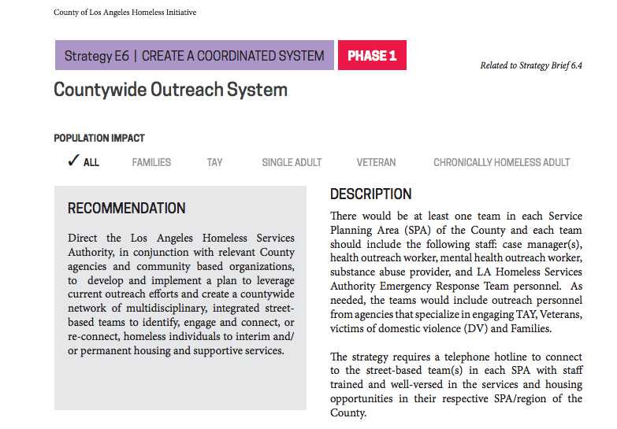
Vision of E-6: Coordinated Outreach Strategy
Develop a coordinated outreach system to reduce duplication and increase efficiencies via:
CES Outreach Coordinators
Centralized Outreach Request Portal
Generalized Outreach Workers
LAHSA Homeless Engagement Teams (HET)
Health Agency contracted Multidisciplinary Outreach Teams
Between LAHSA HET, MDTs and SB-82, Los Angeles County will have nearly 500 outreach workers on the streets by July 2018
Strategy co-led by LAHSA and the Health Agency
To read E6 and the other County Coordination Strategies:
http://homeless.lacounty.gov/wp-content/uploads/2017/01/Strategy-E-1.pdf
To read the recent summary of our E6 Community Design Session
https://www.lahsa.org/documents?id=1433-community-input-session-summary-county-strategy-e6.pdf

Slide 3
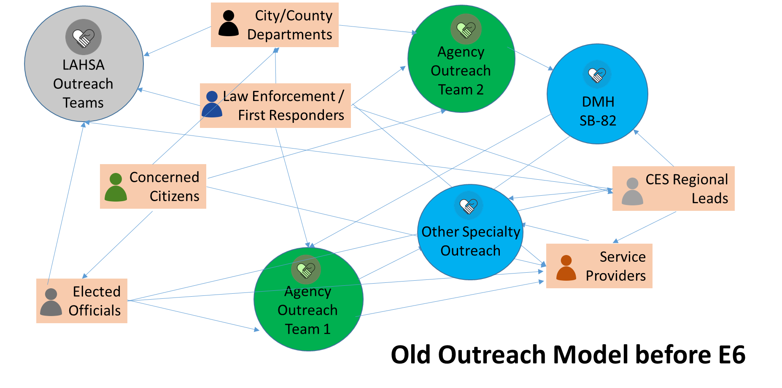
Before…

Slide 4
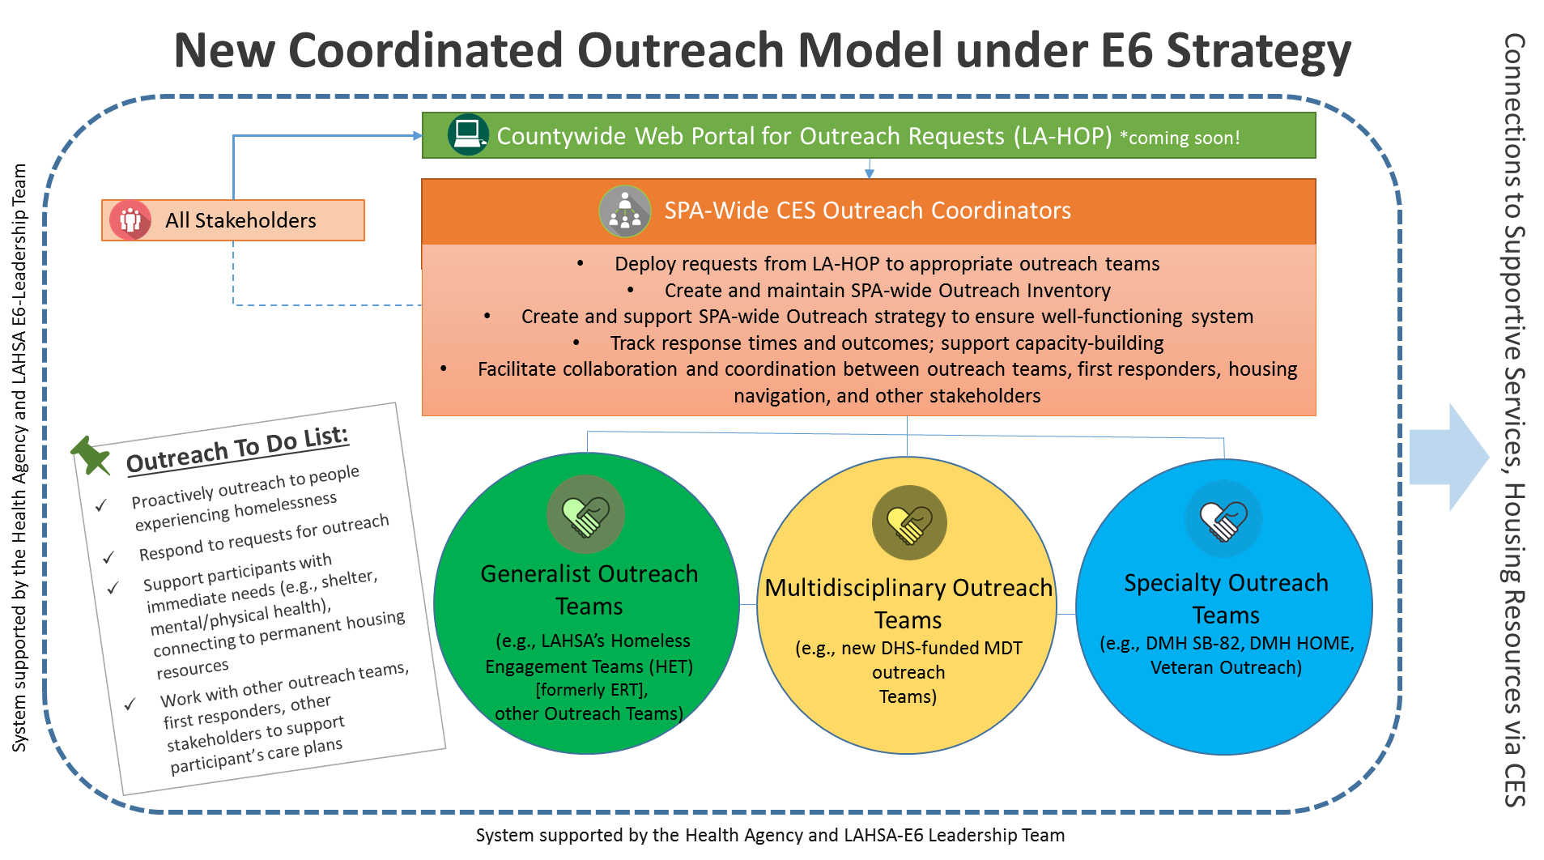
The New Model

Slide 5
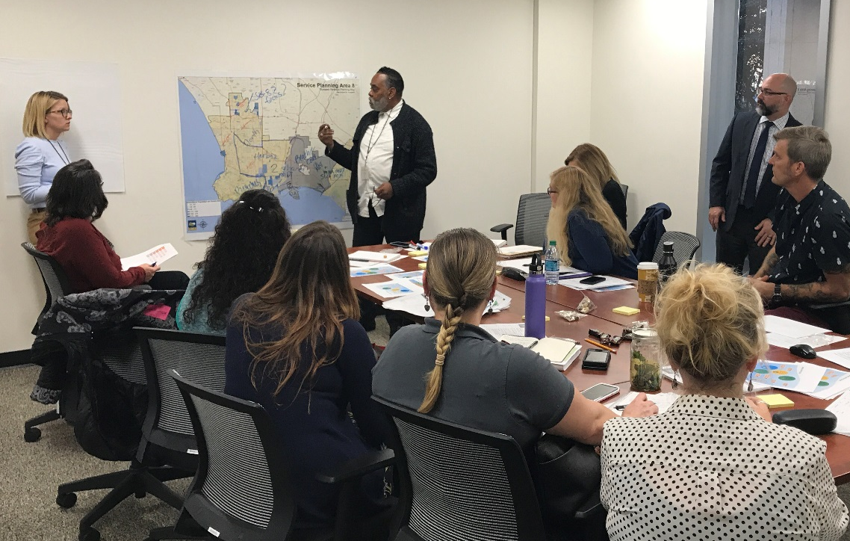
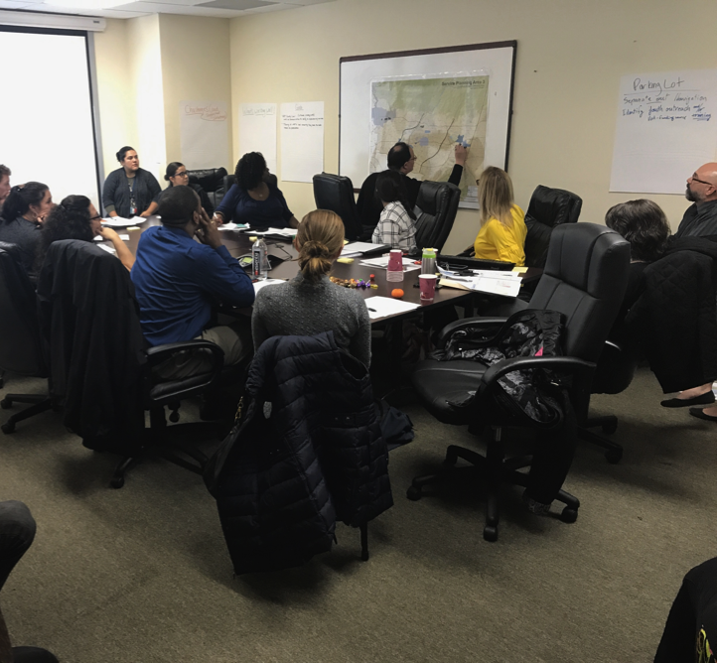
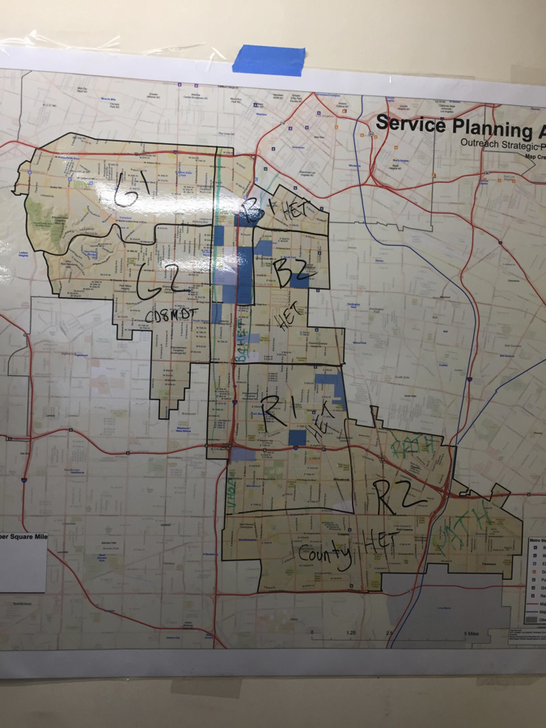
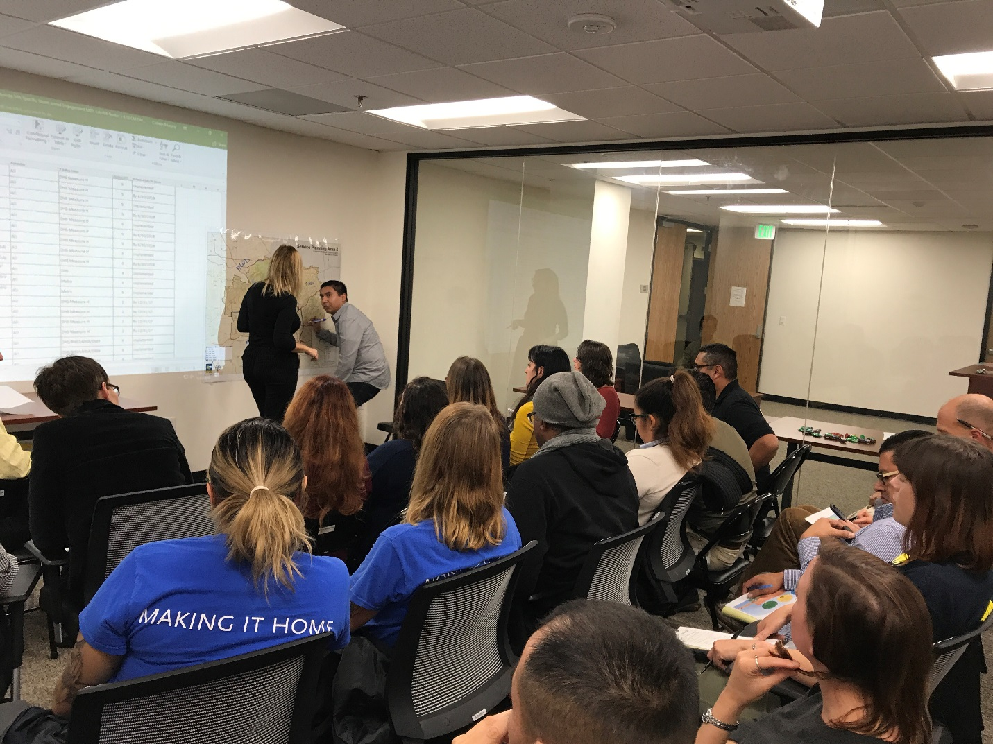
SPA-BASED OUTREACH COORDINATION PLANNING

Slide 6
SPA-BASED OUTREACH TEAM INVENTORY & QUADRANT CASE CONFERENCING
QUADRANT CASE CONFERENCING
Case conferencing is now localized by quadrants, we hope to see you there!
NORTH QUADRANT
Topanga, Pacific Palisades, Malibu, Hollywood Hills, Beverly Hills, West LA VA
Case Conferencing time: 2nd Wednesday of the month at 9am
Location: 10131 National Blvd., Los Angeles, CA 90034
SOUTH QUADRANT
Manchester Square, Westchester, Playa Del Rey, Marina Del Rey, Ladera Heights, and Barnes City
Case Conferencing time: 3rd Wednesday of the month at 1:30pm
Location: Westchester Municipal Building
EAST QUADRANT
West LA, Culver City, Mar Vista, Palms, Westwood, Brentwood
Case Conferencing time: 4th Wednesday of the month, 1:30pm
Location: 11303 W. Washington Blvd, 2nd floor
WEST QUADRANT
Santa Monica & Venice
Case Conferencing time: 3rd Wednesday of the month at 9am
Location: St. Joseph Center
Teams | Restricted Y/N | Restriction Reason | Implementing Agency(ies) | Geography Can Serve | Geography Will Serve | Population | Funding Source | Number of Team Members | Estimated Date On Streets
HET 1 | N |  | LAHSA | SPA-wide |  | All | LAHSA Measure H, LA City | 2 | On streets now
HET 2 | N |  | LAHSA | SPA-wide |  | All | LAHSA Measure H, LA City | 2 | 2/1/2017
HET 3 | N |  | LAHSA | SPA-wide |  | All | LA City | 2 | 1/1/2018
HET HOPE | Y | G | LAHSA | Central Division | Central Division | All | LAHSA Measure H, LA City | 2 | On streets now
HET Contracted CD-11 | Y | G | LAHSA | CD 11 | CD 12 | All | CD 11 | 2 | On streets now
MDT 1 | N |  | SJC | SPA-wide |  | All | DHS Measure H | 5 | On streets now
MDT 2 | N |  | SJC | SPA-wide |  | All | DHS Measure H | 5 | On streets now
MDT 3 | N |  | SJC | SPA-wide |  | All | DHS Measure H | 5 | 1/15/2018
MDT 4 | N |  | SJC | SPA-wide |  | All | DHS Measure H | 5 | 2/15/2018
MDT Contracted Man Square | Y | G | PATH | Manchester Square | Manchester Square | All | DHS Measure H | 2 | On streets now
C3 Contracted Venice | Y | G | SJC | Venice (3rd and Rose) | Venice (3rd and Rose) | All | DHS Homeless Initiative | 5 | On streets now
SJC Outreach | N |  | SJC | Anywhere |  | All | LAHSA CES | 2 | On streets now

Slide 7
Coming Soon!

Slide 8
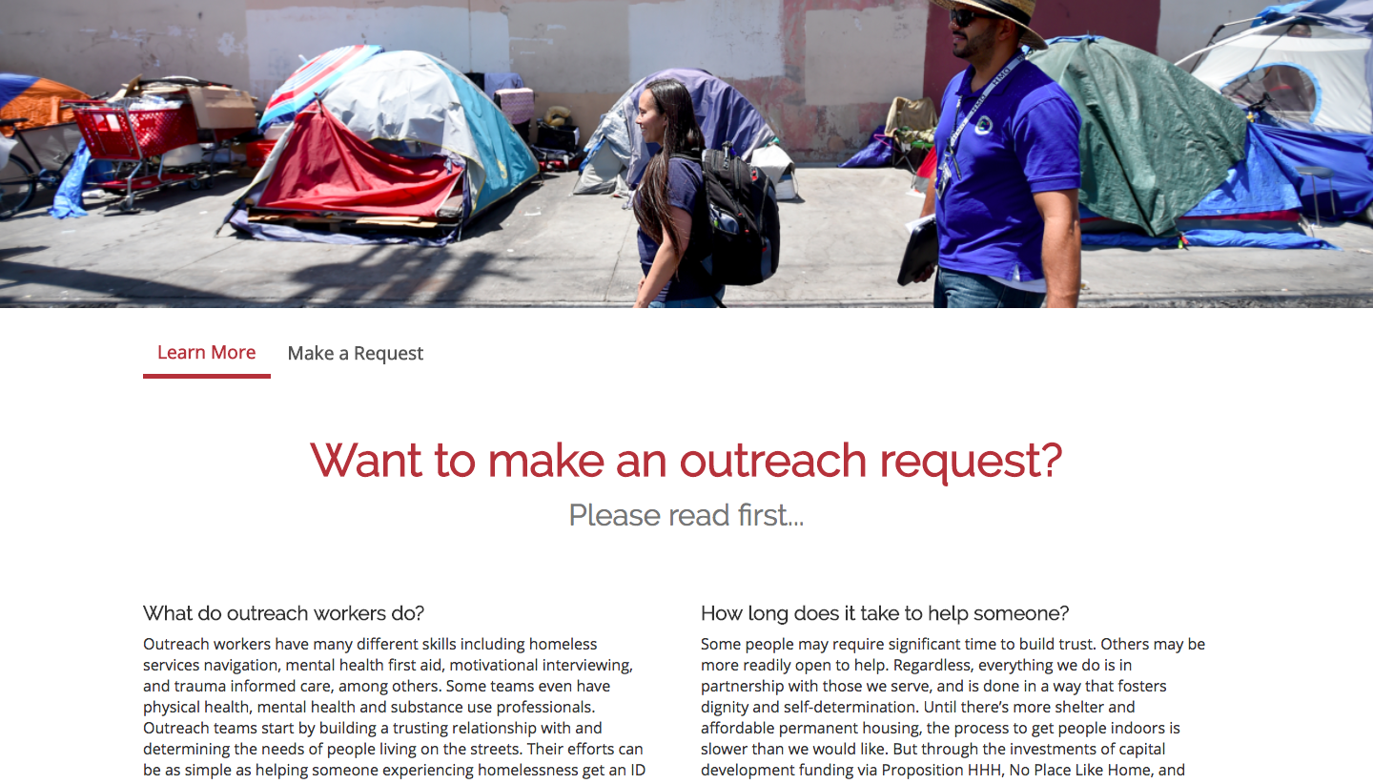
Coming Soon!

Slide 9
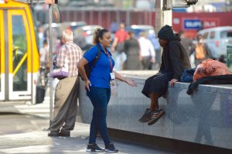
Outreach 101
Where?
Streets, riverbeds, railroad tracks, underpasses, encampments, parks, remote areas, urban areas, beaches, etc.
When?
Usually during daylight hours due to safety and ability to connect to housing and services
Who (types of outreach teams)?
Generalists:
Includes Homeless Engagement Teams (HETs)
May serve a specific population focus (e.g., Youth, Veterans) or partner with law enforcement (e.g., HOPE teams)
Multi-disciplinary Teams (MDTs)
Expertise include: health, mental health, substance abuse, case management, person with lived experience
Public Space Generalists: adjunct to the MDTs focusing on serving public spaces such as parks, libraries, harbors, beaches and METRO stations
Mental Health-focused
SB-82, HOME

Slide 10
E6 Funded Homeless Engagement Teams (HETs) &
Multi-Disciplinary Teams (MDTs) Countywide
SPA | Number of Homeless Engagement Teams (HET) Teams of Two (LAHSA) | Number of Multi-disciplinary Teams (MDTs) Teams of Five (Health Agency) | Number of Public Space Generalists Teams of Two (Health Agency)
SPA 1-MHA | 1 | 2 | 2
SPA 1-LAFH |  | 1 | 0
SPA 2-LAFH | 1 | 4 | 3
SPA 2-SFVMHC |  | 1 | 0
SPA 3-USHS | 1 | 2 | 2
SPA 4-TPC | 1 | 7 | 3
SPA 4-Exodus |  | 2 | 1
SPA 5-St. Joe’s | 1 | 4 | 2
SPA 6-SSG | 1 | 6 | 3
SPA 7-PATH | 1 | 3 | 2
SPA 8- MHA | 1 | 3 | 2
SPA 8- City LB |  | 1 | 0
Total | 8* | 36 | 20
* Measure H also funds 9 additional Countywide HET teams to partner with law enforcement.

Slide 11
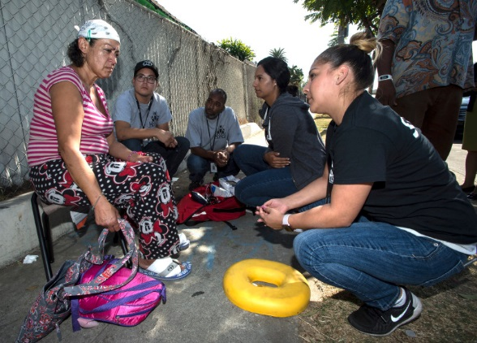
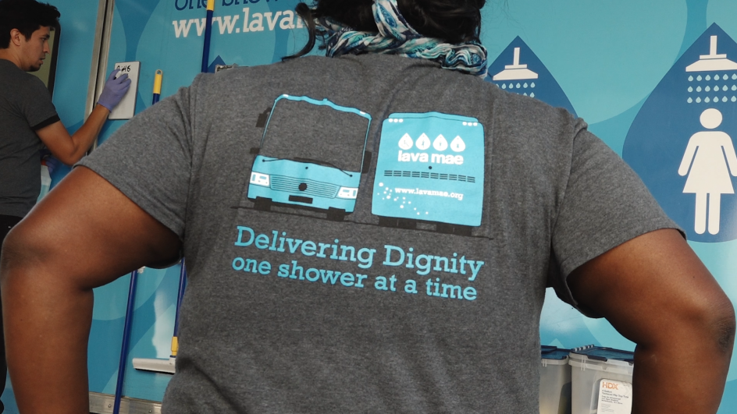
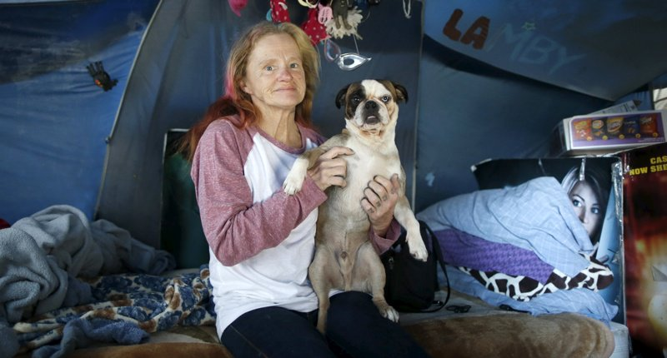
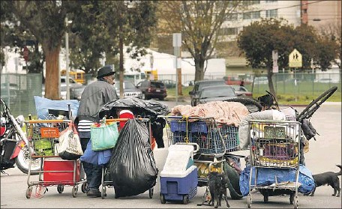
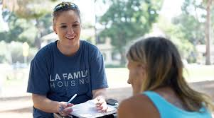
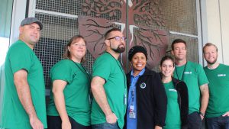

Slide 12
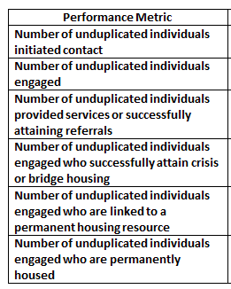
How we measure our success

Slide 13
Success Stories

Slide 14
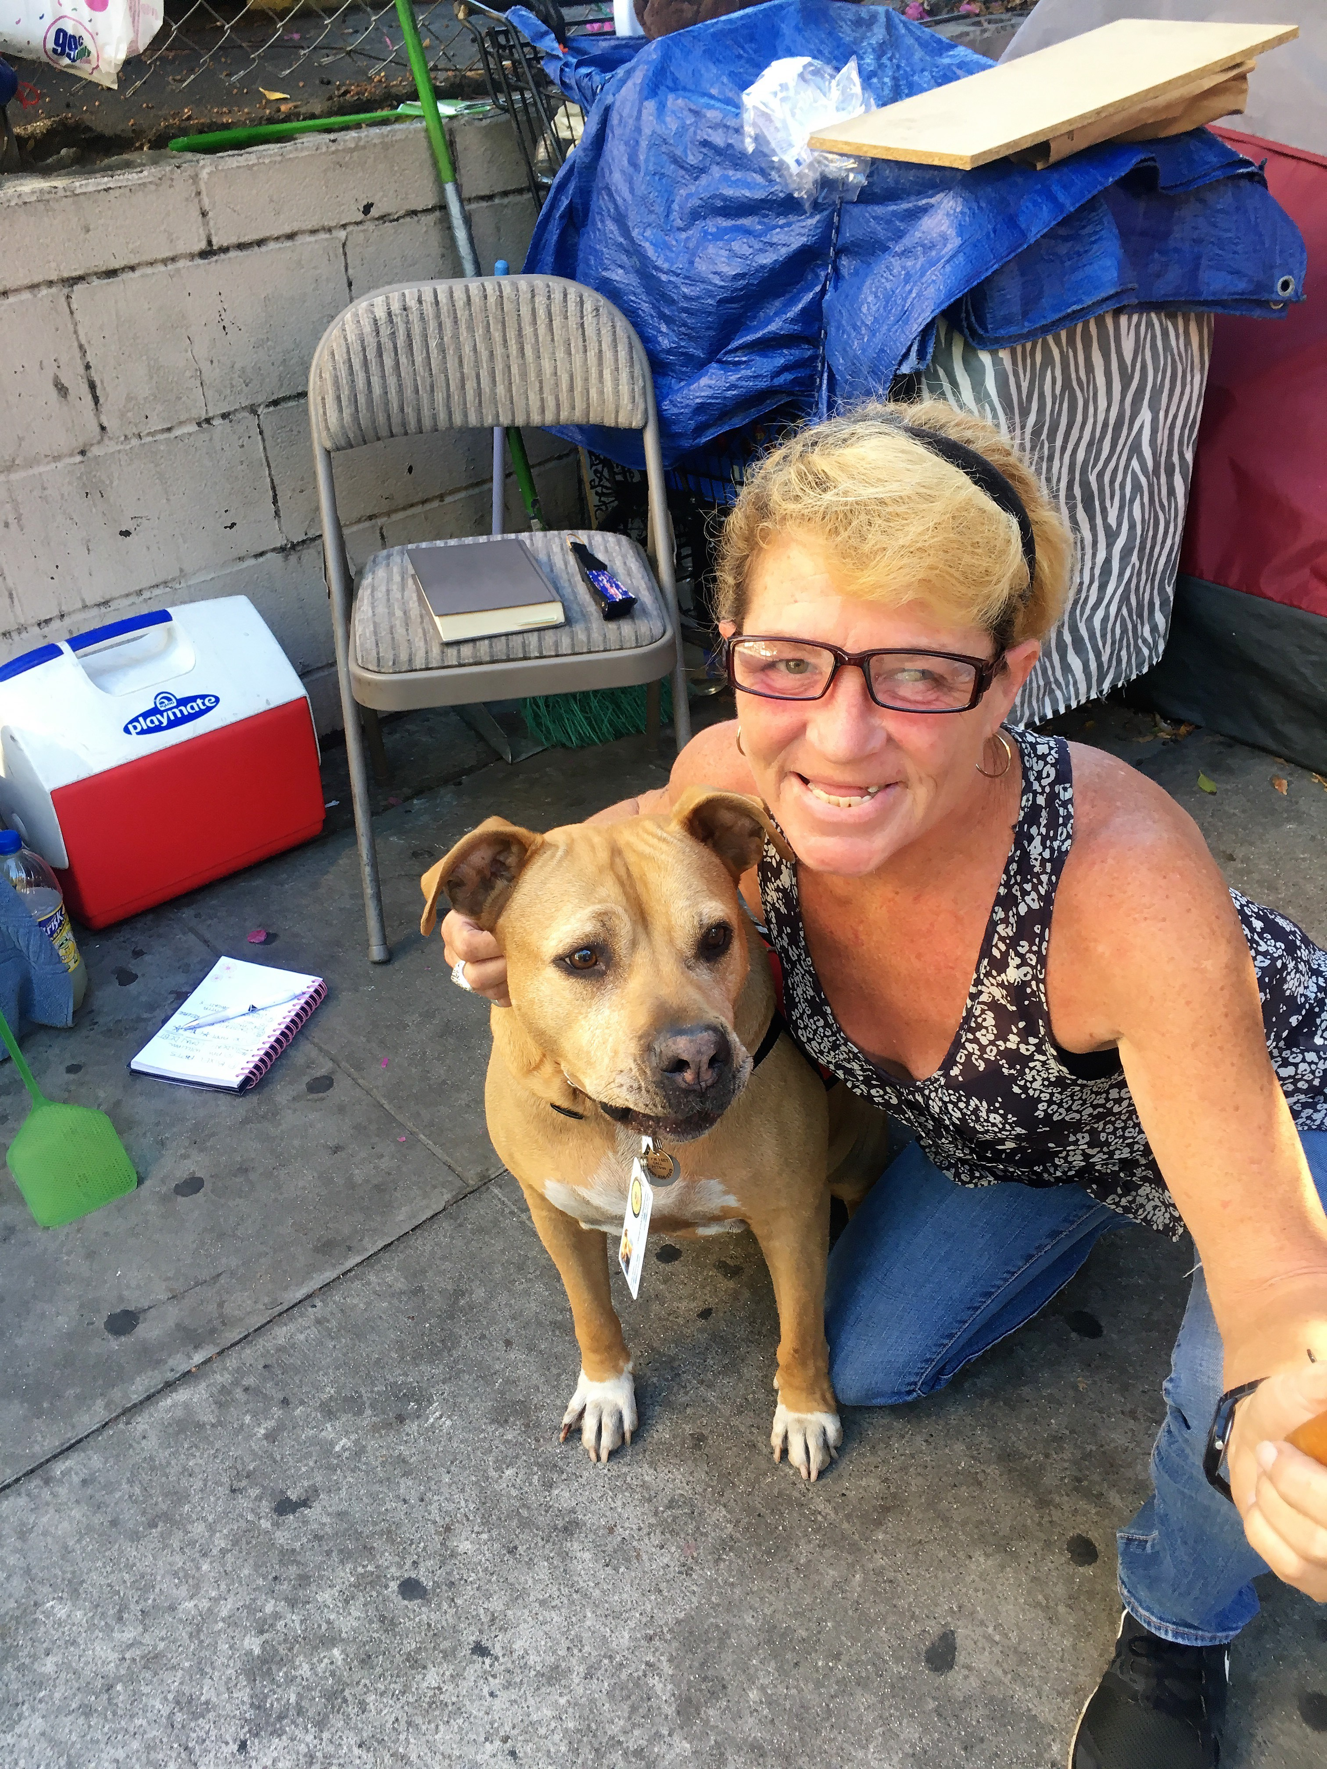
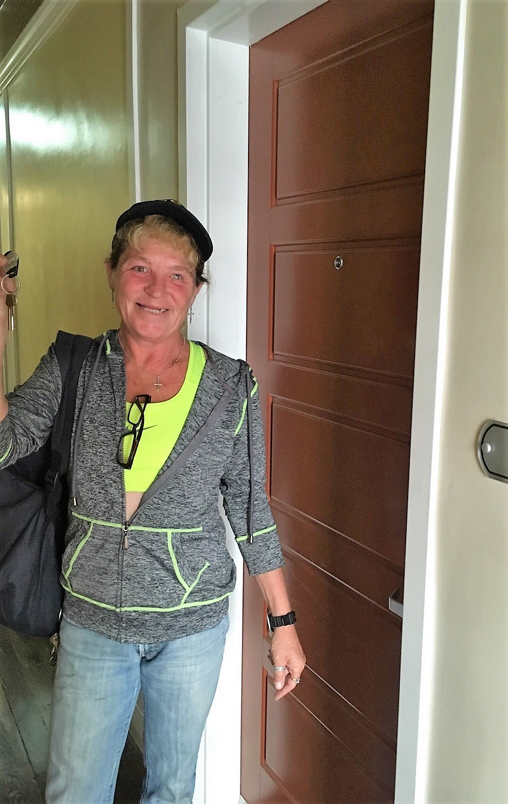

Slide 15
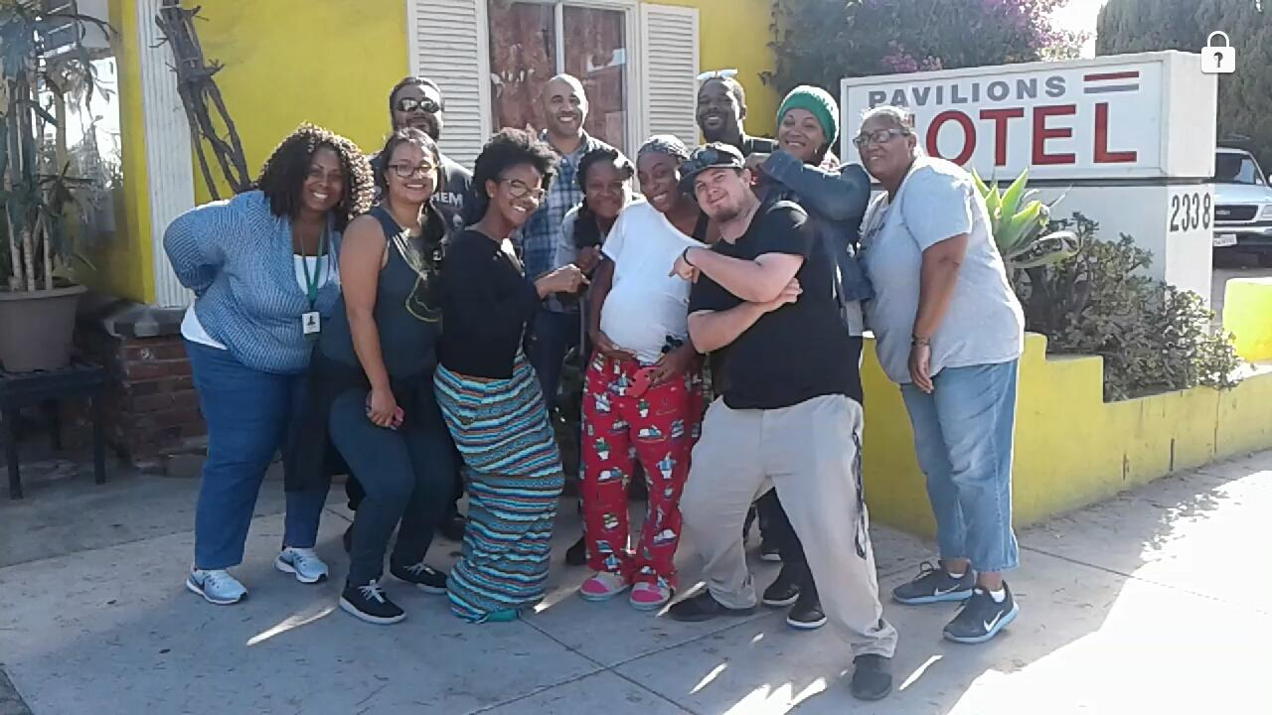

Slide 16
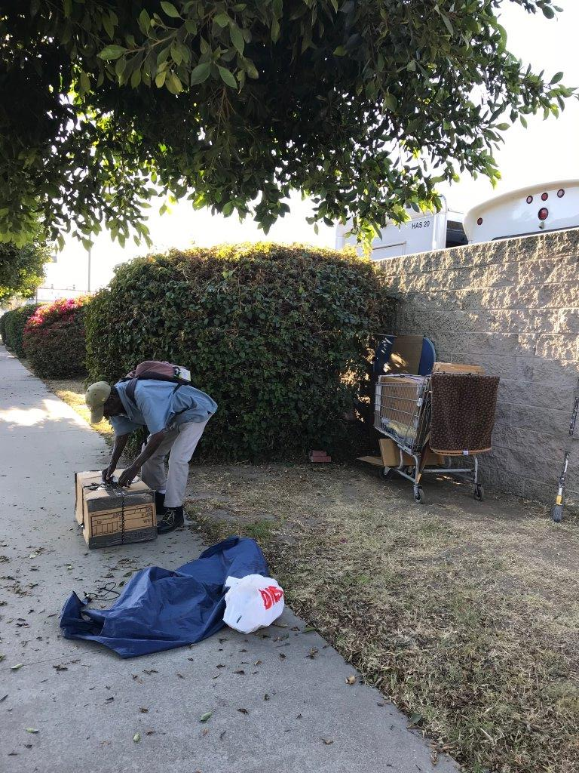
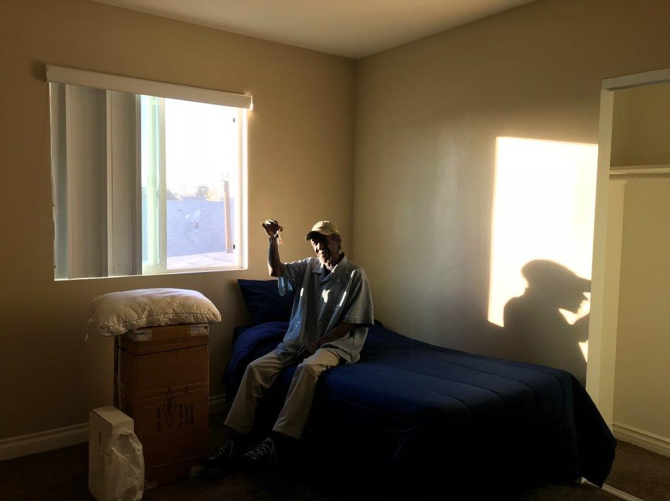

Slide 17
Welcome E6 Strategy Panelists!!
Name | Hilary Aquino, MA
Title | Associate Vice President, Homeless and Diversion Services MDT Lead for Northeast LA (NELA) and LAC+ USC Homeless Task Force
Organization | SPA 4, Exodus Recovery
Name | Breanna Jaijairam, MSW
Title | Regional Outreach Coordinator
Organization | SPA 8, Harbor Interfaith Services
Name | Eric Montoya
Title | Outreach Training Specialist
Organization | SPA 2, LA Family Housing
Name | Chyheeb Joseph
Title | Homeless Engagement Supervisor, SPA 1
Organization | Los Angeles Homeless Services Authority

Slide 19
Maria Funk, Ph.D.
Los Angeles County, Department of Mental Health
Mental Health Clinical Program Manager III
Countywide Housing, Employment and Education Resource Development
695 S. Vermont Ave., 10th Floor
Los Angeles, CA 90005
(213) 251-6582
mfunk@dmh.lacounty.gov
Colleen Murphy, PGDip
Coordinator, Outreach Los Angeles Homeless Services Authority (LAHSA) 811 Wilshire Boulevard, 6th Floor Los Angeles, CA 90017 Office: 213-797-4573
Cell: 213-418-8760 Fax: 213-892-0093 cmurphy@lahsa.org
Elizabeth (Libby) Boyce, LCSW
Director, Access, Referral & Engagement Los Angeles County, Department of Health Services
Housing for Health
238 E. 6th Street Los Angeles, CA 90014
(213) 833-5350/Main Line (323) 274-3209/Direct Line eboyce@dhs.lacounty.gov
Susan L. Spinelli, LCSW
Director, Street-based Engagement Los Angeles County, Department of Health Services
Housing for Health
238 E. 6th Street Los Angeles, CA 90014
(213) 833-5350/Main Line (323) 274-3221/Direct Line sspinelli@dhs.lacounty.gov

