Slide 1




Introduction to Homeless Initiative D-7

Slide 2
HOMELESS INITIATIVEs AND MEASURE H
51 Strategies to Combat Homelessness
March 2017 voters approved a quarter cent sales tax dedicated to funding homeless services.
Strategy D7 “Permanent Supportive Housing” has a goal of providing subsidies and services to 2500 people experiencing homelessness.

Slide 3
Strategy D7 – Provide Services and Rental Subsidies in Permanent Supportive housing (PSH)
Provides Services and Subsidies for PSH
Non-time-limited affordable housing assistance combined with supportive services
Integrated Care Model – providing on-site and field based services
Maximizes the expertise of each County Department

Slide 4
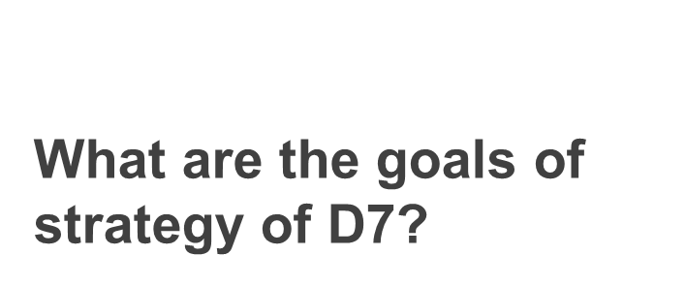

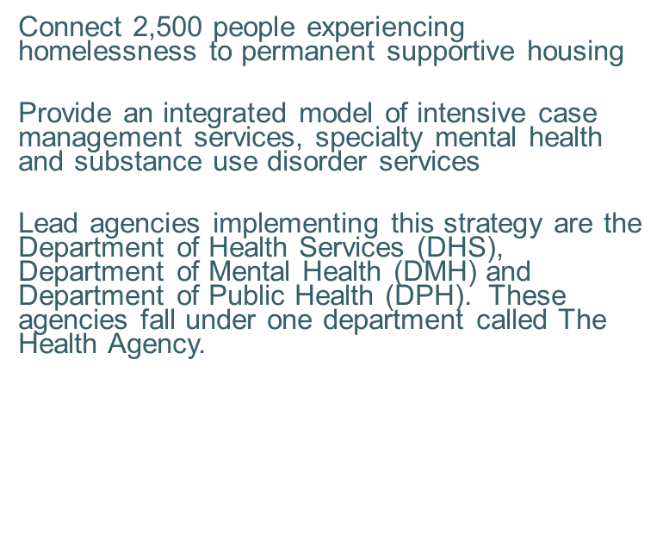
Measure H: Strategy D7 Provide Services and Subsidies for Permanent Supportive Housing

Slide 5
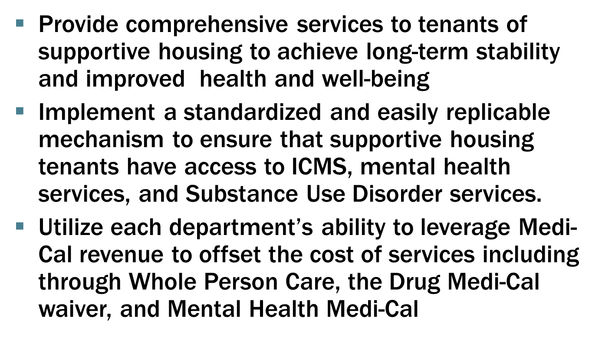
Strategy D7 Provide Services and Subsidies for Permanent Supportive Housing
More Goals

Slide 6
PSH
PSH includes rental subsidies and on-site/field based supportive services
Housing is project based and scattered site
Clients will be housed with federal subsidies and local subsidies
Clients will be matched to D7 housing through the Coordinated Entry System (CES)

Slide 7
PSH Resources
Voucher Commitments from Public Housing Authorities
Pipeline of Project Based Housing
Flexible Housing Subsidy Pool (Measure H funded)

Slide 8
The pathway to Integrated services
The Health Agency coordinates integrated services for D7 participants
The Health Agency will monitor service delivery and quality through Housing for Health, DMH’s CHEERD division and SAP-C
The Coordinated Entry System (CES) will match people experiencing homelessness to housing resources and services
In Fiscal Year 2017-2018 2,500 people experiencing homelessness will be enrolled
Agencies who wish to provide any of the funded integrated services apply to DHS, DMH and/or DPH to become a contracted provider

Slide 9
How will D7 work for a person experiencing homelessness?
START
How does my agency help?
Provide staff training to conduct the VI-SPDAT
Provide staff training to enter information into HMIS
Hire qualified case managers
Receive additional funding to support additional case managers
People may be identified by street based engagement teams, shelter operators, hospitals, clinics, jails, city staff, other systems of care, self referrals, walk-ins to a CES lead agency, etc.
Appropriate triage/assessment tool is administered
Client profile and triage score is updated or created in HMIS
People prioritized into available ICMS slots will be referred and receive ICMS services and will be connected to a housing resource
People will be prioritized by highest acuity/need and length of time homeless to agencies contracted for ICMS

Slide 10
Scenario 1: PSH Resources in a SPA
Project Based Housing Resource is entered into CES
Health Agency assigns Service Provider to Housing
SPA Matcher “matches” to prioritized CES participants who meet PSH eligibility criteria
CES Participant is connected to supportive services and permanent housing

Slide 11
Scenario 2: Countywide PSH Resources
Tenant Based Housing Resource is entered into CES
Health Agency assigns Service Provider to Housing
Countywide Matcher “matches” to prioritized CES participants who meet PSH eligibility criteria
CES Participant is connected to supportive services and permanent housing

Slide 12









Matching
HMIS
MyOrg
Street Outreach
Interim Housing
Housing Navigation
Rapid Re-housing
Permanent Supportive Housing
Transitional Housing
Affordable Housing

Slide 13
Measure H: Strategy D7 Provide Services and Subsidies for Permanent Supportive Housing
1
(1) DHS: Intensive Case Management Services (ICMS)
2
(2) DMH: Housing Full Service Partnership (Housing FSP)
(3) DPH-SAPC: Client Engagement & Navigation Services (CENS)
4
3
(4) DHS: Services Funding for Existing Project Based Sites

Slide 14
Measure H: Strategy D7 Provide Services and Subsidies for Permanent Supportive Housing
100% of all D7 participants will receive Intensive Case Management Services (ICMS)
Approximately 30% will receive Housing Full Service Partnership (Housing FSP) services
Services funding for existing project based sites will begin to roll out to developers
Approximately 30% will receive Client Engagement & Navigation Services (CENS)

Slide 15
Ensuring the Right Level of Services are Available Countywide
DHS
Intensive Case Management Services
DMH
Housing Full Service Partnership
ICMS services are based on a whatever it takes approach so they are comprehensive and tailored for each client.
Obtaining necessary documentation
Completing and submitting rental subsidy application
Housing search
Eviction prevention support and intervention
Ongoing client support and home visits
Making and keeping appointments for health, mental health and SUD services
Transportation
Ensuring access and enrollment in health and income benefits
These services will help clients manage the symptoms of their mental illness and will assist them with their mental health wellness and recovery goals.
Services include:
Individual/Group Therapy/Counseling
Medication Support
Crisis Intervention
Referrals and Linkage
DPH
DHS
Provision of Additional Funding for PSH sites
Substance Use Disorder Services
D7 includes a $7.5 million annual flexible allocation that can fund
Additional new permanent supportive housing
Services in existing permanent supportive housing that have had insufficient services funding
Local rent subsidies if projections for federal subsidies are not realized
Community Engagement and Navigation Services includes outreach and engagement, screening and referral, SUD service navigation, and care coordination to improve access to SUD treatment services
All services are provided by community based service providers through contracts with each department listed above

Slide 16

Making sure the integration in integrated services works
DHS, DMH and DPH work to identify providers for all 3 service types
Providers will be identified in each SPA to ensure accessibility to services
Ongoing expansion of providers to meet the need
DHS, DMH and DPH will facilitate integration of all key contracted partners
ICMS
CENS
Housing FSP

Slide 17
DHS provides funding for Intensive Case Management Services (ICMS) to agencies serving people experiencing homelessness with complex physical and behavioral health conditions.

Slide 18
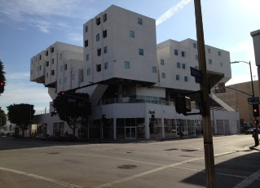

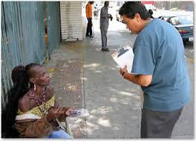
Best Practices in icms
Housing First
Connect people experiencing homelessness to permanent
housing without preconditions or barriers to entry
Harm Reduction
Harm reduction is a set of practical strategies and ideas aimed at reducing negative consequences associated with drug use.
Whatever it Takes
Whatever it Takes is a flexible approach to service delivery for people who are experiencing homelessness or are living in permanent supportive housing and dealing with mental illness, chronic health conditions and or substance use disorders.

Slide 19
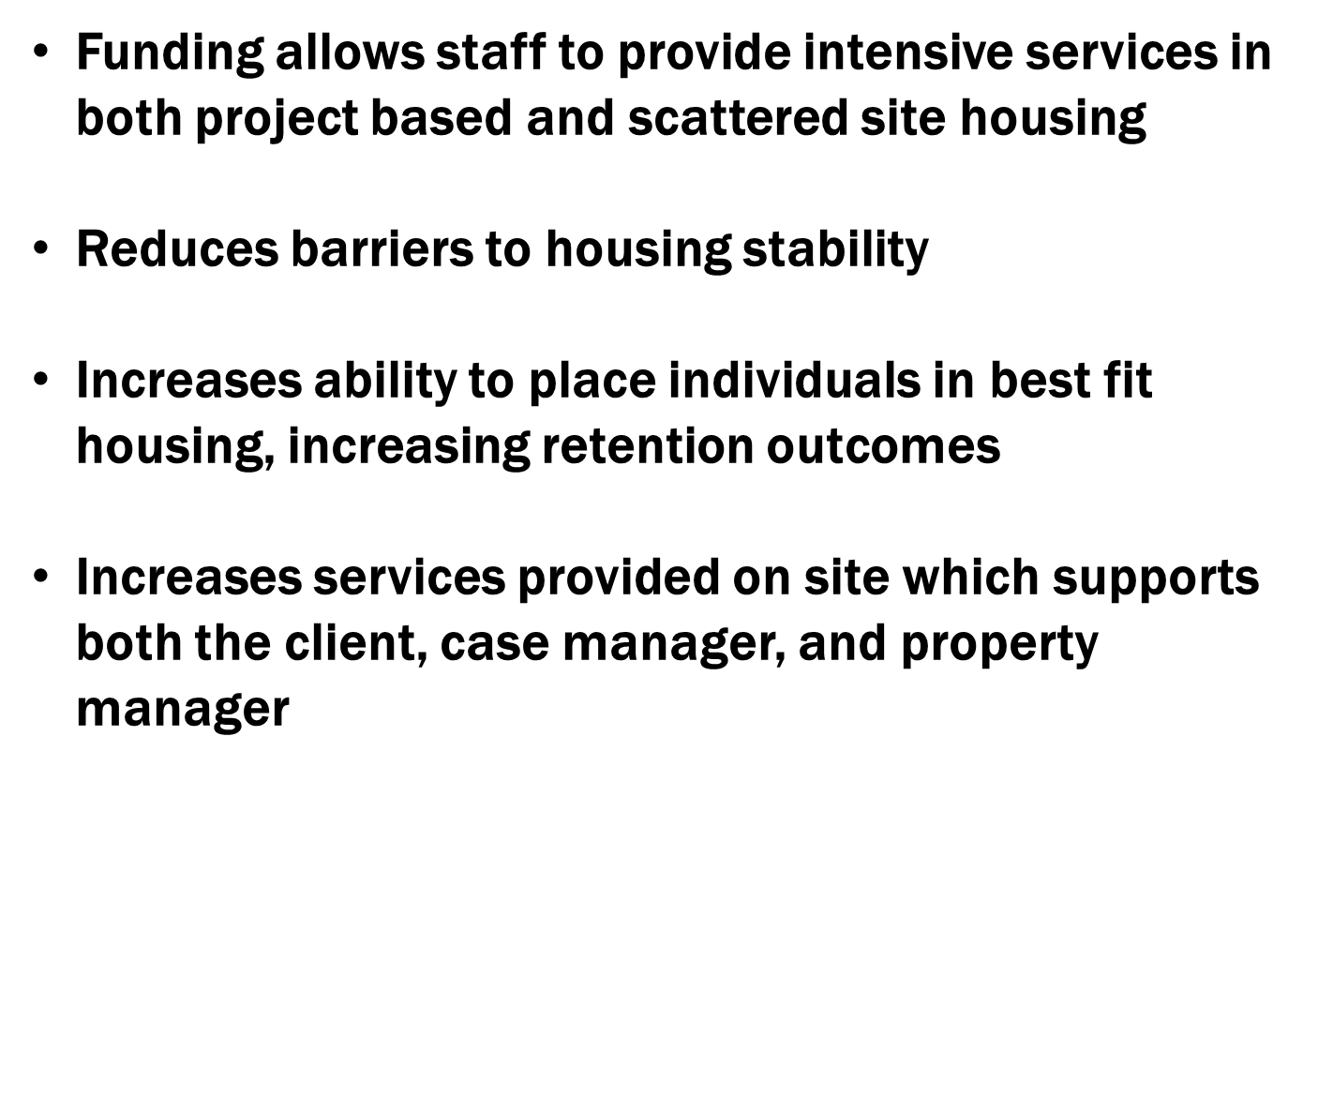
ICMS Provider Role in D7

Slide 20

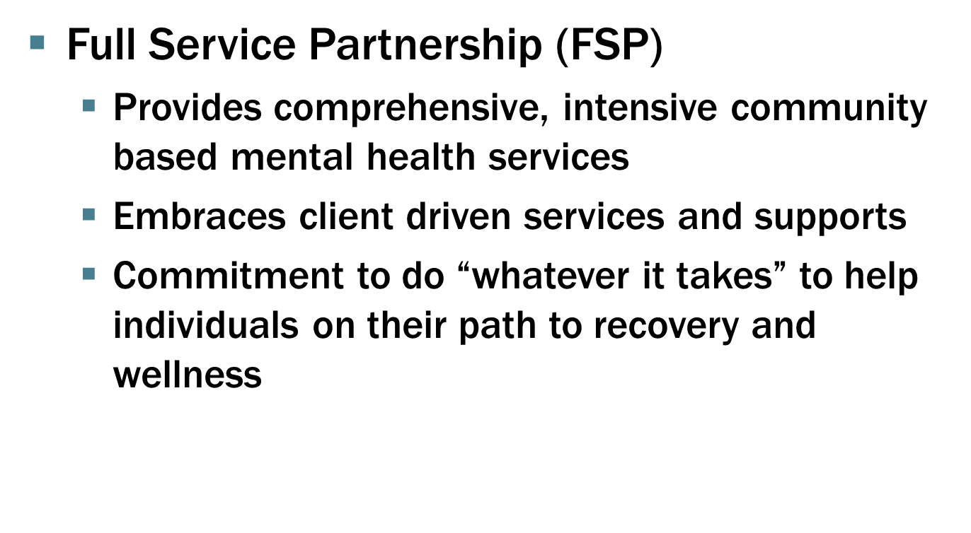

Slide 21

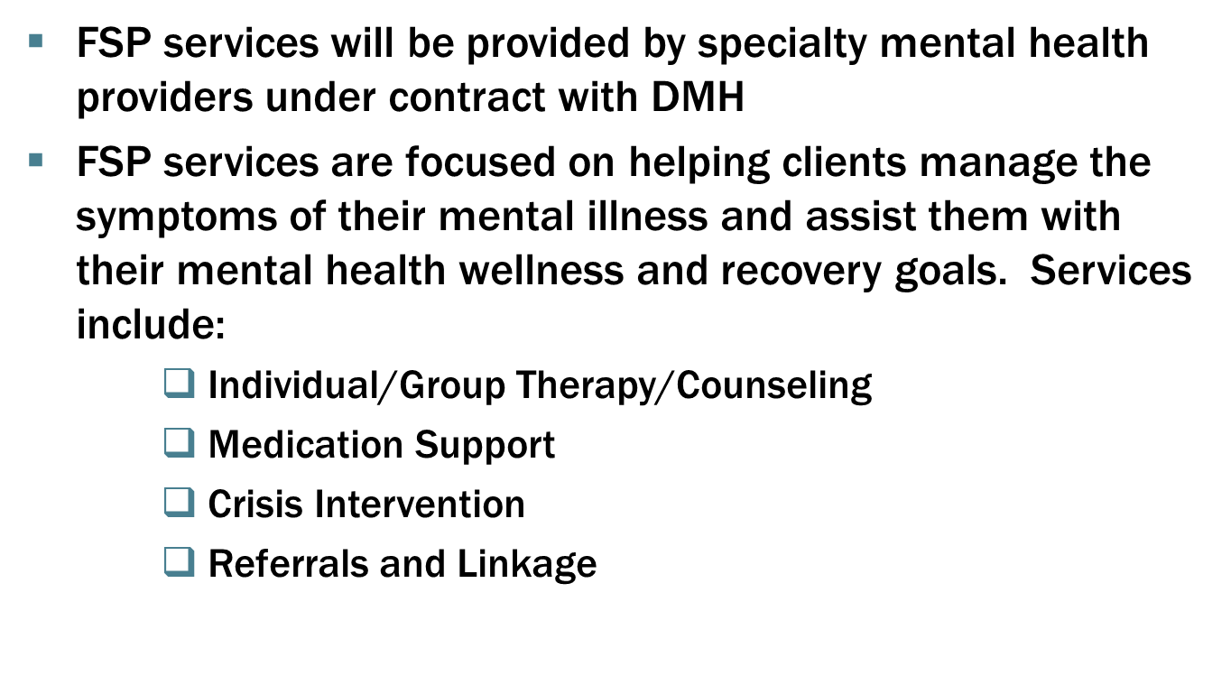

Slide 22

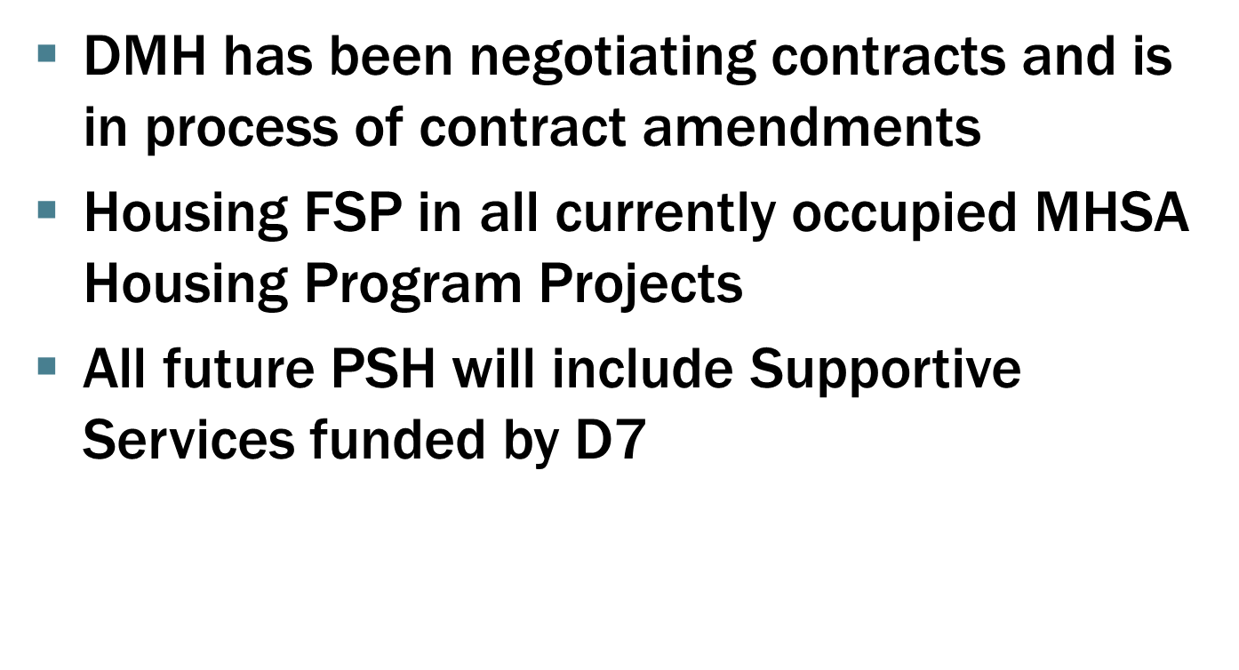

Slide 23
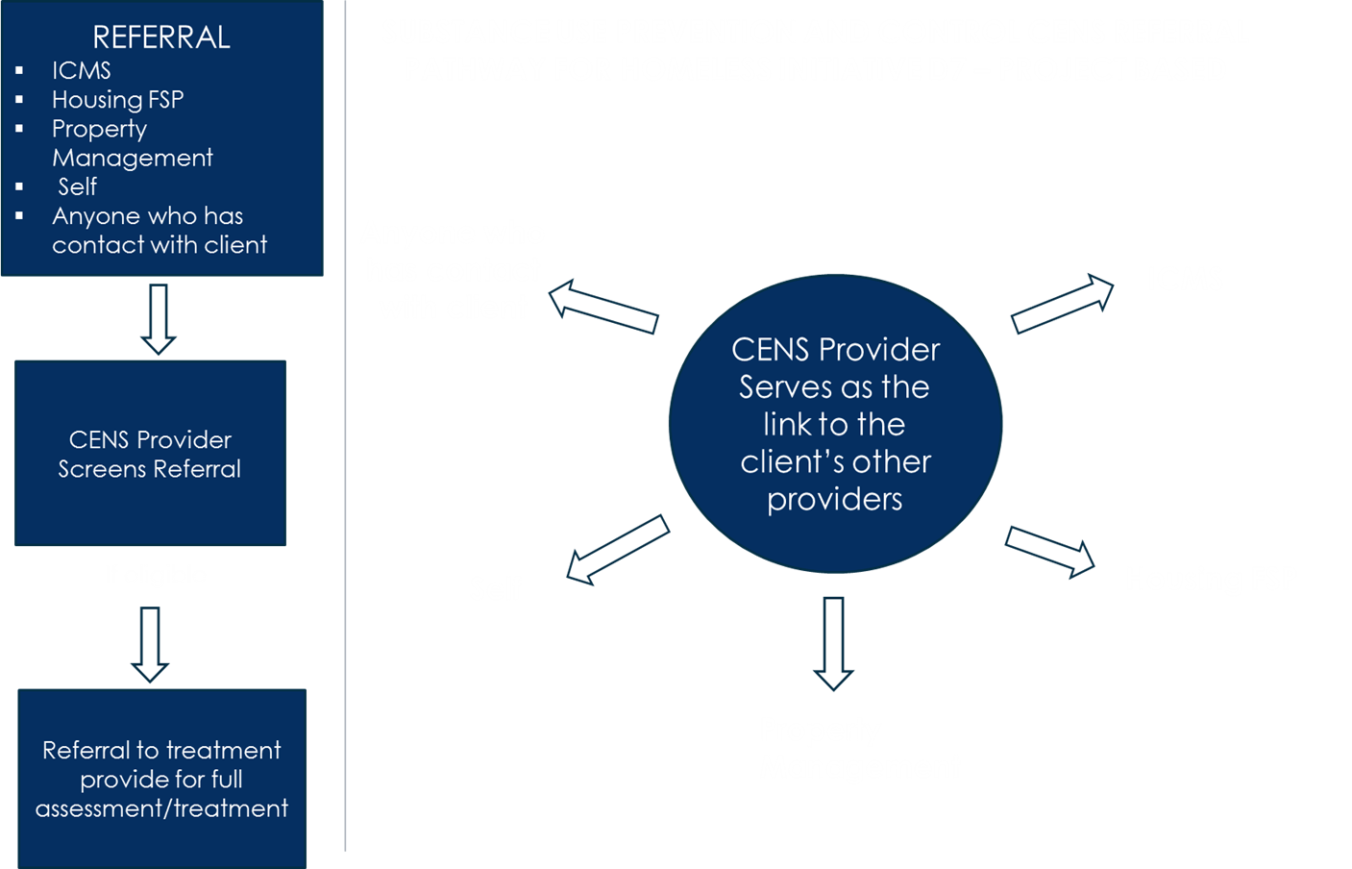
23

Slide 24
ROLE OF cens at PSH SITES
Goal: to prevent eviction due to relapse by connecting residents to substance use disorder (SUD) treatment.
Target population: individuals residing at or matched to project-based and scattered PSH sites throughout Los Angeles County.
Target population: PSH residents who have relapsed and who are referred to CENS for SUD screening and referral.
Number to be served: approximately 1/3 of D7 participants will receive CENS services.
24

Slide 25
WHERE DO CENS PROVIDE SERVICES?
CENS services are provided on-site at project-based and scattered permanent supportive housing sites.
CENS services are also provided at the CENS Area Offices located in each of the 8 service planning areas.
CENS staff meet with residents in a community room or private office.
Currently, CENS are not able to meet with residents in their housing units.
25

Slide 26
WHAT SERVICES DO THE CENS PROVIDE?
Outreach and Engagement | CENS will engage D7 participants and use motivational interviewing techniques to encourage SUD assessment and referral to SUD treatment.
Screening and Referral | CENS will connect D7 participants to SUD treatment based on the following criteria: American Society of Addiction Medicine (ASAM) Triage Tool (ATT) results Proximity of client to SUD treatment service location Type and level of service needed
Service Navigation | CENS will remind D7 participants of their upcoming appointments and will coordinate transportation and/or reschedule appointments, if needed. CENS will follow-up to ensure clients kept or rescheduled their appointments.
Care Coordination | CENS will obtain consent release of information to share treatment and progress information with the referring individual. CENS will document their work, capturing patient service utilization, treatment progress, and outcome information.
26

Slide 27
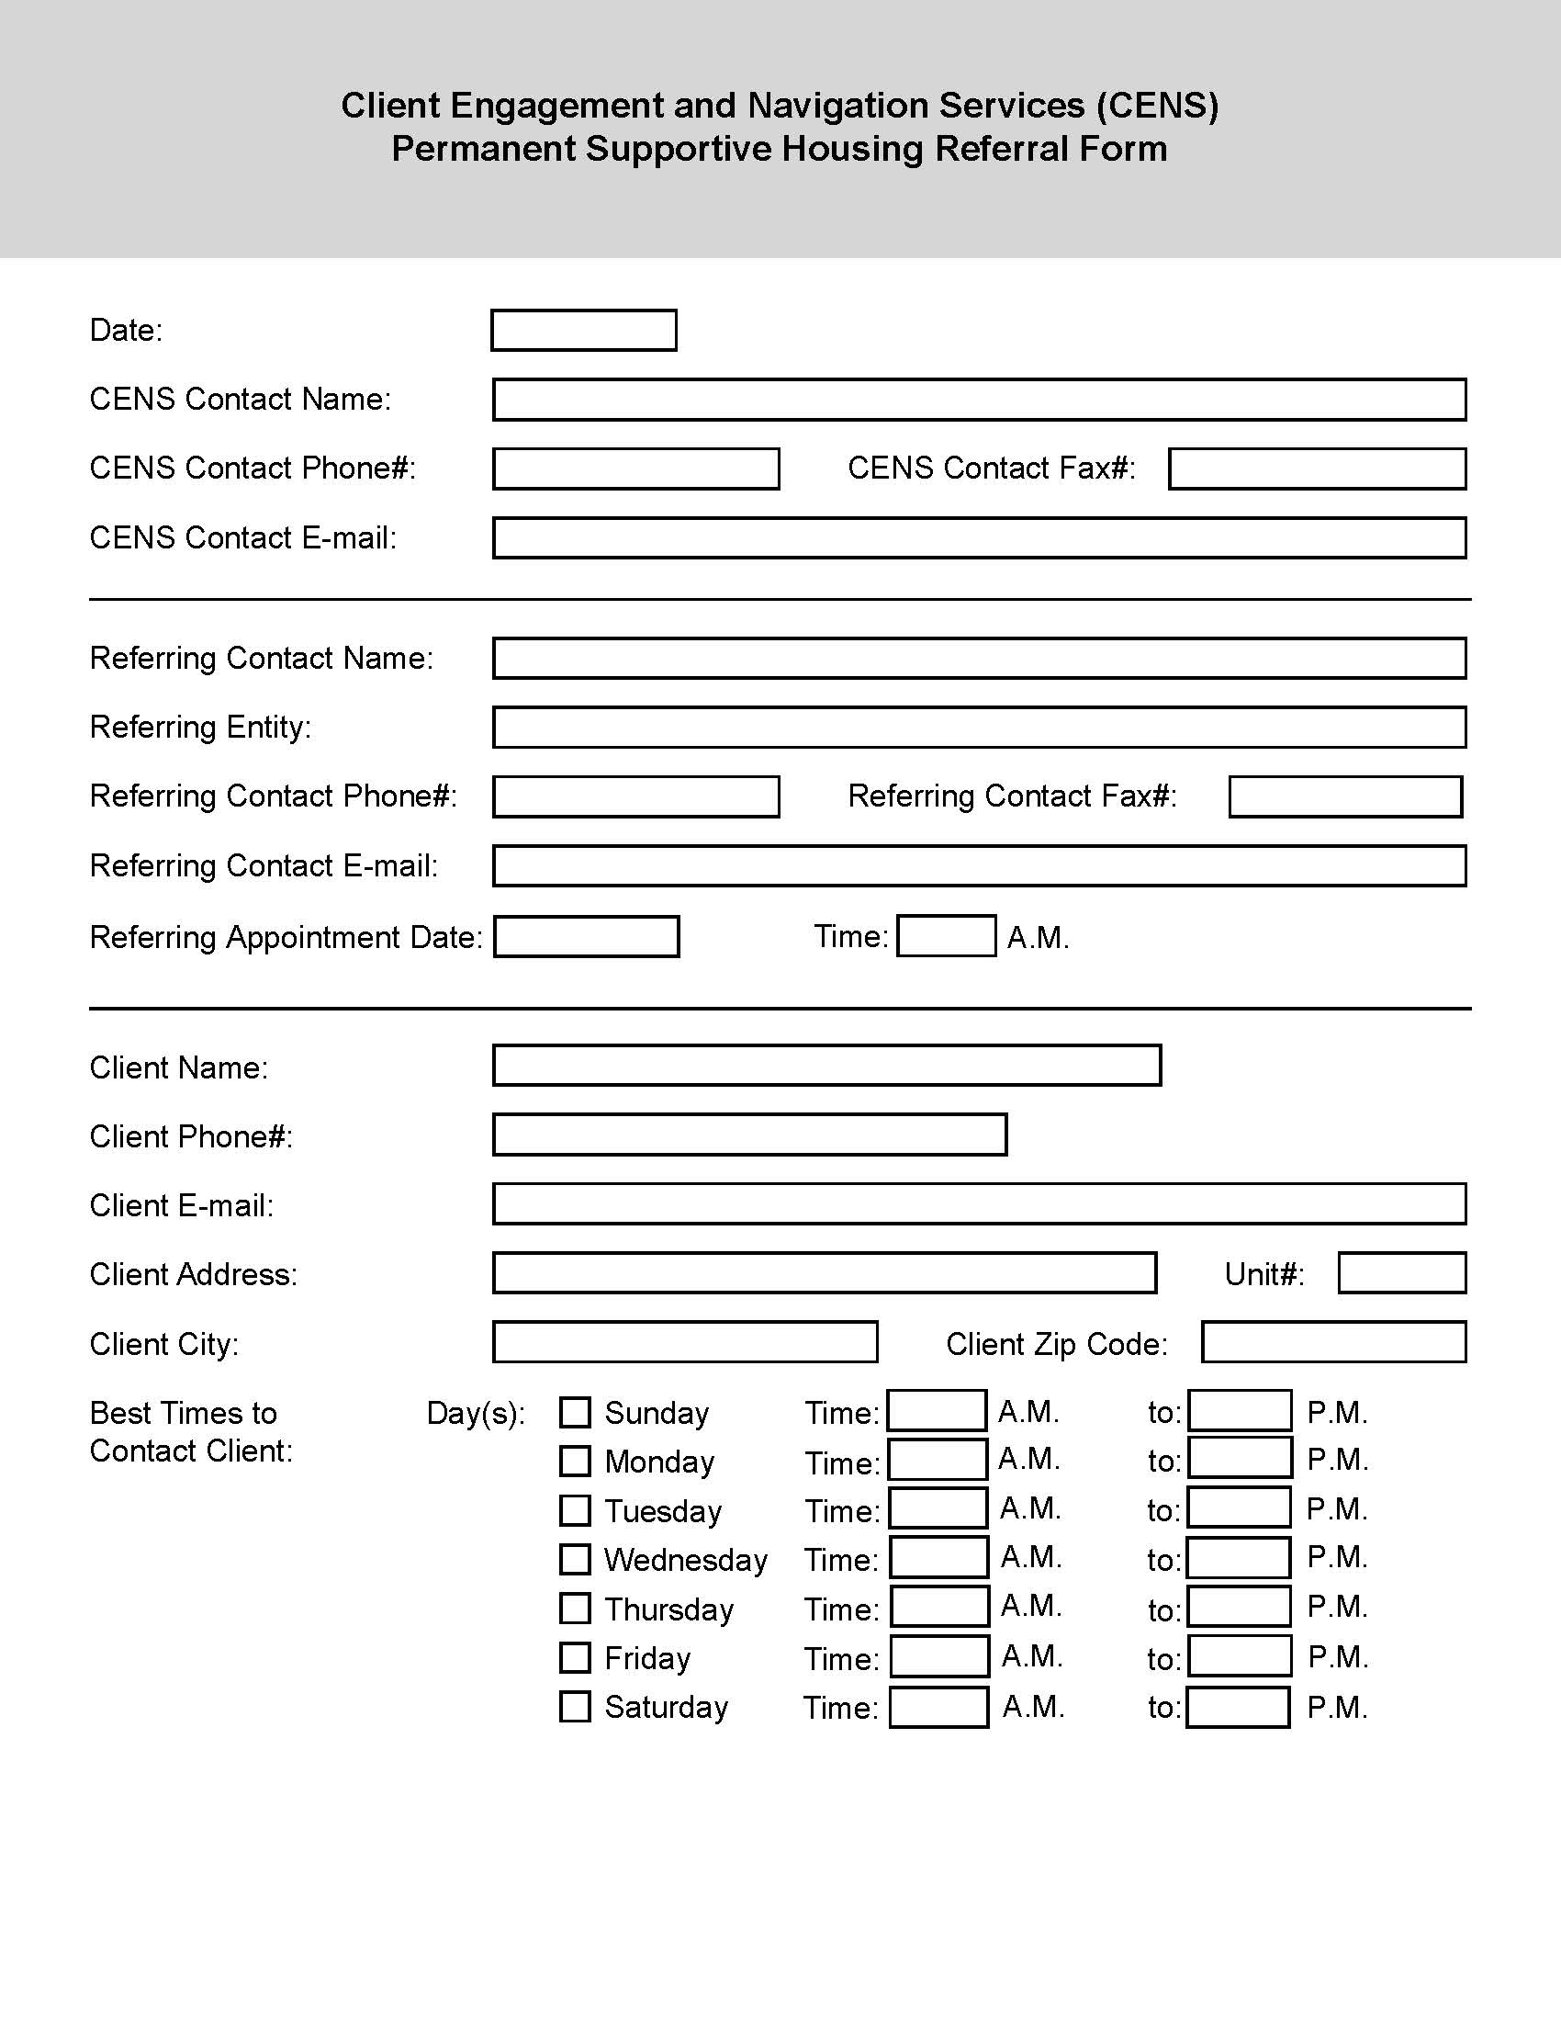

HOW ARE PSH CLIENTS REFERRED TO CENS?
27

Slide 28
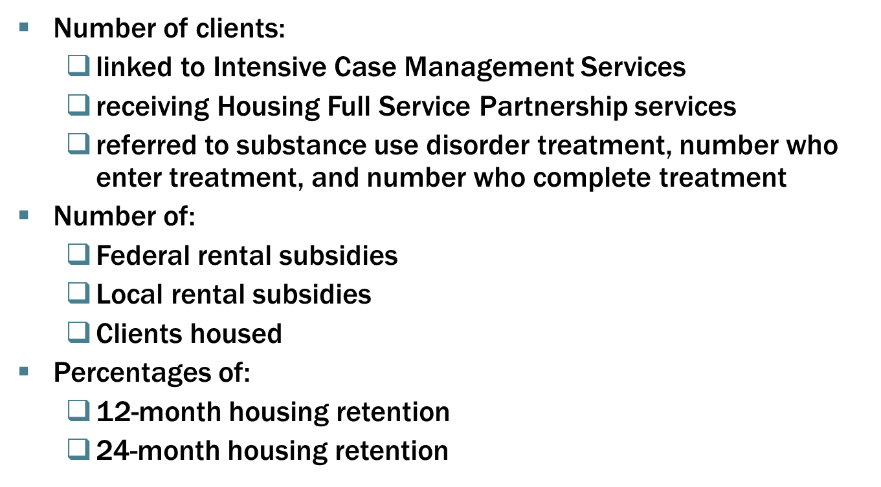
Outcome Metrics

Slide 29
HOW AN AGENCY PARTICIPATES IN D7
How does my agency participate in D7?
Become contracted provider for DHS, DMH and DPH
Hire qualified staff
Receive additional funding
How do I help get my client connected to D7?
Conduct the appropriate triage tool for your client
Enter information in HMIS
Stay in touch with clients until they are matched ICMS
What are the goals for next year?
Enroll 2,950 people into D7

Slide 30

Questions

Slide 31
Contact Information
Richy Myers – DHS Housing for Health – (323) 274-3296 Rmyers@dhs.lacounty.gov
Priscilla Moore – DMH – (213) 251-6567 Pmoore@dmh.lacounty.gov
Glenda Pinney – DPH – SAPC – (626) 293-2960 Gpinney@ph.lacounty.gov
David Dang – LAHSA – (213) 797-4597 Ddang@lahsa.org
Jonathan Sanabria – LAHSA – (213) 797-4628 Jsanabria@LAHSA.org
Julie DeRose – The People Concern – (310) 508 -3863 jderose@thepeopleconcern.org

