Slide 1
Los Angeles County Public Defender’s Office

Slide 2
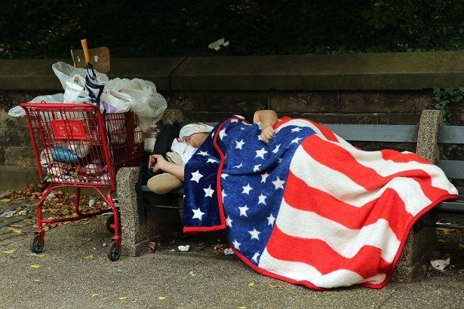
Homelessness

Slide 3
Homelessness
Criminal Record

Slide 4
Barriers to:

Slide 5
Barriers to:
Housing

Slide 6
Barriers to:
Housing
Employment

Slide 7
Barriers to:
Housing
Employment
Education

Slide 8
Barriers to:
Housing
Employment
Education
Legal Immigration status

Slide 9
Homeless Initiative Strategy D6
Criminal Record Clearing Project

Slide 10
Record Clearing Laws

Slide 11
Record Clearing Laws
Prop 47

Slide 12
Record Clearing Laws
Prop 47
Prop 64

Slide 13
Record Clearing Laws
Prop 47
Prop 64
PC 1203.4

Slide 14
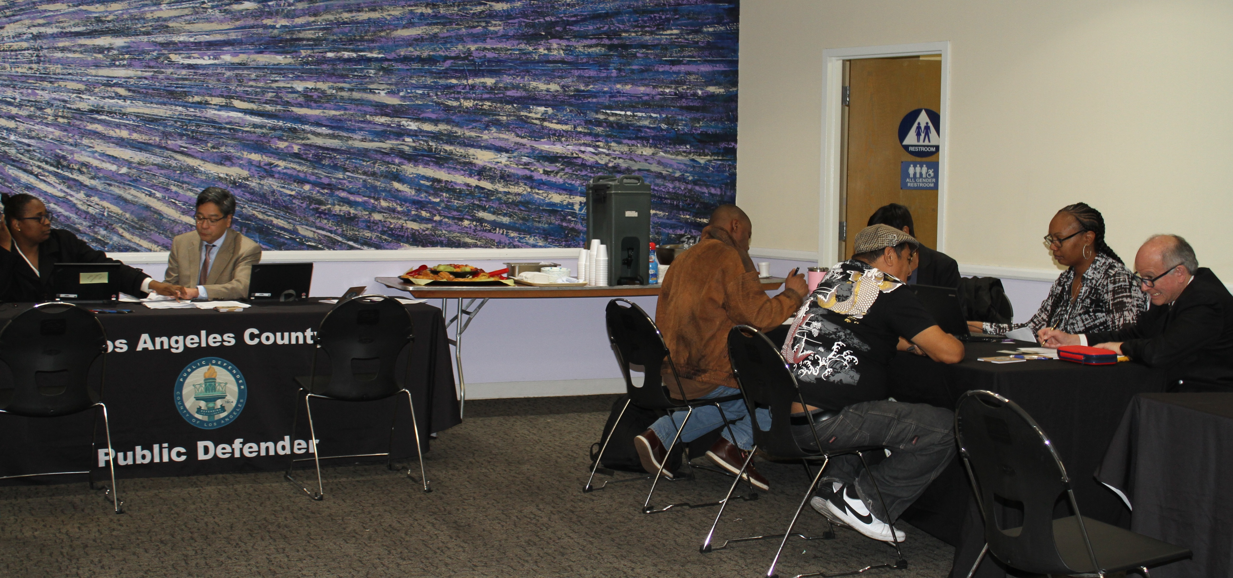
Outreach Events
RECORD CLEARING STATUTES

Slide 15
Outreach Events
Number of Events – 24
RECORD CLEARING STATUTES

Slide 16
Outreach Events
Number of Events – 24
Number of Participants – 334
RECORD CLEARING STATUTES

Slide 17
Collaborations

Slide 18
Collaborations
Shelters

Slide 19
Collaborations
Shelters
CBOs

Slide 20
Collaborations
Shelters
CBOs
County Departments

Slide 21
Los Angeles Mission
Salvation Army
VOA
Downtown Women’s Center
Harbor Interfaith Services
Antelope Valley Veterans Outreach Committee
Los Angeles City Attorney
LASD
DPSS
WDACS

Slide 22
Los Angeles County Public Defender’s Office

