Slide 1
Prevention and Response
at CDC Quarantine Stations
CDC Los Angeles Quarantine Station
MERS-CoV Preparedness Symposium
September 30, 2014

Slide 2
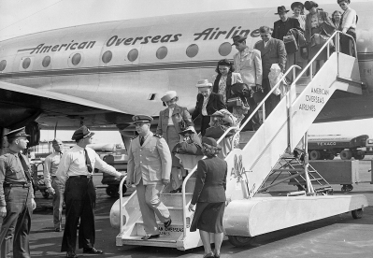
History of U.S. Quarantine System
1799: First quarantine station in Philadelphia due to yellow fever
1878: Natl Quarantine Act passed (state to federal quarantine power)
1944: Public Health Service Act formed fed govt quarantine authority
1967: CDC took over federal quarantine functions
1967─2003: Reorganization of the U.S. Quarantine System with reduced staff and facilities
2003─present: Newly emerging threats led to expansion
2
Notes:
1799 The first quarantine station and hospital in America was built in 1799 at the port of Philadelphia after a yellow fever outbreak in 1793.
1878 The National Quarantine Act was passed in 1878, shifting quarantine powers from state to federal government.
1944 The Public Health Service Act formed the federal government’s quarantine authority in 1944.
1967 CDC (National Communicable Disease Center) took over federal quarantine functions in 1967.
1970s CDC reduced the number of quarantine stations from 55 to 8 because infectious diseases were thought to be a thing of the past.
2004–2007 Number of quarantine stations increased to 20 because of concerns about bioterrorism after World Trade Center attack in 2001 and worldwide spread of disease after SARS outbreak in 2003.

Slide 3
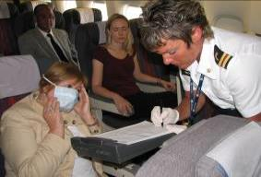
Quarantine and Border Health Services Branch Mission
Ensuring 24/7 public health capability to prevent or mitigate the introduction, transmission, and interstate spread of communicable disease in the United States and territories
3

Slide 4
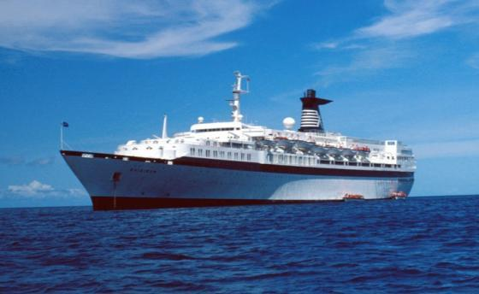
Required Reporting of an Ill Traveler on International or Interstate Conveyance
42 Code of Federal Regulations Parts 70 and 71:
Prior to arriving at a U.S. port, the captain of a plane, ship, or other conveyance is required by federal law to report any death onboard and certain illnesses that may represent a communicable disease to the CDC (international or interstate) or local health authority (interstate)
4

Slide 5
Federal Executive Authority and Communicable Disease Control
Federally Quarantinable Communicable Diseases
Cholera
Diphtheria
Infectious tuberculosis
Plague
Smallpox
Yellow Fever
Viral hemorrhagic fevers
Severe acute respiratory syndrome (SARS)
Novel or reemerging influenza causing or with potential to cause a pandemic (e.g. MERS)
Presidential Executive Order 13295, as amended by Executive Order 13375
5

Slide 6
Criteria for Reporting to CDC
Notify CDC of all deaths and any illnesses in travelers entering the United States with…
FEVER (warm to the touch, history of feeling feverish, measured temperature of ≥ 100°F or ≥ 38°C)
AND
ONE or more of these conditions:
Skin rash
Difficulty breathing
Decreased consciousness
Persistent cough
Unusual bruising or bleeding
Recent paralysis
Jaundice
Swollen glands
Severe vomiting
Severe diarrhea
6

Slide 7
Other Communicable Diseases of Public Health Concern*
Malaria
Typhoid
Varicella
Rabies
Measles
Meningococcal disease
Legionellosis
Polio
Dengue
Zoonotic poxviruses
Pertussis
Mumps
Rubella
Infectious diarrhea
*Based on their ability to spread and cause significant illness or death
7

Slide 8
Definitions
Isolation The separation of ill persons who have a specific infectious illness from those who are healthy and the restriction of their movement to stop the spread of that illness
Quarantine The separation and restriction of movement of well persons who, while not yet ill, have been exposed to an infectious agent and therefore may become infectious
8
Notes:
[

Slide 9
U.S. Ports of Entry and CDC Quarantine Stations
Seattle
Minneapolis
Anchorage
Chicago
Detroit
Boston
New York
Newark
Philadelphia
San Francisco
Washington DC
Atlanta
Los Angeles
San Diego
El Paso
Honolulu
Dallas
Houston
Miami
CDC Quarantine Station (n=20)
U.S. Port of Entry (n= 329)
San Juan
9

Slide 10
CDC Quarantine Station Jurisdictions
AK
Minneapolis
ME
Seattle
Chicago
Anchorage
Detroit
VT
NH
WA
MT
ND
MA
Boston
NY
RI
MN
WI
MI
CT
OR
NJ
New York
ID
SD
PA
Newark
WY
DE
IA
MD
Philadelphia
No.CA
NE
IN
OH
WV
NV
IL
Washington DC
San Francisco
UT
CO
MO
KY
VA
KS
TN
NC
So.CA
OK
AR
SC
Atlanta
Los Angeles
AZ
NM
North TX
AL
MS
GA
San Diego
El Paso
West TX
East TX
LA
FL
Houston
Miami
Honolulu
Dallas
GU
HI
CDC Quarantine Station (n=20)
PR
San Juan
10

Slide 11
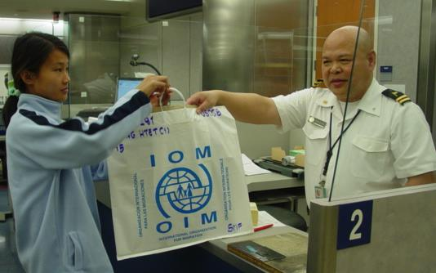
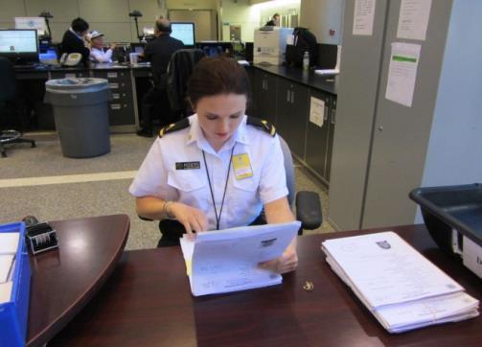
Public Health Processing of Migrants
Prevent the introduction and spread of communicable disease among first-time migrants to U.S.
Review and collect medical info from migrant visa packets
Maintain communication with state health departments
Recognize and respond to communicable disease events among migrants
11

Slide 12
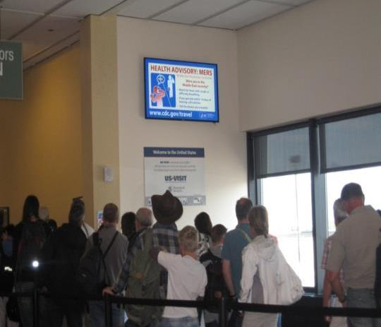
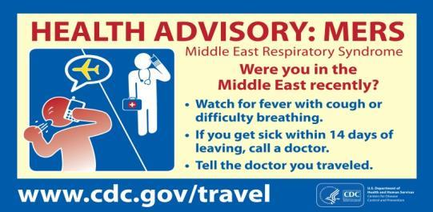
Port of Entry Coordination
Port and community partner training
Public health surveillance
Health information for international travelers
TravAlert
Real-time risk communication messages to targeted audiences at ports of entry
Messages in multiple languages
ANC TravAlert, installed in 2013
12

Slide 13
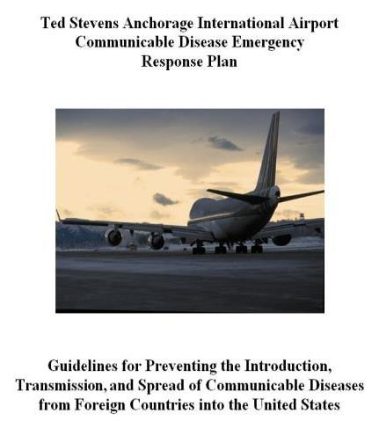
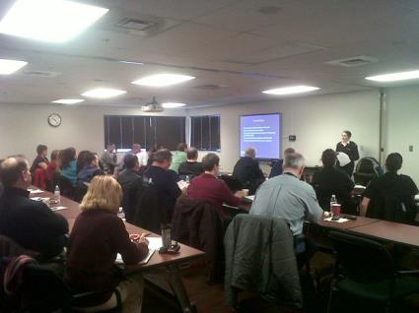
Emergency Preparedness
Disease-specific protocols
Communicable Disease Response Plans
Airport
Maritime
Port of entry screening plan
Exercises
After Action Reports
13

Slide 14
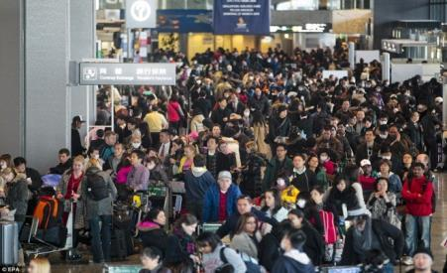
Mass Migration Emergency Planning
Port of entry support role during mass migration emergencies when requested by HHS
e.g. , 2011 Japan Earthquake
Coordination with local, state and federal partners
HHS = Department of Health and Human Services
14

Slide 15
Travel Restrictions and Interventions
Do Not Board (DNB)
Prevents issuance of airline boarding passes to individuals with communicable diseases that pose a public health threat
Applies to all flights (domestic and international)
Lookout
Prompts U.S. Customs and Border Protection to notify CDC Quarantine Station when such persons attempt to enter U.S.
Does not prevent travel
Infectious
Non-compliant or unaware of diagnosis
Expressed intention to travel
The patient must meet all of the above criteria to be placed on the DNB and Lookout lists.
15

Slide 16
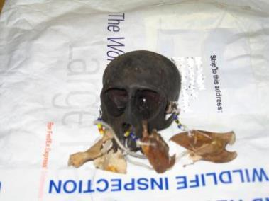
Animal and Cargo Surveillance
Inspection of animals, cargo, other items regulated by CDC
Pose a potential threat to human health
Dogs
Cats
Bats
Turtles < 4 inches
Nonhuman primates
Human remains
Civets
African rodents
Bushmeat
Snails
Infectious biologic agents
Seizure and denial of entry for shipments not in compliance with CDC regulations
16

Slide 17
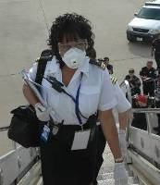
Emergency Illness Response
Suspected or confirmed communicable diseases of public health concern
Isolation and quarantine
Health information to travelers
Facilitate notification, evaluation and treatment or prophylaxis of contacts
On-call and available 24/7
17

Slide 18
CDC Quarantine Station Role in Communicable Disease Response
Determine if illness is a public health threat and needs public health action
Three outcomes from CDC’s assessment:
1
Recommend traveler seek medical care and/or delay travel until noninfectious
2
Require transfer to a hospital if quarantinable disease suspected
3
Allow traveler to continue their voyage
18

Slide 19
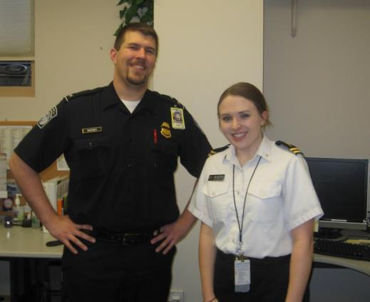
A Work of Partnerships
Critical to detect and control communicable disease threats
Form a Quarantine Network that protects health of international community
Local, state, federal, international & private industry
Port
CBP
EMS
Public Health
Law enforcement
Travel industry
19

Slide 20
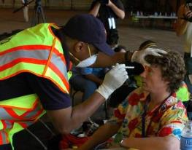
Typical Process for Notification & Response between Partners & CDC
Notification
Ill travelers enter the United States via airports, land borders, and seaports
We learn of illnesses from partners (CBP, EMS, etc…)
Response
If CDC on site: CDC quarantine staff board conveyance with EMS and conduct a public health assessment
If CDC NOT on site: CDC quarantine staff obtain EMS’s assessment and communicate recommendations
20

Slide 21
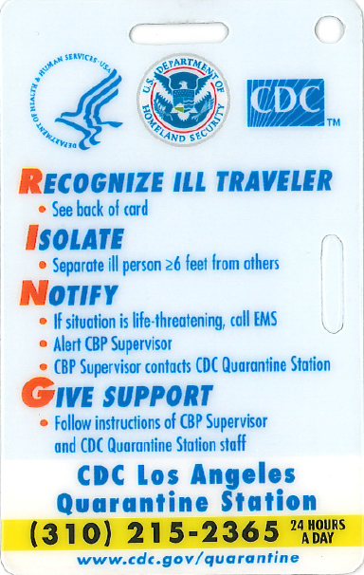
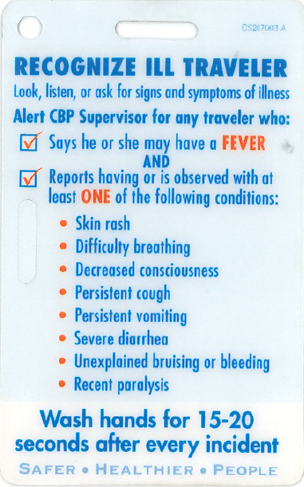
RING Card
Front
Back
21

Slide 22
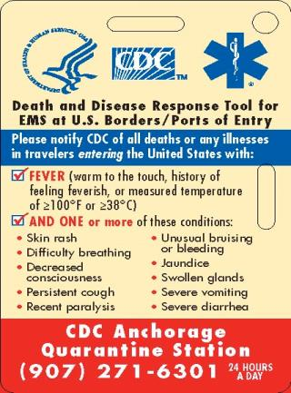
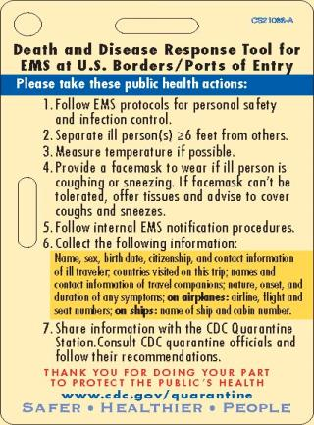
EMS Card
Front
Back
22

Slide 23
Contact Information
CDC Los Angeles Quarantine Station Phone: (310) 215-2365 – 24 hours a day
QS-LosAngeles@cdc.gov
23

Slide 24
Questions?

