Slide 1
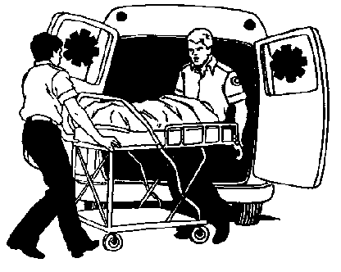

Crushing Trauma and Its Aftermath
Crush Injury
Crush Syndrome
Compartment Syndrome

Slide 2
Crushing Mechanisms
Building & structure collapse
  Earthquakes
  Explosions
Motor vehicle accidents
  Entrapment
  Direct impact
Lack of spontaneous movement
  Deep sleep
  Coma
Notes:
While crush injuries and crush syndrome are as old as mankind, the first description of the effects of crush trauma in medical literature doesn’t appear until 1909 in German literature. It is not covered in English literature until 1940-1941 when the WW II bombing “blitz” of London produced massive causalities from crush situations. Often these victims survived the entrapment, but died shortly AFTER rescue. This phenomena was termed “Rescue Death”.
The most common mechanism resulting in crush situations is the collapse of occupied buildings. In California, earthquakes produce this type of incident, but a new threat of terrorist bombings, such as in Oklahoma City, has increased the likelihood of increased crush injuries. An interesting facet of crush injuries is the propensity to come in “epidemics” or mass casualty situations. The MCI aspects of crush injuries can hamper or change the treatment that is provided. The fact that crush situations happen in a confined space means that treatment at the scene may not always be physically possible.
Other examples of crush mechanisms are motor vehicle accidents that require extrication or provide direct impact on tissues such as situations in which legs are pressed between two bumpers or a finger/hand is slammed in a door. Blunt trauma caused by beatings, sports, or falls are also contributing factors.
Lack of spontaneous movement may also result in crush injury. This may be caused by deep sleep due to drug or alcohol intoxication. A “crushed” limb can be produced when an extremity is hung over the back of a chair resulting in compression of nerves and blood vessels. Patients in a coma who are left for hours without being turned may also suffer crush or compartment syndrome.

Slide 3
Crushing Force
External crushing force applied to body
  High pressure short duration
    leg(s) slammed between two bumpers
  Low pressure long duration
    partially buried in collapse or cave in
  High pressure long duration
    generally results in amputation or death
Notes:
The extent of the crush injury is directly related to the amount of force applied for a specific length of time to a particular body part (injury = force + time + body part).
High pressure short duration (legs crushed between two car bumpers) - causes fractures and direct cellular tissue damage. There is swelling and a high potential for compartment syndrome, but it is unlikely that crush syndrome would develop.
Low Pressure long duration (trapped under rubble or partially buried in dirt/sand) - causes direct tissue and muscle destruction and the tourniquet effect interrupts circulation. Crush and/or compartment syndrome will most likely develop.
High pressure long duration (trapped under heavy object or part caught in machine) - causes somatic death or may require an amputation of the affected part. Crush and/or compartment syndrome will most likely develop and may result in necrosis of the body part, renal failure, and death.
Some unusual situations that have produced crush injuries
90 year old man who fell into a muddy swamp and was not rescued for 18 hours
Stroke victim who was not discovered for days
Persons bitten by horses and hippopotamuses
Use of the pneumatic anti-shock garment (MAST suit)
People who have been struck or beaten repeatedly
Man who was heavily intoxicated and fell asleep sitting on the toilet: by morning he had developed compartment syndrome of his buttocks

Slide 4


Involved Anatomy
Upper extremities & pectoral girdle
Lower extremities & pelvic girdle
Other body areas generally result in immediate death
    Head
    Abdomen
    Chest
Notes:
The anatomy involved in crush or compartment syndrome are:
Lower extremities - common because entrapment often involves the lower body
Upper extremities - less common because there are fewer situations where entrapment occurs
Hips and buttock area - rare occurrence
Head, abdomen or chest - results in such disruption to vital organs that death is usually the end result

Slide 5
Crush Injury
Cellular Response
Damage results in loss of cell membrane integrity
  Intracellular contents spill into surrounding tissues and spaces
  Histamine causes vasodilation & increased capillary permeability
Continued pressure impairs circulation
  Local tissue hypoxia
    Anaerobic metabolism
  Build up of cellular toxins in injured tissues
    Lactic acid, uric acid, Potassium, Phosphates, Myoglobin
Notes:
Compressive force applied to muscle causes cell injury and/or death. Cell integrity is lost and histamine is released resulting in local vasodilatation and increased capillary permeability. INTERcellular fluids spill out into the INTRAcellular areas (interstitial spaces).
If the compressing force is continued for any extended period of time, circulation to the affected area is impaired. The pressure impedes arterial and/or venous circulation (affecting the amount of fluid accumulating in the interstitial space) resulting in poor perfusion.
Without a continuous supply of oxygen, local tissue hypoxia occurs. Cells that survived the initial crush injury begin to metabolize ANAEROBICALLY and lactic acid is produced. Uric acid (a product of protein metabolism) is also released.
Potassium (the main intracellular electrolyte) and myoglobin (a form of hemoglobin used by muscle cells to bind and transport oxygen with in the cell) are spilled into the surrounding tissues.
Without venous perfusion, toxic cellular wastes remain within the tissues. Once the compressive force is released, these toxins enter the systemic circulation.

Slide 6
Crush Syndrome
Vascular Response
Crushing pressure sustained
  Body adapts to decreased vascular space
Crushing pressures released
  Blood flows into tissues (re-perfusion)
    redistributive hypovolemia
    wounds in crushed limb may begin to bleed
Chemicals & toxins enter systemic circulation
Notes:
When the crushing force is sustained, the body adapts to the reduced vascular space. Blood pressure and perfusion appear normal during extrication and rescue procedures.
When the crushing pressure is released, blood rushes into the vessels and body parts where it was previously reduced secondary to compression resulting in a redistributive hypovolemia (similar to distributive shock). The sudden redistribution of intravascular fluid can decrease blood pressure and systemic perfusion significantly. Wounds previously devoid of bleeding may begin to bleed due to the release of the compressive force.
As blood flows into and reperfuses the compressed area(s), it picks up the cellular toxins and metabolic wastes that accumulated outside the cells during the ischemic, anaerobic state. Ordinarily small amounts of these chemicals and toxins entering the systemic circulation cause no problem, but the abnormally high concentration results in significant cardiac and renal compromise.

Slide 7

Crush Syndrome
Systemic Response
Cardiovascular shock
  Third spacing - fluids leave damaged vascular space
Blood chemistry is altered
  Decreased pH (increased acidity)
    Increase of Lactic acid, Uric acid
  Hyperkalemia (increased K⁺)
  Hyperphosphatemia
  Hypocalcemia
  Increased myoglobin in blood
Notes:
Crush syndrome or “rescue death” occurs as the body attempts to adapt to its new physiological state. Besides suddenly increasing the intravascular space, blood leaks into tissues through damaged and dilated vessels made more permeable by histamine. Considerable “third spacing” may occur as a result of these changes.
The cellular by-products entering the systemic circulation alter the blood chemistries significantly. The body pH is lowered, making the blood and urine more acidic.
The extraordinary amount of potassium results in hyperkalemia and leads to cardiac dysrhythmias.
Released phosphorous and phosphates bind with calcium and produce a state of hypocalcemia which can lead to muscle spasms and seizures.
Myoglobin spilled from damaged muscle cells is normally excreted by the kidneys in a dissolved (or solution) state. However, the increased amount results in a highly concentrated sludge that precipitates in the renal tubules in an acidic environment and results in kidney failure.
The presence and quantity of these chemicals cannot be detected in the field. Field measurements of Ca, K, and myoglobin do not yet exist, but the ECG rhythm is an assessment tool that can assist in detecting high levels of potassium.

Slide 8
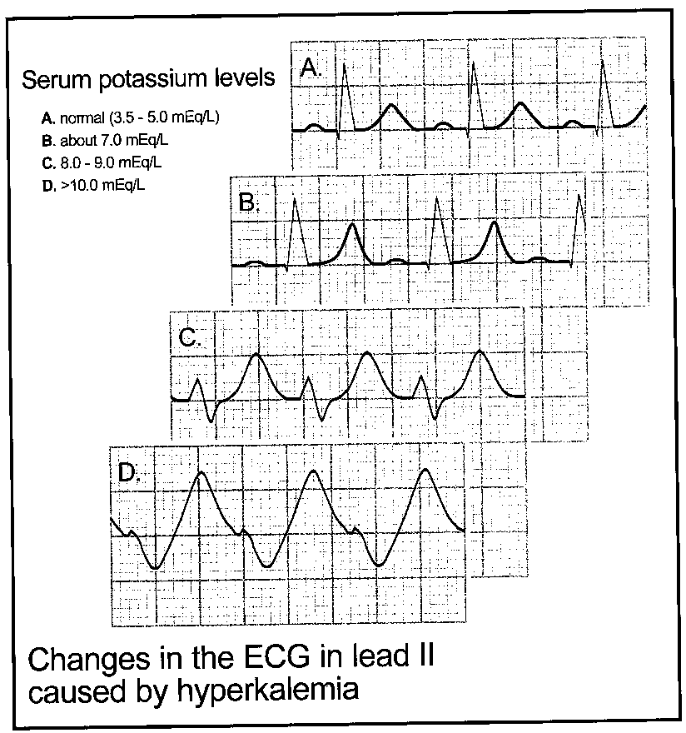
Crush Syndrome
Cardiac Response
Hyperkalemia
  ECG changes
    peaked T waves
    widened QRS complex
    disappearing/absent P wave
  Cardiac dysrhythmias
    heart blocks
    V-tach
    V-fib
    asystole
Notes:
The electrolyte that matters the most in maintaining normal cardiac function is potassium. Of greatest concern is the effect potassium has on the heart’s conduction and regulatory system.
Detecting hyperkalemia in the field is virtually impossible, but ECG changes that should be watched for include:
Peaked T waves
Widened QRS complexes
Disappearing or absent P waves
As the potassium level increases the T waves peak, the QRS widens, and the P waves disappear. Eventually the ECG takes on a “V-tach” appearance. Untreated, this eventually leads to ventricular fibrillation and asystole.

Slide 9
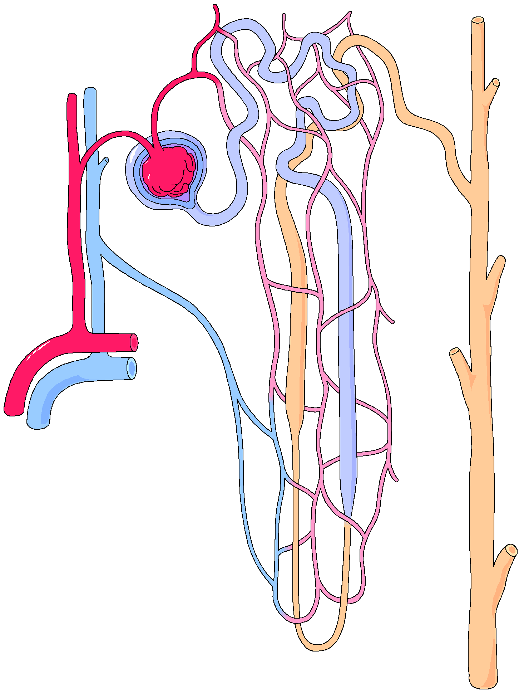
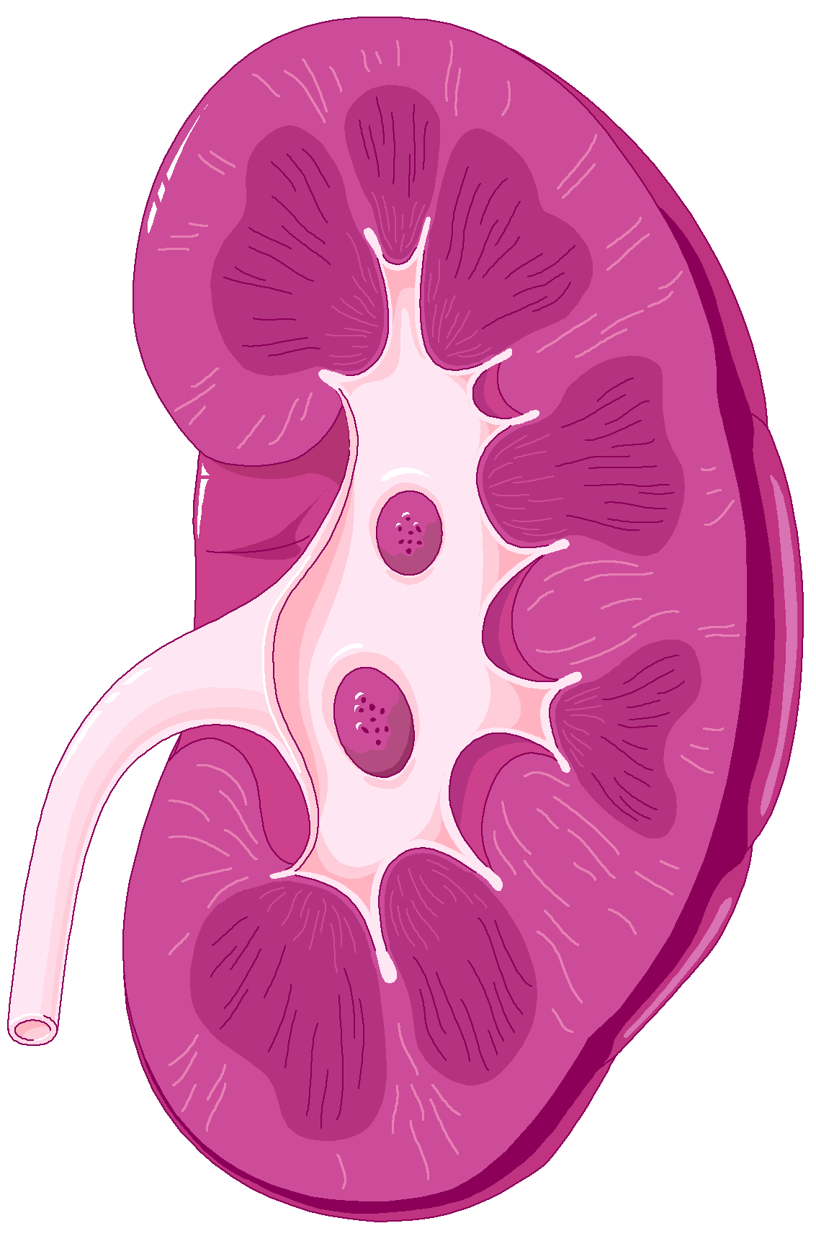
Crush Syndrome
Renal Response
Myoglobin
  Small amounts normally filtered out through kidneys
  Acidic environment causes myoglobin to precipitate out in kidney tubules
    Urine becomes reddish-brown, cola colored
  Causes kidney failure
Notes:
Myoglobin is a normal product of cellular growth and physiology. Small amounts are released and excreted normally. The main pathway for excretion is through the kidneys. Myoglobin, in a dissolved state, easily passes throught the renal tubules and is excreted into the urine.
Myoglobin blood levels increase when either cardiac or skeletal muscle damage occurs. In crush situations, the blood is made more acidic by the acids that were released during the period of anaerobic metabolism. Unfortunately, myoglobin precipitates out in an acidic environment.
Myoglobin sludges up in the kidneys and decreases their effectiveness. A high concentration of myoglobin is also directly toxic to renal tubule cells and results in renal failure which is often irreversible.
Increased amounts of myoglobin turns the urine a brown ‘cola’ color.

Slide 10
Crush Injury/Syndrome
Management
“Treatment in the rubble”
  Treatment should be started before pressure is released
  Treatment may be hampered by the multi-causality incident and confined space of crush injury situations
  Attempt to coordinate release of pressures with extrication specialists
Notes:
Ideally, medical treatment should be started BEFORE the constricting pressures are released due to the predictable and possible reversible physiological changes that occur after the patient is extricated.
The physical rescue and extrication can be time consuming, thus, “treatment in the rubble” should be started if at all possible.
The confined space aspects of the rescue and what is often a multi-causality situation does not always allow for initiating all medical treatment indicated. However, there should be an effort made to coordinate the treatment with the final release between the medical personnel and the extrication specialists.
The goal is to avoid “rescue death”.

Slide 11
Crush Injury/Syndrome
Basic Treatment
Manage airway - assume dust inhalation
  Wipe out mouth with damp cloth
  Administer O₂ via mask or provide dust filter mask
  Albuterol by hand-held nebulizer for wheezing
Start IV in unaffected limb
Hydrate both adult and pediatric patients with 20ml/kg of NS
Notes:
In any trauma situation, the basic management of the airway, spinal immobilization, and controlling major bleeding remain the initial treatment priorities.
When a building collapses, clouds of suspended dust particles fill the space where an individual may be trapped. Dust asphyxiation has been the cause of death in some cases. Trapped victims experience a high incidence of airway injury from dust impaction and toxic inhalation. Therefore, protecting the victim from further exposure is a high priority.
Wipe out the patient’s mouth with a damp cloth then provide O₂ by mask rather than a nasal cannula. The mask has the ability to act as a ‘filter’ and decreases the amount of inhaled dust that exists or will inevitably be kicked up by the rescue operations.
If O₂ is not practical, it is important to somehow shield the patient’s respiratory tract from further dust contamination. This can be done by providing a particulate filter respirator or a regular surgical mask.
After release of the compression force, possible dehydration, redistributive hypovolemia and high concentration of chemicals and cellular toxins enter the systemic circulation. To prevent further complications, the victim should be hydrated to prevent hypovolemia and dilute the toxins.
Start an IV in an unaffected limb.
Infuse initially 20ml/kg of NS for both adult and pediatric patients prior to release.

Slide 12
Crush Injury/Syndrome
Psychological Support
Panic & agitation is common place
    “Don’t leave me in here”
    “Get me out NOW!”
  Talk to patient
    Patient may get ignored during technical aspects of rescue
    Don’t comment on future use or loss of limb
    Field amputation by qualified MD may be
    necessary
Notes:
There are few things that induce more panic than being trapped and not being able to escape. It is a natural instinct to want to flee a dangerous area. Entrapped persons will struggle until exhaustion overcomes them, then re-panic and demand immediate release when rescuers arrive on scene.
Treating crush injury/syndrome involves NOT rescuing the victim UNTIL certain treatments take place. The victim will not understand the necessity of remaining trapped until some of these initial treatments have been administered. Every attempt should be made to explain what is being done to prevent “rescue death”.
Oftentimes extrication is a very complex and technical. The best way to reduce the victim’s stress level is through communication and reinforcing their humanity. Death is a real possibility due to the consequences of multi-trauma, rescue death and further structural collapse. The victim may want to have some “last words” communicated to their family or maybe even make comments concerning a “last will”. These requests should be allowed and encouraged as much as is practical.
Rescuers should NOT comment on the possible prognosis of the crushed limb. It is impossible to determine whether a limb will be functional until after being evaluated and treated in the hospital.
Field amputation by a qualified MD/surgeon might be a consideration. Amputation may be the only means of rescuing the victim and prevents the complications of reperfusion crush syndrome, but it should not be the first consideration. A physician needs to examine the victim, situation, and obtain informed consent before any such procedure takes place. The final decision for performing a field amputation ultimately rests with the victim.

Slide 13
Crush Syndrome
Management
Indications for treatment
  Suspicion of hyperkalemia - ECG changes
  Patient trapped longer than four hours
Prehospital management
  Albuterol 2.5mg/3ml NS continuous inhalation
  Calcium chloride 1 gram IVP
  Sodium bicarbonate IV Infusion
    Add 1mEq/kg to first liter of NS after calcium chloride administration
Notes:
The potential for crush syndrome, hyperkalemia, and renal failure exists if the patient is trapped for more than 4 hours. Hyperkalemia may develop earlier depending on the extend of muscle damage. Renal failure occurs when myoglobin precipitates in the renal tubules in an acidic environment and renal necrosis develops.
Potassium (K⁺) imbalance affects the electrical activity of the myocardium. Severe hyperkalemia can prevent the heart from conducting electrical impulses. The ECG changes seen in the presence of hyperkalemia are small-absent P waves, widened QRS complexes, and tall tent-shaped T waves. If untreated cardiac arrest will result.
Continuous administration of albuterol 2.5mg/3ml NS concentration via a mask assists in reducing hyperkalemia. Albuterol is administered regardless of lung sounds; wheezing may be present due to inhaled dust or other toxins.
Calcium chloride and sodium bicarbonate help to move intravascular and extracellular K⁺ into the cell. This effectively decreases the circulatory level and allows the excess to be excreted by the kidneys. Sodium bicarbonate elevates the pH level combating the acidosis that develops due to anaerobic metabolism and elevated uric acid.
Sodium bicarbonate and calcium chloride are incompatible and must NOT be administered together or calcium carbonate is produced (chalk). Administer calcium chloride first then flush IV tubing completely with NS solution. Add sodium bicarbonate 1mEq/kg to the fist 1000ml NS and infuse rapidly.

Slide 14
Assessment of Crush Victims - Post Rescue
Marks on victim may be minimal
  Keep limb(s) at heart level
  Use non-compressive splints
Paralysis/weakness of affected limbs
  Mimics spinal cord injury
Hypotension and tachycardia
  Redistibutive hypovolemia
Tachypnea
  Metabolic acidosis
Notes:
After extrication, marks on the victims body may be minimal. Lack of overt skin damage should not be taken as a sign of ‘no injury’. Mechanism of injury should always generate a high suspicion of trauma.
Keep the affected limb at heart level. This will aid venous and ‘third space’ fluid return and not impair arterial flow.
If fractures are present, a non-compressive type of splint should be used.
Lack of perfusion to an affected part may disrupt normal nerve transmissions. This lack of nerve function can present itself as limb paralysis and can mimic a spinal cord injury.
As bodily fluids are redistributed within the vascular space, signs of shock such as tachycardia and hypotension should be expected. Tachypnea may be present due to shock increasing the need for O₂ and the body’s attempt to normalize the acid/base balance by decreasing the blood CO₂ level via the respiratory system.

Slide 15
Assessment of Crush Victims - Post Rescue
Pain or paresthesia may increase
  Consider Morphine 2 - 20mg IVP or 10mg IM
    Pediatrics 0.1mg/kg IVP or IM
Distal pulses may be absent
Progressive swelling of affected area
  Compartment syndrome
Notes:
The trapped victim may not experience pain due to fear. During the hypoperfusion state, the transmission of nerve impulses may be impaired causing a type of anesthesia. However, after release and reperfusion, the nerve pathways are re-established and a state of mild to severe pain may result. Damaged nerves may also produce paresthesia (numbness and tingling).
Pain control is not the first priority, but should be seriously considered. Morphine is the drug of choice and is indicated for isolated extremity trauma and careful consideration should be given in the face of multiple system trauma. The euphoric effect of morphine may assist in allaying the psychological panic that an entrapped person experiences.
Distal pulses may or may not be present depending on the amount of crushing pressure applied and the amount of direct damage to blood vessels sustained.
Histamine release and the return of a fluid to the damaged areas is responsible for much of the swelling that occurs after release of the crushing pressure. Evaluation and treatment should include the possibility of the development of compartment syndrome.

Slide 16
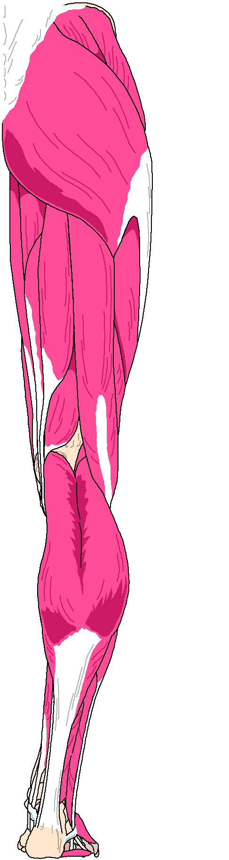
Compartment Syndrome
Usually happens to large muscle groups such as quadriceps & gluteal muscles
Notes:
Compartment syndrome is caused by the increase of pressure in muscle groups confined in tight fibrous sheaths. While this can develop in any muscle group, it seems to be more common in larger muscle groups such as the hips and legs. However, the upper arms or other muscle groups are not immune to this phenomena.

Slide 17
Compartment Syndrome
Pathophysiology
Fluids re-perfuse damaged areas
  Muscle tissues become swollen inside fibrous sheaths
  Increased swelling results in increased pressure
Notes:
Compartment syndrome develops when there is a prolonged period of time in which a compressive force is applied or blunt trauma occured to muscle groups confined in tight fibrous sheaths.
Signs of minimal or no trauma may be present, but muscles are hypoperfused, cellular damage develops, and intramuscular hemorrhage may be present.
Reperfusion increases the edema and the intracompartmental pressure continues to rise causing further ischemia, necrosis, leakage of fluids, and continuous build up of intracompartmental pressure and toxins.

Slide 18
Compartment Syndrome
Signs and Symptoms
General findings
  Pallor
  Paralysis
  Pulselessness
  Pain on passive stretch
  Paresthesia
Most significant findings
  Pain on passive stretch
  Sensory impairment
Notes:
General findings of compartment syndrome are:
Pallor - due to ischemic changes at the site of compression
Paralysis - due to nerve compression or damage
Pulselessness - due to compromised circulation
Pain - due to reestablishment of nerve pathways; pain may be seemingly out of proportion to injury; minimal or no trauma may be visible.
Paresthesia - due to nerve compression or damage
Of the 5 “P”s denoting vascular insufficiency, the earliest and most significant symptoms are pain on passive stretch and sensory impairment.

Slide 19
Compartment Syndrome
Treatment
Early recognition of developing emergency decreases disability
Not treated in the field
  Requires a fasciotomy to open the muscle compartment
Notes:
Compartment syndrome may develop within hours to days and ordinarily would not be a field issue. Early recognition is based on patient history and mechanism of injury. Delayed treatment can result in muscle necrosis, nerve damage, and crush syndrome.
This condition is not treated in the field.
The optimal treatment of local injury of a crushed limb is a matter of debate. Some surgeons feel that the skin is able to withstand extraordinary capacity to withstand pressure and acts as a barrier to infection. Others feel it may require fasciotomy (surgical incision into the muscle compartment) to decompress the compartment and allow for drainage and release of fluids.

Slide 20
Predictable Injuries and Complications
  Direct major organ injury
  Lacerations
  Fractures
  Dust inhalation
  Crush injury
  Crush syndrome
  Compartment syndrome
Notes:
In treating crush injuries, it must be remembered that the victims can also be multi- system trauma patients. The injuries are predictable due to the mechanism of injury.
Injuries that should be expected and assessed for include direct injuries to major organs, lacerations, fractures, and dust inhalation as well as crush syndrome.
Dust inhalation is a common mechanism of injury in a building collapse. Airway and breathing are the first two elements of an assessment and victims have died due to dust and toxic substance inhalation and obstructed airway.
The mechanisms causing crushing injuries and potentially crush syndrome seem to be increasing. The underlying provoking factors have received much press coverage when they happen, such as earthquakes and terrorists bombings, and it is believed that these incidents will increase in the future. Other crush mechanism incidents, such as auto accidents and trench cave-ins, seem to remain constant in their occurrence.
Advances in rescue techniques (USAR & confined space) have a high success in removing victims alive. However, in order to reduce morbidity and mortality, complications of a lengthy entrapment must be considered as part of the overall treatment.
The Los Angeles County Treatment Protocol 1273 “Crush Injury - Crush Syndrome” outlines the treatment in these situations. This treatment guideline has NOT been approved for Standing Field Treatment Protocols (SFTPs), base contact is required.

