Slide 1
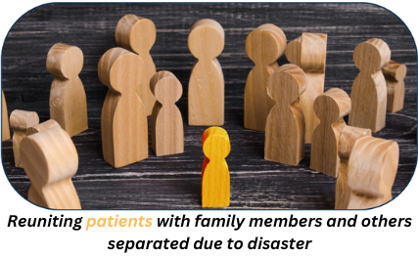
2024 Family Reunification Center Exercise Briefing

Slide 2
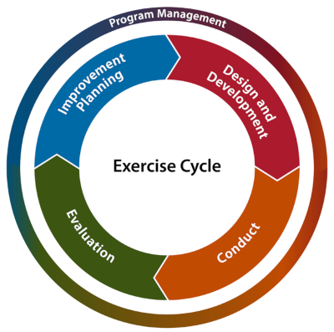
2024 Family Reunification Center (FRC) Exercise
Welcome
FRC Exercise Briefing

Slide 3
2024 Family Reunification Center (FRC) Exercise
  FRC exercise meets the Hospital Preparedness Program (HPP) grant requirements:
  10.9.2 “All participants will receive Six Hundred and Sixty Dollars ($660) to maintain system participation in the FRC application provided through ReddiNet”
  10.7.1 All participants will receive Six Thousand Dollars ($6,000) to participate in exercises and drills in conjunction with County and community partners to ensure hospital preparedness, including but not limited to:
  10.7.1.3 “Conduct Family Reunification Center (FRC) training and tabletop exercise.”

Slide 4
2024 Family Reunification Center (FRC) Exercise
Family Information Center (FIC) Guide
Hospital Specific FIC Plans

Slide 5
Two Components
  FRC Application Training
  FRC Exercise

Slide 6
FRC Application Training
  ReddiNet will provide FRC training:
    June 20th
    June 25th
    July 11th
    July 16th
  Will need FRC username to register
  Registration is open at: https://register.gotowebinar.com/rt/966737239396427352 -
Notes:
This training will focus on the exercise and attendance is required

Slide 7
Scope of Exercise:
    The FRC exercise is for Hospital Preparedness Program (HPP) fund recipients.
    Exercise activities will be conducted at HPP hospitals and will involve each facility identifying a safe and secure location to utilize as their designated reunification area.
    There will be no actual movement of patients. The exercise will last three hours to ensure all task are achieved. Play will take place in the live ReddiNet and FRC systems.
Notes:
Command center activation is not necessary. We added an additional hour to allow more time to complete reunification and to contact the facility where the missing person is located to discover if any disclosure restrictions, to confirm if still at facility, and to close the loop. We also added the task of identifying a safe and secure location to utilize as your designated reunification area. We will request this data in the After-Action survey. No other complexities added to this year’s exercise. It will be very similar as last year’s exercise except different missing person and seeker assignments.

Slide 8
Exercise Participants:
Participants | Role | Extent of Play
Emergency Managers and/or Designee | Controller / Evaluator | Facilitate and evaluate play, Provide injects with needed patient and seeker data to players
*ReddiNet End Users (ED Charge Nurse, MICN, ED staff, etc.) | Player | Hospital ReddiNet MCI Module Management
FRC Application End Users (Registration staff, admission team, etc.) | Player | Hospital FRC Application Management
EMS Agency / MAC | Player | Countywide ReddiNet Messaging and MCI Module Management
*Non-ED facilities will not have ReddiNet End-Users

Slide 9
Exercise Assumption:
Incident meets criteria to activate your Family Reunification Center plan at your site.

Slide 10
Scenario:
A large-scale multi-casualty incident (MCI) has occurred, and multiple patients have been transported to hospital emergency departments throughout the county. Your facility has received one (1) patient via ambulance. Five (5) additional patients have self-dispatched to your facility by private auto and walked-into the emergency department. You have a total of six (6) patients from the incident in your emergency department. The patient that arrived by ambulance is initially amnestic to the incident and is only able to provide first name, age, and DOB. The patient is otherwise stable in the delayed category. The patient has no identification or cell phone and cannot recall family contact information. The other patients who self-dispatched are stable and require observation only.

Slide 11
Scenario:
(Non-ED)
A large-scale multi-casualty incident (MCI) has occurred, and multiple patients have been transported to hospital emergency departments throughout the county. Your facility has received one (1) patient by private auto. You have one (1) patient from the incident in your facility. The patient was initially amnestic to the incident and is only able to provide his first name, last name, and DOB. The patient is otherwise stable and in the delayed category. The patient has identification but no cell phone and cannot recall family contact information.
Notes:
11 non-ED Hospitals:
Barlow
City of Hope
Kindred Hospitals (La Mirada, Paramount, San Gabriel, South Bay)
LA Downtown Medical Center
Los Angeles Community Hospital
Miller Children's Hospital
Rancho
Southern California Hospital at Hollywood

Slide 12
Exercise Play:
Exercise will start at 8:00 a.m. and end at 11:00 a.m. to ensure all tasks are achieved.
Notes:
The exercise will last three hours to ensure all tasks are achieved.

Slide 13
Master Scenario Events List (MSEL):
Inject # | Time | Inject Mode | Synopsis | From | To | Message | Expected Action | Responsible Organization | POC/Author | Comment
1 | 7:00am | In Person | Player Check-in | Controller / Evaluator (C/E) | Players | Player, Controller, Evaluator - Check In | All players check-in and receive appropriate materials. | All Players
2 | 7:45am | In Person | Player Briefing | C/E | Players | Player Briefing (Plan a 15 Min Brief) | Exercise director / facilitator conducts exercise and safety briefing. | All Players
3 | 8:00am | ReddiNet | Start Exercise (StartEx) | Medical Alert Center (MAC) | Hospitals | Start Exercise | Exercise participants initiate play. | All Players
4 | 8:00am | ReddiNet | MCI Initiated | MAC | Hospitals | MAC initiates MCI poll titled "2024 FRC Exercise" | Respond to MCI poll. Input bed availability data into ReddiNet MCI module (minimum quantities 2 Immediate, 2 Delayed, 2 Minor) | Hospital ReddiNet End-Users
5 | 8:00am to 8:10am | ReddiNet | MAC inputs patient destination | MAC | Hospitals | Each hospital will receive one (1) ambulance with one (1) "ambulance patient" | ReddiNet End-User arrives the ambulance in the ReddiNet MCI Module | Hospital ReddiNet End-Users
6 | 8:00am to 8:15am | In Person | Provide pre-designated patient demographic data | C/E | ReddiNet End User | C/E provides the pre-designated "ambulance patient" information to the ReddiNet End-User. The information is needed to update the MCI victim list. The information is regarding the "ambulance patient" who arrived at the Emergency Department by ambulance and contains the patient's first name, gender, age, and triage tag# | ReddiNet End-User updates MCI victim list and enters "ambulance patient": 1. First name, 2. Last Name (Use your hospital's 3 letter hospital code) 3. Sex, 4. Age, 5. Triage Tag # | Hospital ReddiNet End-Users
7 | 8:15am to 8:30am | In Person | Add five (5) additional walk-in patients to the MCI victim list | C/E | ReddiNet End User | C/E informs ReddiNet End-User to enter five (5) additional walk-in patients to the MCI victim list. Use fictional first names and your hospital's three 3- letter hospital code as the last names. | ReddiNet End-User enters five (5) walk-in patients into the MCI victim list. End user must check the box labeled "Walk-In" when adding walk-in patients. Use fictional first names, and gender. Do not enter a triage tag number. Use your hospital's 3-letter hospital code for the last names. | Hospital ReddiNet End-Users
8 | 8:30am | ReddiNet | MAC sends message to all hospitals that the County has activated a FAC to support family reunification | MAC | Emergency Manager | A Family Assistance Center (FAC) has been activated at a location near the MCI. | Emergency Manager mobilizes Family Information Center (FIC) team and briefly discuss internal triggers required to activate the FIC plan. | Hospital EM and FIC team
9 | 8:40am | In Person | FRC End-User logs into Family Reunification Center (FRC) application and activates a "FAC" | C/E | FRC End-User | Designated FRC End-User of the FIC team logs into the FRC application and activates a "FAC" | 1. FRC End-User logs into the FRC application. 2. FRC End-User activates a "FAC" in the FRC application and names the "FAC" your hospital name followed by "- FRC Exercise" (e.g. "ACME Hospital - FRC Exercise"). 3. FRC End-User associates the "FAC" with the MCI titled "2024 FRC Exercise". | FRC End-User
10 | 8:40am | In Person | FRC End-User updates MCI patient profile in FRC application | C/E | FRC End-User | C/E provides the pre-designated "ambulance patient" information to the FRC End-User. The data is needed to update the "ambulance patient" profile in the FRC application. The information is regarding the "ambulance patient" who arrived in the Emergency Department by ambulance. | FRC End-User searches for the "ambulance patient" profile in the FRC application and updates the profile with the following eight (8) data elements: 1. Last name (Change Hospital 3 letter code to actual last name as given in Victim List). 2. DOB. 3. Eye Color. 4. Hair Color. 5. Height. 6. Weight. 7. Language. 8. Ethnicity | FRC End-User
11 | 8:50am | In Person | Register the five (5) pre-designated seekers into the FRC "FAC" | C/E | FRC End-User | Five (5) unrelated persons (designated seekers) each seeking a family member (missing person) involved in the incident arrived at your hospital. The missing persons (patients) are located at other facilities. C/E provides the Seeker data to the FRC End-User to Register into the "FAC" | Register each Seeker into the FRC "FAC" from data provided by C/E. (Seekers will have all demographic data of the missing person) | FRC End-User
12 | 9:00am | In Person | Facilitate family reunification | C/E | FRC End-User | Inform the FRC End-User to locate and reunite each Seeker with the correct missing person (patient) in the FRC application and inform the family (C/E) of their location. | Locate and reunite each designated Seeker with the correct missing person (patient) in the FRC application. | FRC End-User
13 | 9:00am to 11:00am | In Person | Contact other facilities | C/E | FRC End-User | Inform the FRC End-User to contact the facility with the missing person (patient) to confirm the person is at that location, to verify no release of information restrictions, and to close the loop. | After locating the missing person, call the facility with the missing person. Use the telephone number listed in the MCI victim profile. Confirm the person is at that location and no release of information restrictions are in place. Inform the seeking-person (family member) of the missing-person's location only. | FRC End-User
14 | 9:00am to 11:00am | In Person | De-activate FAC | C/E | FRC End-User | Inform the FRC End-User to deactivate "FAC" in FRC when all five (5) Seekers have been informed of the missing person's location | FRC End-User deactivates "FAC" in FRC when all five (5) seekers have been informed of the missing persons location | FRC End-User
15 | 11:00am | ReddiNet | End Exercise (End Ex) | MAC | Hospitals | End Exercise | End all exercise play and activity | All Players
16 | 11:00am to 11:30am | In Person | Debrief with players within your facility | C/E | All Players | Huddle all players for a debrief | Conduct debrief and have all players complete a participant feedback form | All Players

Slide 14
Non-ED Master Scenario Events List (MSEL):
Inject # | Time | Inject Mode | Synopsis | From | To | Message | Expected Action | Responsible Organization | POC/Author | Comment
1 | 7:00am | In Person | Player Check-in | Controller / Evaluator (C/E) | Players | Player, Controller, Evaluator - Check In | All players check-in and receive appropriate materials. | All Players
2 | 7:45am | In Person | Player Briefing | C/E | Players | Player Briefing (Plan a 15 Min Brief) | Exercise director / facilitator conducts exercise and safety briefing. | All Players
3 | 8:00am | ReddiNet | Start Exercise (StartEx) | Medical Alert Center (MAC) | Hospitals | Start Exercise | Exercise participants initiate play. | All Players
4 | 8:00am | ReddiNet | MCI Initiated | MAC | Hospitals | MAC initiates MCI poll titled "2024 FRC Exercise" | Respond to MCI poll. Input bed availability data into ReddiNet MCI module (minimum quantities 2 Immediate, 2 Delayed, 2 Minor) | Hospital ReddiNet End-Users
5 | 8:00am to 8:10am | ReddiNet | MAC inputs patient destination | MAC | Hospitals | Each hospital will receive one (1) ambulance with one (1) "ambulance patient" | ReddiNet End-User arrives the ambulance in the ReddiNet MCI Module | Hospital ReddiNet End-Users
6 | 8:00am to 8:15am | In Person | Provide pre-designated patient demographic data | C/E | ReddiNet End User | C/E provides the pre-designated "ambulance patient" information to the ReddiNet End-User. The information is needed to update the MCI victim list. The information is regarding the "ambulance patient" who arrived at the Emergency Department by ambulance and contains the patient's first name, gender, age, and triage tag# | ReddiNet End-User updates MCI victim list and enters "ambulance patient": 1. First name, 2. Sex, 3. Age, 4. Triage Tag # | Hospital ReddiNet End-Users
7 | 8:15am to 8:30am | In Person | Add five (5) additional walk-in patients to the MCI victim list | C/E | ReddiNet End User | C/E informs ReddiNet End-User to enter five (5) additional walk-in patients to the MCI victim list. Use fictional first names and your hospital's three 3- letter hospital code as the last names. | ReddiNet End-User enters five (5) walk-in patients into the MCI victim list. End user must check the box labeled "Walk-In" when adding walk-in patients. Use fictional first names, and gender. Do not enter a triage tag number. Use your hospital's 3-letter hospital code for the last names. | Hospital ReddiNet End-Users
8 | 8:30am | ReddiNet | MAC sends message to all hospitals that the County has activated a FAC to support family reunification | MAC | Emergency Manager | A Family Assistance Center (FAC) has been activated at a location near the MCI. | Emergency Manager mobilizes Family Information Center (FIC) team and briefly discuss internal triggers required to activate the FIC plan. | Hospital EM and FIC team
9 | 8:40am | In Person | FRC End-User logs into Family Reunification Center (FRC) application and activates a "FAC" | C/E | FRC End-User | Designated FRC End-User of the FIC team logs into the FRC application and activates a "FAC" | 1. FRC End-User logs into the FRC application. 2. FRC End-User activates a "FAC" in the FRC application and names the "FAC" your hospital name followed by "- FRC Exercise" (e.g. "ACME Hospital - FRC Exercise"). 3. FRC End-User associates the "FAC" with the MCI titled "2024 FRC Exercise". | FRC End-User
10 | 8:40am | In Person | FRC End-User registers designated patient into FRC application | C/E | FRC End-User | C/E provides pre-designated patient data to the FRC End User. The data is needed to register the desginated patient into the FRC system. | FRC End User enters the patient data into the FRC application with the following eleven (11) data elements: 1. Triage tag #. 2. First Name. 3. Last name. 4. DOB. 5. Gender. 6. Eye Color. 7. Hair Color. 8. Height. 9. Weight. 10. Language. 11. Ethnicity | FRC End-User
11 | 8:50am | In Person | Register the five (5) pre-designated seekers into the FRC "FAC" | C/E | FRC End-User | Five (5) unrelated persons (designated seekers) each seeking a family member (missing person) involved in the incident arrived at your hospital. The missing persons (patients) are located at other facilities. C/E provides the Seeker data to the FRC End-User to Register into the "FAC" | Register each Seeker into the FRC "FAC" from data provided by C/E. (Seekers will have all demographic data of the missing person) | FRC End-User
12 | 9:00am | In Person | Facilitate family reunification | C/E | FRC End-User | Inform the FRC End-User to locate and reunite each Seeker with the correct missing person (patient) in the FRC application and inform the family (C/E) of their location. | Locate and reunite each designated Seeker with the correct missing person (patient) in the FRC application. | FRC End-User
13 | 9:00am to 11:00am | In Person | Contact other facilities | C/E | FRC End-User | Inform the FRC End-User to contact the facility with the missing person (patient) to confirm the person is at that location, to verify no release of information restrictions, and to close the loop. | After locating the missing person, call the facility with the missing person. Use the telephone number listed in the MCI victim profile. Confirm the person is at that location and no release of information restrictions are in place. Inform the seeking-person (family member) of the missing-person's location only. | FRC End-User
14 | 9:00am to 11:00am | In Person | De-activate FAC | C/E | FRC End-User | Inform the FRC End-User to deactivate "FAC" in FRC when all five (5) Seekers have been informed of the missing person's location | FRC End-User deactivates "FAC" in FRC when all five (5) seekers have been informed of the missing persons location | FRC End-User
15 | 11:00am | ReddiNet | End Exercise (End Ex) | MAC | Hospitals | End Exercise | End all exercise play and activity | All Players
16 | 11:00am to 11:30am | In Person | Debrief with players within your facility | C/E | All Players | Huddle all players for a debrief | Conduct debrief and have all players complete a participant feedback form | All Players
Notes:
11 non-ED Hospitals:
Barlow
City of Hope
Kindred Hospitals (La Mirada, Paramount, San Gabriel, South Bay)
LA Downtown Medical Center
Los Angeles Community Hospital
Miller Children's Hospital
Rancho
Southern California Hospital at Hollywood

Slide 15
ReddiNet Message Screen:
Notes:
ReddiNet Message Screen:
Inject #3

Slide 16
ReddiNet MCI Screen:
Notes:
ReddiNet MCI Screen:
Inject #4
Non-ED’s will not be assigned MCI patients in ReddiNet

Slide 17
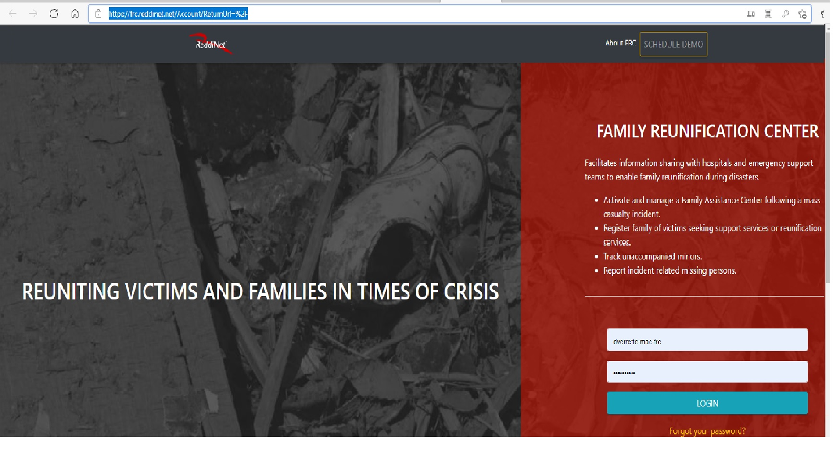
Notes:
FRC Login Screen
Inject #9

Slide 18
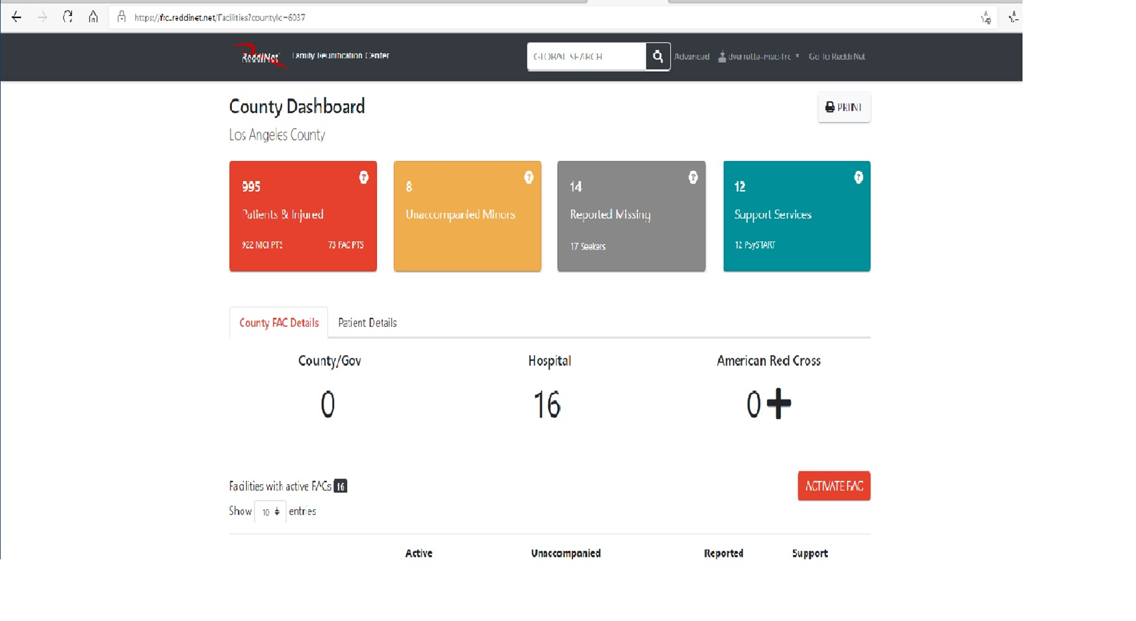
FRC Application Dashboard:
Notes:
FRC Application

Slide 19

Patient and Seeker Data:
Patient Data
Seeker Data

Slide 20
Healthcare Coalition Website

Slide 21
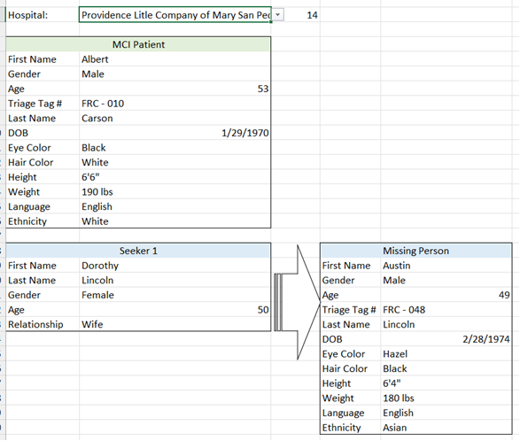
Injects:

Slide 22
Player Role After Exercise
Conduct debrief with players at your facility
Complete and submit a Participant Feedback form

Slide 23
Confirmation of Exercise Participation:
AAR / IP Submission
Within 60 days following exercise
Notes:
Submit within 60 days following exercise. Will utilize survey monkey to capture AAR data.

Slide 24
Documentation:
Available on HCC Website
Exercise Plan
Controller / Evaluator Handbook
Exercise Evaluation Guide
Participant Feedback Form
After-Action Report/Improvement Plan
Master Scenario Event List (MSEL)
Patient and Seeker Data – (EMO Only)
Notes:
The Exercise Plan (ExPlan) gives elected and appointed officials, observers, media personnel, and players from participating organizations information they need to observe or participate in the exercise. Some exercise material is intended for the exclusive use of exercise planners, controllers, and evaluators, but players may view other materials that are necessary to their performance. All exercise participants may view the ExPlan.
The Controller/Evaluator (C/E) Handbook describes the roles and responsibilities of exercise controllers and evaluators, and the procedures they should follow. Because the C/E Handbook contains information about the scenario and about exercise administration, it is distributed to only those individuals specifically designated as controllers or evaluators; it should not be provided to exercise players. The C/E Handbook may supplement the Exercise Plan (ExPlan) or be a standalone document.
The Exercise Evaluation Guides (EEGs) are structured to capture information specifically related to the evaluation requirements developed by the Exercise Planning Team. The following evaluation requirements are documented in each EEGthe capability target will be met. Critical tasks generally

Slide 25

Questions?

Slide 26
Thank You!

