Slide 1
NALOXONE Administration
Program Approved by the
Los Angeles County EMS Agency

Slide 2
Special Thanks for the Development of this Program
UCLA Center for Prehospital Care
Los Angeles EMS Agency Curriculum Committee

Slide 3
This training program meets the regulatory requirements for training of EMTs in the administration of Naloxone.
Other counties may have different policies, procedures, and training requirements.
Notes:
Review the slide

Slide 4
Objectives
Review assessment of the patient with a complaint of altered level of consciousness or suspected opioid overdose.
Review the causes, pathophysiology and initial treatment of ALOC and suspected opioid overdose.
Discuss the scope of practice changes for the use of naloxone (Narcan®) by EMTs.
State the indications, mechanism and actions, adverse effects, dosage, contraindications of administration of naloxone.
State the factors that must exist in order for an the EMT to administer naloxone.
Notes:
Review the slide

Slide 5
Objectives
Discuss the procedure to check a medication before administration.
Demonstrate the ability to successfully administer naloxone using the LA County skill sheet for both IM and nasal administration.
Know the appropriate documentation needed for medication administration in LA County.

Slide 6
Scope of Practice
An EMT Provider Agency may stock naloxone on the ambulance or fire apparatus if they have applied and have been approved by the EMS Agency Medical Director to do so.
An EMT may use the stocked naloxone when they are on duty and working for the provider agency that has been approved by the EMS Agency Medical Director.
Reminder: An EMT may assist the patient with the patient’s own prescribed naloxone
Notes:
Review the slide
While this is part of mandatory EMT training, an EMT may only administer naloxone if they are working for a provider agency that has applied and been approved by the EMS Agency Medical Director to carry naloxone on the EMT ambulance.
An EMT MAY NOT CARRY, AND ADMINISTER THEIR OWN PURCHASED NALOXONE

Slide 7
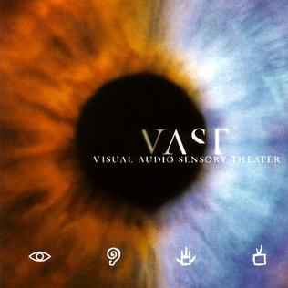
THE PROBLEM
Opioid Abuse and Death is Considered a
National Epidemic
Notes:
The scope of the problem is VAST.
Legislation is needed to provide funding and a solution to this problem.

Slide 8
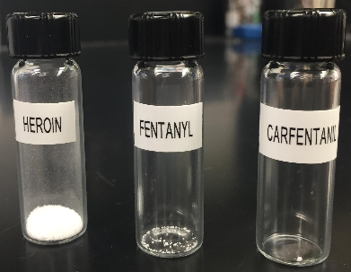
Death From Opioids
Heroin increasing
Fentanyl increasing at a much faster rate
Heroin that is combined with fentanyl is sky-rocketing
Lethal Dose of Each
Notes:
A picture speaks a thousand words!
Fentanyl facts:
50 to 100 times more potent than morphine.
Some synthetic fentanyl, which are designed to mimic its pharmacological effects, may be as much as 10,000 times more potent than morphine.

Slide 9
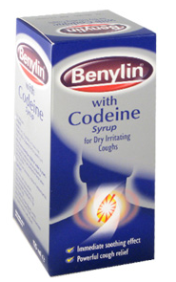
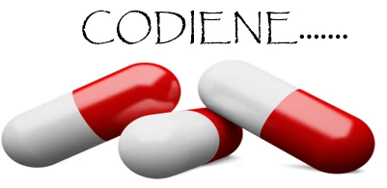
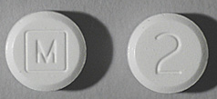
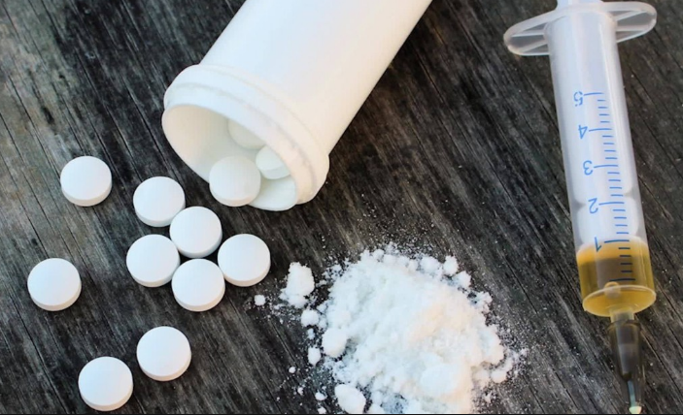
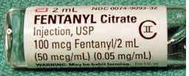
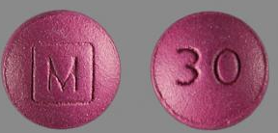
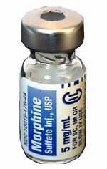
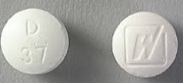
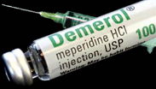
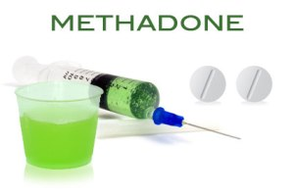
Common Opioids
Codeine
Fentanyl/Carfentanil
Morphine
Hydrocodone (Vicodin®)
Hydromorphone (Dilaudid®)
Meperidine (Demerol®)
Methadone
Hydrocodone
Dilaudid/Hydromorphone
fentanyl
Notes:
While these may be the most commonly abused opioids, the list keeps on expanding.
Some synthetic fentanyl, which are designed to mimic its pharmacological effects, may be as much as 10,000 times more potent than morphine.

Slide 10
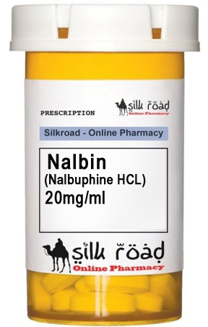
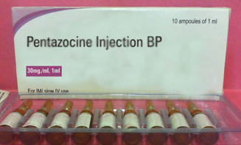
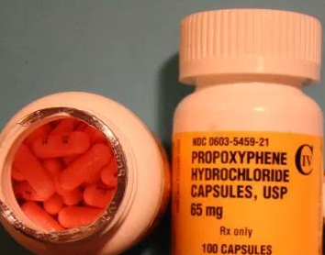
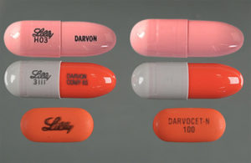
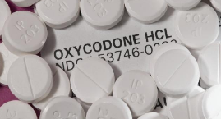
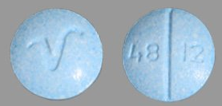
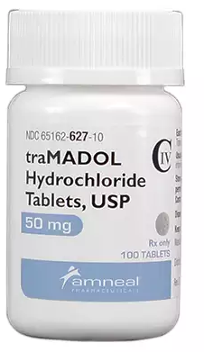
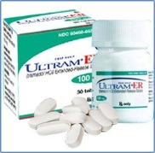
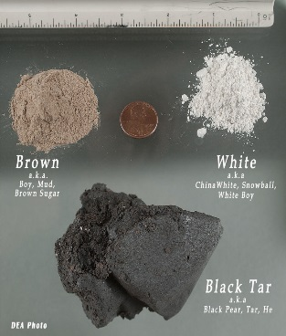
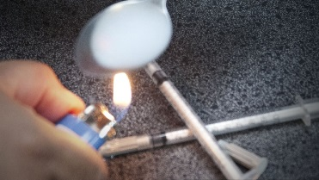
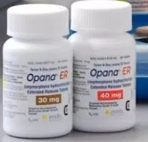
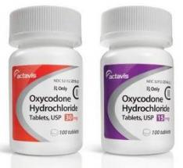
Common Opioids
Nalbuphine (Nubain®)
Oxycodone (Percocet®/Percodan®)
Tramadol (Ultram®)
Oxymorphone (Opana®)
Pentazocine (Talwin®)
Propoxyphene (Darvon®)
Heroin
Notes:
Opioids also come in all forms.

Slide 11
Pathophysiology of an Opioid Overdose
Notes:
An overdose occurs when larger quantities of opioids are ingested in the body in doses that are more than physically tolerated.
These opioids bond with receptors in the brain that results in central nervous system (CNS) and respiratory depression, miosis (constricting of the pupils), and apnea (without breath), which can be fatal if not treated rapidly.
According to the Los Angeles County Coroner’s Office, one of the most common periods of time for an overdose to occur is right after the patient has been released from rehab.
This occurs because they resume their pre-rehab dose which is stronger than needed to induce the same “high” and they overdose and frequently die.

Slide 12
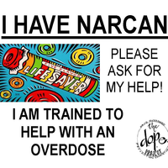
Administration OF Naloxone (narcan®)
Notes:
This is making me change the way I look at a role of lifesavers!

Slide 13
Preparation

Slide 14
Scene Safety and BSI
Scene safety
Look for the presence of syringes and needles or any other hazards you may encounter
Consider spinal motion restriction – if indicated
Take body substance isolation precautions
Notes:
Take the appropriate body substance isolation precautions.
Consider the route of administration you will choose to help determine the level of BSI needed.

Slide 15
Caution
Use caution when performing a body check to avoid the possibility of a needle stick
Notes:
Use extreme care when performing a complete body check to minimize the possibility of a needle stick.
Check the pockets carefully.
Needles may be hiding in pockets, cuffs of pants sleeves etc.
Be alert for weapons such as knives, guns, etc.

Slide 16
Primary Assessment of the
ALOC Patient
General Impression
Is there a life-threating condition
Mental Status/Stimulus (AVPU)
Assess and manage airway and breathing
Begin positive pressure ventilation if hypoventilation
Assess and manage circulation
Obtain an oxygen saturation reading – if available
Notes:
As a review, obtain a general impression of the patient
During this phase of the assessment, a GCS is not obtained; only determine if the patient is alert, and if not, are they alert to verbal, pain (noxious stimulus), or are they unresponsive.
Oxygen administration is a priority when a patient is hypoventilating
Patients presenting with an altered mental status and hypoventilation must receive positive pressure ventilation with a BMV device.
High dose opioids may cause CNS depression , which leads to respiratory depression and then cardiac arrest.
Opioids may have been taken in combination with other drugs that may further increase respiratory depression.
*IMMEDIATELY Administer high flow oxygen or assisted ventilations if the patient is not breathing or is hypoventilating.
If ventilations are needed BMV patient 1 breath every 5-6 seconds (10-12 per minute).
If the patient has vomited, suction is a priority before ventilation.

Slide 17
Secondary Assessment
SAMPLE
Focused assessment of the associated body regions
Time of onset
Vital Signs (continue to monitor)
Skin signs
Accessory muscle use
Lung sounds
Obtain oxygen saturation SpO2 (if available)
NOTE: Patients with opioid overdose can deteriorate rapidly, you must constantly reassess the patient
Notes:
Unconscious/Unresponsive receives a rapid physical exam including visualization and palpation.
Assess the 5 vital signs which are:
BP
Pulse
RR
Skin temperature
O2 saturation

Slide 18
Assisting Patient with their own NALOXONE
ALS unit must be requested
Prescribed to the patient
Meets indications
No contraindications
Notes:
The use of the patient’s own naloxone is allowed and may be the first treatment rendered.
In order for an EMT to assist patient’s with their own medication:
Must be the patient’s medication
The indications must be met (severe asthma attack or anaphylaxis).
Ensure there are no contraindications
ALS must have been contacted and enroute
Assisting a patient’s with their own medication is considered as “administering.”
If naloxone administration is required, an ALS Unit must be contacted and be enroute. However, if the ETA for the responding ALS unit exceeds the ETA to the most appropriate emergency department, the EMT may consider transporting the patient.

Slide 19
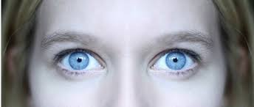
Signs and Symptoms of Opioid Overdose
Altered mental status
Extreme drowsiness
Slow, shallow breathing or apnea
Pinpoint pupils
Bradycardia (< 60) or Tachycardia (> 100)
Environment
Drugs and paraphernalia
Syringes
Notes:
The degree of altered mental status may vary depending on the ventilatory status of the patient.
Terms such as lethargy should be avoided, simply document what you see (objective findings)
Check environment for drug paraphernalia such as spoons, lighters, constricting bands, etc. These provide clues as to what may be going on with the patient.

Slide 20
Consider all Causes of Altered Level of Consciousness
A – Alcohol, Apnea, Arrhythmia, Anaphylaxes, Atypical migraine
E – Epilepsy, Electrolytes
I – Insulin (hypoglycemia)
O – Oxygen, Overdose
U – Uremia (kidney failure), Under dose
T – Trauma, Tumor
I – Infection
P – Psychological, Poisoning
S – Seizure, Shock, Subarachnoid hemorrhage, Sepsis, Stroke
Notes:
AEIOU is a mnemonic used to consider the causes of ALOC.
Review the slide

Slide 21
Criteria for administering Naloxone by an EMT
An ALS unit must be enroute if administering naloxone.
EMTs may transport the patient if the ETA for the ALS unit exceeds the ETA to the most appropriate emergency department
Notes:
Transport to the most appropriate ED for pediatric patients 14 years old and under.
This will be an EDAP

Slide 22
Naloxone
Mechanism of Action
Reverses the effects of opioids by competing with the receptor sites
Reverses respiratory and CNS depressant effects
Notes:
Naloxone reverses the effects of opioids by competing with receptor sites in the CNS.
Binds to opioid receptors in the brain and blocks the receptors from responding to the opioid.

Slide 23
Dosage
Adult - 2mg IM or IN
2mg IM/0.4mL auto-Injector
1mg/mL ampule or vial
4mg/0.1mL nasal spray
Pediatric
Pediatrics 0.1mg/kg (based on a formulation of 1mg/mL) (maximum single dose is 2mg)
4mg/0.1mL nasal spray
Notes:
While the initial dose in LA County currently is 2mg, if the only dose available is IN 4mg, it may be administered to an adult or a pediatric patient.
When administering naloxone to a pediatric patient, the dosage will be determined by use of a pediatric length based tape (i.e. Broselow)
The maximum single dose of withdrawn naloxone for a pediatric patient is 2mg.
As a reminder, a pediatric patient in Los Angeles County is 14 or less.

Slide 24
Onset and Duration
Onset
2-3 minutes
Duration
20-120 minutes
Notes:
The duration of naloxone is less than the duration of opioids.
Therefore, carefully re-assess the patient and be prepared to administer a 2nd dose.

Slide 25
Indications
Suspected opioid overdose with altered mental status
Hypoventilation/apnea
Breathing too slow (bradypnea)
Breathing too shallow (decreased tidal volume)
AND
Notes:
Review the slide

Slide 26
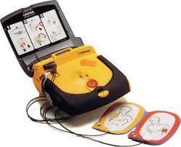
Contraindications
Altered mental status with adequate breathing
Patients in cardiac arrest
Notes:
Like most medications, naloxone has side effects but it is life saving for patients who are hypoventilating to prevent deterioration into cardiac arrest.
Naloxone is not the first line drug for patients in cardiac arrest.
For apneic and pulseless patients, initiate CPR and apply an AED.

Slide 27
Side Effects
Cardiovascular
Tachycardia
Hypertension
Chest Pain/Angina
Arrhythmias
Increase oxygen demand
Central Nervous System
Seizures
Tremors
Anxiety/ Agitation
Nervousness/restlessness
Gastrointestinal
Abdominal Pain
Nausea/Vomiting
Respiratory
Pulmonary Edema
Notes:
The administration of naloxone stimulates the release of endogenous (the body’s own) epinephrine
The side effects of naloxone may be due to this release of epi.
Briefly review side effects.

Slide 28
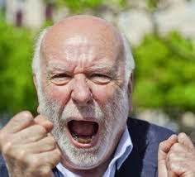
IMPORTANT NOTE
Naloxone may induce opioid withdrawal
Be prepared to deal with a violent patient
Be prepared for vomiting
Notes:
When you reverse the effects of opioids, you may induce withdrawal symptoms.
Therefore, you must be prepared for violent behavior after administration.
Continue to perform scene safety and protect patient's airway.
Properly position the patient on their left side if you are able and have suction available.

Slide 29
Preparing Naloxone
D - Drug name
I - Integrity of container/medication
C - Concentration/Dose
C - Clarity
E - Expiration date
Notes:
You have the correct drug
The container dose not appear to be contaminated
Your are using the correct concentration and dose
The medication does not appear cloudy
The medication has not expired

Slide 30
State of California has approved two (2) routes of administration of Naloxone

Slide 31
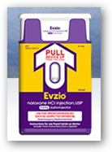
Intranasal (IN)
Intramuscular (IM)
Notes:
The State of California has approved 2 routes of administration for naloxone.

Slide 32
But First
We need to talk about medication math

Slide 33
Definitions
Milligram (mg)
A unit of measurement to describe the strength of a medication in the metric system equal to a thousandth of a gram. (1 mg = 0.001 grams)
STRENGTH
Milliliter (mL)
A unit of volume (fluid) that is equal to one thousandth of a liter (1 mL=0.001 liters)
AMOUNT
Notes:
Review the slide

Slide 34
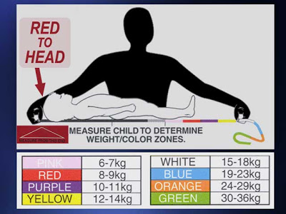
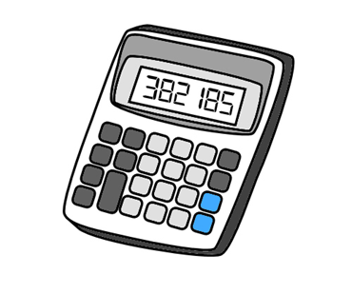
Dosage Calculations (Have/Want)
You have a pediatric patient who is 10 kg (purple on the Pediatric Resuscitation Tape)
The dosage is 1mg (want)
0.1mg/kg x 10kg = 1mg
You (have) one (1) ampule containing 2mg/1mL of Naloxone
How many milliliters (mL) would you draw up?
Calculations:
2mg = 1mg
1mL X mL
Cross multiply
2mg = 1mg = 1mg
1mL X mL 2mL
Divide 1 = 0.5mL
2
Notes:
Remember, all pediatric patients must be measured on the Pediatric Resuscitation Tape to determine the correct dose.
The pediatric dose of naloxone is based upon the formula of 0.1mg/kg
Review the math on the right side of the slide

Slide 35
Administration Procedure
Naloxone can be withdrawn from an
ampule or vial
Notes:
Review the slide
The only thing that is difference is which type of needle you must use

Slide 36
Procedure
Medication Withdrawal From a Single Dose Ampule
Notes:
The outside of the vial contains the name of the medication and the expiration date along with other information

Slide 37
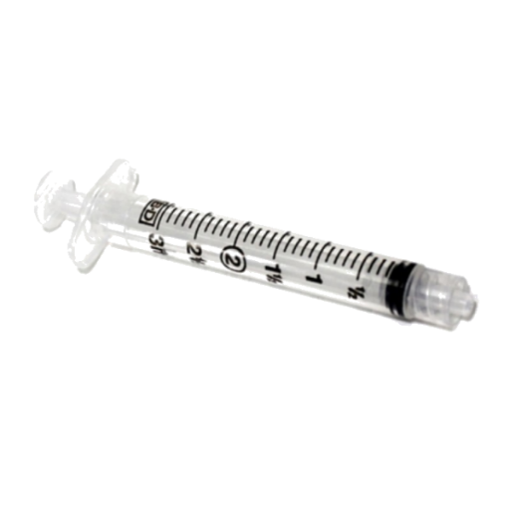
Supplies Needed
Naloxone ampule
3mL syringe
Alcohol wipe
2x2 gauze
Filter needle
1” or 1-½” 21-23 gauge needle for IM injection
Mucosal Atomization Device (MAD)
Notes:
When you are withdrawing medication from a ampule, you must use a filter needle
This is because you must break of the top of the ampule and the use of a filter needle decreases the chances of drawing up glass particles into the syringe

Slide 38
Withdrawing Medication
Flick or tap the top of ampule
Moves naloxone to the bottom of ampule
Using 2x2 gauze, snap off ampule top away from your fingers
Notes:
Sometimes the medications backs up into the top of the ampule
Therefore, you must flick or tap the top of the ampule to move the medication down into the bottom of the ampule
Using a gauze 2x2 helps protect your fingers from being cut by the broken edge of the ampule

Slide 39
Withdrawing Medication
Put filter needle on syringe
Pull cap off filter needle and insert needle into ampule
Notes:
Demonstrate the procedures shown on the slide

Slide 40
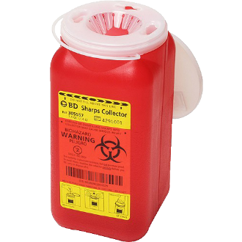
Withdrawing Medication
Invert ampule
Pull back on the plunger to withdraw medication into syringe
Re-confirm you have the correct medication by rechecking the ampule before discarding ampule
Remove the filter needle and place into an approved sharps container
Notes:
Review the slide
Keep the tip of the needle under the level of medication otherwise you will be drawing up air into the syringe.
While the slide and skill sheet states to invert the ampule, it is not an absolute requirement.

Slide 41
Procedure
Medication Withdrawal From a Vial

Slide 42
Supplies Needed
Naloxone vial (1mg/mL)
3mL syringe
Alcohol wipe
Needle
1” or 1 ½” 21-23 gauge is best
In some cases comes attached to syringe
Mucosal Atomization Device (MAD)
Notes:
Discuss differences between single-dose and multi-dose vials.
The only thing that is different is the needle.
It does not need to be a filter needle.

Slide 43
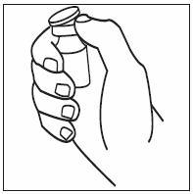
Withdrawing Medication
Remove cap
Clean top of vial with alcohol wipe
Attach the 1 to 1.5 inch 21-23 gauge needle on syringe
Notes:
The top of a vial is not sterile, therefore it needs to be wiped with an alcohol pad.
Demonstrate the steps on the slide

Slide 44
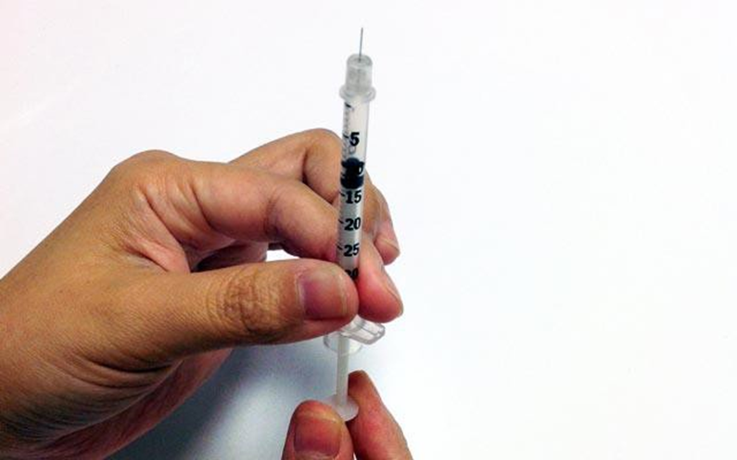
Withdrawing Medication
Pull back plunger to allow air into syringe
Insert needle into cleaned top of vial
The air from syringe should go into vial, if not, push plunger with air into vial
Notes:
Pull plunger back farther than the amount you are withdrawing from the vial
If you insert too much air into the vial, medication may leak out and in extreme cases, the rubber membrane on the top of the vial may pop out

Slide 45
Withdrawing Medication
Invert vial and withdraw naloxone into the syringe
Make sure needle is below surface of the medication
Re-confirm you have the correct medication by rechecking the ampule before discarding ampule
Remove the needle and place into an approved sharps container
Notes:
Insert tip of needle under the level of medication to avoid the aspiration of air into the syringe
Not required to invert.
Review the rest of the slide.

Slide 46
Procedure
Naloxone withdrawn with a syringe can be administered intranasal or intramuscular
Notes:
Review the slide

Slide 47
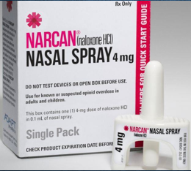
Prefilled Nasal spray Procedure
Remove from box and peel back the top and remove device
Perform DICCE
DO NOT Prime the device
This will deliver most of the medication into the air and not the patient
Notes:
Nasal spray can come in 2mg or 4mg doses.
While the initial dose in LA County currently is 2mg, if the only dose available is IN 4mg, it may be administered to an adult or a pediatric patient.
Do not prime device, priming cause the medication to be dissipated into the air.

Slide 48
Prefilled Nasal spray Procedure
Hold naloxone spay with thumb on bottom of plunger with your first and middle fingers on either side of the nozzle
Place nozzle tip in either nostril until your fingers touch the patients nose
Keep nozzle parallel with septum
Briskly depress plunger with your thumb to deliver naloxone
Re-evaluate Patient
Notes:
Demonstrate the procedure
Choose the clearest nostril
If drainage, wipe prior to inserting medication
Drainage prevents absorption of the medication.

Slide 49
Preloaded syringe with Nasal Adapter Administration
2mg/2ml
Notes:
Most ALS provider agencies carry naloxone in this format.
MAD device attached directly to preload.

Slide 50
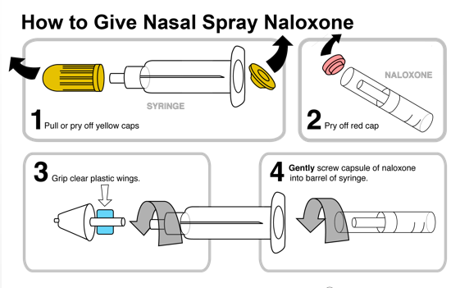
Notes:
Follow manufacturers directions to assemble device.

Slide 51
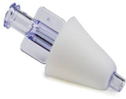
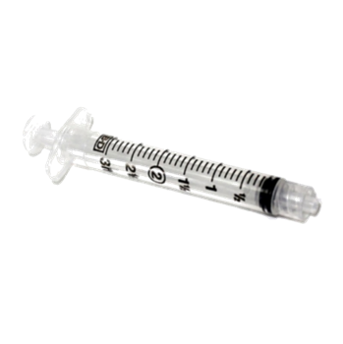
Nasal Administration from Syringe Procedure
Attach MAD device to the tip of the syringe
If withdrawing from an ampule or vial
Notes:
The MAD device also attaches directly to syringes.
Demonstrate the procedure

Slide 52
Nasal Administration Procedure
Place your thumb on the end of the preload with your first and middle fingers on the wings of the syringe
Notes:
Demonstrate procedure for students.

Slide 53
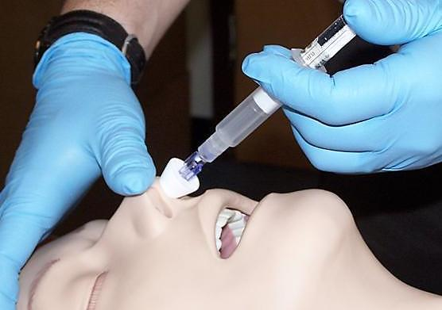
Nasal Administration Procedure
Place the head in a neutral position
Gently place the tip of the MAD device into either nostril
Keep the syringe parallel with septum
Notes:
Use caution to avoid hyper-extension of the neck as this leads to the medication running down the back of the throat into the patient’s mouth.
Pulling outward on the tip of the nostril enlarges the nares to create more surface area for medication absorption.
Demonstrate the procedure

Slide 54
Nasal Administration Procedure
Depress the plunger with your thumb to deliver ½ of the syringe (1mL for an adult)
Give the remainder of the medication in the other nostril (1mL for an adult)
Resume and continue BMV
(if indicated)
Re-evaluate patient
Notes:
Deliver no more than 1mL per nostril.
Demonstrate technique for students.

Slide 55
Pediatric Nasal Administration
Must be > 12 months of age
0.1mg/kg
Pediatric Resuscitation Tape
Must have at least 0.5cc of fluid for nasal
Maximum single dose cannot exceed 2mg
Notes:
Same administration process as adult, however pediatric patients must be measured on the pediatric resuscitation tape.
The formulation of the medication is the dosage form of the medication.
Waste the excess medication to the correct dosage to be administered to help prevent an error in delivery.
While the initial dose in LA County currently is 2mg, if the only dose available is IN 4mg, it may be administered to a pediatric patient.

Slide 56
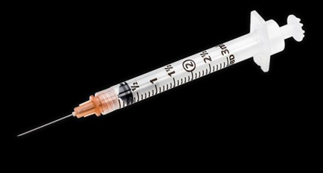
intramuscular (IM) Injection Procedure
Auto-injector
Syringe withdrawal from a vial or ampule with filtered needle
Notes:
Filter needle must be used for ampules.
Regular needle for vials.

Slide 57
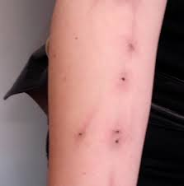
intramuscular (IM) Injection Procedure
Areas to avoid:
Bruised
Scarring
Areas that have superficial
blood vessels
Track marks
Blogspot.com
Notes:
It is common to find areas on the patient’s body where the veins are very darkened, which is due to scarring and the buildup of toxins along the length of the vein. These darkened areas are called track marks.
Review the slide.

Slide 58
Never administer through clothing
Notes:
Review the slide

Slide 59
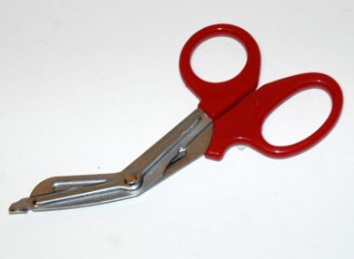
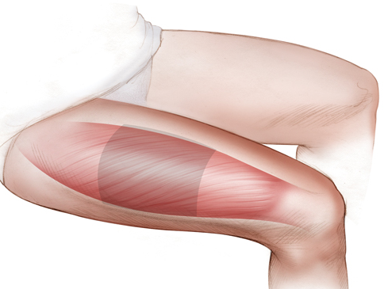
Intramuscular Procedure (Auto-injector)
DICCE naloxone auto-injector
Note: 2mg/0.4mL
Remove or cut clothing to expose the thigh
Rectus Femoris
Notes:
Be careful of dangerous objects in pants pockets or clothing.
Instead of taking off the pants, you may cut the leg of the pant off or create a hole in which to deliver the medication.
Remember rescuer safety comes first!

Slide 60
Intramuscular Procedure (Auto-injector)
Cleanse injection site with alcohol wipe in a circular motion from inner to outer
Notes:
Demonstrate Technique
May require multiple alcohol wipes on some patients to achieve a certain degree of sanitation.

Slide 61
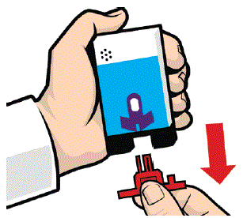
Intramuscular Procedure (Auto-injector)
Remove auto-injector from outer case
Remove safety cap from auto-injector
Notes:
Follow manufacturer recommendations.
The training device talks to you just like an AED.

Slide 62
Intramuscular Procedure (Auto-injector)
Place tip of auto-injector at 90^{O} angle
Push down with pressure to activate device
Continue to hold auto-injector in place for at least 3 seconds to ensure all the medicine has been delivered
Discard device in an appropriate container
Re-evaluate the patient
Notes:
Tip of the auto-injector is in the direction of the arrow and also located where you removed the safety cap.
Push down until the device activates and hold it in place for three (3) seconds

Slide 63
Intramuscular Procedure (Using a syringe)
Prepare the naloxone (DICCE)
Remove and/or cut clothing to expose upper arm
Notes:
Review slide

Slide 64
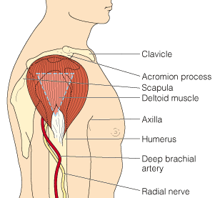
Intramuscular injection (Using a syringe)
Identify the location of the deltoid muscle
3 to 4 finger-breaths below the acromion process
Target area
Notes:
Have students demonstrate on themselves proper IM location.
Identify acromion process on themselves or the person sitting next to them.
IM injections penetrate the dermal and subcutaneous tissue.
The deltoid muscle is very vascular and permits for easy absorption.

Slide 65
Intramuscular injection (Using a syringe)
Cleanse injection site with alcohol wipe in a circular motion from inner to outer
Notes:
Again, many of these patients may require the use of multiple alcohol wipes

Slide 66
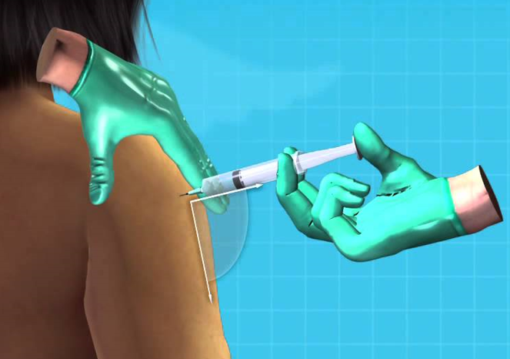
Intramuscular injection (Deltoid muscle)
Remove cap on the needle
Stretch skin taut
Insert needle into skin at a 90º angle
Notes:
Making the skin taut is accomplished by using the thumb and the index finger on your non-dominant hand to stretch the skin.
Demonstrate the procedure

Slide 67
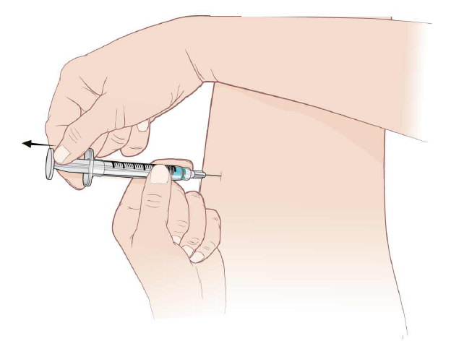
Intramuscular injection (Deltoid muscle)
Pull back on plunger (aspirate) of the syringe to check for presence of blood in the syringe
Inject medication slowly by depressing the plunger until the syringe is empty
Should Have NO BLOOD
If blood appears in the syringe, withdraw the syringe, activate the safety device on the needle and dispose into a sharps container
User the other arm to deliver the medication
Notes:
If blood is aspirated into the syringe, this indicates that the needle is in a blood vessel.
Withdraw, activate the safety device and dispose of the syringe and needle.
Repeat the procedure in the opposite arm.

Slide 68
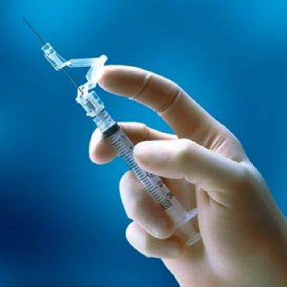
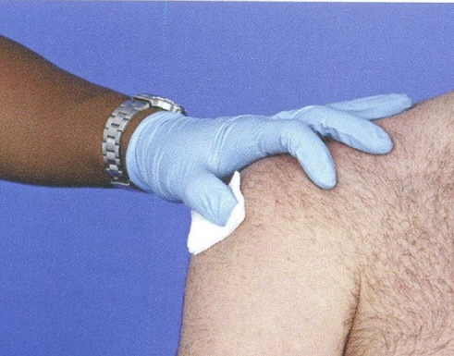
Intramuscular injection (using a syringe)
Remove needle and activate the safety device on the needle
Apply pressure to injection site with opposite hand using a sterile 2x2 if site is bleeding
Cover with a Band-Aid
Notes:
Patients who abuse narcotics may have communicable diseases such as hepatitis B and C and HIV.
The blood clotting factors are produced in the liver and may be affected by liver damage, which will lead to prolonged bleeding.
Use caution to avoid contact with the patient’s blood.
Therefore, you must hold pressure longer than normal.

Slide 69
Intramuscular injection (using a syringe)
Place syringe and needle into an appropriate sharps container
Re-evaluate patient
Notes:
An over-stuffed sharps container can lead to needles puncturing through the plastic and causing an inadvertent needle stick.
Replace the sharps disposal container when it is ¾ full

Slide 70
Reassessment
Evaluate response to treatment
Improved level of consciousness
Improved respiratory status
Repeat an ongoing assessment minimum of every 5 minutes
Primary and relevant portion of secondary
Vital signs
SpO2
Breathing – rate, depth, tidal volume
Notes:
Serial re-assessments of the patient are crucial
Evaluating and comparing the results of a prior assessment assists with recognition of a patient who is improving, responding to treatment or deteriorating.
A repeat dose of naloxone may be administered to an adult or pediatric patient in 2-3 minutes if limited or no response for patient condition and ALS is delayed, or if transporting, the ETA to the closest ED is greater than the time for the repeat dose administration need.

Slide 71
Reassessment
May repeat the dose (Adult and Peds) of naloxone if:
Limited or no response to initial dose
After 2-3 minutes if ALS has not arrived on scene
The ETA to the most appropriate emergency department exceeds the ETA of the ALS Unit
Notes:
A repeat dose of naloxone may be administered to an adult or a pediatric patient in 2-3 minutes if limited or no response to first administration and ALS is delayed or if transporting, the time to the closest ED is greater than repeat dose administration need.

Slide 72
Patient Report and Documentation
Document
Assessment findings before and after administration
Drug
name, dose, route, site, time, who administered
Patient’s response to medication
Respiratory and cardiovascular status
Mental status
Vital signs
Notes:
After each reassessment, document all findings

Slide 73
Skill Demonstration and Verification
You will be given the opportunity to practice naloxone administration skill
You will required to show competency in the skill of naloxone administration, meeting the LA County Standards, see skill sheet

Slide 74
References
California Code of Regulations Title 22, Division 9, Chapter 2
LA County EMS Agency Medication Administration Naloxone Skill Sheet
Naloxone Supplemental Information

