Slide 1

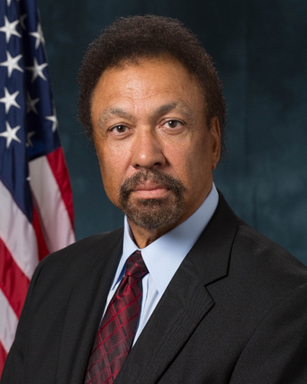
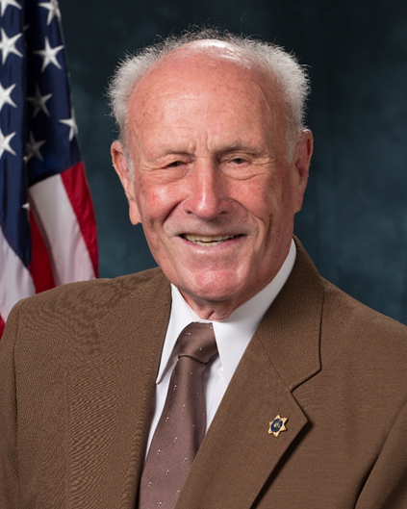
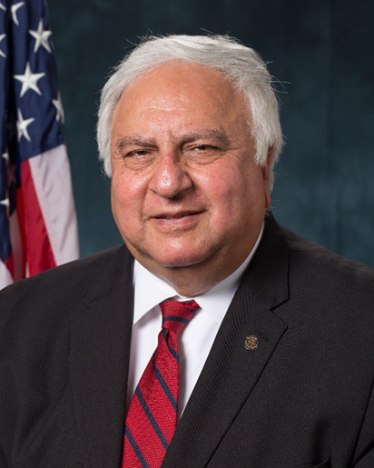
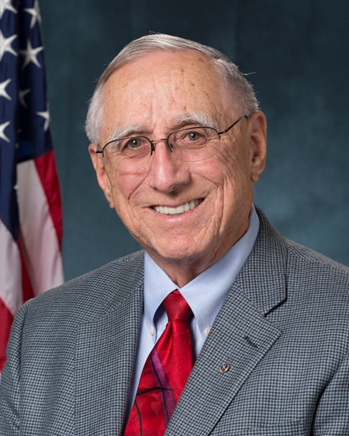
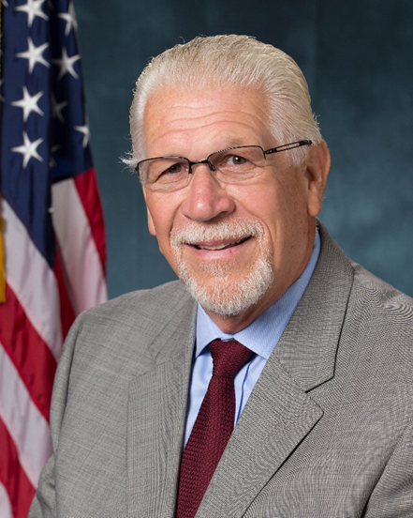
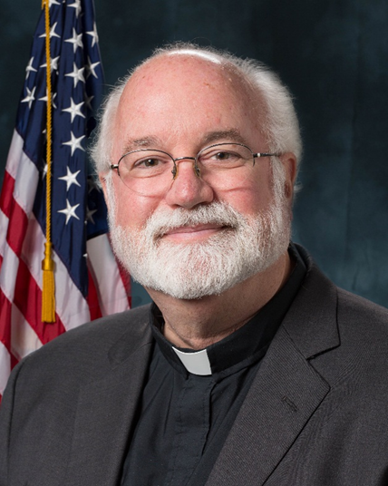
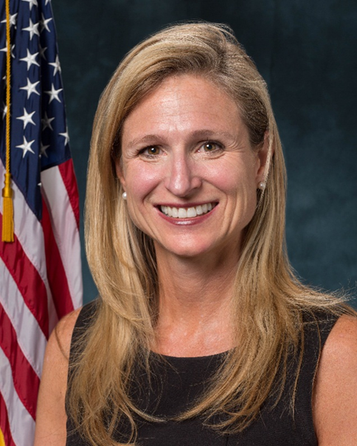
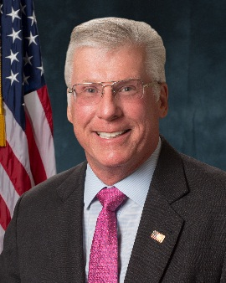
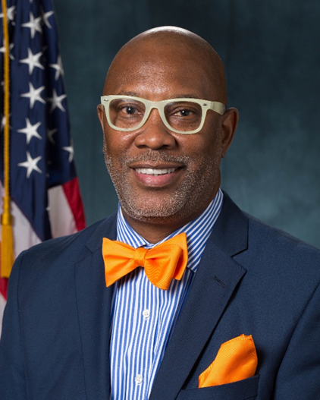
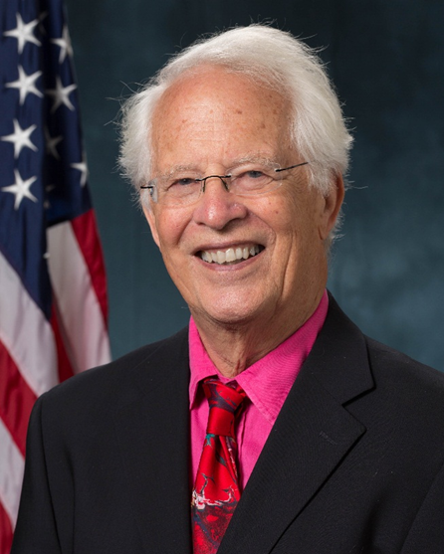
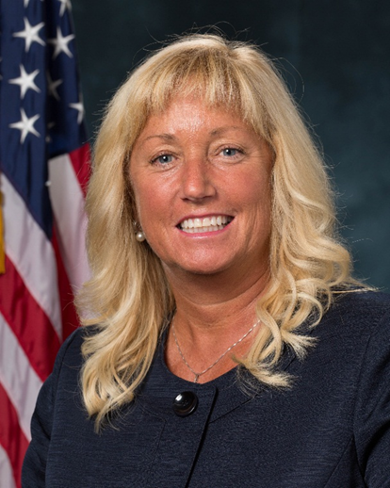
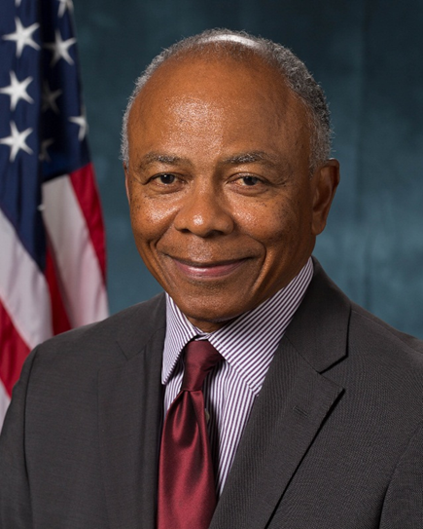
INMATE WELFARE COMMISSIONERS
Robert L. Jones
Chairman
Emeritus
Jay R. Stroh
Commissioner
Dr. Garbis Der-Yeghiayan
Commissioner
Keith R. Ellis
Commissioner
John A. Franklin
Commissioner
Gregory J. Boyle
Commissioner
Tamerlin J. Godley
Commissioner
Brent Braun
Commissioner
Gregory A. Saunders
Commissioner
Wellford W. Wilms
Commissioner
Jayna Gaskell
Commissioner
Larry E. Thompson

Slide 2
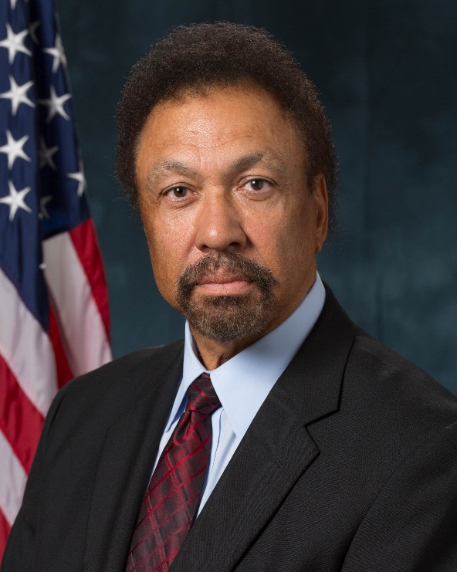
ROBERT L. JONES - Chairman
Appointed December 12, 2003
Director, Area 3 Operations
National Insurance of Crime Bureau
Robert began his career with the Omaha Police Department, Omaha, Nebraska. He worked with the department from 1970 to 1975 and promoted to police sergeant. He began his career with the Federal Bureau of Investigation (FBI) in 1975 and worked for them as a Supervisory Special Agent until 2001. He then worked for the National Insurance Crime Bureau (NICB) in 2001 as the Director of Field Operations and is still working today.
Robert attended the University of Nebraska from 1968 to 1975 where he received a Bachelor’s of Science degree in Political Science and a Masters of Science degree in Guidance and Counseling. He attended the University Of West Los Angeles School Of Law from 1981 to 1985, and received his Juris Doctorate.

Slide 3

JAY R. STROH - EMERITUS
Appointed December 1991
On July 15, 2000, Jay retired from the California Department of Alcoholic Beverage Control after serving in that position for 17 years. As a former director of the Florida Division of Alcoholic Beverages & Tobacco.
Jay began his government service career 49 years ago with the Los Angeles Sheriff’s Office, where he earned many promotions. Jay then had the opportunity to expand his personal growth in providing leadership to people and managing projects. He was appointed the Chief of Police of Inglewood, California, where he served for 10 years. Then Jay was appointed Chief of Police of El Segundo before being appointed to lead California’s Department of Alcoholic Beverage Control as its director.
Jay was very active in contributions of innovative ideas regarding the regulation of the industry. He will probably be remembered most for his efforts to train and to educate the industry and its employees as well as the state’s high school students to reduce the risk associated with unintentionally violating the state’s alcohol beverage regulations. Jay was an active member of the National Conference of State Liquor Administrators and was always available to meet with industry members.

Slide 4

DR. GARBIS DER-YEGHIAYAN
Appointed November 14, 2003
President, Mashdots College
Dr. Garbis was a High School teacher and principal in various schools in Lebanon.
He was the President and Dean of the University of La Verne/American Armenian International College from 1976-1992. He has been the President of Mashdots College in the city of Glendale, California from 1992 to present. Dr. Garbis is also the President of the American University for Humanities, Multicampus from 2007 to present.
He attended the Northwestern University in Evanston, Illinois and in 1977 earned his Ph.D. in Human Development and Social Policy. He also earned his Doctoral Degrees in Mathematics and Public Diplomacy. In 1980 he attended the University of La Verne and earned his Doctorate in Organizational Leadership and Educational Management. He attended the American University of Beirut in 1974, and earned his M.A. in Educational Administration, and a M.A. in International Law. He earned his B.S degree in 1971 from the American University of Beirut, in Mathematics and his B.A. in Political Science and Public Administration. Dr. Garbis also holds Honorary Doctorates from five universities and Honorary Professorships at seven universities.

Slide 5
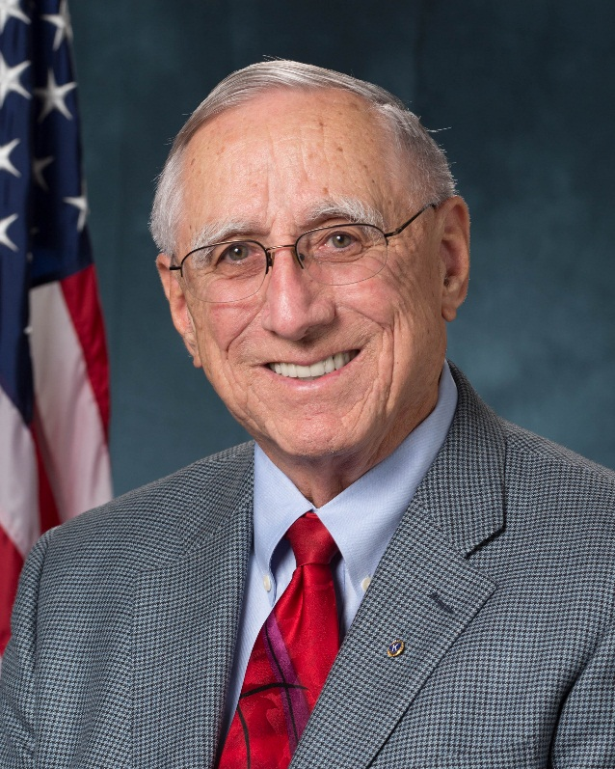
KEITH R. ELLIS
Appointed November 5, 1999
Keith holds the position of Senior Vice President / Corporate Banking Manager for Premier Business Bank in Los Angeles, CA. His banking experience includes the startup of major departments, acquisitions of several banks and numerous negotiations of business divestitures and merger transactions. He specialized in corporate investments and cash management services as an executive with Merrill Lynch. He's been a fully licensed stockbroker on the New York, American, and the Chicago Board of Trade Exchanges.
He spent eight years in the US Navy serving primarily on Nuclear Submarines. He was recognized as one of the Navy's leading authorities on Inertial Navigation Systems. Upon leaving the Navy, his expertise led him to an engineering position with a leading aerospace contractor.
Keith graduated with honors from California State University at Fullerton with a BA degree in Business Administration as a Marketing Major. He is also an honors graduate from the Pacific Coast Banking School at the University of Washington.
Keith’s broad business, financial and managerial background provides extensive insight into complex financial transactions for the small to medium sized business. His strengths are deal structuring, marketing and negotiations directed towards assisting businesses to more easily obtain favorable financing options. He is also a Member of the Rotary Club of Los Angeles and is a Rotary Paul Harris Fellow.

Slide 6
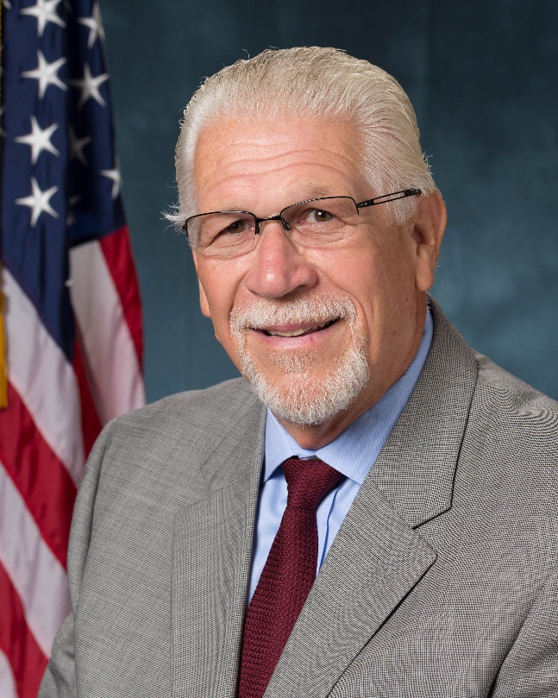
JOHN A. FRANKLIN
Appointed March 27, 2009
John worked for the Sheriff’s Department for 37 years. He worked Patrol, Custody, Detective Division, Administrative Division - Pre-Employment - for 11 years as a deputy, sergeant and lieutenant, and retired as a commander. Currently, he works for the Los Angeles City Attorney as his Director of Communications.
John’s education includes an AA Degree in Liberal Arts from Cypress Jr. College, and a BA Degree in Communications from Long Beach State University in 1974.

Slide 7

GREGORY J. BOYLE
Appointed September 25,2015
Priest, Home Boy Industries/Homegirl Cafe
Greg was born in Los Angeles, one of eight children and worked in the family-owned dairy in Los Angeles County. He was ordained a priest in the Society of Jesus (Jesuits) in 1984. He received his B.A. degree in English from Gonzaga University; a M.A. degree in English from Loyola Marymount University; a Master of Divinity from the Weston School of Theology; and a Sacred Theology Masters degree from the Jesuit School of Theology. He taught at Loyola High School and worked with Christian Base Communities in Cochabamba, Bolivia. He served as a Pastor of Dolores Mission in Boyle Heights, and he served as Chaplain of the Islas Marias Penal Colony in Mexico and Folsom Prison. He founded Homeboy Industries in 1988 through a “Jobs for a Future” program. In 1992, he created Homeboy Bakery with a mission to create an environment that provided training, work experience, and the opportunity for rival gang members to work side by side.

Slide 8

TAMERLIN “TAMMY J. GODLEY
Appointed September 25, 2015
Attorney
Tamerlin Godley is a litigation partner with Munger, Tolles & Olson. She excels at handling complex business litigation disputes and specializes in entertainment litigation and advising. She serves as counsel to the major studios, networks, recording companies and music publishers, including Turner Broadcasting, Cartoon Network, Warner Bros., Sony Pictures, Warner Music Group and Warner/Chappell, along with many other entertainment related entities. Ms. Godley has been recognized as a leading lawyer by Chambers USA. In 2012, she received a California Lawyer Attorneys of the Year Award for her representation of Warner Bros. in its highly publicized dispute with Charlie Sheen.
Ms. Godley graduated from UCLA with a double major in English and political science, obtained a master's degree in English from Cal State Northridge and taught in South Central Los Angeles before going to law school. She received her J.D. from the USC in 1996, Order of the Coif, where she was a notes editor of the Law Review and a writing instructor for first year law students. Prior to joining Munger Tolles, Ms. Godley clerked for U.S. District Court Judge Harry L. Hupp of the Central District of California.
Not content with being just an outstanding attorney, Ms. Godley is passionately committed to giving back to the community. She serves on the executive committee of the Los Angeles County Bar Association’s Center for Civic Mediation as vice president of the Pasadena Educational Foundation, as vice president and president-elect of the Armory Center for the Arts and as vice chair of the board of the Odyssey Charter School. Ms. Godley also serves on the Pasadena Human Relations Commission. She previously served as an elected official on the South Pasadena School Board, as regional director for the Los Angeles County Young Women of the Year scholarship program and on the Primary Center Task Force for the Los Angeles Unified School District, which brought together the expertise of community members and district personnel to build the only school facilities completed by LAUSD in the 1990’s. She also served on the Rampart Independent Review Panel, which investigated and analyzed the Los Angeles Police Department’s discipline and oversight practices and put forth recommendations for improvement after the Rampart Division scandals.

Slide 9
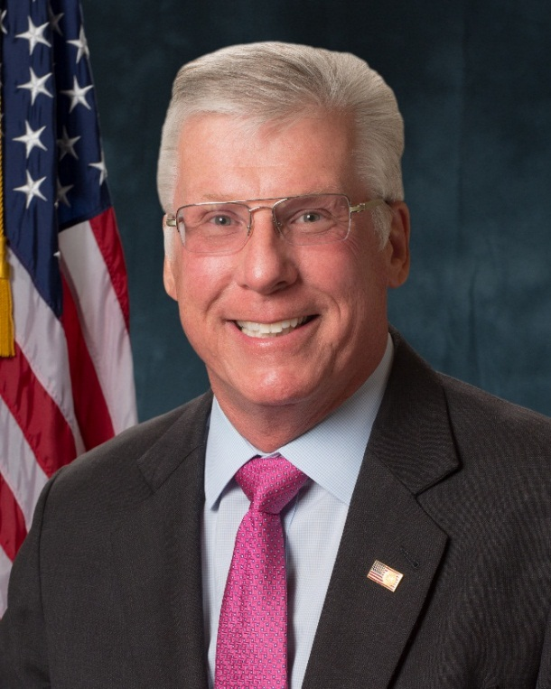
BRENT BRAUN
Appointed October 23, 2015
Worked with the Citizen’s Commission on Jail Violence
Brent is the current owner of Braun Consulting Group, INC. and previous owner of Technical Threat Analysis Group, INC. He retired as the Acting Assistant Special Agent in charge of the Los Angeles FBI’s White Collar Crime Division, prior to that he was a Supervisory Special Agent, FBI Los Angeles White Collar Crime Division, Corporate/Securities Frauds Team Leader and International Training and Assistance Programs (SEED ACT). He was a designated Master Police Instructor, FBI Academy, First Class Radio Telephone Operators License FCC, and technically trained agent for the FBI. He was admitted to the California Bar, USDC for the Central District of California, Ninth Circuit Court of Appeals.
Brent attended California State University-Northridge from 1970 to 1973 and received his Bachelors degree in Radio and Film. He attended the Southwestern School of Law from 1973 to1976 and received his JURIS Doctor in Law.

Slide 10

GREGORY A. SANDERS
Appointed September 25, 2015
Pastor, The Rock Christian Fellowship
The Reverend Gregory Sanders is the pastor of The Rock Christian Fellowship and President of the Long Beach Ministers Alliance. He is also a member of the Long Beach Violence Prevention Plan Steering Committee and the NAACP Long Beach Branch.

Slide 11

Wellford “BUZZ” W. WILMS
Appointed September 25, 2015
Professor Emeritus UCLA
Wellford W. Wilms is a professor in the Educational Leadership Program at UCLA’s Graduate School of Education and Information Studies, where he has also served as director, assistant dean, and elected chair of the faculty. He has studied a wide range of organizations, from corporations and trade unions to teacher unions, public schools, universities, and police agencies. Wilms has written a number of books, including “Restoring Prosperity: How Workers and Managers Are Forging a New Culture of Cooperation,” “Awakening the Academy,” and “Liberating the Schoolhouse.” He wrote a book on the LAPD and his research is supported by the National Institute of Justice, the Alfred P. Sloan Foundation, the John and Dora Haynes Foundation, and the Pew Charitable Trusts. Wilms has a Ph.D. In Education Policy from the University of California, Berkeley.

Slide 12

JAYNA GASKELL
Appointed September 25, 2015
Executive Director for Pivot Charter Schools
Jayna has worked in education for the last 26 years. She holds a M.A. degree in secondary education from Emory University. She moved from Florida to California in 1993 to serve as Director of Admissions and Academics of a small boarding and day school for four years. In 1998, she co-founded and directed a California charter school for five years. She established a charter school consulting business assisting schools by drafting and review charter petitions, writing grants, creating charter renewals, conducted training, compliance reviews and strategic planning projects. She served a two-year term on the State Superintendent’s Advisory commission on Charter Schools.
Jayna served as the founding board member and chair of the Board of the California Montessori Project, one of the largest public Montessori schools in operation for 10 years. She has been the Executive Director for Pivot Charter Schools since November 2010.

Slide 13

LARRY E. THOMPSON
Appointed September 25, 2015
Consultant, Los Angeles Chamber of Commerce
Larry is a Consultant of the LA Chamber of Commerce. Prior to his current assignment, he was Senior Vice President Western Operations for Xerox Corporations, and VP in charge of Western Education and Government Operations. Larry is also active in the community. He was CEO of the Children’s and Youth Arts & Sports Foundation, and is a UNITE LA board member, and is active in Leadership LA Alumni Association. Larry joined the WIB Board in 2001, and now serves on the Sector Advisory Committee.

